Slide 1

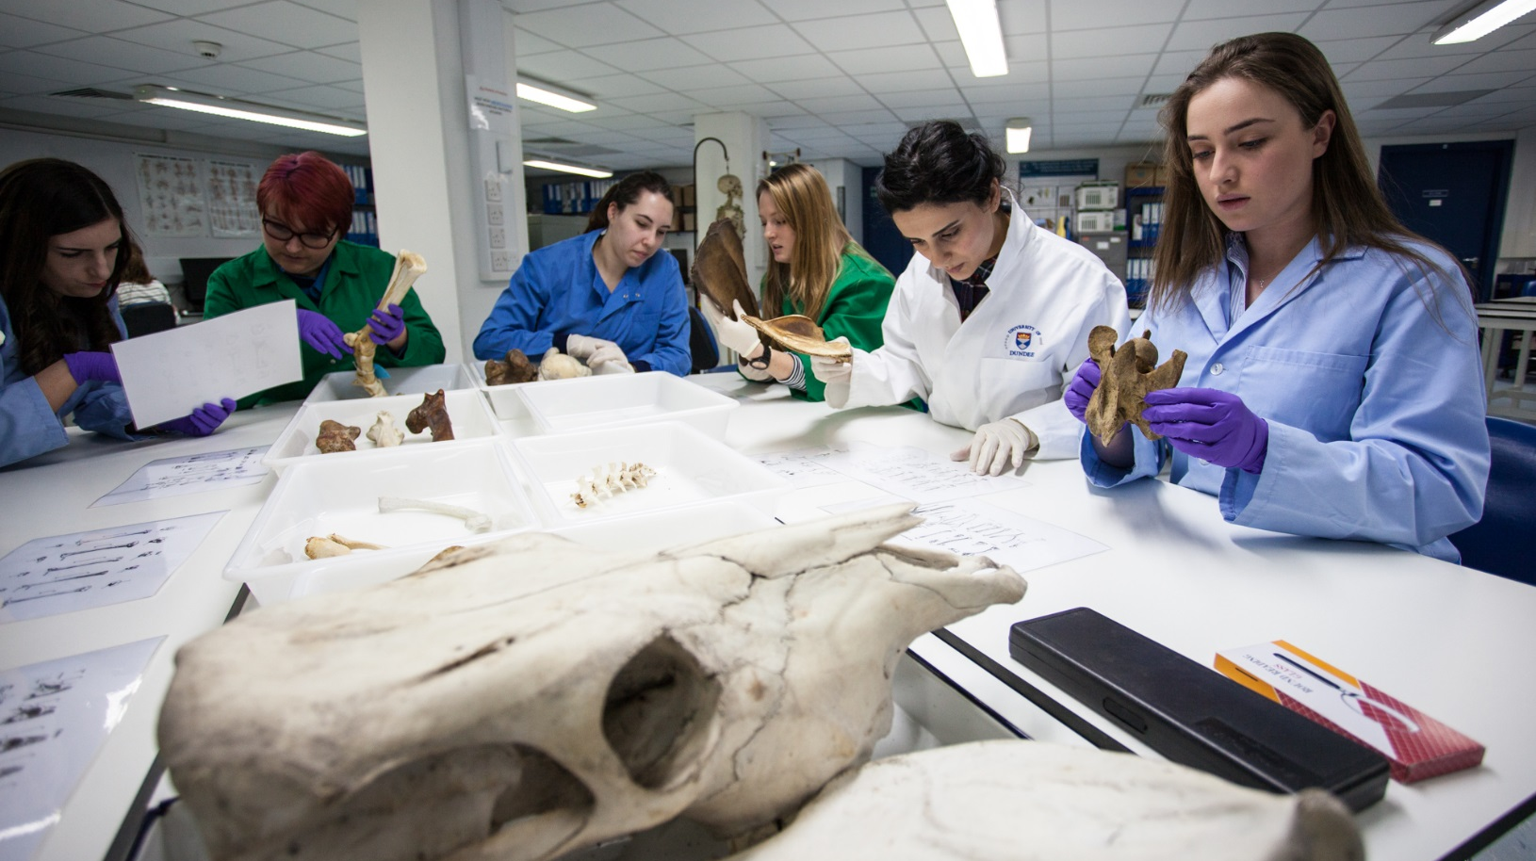
Providing your details to the University of Dundee
One of the UK’s top 20 universities (Guardian University Guide 2021)
A guide to completing our application form

Slide 2
Process for DiiCSU
Web links will be created for the 5 courses available for applicants to apply.
If required, in liaison with Web Team, links can be placed on a website at CSU.
Applicants will,
Click on the appropriate link.
Create a username and password for the direct application form.
Complete each stage of the application form.

Slide 3
BSc (DiiCSU) | Link
BEng (Hons) Civil Engineering (joint degree with Central South University) 土木工程 | https://uod.ac.uk/csu-h200
BEng (Hons) Mechanical Engineering (joint degree with Central South University) 机械设计制造及其自动化 | https://uod.ac.uk/csu-h300
BSc (Hons) Computing Science (joint degree with Central South University) 计算机科学与技术 | https://uod.ac.uk/csu-g401
BSc (Hons) Mathematics (joint degree with Central South University) 数学与应用数学 | https://uod.ac.uk/csu-g100
BEng (Hons) Mechanical Engineering with Transportation (joint degree with Central South University) 交通设备与控制工程 | https://uod.ac.uk/csu-h304

Slide 4
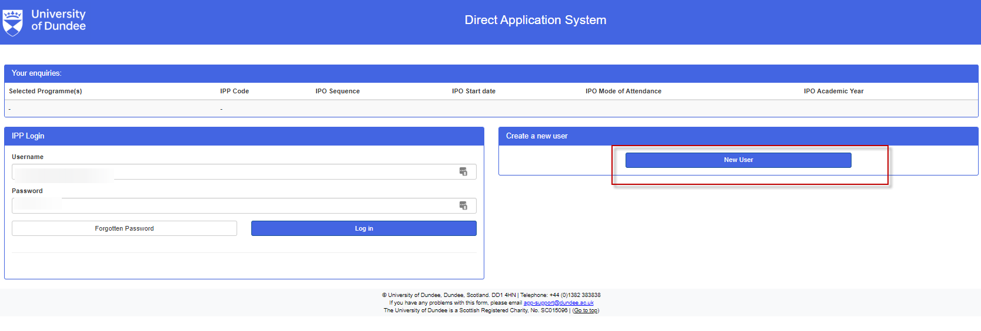
Click New User
Please note, top bar will be populated with the appropriate course details once web links have been set up

Slide 5
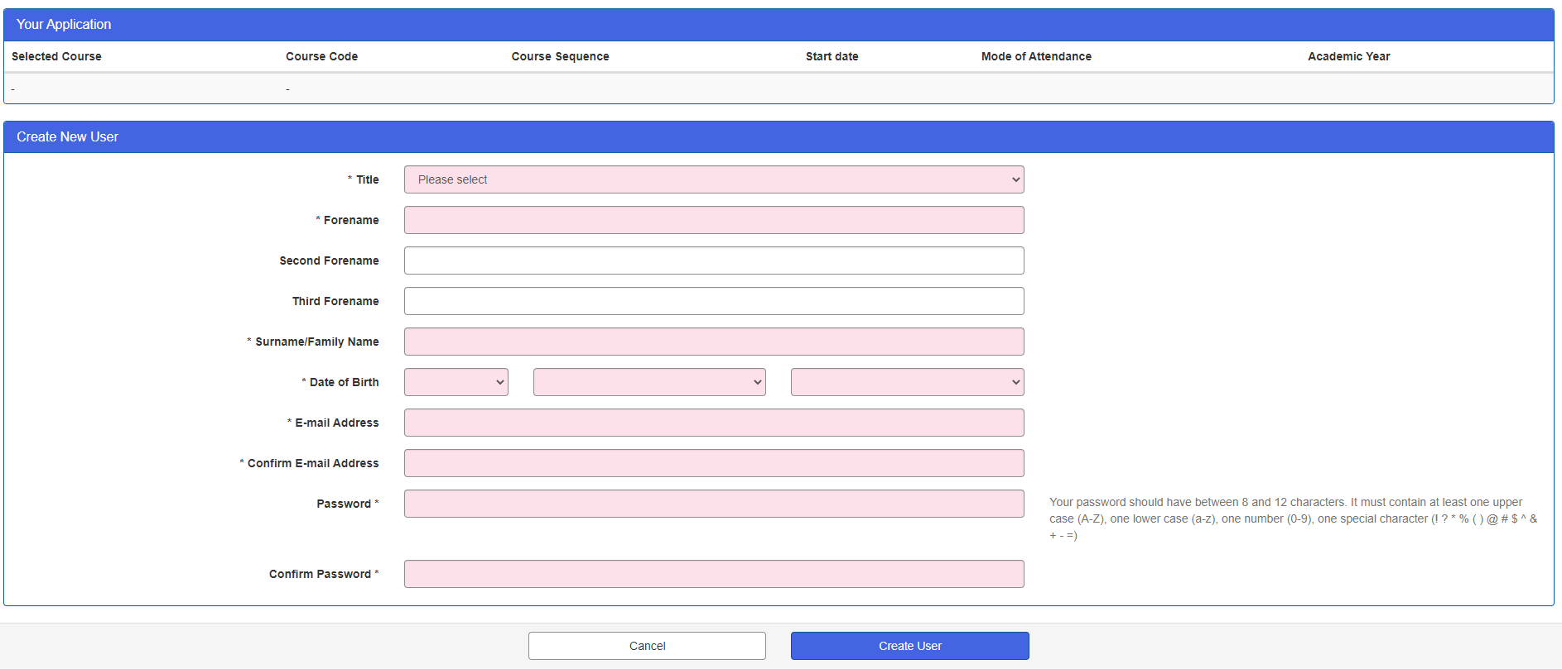
Fill in your name, date of birth, email address and create a password.
Notes:
Title 男生选择Mr, 女生选择Miss
Forename填写名的拼音，surname填写姓的拼音

Slide 6
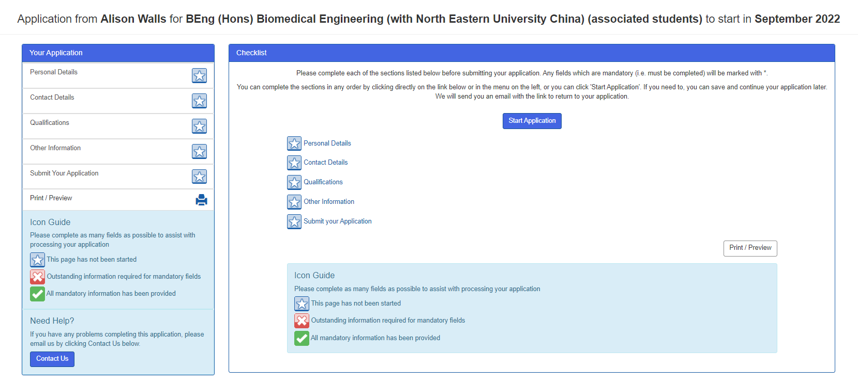
Click Start Application
Please note, top bar will be populated with the applicant’s name and appropriate course details once web links have been set up

Slide 7
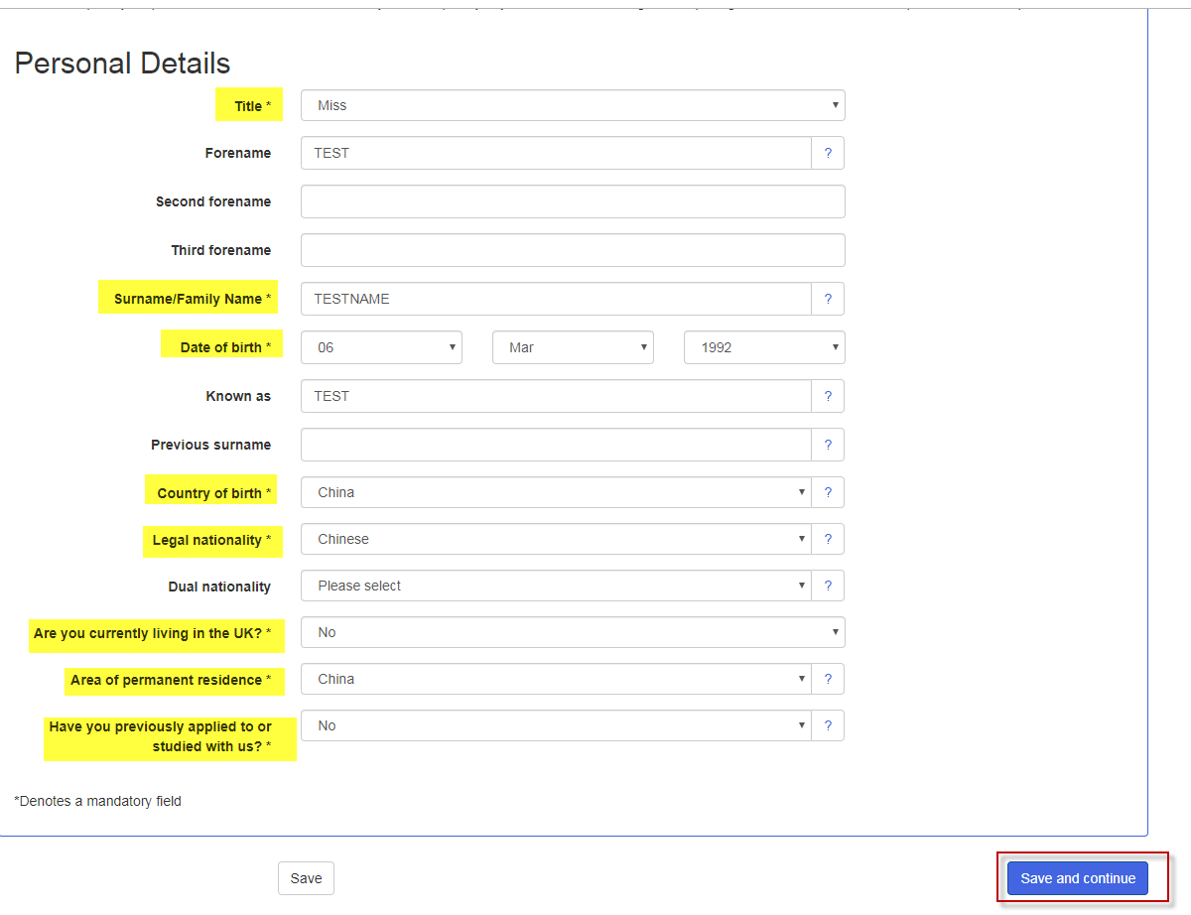
Enter your personal details and click save and continue
Fields highlighted in yellow are mandatory
Notes:
Known as 一栏请不要填写

Slide 8
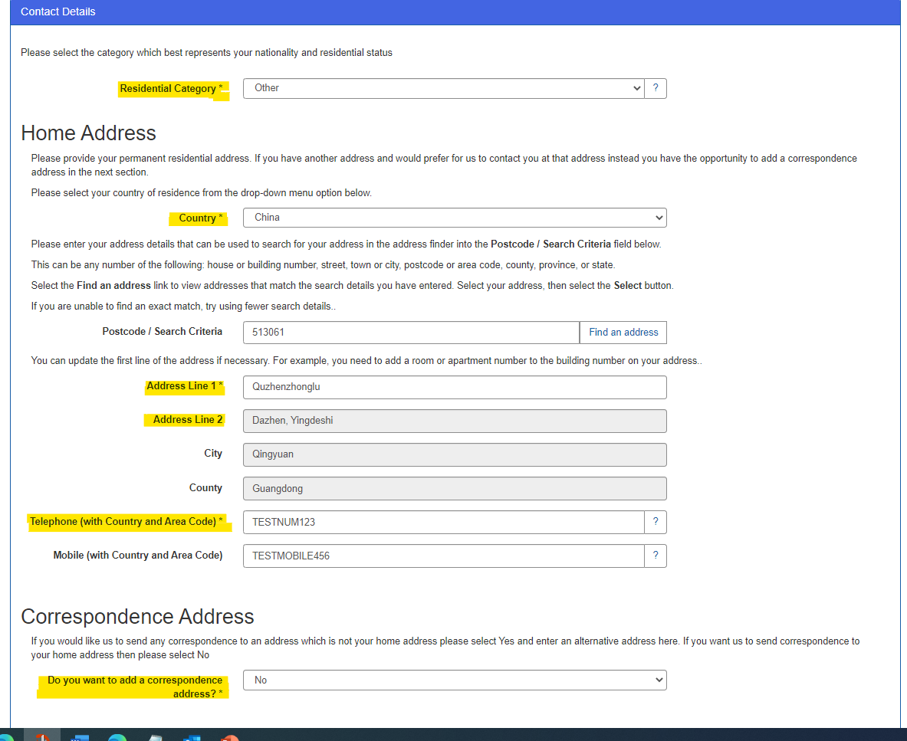
Enter your contact details, then click save and continue
Notes:
Telephone: 如果没有座机号，填写“86+手机号”，如果有座机号，填写“86+区号+座机”
Address line 1：从房间号开始填写，能填多少信息是多少信息
Address line 2，city和country如果不能填写的话可以不填写

Slide 9
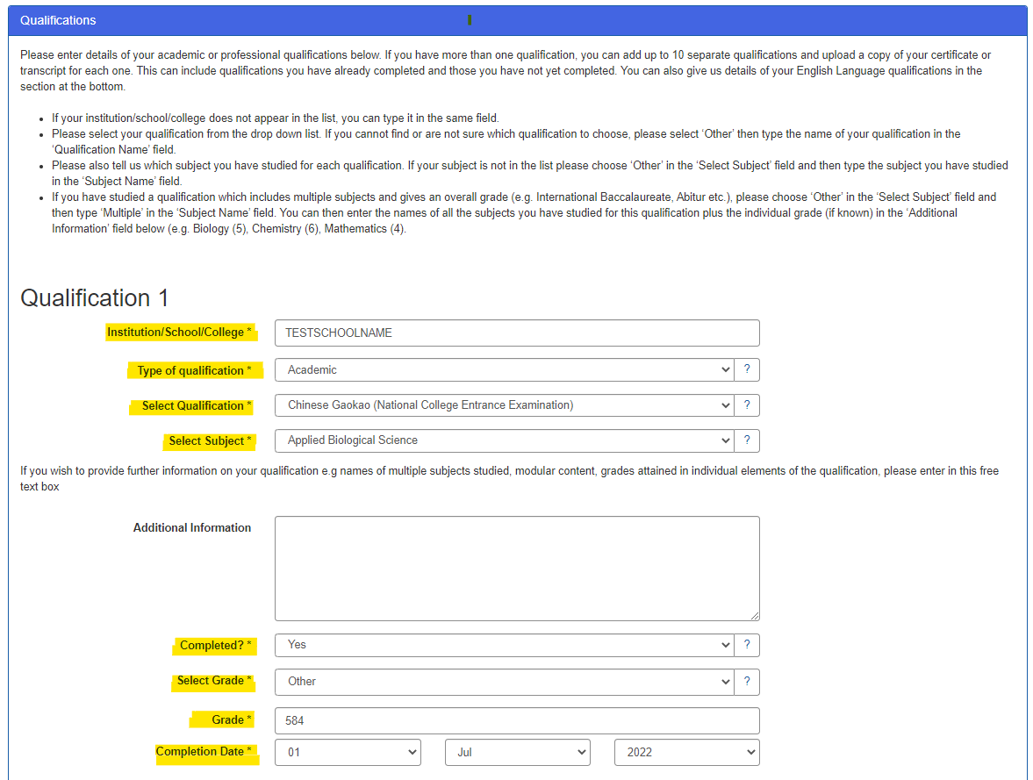
Enter your qualifications, then scroll down
Notes:
Institution/school/college填写高中名
Select subject 文科选art，理科选science，新高考选择other，并填写xingaokao

Slide 10
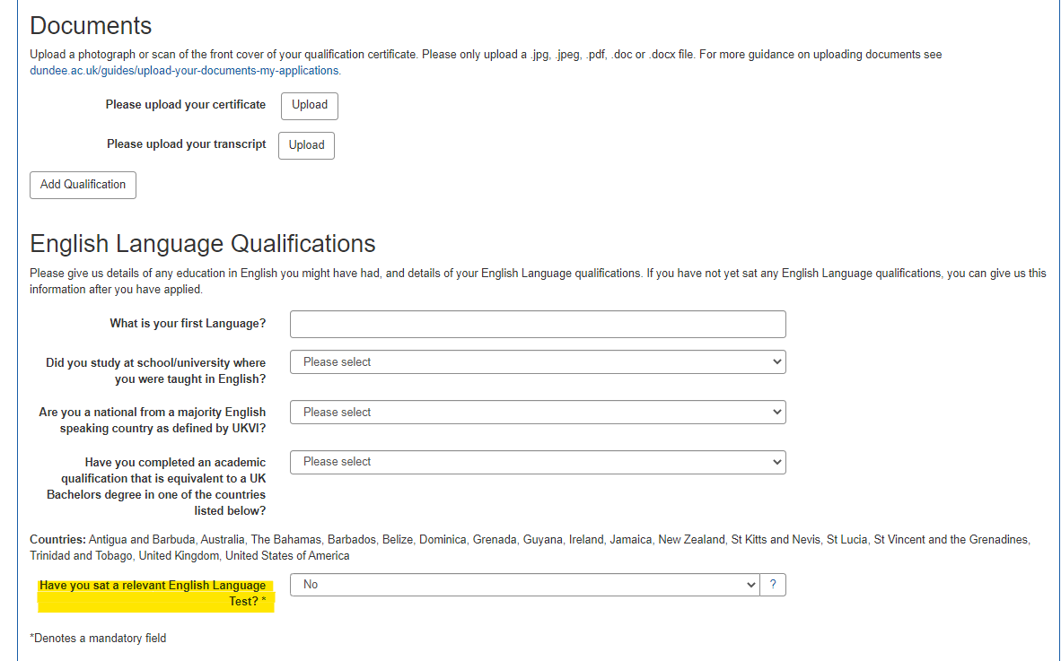
If required, complete the English Language Qualifications, then click save and continue

Slide 11
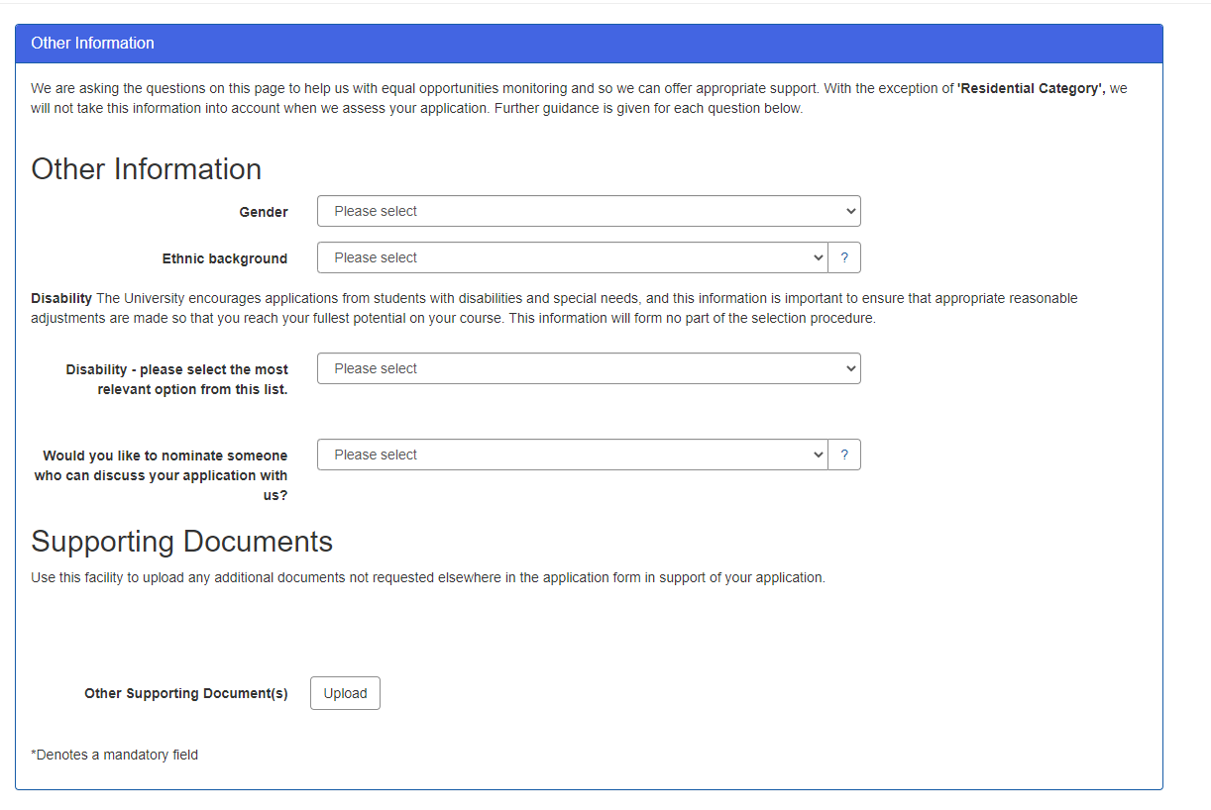
Complete the other information section, and click save and continue

Slide 12
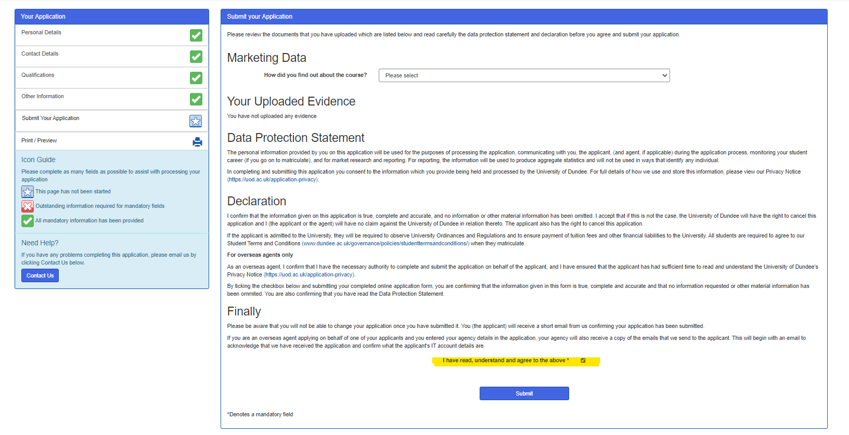
You can now submit your application.

Slide 13
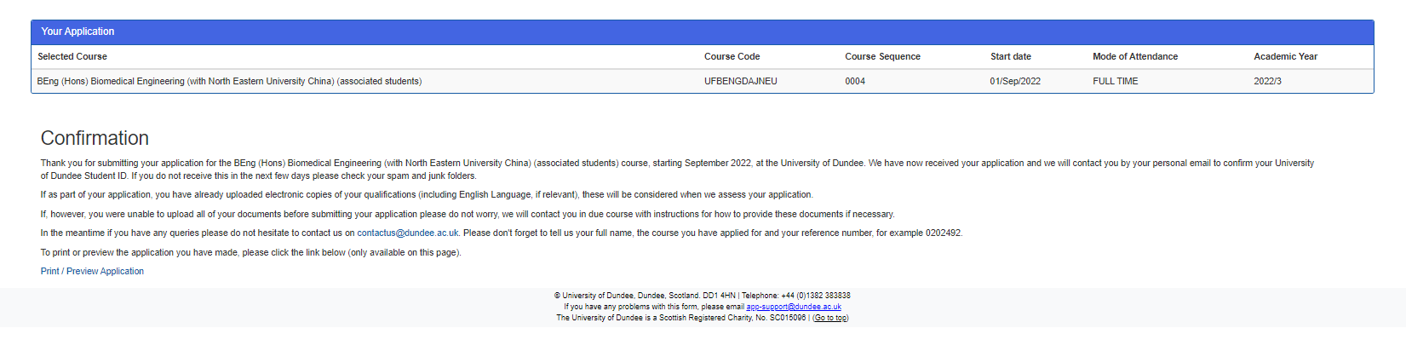
Confirmation screen.
Please note, top bar will be populated with the appropriate course details once web links have been set up

Slide 14
dundee.ac.uk

