Slide 1
Map

Slide 2
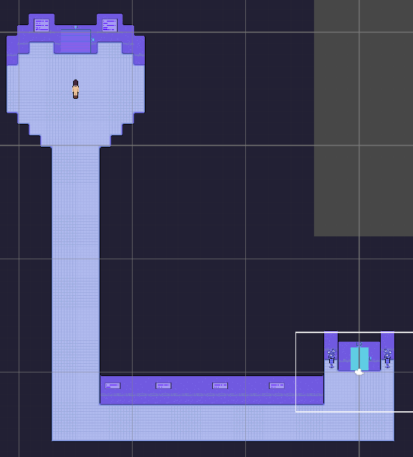

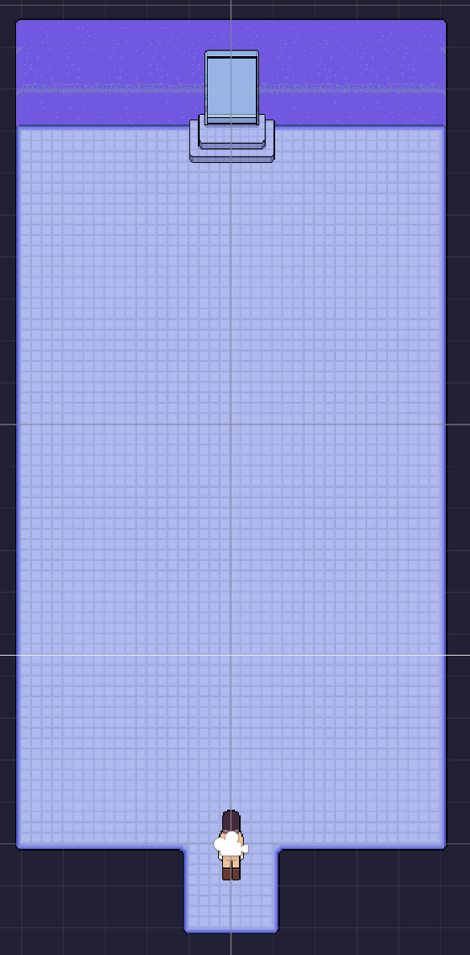
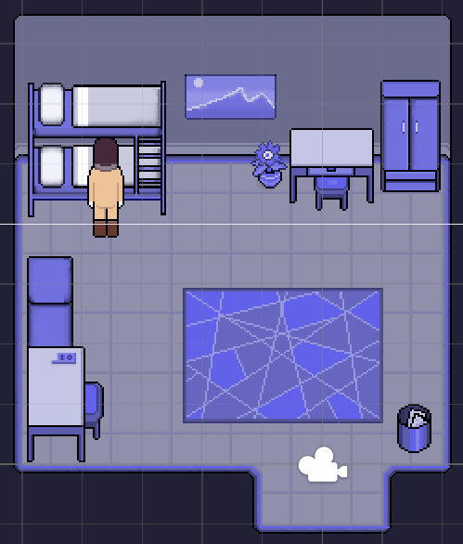
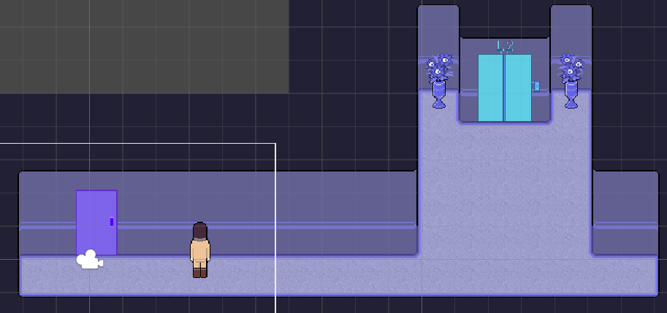
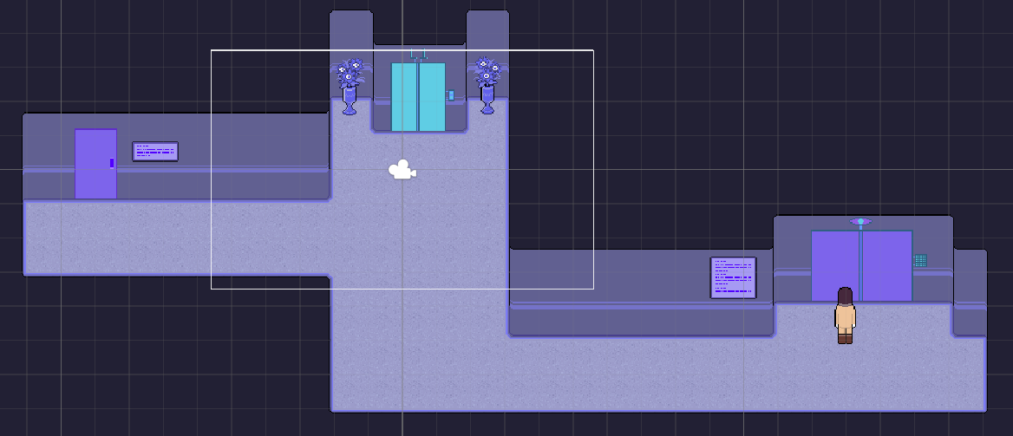
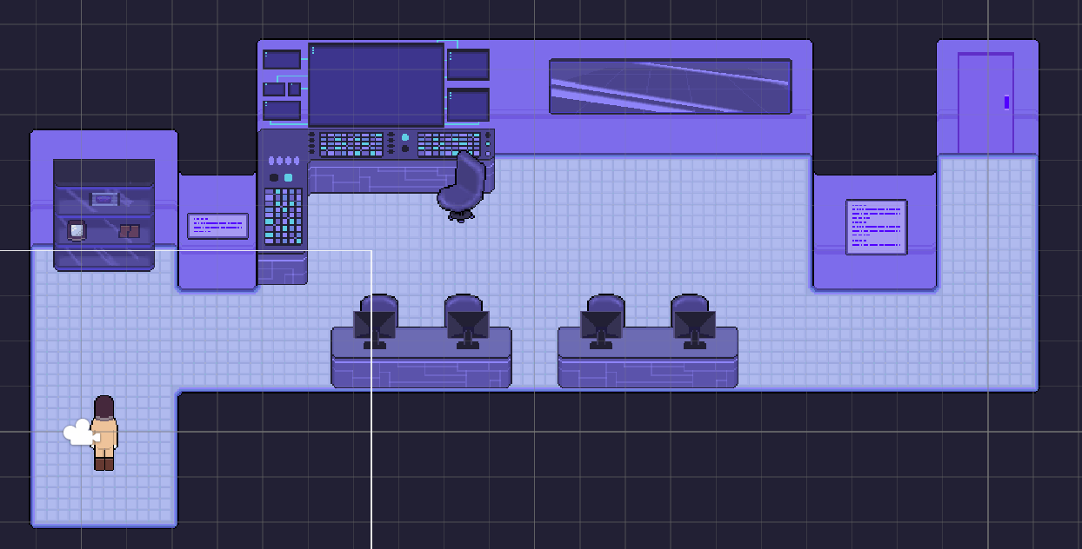
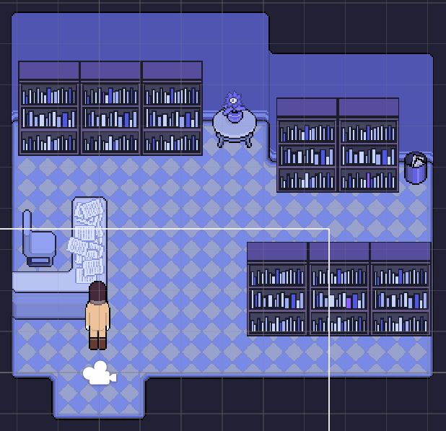
4 rooms + 3 floors
2 rooms are locked
2 doors lead to 3 endings

Slide 3
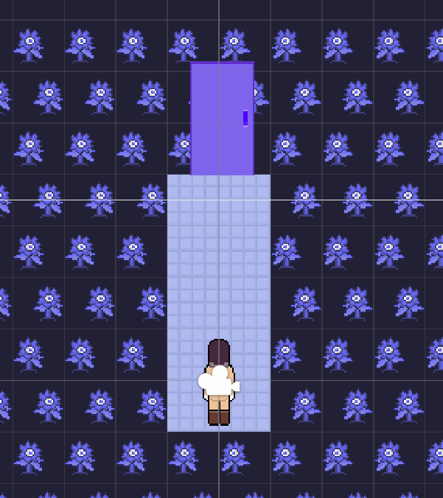
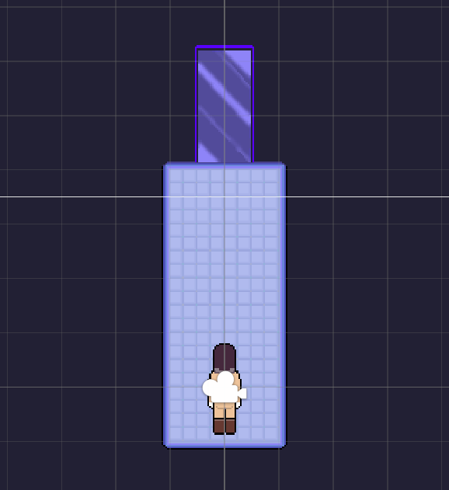
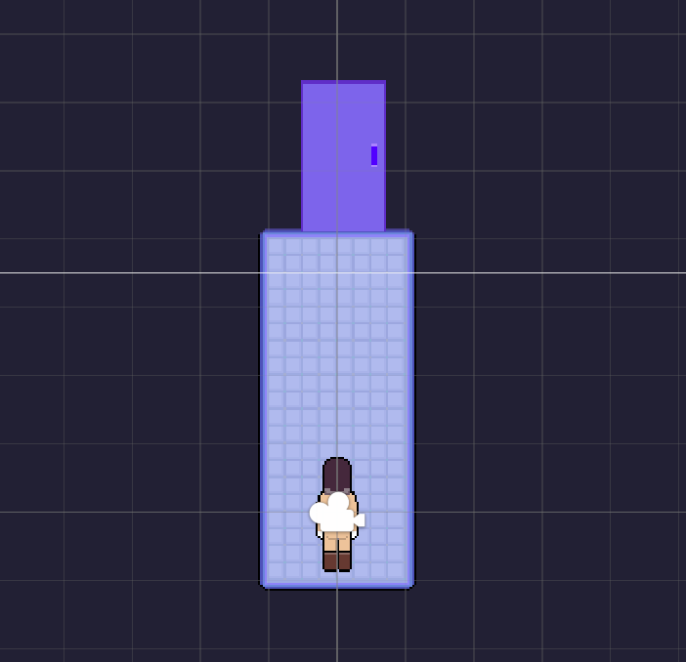
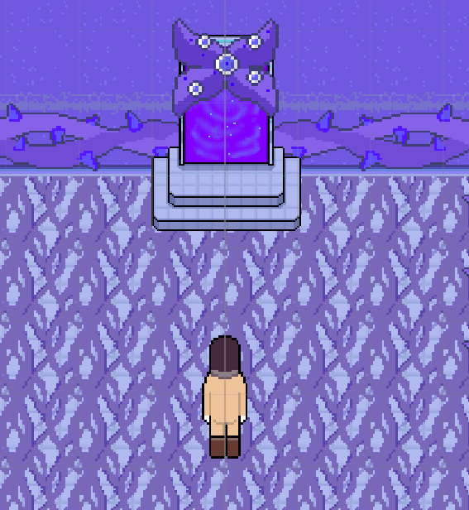
3 endings

Slide 4
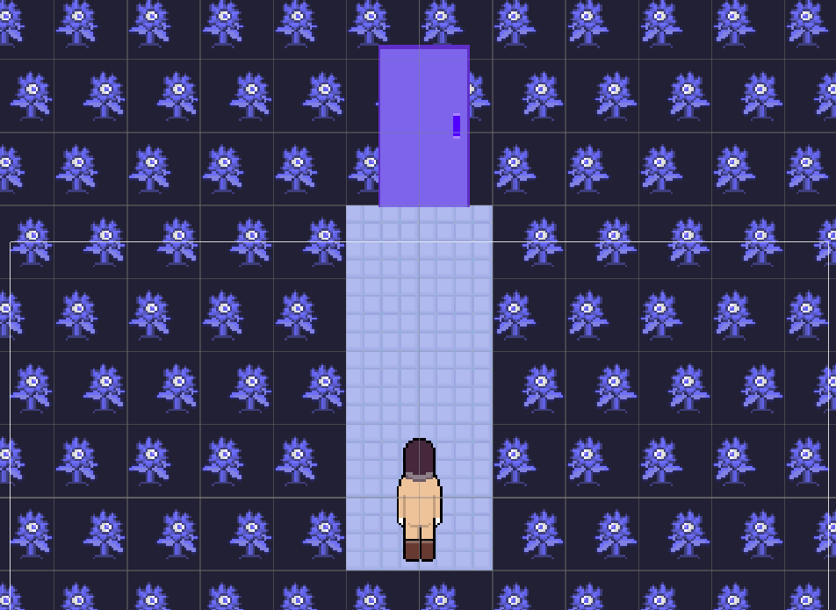

ending 1

Slide 5
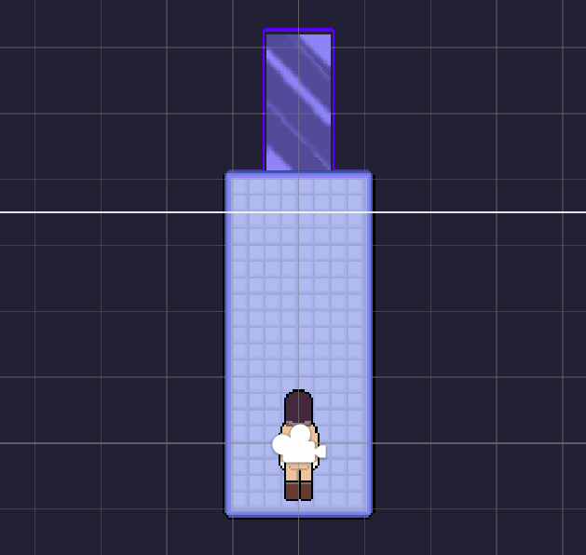
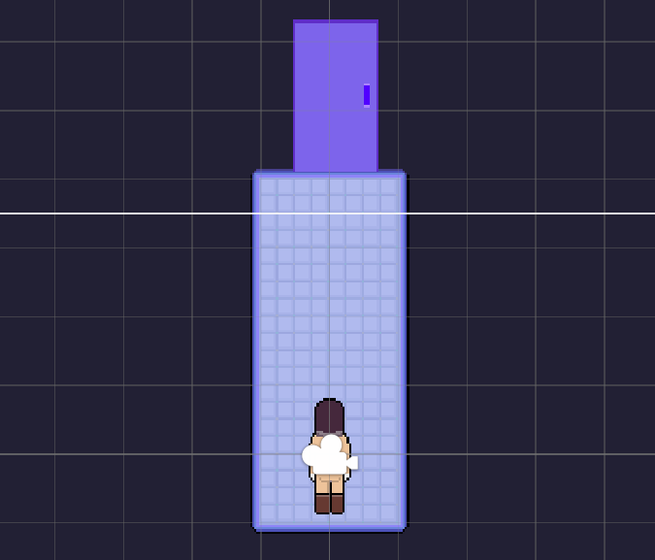
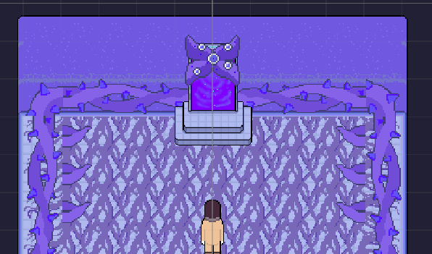
ending 2 & 3

Slide 6
Story

Slide 7
Stage1: Dormitory
find key to stage 3
Stage2: Corridors
can lead to ending 1: death
Stage3: Archive Room
known important information of stage 5
Stage4: Control Room
choose equipment, influence stage 5
Stage5: Portal Room (Monster)
Ending 1/ Ending 2/ Ending 3

Slide 8




stage0: Introduction
stage4: find out truth
stage5: meet monster
Happy ending

