Slide 1
DEVELOPMENT OF MACHINE LEARNING MODEL FOR PREDICTION OF FOREST FIRE
By: ANJALI KALIA & RICHA MISHRA
Dr T.O. Siddiqi
Head, Dept. of Botany
Jamia Hamdard
Dr. Vinita Kumari
Dept. of Computer Science
Jamia Hamdard

Slide 2
Machine Learning
Machine learning is a field of computer science that uses statistical techniques to give computer systems the ability to "learn" with data, without being explicitly programmed.
It is also used to devise complex models and algorithms that lend themselves to prediction; in commercial use, this is known as predictive analytics.

Slide 3
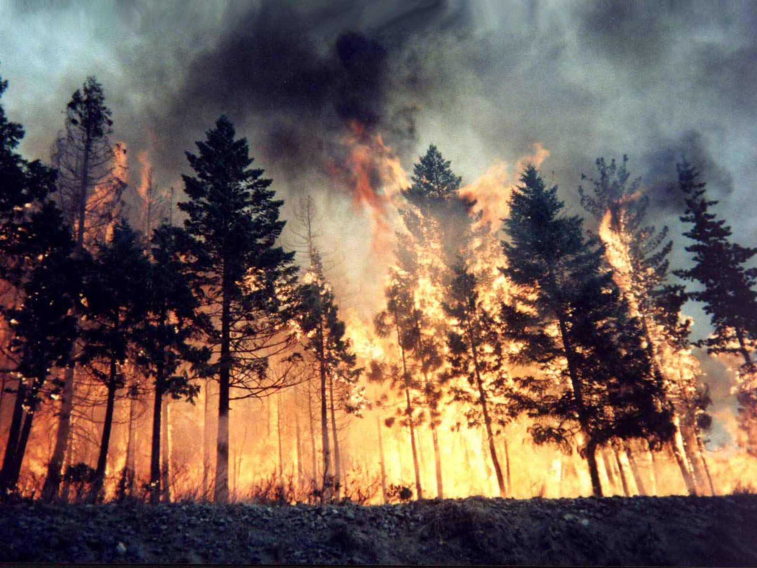
Forest Fires

Slide 4
FOREST FIRES
FACTORS AFFECTING
Forest fires are one of the major environmental issues.
Risks include:
Destruction of biodiversity
Loss of economy
Disturbance in Environment
Human Lives in danger
Factors affecting fire breakout:
Weather: Temperature, wind Speed and direction, Rain, Relative humidity
Seasons
Topography
Forest Complex
Type of vegetation
Human Activities

Slide 5
Increasing Forest Fires
Recently the Occurrence of Forest Fires has become more frequent.
There are the following reasons behind this:
Rise in Global Temperature
Decrease in Precipitation
Human Activities

Slide 6
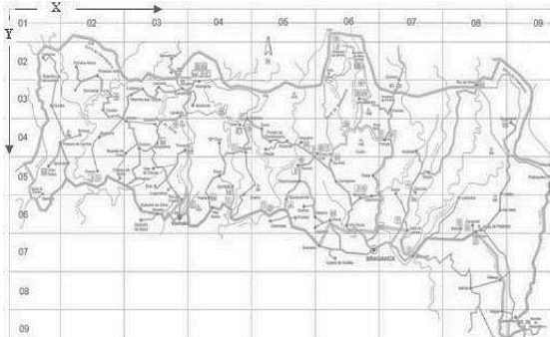
Our Dataset
In our study we are using the forest fire data of Montesinho Natural park(Portugal), collected from January 2000 to December 2003.
This park has a high diversity of flora and fauna.
This data set was taken from the UCI Machine learning repository
The dataset has 517 instances and13 attributes.
The dataset includes 5 main types of Attributes.
Figure1: Map of Montesinho Natural Park

Slide 7
ATTRIBUTES
SPATIAL
TEMPORAL
FWI
METEORO-LOGICAL
Target Attribute
X
Y
Months
Day
FFMC
DMC
DC
ISI
Temperature
Rain
RH
Wind
Burned Area

Slide 8
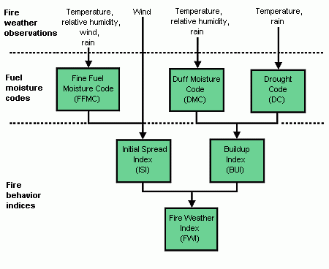
Component Of FWI | Importance
FFMC: | It denotes the moisture conent of surface litter
DMC: | It denotes the moisture content of shallow organic layer
DC: | It denotes the moisture content of deep organic layer
ISI: | It denotes Fire velocity spread,with FFMC
Figure: Various Components of FWI System

Slide 9
Fire data and meteorological data
Trends can be observed
Is used in prediction of fire

Slide 10
Steps Involved
1
Collecting Forest Fire and Weather dataset
Comparison of Model
2
Pre-processing of Dataset
3
Model development
5
Evaluation of Model
6
Processing
4

Slide 11
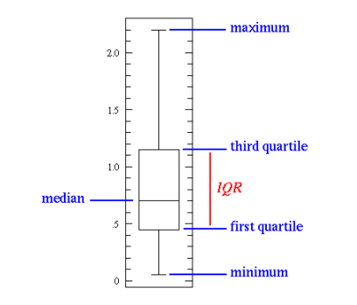
Data Visualization
Boxplots and Histograms
It is done prior to pre-processing.
Gives the knowledge about the data distribution.
The uniformity or skewness of the data distribution is determined.
Presence or absence of outliers is determined.
Figure2: A typical Boxplot distribution showing its features.

Slide 12
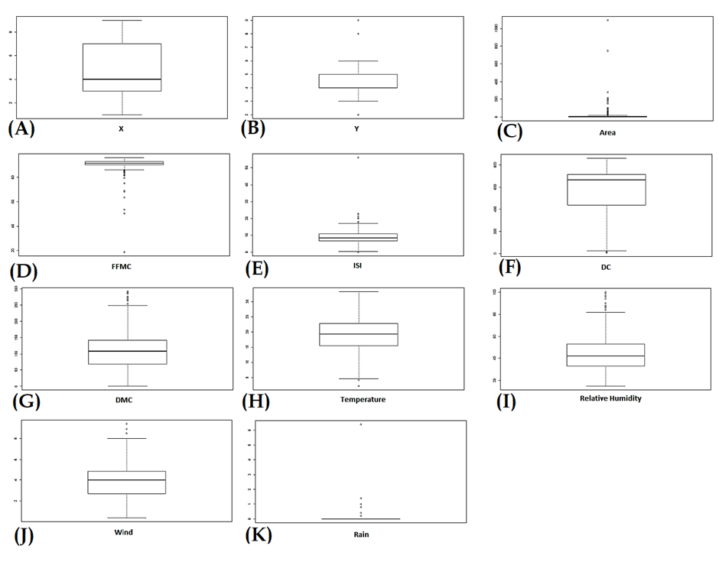
Figure3: Boxplot distribution of the 11numerical variables of the dataset(A)X, (B)Y, (C)Area, (D)FFMC, (E)ISI, (F)DC, (G)DMC, (H)Temperature, (I)Relative Humidity, (J)Wind and, (K)Rain

Slide 13

Data Pre-processing
Real-world data in many cases is incomplete, inconsistent, or lack certain behaviours or trends, is likely to contain many errors. It prepares the raw data for further processing.
It involves the following:
Checking and Replacing Missing Values: presence of missing values affects the conclusions derived from the data.
We checked missing values using any(NA) function and, there were no missing values in our data.
Data Clustering : Clustering of data is done to deduce the correlation between the varous attributes.

Slide 14
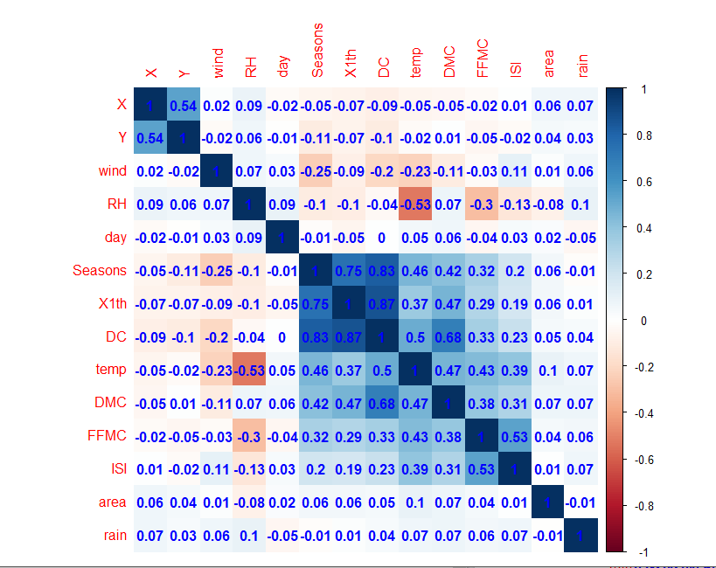
Model used for clustering: K means Model
It helps to understand the relationship(+ve or –ve) of the attributes with the target attribute which is Area.
Figure 4 Shows Correlation Plots of Various Attributes.
Figure: Correlation among the attributes, shown by Corrplot

Slide 15
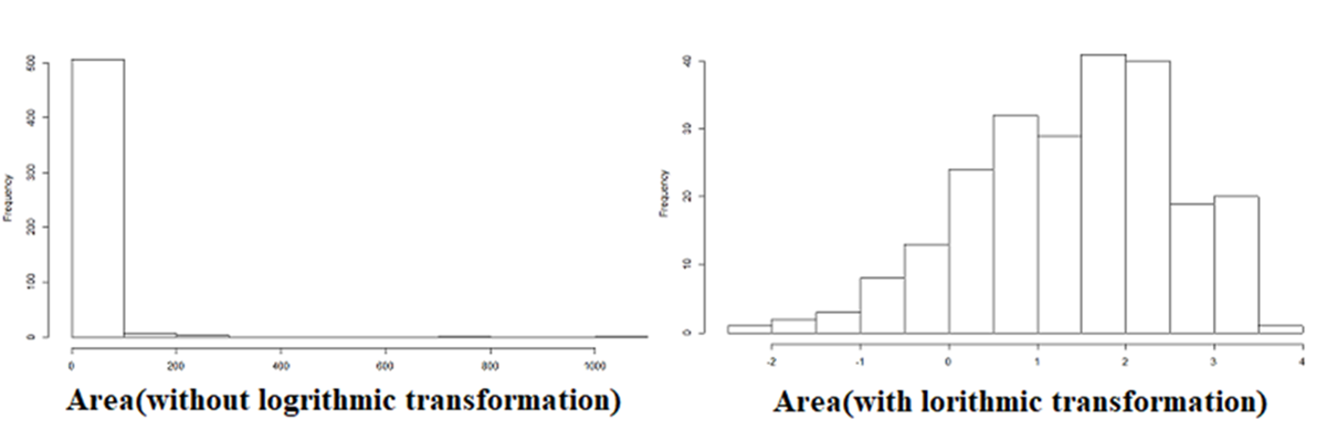
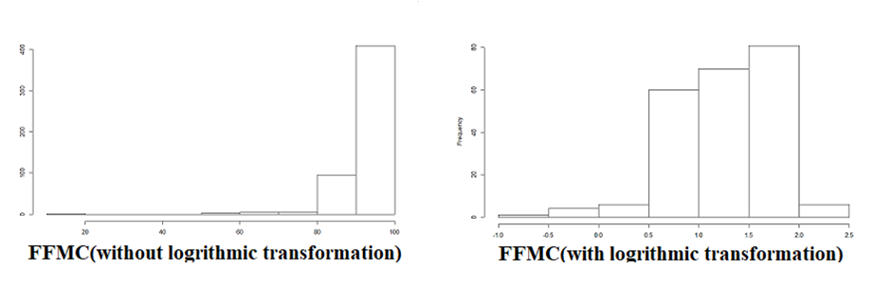
Logarithmic Transformation:
The attribute area is positively skewed and FFMC is negatively skewed as observed in their distribution in its histogram and boxplot visualization.
Therefore requires logarithmic transformation.
Log150 (Area) is taken and Log10(FFMC) is done.

Slide 16
Attribute Selection: The attributes Log10 (FFMC), Log150(Area).100, DMC, DC, ISI, X, Temperature and Seasons are taken.
Range Selection:
Area, the values between 0 and 800 are taken.FFMC, the values greater than equal to 80 are taken.ISI, the values between 0 and 50 are taken.For the rain attribute values less than 1 are taken. For DC And lastly for attributes wind and seasons the values less than 9 and values greater than 1 are taken respectively.
Data Mutation:
To build predictive model we have mutated the data by adding seasons. Log FFMC and Log150 Area . 100, attributes are mutated in the dataset.

Slide 17
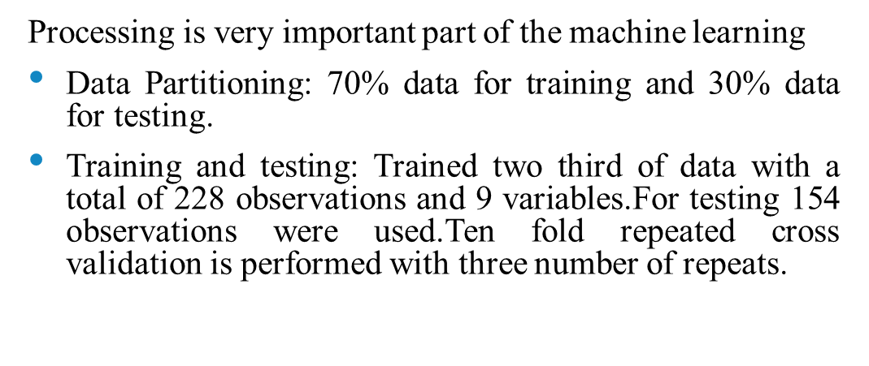
Processing

Slide 18

Machine Learning
In our work we have used machine learning to build a model for prediction of forest fire.
Target value(value to be predicted): Burned area
Software used: R studio
language-R programming.
Algorithms used - Support vector machine(SVM) and k-nearest neighbors(kNN).

Slide 19

Model Development
S.No. | Model Name | Fitting Parameter
1. | SVM radial | Gamma=1.316872e-06
2. | kNN | K= 23

Slide 20
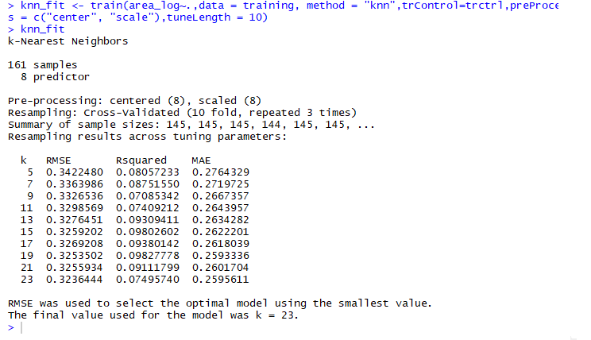
K-NEAREST NEIGHBOR MODEL
Fitting parameter is k which is the number of most similar instances.
The values are predicted by taking mean of most similar instances (k).
For our trained and tested data k is 21 at which Root mean square error (RMSE ) is 0.323.
Picture depicts k-NN result for k values for statistical parameters RMSE, R-SQUARED and MAE.

Slide 21
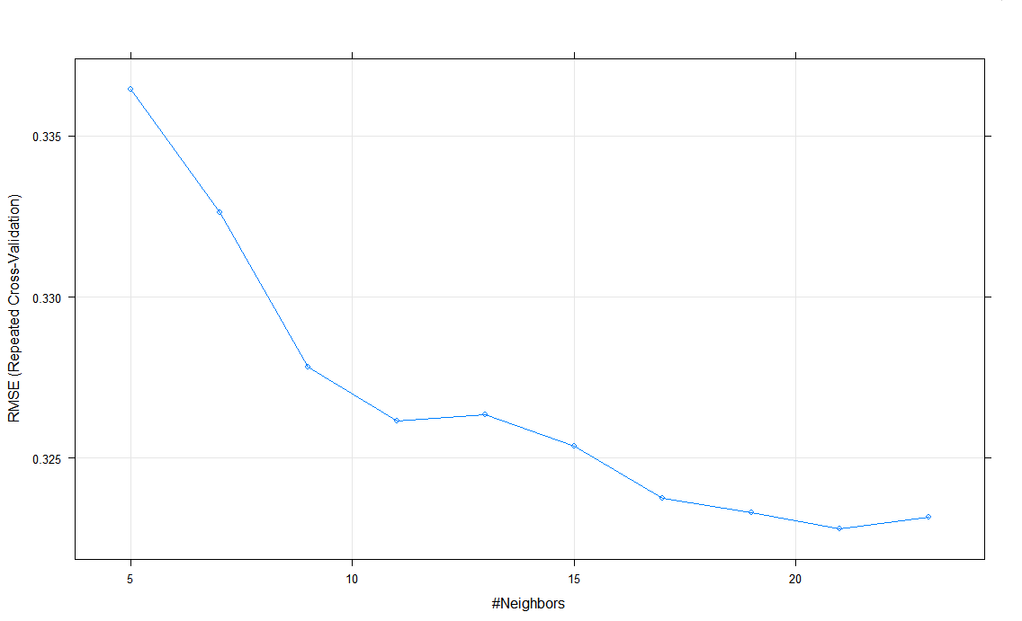
K-NN Model

Slide 22
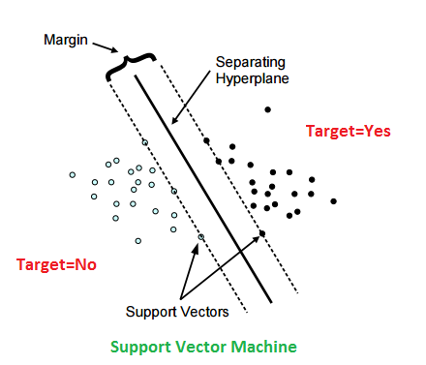
SVM Model
1.
Permits construction of nonlinear model without changing explanatory variables.
For better result fine tuning of range selection of attributes before processing is done.
3
Creates hyperplane around with expanded margin around which predicted variable scattered.
5
Kernel function- radial (transformed data from non linear to linear space).
Centre line is line of regression
Gamma value-$0.3168$at cost 100.
Gamma value-0.3168 at cost 100.
4
2
6
Figure depicts SVM working principle.

Slide 23
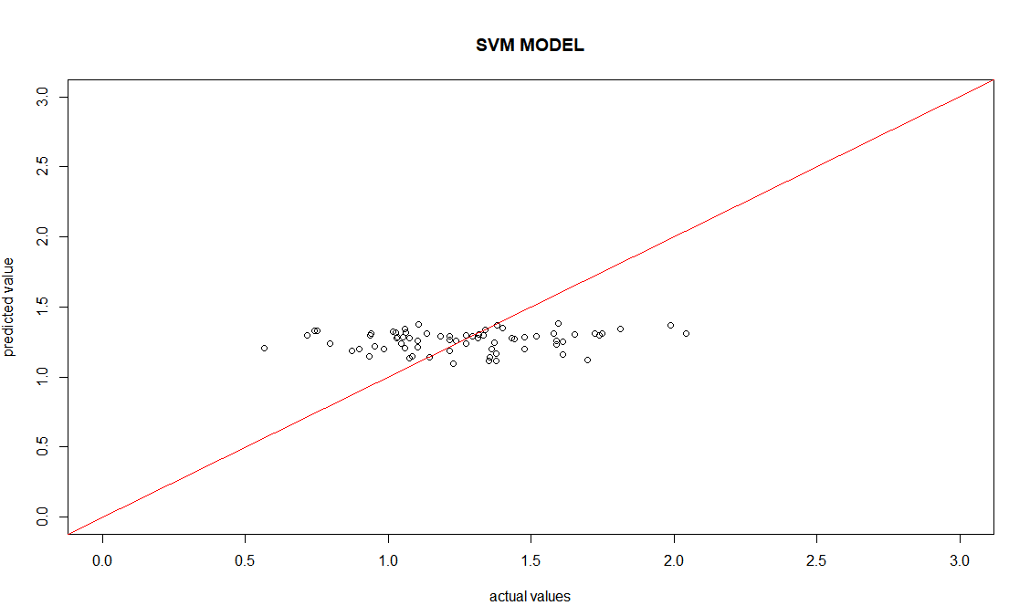
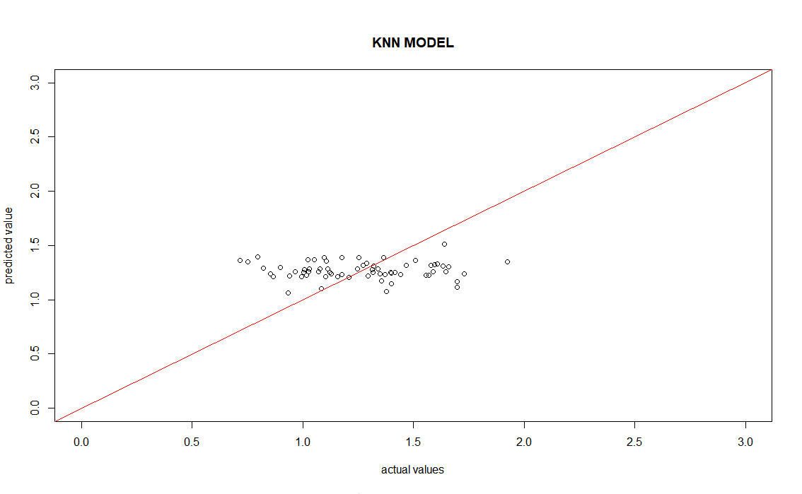
Prediction and Accuracy Graph of SVM and Knn model
Accuracy plot of SVM model.
Accuracy plot of knn model.

Slide 24
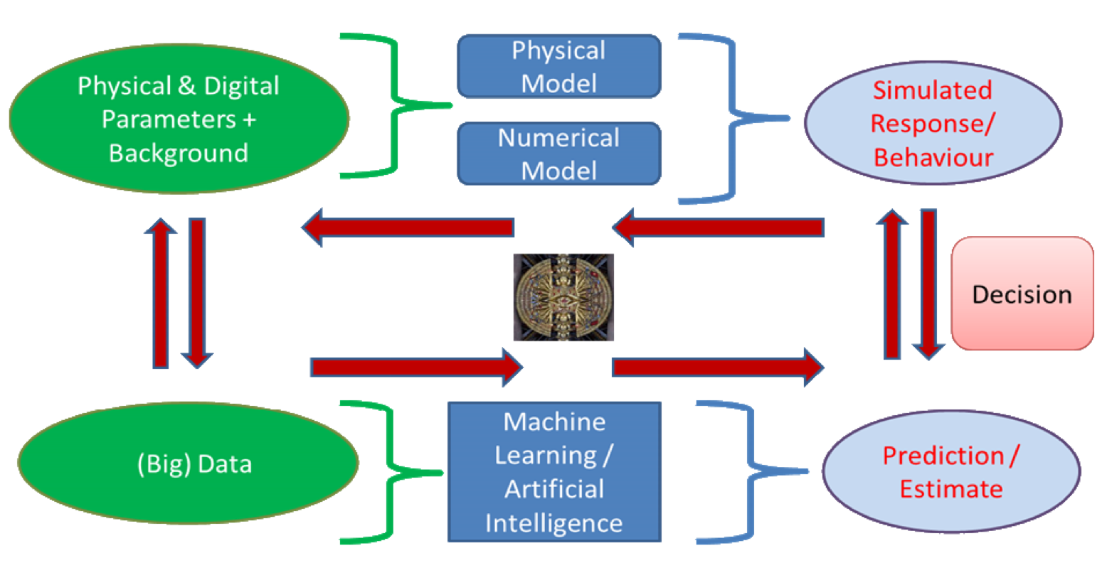
Model Comparison
PARAMETERS USED FOR COMPARING EFFICIENCY AND ACCURACY OF MODELS
MEAN ABSOLUTE ERROR
ROOT MEAN SQUARE ERROR
R SQUARE

Slide 25
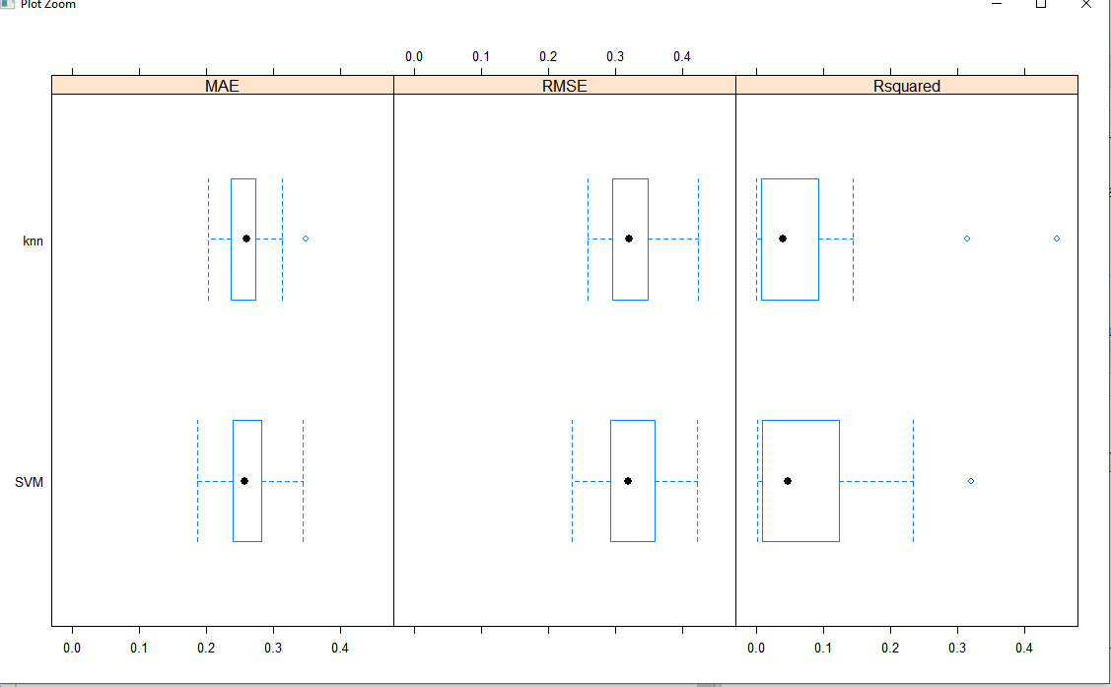
Model Comparison

Slide 26
Result And Conclusions
The model which has high efficiency and accuracy is best fitted model for trained and tested data.
Best Fitted model for prediction of burned area is SVM.
Mean Absolute Error(MAE) is used as a final selecting parameter for best fitted model.
The MAE value of SVM model is 0.24.

Slide 27
Importance
i
By the help of predictive model current weather conditions can be considered to determine chances of fire break out.
ii
Forest fires directly effect environment and by further extension of models can be used to study its effect on pollution.
Predictive model can used to study the loss biodiversity due to forestfires.
iv
By further extension of data it can be used to study the impact of forestfires on flora and fauna in Telangana and Tamilnadu.
iii

Slide 28
THANK YOU

