Slide 1


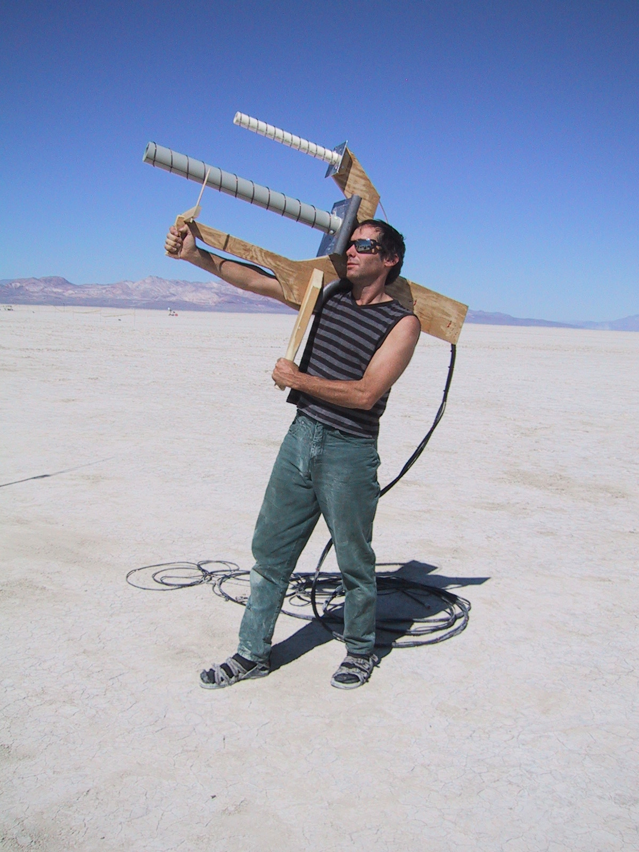


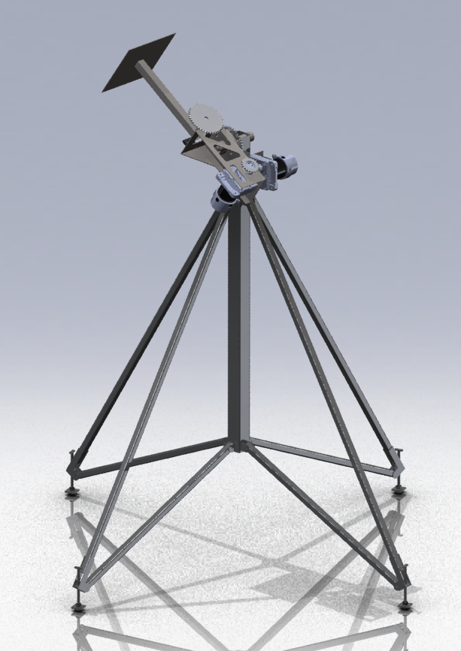
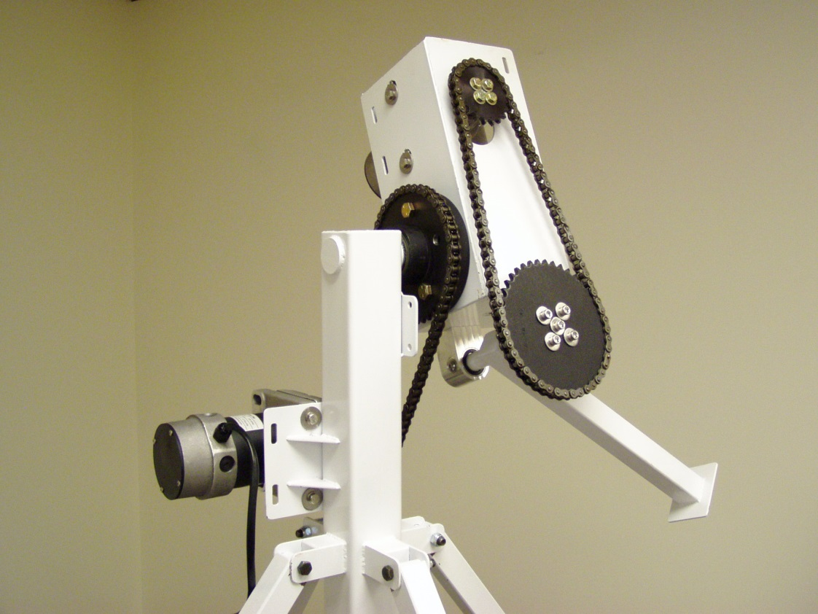



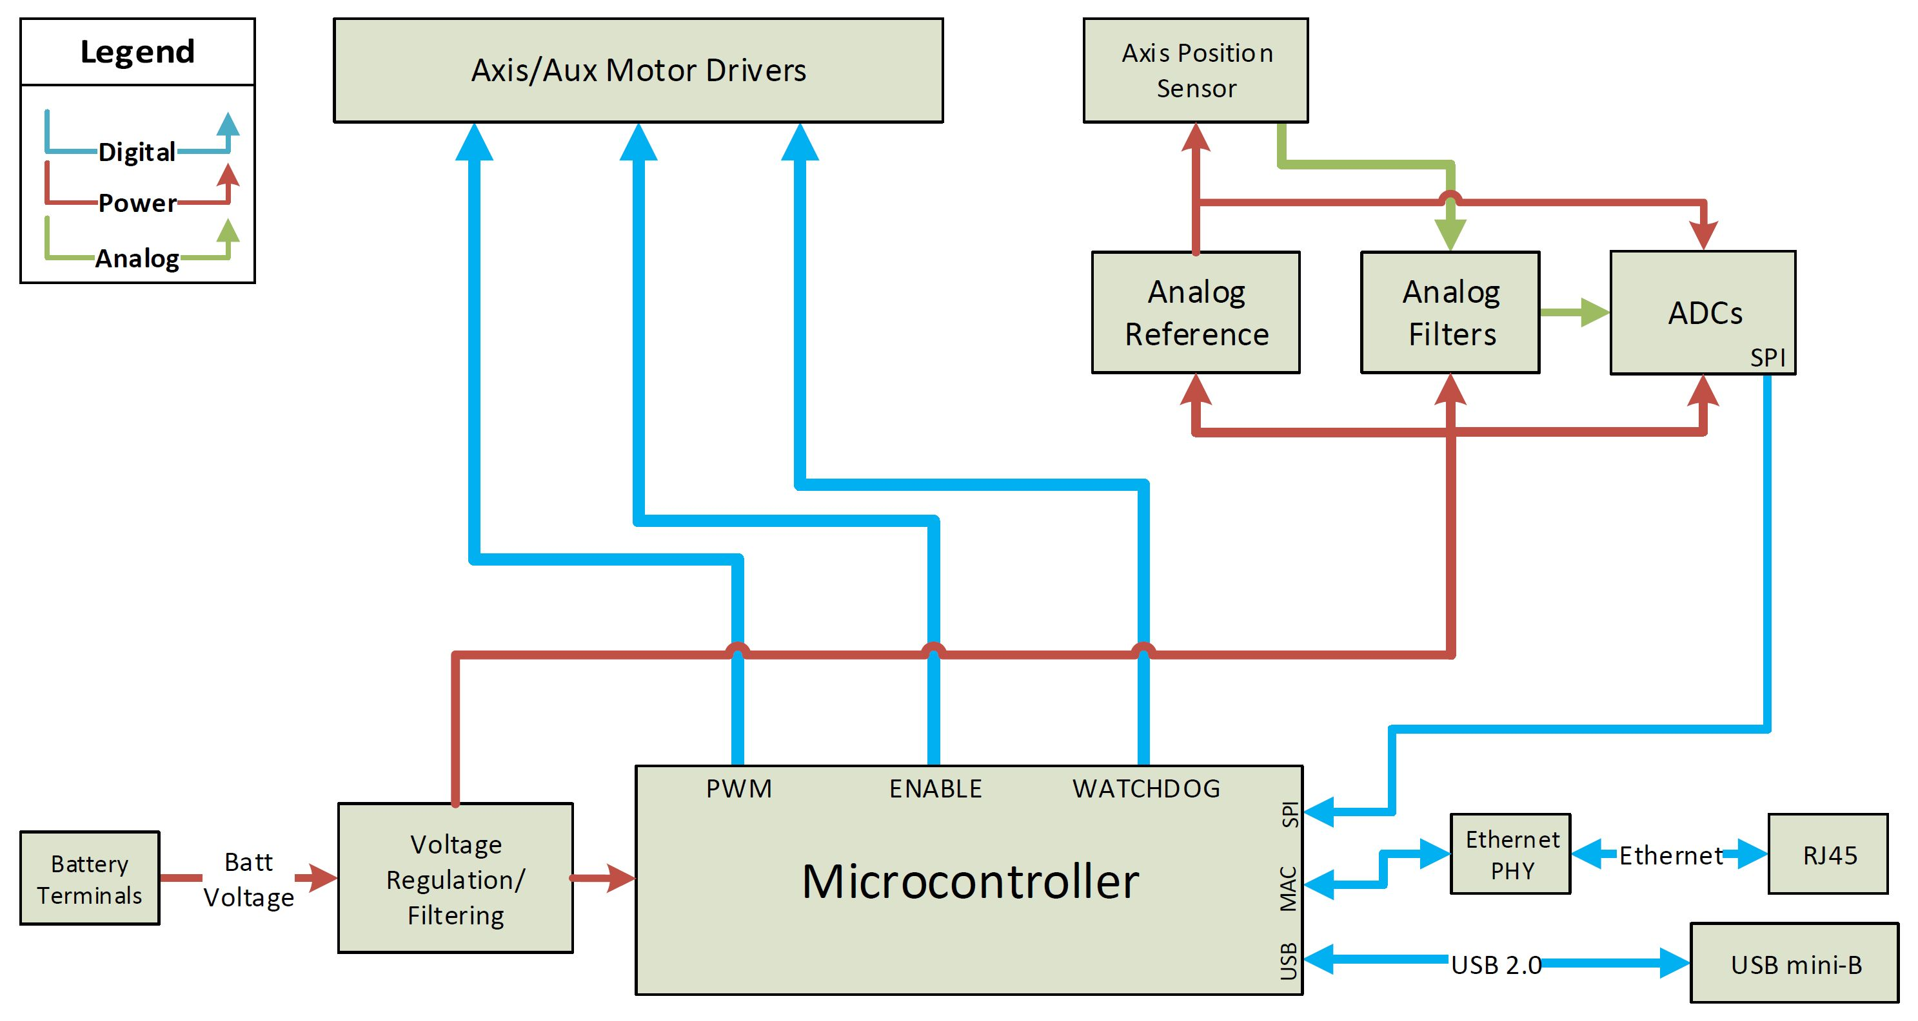
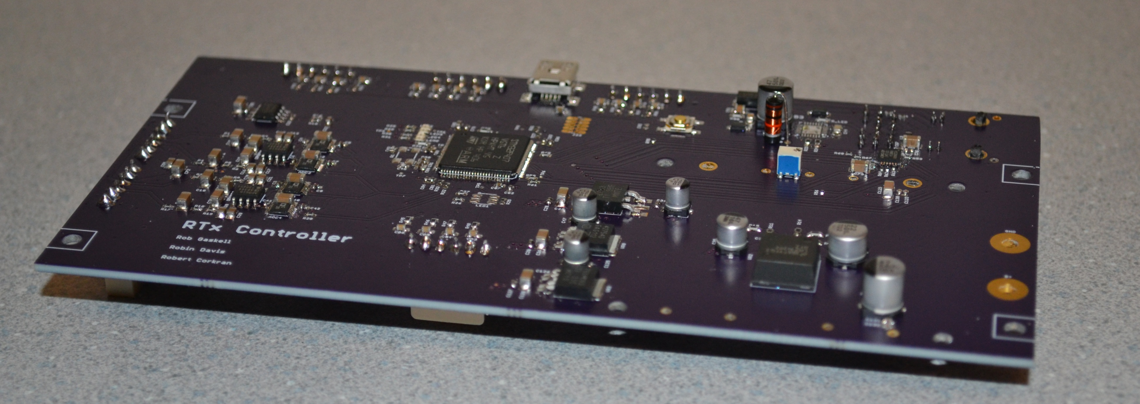
RocketTracks
Portland State
Aerospace Society
Portland State
University
Sponsor: Andrew Greenberg
Rob Gaskell, Robin Davis, Robert Corkran
Advisor: Malgorzata Jeske
PROBLEM
HOW IT WORKS
What good is a high tech rocket if you can’t track it?
Current PSAS methods of tracking are limited by dependence on human eye.
User selects mode
Manual Mode:
User can adjust the direction that RocketTracks points by turning two nobs corresponding to the horizontal and vertical axes
Automatic Mode:
User selects object to track using laptop.
Camera provides feedback to Sightline® as to position of the object.
RTx Controller adjusts mechanical position accordingly
Rockets move fast.
Keeping antennas and cameras pointed at them during flight is a challenge.
RocketTracks was originally conceptualized in 2011 as a mechanical structure controlled by a manual control box.
RTx
Controller
While this was an improvement over earlier handheld models, it still left too much room for human error.
Emergency Stop
Automatic removal of power to system if:
Big red button is pushed
User gets too close to system
Any single component breaks that could result in loss of system control
Manual
Control
IDEA
Eliminate human error by adding automatic tracking capabilities to the existing RocketTracks system.
ROCKET TRACKS CONTROLLER
BLOCK DIAGRAM
IMPLEMENTATION
Create RocketTracks controller board to interface mechanical system with automatic and manual control boards
Implement Ethernet for communication between different blocks of RocketTracks system
Interface with Sightline SLA-1500 to add automatic tracking
Improve control loop for manual controller and interface via Ethernet
Create safety protocols and perform FMEA analysis to protect from personal injury or damage to system

