Slide 1


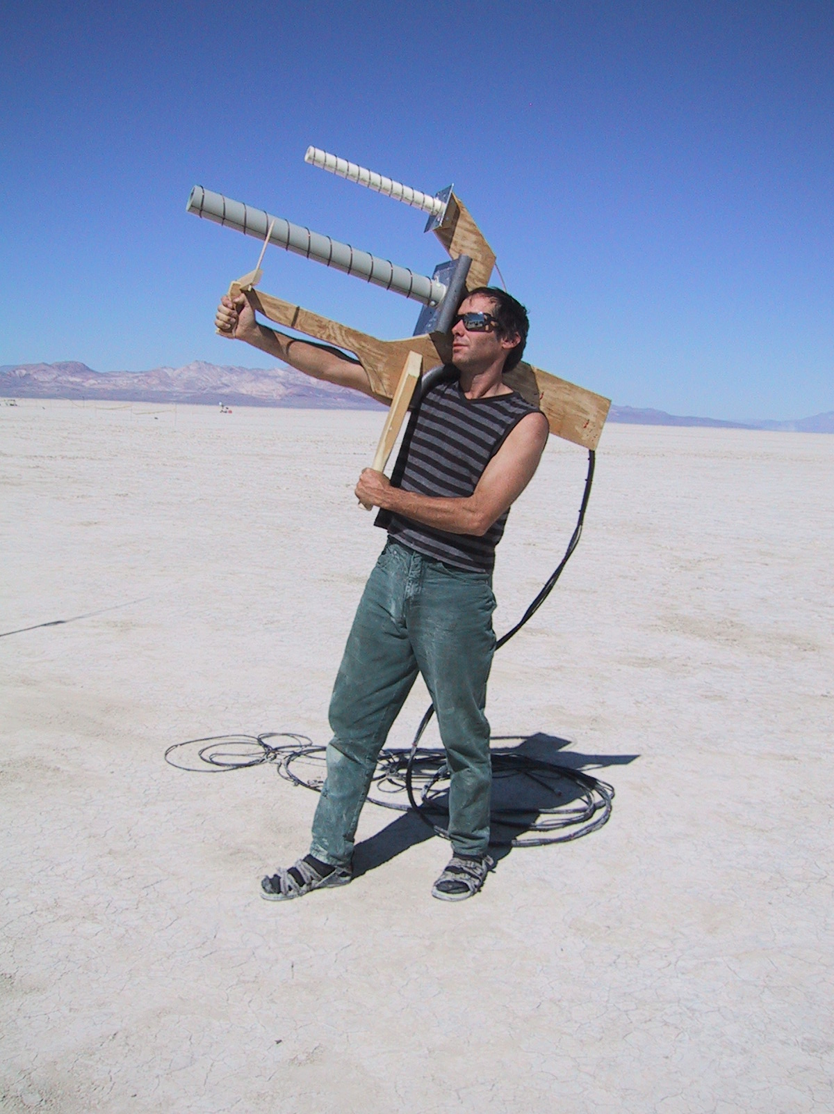
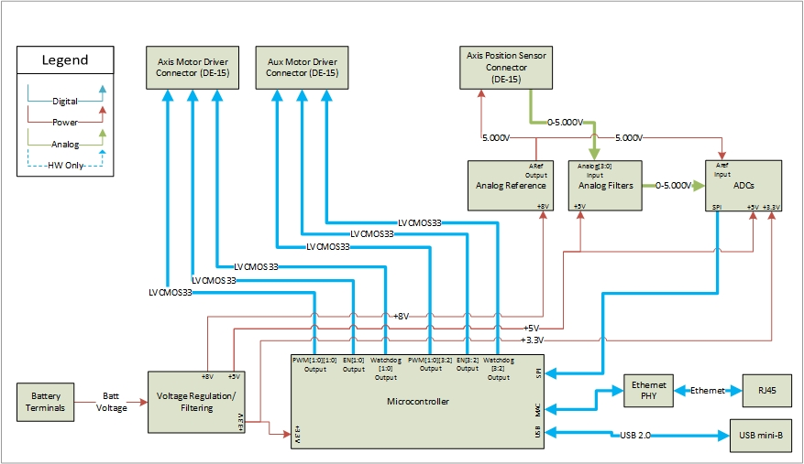
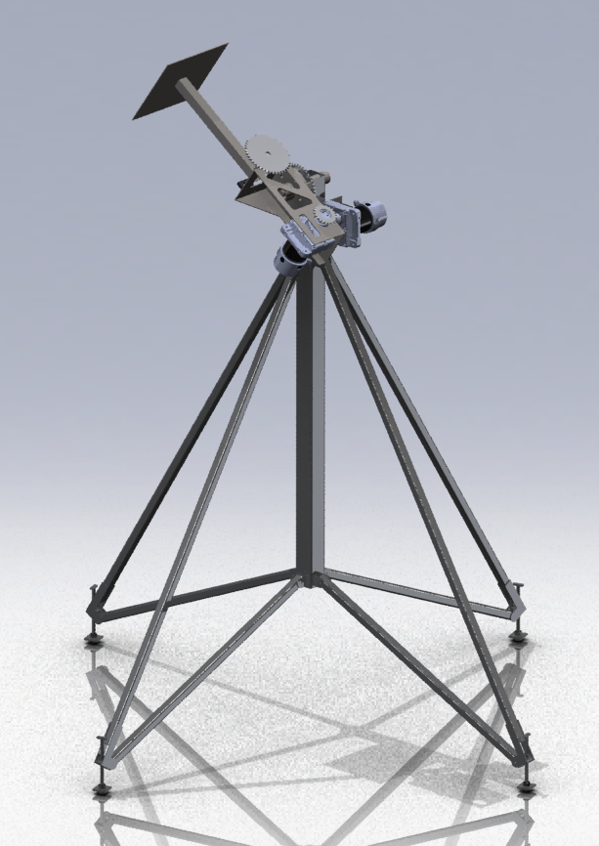
RocketTracks
Portland State
Aerospace Society
Portland State
University
Sponsor: Andrew Greenberg
Rob Gaskell, Robin Davis, Robert Corkran
Adviser: Malgorzata Jeske
PROBLEM
BLOCK DIAGRAM
PSAS has been launching rockets since 1998. While the rockets technology rapidly improves, the method for tracking them has remained the same.
It is time to bring rocket tracking methods up to speed and automate the process. It is time to remove the need for hand held manually controlled antennas and replace this system with an automated video tracking system.
IDEA
RocketTracks was originally conceptualized in 2011 by a group of PSAS members (Rob Gaskell, Dan Kirkpatrick, Chris Mullens). The mechanical structure was designed along with a simple manual control box.
The RocketTracks capstone team’s job was then to integrate the existing mechanical structure and motor drivers with a video tracking system (Sightline SLA1500) to enable automatic tracking capabilities.
GOALS
Be capable of tracking the PSAS launch vehicle throughout the duration of its boost stage of flight
Be portable/self-powered
Allow for manual control of individual axes
Support remote operation
Communicate via Ethernet
Interface with existing mechanical design and motor drivers
Interface with Sightline SLA1500

