Slide 1
RocketTracks Capstone
Rob Gaskell Robert Corkran Robin Davis

Slide 2
Problem or Need
What good is a high tech rocket if you can’t track it?
Current PSAS methods of tracking are limited by dependence on human eye
Rockets move fast
Keeping antennas and cameras pointed at them during flight is a challenge
RocketTracks was originally conceptualized in 2011as a mechanical structure controlled by a manual control box
While this was an improvement on earlier handheld models, it still left too much room for human error
Idea
Eliminate human error by adding automatic tracking capabilities to the existing RocketTracks system

Slide 3
Implementation
Create RocketTracks controller board to interface mechanical system with automatic and manual control boards
Implement Ethernet for communication between different blocks of RocketTracks system
Interface with Sightline SLA-1500 to add automatic tracking
Improve control loop for manual controller and interface via Ethernet
Implement power pre-charge circuitry
Create safety protocols and perform FMEA analysis to protect from personal injury or damage to system

Slide 4
Top-Level Requirements
Be capable of tracking the PSAS launch vehicle throughout the duration of its boost stage of flight
Be portable / self-powered
Withstand exposure to rain while powered down (Excluding payload)
Be operable in temperatures typical of Brothers, OR year-round
Prevent single points of failure from causing injury or permanent damage to the unit or properly attached payloads
Allow manual control of individual axes
Interface with existing mechanical design and motor drivers
Support remote operation
The system will contain an API for relevant communications via Ethernet
Interface with Sightline SLA1500 via Ethernet
Provide power over Ethernet to payload devices

Slide 5
Design & Implementation

Slide 6
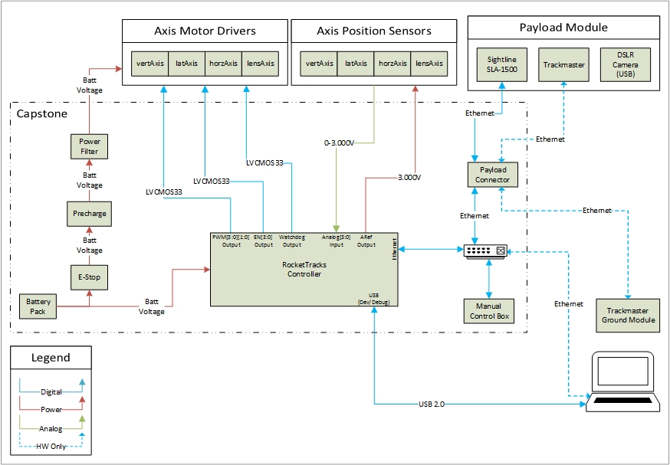
System Level Block Diagram

Slide 7
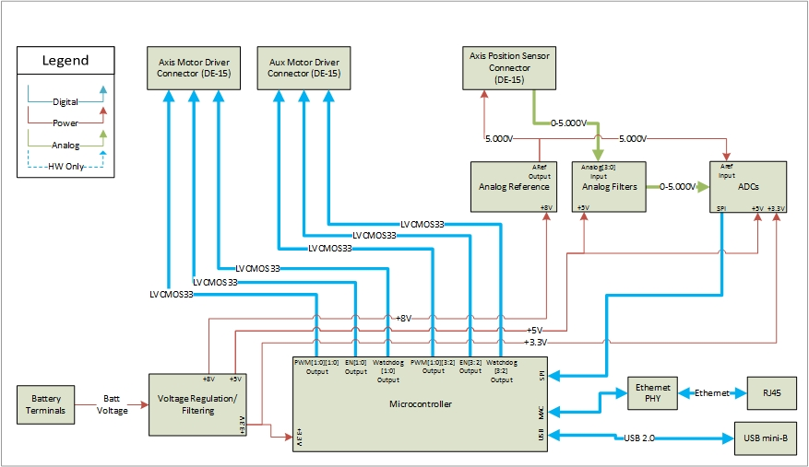
RTx Controller Block Diagram

Slide 8
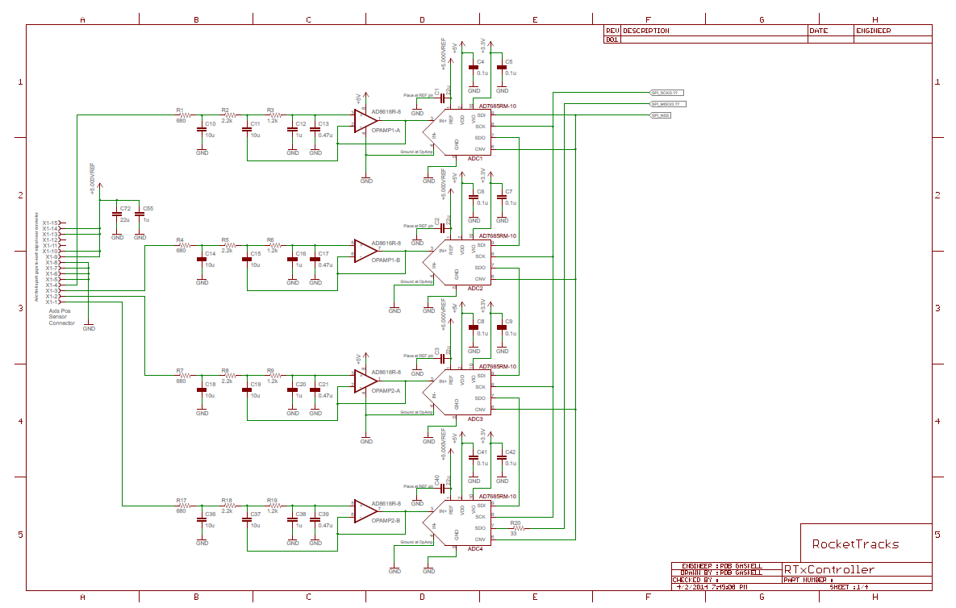
Implementation: RTx Controller ADC Circuitry

Slide 9
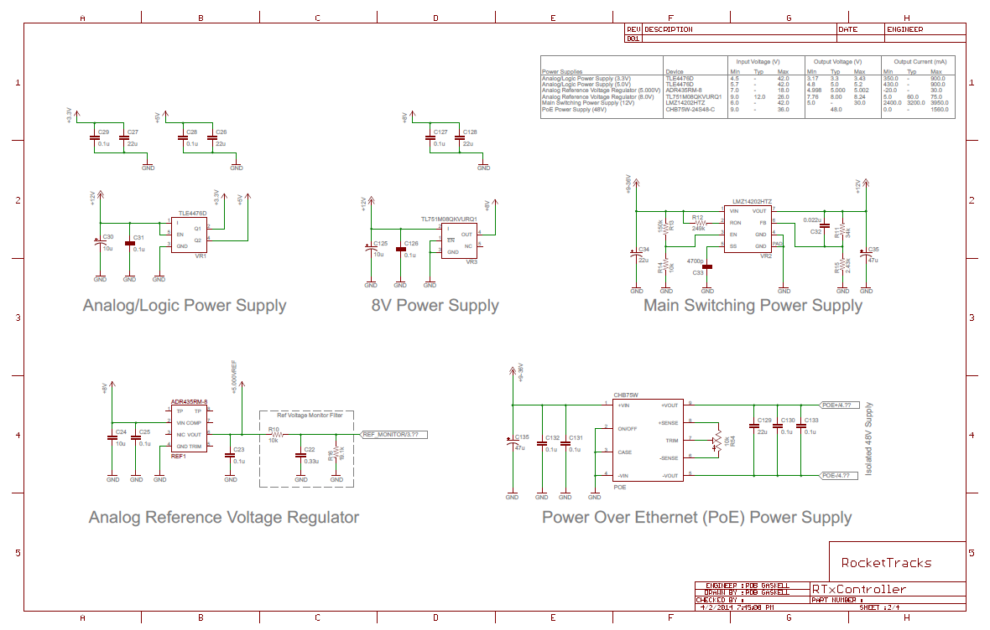
Implementation: RTx Controller Power Circuitry

Slide 10
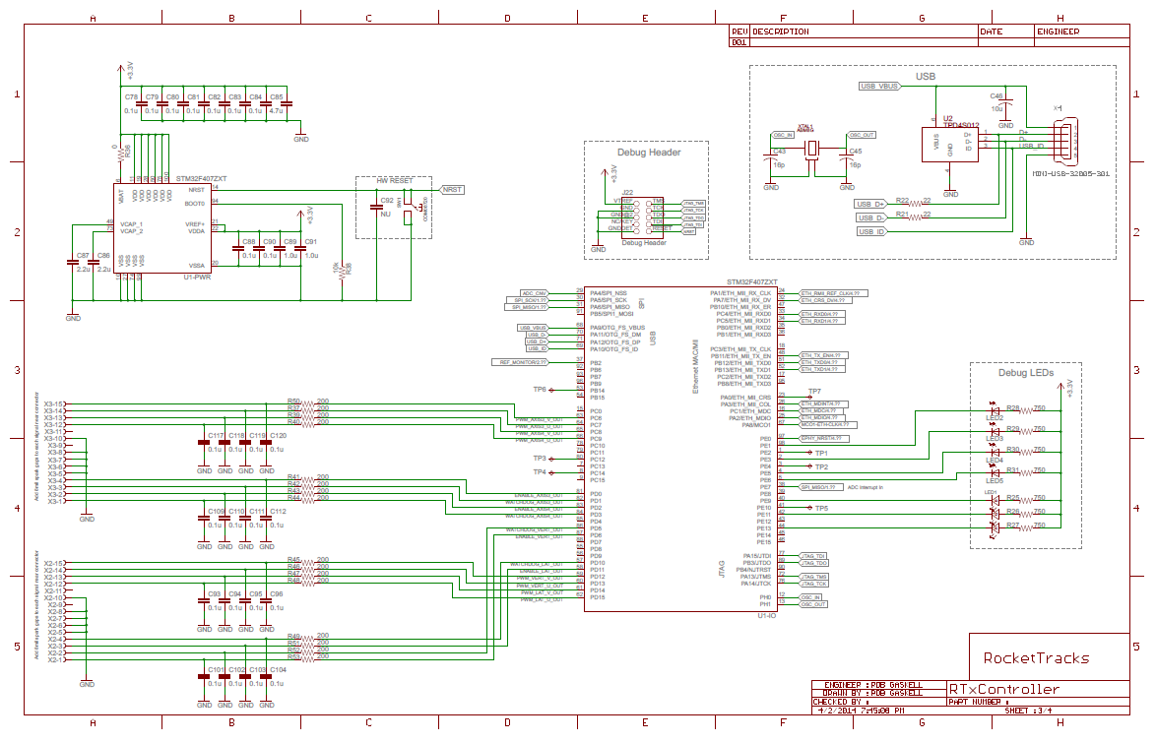
Implementation: RTx Controller μC Circuitry

Slide 11
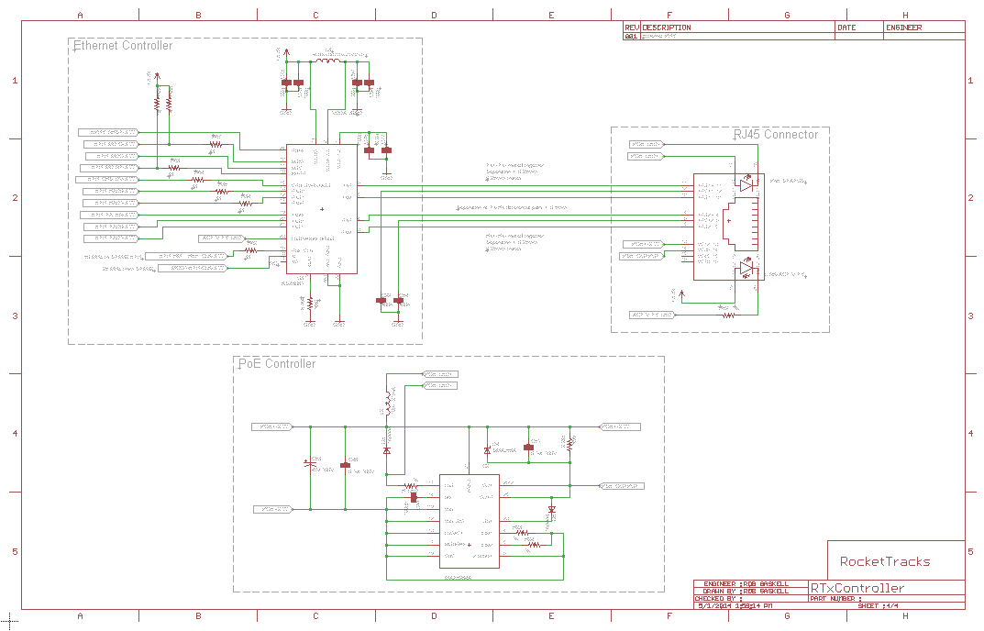
Implementation: RTx Controller Ethernet Circuitry

Slide 12
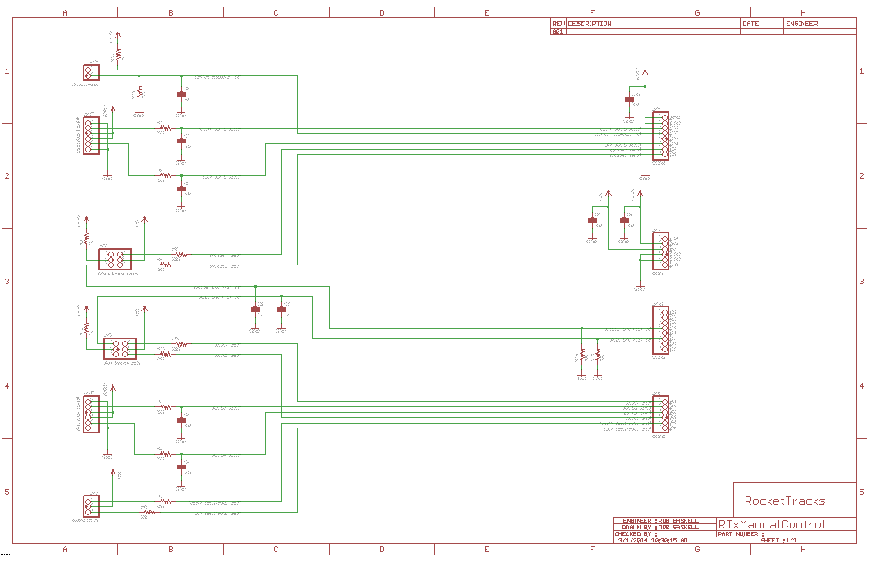
Implementation: Manual Remote

Slide 13
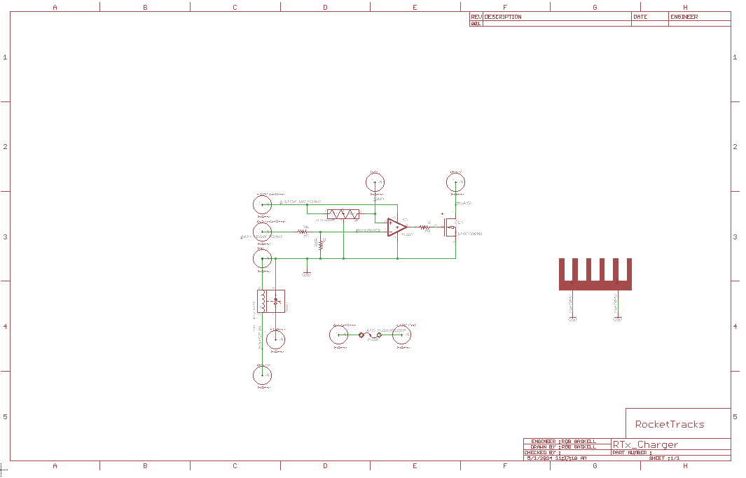
Implementation: Precharge Circuit

Slide 14
Issues Encountered

Slide 15
Issues Encountered: Hardware
USB connector case not properly grounded
Relays’ cases needed to be connected to power and isolated from enclosure
Wrong capacitor footprint used so cap bank needs to be reworked
Incorrect connector pinouts from motor driver boards to RTx controller
PoE not performing at full potential

Slide 16
Issues Encountered: Software
Ethernet message passing errors
High-latency on the receiver end of Ethernet packets
SPI config and interrupt triggering

Slide 17
Future Work/Expansion and Improvement

Slide 18
Next Steps
Test at launch 11 on July 20th
Provide data to Sightline to improve their tracking algorithm
Update board files to correct for issues found
Build safety perimeter
Design and build payload connector
Expansion and Improvement
Possibly create cellphone app to interface with system
removes need for physical proximity to mechanical structure

Slide 19
RocketTracks Project Presentation/Demo

Slide 20
Q&A

