Slide 1


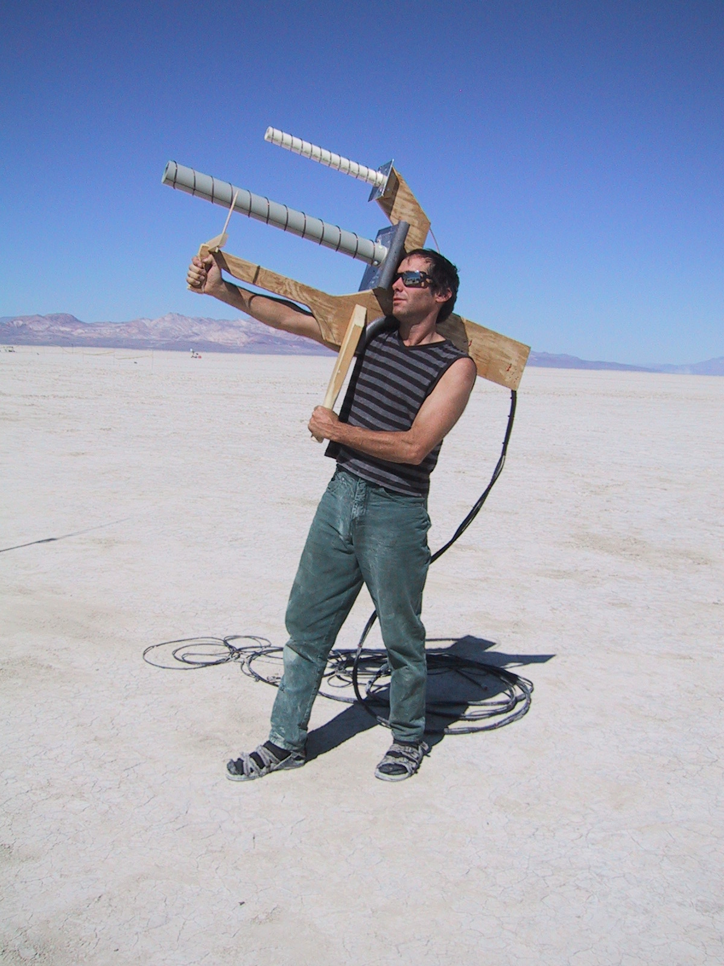


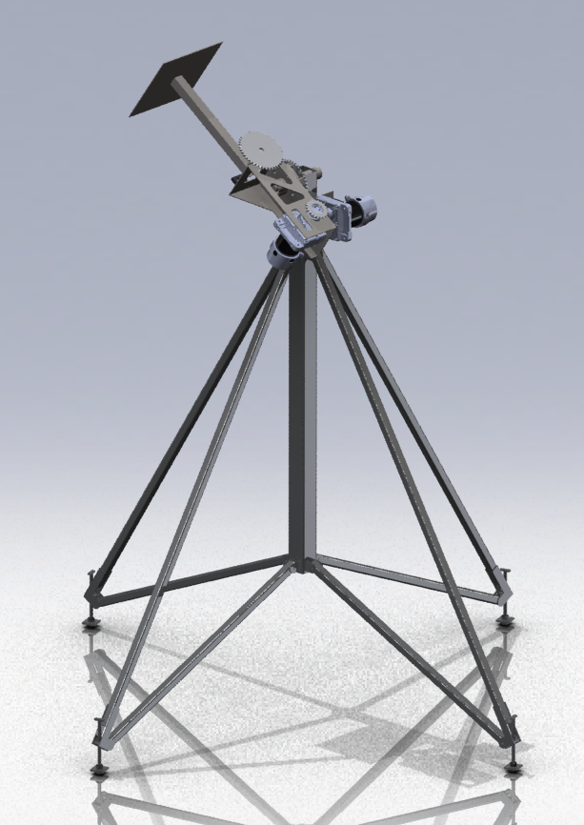
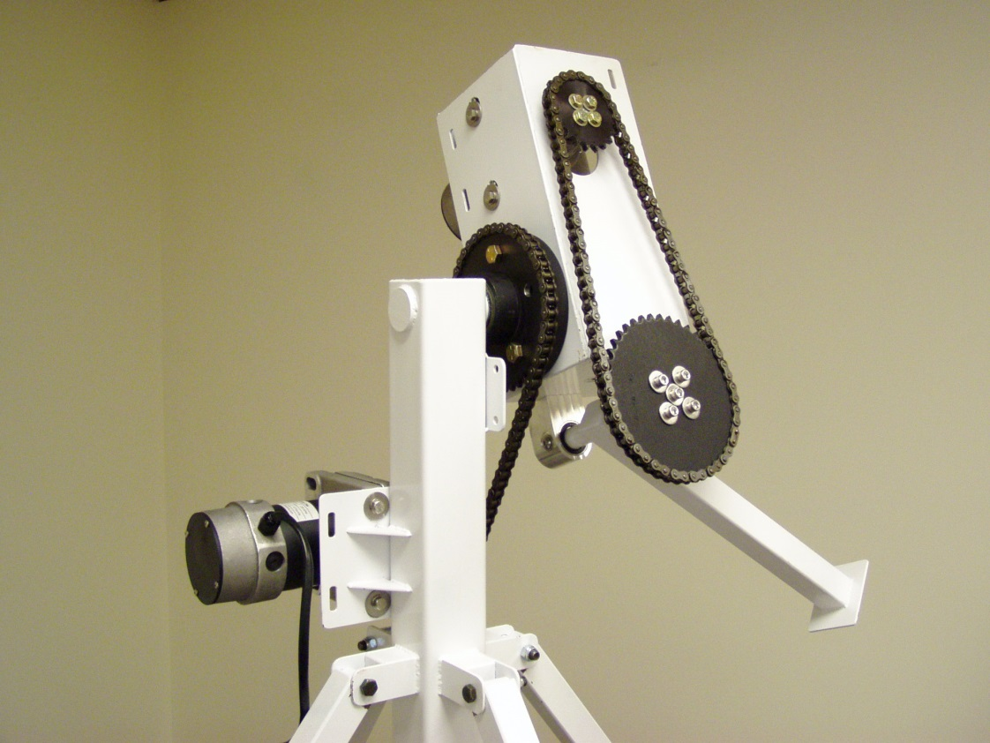



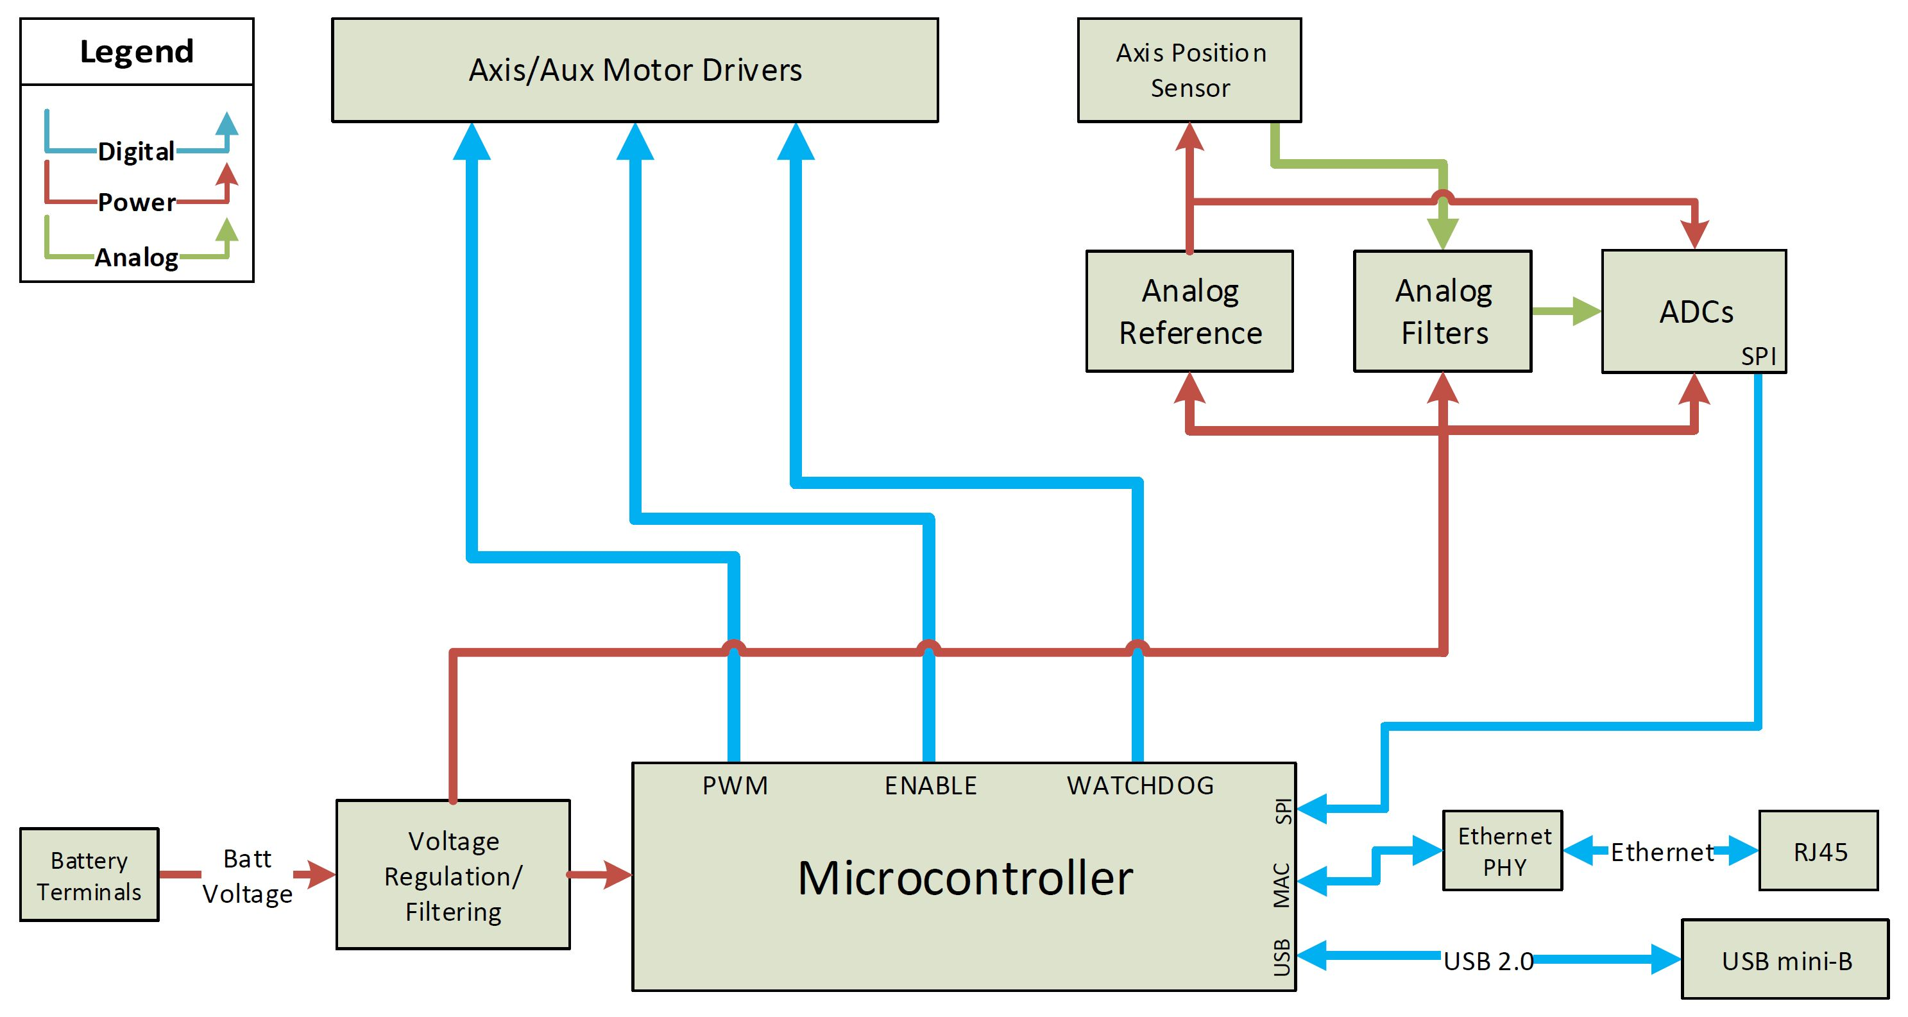
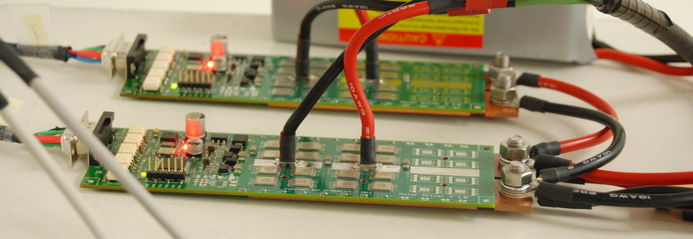
RocketTracks
Portland State
Aerospace Society
Portland State
University
Sponsor: Andrew Greenberg
Rob Gaskell, Robin Davis, Robert Corkran
Advisor: Malgorzata Jeske
PROBLEM
HOW IT WORKS
What good is a high tech rocket if you can’t track it? Current methods of tracking are limited by dependence on human eye.
User selects mode
Manual Mode:
User can adjust the position RocketTracks points by turning two nobs corresponding to the two axis
Automatic Mode:
User selects object to track using laptop.
Camera provides feedback to Sightline as to position of rocket.
RTx Controller adjusts position accordingly
Rockets move fast. Keeping antennas and cameras pointed at them is hard.
RocketTracks was originally conceptualized in 2011 as a mechanical structure that uses a manual control box.
Emergency Stop:
Automatic removal of power to system if:
Big red button is pushed
User gets too close to system
Any single component breaks that could result in loss of system control
RTx
Controller
While this was an improvement over earlier handheld models, it still left too much room for human error.
Manual
Control
IDEA
Eliminate room for human error by adding automatic tracking capabilities to the existing RocketTracks system.
ROCKET TRACKS CONTROLLER
BLOCK DIAGRAM
IMPLEMENTATION
Redo manual controller to improve its control loop and interface via Ethernet
Interface with Sightline SLA-1500 to add automatic tracking
Create RTx controller board to interface between the mechanical system and the two control boards
Implement Ethernet for communication between different blocks of RocketTracks system
Preform FMEA analysis and safety protocols to protect from injury or damage to system

