Slide 1


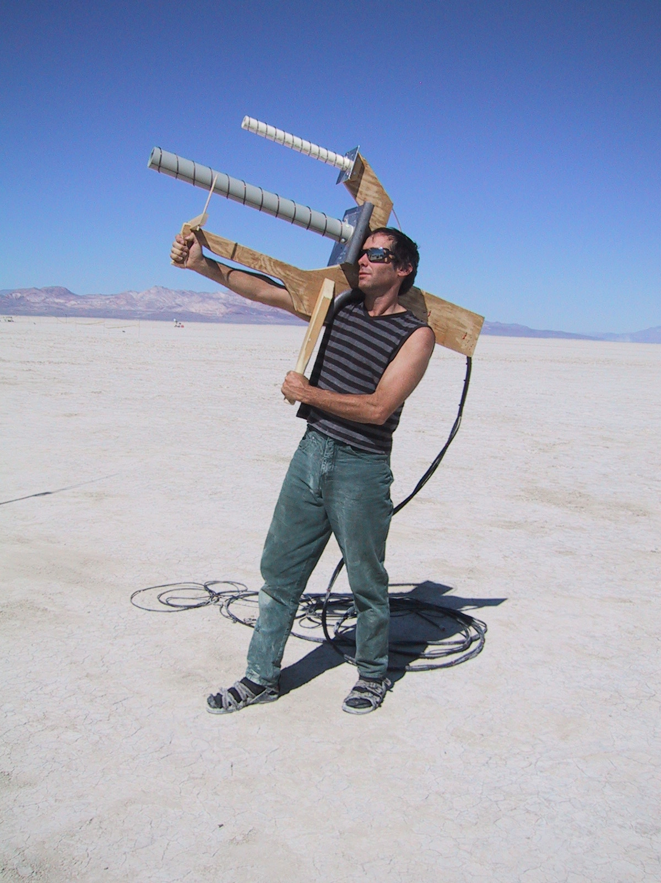
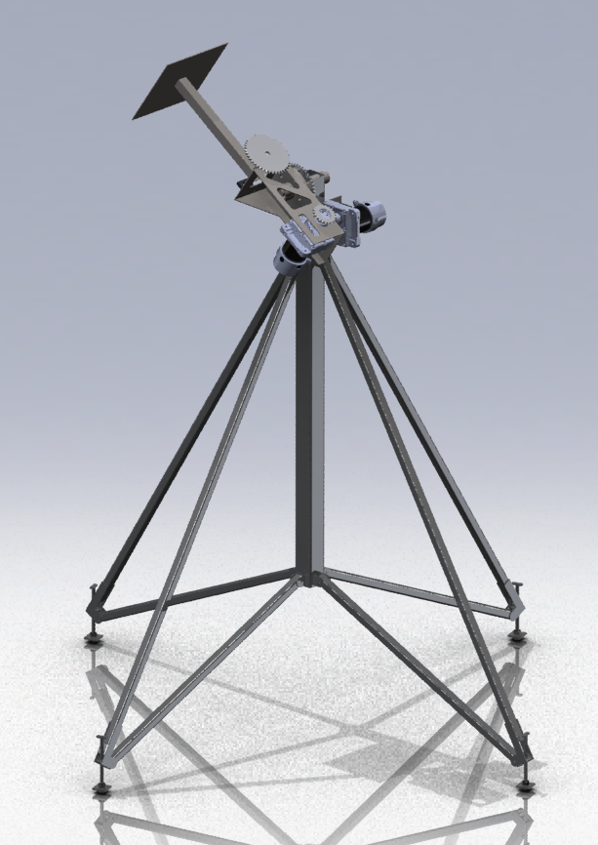
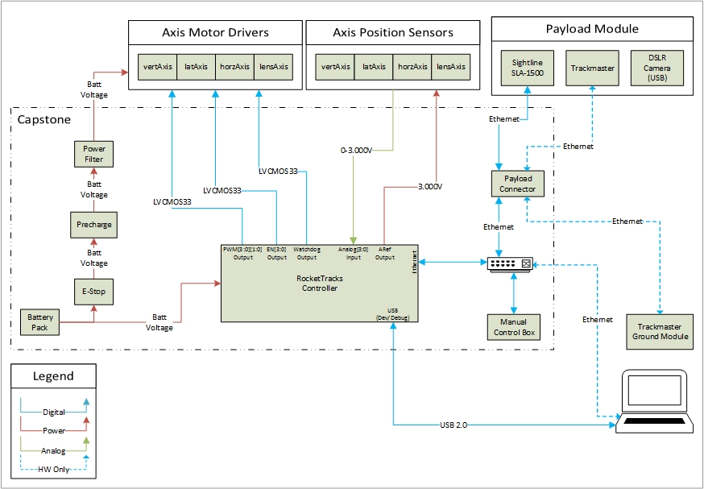

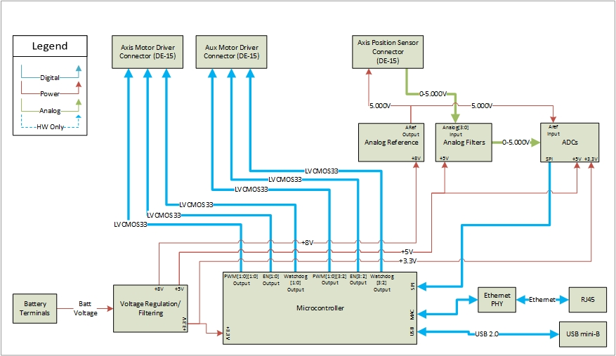
RocketTracks
Portland State
Aerospace Society
Portland State
University
Sponsor: Andrew Greenberg
Rob Gaskell, Robin Davis, Robert Corkran
Adviser: Malgorzata Jeske
PROBLEM
IMPLEMENTATION
What good is a high tech rocket if you can’t track it?
Current tracking technology is limited by its dependence on the human eye. Automation and streamlining of tracking technology can give us more consistent and reliable data but such improvements have yet to be made.
We integrated the previous RocketTracks structure with the Sightline video tracking system through the use of an universal control board. We also designed several new components to the system including the use of an Ethernet interface.
Existing technology:
Axis Motor Drivers
Axis Position Sensors
Sightline SLA-1500
DSLR Camera
Designed by our team
Payload connector
Ethernet PHY
Manual Control Box
E-Stop
Precharge Circuit
Power Filter
SYSTEM LEVEL BLOCK DIAGRAM
RocketTracks was originally conceptualized in 2011 by a group of PSAS members (Rob Gaskell, Dan Kirkpatrick, Chris Mullens). They designed a mechanical structure that was used a manual control box. While this was an improvement over earlier handheld models it was still left too much room for human error.
IDEA
To eliminate human error from the existing structure the controls would need to be automated and the overall system would need to be streamlined for practical use. However, we did not want to fully eliminate the ability for manually controlled tracking. The incorporation of a video tracking system (Sightline SLA1500) was an ideal way to address this problem.
BOARD LEVEL BLOCK DIAGRAM
GOALS
Be capable of tracking the PSAS launch vehicle throughout the duration of its boost stage of flight
Be portable/self-powered
Allow for manual control of individual axes
Support remote operation
Communicate via Ethernet
Interface with existing mechanical design and motor drivers
Interface with Sightline SLA1500

