Slide 1

Position Based Fluid Simulation
Liu Zhaopeng, Lu Guowei

Slide 2
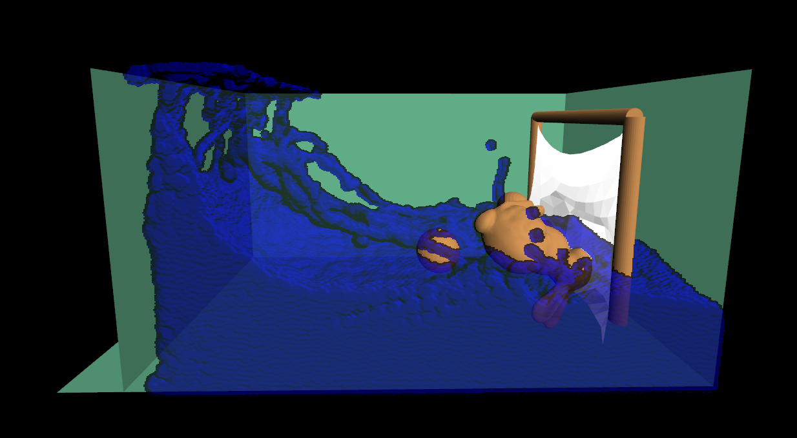
Introduction
Fluid simulation
Fluid – rigid body interaction
Fluid – Cloth interaction
Fluid surface reconstruction
Paper: Miles Macklin Matthias Muller Position Based Fluids
Key idea: enforce incompressibility using position constraints
Youtube: https://www.youtube.com/watch?v=SmXAzGKavYk

Slide 3
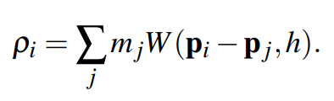
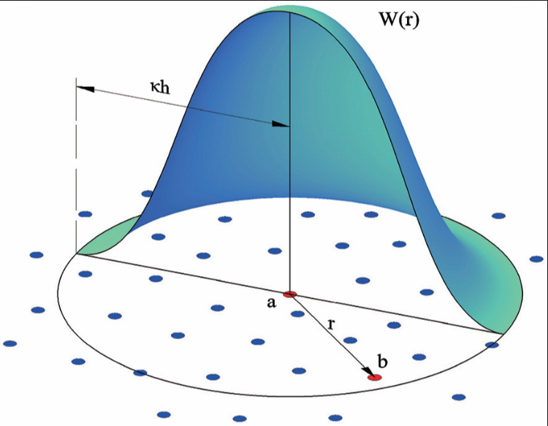
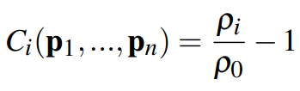
Simulation
Use neighbor particles to local estimate density.
Local Density:
Density Constraint:
Position Based Constraint Solution
For each particle:
solve position constraints (implicit velocity).
Position Based Time Integration
For each particle:
x(t + Δt) = 2x(t) - x(t - Δt)
https://ascelibrary.org/doi/abs/10.1061/%28ASCE%29HY.1943-7900.0001163

Slide 4
Main Loop
Predict particle positions.
Solve density constraint
Solve boundary constraints.
GPU
Solve density constraint
5 iterations
Rigid body
CPU
100k particles, ~30 neighbors
Cloth
Reconstruct Surface

Slide 5
Screen Space Fluid Rendering
http://developer.download.nvidia.com/presentations/2010/gdc/Direct3D_Effects.pdf

Slide 6
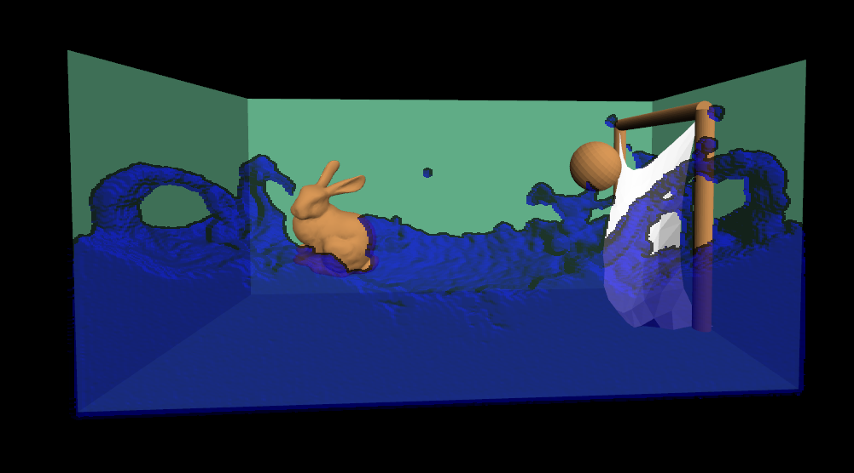
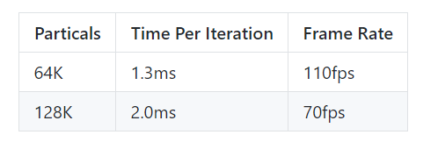
Features
Rigid Body
fixed
unfixed
Fluid
Mass Spring
GTX1060 with 5 iterations per frame

Slide 7
Project Show

