Slide 1

Position Based Fluid Simulation
Liu Zhaopeng, Lu Guowei

Slide 2
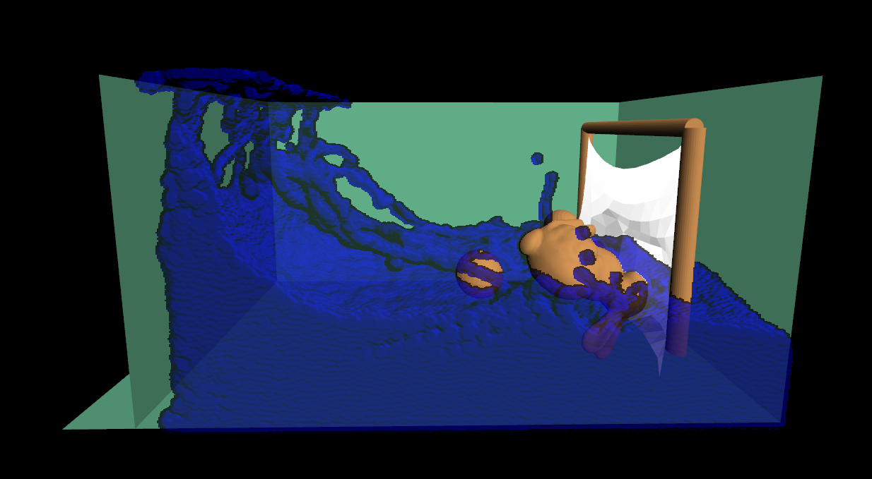
Introduction
Paper: Position Based Fluids
Key idea: enforce incompressibility using position constraints
Youtube: https://www.youtube.com/watch?v=SmXAzGKavYk

Slide 3
Simulation
Smoothed Particle Hydrodynamics (SPH)
Constraint
Intensity is incompressible
Integration
Position based

Slide 4
Screen Space Fluid Rendering

Slide 5
Features
Fluid
Rigid Body
Mass Spring
Performance

