Slide 1

Position Based Fluid Simulation
Liu Zhaopeng, Lu Guowei

Slide 2
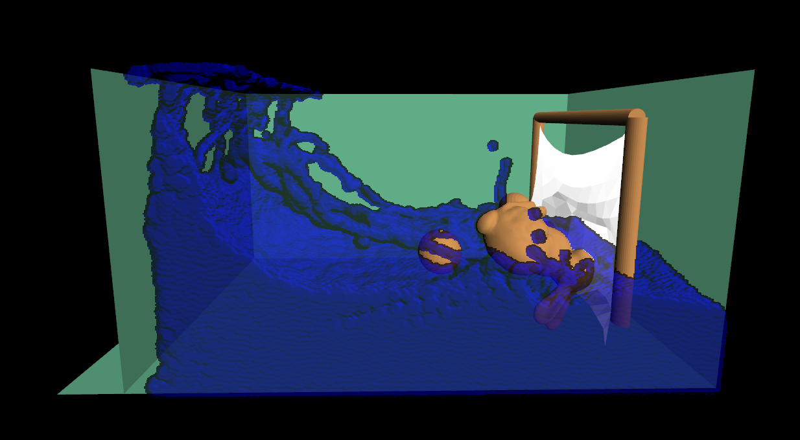
Introduction
Paper: Position Based Fluids
Key idea: enforce incompressibility using position constraints
Youtube: https://www.youtube.com/watch?v=SmXAzGKavYk

Slide 3
Simulation
Smoothed Particle Hydrodynamics (SPH)
Constraint
Intensity is incompressible
Integration
Position based

Slide 4
Screen Space Fluid Rendering
http://developer.download.nvidia.com/presentations/2010/gdc/Direct3D_Effects.pdf

Slide 5
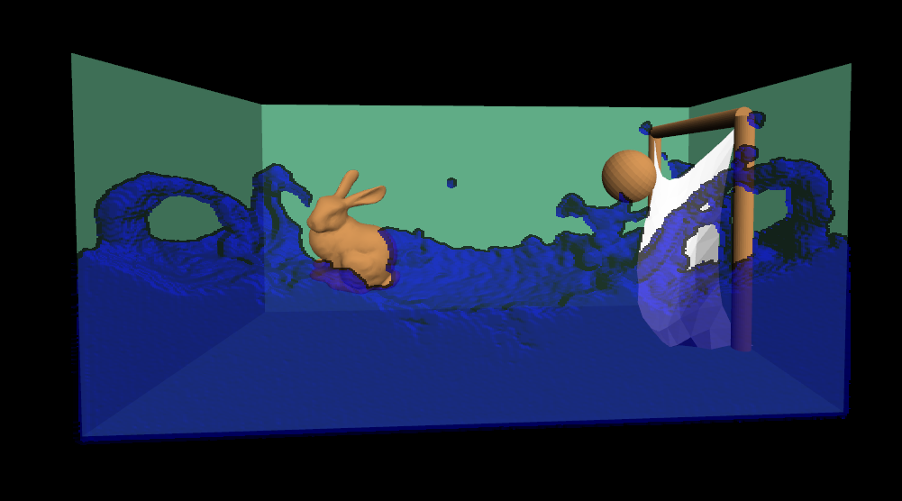
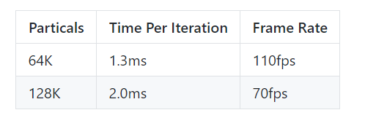
Features
Rigid Body
fixed
unfixed
Fluid
Mass Spring
GTX1060 with 5 iterations per frame

Slide 6
Project Show

