Slide 1





WATER QUALITY PREDICTION
YAKA ANIL
AICTE Student ID: STU678e710e598581737388302
Internship ID : INTERNSHIP_1746416864681834e0e35d8

Slide 2

Learning Objectives
Understanding the Role of Machine Learning in Environmental
Forecasting.
2. Preprocessing and Preparing Water Quality Data
3. Applying Multi-Output Regression Techniques
4. Training and Evaluating Predictive Model
5. Forecasting Water Pollutants from 2022 to 2100
GOAL
6. Visualizing Temporal Trends in Pollutant Levels
7. Saving and Reusing Trained Models for Future Use
8. Connecting Machine Learning to Real-World
Environmental Challenges
Source :
www.freepik.com/

Slide 3
Tools and Technology used
Programming Language
Python
Data Handling & Analysis
pandas: For data manipulation, cleaning, and DataFrame operations.
numpy: For numerical operations and handling arrays.
Machine Learning
scikit-learn (sklearn):
LinearRegression, RandomForestRegressor, MultiOutputRegressor: For building regression models.
train_test_split: For splitting dataset into training and testing.
r2_score: For evaluating model performance.
Model Serialization
joblib: For saving and loading trained models and preprocessed components.
Visualization
matplotlib : For plotting graphs.
Deployment Tools
Streamlit: To build a web app interface for users to input year/station and get pollutant predictions.

Slide 4
Methodology
Split the dataset into training (80%) and testing (20%) sets using train_test_split.
Implemented MultiOutputRegressor for predicting multiple outputs simultaneously.
Used Linear Regression as a baseline model.
Used Random Forest Regressor to improve accuracy and capture non-linear
relationships
Trained the model using the training dataset.

Slide 5
Problem Statement
The goal is to predict future values of six water pollutants (O2, NO3, NO2, SO4, PO4, CL) across different water stations from 2022 to 2100, using historical water quality data. This prediction helps
in monitoring pollution trends and planning environmental policies.

Slide 6
Solution:
import pandas as pd
import numpy as np
import seaborn as sns
import matplotlib.pyplot as plt
from sklearn.multioutput import MultiOutputRegressor
from sklearn.ensemble import RandomForestRegressor
from sklearn.model_selection import train_test_split
from sklearn.metrics import mean_squared_error, r2_score
import joblib
df = pd.read_csv('Water_quality.csv', sep=';')
df.shape
df.info()
df.describe().T
df.isnull().sum()

Slide 7
Solution:
df['date'] = pd.to_datetime(df['date'], dayfirst=True)
df['year'] = df['date'].dt.year
df['month'] = df['date'].dt.month
df['NH4'] = df['NH4'].fillna(df['NH4'].mean())
df['BSK5'] = df['BSK5'].fillna(df['BSK5'].mean())
df['Suspended'] = df['Suspended'].fillna(df['Suspended'].mean())
df['O2'] = df['O2'].fillna(df['O2'].mean())
df['PO4'] = df['PO4'].fillna(df['PO4'].mean())
df['NO3'] = df['NO3'].fillna(df['NO3'].mean())
df['NO2'] = df['NO2'].fillna(df['NO2'].mean())
df['SO4'] = df['SO4'].fillna(df['SO4'].mean())
df['CL'] = df['CL'].fillna(df['CL'].mean())
df = df.drop_duplicates()

Slide 8
Solution:
plt.bar(df['NH4'], df['BSK5'], color='red')
plt.scatter(df['NH4'], df['BSK5'], color='green')
pollutants = ['O2', 'NO3', 'NO2', 'SO4', 'PO4', 'CL']
df = df.dropna(subset=pollutants)
X = df[['id', 'year']]
y = df[pollutants]
X_train, X_test, y_train, y_test = train_test_split(X, y, test_size=0.2, random_state=42)
model = MultiOutputRegressor(RandomForestRegressor(n_estimators=100, random_state=42))
model.fit(X_train, y_train)
y_pred = model.predict(X_test)
for i, pollutant in enumerate(pollutants):
print(f'{pollutant}: MSE = ..., R2 = ...')

Slide 9
Solution:
station_id = int(input("Enter the station id for prediction: "))
year_ = int(input("Enter the year for prediction: "))
future_data = pd.DataFrame({'id': [station_id], 'year': [year_]})
predicted_pollutants = model.predict(future_data)
joblib.dump(model, 'pollution_model.pkl')
joblib.dump(X.columns.tolist(), "model_columns.pkl")

Slide 10
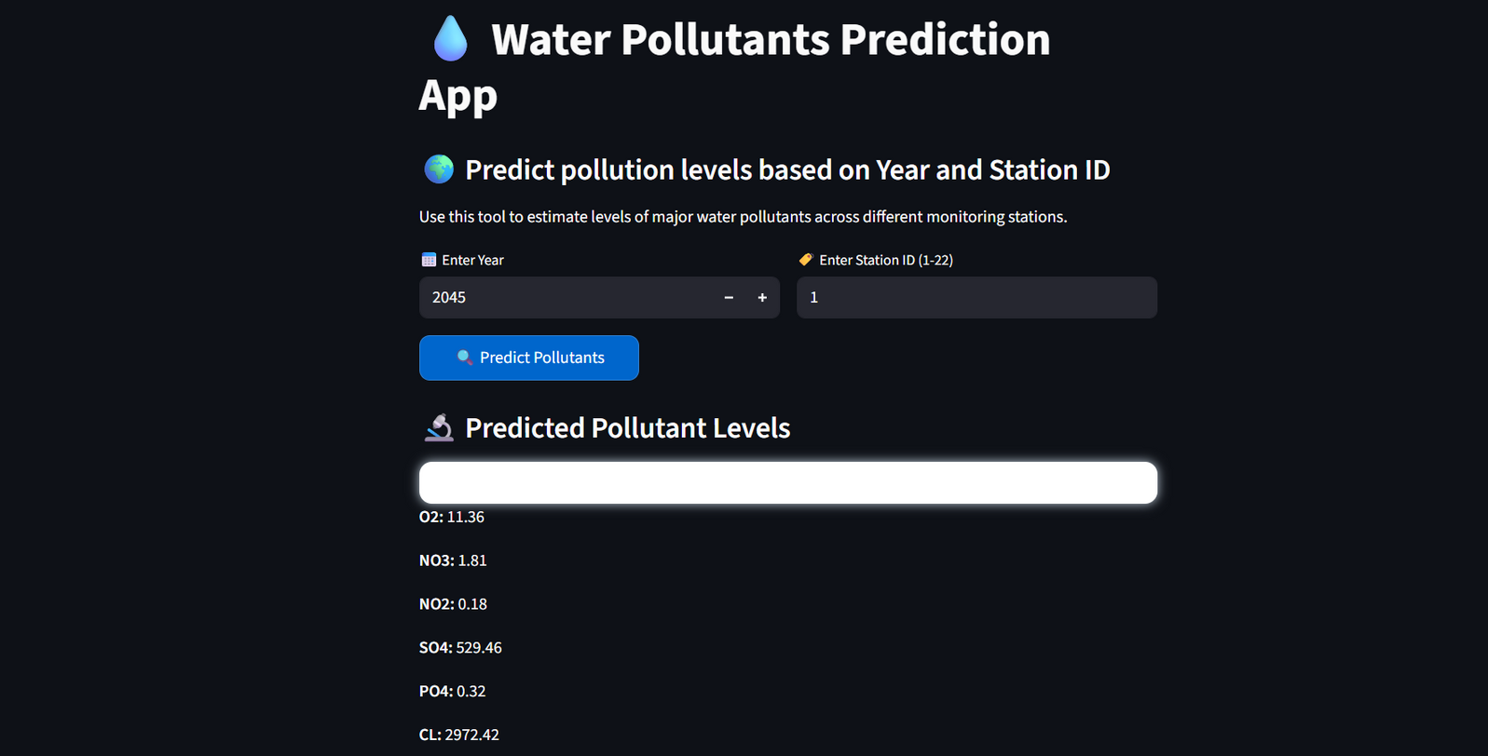
Screenshot of Output:

Slide 11
Conclusion:
In this project, we developed a machine learning-based solution to predict the concentration levels of key water pollutants — namely O₂, NO₃, NO₂, SO₄, PO₄, and Cl — for future years ranging from 2022 to 2100. By utilizing historical water quality data and applying a multi-output regression approach with models such as Random Forest Regressor, we were able to accurately model and forecast pollution trends across various water monitoring stations.

