Slide 1
Welcome To My Presentation

Slide 2
Antecedents of mobile financial service adoption among citizens in Bangladesh

Slide 3
Relationship between Performance Expectations and User Behavior
Performance expectations (PE) can be defined as the advantages and features (such as time and effort savings, effectiveness, accessibility, customization, and ease) that could be obtained by employing such cutting-edge channels (Venkatesh et al., 2003).
PE is described as "the extent to which a person believes that using technology will enable him or her to achieve improvements in job performance.

Slide 4
Relationship between effort expectancy and user behavior
Effort expectancy is defined as the degree of ease related to a customer's use of technology (Venkatesh et al., 2012).
Effort expectancy refers to how easily a consumer believes a task to be accomplished (Hassan et al., 2023).
When users perceive that using mobile payments is simple and doesn't require much work, their expectations for achieving the intended results are higher (Venkatesh et al., 2003).
According to (Hassan et al., 2023), there was a favorable correlation between behavioral intention to use mobile money services and effort expectation.

Slide 5
Relationship between social influence and user behavior
Social influence can be described as the degree to which a person is aware that influential people believe they should purchase new technologies (Venkatesh et al., 2003).
According to (Venkatesh et al., 2012) social influence is the process through which people alter their opinions and actions to fit the norms of a social group, such as friends and family.
Social influence is the extent to which consumers perceive that others believe they should use a particular technology.
It was determined that social behavior predicted behavioral intentions (Khan et al., 2017).

Slide 6
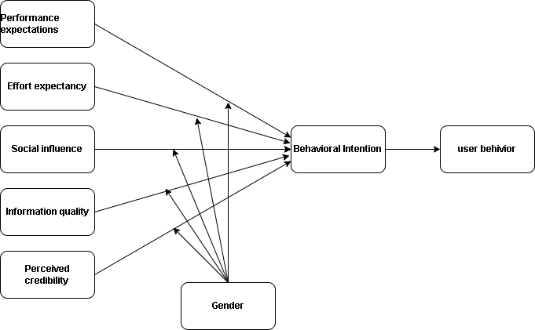
Relationship between the effects of gender moderation and behavioral intentions to adopt mobile banking
Figure: 1 conceptual framework

Slide 7
The measurement scale’s descriptive statistics
Table 1. Descriptive statistics of respondents’ characteristics (n = 303).
Variable | Details | Frequency | Percentage
Gender | Male | 183 | 73.4
 | Female | 65 | 26.6
Age | 16-25 | 196 | 64.7
 | 26-35 | 82 | 27.1
 | 36-45 | 20 | 6.6
 | 46-55 | 5 | 1.7
Level of Education | HSC | 66 | 21.8
 | Graduations | 178 | 58.7
 | Masters | 59 | 19.5
 | Total(n) | 303 | 100

Slide 8
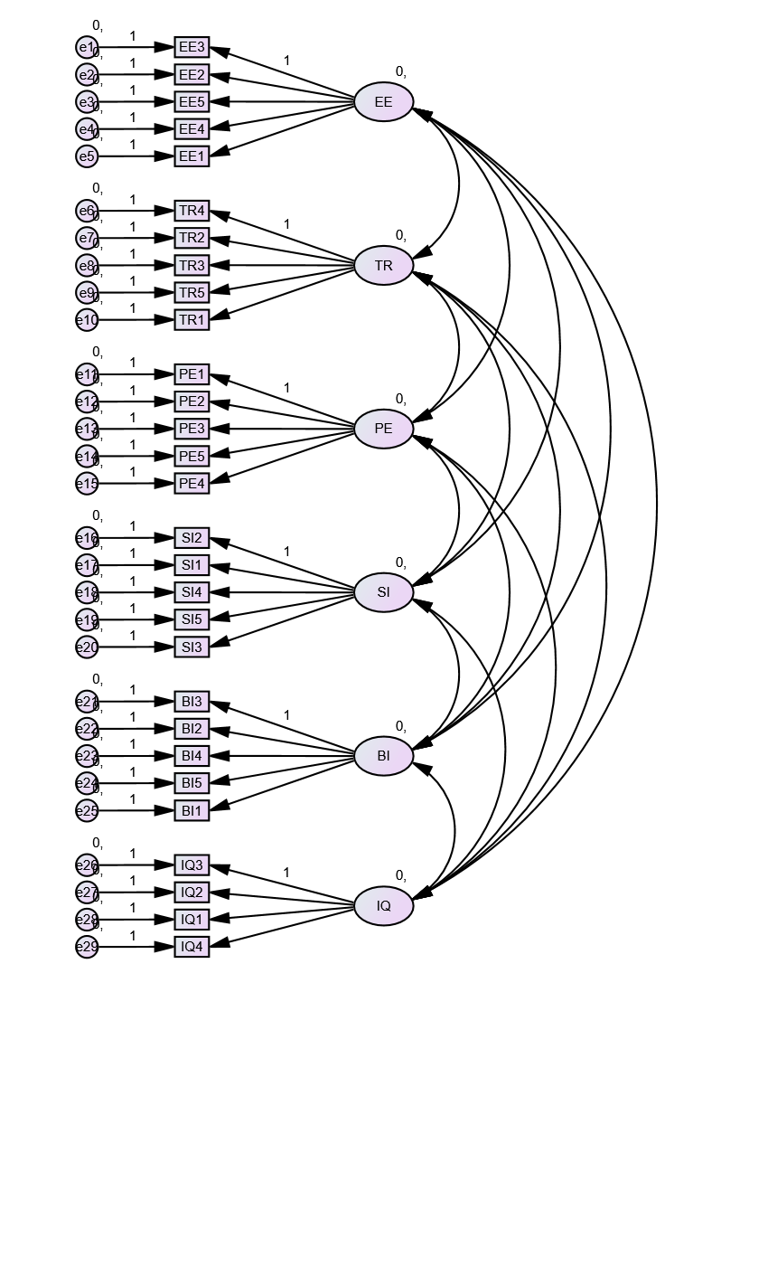
Structural Equation Modeling and Hypotheses Testing
Figure 1. Structural Equation Model

Slide 9
Thank You

