Slide 1

Network
Congestion
Analysis
TEAM 7

Slide 2

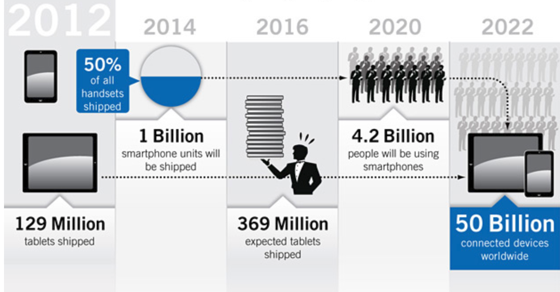
Why Important?
Telecommunication Industry – Key Trends and Congestion
“We are all now connected by internet, like neurons in a giant brain,”
-Stephen Hawking
Reasons for Revenue Analysis of new ATMs

Slide 3

Why Important?
Telecommunication Industry – Key Trends and Congestion

Slide 4
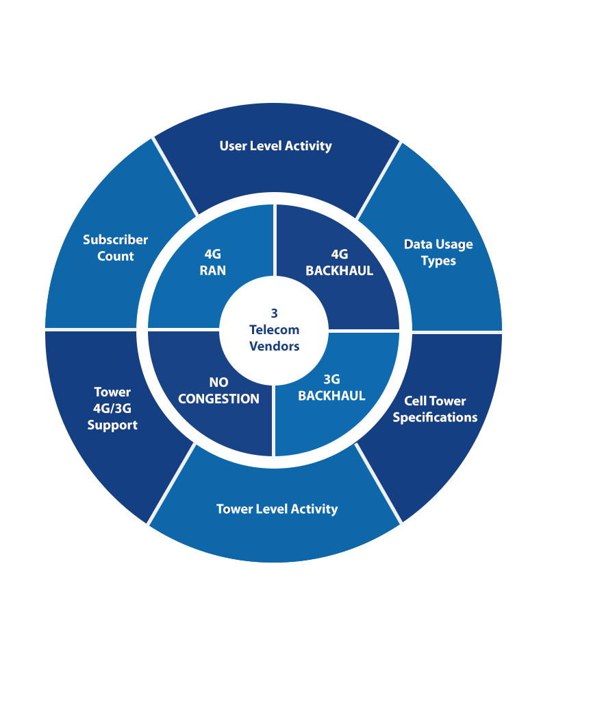
Data in hand

Slide 5
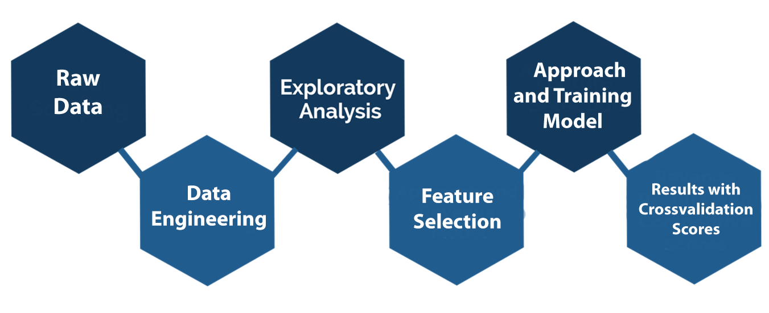
Work Flow

Slide 6
Data Attributes
Data Dictionary
Usage Data
Cell Tower Specifications
Cell Name
Year Parameter
Month Parameter
Day Parameter
Hour Parameter
Minute Parameter
Usage Data
Cell Tower Specifications
Cloud Computing
Web Security
Email
Software Download
Photo Sharing
File Sharing
Speed Test
Storage Services
Location Services
Cell Tower Tilt
Tower Beam Direction
Cell Tower Range
Service Vendor
Subscriber Count
4G/3G Support

Slide 7
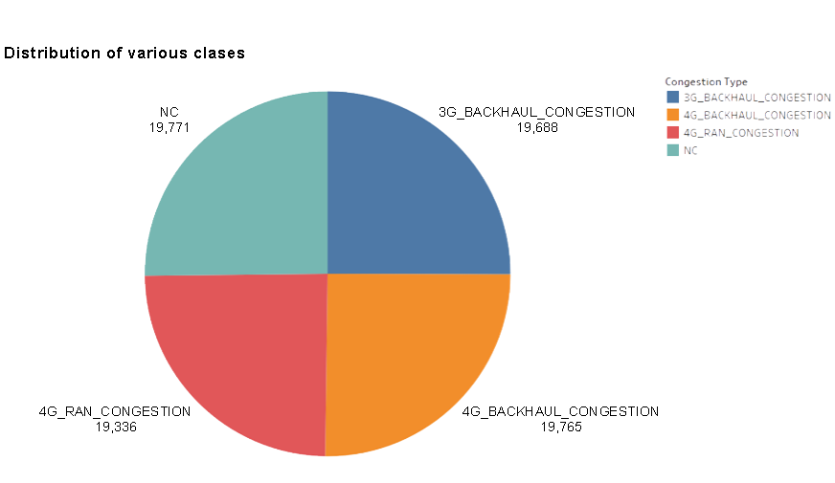
Exploratory Analysis
The training dataset was perfectly balanced with almost equal number of entries for each of the Congestion Type

Slide 8
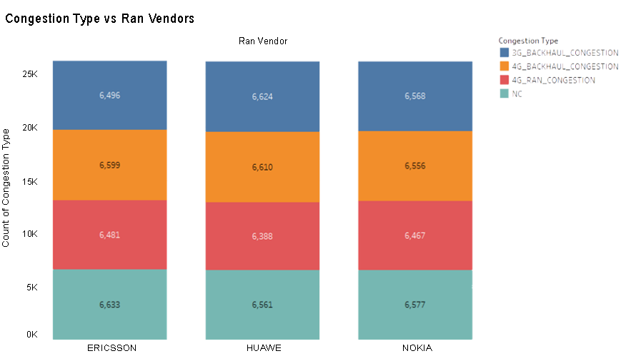
Exploratory Analysis
The congestion type for cell towers of each of the telecommunication firms had a uniform distribution throughout the dataset.

Slide 9
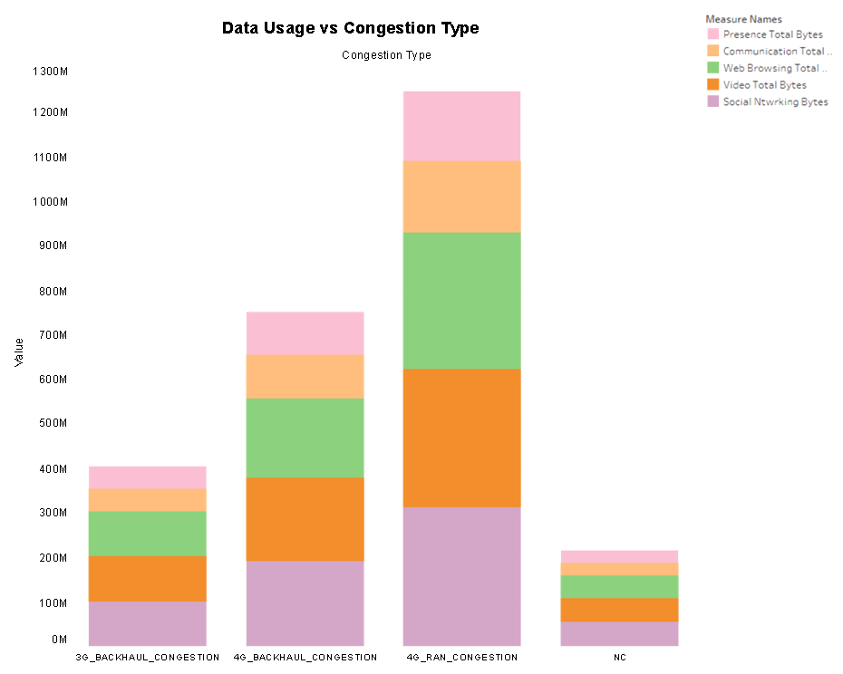
Exploratory Analysis
The cell tower congestion is dependent on data traffic as total data consumption is highest for 4G RAN Congestion and minimum for No Congestion.

Slide 10
Tableau Walkthrough

Slide 11
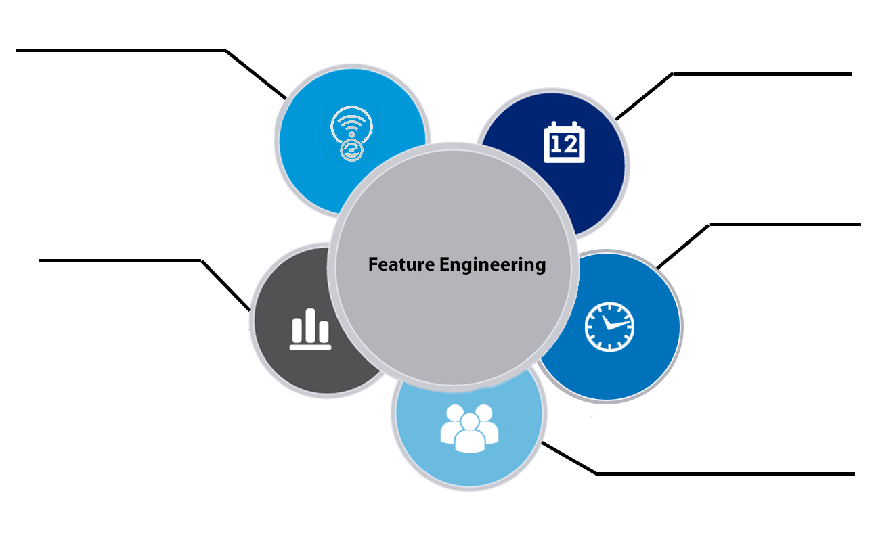
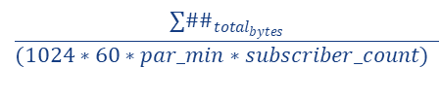
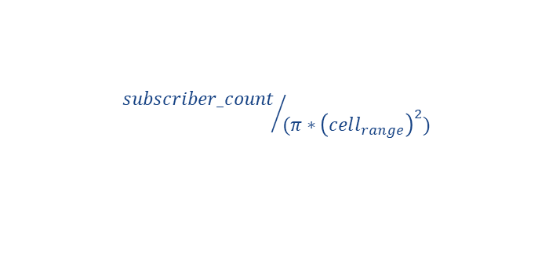

Feature Engineering
Data Speed
Weekday
$$\frac{∑\#\#_{total_{bytes}}}{(1024∗60∗par_min∗subscriber_count) }$$
$day_{week}=\left(par_day\right)\%7$
Hour bucket
Data Chunk Size
Feature Engineering
Divided par_hour feature into 4 buckets depending on data usage
Divided the data usage into large data/ small data depending on chunk size
Subscribers per area
$${subscriber_count}/{(π∗{\left(cell_{range}\right)}^{2})}$$

Slide 12
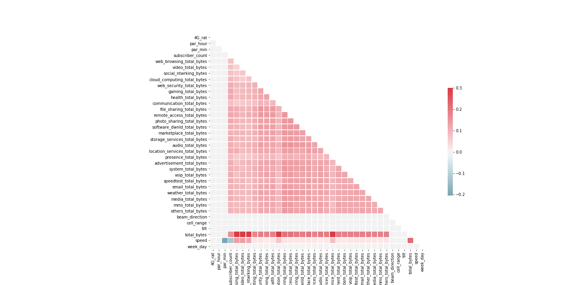
Feature Correlation

Slide 13


Feature Selection
XGBoost Feature Importance
Feature Selection
Principal Component Analysis
Recursive Feature Elimination

Slide 14
Feature Selection

Slide 15
Feature Selection
Principal Component Analysis:
PCA is used to reduce the dimensionality of a data set consisting of many variables correlated with each other, either heavily or lightly, while retaining the variation present in the dataset, up to the maximum extent.

Slide 16
Feature Selection
Recursive Feature Elimination:
RFE algorithm is applied on the 36 selected features from the given data for the applied XGB Classifier model. Later, the feature selection is done according to the rank predicted for the features.
Important Variables Obtained
Subscriber Count
Cloud Computing Total Bytes
Web Security Total Bytes
Email Total Bytes
Gaming Total Bytes

Slide 17
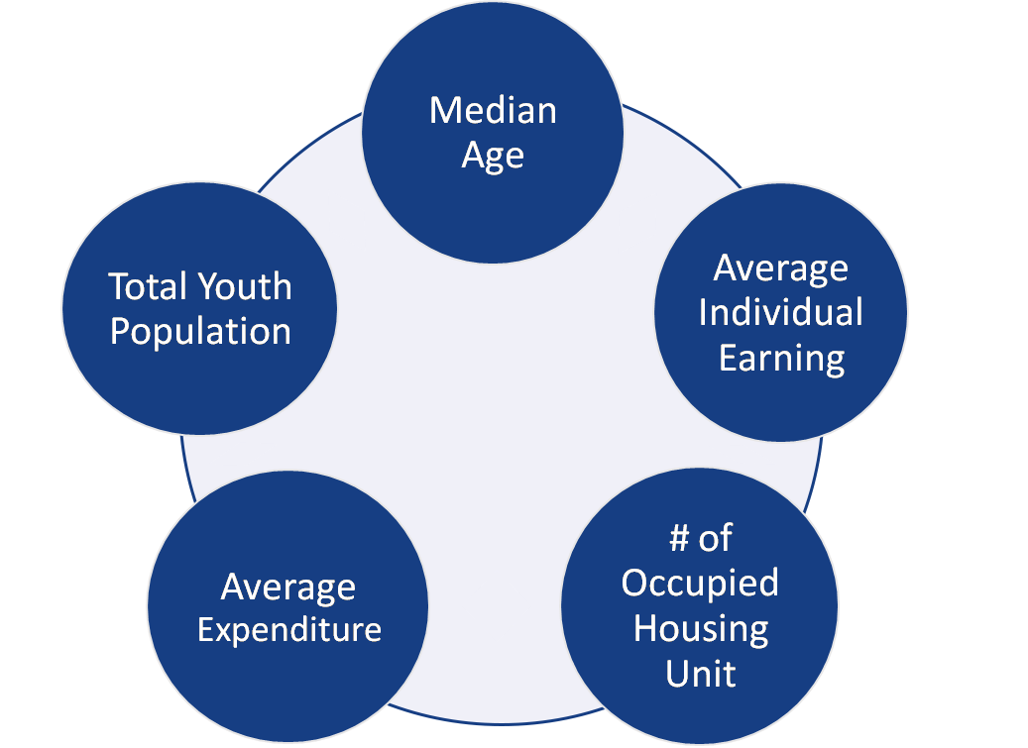
Feature Selection
Cloud Computing Total Bytes
MMS Total Bytes
Email Total Bytes
Speedtest Total Bytes
Gaming Total Bytes

Slide 18
2 Step Model
The whole exercise involves a concrete methodology to predict the congestion type for the cell towers of all three telecommunication vendors
The Matthews correlation coefficient is used as the basis for defining the competence of the applied model
In the analysis performed, a two step classification algorithm has been taken into consideration after extensive research for an optimum framework

Slide 19
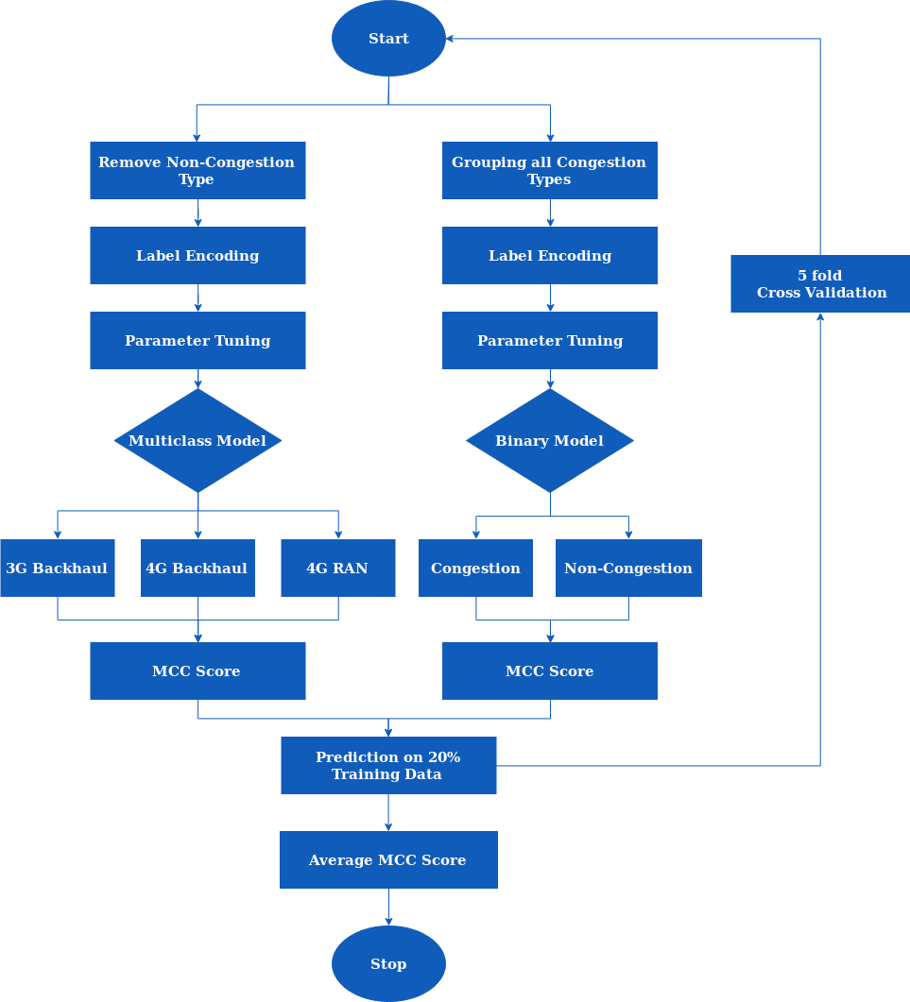
2 Step
Model

Slide 20
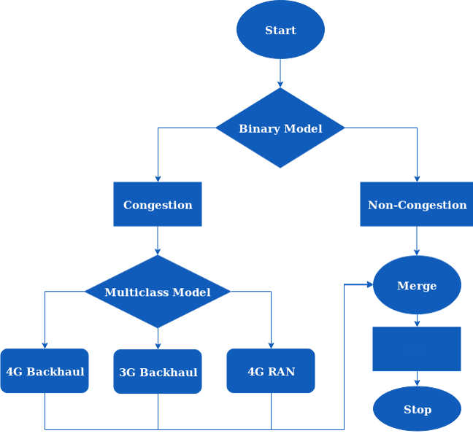
2 Step Model
2 Step Testing Workflow:
Submission

Slide 21
2 Step Model
XGBoost Algorithm
XGBoost is an optimized distributed gradient boosting library designed to be highly efficient, flexible and portable
It uses a gradient descent algorithm to minimize the loss when adding new models
The computing time is efficiently reduced and memory resources are allocated for an optimal usage
Gradient boosting is an approach where new models are created that predict the residuals or errors of prior models and then added together to make the final prediction

Slide 22

2 Step Model
Matthews correlation coefficient:
The Matthews correlation coefficient is a measure of correlation between the observed and predicted classifications
A coefficient of +1 represents a perfect prediction, 0 no better than random prediction and −1 indicates total disagreement between prediction and observation.
$$MCC=\frac{c∗s−\sum_{k}^{K}{p_{k}∗t_{k}}}{\sqrt{\left(s^{2}−\sum_{k}^{K}{{p_{k}}^{2}}\right)∗(s^{2}−\sum_{k}^{K}{{t_{k}}^{2})}}}$$

Slide 23
Feature Selection
Feature Importance Calculation
Principal Component Analysis
Robust Model Selection
XGBoost with Parameter Tuning
K-Fold Cross validation
10 Fold CV on 80% Training Data
Average MCC on 20% Training Data
Tackling Overfitting

Slide 24
2 Step Model Results
XGBoost Binary Tuning Results :
Tuned Parameters:
colsample_bytree=1
gamma=0
learning_rate=0.1
max_depth=2
min_child_weight=4
n_estimators=900
reg_alpha=0
reg_lambda=1
subsample=1
crossvalidation_MCC=86.39
XGBoost Multiclass Tuning Results :
Tuned Parameters:
colsample_bylevel=1
gamma=0
learning_rate=0.1
max_depth=2
min_child_weight=4
n_estimators=850
reg_alpha=0
reg_lambda=1
subsample=0
crossvalidation_MCC=73.95
Tuned parameters | Values
colsample_bytree | 1
gamma | 0
learning_rate | 0.1
max_depth | 2
min_child_weight | 4
n_estimators | 900
reg_alpha | 0
reg_lambda | 1
subsample | 1
crossvalidation_MCC | 86.39
Tuned parameters | Values
colsample_bytree | 1
gamma | 0
learning_rate | 0.1
max_depth | 2
min_child_weight | 4
n_estimators | 850
reg_alpha | 0
reg_lambda | 1
subsample | 0
crossvalidation_MCC | 73.95

Slide 25
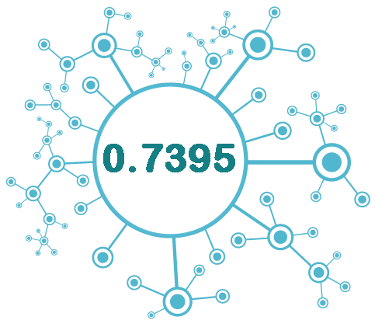
2 Step Model Results

Slide 26
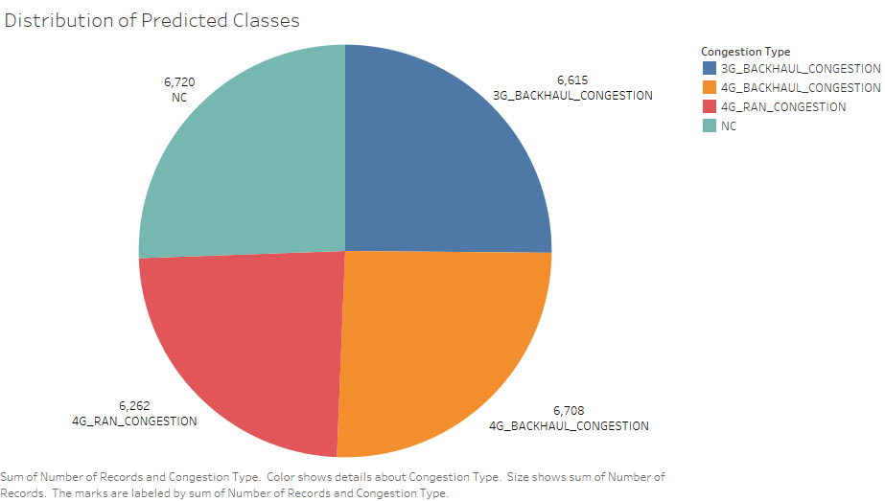
2 Step Model Results

Slide 27
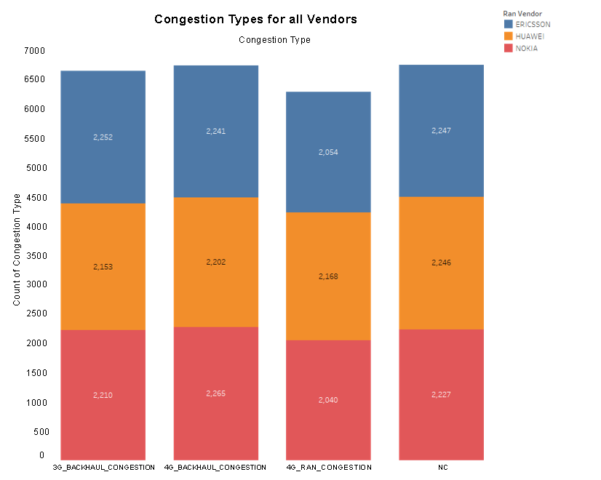
2 Step Model Results

Slide 28






Business Insights
REDUCED MAINTENANCE COST
Due to early prediction of network congestion, vendors can take precautionary measures on maintenance of selective cell towers
OPTIMAL LOCATION
As we can identify the buggy towers in the network, the firms can choose appropriate locations for setting up new towers
RE-EVALUATE CELL TOWER SPECIFICATIONS
The firms can tune the specifications of the cell tower properly to reduce the likelihood of network congestion
INCREASED CUSTOMER LOYALTY
As a firm can take precautionary steps to prevent network congestion, it is more likely to get satisfied and loyal customers

Slide 29

THANK YOU !

