Slide 1



NYAN
Yaksh Aaryan Harman Raman Fadil

Slide 2

Problem
Traditional non-player characters (NPCs) are static state machines.
The game experience is predictable.
Player engagement is minimal.
Reduced long-term engagement.
Even classic games like Pokémon Red/Blue or Legend of Zelda: Ocarina of Time use static dialogues that never change, even after major story events.

Slide 3


Solution Overview
2-d game prototype featuring ‘evolving’/’changing’ personality.
Implement dual-personality model.
‘Genetic’ and ‘growth’ personalities.
This may foster unique, adaptive responses.
Ideally changing on user choices and inputs.

Slide 4
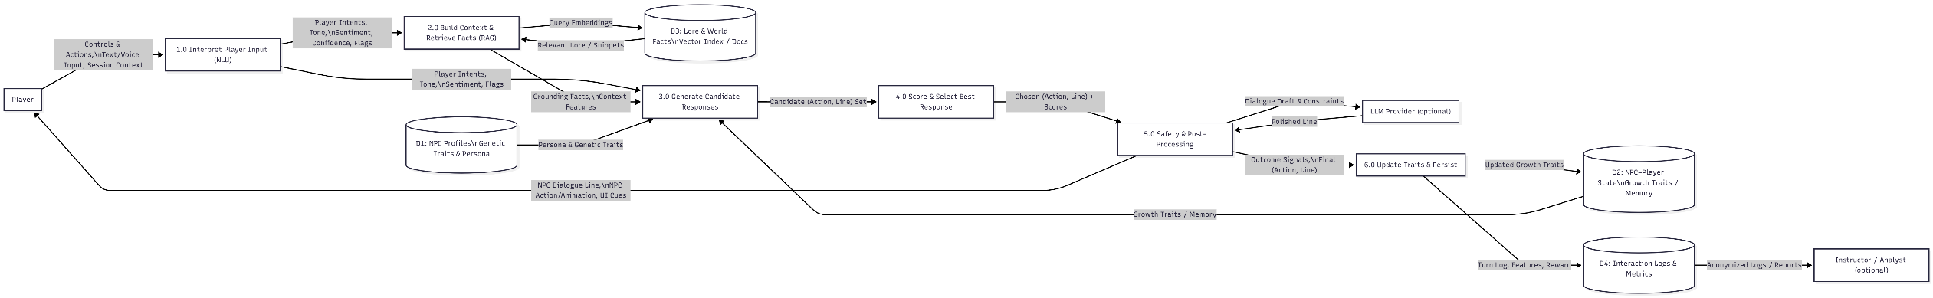

System Design Overview
Unity client calls /interact only on text or meaningful ActionEvent
NLU (local) → intents, tone/sentiment, safety flags
Context/RAG pulls lore/policy; Candidates via templates ± tiny drafts
Re-Ranker chooses (action, line); Safety/Post enforces rules
Persist genetic vs growth traits; log metrics

Slide 5

Research: NLU Options & Decision Rule
BoW/TF-IDF + Logistic/Linear SVM → tiny, fast, interpretable
fastText (subword, char n-grams) → robust to slang/typos; great on deviceSmall
LSTM/GRU → uses order (negation), heavier; use only if needed
Decision: Start fastText; if micro-F1 < 0.85 on tricky phrases → trial small LSTM/GRU; otherwise stick with fastText (optionally try the results from the BoW and compare with the fasttext as the speed is higher for BoW.

Slide 6
Research: Selection, Exploration & Safety
Performance.
Reliability.
Scalability.
Usability.
Maintainability.
Portability.

Slide 7

Challenges and risk
Integrating Unity and backend via http.
Designing realistic adaptive logic with limited data.
Balancing learning and performance complexity.
Persistence of NPC state.
Training the ai/ml model.

Slide 8


Software Tools
Unity
ASP.Net Core
Database: Postgres
GitHub and Unity Version Control
ML libraries and LLM models.

Slide 9
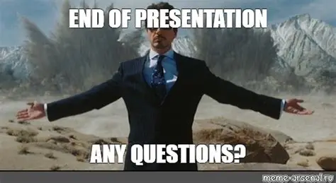
Questions??

Slide 10
