Slide 1



NYAG
Yaksh Aaryan Harman Raman

Slide 2

Problem
Traditional non-player characters (NPCs) are static state machines.
The game experience is predictable.
Player engagement is minimal.
Reduced long-term engagement.
Even classic games like Pokémon Red/Blue or Legend of Zelda: Ocarina of Time use static dialogues that never change, even after major story events.

Slide 3


Solution Overview
2-d game prototype featuring ‘evolving’/’changing’ personality.
Implement dual-personality model.
‘Genetic’ and ‘growth’ personalities.
This may foster unique, adaptive responses.
Ideally changing on user choices and inputs.

Slide 4

System Overview
Unity Game ↔ ASP.NET Core Backend ↔ Database (PostgreSQL/SQL Server).
Key Objectives
2-D game client in Unity.
AI/ML model personality system.
Adaptive dialogue & behaviour
Persistent NPC state storage.
Smooth front-end and back-end integration.

Slide 5

Functional Features
Game logic.
Player interaction.
NPC personality.
Persistence of NPC state.
Backend and frontend integration.
AI/ML integration.

Slide 6
Non-functional Features
Performance.
Reliability.
Scalability.
Usability.
Maintainability.
Portability.

Slide 7

Challenges and risk
Integrating Unity and backend via http.
Designing realistic adaptive logic with limited data.
Balancing learning and performance complexity.
Persistence of NPC state.
Training the ai/ml model.

Slide 8


Software Tools
Unity
ASP.Net Core
Database: Postgres
GitHub and Unity Version Control
ML libraries and LLM models.

Slide 9
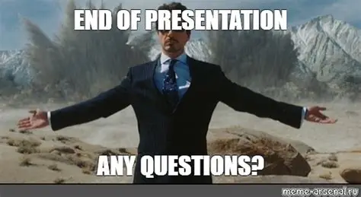
Questions??

Slide 10
