Slide 1
Predicting Renewable Energy Production Based on Climate Conditions
YAKUB REDDY ADLA
GitHub/Yakubreddy2000/Yakub_Capstone_Project

Slide 2
Introduction / Problem Statement
What problem are you solving?
Reduced Cost
Grid Reliability
Why is it important?
New Product
Industry Demand
Who are the Stakeholders?
Retail Companies
Policy Makers & Researchers
Notes:
What problem are you solving?
Reduced Cost: Enhance the probability of accurate estimates on the levels of renewable energy, specifically solar and wind energy, due to changes in climate factors.
Grid Reliability: Mitigate energy demand-supply imbalance by reliability due to unpredictable nature of renewable energy production.
Why is it important?
New Product: Aids energy systems to manage new and enhanced climate variation.
The requirement for accurate predictions of renewable energy is prevalent in utility companies, smart power networks, and sustainable energy management.
The stakeholders or target audience of this report would be the management and shareholders of the Company and the investors interested in the Company.
Retail Companies: energy retailers or electricity pricing can use it to determine prices for the electricity they supply.
Policy Makers & Researchers: For planning sustainable infrastructure and climate-responsive energy policy.

Slide 3
Objectives / Research Questions
Clear, concise goals you achieved:
Energy Forecasting Accuracy
Data Driven Insights
Optimized Planning
Specific questions you aim to answer with data
Effect of Climatology
Optimal Energy Output Prediction
Energy Generation Efficiency
Notes:
Clear, concise goals you achieved:
Energy Forecasting Accuracy: In developing an accurate description of climate conditions, completed models of renewable energy production were created.
They have applied weather and energy history data to forecast renewable energy output historical records.
Optimised Planning: Greater efficiency of grid operators and their decision-making due to accurate prediction of energy production.
It is necessary to outline the specific questions you are expecting to answer with the help of data:
Effect of Climatology: In this post, we will learn how climate influenced affects renewable energy production particularly solar & wind.
The goal is to define which climatic variables are the most suitable to predict the energy yield from renewable energy sources under various climatic conditions?
Energy Generation Efficiency: Is it possible to determine that climate conditions tell about inefficiencies/ gaps in renewables generation?

Slide 4
Data Collection & Sources
Where did your data come from?
Kaggle Dataset
Weather & Energy Data
How much data did you collect?
Data Volume
Granularity
Any challenges or limitations in getting the data?
Data Completeness
Data Granularity
Data Variety
Notes:
Where did your data come from?
Kaggle Dataset: Data sourced from the "Renewable Energy and Weather Conditions" dataset on Kaggle.
Weather & Energy Data: Includes historical weather data (temperature, humidity, etc.) and renewable energy production data (solar, wind).
How much data did you collect?
Data Volume: The dataset includes multiple years of weather and energy production data, covering hundreds of thousands of data points.
Granularity: Data spans daily and hourly records for both renewable energy production and climate conditions.
Any challenges or limitations in getting the data?
Data Completeness: Missing values in certain weather or energy parameters, requiring preprocessing techniques like imputation.
Data Granularity: The dataset’s time intervals might not align perfectly with actual energy grid needs, posing challenges in high-resolution forecasting.
Data Variety: Weather conditions may not cover all locations, leading to potential biases or gaps in geographic coverage.

Slide 5
Data Cleaning & Preparation
How did you handle missing values, outliers, or inconsistent formats?
Missing Values
Outliers
Inconsistent Formats
Feature engineering or transformation techniques:
Datetime Features
Weather-Energy Interaction
Normalization/Scaling
Tools/libraries used:
- Pandas & NumPy
- Scikit-learn
- Matplotlib & Seaborn
Notes:
How did you handle missing values, outliers, or inconsistent formats?
- Missing Values: Used techniques like forward fill, mean imputation, or dropping rows with excessive missing data.
- Outliers: Detected using IQR and z-score methods; removed or capped extreme values to maintain data quality.
- Inconsistent Formats: Standardized date/time formats and converted units (e.g., temperature in °C) for consistency.
Feature engineering or transformation techniques:
- Datetime Features: Extracted day, month, hour from timestamps to identify temporal patterns in energy generation.
- Weather-Energy Interaction: Created interaction features like temperature × humidity or wind speed categories.
- Normalization/Scaling: Applied Min-Max Scaling or StandardScaler to normalize input features for better model performance.
Tools/libraries used:
- Pandas & NumPy: For data cleaning, manipulation, and handling missing values.
- Scikit-learn: For preprocessing (scaling, encoding), outlier detection, and feature engineering.
- Matplotlib & Seaborn: For data visualization and outlier detection via plots.

Slide 6
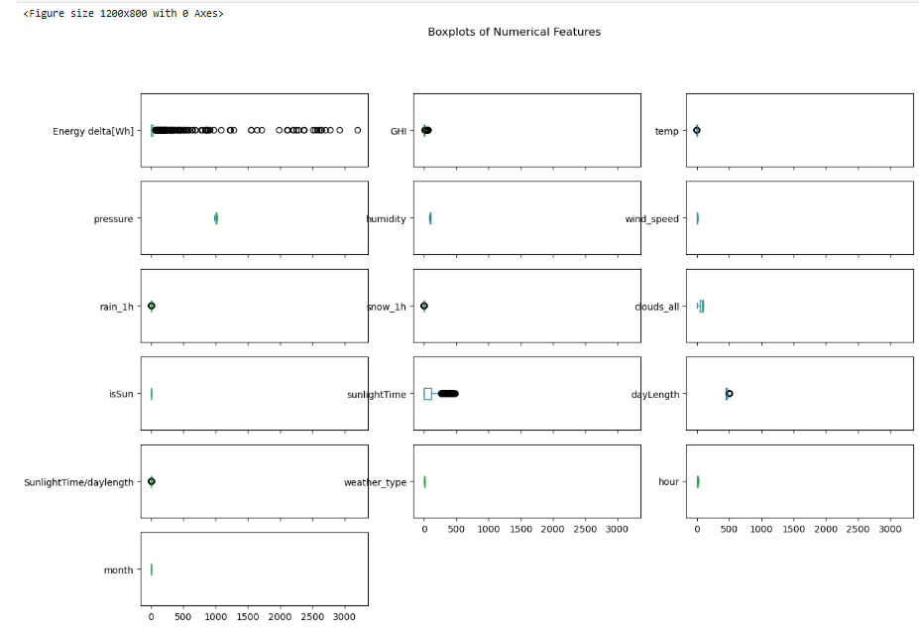
Exploratory Data Analysis (EDA)
1. Issues Identified in the Data
Missing Values
Outliers
Feature Relationships
Skewed Distributions
Notes:
1. Issues Identified in the Data
Missing Values: Some features contain NaN values, particularly in weather-related attributes like humidity and wind speed. These will be handled through imputation techniques such as mean/mode filling or forward-fill methods.
Outliers: Boxplots reveal potential extreme values in energy production and wind speed, requiring further analysis to determine whether they are measurement errors or valid extreme weather conditions.
Feature Relationships: Initial correlation analysis shows a strong relationship between solar radiation (GHI) and energy production, as well as between temperature and humidity.
Skewed Distributions: Histograms indicate that some numerical features, such as wind speed and pressure, have skewed distributions, which may require transformation (log or Box-Cox) for better model performance.

Slide 7
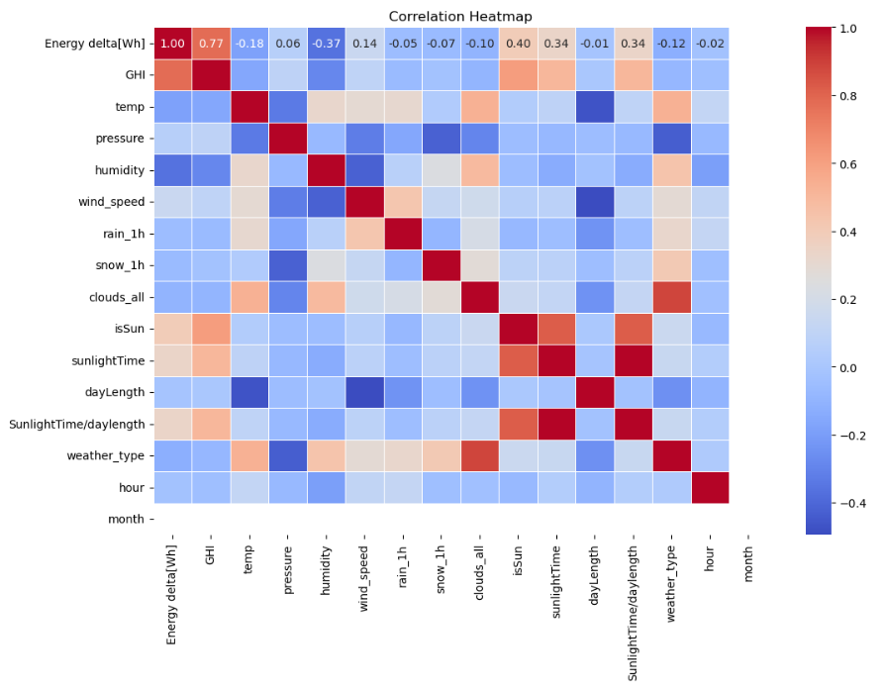
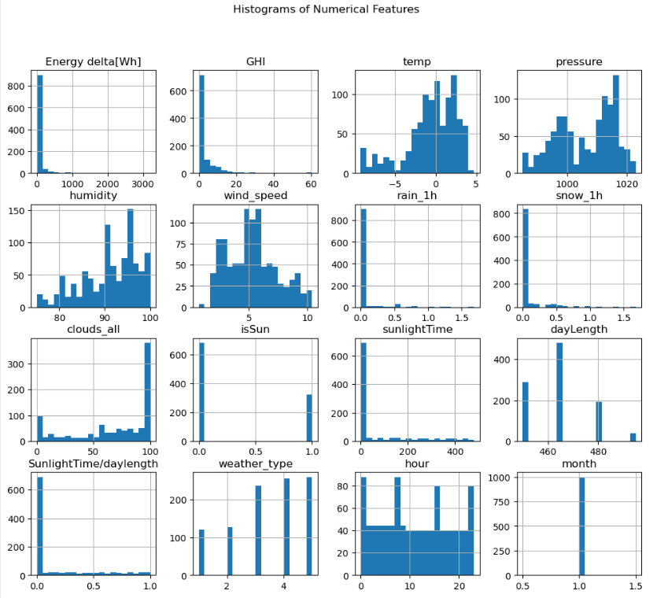

Slide 8
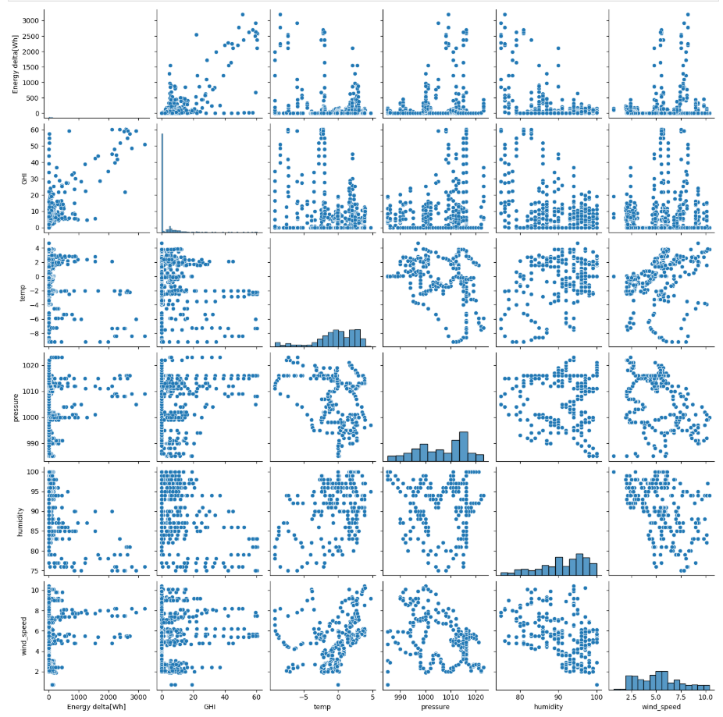
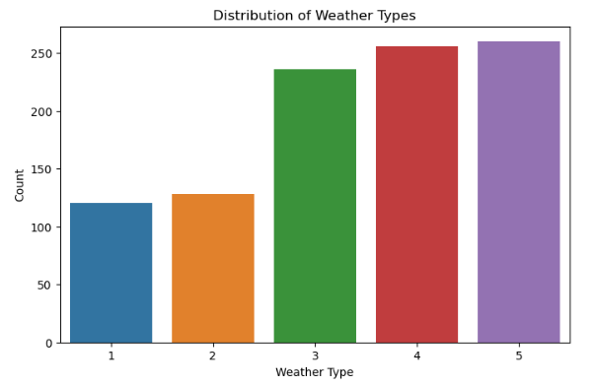

Slide 9
Modeling / Analysis Techniques
Algorithms or statistical methods used
PCA (Principal Component Analysis)
LIME & SHAP
ARIMA & LSTM
Transformer-Based Models
Random Forest
Why you chose them
Model Diversity
Interpretability vs. Performance
Time-Series Adaptability
Evaluation metrics used
MAE
RMSE
Notes:
Algorithms or statistical methods used:
PCA (Principal Component Analysis): Used for dimensionality reduction to eliminate redundant features and improve model efficiency.
LIME & SHAP: Applied for model interpretability, helping to explain feature importance and individual prediction behavior.
ARIMA & LSTM: ARIMA for time-series trend analysis; LSTM for capturing temporal dependencies in sequential weather-energy data.
Transformer-Based Models: Employed for advanced sequence modeling and handling long-term dependencies in climate data.
Random Forest: Chosen for its robustness to overfitting and ability to handle non-linear relationships in energy prediction.
Why you chose them:
Model Diversity: Combined classical (ARIMA, PCA), machine learning (Random Forest), and deep learning (LSTM, Transformer) to compare effectiveness.
Interpretability vs. Performance: LIME/SHAP provided transparency, while LSTM/Transformer improved prediction accuracy.
Time-Series Adaptability: ARIMA and LSTM were well-suited for the time-based nature of energy and climate data.
Evaluation metrics used:
MAE (Mean Absolute Error): Measures average magnitude of errors without considering direction—good for intuitive interpretability.
RMSE (Root Mean Square Error): Penalizes larger errors more heavily—useful for assessing impact of large prediction deviations.
R² Score (Optional): Sometimes used to assess proportion of variance explained by the model (used in Random Forest or regression models).

Slide 10
Results
Key findings and model performance
LSTM outperformed ARIMA
Deep Learning Advantages
Model Robustness
Interpretation of the results
Lower Error Metrics
Temporal Awareness
ARIMA Limitation
How they address the original problem
Improved Forecasting
Support Grid Planning
Data Driven Decision
Notes:
Key findings and model performance:
LSTM proved to be more accurate as compared to ARIMA because LSTM had less MAE (35.78) and RMSE (76.77), as compared to ARIMA model which had MAE of 36.81 and RMSE of 80.75.
Organization Overweight: LSTM was even better in capturing temporal patterns which are complex in nature compared to other traditional statistical models.
– An aspect of model robustness: Moreover, performance difference reveals the fact that the modern sequence models such as LSTM are more effective in terms of climate driven energy prediction task.
Interpretation of the results:
Lower Error Metrics: Addresses the factors improving LSTM’s performance in different climate conditions as well as the performance of energy output forecast.
Temporal Awareness: LSTM models gained temporal awareness of the weather data source and therefore drove enhanced forecast accuracy.
ARIMA Limitation: Also, known to have some problems with non-linear and complex interaction phenomena which made it quite challenging to work with regularly.
That is exactly how they solve the initial issue:
–Better forecast: The LSTM model enables accurate predictions of renewable energy sources in relation to climatic variables, because it tackles variability of energy.
Employed in Grid Planning: Electricity consumption and production forecasts help the providers to better balance the supply and demand and incorporate renewable resources.
Data Driven Decisions: Results enable the stakeholders to be more knowledgeable on great resource allocation and the reduced utilization of fossil backup systems.

Slide 11
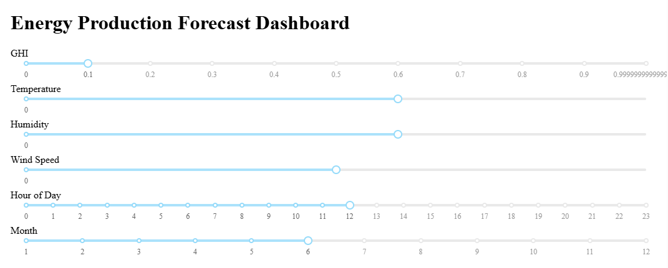
Visualization & Dashboard (if applicable)

Slide 12
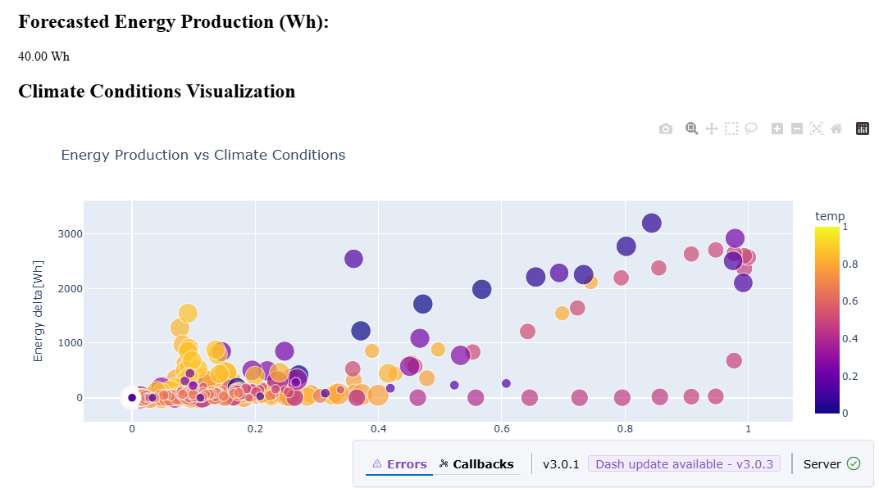
Dashboard 2

Slide 13
Conclusion & Recommendations
Summary of insights:
Climate Changes
LSTM Effectiveness
Actionable recommendations:
Extend the Infrastructure:
Weather-Driven Planning
Business or practical implications:
Cost savings
Stability of the grid
What could be improved?
Model Understanding Methods
Enhancement
What would you do if you have more time to process information or more information to process in a given time?
Geographic Extension
Hybrid Model Implementation
Notes:
Summary of insights:
Climate Changes: They influence the amounts of energy the assets produce and can impact them, for instance, temperature, humidity, and wind speed existent in weather conditions.
LSTM Effectiveness: LSTM models gave out the highest accuracy of predictions, meaning that deep learning is good for time-series energy forecasting.
Actionable recommendations:
– Extend the Infrastructure: Incorporate the functionalities of LSTM into the energy grid so as enhance the load forecasting.
- Weather-Driven Planning: It is a type of planning that incorporates climate predictions to estimate the controllability of renewable owing and productive uses of energy.
Business or practical implications:
– Cost savings: due to better forecast, there will be decreased consumption of expensive backup power, improved operations.
Stability of the grid: Precise forecasts ensure that measures of supply and demand come in handy in the sustainable management of energy infrastructure.
What could be improved?
– Model Understanding Methods: Explainability again can be improved through the help of techniques like SHAP or LIME for Building Trust.
-Enhancement: Additive features of the model such as the amendment of integrating solar radiation, wind direction or energy usage history to improve the results.
What would you do if you have more time to process information or more information to process in a given time?
– Geographic Extension: It is important to apply the model in other geographic areas to establish generalization results across different climate zones.
- Hybrid Model Implementation: Try to integrate LSTM with the Transformer models or other ensemble methods to improve the model’s performance and resilience.

