Slide 1




LEVERAGING HOSPITAL DATA TO EFFECTIVELY ENHANCE PERFROMANCE.
(A DETAILTED ANALYSIS OF HOSPITAL DATA)
ANALYSIS AND PRESENTATION BY:
ANDREW YAKUBU
yakubuandrew17@gmail.com
LinkedIn
+2349031965446

Slide 2

1.1 PROBLEM STATEMENT…
Faith Specialist Hospital is a bustling healthcare facility serving a diverse population. Over the years, the hospital has accumulated a wealth of patient data, ranging from demographic details to admission records and health outcomes. However, the hospital is facing significant challenges in leveraging this data effectively.
The management has noticed an increasing number of patients being discharged against medical advice, a rising trend in chronic diseases as well as a concerning mortality rate among certain patient groups.

Slide 3

1.2 OBJECTIVE..
1.Analyze patient demographics in relation to hospital outcomes.
2.Identify common reasons for discharge against medical advice (DAMA) and their impact on mortality.
3.Examine the prevalence and impact of chronic illnesses among patients.
4. Assess the impact of lifestyle factors on hospital outcomes.
5. Evaluate the performance of the doctors based on patient outcomes, specialization, and workload.
6. Provide data-driven insights that can help improve hospital management and patient care

Slide 4
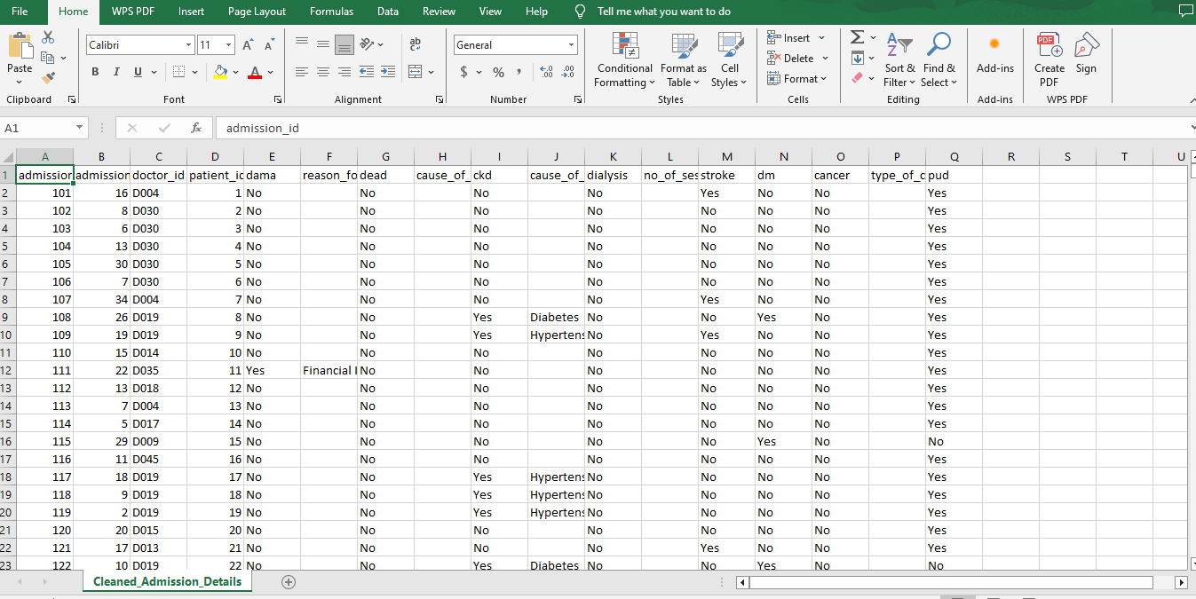
2.1 ANALYSIS…
2.1.1 DATA CLEANING
The given data sets (patients_data, admission_data, doctors_data and risk_factor_data) were imported into excel for cleaning.
Data consistency was ensured.
Missing values and duplicates were cleaned and rectified.

Slide 5
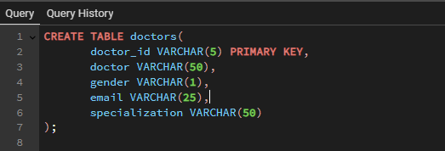
2.2 SQL COMMANDS AND QUERIES…
2.2.1 TABLE CREATION – DOCTOR’S TABLE

Slide 6
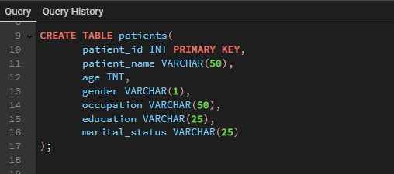
2.2 SQL COMMANDS AND QUERIES…
2.2.2 TABLE CREATION – PATIENT’S TABLE

Slide 7
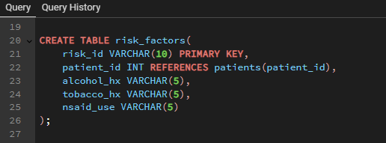
2.2 SQL COMMANDS AND QUERIES…
2.2.3 TABLE CREATION – RISK FACTOR TABLE

Slide 8
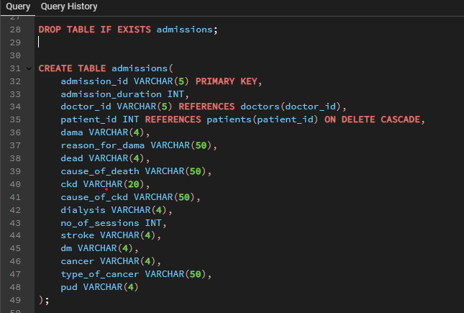
2.2 SQL COMMANDS AND QUERIES…
2.2.4 TABLE CREATION – ADMISSION TABLE

Slide 9
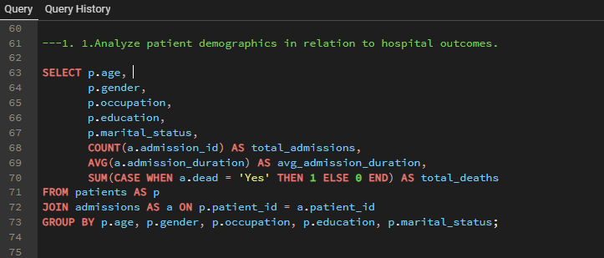
2.3 SQL COMMANDS AND QUERIES…
2.3.1 QUERIES..

Slide 10
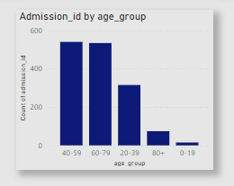
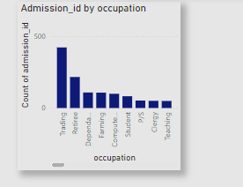
3.1 INSIGHT AND RECOMMENDATION
3.1.1.Analyze patient demographics in relation to hospital outcomes.
INSIGHT
Majority of the patients are within the ages of 40-79 years
A large proportion of admitted patients are traders and retirees
RECOMMENDATION
Seeing that this age range falls within the active working age of individuals, and their major occupation is trading, sensitization campaigns should be held to create awareness on the danger of DAMA.

Slide 11
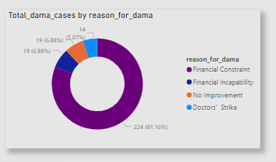
3.1 INSIGHT AND RECOMMENDATION
3.1.2.Identify common reasons for discharge against medical advice (DAMA) and their impact on mortality.
INSIGHT
Financial constraint shows the highest reason for DAMA
RECOMMENDATION
Financial intervention strategies should be implemented to assist patients. The Hospital can partner with Government agencies and NGOs.

Slide 12
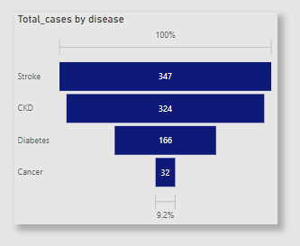
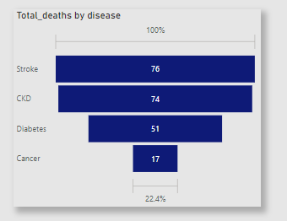
3.1 INSIGHT AND RECOMMENDATION
3.1.3.Examine the prevalence and impact of chronic illnesses among patients.
INSIGHT
Stroke and CKD has the highest prevalence.
RECOMMENDATION
Quick response can reduce stroke related disabilities and deaths.
Neurologists and rehab specialists should be trained to diagnose and treat stroke rapidly. Thrombolysis should carried out for ischemic stroke within 4-5 hours of admission.
For CKD, necessary equipment and trainings for early detection should be put in place.

Slide 13
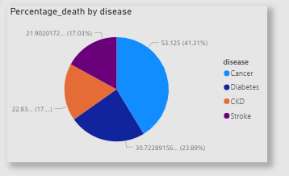
3.1 INSIGHT AND RECOMMENDATION
3.1.3.Examine the prevalence and impact of chronic illnesses among patients.
INSIGHT
Cancer has the highest percentage by death.
RECOMMENDATION
Oncology services should be expanded.

Slide 14
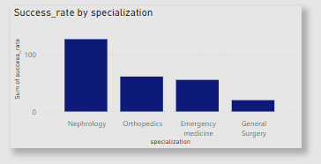
3.1 INSIGHT AND RECOMMENDATION
3.1.4. Evaluate the performance of the doctors based on patient outcomes, specialization, and workload.
INSIGHT
Nephrology has the highest success rate while General surgery has the least success rate.
RECOMMENDATION
Further trainings should be conducted for health practitioners in General surgery.
High performing doctors should be rewarded.
Workload across these specializations should be examined to see areas that need more hands.

Slide 15
3.2 RECOMMENDATION SUMMARY
The top DAMA reason, being Financial constraint should be addressed with targeted financial support systems by partnering with Government agencies, NGOs and Foreign health schemes.
More resources should be allocated to the prevalent Chronic illness being CKD (Chronic Kidney disease) .
Best practices should be implemented for best performing doctors to improve overall performance.

Slide 16
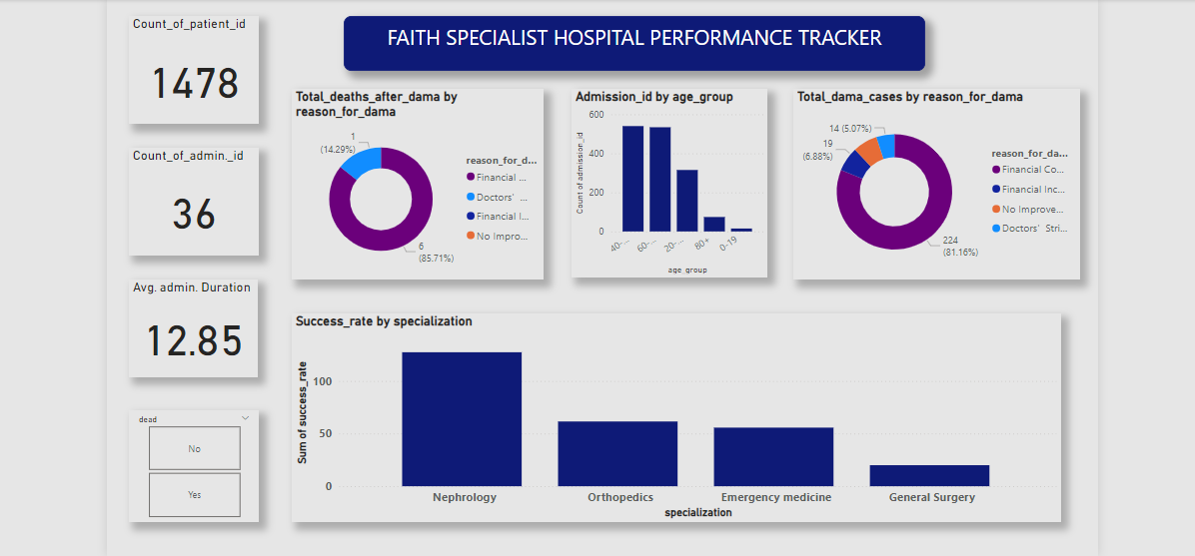
4.1 DASHBOARD

Slide 17
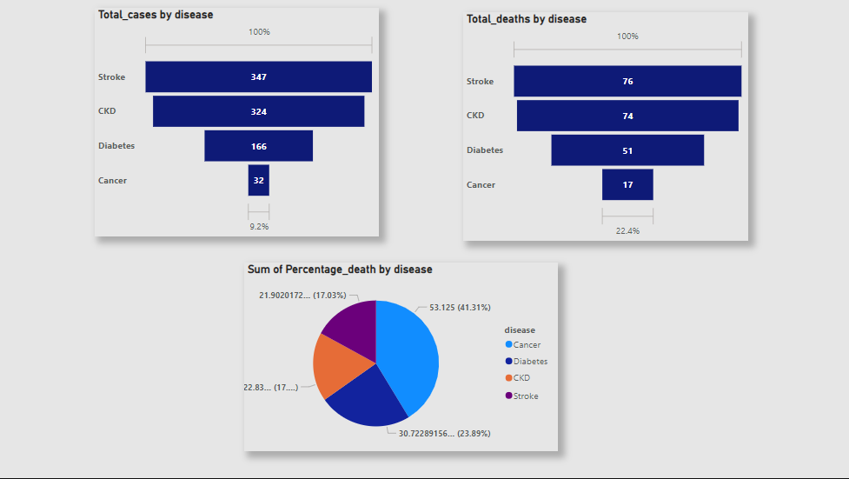
4.2 DASHBOARD

Slide 18

ANALYSIS AND PRESENTATION BY:
ANDREW YAKUBU
yakubuandrew17@gmail.com
LinkedIn
+2349031965446

Slide 19

THANK YOU

