Slide 1
The song clash bot
Yakutov Dmitry
Semenov Vadim

Slide 2
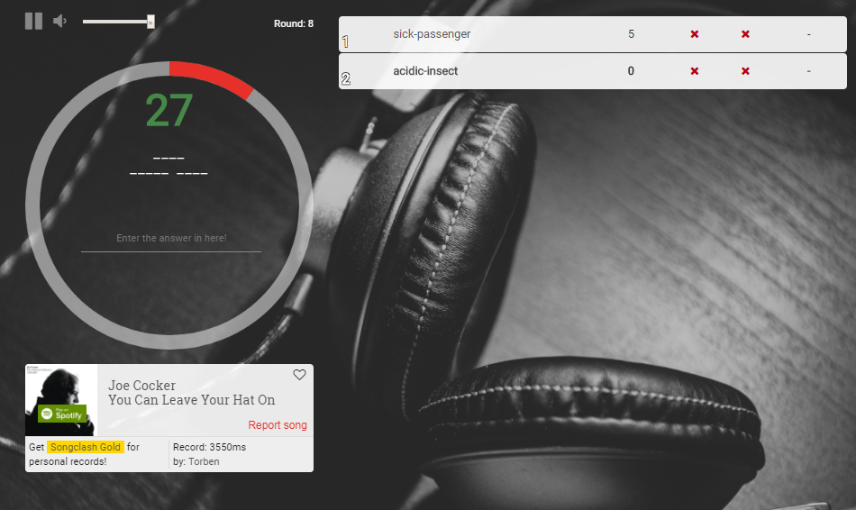
What is song clash

Slide 3
Design
SoftCheater
Engine
HardCheater
BboxConfig
Application
Base song info grabber
DBUpdater

Slide 4
Tools
pillow
selenium - loading database
pyscreenshot - get base info of song
pypiwin32 - typing answer
pillow - image processing
tkinter - front-end

Slide 5
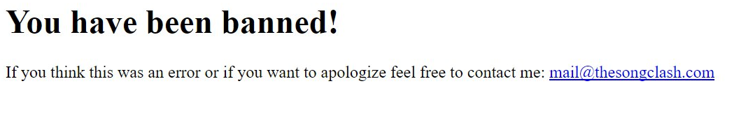
Questions?
pillow

