Slide 2
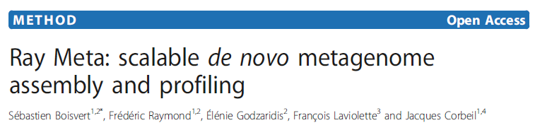

Slide 3
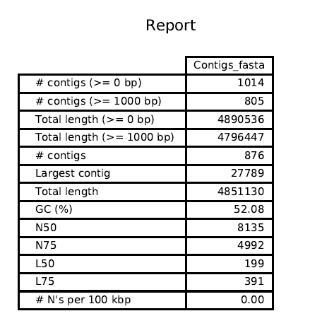

Slide 7
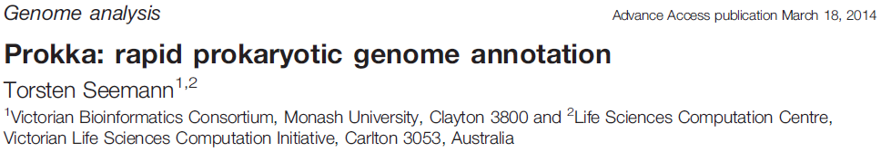
Provide reference protein database (S. enterica Typhimurium SL1344)
Searches with BLASTp
Then, searches multiple databases to annotate genome in succession
UniProt, using BLAST+
RefSeq (finished bacterial genomes for a genus) [Salmonella]
HMMER3.1 hidden Markov model profile db’s (Pfam)
Basically searches for homologues to known proteins
Failing to annotate everything, will fill in remaining CDS with “hypothetical protein”

Slide 8
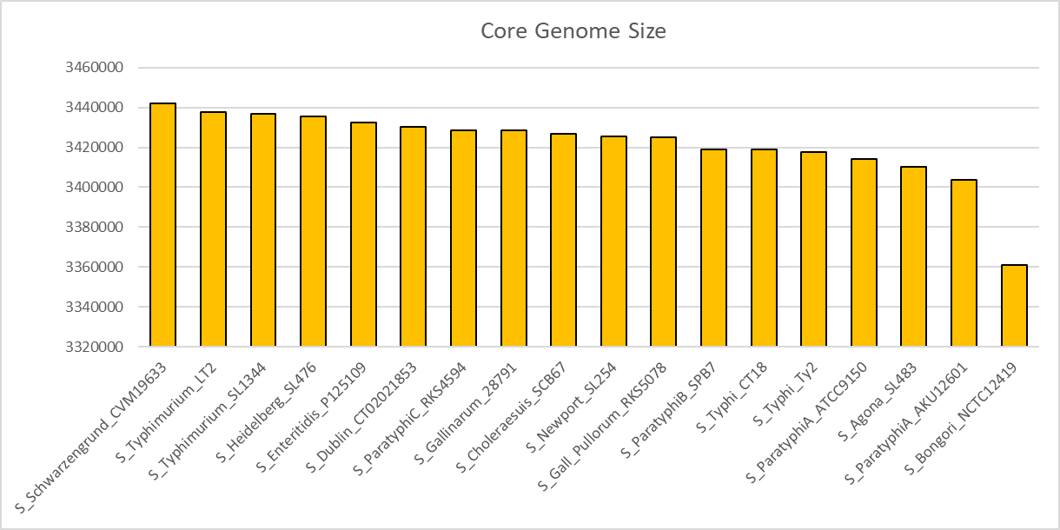

Slide 9
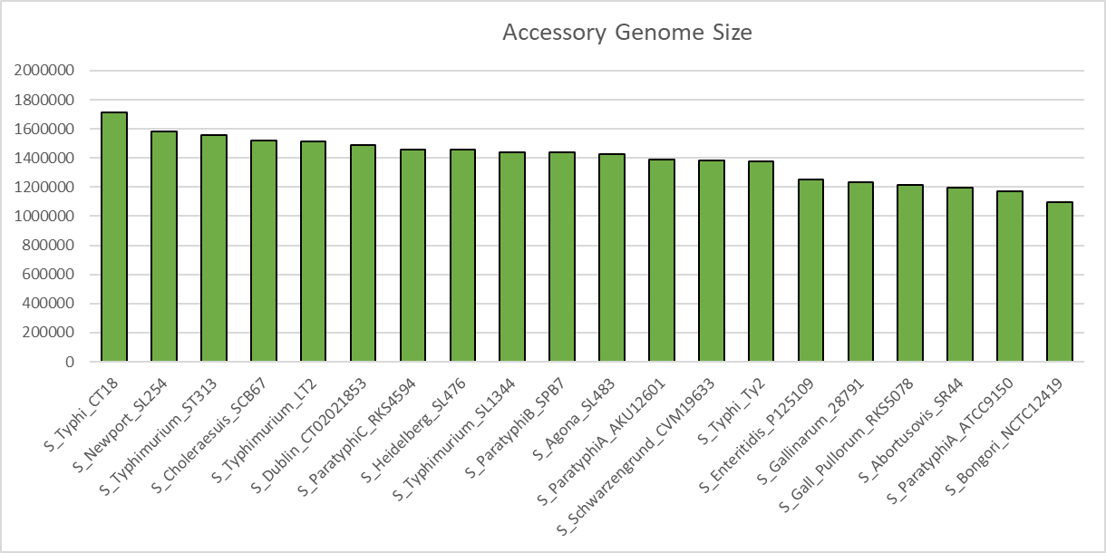

Slide 10
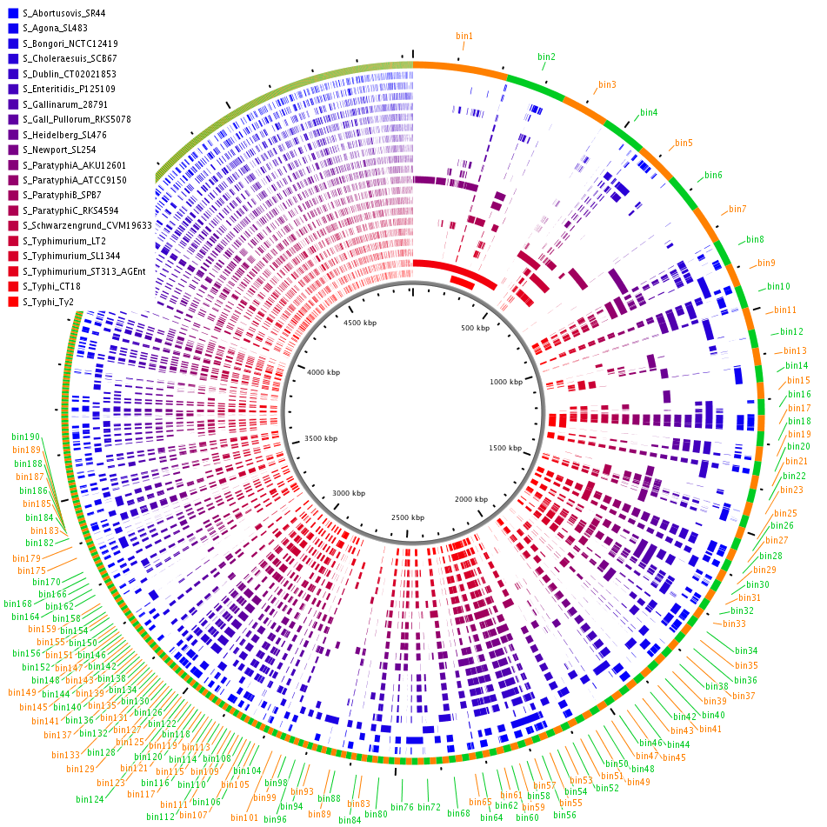

Slide 11
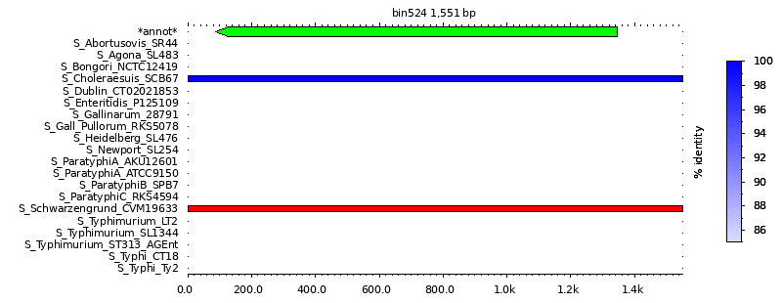

Slide 12
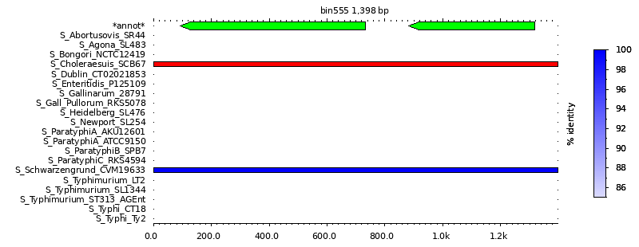

Slide 13
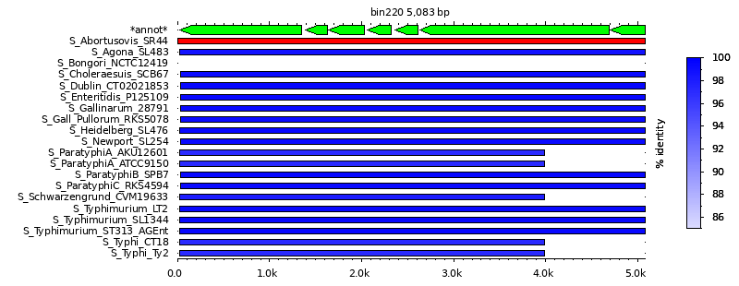

Slide 14
