Slide 1
Comparative Functional Genomics on accessory genomic elements in Salmonella
Andrew Verdegaal
April 25, 2019
E&EB 723

Slide 2
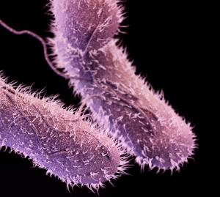
Salmonella enterica
Gram (-) Bacteria
1.2 million cases of Salmonella related illness/year in U.S. alone
Three types of sicknesses:
1) Salmonellosis (non- paratyphoid/ non-typhoid)
2) Paratyphoid fever
3) Typhoid fever
http://www.cidrap.umn.edu/news-perspective/2016/12/cdc-resistant-salmonella-causes-6200-illnesses-year

Slide 4
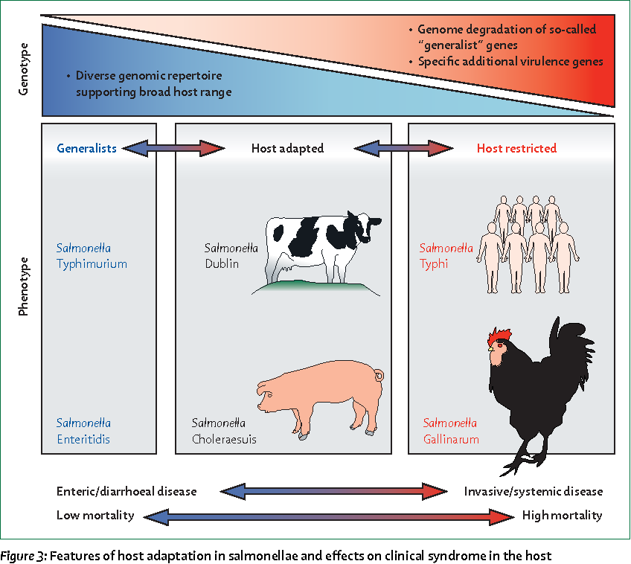
Feasey et al.
(The Lancet, 2012)

Slide 5
What can we learn from comparing Salmonella serovar genomes?
Requirement for host specificity/ adaptation
Mechanisms of virulence in different environments/ hosts
Type III Secretion/ Invasion
Attachment
Antibiotic resistance
Understand the core genome of Salmonella enterica and accessory genomic elements for each serovar responsible for these phenotypes
Use these to inform on relevant pathogenic accessory genomic elements of newly sequenced serovars

Slide 6
Pipeline
Comparison of AGE’s with one another
Create phylogenetic relationships based on AGE
Create bins of accessory elements shared between serovars
18 Salmonella
reference genomes
(NCBI Database)
Spine
Determine core genome components
ClustAGE
Determine Accessory Genomic Elements (AGE)
AGEnt
Prokka
Two Draft Salmonella genomes,
One only as .fastq files
Annotated draft genomes
Ray
QUAST
Assembled genome
Serovar Typhimurium ST313
Quality Control Analysis of assembled genome

Slide 7
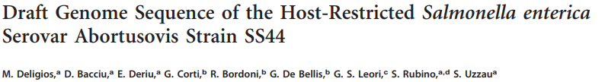
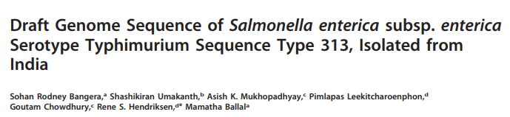
Strain
S Bongori NCTC12419
S Schwarzengrund CVM19633
S ParatyphiA AKU12601
S ParatyphiA ATCC9150
S Typhi CT18
S Typhi Ty2
S Choleraesuis SCB67
S ParatyphiC RKS4594
S Newport SL254
S Heidelberg SL476
S Typhimurium LT2
S Typhimurium ST313
S Typhimurium SL1344
S ParatyphiB SPB7
S Abortusovis SR44
S Agona SL483
S Dublin CT02021853
S Enteritidis P125109
S Gallinarum 28791
S Gall Pullorum RKS5078
Draft Genomes
2014
Reference Genomes
2018

Slide 8
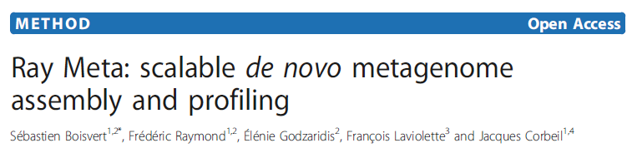
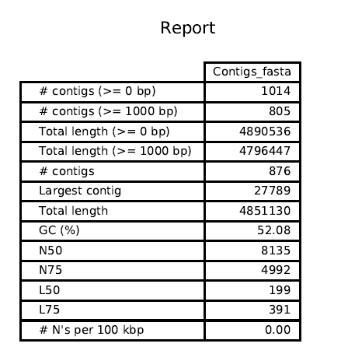
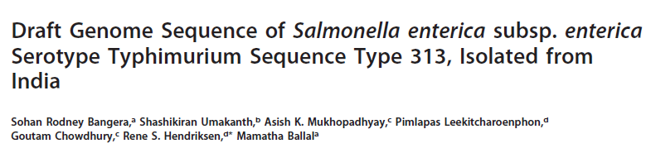
On genome from:

Slide 12
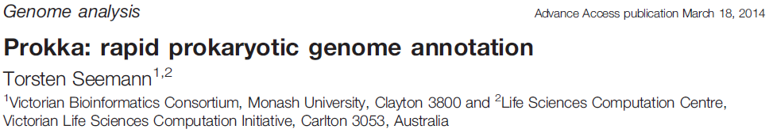
For Draft Genomes of S. enterica serovars Typhimurium ST313 & Abortusovis SR44
Provide reference protein database (S. enterica Typhimurium SL1344)
Searches with BLASTp
Then, searches multiple databases to annotate genome in succession
UniProt, using BLAST+
RefSeq (finished bacterial genomes for a genus) [Salmonella]
HMMER3.1 hidden Markov model profile db’s (Pfam)
Basically searches for homologues to known proteins/ protein domains
Failing to annotate everything, will fill in remaining CDS with “hypothetical protein”

Slide 13
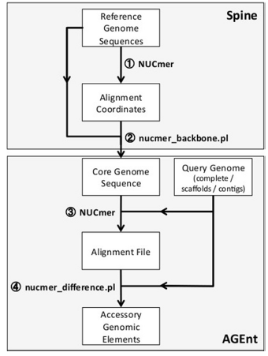
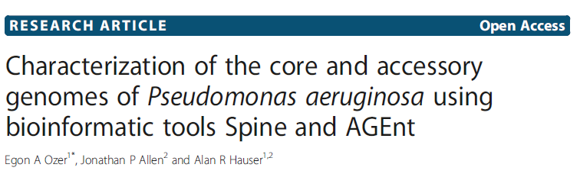
18 Salmonella
reference genomes
(NCBI Database)
Determine core genome components
Determine Accessory Genomic Elements (AGE)
Spine
Annotated draft genomes
(ST313 and SR44)
Determine Accessory Genomic Elements (AGE)
AGEnt
In silico Core genome components comparison

Slide 14
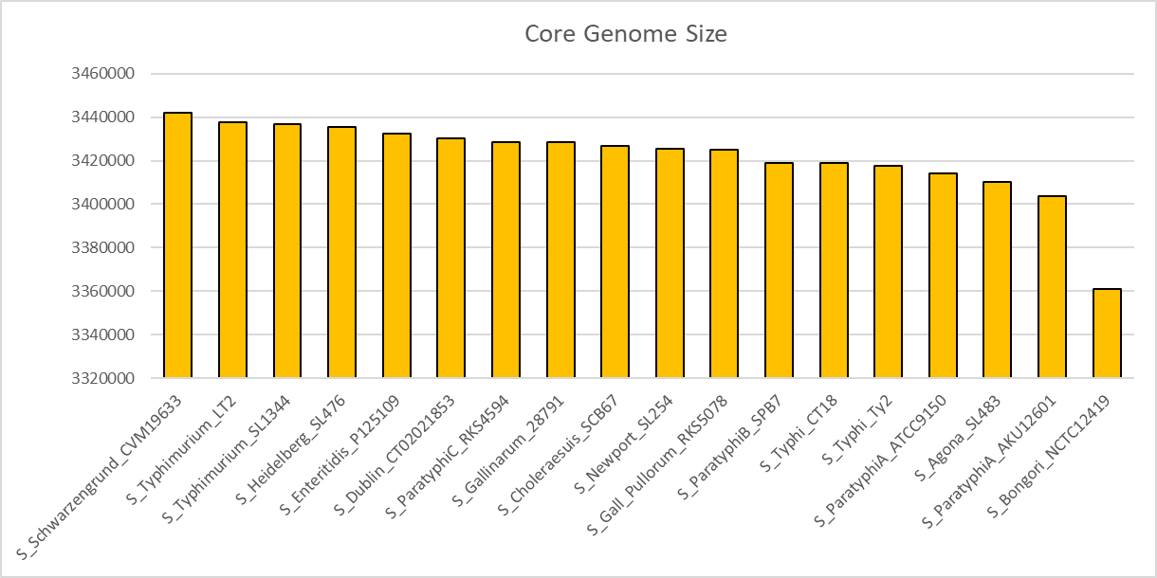

Slide 15
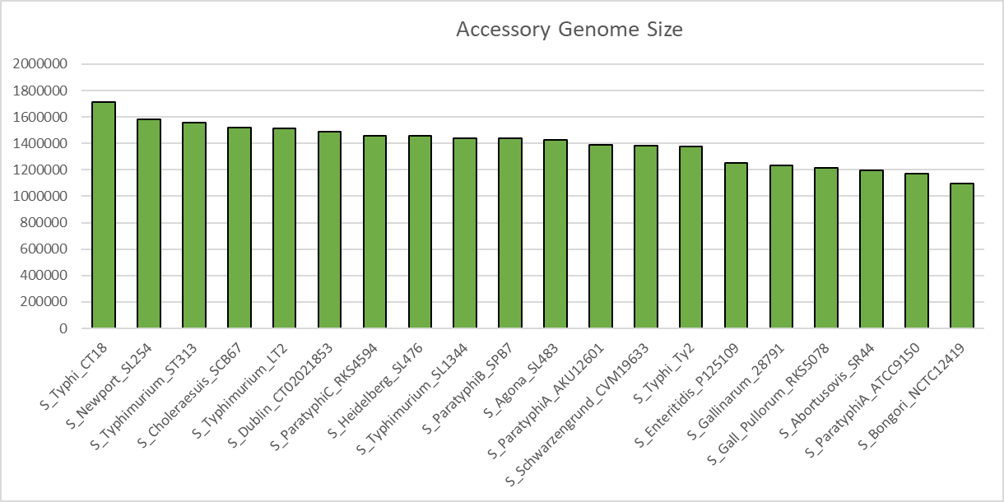

Slide 16

Create bins of accessory elements shared (or not) between serovars
Comparison of AGE’s with one another
Create phylogenetic relationships based on AGE
Annotated Accessory Genomic Elements (AGE)
Reference + Draft

Slide 17
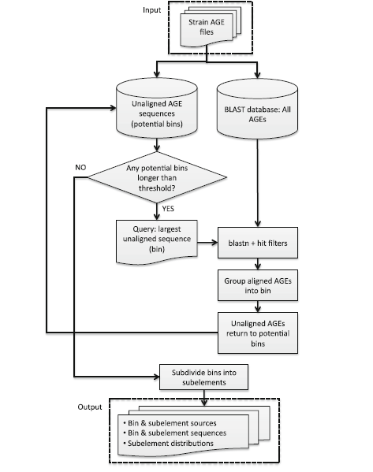

Slide 18
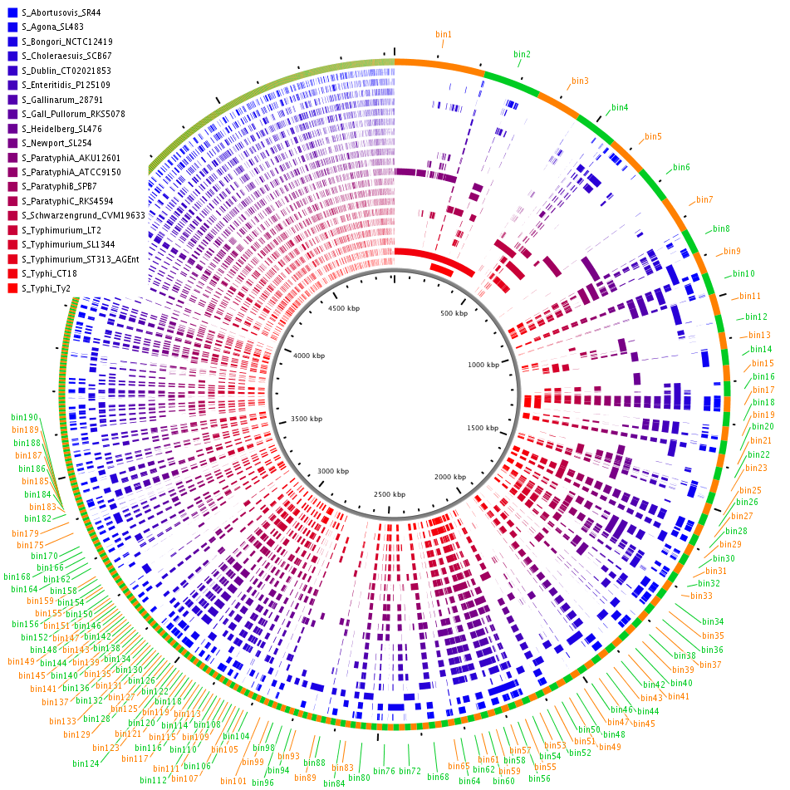

Slide 19
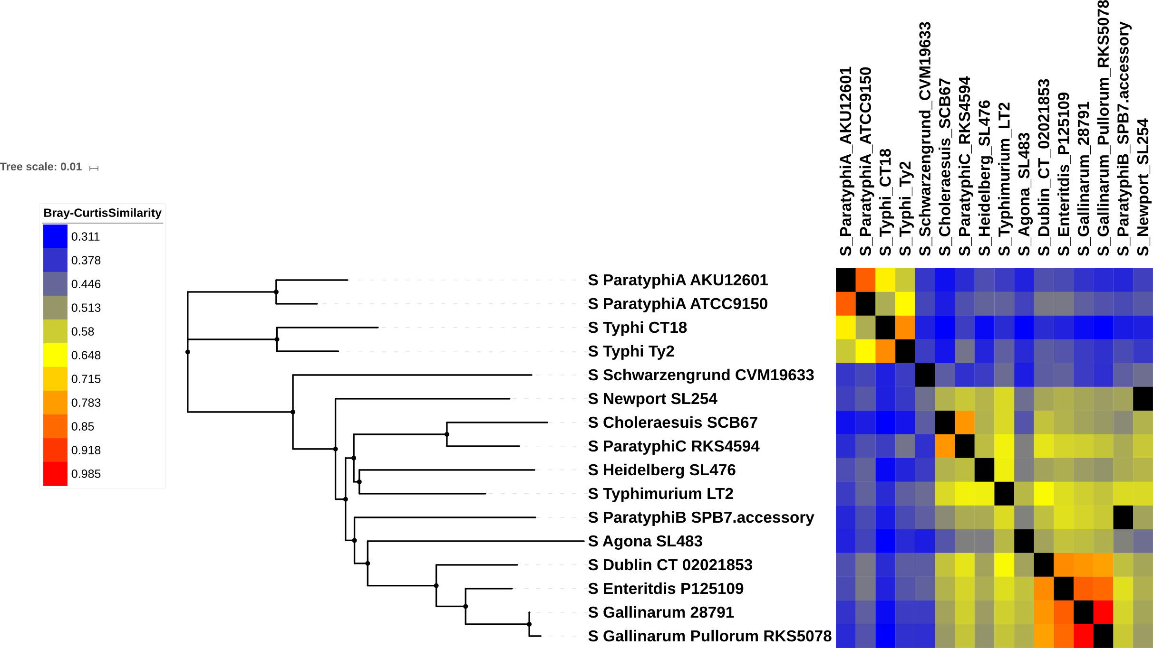
Viewing ClustAGE Analysis of Similarity in Salmonella serovars
16 Reference Genomes Analyzed
Tree software: Phylip3.695
Visualization: iTOL
Bray Curtis Distances/ NJ Tree

Slide 20
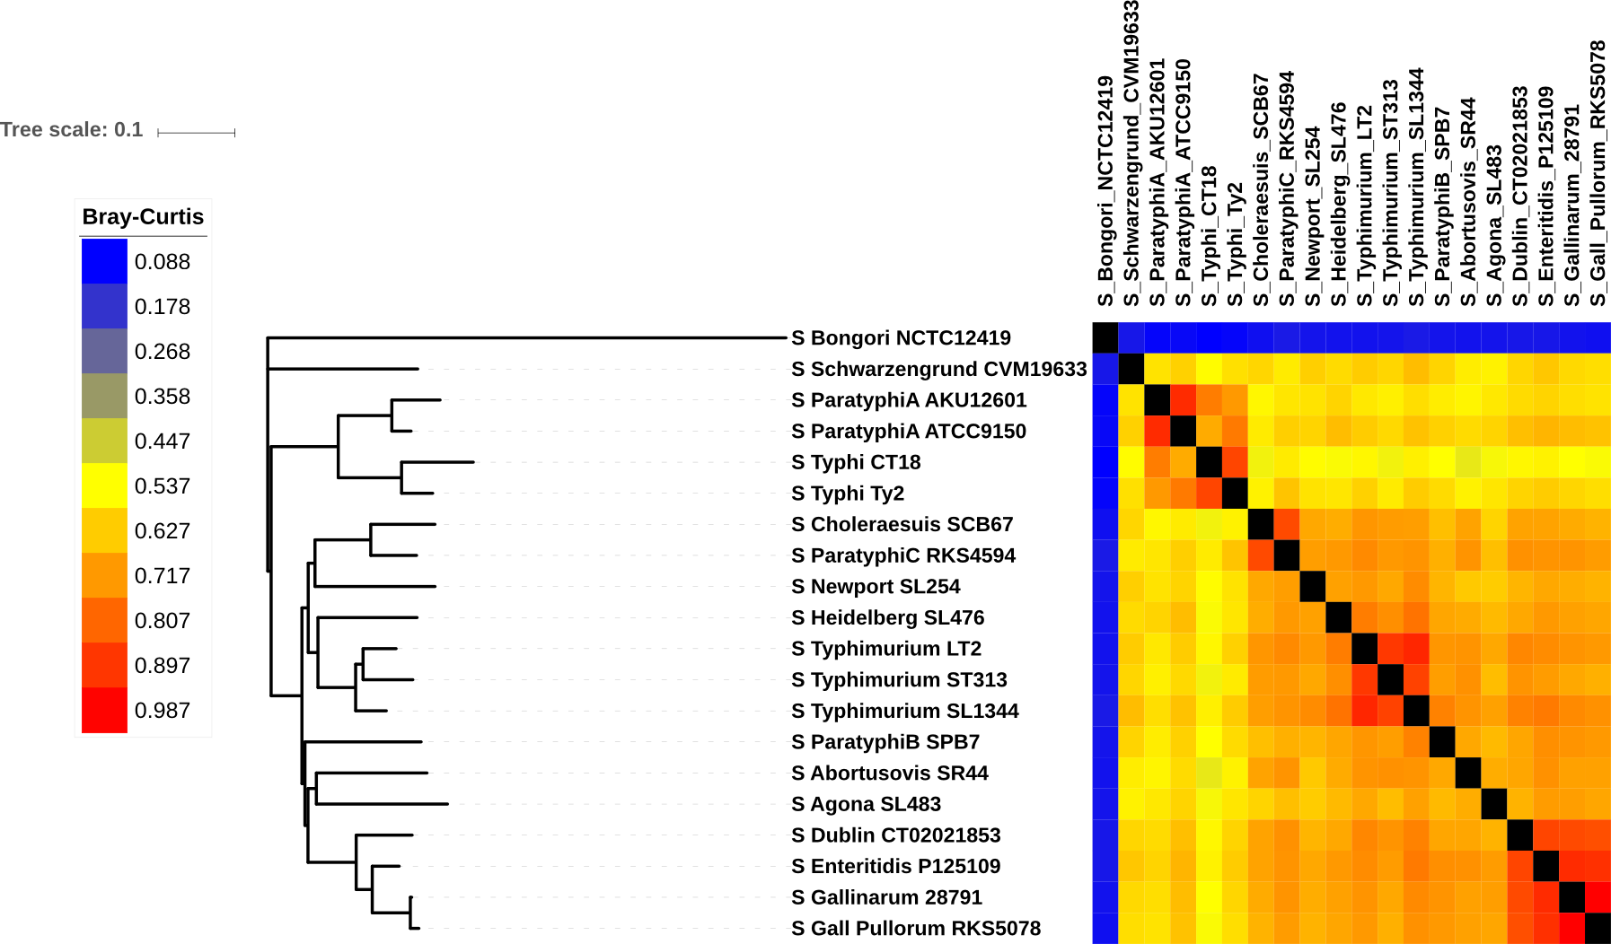
Similarity in Salmonella serovars with iTOL, larger dataset, includes “outlier” S. bongori
18 Reference, 2 Draft Genomes Analyzed

Slide 21
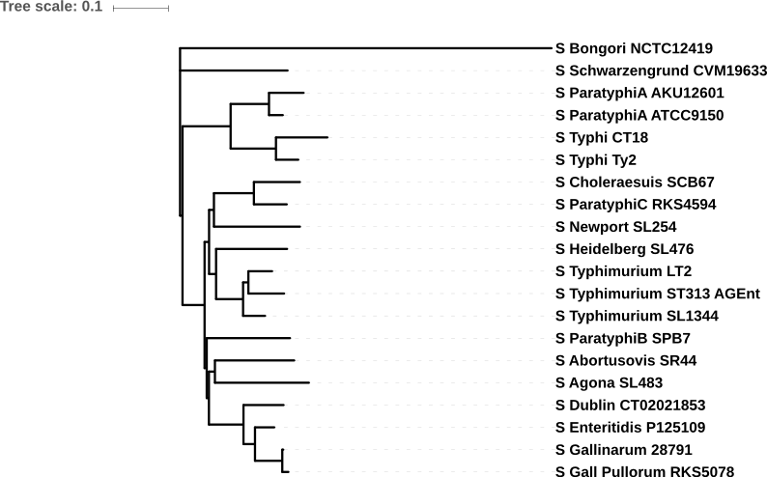
Depiction of ClustAGE Phylogenetic Relationships alongside Host Adaptation
Strain | Host Adaptation
S Bongori NCTC12419 | Cold-blooded
S Schwarzengrund CVM19633 | Humans
S ParatyphiA AKU12601 | Humans
S ParatyphiA ATCC9150 | Humans
S Typhi CT18 | Humans
S Typhi Ty2 | Humans
S Choleraesuis SCB67 | Swine
S ParatyphiC RKS4594 | Humans
S Newport SL254 | Humans
S Heidelberg SL476 | Humans
S Typhimurium LT2 | Avirulent
S Typhimurium ST313 | Broad
S Typhimurium SL1344 | Broad
S ParatyphiB SPB7 | Humans
S Abortusovis SR44 | Ovine
S Agona SL483 | Swine
S Dublin CT02021853 | Bovine
S Enteritidis P125109 | Broad
S Gallinarum 28791 | Chicken/Fowl
S Gall Pullorum RKS5078 | Chicken/Fowl
Cold-blooded
Humans
Swine
Humans
Broad
Humans
Ovine
Swine
Bovine
Broad
Chicken/Fowl

Slide 22
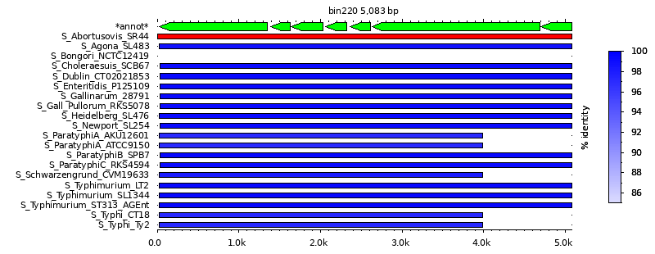
Shared genes between all Salmonella sp. except S. bongori
Type III Secretion System Effector Proteins (necessary for virulence and invasion of host cells)

Slide 23
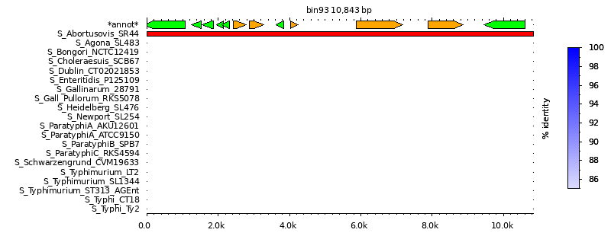
Salmonella enterica serovar Abortusovis SR44, new unique gene set?
“Hypothetical Proteins”

Slide 24
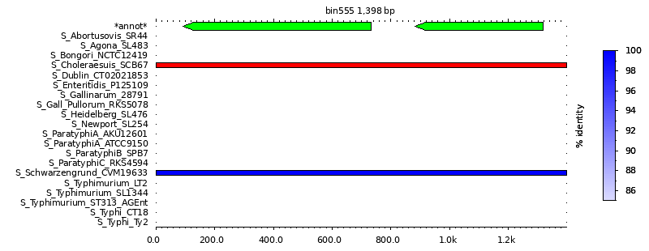
Chloramphenicol resistance: Shared by Choleraesuis SCB67 and Schwarzengrund CVM19633
cat2
Chloramphenicol
acetyltransferase
SCH_012
(unknown fxn,
topoisomerase?)

Slide 25
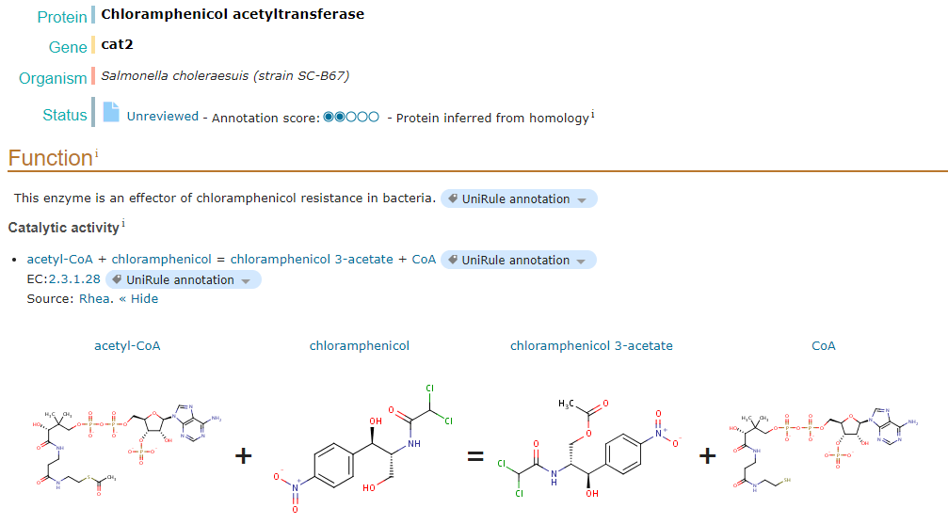
Chloramphenicol and Chloramphenicol Acetyltransferase
Chloramphenicol
Widespread action against Gram (+) and Gram (-) Bacteria
Inhibits Ribosomal 50S subunit, no protein translation
Source: UniProt

Slide 26
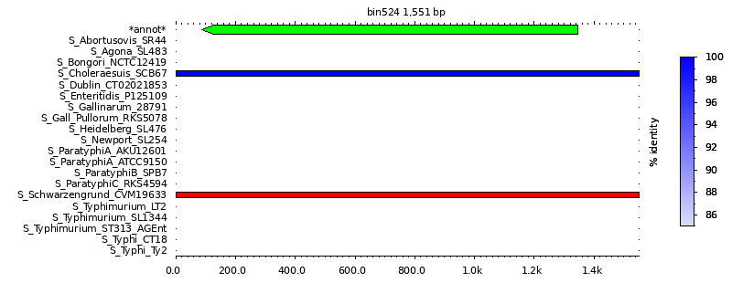
Chloramphenicol resistance (continued)
Bcr/CflA family efflux transporter (putative)

Slide 27
Challenges/ Difficulties/ Caveats
Experimental
Some virulence genes may be “house-keeping” essential genes
Can run into issues with draft genome assembly/ coverage
Show as missing an AGE, when in reality it may share it
HGT in bacteria makes genomic comparison and evolutionary relationships difficult (or does it?)

Slide 28
Challenges/ Difficulties/ Caveats
Computing
Overwhelming at times
Programs don’t want to run sometimes
Missing dependencies/ working on WSL instead of a Unix OS
Could be more efficient
Limited personal knowledge of software available
Originally:
Trying to follow different path
Used/ attempted to implement MANY other programs (ultimately unfruitful effort)
ie: Multiple genome alignment programs (MAFFT, progressiveMauve)
ie: Phylogenetic analyses software (FastTree, PhyML, etc.)

Slide 29
Conclusions and Moving Forward
Strong pipeline to analyze pathogenic bacteria with many genomes available
Ability to analyze new draft genomes and find relationships based on accessory genome components not shared between closely related strains
Can use the data from this study to:
Discover relationships between Salmonella serovars
Find shared or novel genes or regulatory regions affecting bacterial host-specific pathogenesis

Slide 30
Thank you!

