Slide 1
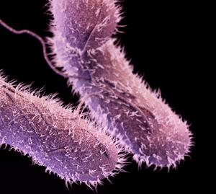
Salmonella enterica
Gram (-) Bacteria
1.2 million cases of Salmonella related illness/year in U.S. alone
Three types of sicknesses:
1) Salmonellosis (non paratyphoid/ typhoid)
2) Paratyphoid fever
3) Typhoid fever
http://www.cidrap.umn.edu/news-perspective/2016/12/cdc-resistant-salmonella-causes-6200-illnesses-year

Slide 2
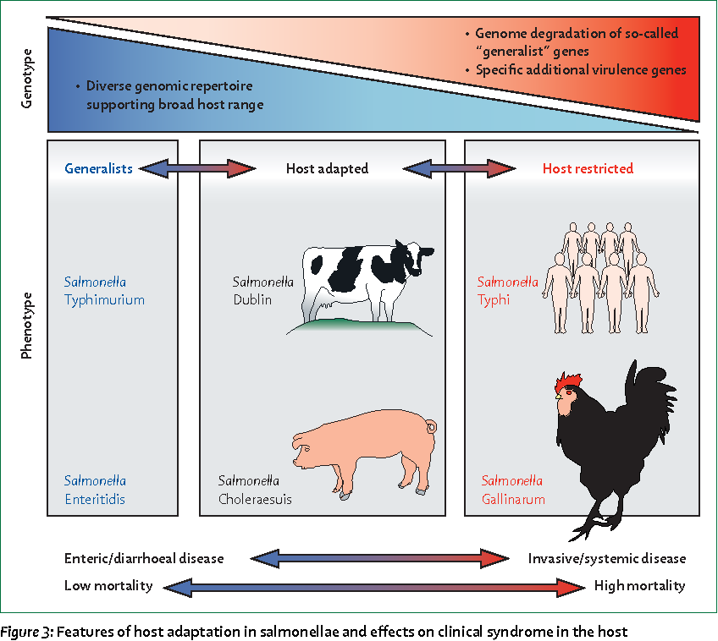
Feasey et al.
(The Lancet, 2012)

Slide 4
What can we learn from comparing Salmonella serovar genomes?
Requirement for host specificity/ adaptation
Mechanisms of virulence in different environments/ hosts
Type III Secretion/ Invasion
Attachment
Antibiotic resistance
Understand the core genome of Salmonella enterica and accessory genomic elements for each serovar responsible for these phenotypes
Use these to inform on relevant pathogenic accessory genomic elements of newly sequenced serovars
ClustAGE Pipeline

Slide 5
Pipeline
Comparison of AGE’s with one another
Create phylogenetic relationships based on AGE
Create bins of accessory elements shared between serovars
18 Salmonella
reference genomes
(NCBI Database)
Spine
Determine core genome components
ClustAGE
Determine Accessory Genomic Elements (AGE)
AGEnt
Prokka
Two Draft Salmonella genomes,
One only as .fastq files
Annotated draft genomes
Ray
Assembled genome
Serovar Typhimurium ST313

Slide 6
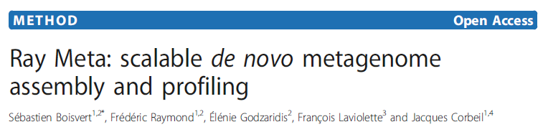
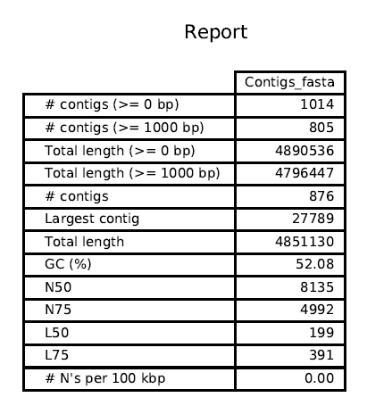

Slide 10
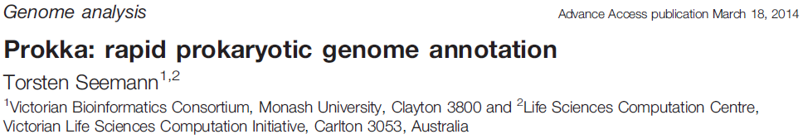
Provide reference protein database (S. enterica Typhimurium SL1344)
Searches with BLASTp
Then, searches multiple databases to annotate genome in succession
UniProt, using BLAST+
RefSeq (finished bacterial genomes for a genus) [Salmonella]
HMMER3.1 hidden Markov model profile db’s (Pfam)
Basically searches for homologues to known proteins
Failing to annotate everything, will fill in remaining CDS with “hypothetical protein”

Slide 11
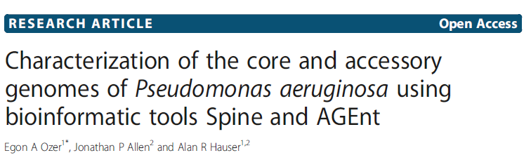

Slide 12
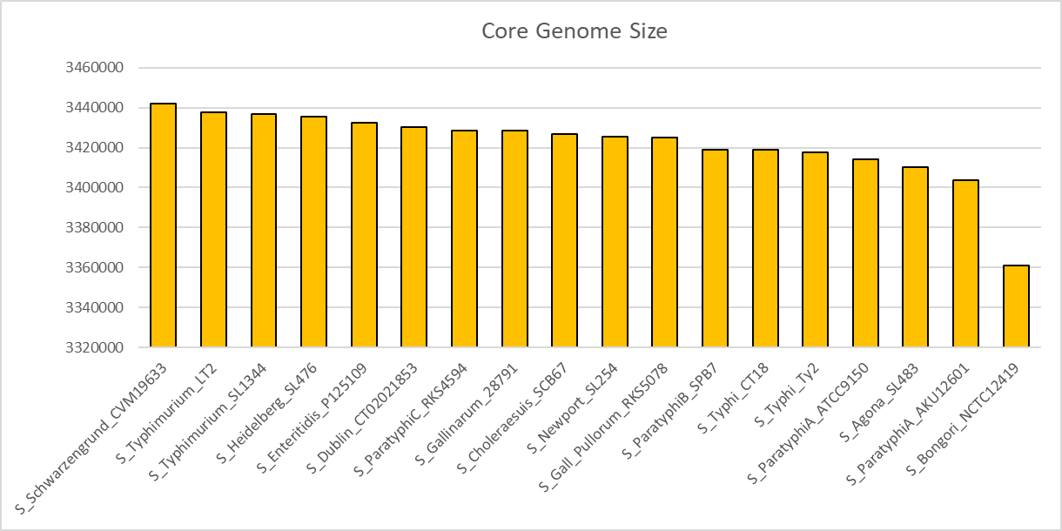

Slide 13
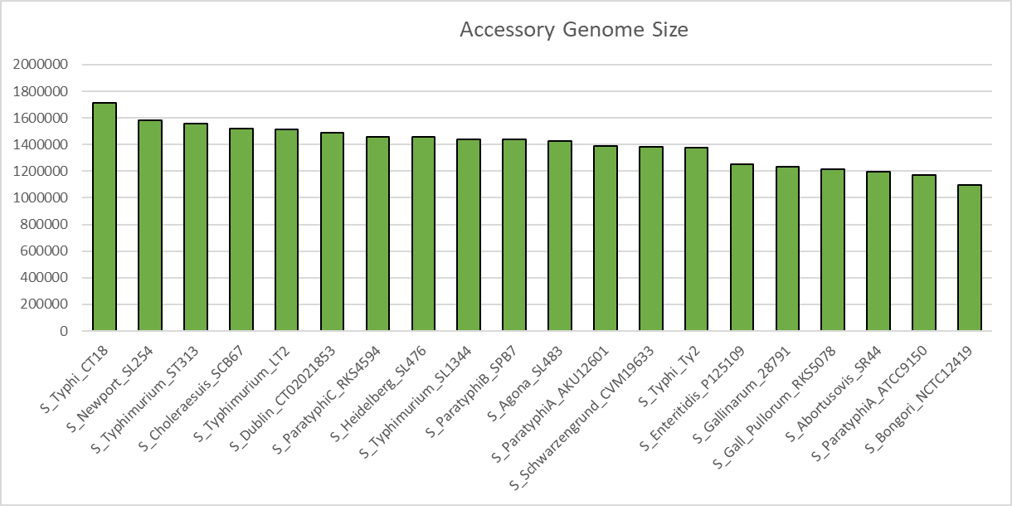

Slide 14


Slide 15
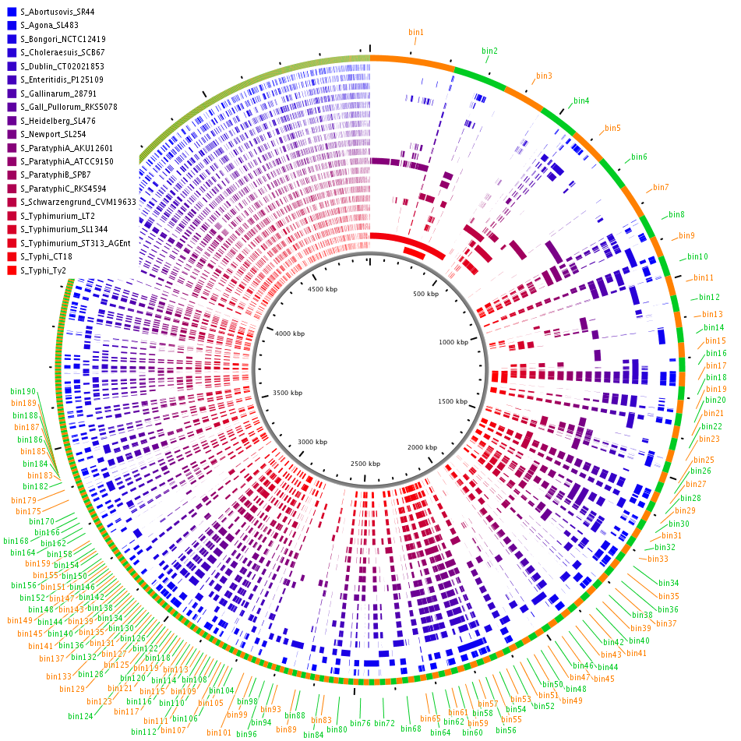

Slide 16
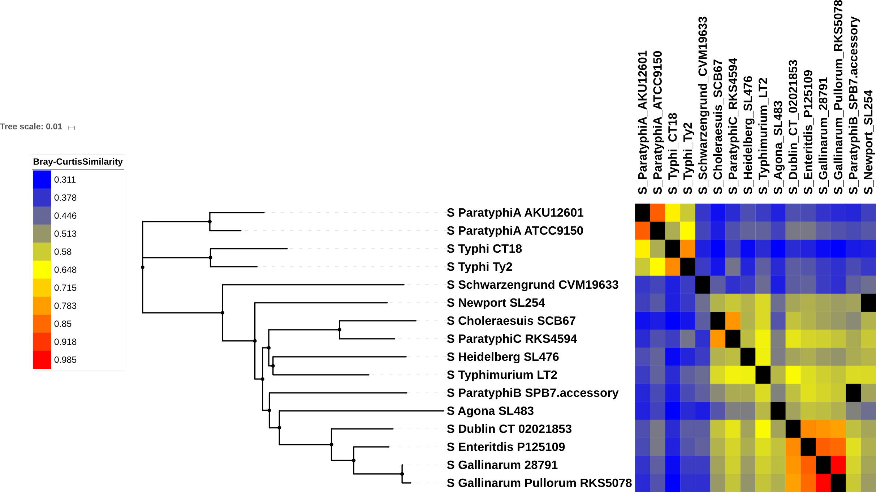
Viewing ClustAGE Analysis of Similarity in Salmonella serovars with iTOL

Slide 17
Depiction of ClustAGE Phylogenetic Relationships alongside Host Adaptation

Slide 18
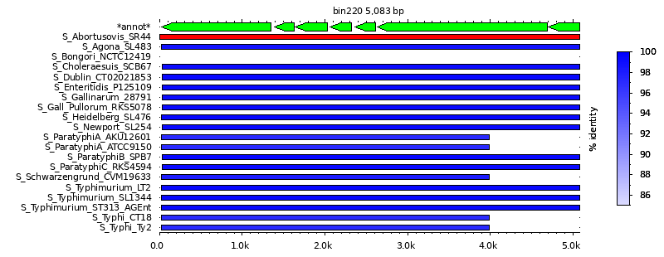
Shared genes between all Salmonella sp. except S. bongori
Type III Secretion System Effector Proteins (necessary for virulence and invasion of host cells)

Slide 19
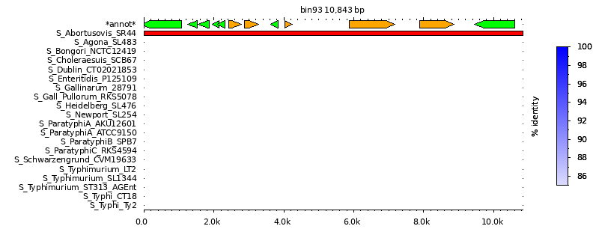
Salmonella enterica serovar Abortusovis SR44, new unique gene set?
“Hypothetical Proteins”

Slide 20
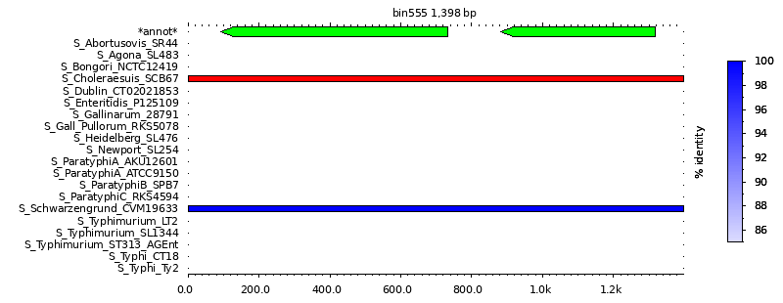
Chloramphenicol resistance (continued)
cat2
Chloramphenicol
acetyltransferase
SCH_012
(unknown fxn,
topoisomerase?)

Slide 21
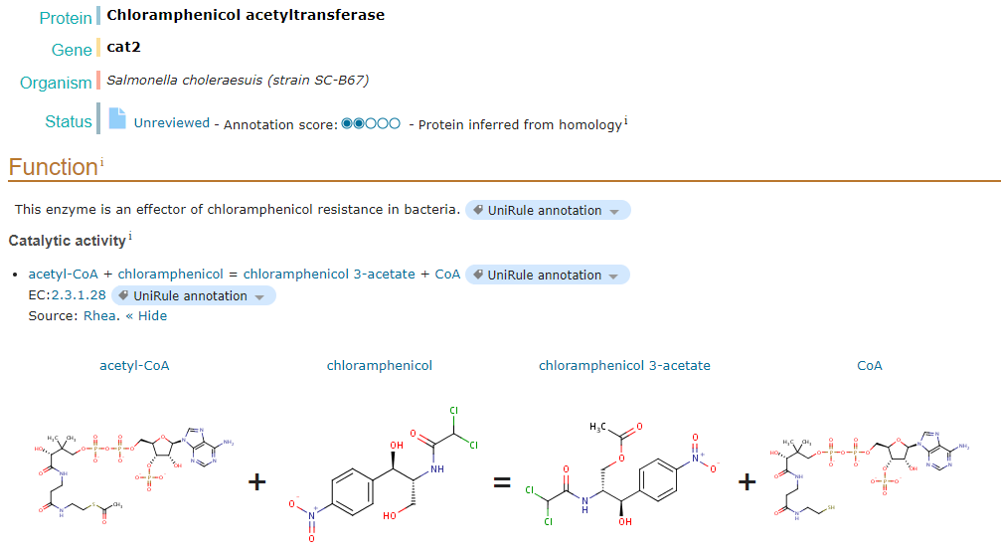
Chloramphenicol and Chloramphenicol Acetyltransferase
Chloramphenicol
Widespread action against Gram (+) and Gram (-) Bacteria
Inhibits Ribosomal 50S subunit, no protein translation
Source: UniProt

Slide 22
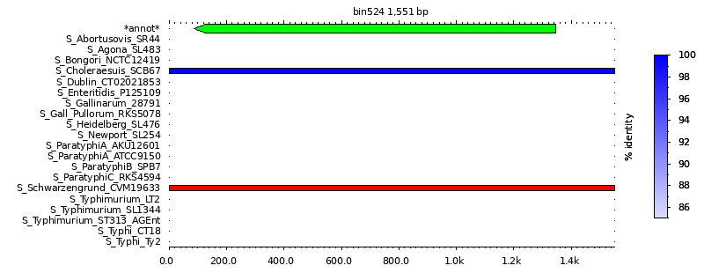
Chloramphenicol resistance: Shared by Choleraesuis SCB67 and Schwarzengrund CVM19633
Bcr/CflA family efflux transporter (putative)

