Slide 1
Functional Genomics and RNA-seq Technologies
Comparative Genomics EEB 723

Slide 2
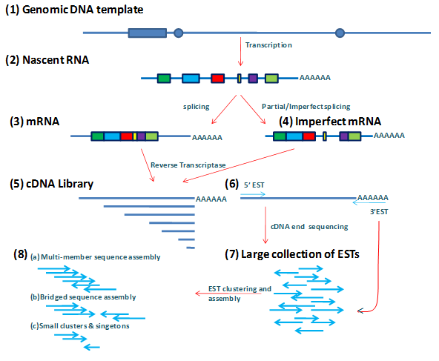
Predecessors of RNA-seq
Expressed Sequence Tags (EST)
  Sequence cDNA clones, find abundance of corresponding RNAs
  Huge role in early 90’s genetics/genomics movement
  Disadvantages:
    High cost
    Only semiquantitative
Adapted from: Course in Proteomics & Genomics, Dr. Dubey; National Programme on Technology Enhanced Learning (NPTEL) - Phase II
https://nptel.ac.in/courses/102103017/module33/lec33_slide2.htm

Slide 3
Predecessors of RNA-seq
Serial Analysis of Gene Expression (SAGE) OR CAGE/MPSS
  Sequence only a short tagged region per cDNA
  Cut down cost on a per gene basis
  Disadvantages
    Still expensive (Sanger Sequencing)
    Can be difficult to map to reference genome

Slide 4
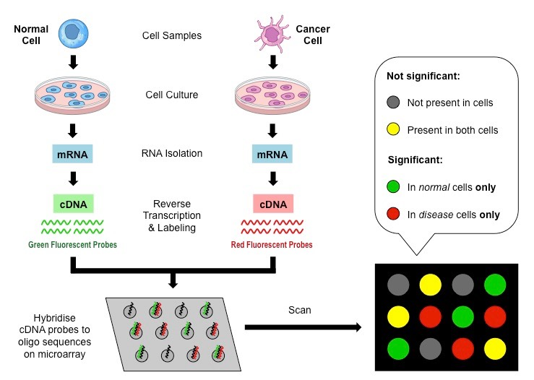
Predecessors of RNA-seq
Microarray
  Conceived by Pat Brown in early 90’s
  Larger scale, more affordable
  Hybridize labeled targets derived from RNA transcripts to probes attached to a surface
  Able to interrogate RNA expression genome wide
Disadvantages:
  Need a priori sequence information
    Prior reference genome/transcriptome
  Not useful for de novo generation/ discovery of gene expression patterns/ new genes
THEN deep sequencing/NGS came along…
BioNinja.com.au

Slide 5
RNA-seq
2nd Generation Sequencing (SGS) Tech
Understand abundance of RNA of choice in a specific condition
Identify new RNA / unknown gene expression patterns
  Relies on NGS to produce new information on RNA transcripts
  Can create de novo transcriptomes
Can reveal sequence identity for unknown genes or unknown isoforms of genes

Slide 6
General Process of RNA-seq
RNA Sample Prep
  Remove rRNA
  Isolate RNA of interest (usually mRNA)
cDNA prep of sample RNA
  Different methods to create cDNA
  Relies on NGS technology based on DNA sequencing
  Potentially includes sheering of DNA (for Illumina reads)
Library creation
  cDNA flanked by adapter sequences to aid in directionality detection and unique hits
  Prep method can vary depending on RNA species being investigated

Slide 7
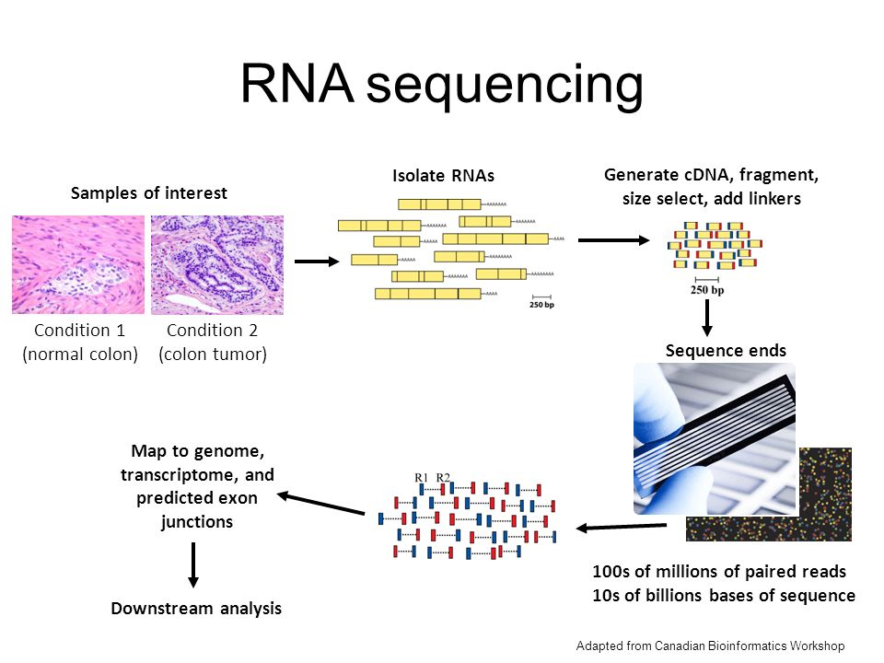
Adapted from Lecture 11. Microarray and RNA-seq II (Kim, 2015)

Slide 8
RNA Sample Prep
Variable depending on RNA being studied
  Ex: Eukaryotic mRNA
    Poly(A) tails can be targeted for enrichment, easier processing potentially
Elimination of rRNA
  Ribosomal RNA most abundant type found in cells
  Can use probes to hybridize rRNA’s (biotinylated DNA/ locked nucleic acid probes)
    Pull down with streptavidin binding, remove from sample
    OR Probe Directed Degradation (PDD)
      Use antisense DNA oligos, digest w/ RNase H

Slide 9
RNA Sample Prep
Fragmentation
  If using Illumina, fragmentation is necessary
    Need fragments <600bp
    Can use:
      Chemical
      Enzyme
      Acoustic shearing
      Transposon-based
        Can cleave ds cDNA AND add adapters simultaneously

Slide 10
RNA Sample Prep
Adapters and Directionality
  Need to properly ID correct sense of mRNA fragment, could be either one in the cDNA library if not careful
  Ligate on RNA before amplification
  Differences in 5’ and 3’ adapters can preserve strandedness
    Random nucleotides as adapters
    OR can use UTP in second created strand
      Preserve strandedness since there's only one acting as a template

Slide 11
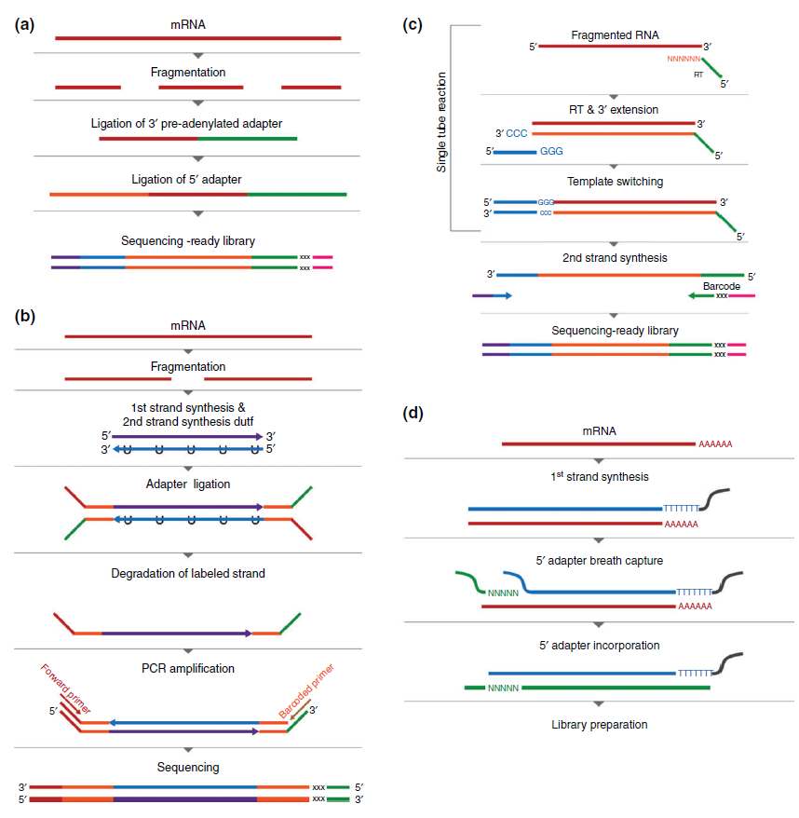
Hrdlickova et al. (2017, Wiley Interdisc. Rev. RNA)

Slide 12
Classic RNAseq Protocol
Hrdlickova et al. (2017, Wiley Interdisc. Rev. RNA)

Slide 13
RNAseq Using dUTP Integration
Hrdlickova et al. (2017, Wiley Interdisc. Rev. RNA)

Slide 14
RNASeq Template Switching Reaction
Hrdlickova et al. (2017, Wiley Interdisc. Rev. RNA)

Slide 15
RNASeq Using Template “Breathing”
Hrdlickova et al. (2017, Wiley Interdisc. Rev. RNA)

Slide 16
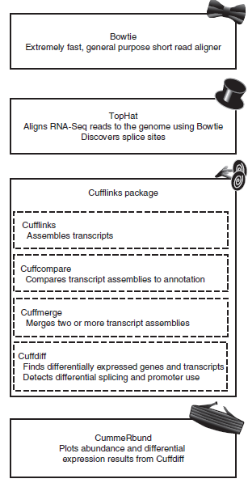
RNA-seq Data Mapping
Use software packages to map RNAseq reads to genome(s)
  < 1day of computing power needed, ~1h hands on time
    TopHat
    Cufflinks
Map to genome
Compare genes/transcripts under two or more conditions
Limitations:
  Need sequenced genome
  Assume data is from Illumina or SOLiD technology
Trapnell et al. (2012, Nature Protocols)

Slide 17
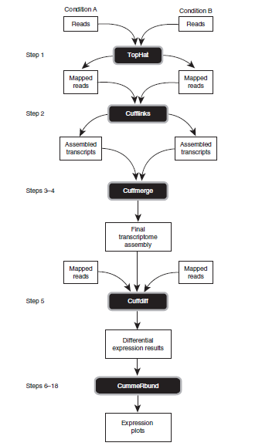
RNA-seq Data Mapping
Bowtie:
  Most updated read aligner
  Limitation in spanning introns
    TopHat made to alleviate this issue
Tuxedo Pipeline
  Cufflinks:
    Assembly of transcripts aid users in IDing new splice variants or genes
    Attempts to assemble all isoforms of mRNA to correct the gene
      Can be multiple isoforms = multiple possibilities
Trapnell et al. (2012, Nature Protocols)

Slide 18
Single Cell RNA Sequencing
RNA-seq of cell populations leads to average expression profiles
Single cell RNA-seq able to detect new subtypes of cells/ expression patterns
  Impossible to do in a population analysis
  Co-expression patterns of genes lost as well
Cluster reads and compare between individual cells in the population
Can infer new cell types or developmental patterns

Slide 19
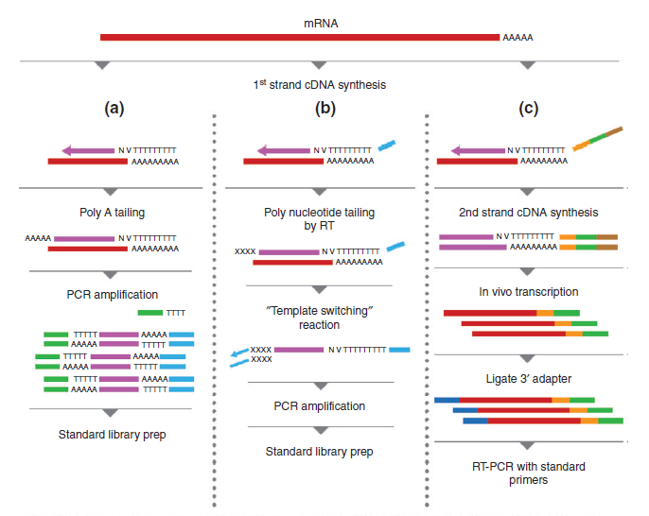
Single Cell RNA Sequencing
Hrdlickova et al. (2017, Wiley Interdisc. Rev. RNA)

Slide 20
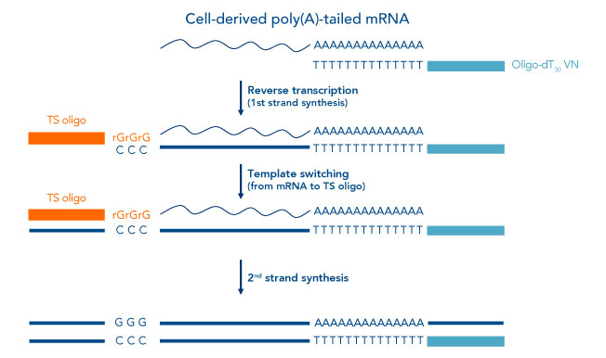
Template Switching Reaction
Aim: Increase representation of 5’ ends
Adapted from IDT website

Slide 21
Single Cell RNA Sequencing
Challenges:
  Isolation of single cells
  Low inputs of RNAs
  Small # of cells inadequate for proper analysis
    Noise
  Computational methods for single cell analysis
    Barcodes to label individual cells
  Need higher amounts of amplification
  Large scale studies = lots of $$$ to make cDNA libraries

Slide 22
Single Cell RNA Sequencing
Overcoming challenges:
  Microfluidics aid in reaction efficiency/ reduction of noise
  Lab-on-a-chip, automate cell picking vs manually
  Microwell-based approach lower cost, increased throughput
  Droplet based approaches are extremely high throughput
    nL volume for single cell rxns, 10,000’s/sec
    Partially limits cost and labor

Slide 23
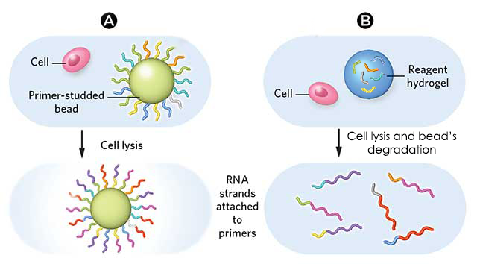
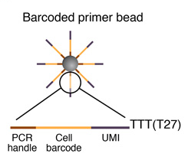
DropSeq Single Cell RNA Sequencing
Adapted from Elveflow website (Wilfred Sire)

Slide 24
DropSeq Single Cell RNA Sequencing
“Each primer contains:
a 30 bp oligo(dT) sequence to bind mRNAs;
an 8 bp molecular index to identify each mRNA strand uniquely;
a 12 bp barcode unique to each cell
a universal sequence identical across all beads”
Adapted from Illumina website

Slide 25
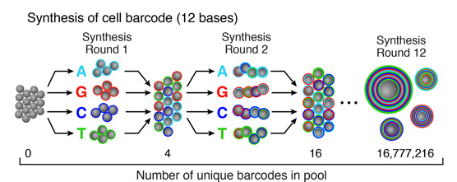
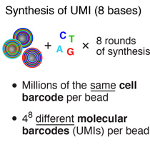
How Cell Barcodes are Made
Adapted from Elveflow website (Wilfred Sire)

Slide 26
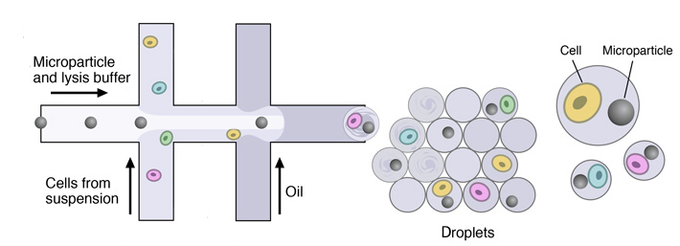
DropSeq Single Cell RNA Sequencing
Adapted from Elveflow website (Wilfred Sire)

Slide 27
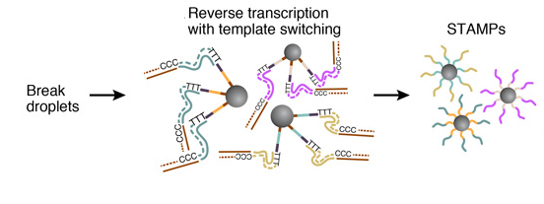
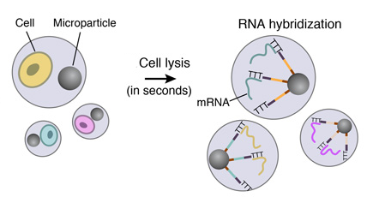
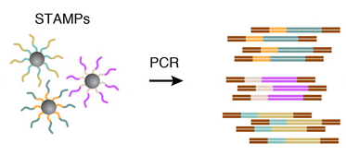
DropSeq Single Cell RNA Sequencing
STAMP = single-cell transcriptomes attached to microparticles
Adapted from Elveflow website (Wilfred Sire)

Slide 28
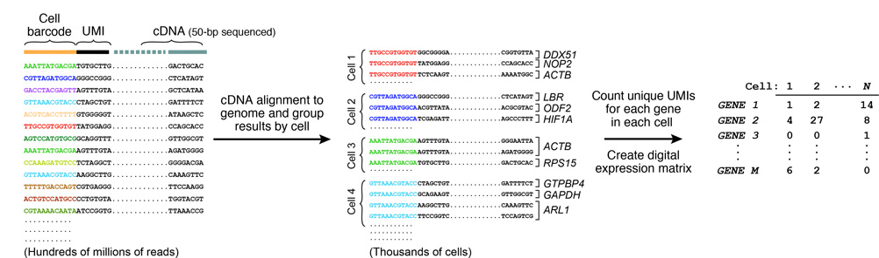
DropSeq Single Cell RNA Sequencing
Adapted from Elveflow website (Wilfred Sire)

Slide 29
inDrop Single Cell RNA Sequencing
Adapted from Illumina website

Slide 30
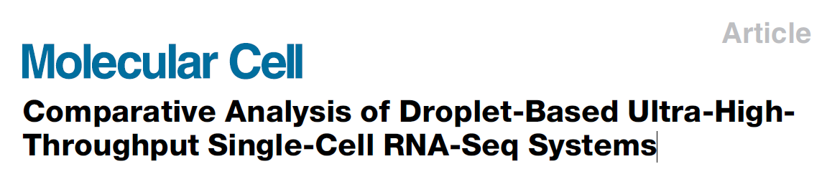
Research Article:

Slide 31
Overview of the Three Platforms, Experimental Design, and Data Analysis Pipeline
Zhang et al. (2019, Molecular Cell)

Slide 32
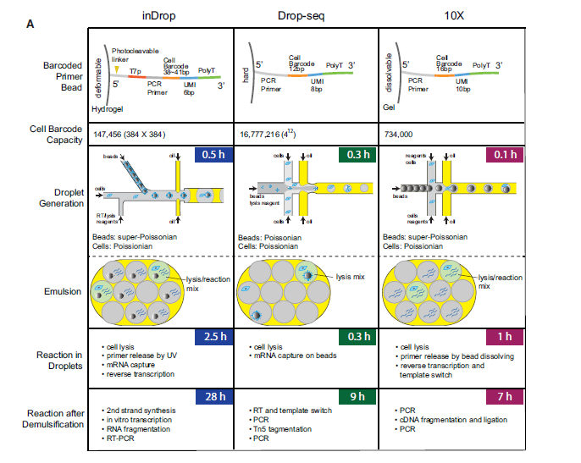
Overview of the Three Platforms, Experimental Design, and Data Analysis Pipeline
Zhang et al. (2019, Molecular Cell)

Slide 33
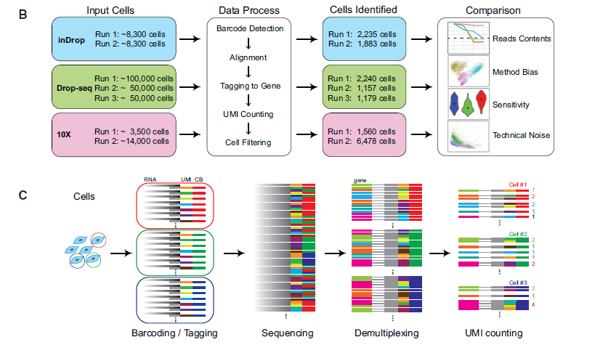
Overview of the Three Platforms, Experimental Design, and Data Analysis Pipeline
Zhang et al. (2019, Molecular Cell)

Slide 34
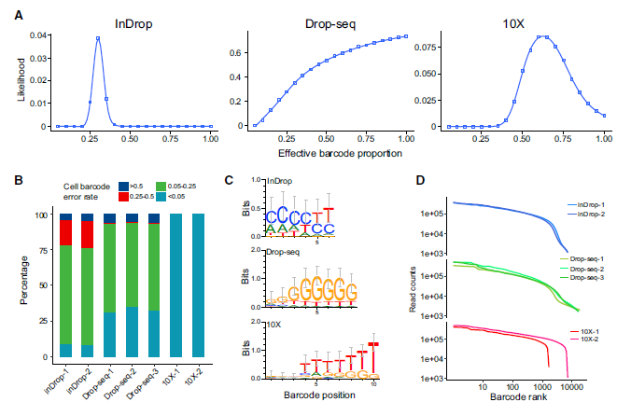
On-Bead Primer Library Size and Quality Assessment
Zhang et al. (2019, Molecular Cell)

Slide 35
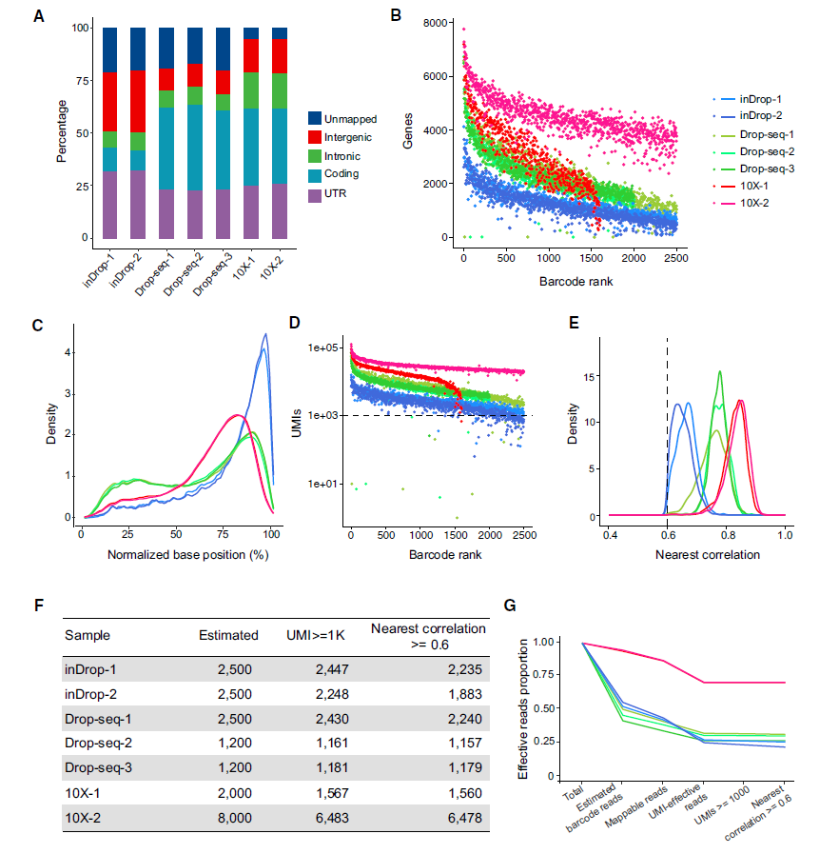
Data Processing
Steps and Results
Zhang et al. (2019, Molecular Cell)

Slide 36
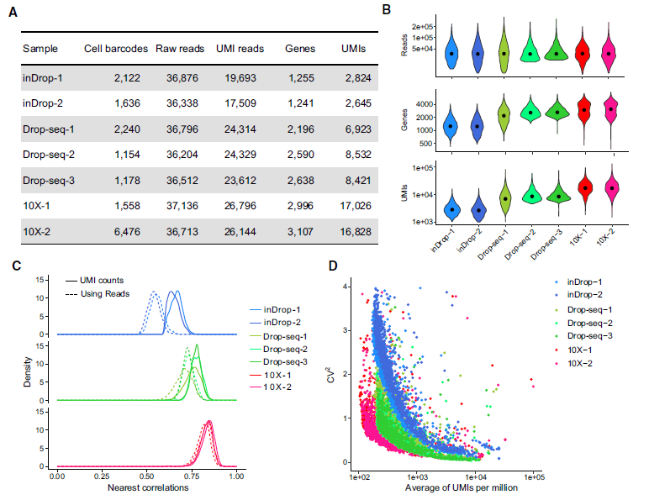
Demonstration of the Sensitivity and Technical Noise of Each Platform
Zhang et al. (2019, Molecular Cell)

Slide 37
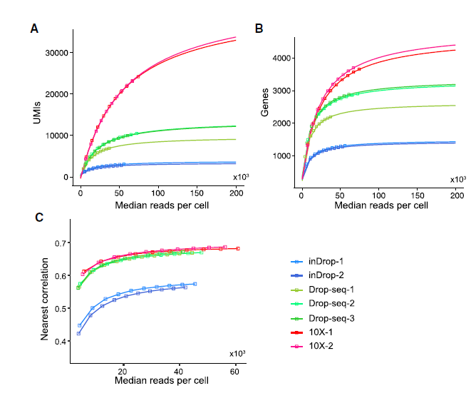
Transcriptome Analysis Sensitivity and Noise Level at Different Sequencing Depths by Subsampling Analysis
Zhang et al. (2019, Molecular Cell)

Slide 38
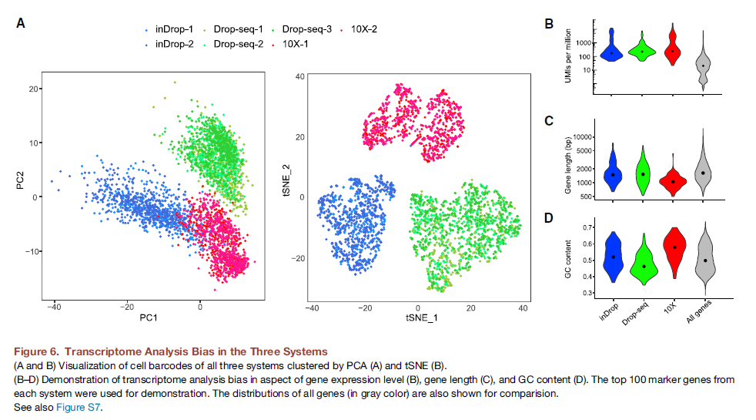
Transcriptome Analysis Bias in the Three Systems
Zhang et al. (2019, Molecular Cell)

Slide 39
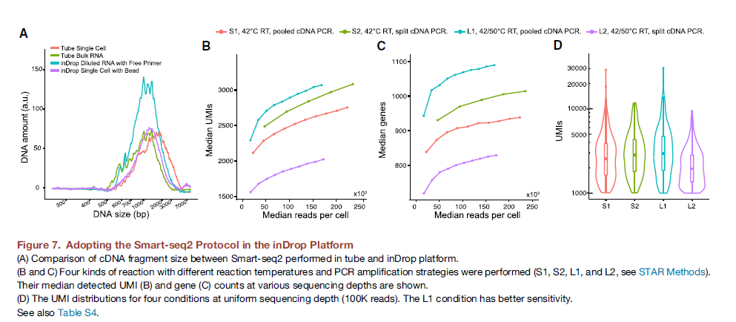
Adopting the Smart-seq2 Protocol in the inDrop Platform
Zhang et al. (2019, Molecular Cell)

Slide 40
Conclusions
DropSeq like 10x but cheaper
  $30,000 set up
  $0.10/cell
inDrop is an “open-source” version of 10X Chromium
  Both use hydrogel approach
  inDrop lower cost/ cell
  Can be modified with different RNA-seq protocols
Figure 7 delves into tweaking/optimizing inDrop

