Slide 1
BERTology
Pranav Krishna
September 22, 2020

Slide 2
What is BERTology?
The study of how BERT (and other large pretrained models) work
It’s hard to interpret billions of parameters completely!
Generally focuses on two areas:
Linguistic - how does BERT encode syntactic structure and lexical properties of words
Commonsense - how does BERT encode real-world knowledge?
This presentation will focus on Lexical and Syntactic Properties, as well as how they generalize in multilingual models

Slide 3
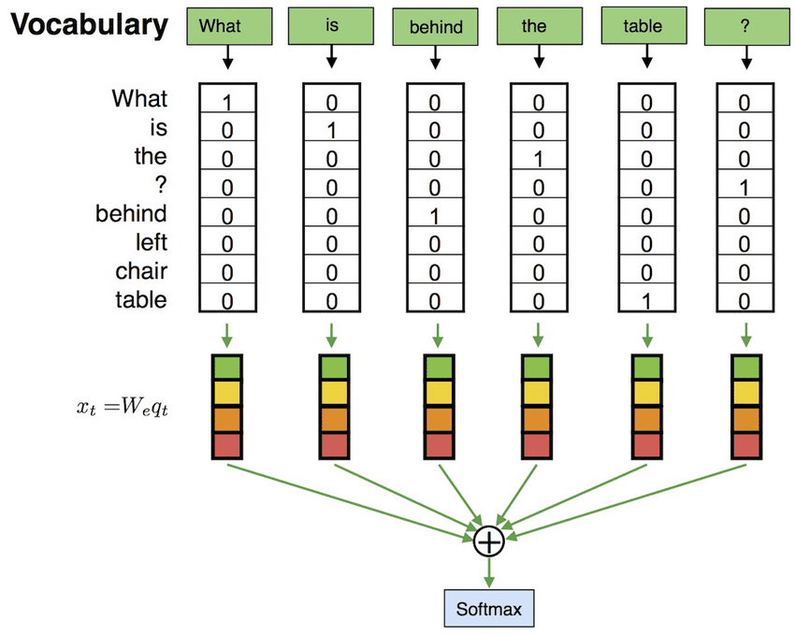
Recap: How did we get here?
Early language models used one-hot vectors directly
Enumerate all vocab in the training set/test set and map each word to a specific dimension
Bag of words model - feed in a vector of number of occurrences of each word
Few problems:
Couldn’t represent similar words that didn’t appear in the vocabulary of the training/test set well
Couldn’t account for syntactic structure
If only we had representations for words that could encode similarities in meaning/syntactic roles!
Image source: prathapkudupublog.com

Slide 4
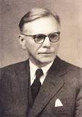
“You shall know a word by the company it keeps”

Slide 5
“You shall know a word by the company it keeps”
John Rupert Firth, 1957

Slide 6
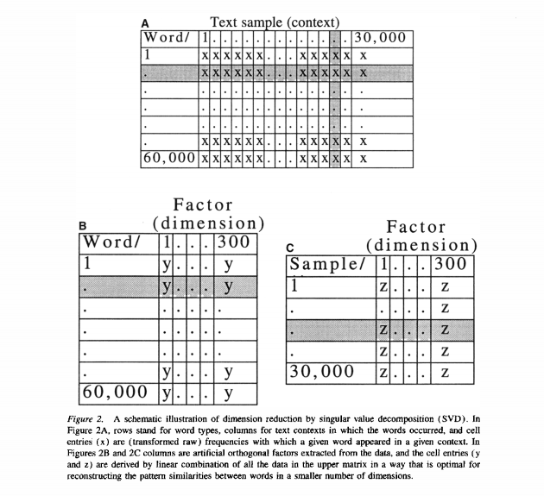
Latent Semantic Analysis (LSA)
Define similarity using the dot product (a general theme)
Take a word co-occurrence matrix
Use Single-Value Decomposition (SVD) to factor the matrix
Take the first k columns for some predetermined k
Source: (Landauer and Dumais 1997)

Slide 7
Can we do better?

Slide 8
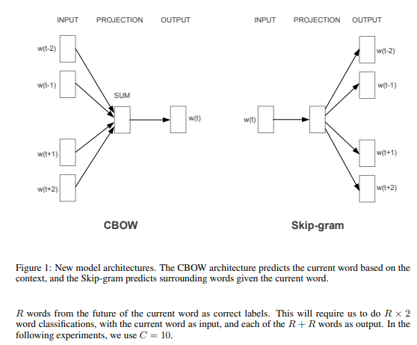
Word2Vec
Skip-gram model
Use word to predict surrounding words within a context window c
Train a 2-layer neural net without internal nonlinearities and take the first weight matrix as the word embeddings
Choose dimensions of word vectors through size of the hidden layer
Original Paper: (Mikolov et al 2013)

Slide 9
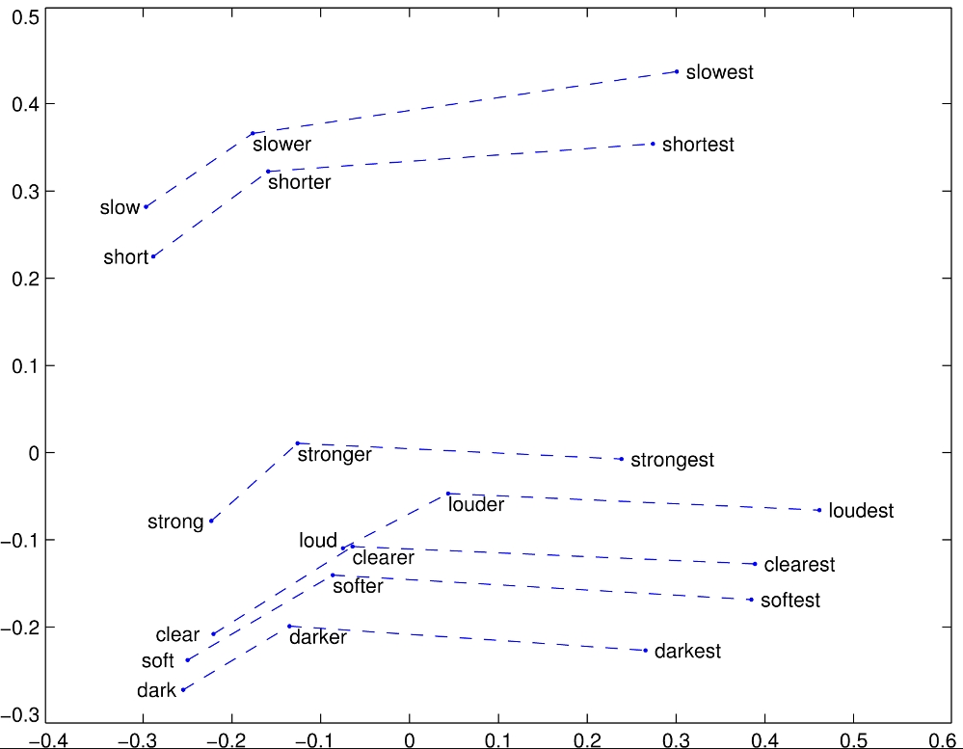
GloVe
Combines co-occurrence with the idea of predicting neighboring words.
Looks at co-occurrence ratios to determine semantic analogies
Uses the dot-product/cosine-similarity as the metric for vector comparison
Original Paper: (Pennington et al 2014)

Slide 10
Can we do much better?

Slide 11
Limitations of Connectionist Architecture
Connectionist Architecture, as defined in Fodor and Pylyshyn (1998), are:
Consist of very large numbers of simple but highly interconnected “units”
Each unit takes in real-valued inputs and normally does not much more than sum them and change their state using this sum
A connection between nodes is allowed to modify their input using a function of their weight
A combination of states of nodes represents some idea
Can it represent language, i.e. a sentence?
Fodor and Pylyshyn’s claim: no, it cannot
Any representation scheme would need to be able to uniquely represent sentences with their syntactic structure

Slide 12
Anti-Connectionist Argument
likes
Mary
John
Is the sentence “Mary likes John” or “John likes Mary”?

Slide 13
Anti-Connectionist Argument
Mary-[SUBJ]
likes
John-[OBJ]
Resolved… for now

Slide 14
Anti-Connectionist Argument
Mary-[SUBJ]
John-[OBJ]
likes
James-[SUBJ]
Sue-[OBJ]
Is the sentence “Mary likes John and James likes Sue” or “Mary likes Sue and James likes John”?

Slide 15
Anti-Connectionist Argument
Mary-[SUBJ] likes John-[OBJ]
James-[SUBJ] likes Sue-[OBJ]
Resolved? But then the number of nodes is O(number of sentences possible)!

Slide 16
Can we do better?

Slide 17

ELMo (Embeddings for Language Models)
Word embeddings are great but they exist as sort of an average of all instances of a word
We want contextualized embeddings, or those that tell us the meaning of a specific instance of a word
Idea: use multiple layers of bidirectional LSTMs, starting with normal word vectors as inputs
Use a weighted average of hidden states of the different layers; the weights are task-specific
Source: (Peters et al 2018)

Slide 18
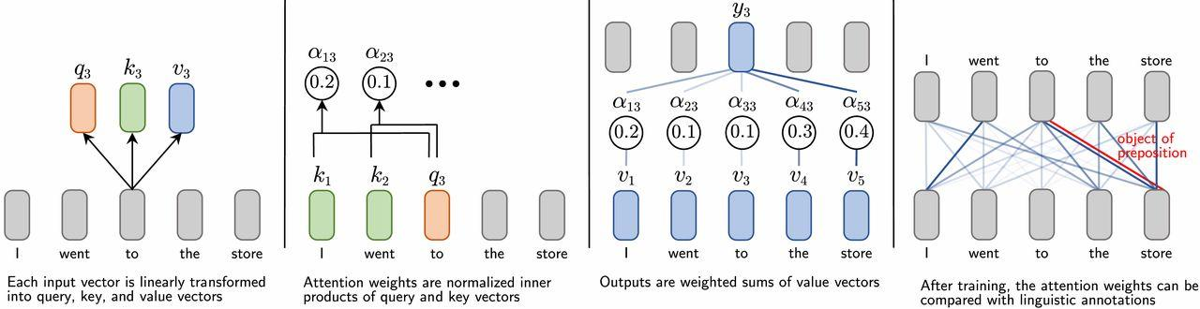
Attention and Transformers
Each vector forms into a query, key, and value vector
Compute inner dot product between query and key vectors and softmax over all the words to get a probability distribution - the weights
Output becomes a weighted sum of the value vectors, using the weights from before
Analysis of attention-based mechanisms usually involves analyzing the outputs, or the weights
(Figure: From Paper 2)

Slide 19

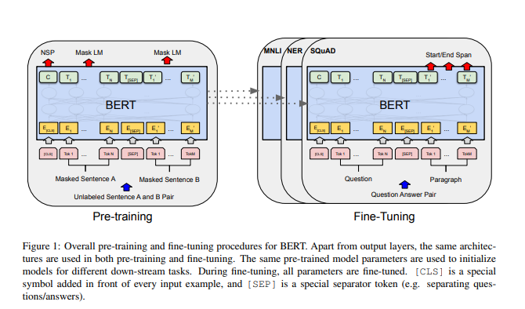
BERT: Bidirectional Encoder Representations from Transformers
Uses bidirectional self-attention, where words can attend to all words in its left and right contexts.
Starts from GloVe embeddings and goes through multiple layers of the attention (for BERT_{LARGE}, 24)
Performs exceptionally well at many tasks after fine tuning
The other key part of the “Sesame Street Revolution” of NLP
Source: (Devlin et al 2018)

Slide 20
How did we do better?

Slide 21
Paper 1: “What does BERT Look At? An Analysis of BERT’s Attention”
Kevin Clark, Urvashi Khandelwal, Omer Levy, Christopher D. Manning
ACL 2019

Slide 22
Paper 1: Overview
Many papers have analyzed BERT’s ability through model outputs and internal vector representations. This paper in particular:
Attempts to help analyze how BERT is so effective through analysis of the individual attention heads in the model
Demonstrates that many heads exhibit patterns such as:
Attending to previous or next words
Attending to delimiter tokens
Broadly attending to the whole sentence
Finds heads that seem to mirror more linguistically-aligned patterns, such as:
Coreference resolution
Mirroring certain dependency relations
Clusters similar heads together
Finds that heads in the same layer have similar functions (compared to two randomly chosen heads)

Slide 23
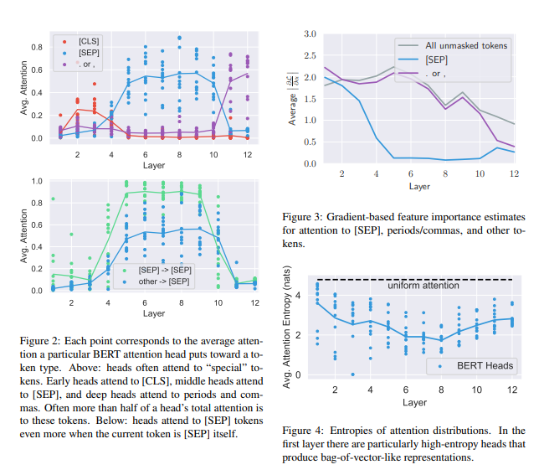
Surface-Level Analysis
Paper presented 3 preliminary questions before probing individual attention heads:
How much attention is paid to the current token?
How much attention is paid to separator tokens, and what is the function of it?
How focused/broad are the attention heads?

Slide 24
Surface-Level Analysis
Answers to these questions:
Little attention is paid; though there are certain heads that pay attention to the next or previous token
A surprisingly large amount, and there is strong evidence to suggest that paying attention to [SEP] is the equivalent of a no-op
The general trend is that attention heads are broad in the first few layers and get more focused, though [CLS] stays broad.

Slide 25
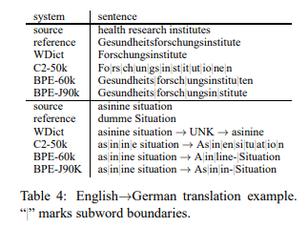
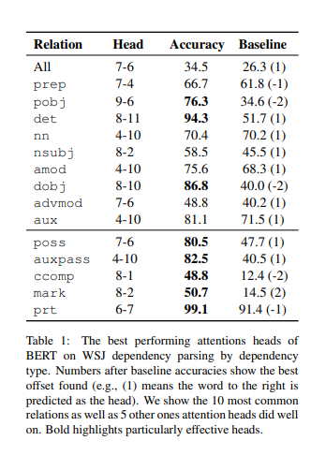
Probing Individual Attention Heads
BERT uses byte-pair tokenization (see to the right), which means some words (~8% of them) were split up into multiple pieces
Convert to word-based attention for analysis
Attention to a split up word is summed; Attention from a split up word is averaged
Preserves property that sum of attentions is 1
Define the “prediction” of a head to be the token for which the attention weight from that head is greatest
Evaluate individual attention heads on labelled corpora for certain linguistic tasks
Dependency Parsing
Coreference Resolution
Results:
No one head does well at dependency parsing
Certain heads are good at certain subtasks within dependency parsing (i.e. matching direct object to verb, etc.)
For coreference - one head (named 5-4) does quite well

Slide 26
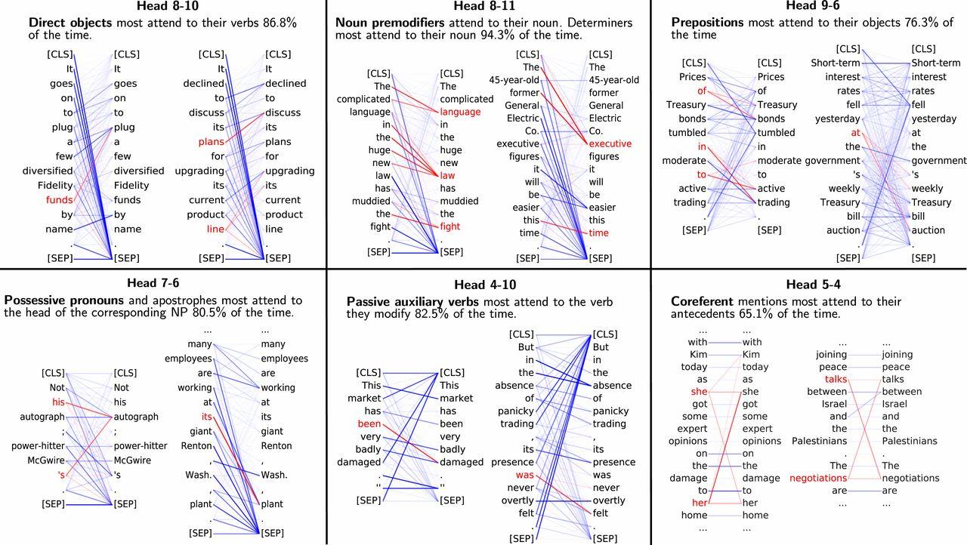

Slide 27
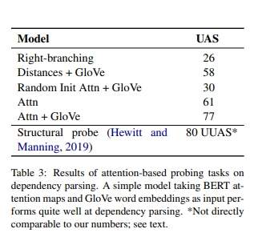


Probing Attention Head Combinations
We want to see how effective BERT heads are in combination
Train a classifier to predict the probability of word i being word j’s syntactic head
Two different classifiers:
Attention-only
Attention-and-words:
Attention + GloVe performed significantly better than baselines!

Slide 28
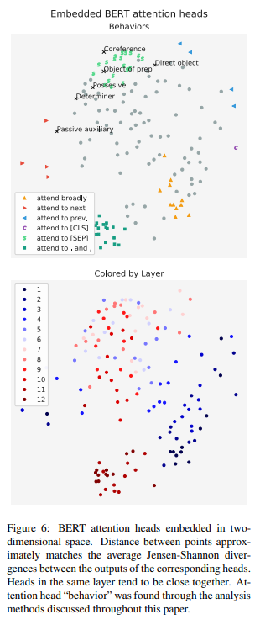

Clustering Attention Heads
Want to see which heads are similar in their probability distributions
We calculate the similarity of two nodes as:
where JS is the Jensen-Shannon divergence,
and Hi(token) is the attention weight of head i
towards the subject
Embed the results in 2 dimensions using multidimensional scaling

Slide 29
Clustering Attention Heads: Question
Heads in the same layer seem to be clustered together. This is surprising because it is seen in this paper (Tu et al 2018) that making heads disagree can help performance. Why do you think heads in similar layers are clustering together?

Slide 30
Clustering Attention Heads: Question
Heads in the same layer seem to be clustered together. This is surprising because it is seen in this paper (Tu et al 2018) that making heads disagree can help performance. Why do you think heads in similar layers are clustering together?
Proposed answer given in paper: Training with dropout causes multiple heads to need to do the same thing.

Slide 31
Conclusion
Introduced novel methods to analyze BERT that focused on attention heads
Concluded that there are heads that can fulfill linguistic tasks such as dependency parsing and coreference resolution
Substantially supplements the knowledge already gained through analyzing hidden states or surprisal during modelling

Slide 32
Visualization Tools

Slide 33
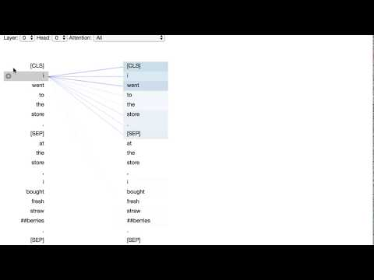
Github: bertviz
Paper: (Vig 2019)

Slide 34
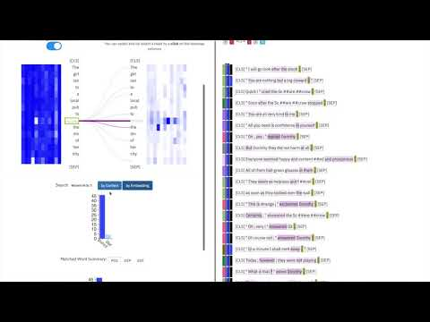
Website: exBERT
Paper: (Hoover et al 2019)

Slide 35
Paper 2: “Emergent Linguistic Structure in Artificial Neural Network Trained by Self-Supervision”
Christopher D. Manning, Kevin Clark, John Hewitt, Urvashi Khandelwal, and Omer Levy
PNAS 2020

Slide 36
Paper 2: Overview
Accepted into the Proceedings of the National Academy of Sciences - a proud accomplishment for the Computational Linguistics Community!
Develops techniques to probe BERT and other pretrained models for learned hierarchical structure
Demonstrates that BERT learns hierarchical structure on its own

Slide 37
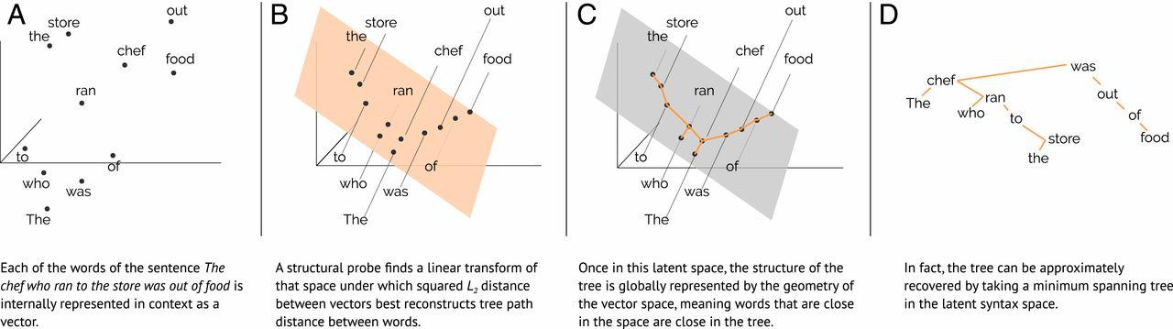
The Structural Probe
We can reanalyze the tree as a space with a distance metric d_{T}(x, y) = the length of the shortest path between nodes x and y in the dependency parsing tree.
Idea: define a new distance metric between BERT embeddings that can map best to the distance metric established by a tree

Slide 38
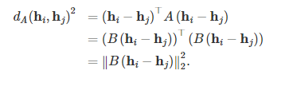

The Structural Probe
Generalized L₂ norm involves a positive semidefinite matrix A, which can always be written in the form B^{T}B for some matrix B. Gives distance of:
Minimize the objective function below, which represents the difference in distance values between the two metrics normalized for the sentence length.

Slide 39
The Structural Probe
Once B is found, one can find the minimum spanning tree of the embeddings to reconstruct the dependency parsing!
Take the constructed tree and compare with human-annotated trees
Question: This is all good, but we are ignoring one crucial fact about dependency trees - what is it?

Slide 40
The Structural Probe
Once B is found, one can find the minimum spanning tree of the embeddings to reconstruct the dependency parsing!
Take the constructed tree and compare with human-annotated trees
Answer: Dependency Trees have directed edges - order matters!

Slide 41

The Structural Probe
Introduce a new tree-based metric: the depth norm
Defined as the length of the shortest path from the root node of the tree to the target word
Consider this metric analogous to the L₂ norm, i.e. distance from the origin.
Similar to last time, we want to find a parameter B such that the following expression is minimized:

Slide 42
Evaluation
Evaluate the models based on three metrics:
UUAS: Undirected unlabelled attachment score - represents the percentage of edges that are shared between the human-labelled dependency tree and the constructed minimum spanning tree
DSpr: Distance Spearman correlation - represents how well the model’s output correlated with the actual tree-based distance
NSpr: Norm Spearman correlation - represents how well the model’s output correlated with the actual tree-based norm

Slide 43
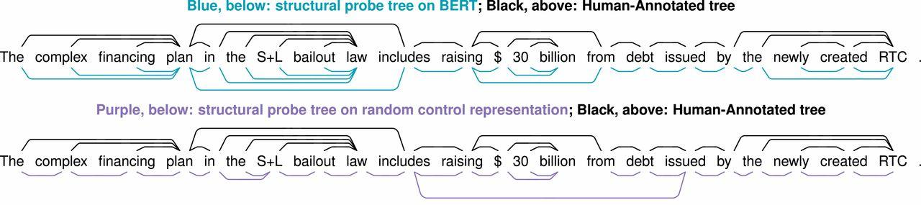
Results
In essence: BERT does really well!

Slide 44
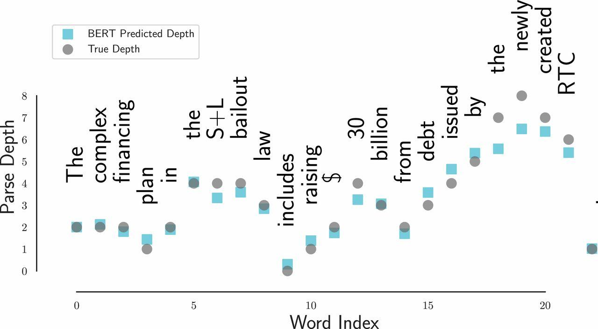
Results

Slide 45
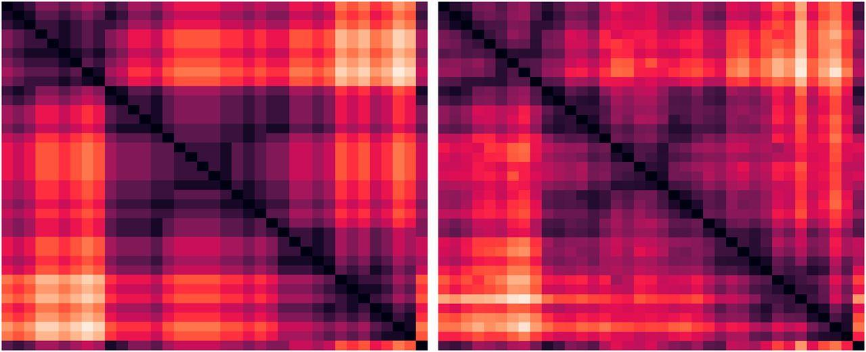
Results
Heat maps representing distance between pairs of words in the dependency parsing trees. Left is gold, right is BERT; black indicates the pair of words are closer.

Slide 46
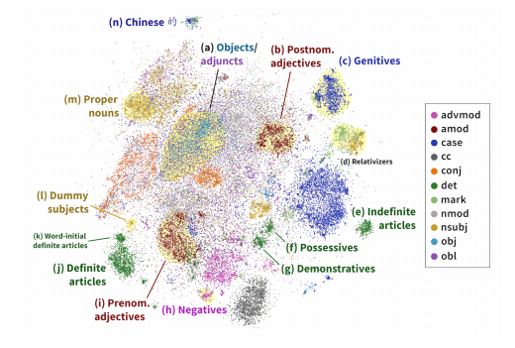
Extending it to Multilingual BERT
A recent paper at the ACL 2020 extended this method to multilingual BERT, and found similar results!
Source: (Chi et al 2020)

Slide 47
Paper 3: “Emerging Cross-Lingual Structure in Pretrained Language Models”
Alexis Conneau, Shijie Wu, Haoran Li, Luke Zettlemoyer, Veselin Stoyanov
ACL 2020

Slide 48
Paper 3: Overview
Analysis of models that are designed for Multilingual Masked Language Modelling
Tries to explain why these models are so good at cross-lingual transfer
Common “anchor point” words are not that necessary
Monolingual model representations can be aligned, revealing universal symmetries - these seem to be aligned by the models during training

Slide 49
Model Training
Followed methodology of mBERT and XLM - 15% of words masked by 80% mask tokens, 10% same word, and 10% a random word (could be foreign) in the corpus
Architectures are Transformers (8 layers, 12 heads) using the GELU activation function
Fine-tuned on:
NLI (Natural Language Inference) - XNLI dataset
NER (Named Entity Recognition) - WikiAnn dataset
Parsing (using Universal Dependencies) - 4 separate treebanks
Zero-shot transfer - fine-tune for a specific task in English and test that task in another language

Slide 50

Factor 1: Domain Sharing
Hypothesis: a reason why mBERT and XLM do well is that the multilingual corpora are all of the same domain (Wikipedia)
Test: Train models with English wikipedia and subset of Common Crawl - domain mismatch
Found a modest decrease in performance

Slide 51

Factor 2: Anchor Points
Defined as phrases that look exactly the same in both languages (i.e. “Paris” or “DNA”)
Though to be extremely important for effective cross-lingual transfer
Experiment design
Use BPE with only 40k merges (down from 80k) to test if these points help performance
Use a bilingual dictionary to replace words with translations in their target language to see if increased anchor points improves the model
Found also to have a limited effect on accuracy

Slide 52
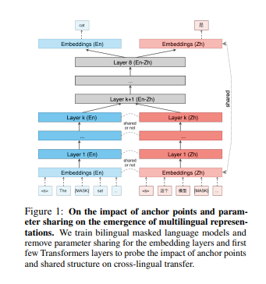
Factor 3: Parameter Sharing
We want to discover to what extent we need to share the parameters of our model to achieve good cross-lingual transfer results.
We consider separating the embeddings layers, as well as a subset of the first few layers (either 1-3, or 1-6)
Found to have a profound effect on the accuracies

Slide 53
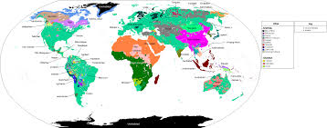
Factor 4: Language Similarity
Language similarity does have an effect on the quality of translations
Gap decreases as the number of anchor points increases
Increased complexity of the task is correlated with an increase in the gap

Slide 54
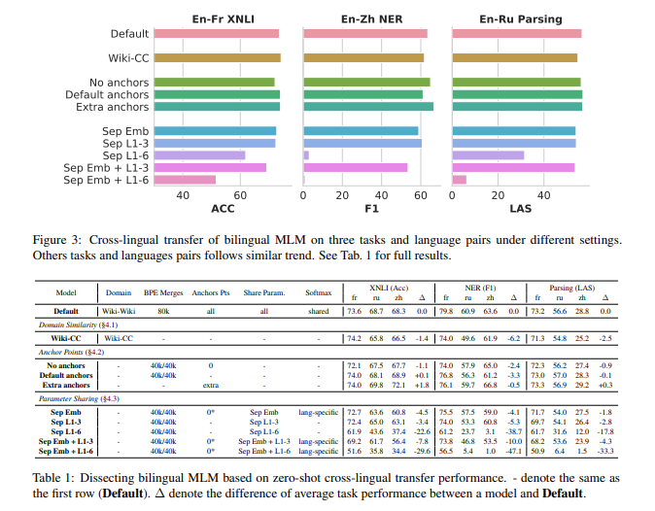
Results

Slide 55

Similarities between Monolingual BERTs
Evaluate using the Procrustes approach
X, Y are the BERT embeddings of two different models
Apply iterative normalization on X, Y - a process that ensures all word vectors have a sum of 0 and a magnitude of 1

Slide 56
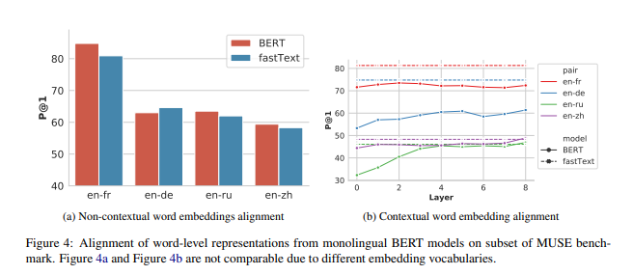
Comparing Word Embeddings
Non-contextual: take X and Y as the embeddings in the final layer of BERT, using only word with one subword
Contextual: Average the vectors of all the instances of a word within a corpus of 500K sentences
Use fastText as a baseline, and finds that monolingual BERTs align better with this metric

Slide 57
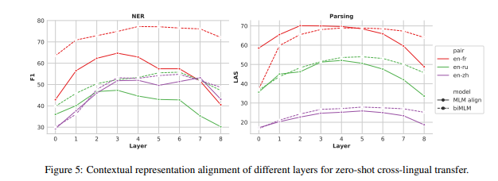
Comparing Word Embeddings: Tasks
Fine tune BERT on NER and parsing
Compare embeddings layers after keeping the bottom i layers the same from the normal language models (varied between 0 and 8)
Use the same Procrustes Method for projecting the embeddings onto each other

Slide 58
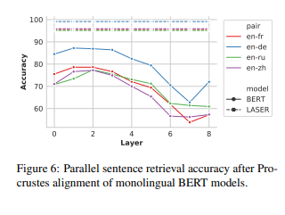
Comparing Sentence Embeddings
Uses XNLI for data
Embeddings are calculated by averaging embeddings of all the subwords in each layer
Surprising amount of accuracy given small dataset size (~10K), compared to state-of-the-art LASER (trained on millions of sentences)

Slide 59
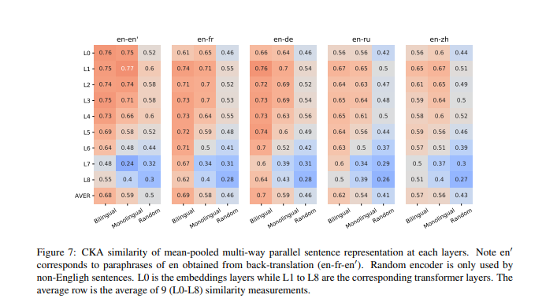

Network Similarity
Used Centered Kernel Analysis (Kornblith et al 2019) for comparison purposes
Used mean-pooling of subword representations at each layer

Slide 60
Conclusion
Anchor points and Domain Similarity, factors thought to be very important to multilingual translation, have a limited effect
Parameter sharing and language similarity have larger effects on performance
Multilingual models are actually quite similar in their embedding spaces on multiple levels

Slide 61
Paper 4: “Linking Artificial and Human Neural Representations of Language”
Jon Gauthier, Roger P. Levy
ACL 2019

Slide 62
Paper 4: Overview
Try to train a model to predict the sentence a participant saw given an fMRI signal
For sentence encoding, BERT is used and fine-tuned on a variety of Natural Language Understanding (NLU) tasks to see if any improvements can be made to the prediction model
Found that tasks that produce syntax-light representations of words correspond to improvements in prediction power of the fMRI signal
Suggests limitations on gaining syntactic information or learning about syntactic parsing from fMRI signals

Slide 63
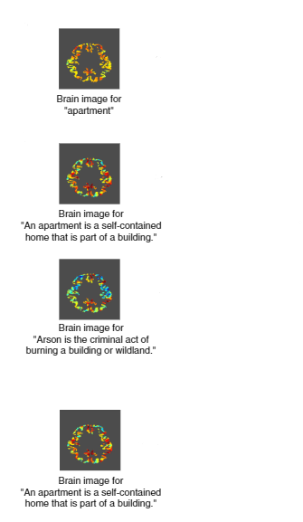

Data and Representations
fMRI signals: first encoded into a ~200,000 dimensional vector representing the activity levels of different voxels (small 3D subsections of the brain)
Use PCA to reduce this to a set of 256-dimensional vectors
Sentence Representations: taken from a fine-tuned BERT on some task T
The representations r(x) of sentences x are (practically) linearly separable in the output classes y of the task T; A is an affine transformation
Source for image, MRI dataset: (Pereira et al 2018)

Slide 64
The Models
Various NLU tasks:
Paraphrase Classification with Quora Question Pairs
Question Answering with SQuAD 2.0
Natural Language Inference with MNLI
Sentiment Analysis with SST-2
Various Custom Tasks
LM-scrambled: BERT is fine-tuned on scrambled text, though words stay within their sentences
LM-scrambled-para: BERT is fine-tuned on scrambled text with words staying within their paragraphs
LM-pos: BERT is fine-tuned on a task where it only needs to predict the part of speech of the masked word
LM control: BERT fine-tuned on a Book Corpus for language modelling.
Various Baselines:
Baseline BERT with no fine-tuning
Baseline word embeddings (GloVe)

Slide 65


Brain fMRI Decoding
Given “brain vectors” for each sentence, we learn a linear mapping to sentence representations from the various models through minimizing a regularized loss:
Evaluate this mapping using two separate metric:
Mean-Squared Error in prediction of model activations
Average Rank: find the rank of the actual sentence among a list of nearest-neighbors to prediction sentence (by cosine distance)

Slide 66
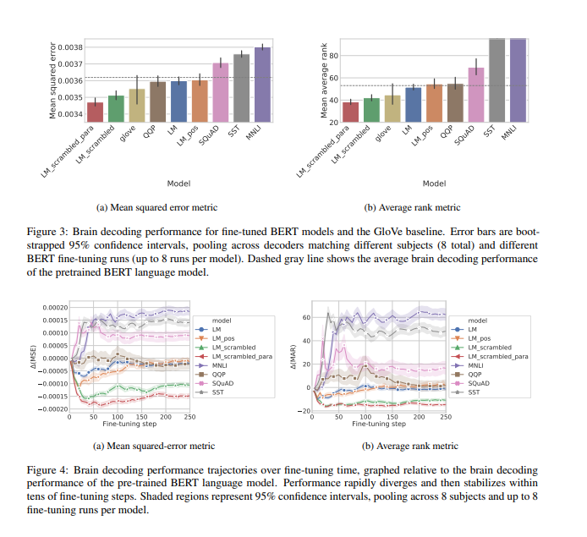
Results
Fine tuning on NLU resulted in increases in error
Curiously, LM-scrambled and LM-scrambled-para did the best out of all the models
LM-pos and LM did slightly better than the BERT baseline in terms of MSE, but no change in AR

Slide 67
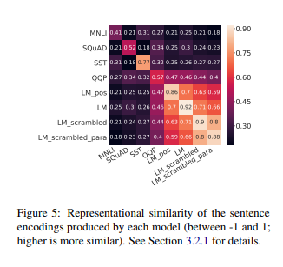
Representational Analysis
Compute how similar the representations of models are using Representational Similarity Analysis (Kriegeskorte et al 2008)
All models except the two scrambled ones diverge from each other significantly
Representations aren’t that self-consistent either

Slide 68
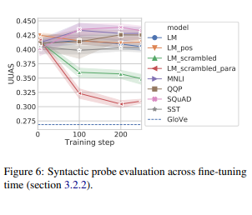
Role of Syntax
Due to the unexpected high performance of BERT fine-tuned on scrambled sentences, we should investigate - does syntactic information negatively correlate with fMRI scan decoding?
Measures syntactic content using Structural Probe (from Paper 2) - and finds that yes, the relatively successful models have less syntactic information

Slide 69
Discussion Question
How do the results in this experiment compare with the conclusions drawn in the Fodor and Pylyshyn (1998) paper? Is it likely that the brain mirrors connectionist architecture?

Slide 70
Conclusions
Unlikely to be able to find fine-grained syntactic information through analyzing fMRI scans
Could be the result of limitations in the hypotheses tested:
Linear Linking Hypothesis - the way the brain was decoded corresponded to a linear map between brain encodings and sentence representations, which may not necessarily be true
Data - the participants whose brain scans were analyzed were simply asked to think about the sentence, which may correlate with more shallow sentence representations, allowing them to map better with the representations created by LM-scrambled and LM-scrambled-para
Findings are compatible with the idea that some syntactic features are encoded in the brain

Slide 71
Discussion Questions

Slide 72
Question 1: Why should we care?
A short paper at the ACL 2020, entitled “Overestimation of Syntactic Representation in Neural Language Models (Kodner and Gupta 2020)”, presented an experiment where they trained an n-gram model and an LSTM with scrambled inputs and still got positive results for a syntactic understanding task.
This begs the following question: are the results of all the papers I presented statistically
significant? Will there be a time where enough parameters are used in language models such
that any randomized initialization of the model’s parameters can be probed for “syntactic structure”?

Slide 73
Question 2: Fodor’s Folly
As mentioned in this paper, despite Fodor’s claims that connectionist architecture would never be able to efficiently and effectively represent necessary structural components of language, we can see that BERT is largely successful in a variety of tasks, and seem to represent syntactic structure very well.
Is there a flaw in Fodor’s logic? If so, what? How can BERT enjoy success despite being a type of connectionist architecture?

Slide 74
Question 3: Diverging Fields
We have seen that over the years, Natural Language Processing has drifted further and further away from Linguistics, as encapsulated by a quote attributed to Frederick Jelinek - “Every time I fire a linguist, my performance goes up”.
How relevant are the two fields to each other, and how can we bridge the gap (or should we attempt to in the first place)? What can Linguistics and Deep Learning Contribute to each other?

Slide 75
For the future
Tal Linzen (JHU) wrote an article describing how Linguistics and Deep Learning can still have a symbiotic relationship with each other
Using linguistics as a normative standard, i.e. to evaluate models based on its ability to capture a specific linguistics phenomenon
Using test suites designed in psycholinguistic settings to do the first bullet point efficiently (as existing datasets might be too small/limited)
Using neural architectures to determine innate biases when it comes to language acquisition
Using neural architectures to model human sentence processing
Hopefully they will still continue this relationship for years to come!

