Slide 1
ANLP: Semantic Parsing
Aarohi Srivastava
CPSC 677 Fall 2020

Slide 2
Outline
Background
Papers
1. Transforming Dependency Structures to Logical Forms for Semantic Parsing
2. Exploring Unexplored Generalization Challenges for Cross-Database Semantic Parsing
3. Decoupling Structure and Lexicon for Zero-Shot Semantic Parsing
4. Bootstrapping a Crosslingual Semantic Parser
Discussion Questions

Slide 3
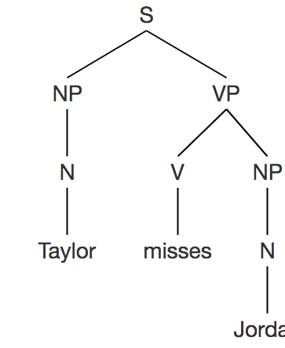
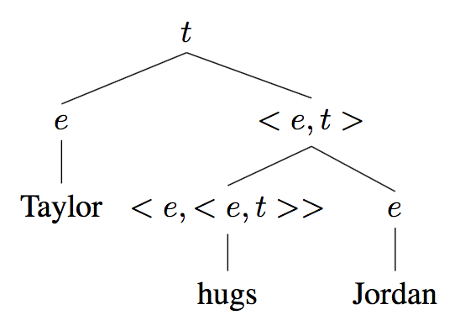
Syntactic and Semantic Parsing
Syntactic parsing: hierarchical representation of natural language.
Semantic parsing: mapping natural language to logical form.
λy.[λx.x hugs y] or λy.[λx.hugs(x,y)]
x = Taylor, y = Jordan
subject/object relationship preserved
Or
hugs
Jordan
Notes:
A semantic parse of an utterance often builds on the syntactic parse, though it is not necessary.

Slide 4
Syntax-Semantics Interface: CCG Parsing
Syntax: Utah borders Idaho.
Each word corresponds to a syntactic type:
Utah: NP
borders: (S \ NP) / NP
Idaho: NP
Constituents are composed to the head:
‘\NP’: object NP from the right
‘/NP’: subject NP from the left
(S \ NP) → borders Idaho
[borders Idaho] / NP → Utah borders Idaho
Notes:
CCG parsing is a great way to see this syntax-semantic interface:

Slide 5

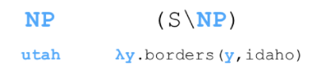

Syntax-Semantics Interface: CCG Parsing
Semantics: Utah borders Idaho.
The (S \ NP) / NP structure indicates that borders is a predicate with two arguments:
and borders Idaho is a predicate with one argument:
→
Images from Ellie Pavlick’s slides on Sentence Representation Learning: Theories of Semantic Representation

Slide 6
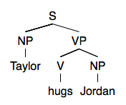
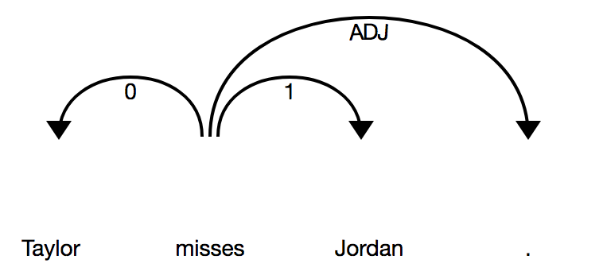
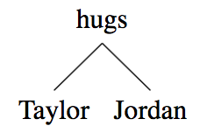
Dependency Parse
Popular for syntactic parsing
Easier to annotate
Significant advances to develop fast and accurate dependency parses for many languages
McDonald et al., 2005
Nivre et al., 2007
Martins et al., 2013
Dependency Parse Derivation Tree
Derived Syntax Parse Tree
Taylor hugs Jordan

Slide 7
Semantic Types and Composition
Basic types: entities (e) and truth values (t)
<e, t> takes in an entity and outputs a truth value

Slide 8
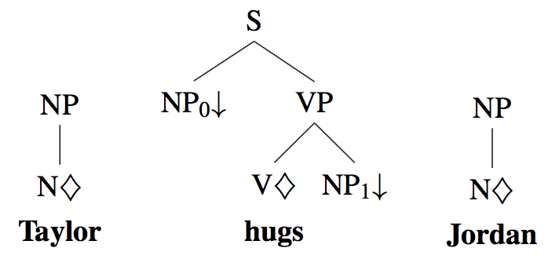
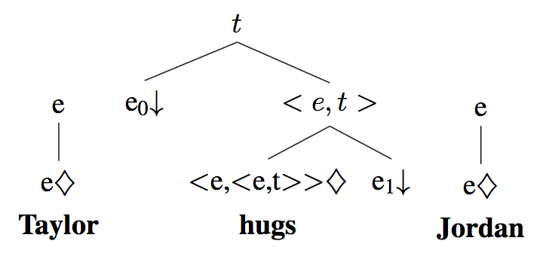
Syntactic and Synchronous Parsing
Via strongly-typed grammars (TAG, CCG)
Syntactic types
Derivation tree (from dependency parse)
Semantic types
Derivation tree (from dependency parse)

Slide 9
Meaning Representations
Mary eats cheese.
First order predicate logic:
∃x∃y: Mary(x) ∧ cheese(y) ∧ eats(x, y)
Lambda calculus:
transitive: λy.[λx.x eats y]
x: Mary, y: cheese
Prolog:
eats(Mary, cheese)
SQL: Who eats cheese?
SELECT name
FROM people
WHERE current_food = ‘cheese’
Notes:
In addition to strongly-typed grammars like CCG and TAG, as well as AMR which we learned about last week, ...

Slide 10
Datasets
ATIS (Hemphill et al., 1990; Dahl et al., 1994)
~800 queries for flights database paired with lambda calculus form
Geoquery (Zelle and Mooney, 1996)
880 questions about US geography
Free917 (Bollacker et al., 2007; Cai and Bates 2013)
917 NL questions manually annotated with their Freebase query
WebQuestions (Berant et al., 2013)
5810 question-answer pairs
Overnight (Wang et al., 2015)
13,682 examples of utterance-logical form pairs across 8 domains
Spider (Yu et al., 2018)
10,181 questions: large-scale text-to-SQL cross-domain semantic parsing

Slide 11
Applications
Database query
Zettlemoyer and Collins, 2005; Wong and Mooney, 2006
Robotics
Chen and Mooney, 2011
Information extraction
Krishnamurthy and Mitchell, 2012
Visual scene captioning
Matuszek et al., 2012

Slide 12
Paper 1: Transforming Dependency Structures to Logical Forms for Semantic Parsing
Reddy et al., 2016 (TACL)

Slide 13
Significance
Makes use of foundational ideas in semantic parsing and discusses a useful new meaning representation in detail.
Developed important approach of semantic parsing: from syntactic dependency trees to logical form, which takes advantage of the wealth of dependency-parsed data and the low annotation effort of this method. Useful for the direction of future research (Papers 2-4) exploring cross-domain and cross-lingual semantic parsing.
Achieved SOTA performance at the time on popular datasets.
Notes:
Motivation: Dependency structures are easier to annotate than strongly-typed grammars and are thus popular for syntactic parsing tasks; however, because they do not follow a grammar, it is difficult to derive logical forms from dependency structures. If we can derive an MR from dependency structures, we can take advantage of the significantly lower annotation effort (e.g., for future domain adaptation / multilingual tasks), as well as the existing wealth of syntactically-parsed data due to the popularity of dependency parsing.

Slide 14
Summary
Logical forms that represent underlying predicate-argument structures
They introduced a new type system: constituent → a single type
Motivation: no need for type checking.
Type system useful in syntactically complex cases (that do not mirror typical predicate-arg relationships): conjunctions, prepositional phrases, relative clauses, wh-questions .
These are ungrounded logical forms.

Slide 15
GraphParser
Used GraphParser (Reddy et al., 2014): logical predicates → Freebase
Result: grounded Freebase queries
With GraphParser: SOTA performance
Without GraphParser (directly dependency tree → Freebase query): significantly lower

Slide 16
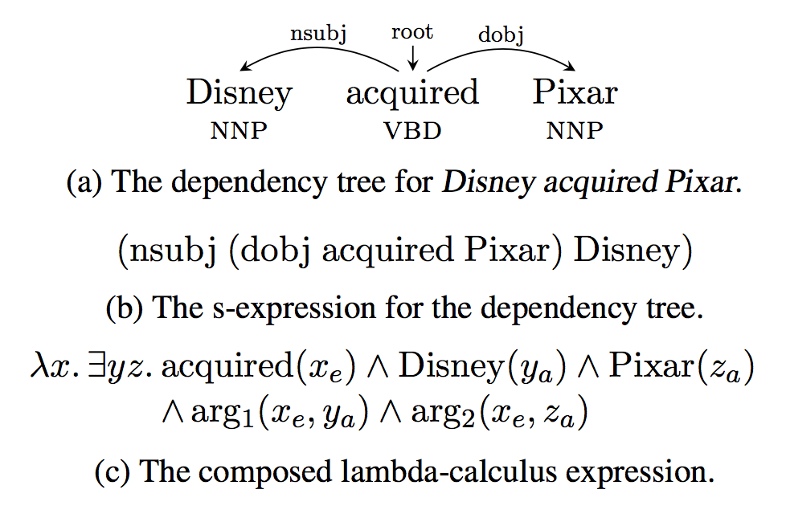
DepLambda: dependency tree → s-expression → lambda calculus
Dependency tree binarized to give s-expression.
An s-expression describes how functions are applied to args.
Each node of s-expression is substituted for a lambda calculus expression.
This relabeled s-expression is beta-reduced to give logical form.
Images from Reddy et al., 2016

Slide 17
Logical Forms
Three base types:
individuals (Ind)
nouns
events (Event)
verbs
truth values (Bool)
full sentence
Variable x
Type: Ind x Event
X = (x_{a}, x_{e})
Notes:
Dependency labels (exp1) always have type n → (n → n)
Where exp2 and exp3 both have type n, and the full expression has type n

Slide 18
Constituents as Lambda Calculus Expressions
Rule: All natural language constituents have a lambda calculus expression of type Ind x Event → Bool
Helps simplicity and robustness of resultant system
Motivation example:
President in 2009
λx. ∃y. president(xa) ∧ president event(xe) ∧arg1(xe, xa) ∧ 2009(ya) ∧ prep.in(xe, ya)
Difficulty with some linguistic constructions
Spurious variables are easily identified and discarded
Notes:
Constituent - single word or s-expression

Slide 19
Example:
Disney acquired Pixar.
Acquired: λx. acquired(x_{e})
Disney: λy.Disney(y_{a})
Pixar: λz.Pixar(z_{a})
λx. ∃yz. acquired(x_{e}) ∧ Disney(y_{a}) ∧ Pixar(z_{a}) ∧ arg1(x_{e}, y_{a}) ∧ arg2(x_{e}, z_{a})

Slide 20
Step 1: Binarization
Map a dependency tree to an s-expression
Recursive definition of s-expression:
Form (exp1 exp2 exp3)
Exp1: dependency label
Exp2 and exp3: word OR s-expression
Strict ordering on the modifiers to each head in the dependency tree
Ex: in (nsubj (dobj acquired Pixar) Disney), dobj must attach before nsubj

Slide 21
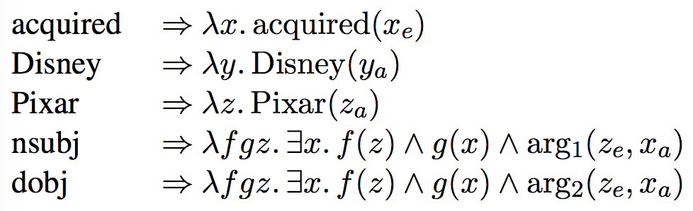
Step 2: Substitution
Each symbol in the s-expression is assigned a lambda expression
Images from Reddy et al., 2016

Slide 22
Step 3: Composition
Compose lambda expression terms using beta reduction
Result of composition operation mirrors dependency structure
result is isomorphic to the original dependency structure
(dobj acquired Pixar) is the innermost s-expression, so let’s start there:
Z_{e} and x_{a} correspond to acquired and Pixar; arg2 corresponds to dependency relation acquired → Pixar
Images from Reddy et al., 2016
Notes:
(exp1 exp2 exp3): function exp1 is applied to args exp2 and exp3

Slide 23
Graph Matching for Semantic Parsing
Great, now we have the ungrounded logical forms! How do we get grounded semantic representation to answer questions with Freebase?
Manually assembled question-answer pairs
For each training question:
Find the set of oracle grounded graphs - Freebase subgraphs that yield the correct answer and are derivable from the question’s logical form
Oracle graphs are used to train a structured perceptron model

Slide 24
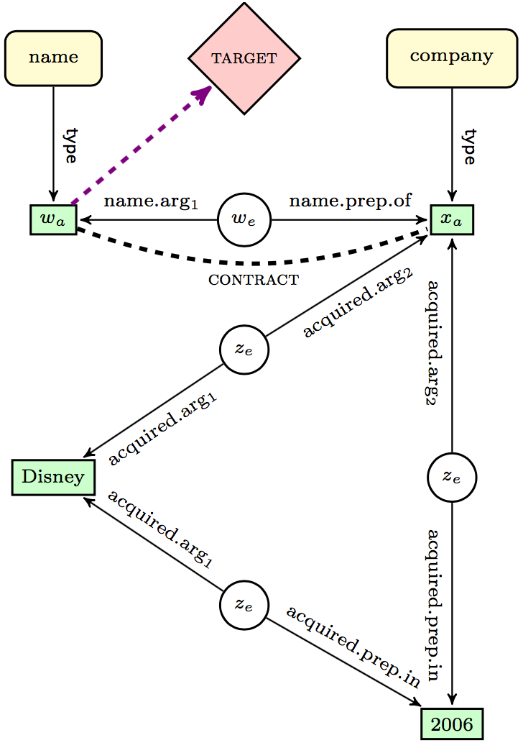
Ungrounded Graph
What is the name of the company which Disney acquired in 2006?
Green rectangles: resolved entities vs. entity predicates
Disney(y_{a}) vs. name(w_{a})
Target(w_{a}) node connects to the entity node whose denotation corresponds to the answer
Grounding: ungrounded graph → Freebase subgraph
Entity nodes → Freebase entities
Entity-entity edges → Freebase relations
Entity type nodes → Freebase types
Images from Reddy et al., 2016

Slide 25
Entity Resolution Algorithm
For Free917: string matching against the entry lexicon provided in the dataset.
For WebQuestions:
Entity span candidates are identified using handcrafted POS patterns
Using Stanford CoreNLP caseless tagger
For each candidate:
Retrieve top 10 entities via Freebase API
Create lattice:
Nodes correspond to mention-entity pairs.
Edges verify that span does not overlap in a joint assignment from entities to mentions.
Top 10 paths through the lattice yield ungrounded graphs.
Nodes scored via Freebase API.
Final entity disambiguation among these ungrounded graphs is done at a later stage.

Slide 26
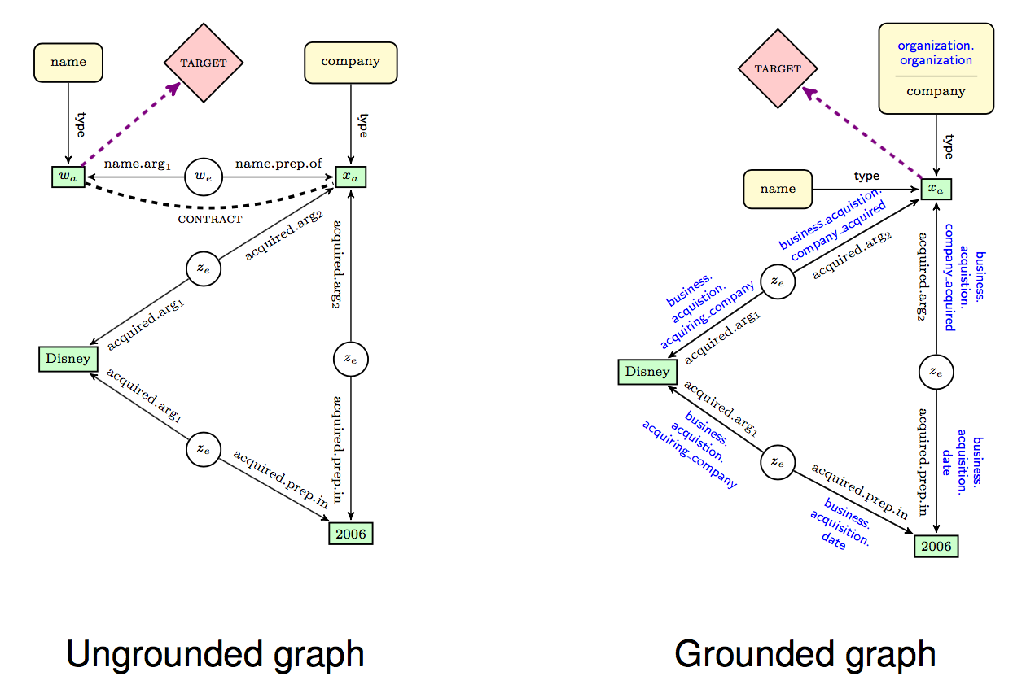
contract
→
Images from Reddy et al., 2016
Notes:
2 operations introduced because ungrounded and Freebase subgraphs are not necessarily isomorphic: Contract and Expand
Contract: merge entity node pair (2 entities connected by an edge)

Slide 27
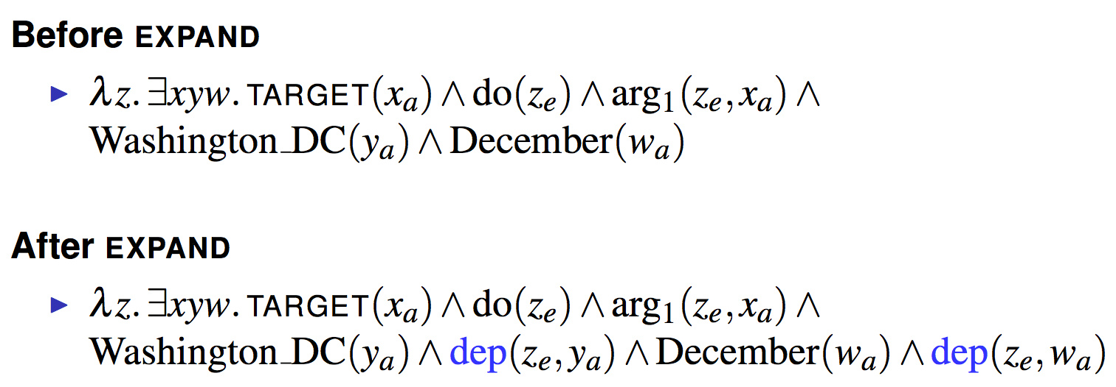
Expand Operation
To deal with parse errors leading to disconnected components; also deals with ungrammatical user input.
What to do Washington DC December?
Images from Reddy et al., 2016

Slide 28
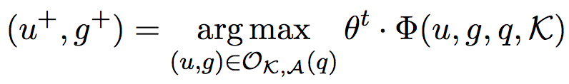
Learning
Model: ungrounded → grounded graphs
Supervised via question-answer pairs
Instead of “gold” graphs, oracle graphs are obtained beforehand to get all grounded graphs reachable by the ungrounded graph.
O_{K,A}(q): set of pairs (u, g) derivable from the question q whose denotation has minimal F1-loss against the gold answer A.
q = question
u = ungrounded graph for q
K = knowledge base
g = grounded graph
Images from Reddy et al., 2016
Notes:
Grounded graph: Nodes and edges of u grounded to knowledge base K

Slide 29
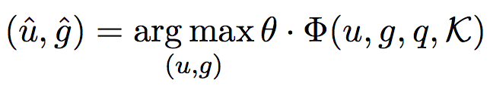
Structured Perceptron + Beam Search
To find highest scoring pair of ungrounded and grounded graphs under the model θ
q = question
u = ungrounded graph for q
K = knowledge base
g = grounded graph
features for (u, g)
Features: edge alignment, stem overlap, contextual features, indication of use of Contract operation
Beam search over entity-entity edges and entity type nodes of each ungrounded graph
Images from Reddy et al., 2016

Slide 30
Experimental Setup
Baseline representations tested (in addition to their new DepLambda)
DepTree
Ungrounded graph is created directly from original dependency tree
Dependents linked to event with edge labeled “rel”
Parent linked to event with edge labeled arg0
Target pred attached to wh-/question word
SimpleGraph (adapted from Yao 2015; Bast and Haussmann 2015)
All entities are connected to a single event with predicate arg1
Target node connected to event with predicate arg0
Cannot represent compositional structure
CCGGraph (Reddy et al. 2014)

Slide 31
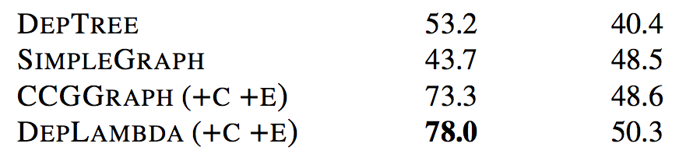
Results
Free917 WebQuestions
Images from Reddy et al., 2016

Slide 32
Error Analysis (DepLambda)
Of 100 errors:
43: correct answer present in the beam (at lower rank)
35: subset of the answer is correct
What countries in the world speak German?
Answer: only Germany
10: missing/unknown entities
9: incomplete gold annotation
3: structural mismatch
Who is the new governor of Florida 2011?

Slide 33
Paper 2: Exploring Unexplored Generalization Challenges for Cross-Database Semantic Parsing
Suhr et al., 2020 (ACL)

Slide 34
Significance
Analyzed cross-database semantic parsing for NL → SQL system when evaluated on unseen databases/domains.
Challenges in contemporary semantic parsing:
Reliance on domain-specific meaning representation and/or task-specific evaluation.
Even SOTA systems face difficulty in generalizing / for out-of-domain use.
This paper does a great job of summarizing the big areas in which semantic parsing is currently lacking today to inform the direction of future work.

Slide 35
Cross-Domain Semantic Parsing
Single-database semantic parsing (SSP) vs. cross-database semantic parsing (XSP)
The issue is circular: even if we create a multi-domain database for semantic parsing and evaluate on that, we are still restricted to that dataset designed for the task of XSP.
Their approach: Train a model (accounting for generalization challenges) on XSP dataset and evaluate on several domains/datasets.

Slide 36
Error Analysis
40%: entity-column matching
31.3%: missing constraint (e.g., failing to use a relevant entity in the predicted query)
28.8%: entity identification and copying (e.g., entity span)
26.9%: dataset conventions
20.0%: domain-specific phrases

Slide 37
Method and Metric
Single model trained on XSP dataset and evaluated separately on several evaluation datasets (SSP and XSP).
Datasets originally designed for SSP more difficult in XSP setting.
Evaluation metric: execution accuracy
# events when: output table of predicted query when executed on database = output of correct query
Total # events

Slide 38
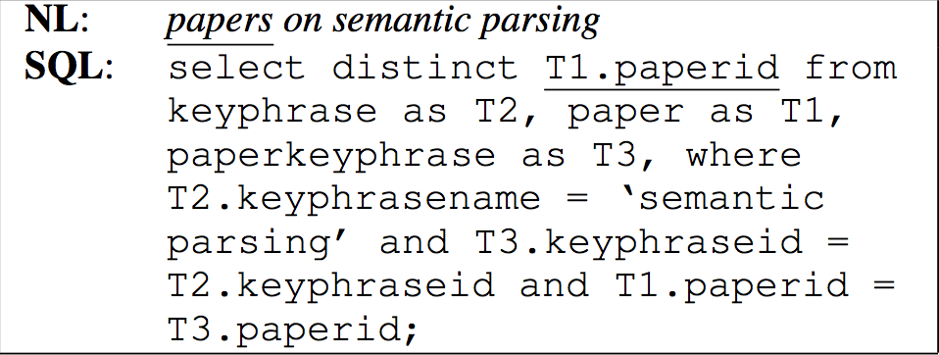
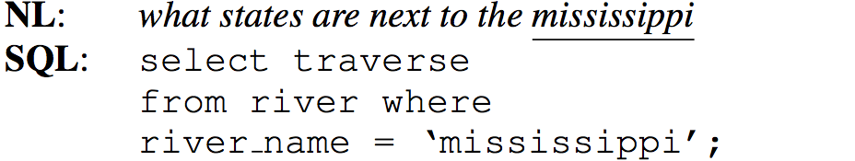
Generalization Challenges
Language variation across domains
Identifying entities
Mapping entities to columns
Domain-specific phrases
Novel database and query structures
Dataset conventions
Images from Suhr et al., 2020

Slide 39



Model and Learning
Input to encoder: utterance x̅ + database schema S (first through BERT)
Paired with gold SQL queries
Decoder: autoregressive transformer
Database schema:
t_{i}: table serialization = tokenization of table name + serialization of columns
Column serialization: column type (numerical, text, etc.) + tokenization of column name
Encoder-decoder trained end-to-end
Objective: minimize token-level cross-entropy loss of gold query
Training database does not include examples from evaluation database
Images from Suhr et al., 2020

Slide 40
Generalization Strategies
Value copying
Decoder output step: distribution over possible actions (e.g., copy token from input)
If copy action selected: mask invalid copy actions.
Multiple data sources
Training data: Spider and WikiSQL
Spider - XSP (grounded in multi-table databases)
Performed competitively well on Spider
WikiSQL - compositionally simple; SSP
Improves generalization

Slide 41
Paper 3: Decoupling Structure and Lexicon for Zero-Shot Semantic Parsing
Herzig and Berant, 2018

Slide 42
Significance
Zero-shot approach to semantic parsing.
Parses input from unseen domains (not among training source domains).
Pipeline:
Utterance →
abstract, domain independent logical form w/ slots →
lexical alignment and global inference →
logical form w/ KB constants
KB constants - relations and entities specific to a knowledge-base
Highlights why XSP is difficult (conceptually).
Presents a promising, abstract method of XSP.

Slide 43
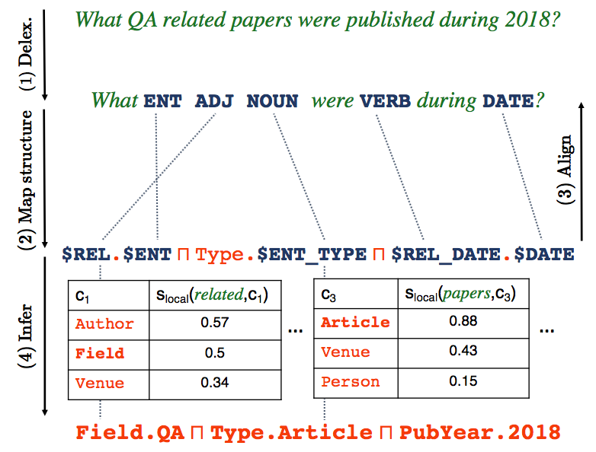
Images from Herzig and Berant, 2018

Slide 44
Key Idea
Principle: language is composed the same way across domains, even when vocabulary and KB constants change.
Herzig and Berant, 2017; Su and Yan, 2017; Fan et al., 2017; Richardson et al., 2018
Goal: structure of natural language → abstract logical form; abstract away domain-specific information.

Slide 45
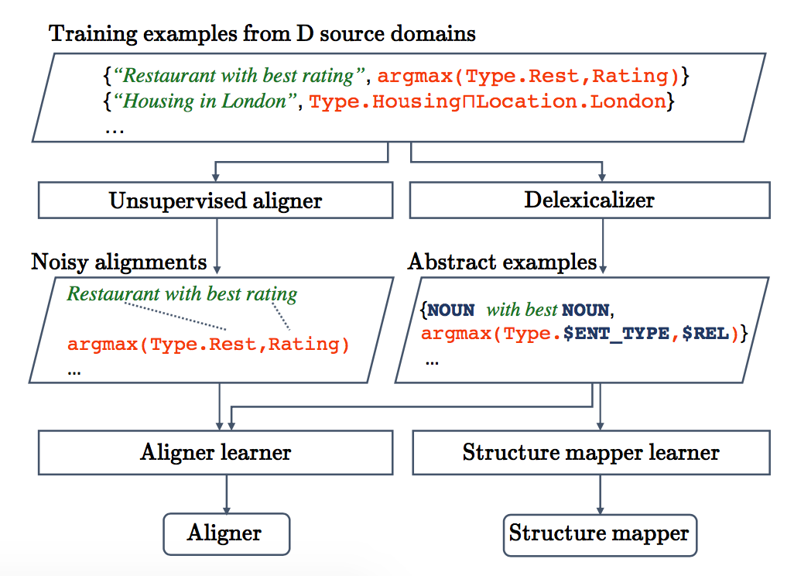
Images from Herzig and Berant, 2018
Notes:
2 models to decouple structure from lexicon:
Structure mapper: abstract utterances → abstract logical forms
Aligner that aligns abstract logical form to abstract utterance tokens

Slide 46
Step 1: Delexicalization
From input utterance: remove domain-specific components while preserving domain-independent parts.
Output: abstract representation that accommodates structural linguistic regularities across domains.

Slide 47
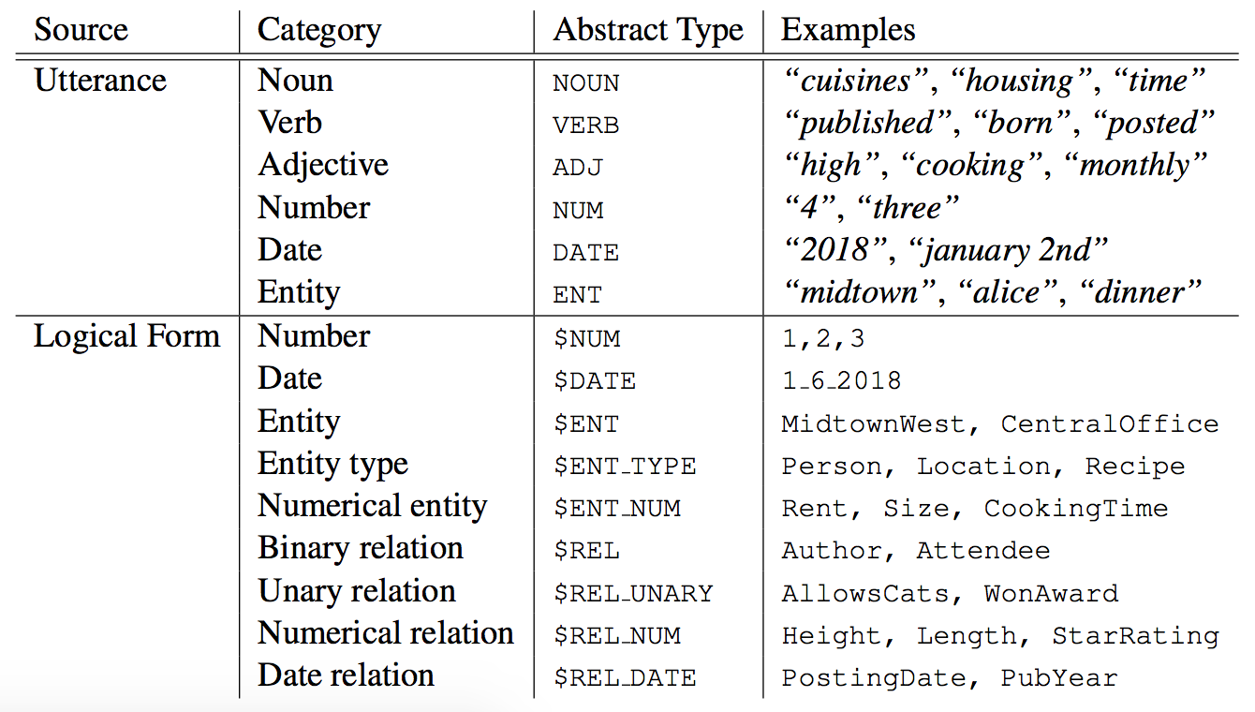
Images from Herzig and Berant, 2018

Slide 48
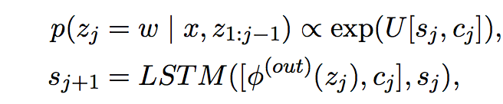
Step 2: Structure Mapper
Neural semantic parser: input language tokens → output logical tokens
Jia and Lang, 2016
Encoder: bidirectional LSTM; input language tokens → sequence of context sensitive states
Decoder: LSTM language model
Decoder states: s_{j}
Embedding function: Φ^{(out)}
Decoder parameters: U, Φ^{(out)}
Context vector: c_{j}
From global attention
Single encoder-decoder pair shared across all domains
Output: abstract logical form with slots rather than KB constants
Images from Herzig and Berant, 2018
Notes:
s_j: decoder states

Slide 49
Step 3: Aligner
Assign KB constant to each slot from the structure mapper output
Model: abstract utterance-logical form pair → alignment matrix
Distillation strategy:
No gold alignments available for training, so use SOTA unsupervised model (Dyer et al., 2013) to get noisy alignments and use as “gold” later.
Objective: minimize negative log-likelihood of gold alignments

Slide 50
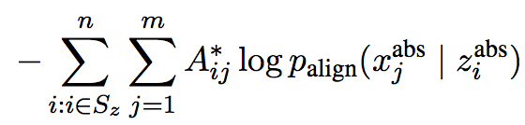
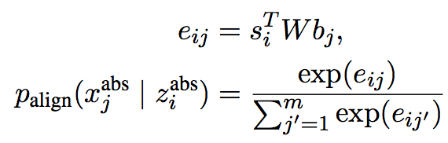
Aligner Model
Like an attention model
Bi-LSTMs first encode abstract utterance-logical form pair as context sensitive states
utterance → b
logical form → s
Cross-entropy loss:
Images from Herzig and Berant, 2018

Slide 51
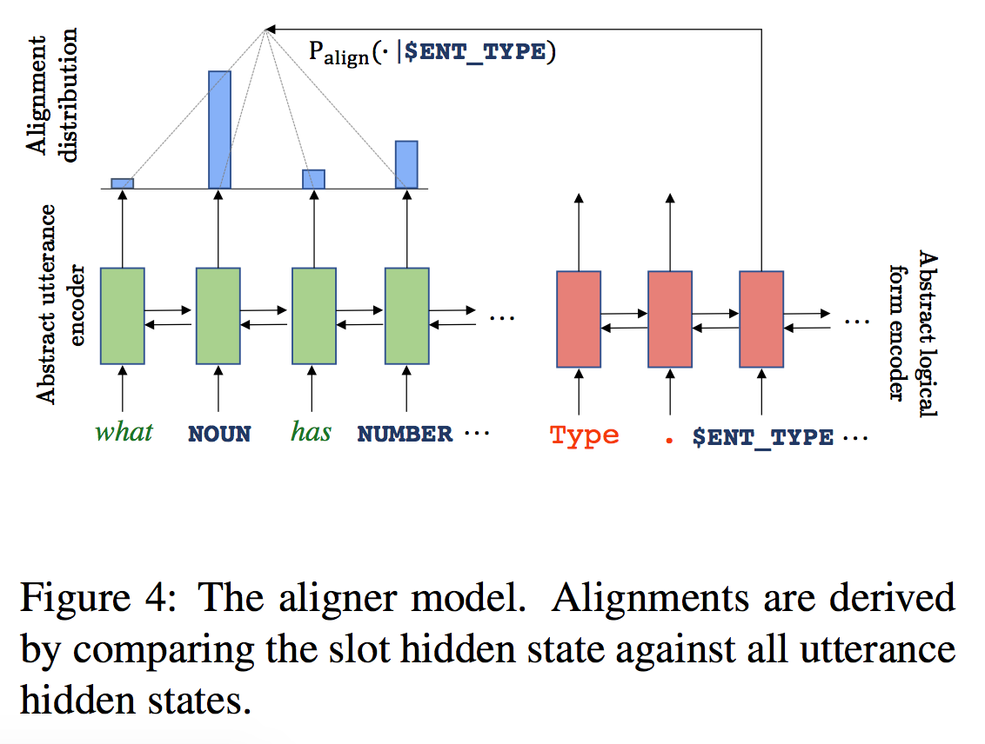
Images from Herzig and Berant, 2018

Slide 52
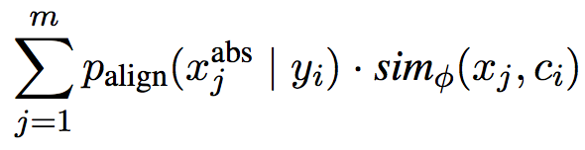
Step 4: Inference
Input (from Aligner): alignment matrix.
Goal: replace each slot with KB constant.
Scoring functions:
Local score - assign KB constant that is highly similar to the word(s) that slot is assigned to (expected semantic similarity for each slot under the alignment distribution)
Global score - to mitigate issues ignored by local scoring:
Slots were treated independently
KB constants need not align to an explicit utterance
Images from Herzig and Berant, 2018

Slide 53
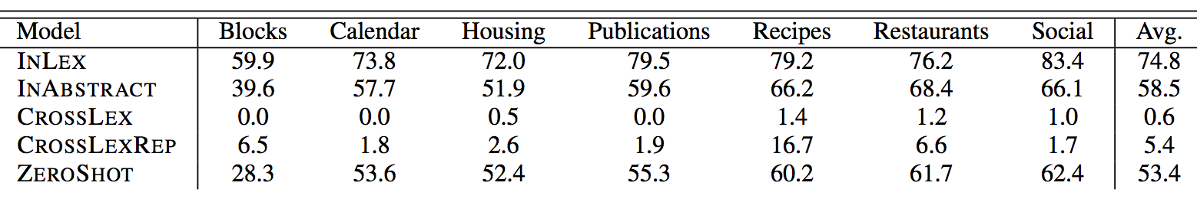
Results
Images from Herzig and Berant, 2018

Slide 54
Paper 4: Bootstrapping a Crosslingual Semantic Parser
Sherborne et al., 2020

Slide 55
Significance
This paper tackles important, open questions in semantic parsing: cross-lingual parsing, and domain adaptation with minimal annotation. Moreover, they specifically highlight a “cost-effective” methodology.
They make use of a strong English semantic parsing model, arm it with tools like multilingual BERT, joint paraphrasing, and machine translation, and evaluate its performance on unseen languages and domains.

Slide 56
Task
seq2seq neural semantic parsing
Sequence transduction between natural and formal languages
multilingual semantic parsing
Multiple languages in parallel
vs. crosslingual semantic parsing
Adapting a model trained on one language to work for another language
English, Chinese, and German data utilized: ATIS, Overnight

Slide 57

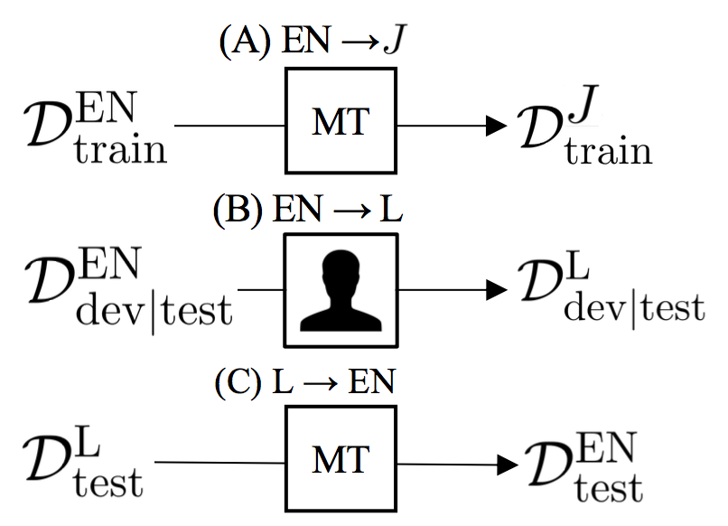
Crosslingual Modeling
Dataset in language L
N examples
x^{L}: input utterance
y: logical form
d = KB(y) //denotation from KB
Images from Sherborne et al., 2020

Slide 58
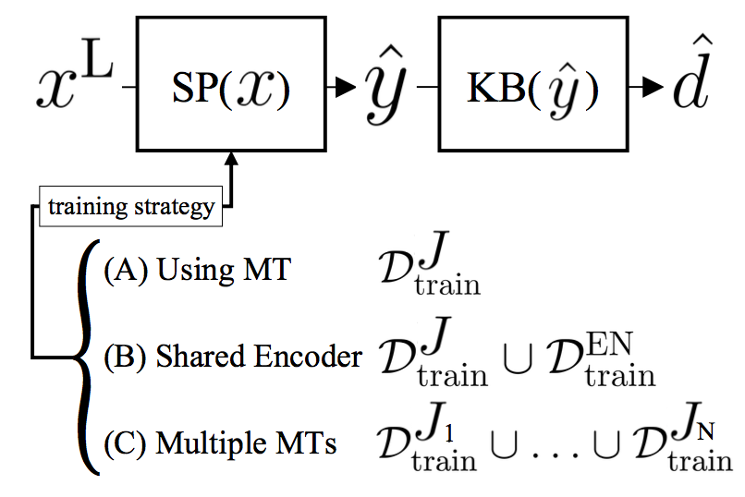
Feature Augmentation
Beyond machine translation on training data, using external resources and transfer learning:
Pre-trained representations
Multilingual “shared” encoder
Machine translation as paraphrasing
Images from Sherborne et al., 2020

Slide 59
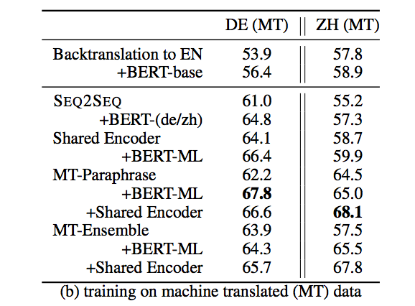
Results and Analysis
First executable semantic parser on ATIS and Overnight in another language
Comparable numbers across the eight Overnight domains.
All experiments: 200 epochs w/ Adam Optimizer; LR=.001
Performance on German (DE) and Chinese (ZH) ATIS:
Images from Sherborne et al., 2020

Slide 60
Discussion Question 1: Big Picture
Which of the strategies discussed today seems the most promising for the future to you (particularly XPS), whether individually or when combined, and why?
Building from syntactic parse (e.g., dependency parse - Paper 1)
Zero shot learning by decoupling structure and lexicon - Paper 3
Logically-rich meaning representations (e.g., lambda calculus - Paper 1)
Bootstrapping with huge pretrained models (e.g., BERT - Paper 4)
Database representations (e.g., SQL, Freebase API)

Slide 61
Discussion Question 2: Overcoming Generalization Challenges
Language variation across domains
Identifying entities
Mapping entities to columns
Domain-specific phrases
Novel database and query structures
Dataset conventions
Thoughts on how to overcome these?
How could the bootstrapping methods (BERT, paraphrasing, MT) from Paper 4 help?
How could strong syntactic representation (e.g., dependency parses from Paper 1) help?
How could decoupling structure and lexicon, like filling in KB constants at the end (Paper 3) help?
Images from Suhr et al., 2020

Slide 62
Discussion Question 3: Using DepLambda
Transforming Dependency Structures to Logical Forms for Semantic Parsing
Though Paper 1 did not explicitly mention any cross-domain tasks, the motivation to use dependency parses was their low annotation effort and the high availability of dependency-parsed data. They had two contributions:
DepLambda: dependency parses → ungrounded lambda calculus MR
DepLambda → graph grounded in the knowledge base
How does their approach for Step 2 bode for XPS tasks? Did they rely too heavily on one database, Freebase?
How else could DepLambda be used in semantic parsing? Maybe to improve Paper 3 or 4?

