Slide 1
Latent Variable Models for NLP
Brian Kitano
November 27

Slide 2
Outline
Background
Motivation
Intuition
Previous Work
Markov Chain Monte Carlo (MCMC)
Current Trend: Variational Inference
Primer
Paper 1: Neural Variational Inference for Text Processing (2016)
Paper 2: Discovering Discrete Latent Topics with Neural Variational Inference (2017)
Paper 3: Generating Sentences from a Continuous Space (2016)
Conclusion
Discussion Questions

Slide 3
Background - Motivation
Recall: a generative model learns the entire probability distributions of observations x and latent variables z: p(x,z)
Easiest example: rolling a weighted die
simple latent variable: just the probability of each side being landed on (a vector)
Harder example: choosing a die from a bag, then rolling it
each roll first depends on the probability of drawing the die from the bag, then the probability that that die lands on a given side
In this context, inference means learning p(z | x)
Notes:
Recall:
it's just Bayes' rule
p(z) is the prior density
Context:
p(z | x) is the posterior density
"given all the data we've seen, what's likely to be the latent variable?"

Slide 4
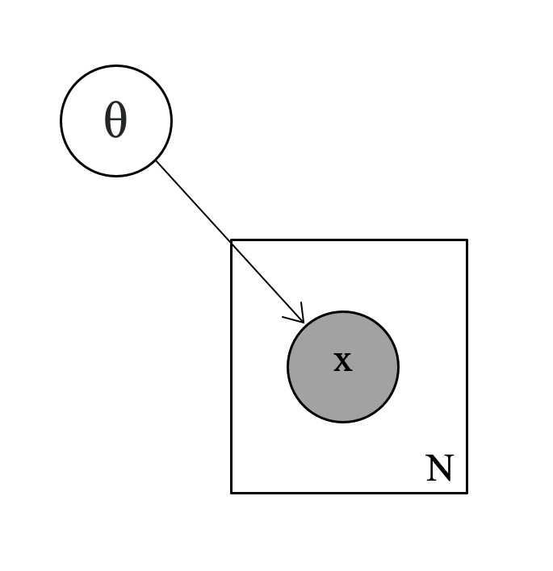
Background - Intuition
Plate notation: good for diagramming generative models
Filled circles = observed, unfilled = latent
Square plates = repetitions
Here's our easy example: θ is the parameter for the die

Slide 5
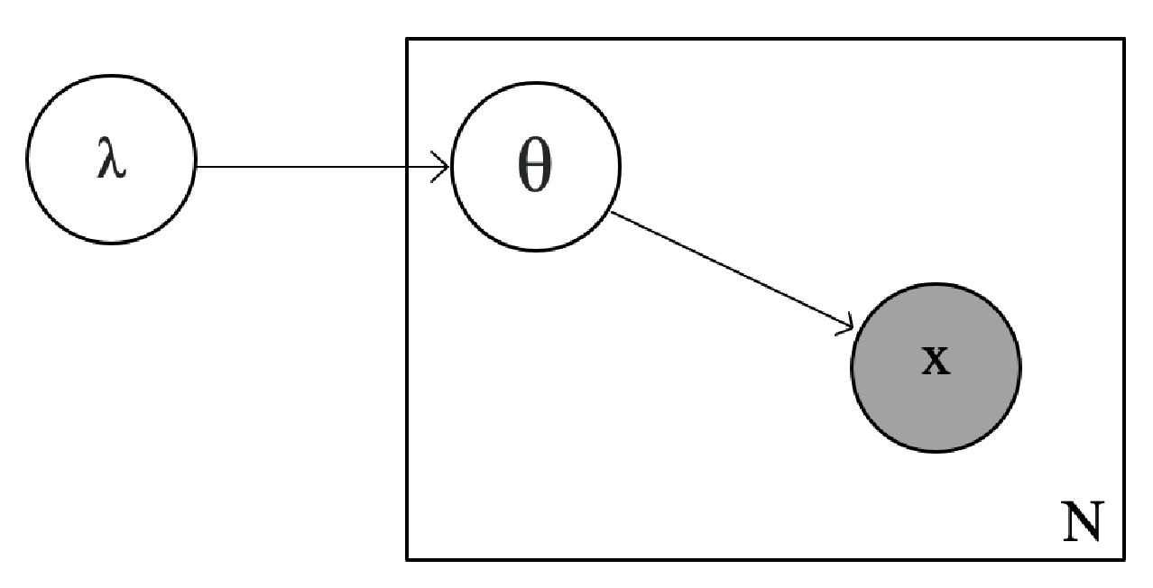
Background - Intuition
Harder example: λ is the latent parameter determining the probability of drawing one of the die from the bag

Slide 6
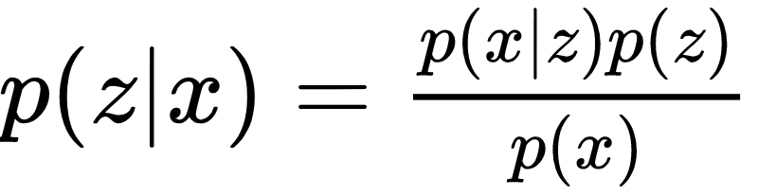
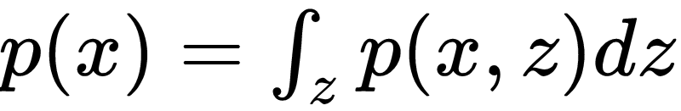
Background - Motivation
So we want p(z | x)
Bayes' rule: The numerator is easy if we define a prior for z p(z) is Dirichlet or Gaussian, etc.
The denominator is intractable to calculate!
Notes:
Why is the denominator hard? It's asking us to integrate over all possible values the latent variable could take.

Slide 7
Background - Motivation
We need to be able to approximate p(x) to learn about p(z | x).
Notes:
We need to understand what our observations could look like in order to understand what causes them.

Slide 8
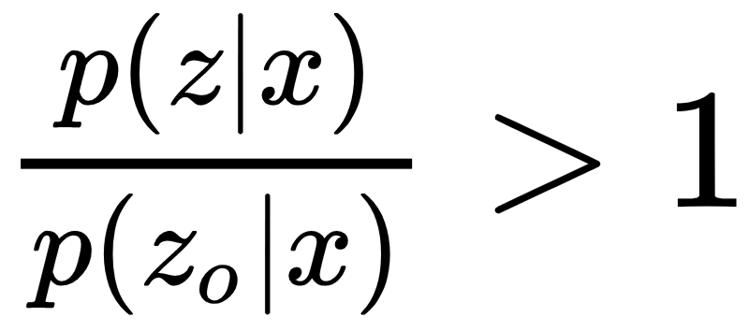
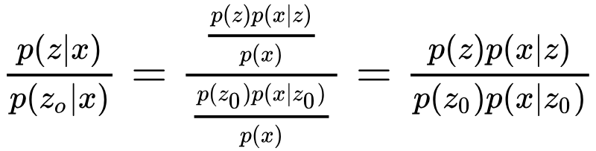
Previous Work - MCMC
We iteratively propose prior distributions for z by randomly "jumping" around (aka sampling) the search space, then use a trick to determine whether we update the best guess.
The trick: let z₀ be our current guess, and z be our proposed guess. We update z₀ if z is more likely than z₀, or
Now, note that
so we never need p(x)!
Notes:
We're able to avoid the intractable p(x)
But this doesn't work when datasets are large or models are very complex.

Slide 9
Don't sample, optimize.

Slide 10
Variational Inference

Slide 11
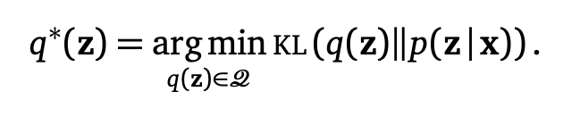
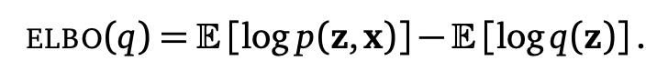
Variational Inference - Primer
Instead of jumping and sampling, we try to optimize our posterior by minimizing the difference between our approximate posterior q and the true posterior p, with the added constraint that our guess q is in some family of distributions D.
This is still dependent on p(x), so we use a closely related objective, the Evidence Lower Bound (ELBO). Maximizing ELBO is equivalent to minimizing KL, and we can use vanilla SGD.
Notes:
More intuition on ELBO

Slide 12
Variational Inference Example: Latent Dirichlet Allocation
Latent Dirichlet Allocation (LDA) for Topic Modeling - Blei et al., 2003
Given a corpus of documents, determine what words belong to what topics, and what topics belong to what documents
Assumptions:
Bag-of-words mixtures
Exchangeability

Slide 13
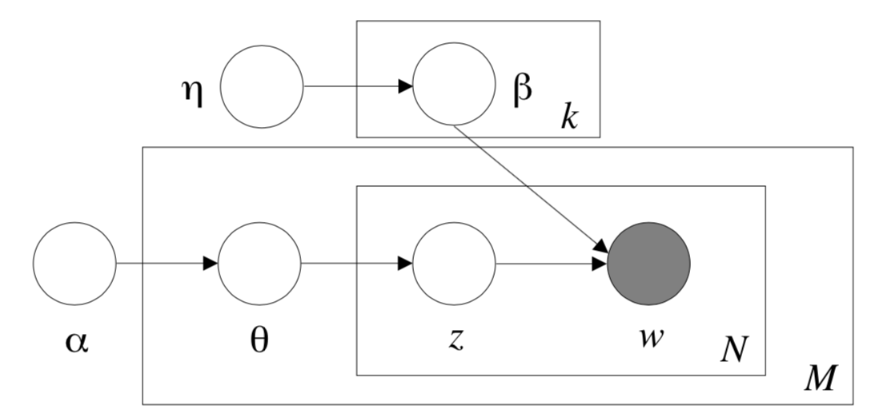
Variational Inference Example: LDA (2003)
Notes:
η - Dirichlet prior parameter used to model how "mixed" the vocabulary is within each topic; corpus level parameter
β - Multinomial drawn from topic-word Dirichlet prior, where each element corresponds to the probability of drawing that word given the kth topic
α - Dirichlet prior parameter used to model how "mixed" the topics of documents are; corpus level parameter
θ - drawn vector from the document-topic Dirichlet, used as the parameter for a multinomial distribution representing the mixture of topics in a document; sampled once per document
z - a topic, drawn once for each word from Μult(θ)
w - a word, drawn once for each word from Mult(β)
N - number of words in a document
M - number of documents in a corpus
What are our latent variables in this model?

Slide 14
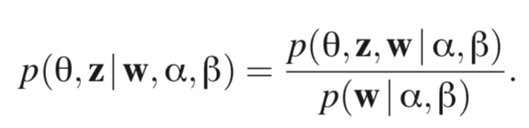
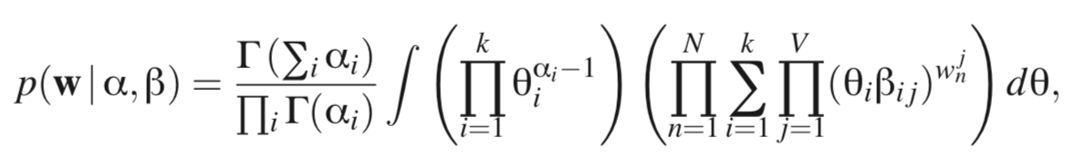
Variational Inference Example, cont'd
Why do we need variational inference here? Want to learn but...
Notes:
There's a coupling between θ, β when trying to estimate the posterior, so this is a special case where the posterior is intractible for exact inference.

Slide 15
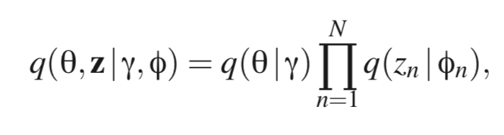
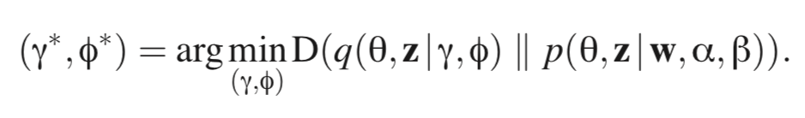
Variational Inference Example, cont'd
How to use variational inference where γ is the Dirichlet parameter for document mixing and φ are the N individual topic multinomial parameters over all the words in the vocabulary.
Notes:
There's a coupling between θ, β when trying to estimate the posterior, so this is a special case where the posterior is intractable for exact inference.
So, we assume that the mechanism for determining topics and determining document mixtures is separate, thus decoupling the things that make the posterior inference intractable, then use variational inference to determine the parameters of the decoupled models.

Slide 16
Variational Inference Example, cont'd
Problem: LDA relies on a trick, much like MCMC
For modeling topic-words, we use a multinomial which sums to 1 (since it's a probability distribution)
To making inference p(z|x) easy on a given likelihood model p(x|z), we want to choose a prior p(z) such that p(x|z) p(z) is in the same family as p(z|x), aka choose a conjugate prior
That's why we use a Dirichlet prior on p(z), because the Dirichlet is conjugate to the Multinomial
What if we want a non-conjugate prior?
Notes:
Note that p(z | x) is proportional to p(x|z) p(z)
Non-conjugate methods are an active field of research, but I'm going to focus on one method to address them
Sources
https://www.seas.upenn.edu/~cis520/lectures/LDA.pdf

Slide 17
Our goal: p(z | x).
Why not just use a neural net?

Slide 18
Neural Variational Inference

Slide 19
Neural Variational Inference - Primer
Use a neural network to learn z given x by minimizing ELBO. Now the parameters of q are learned by a neural net, instead of relying on conjugacy to make the computation tractable.
Notes:
Intuition: "Given my observation, what does my latent variable's distribution look like?"

Slide 20
Discovering Discrete Latent Topics with Neural Variational Inference
Miao et al., ICML 2017

Slide 21
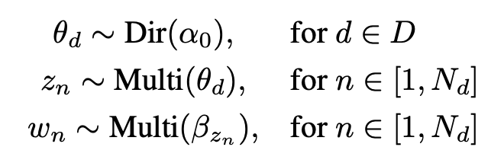
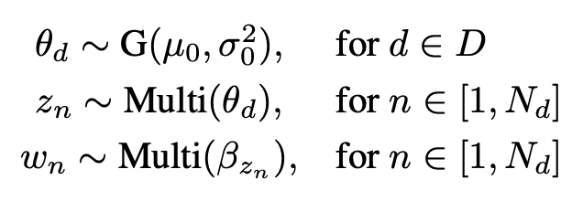
Miao et al., 2018 - Model
LDA way:
NVI way:
Notes:
LDA
α - Dirichlet parameter for document-topic mult dist params
β - Mult parameter for topic-word mult dist
θ - Mult parameter for document-topic dist
NVI
G is a Gaussian and a neural network where we learn the parameters μ and σ
If G were just a Gaussian, then θ won't sum to one. So how do we modify it to pass it as a parameter to the Mult distribution for z?

Slide 22
Variational Inference Example: LDA (2003)
η is the parameter of the Dirichlet prior for topic-word dist.
α is the parameter of the Dirichlet prior for doc-topic distribution
Notes:
η - Dirichlet prior parameter used to model how "mixed" the vocabulary is within each topic; corpus level parameter
β - Multinomial drawn from topic-word Dirichlet prior, where each element corresponds to the probability of drawing that word given the kth topic
α - Dirichlet prior parameter used to model how "mixed" the topics of documents are; corpus level parameter
θ - drawn vector from the document-topic Dirichlet, used as the parameter for a multinomial distribution representing the mixture of topics in a document; sampled once per document
z - a topic, drawn once for each word from Μult(θ)
w - a word, drawn once for each word from Mult(β)
N - number of words in a document
M - number of documents in a corpus
What are our latent variables in this model?

Slide 23
Miao et al., 2018 - Model
In addition, we use a softmax on topic vectors t and vocabulary matrix v to create the topic-word distribution multinomial matrix β
In contrast, here we are using a neural network to approximate the latent document-topic prior distribution.
Learning all the generative latent variables without relying on conjugacy!
Notes:
t_k is a Hx1 topic vector; t is a KxH matrix for all topics
v is a VxH matrix where each column is a word embedding
β_k = soft(v * t_k^T) which is VxK, each topic's multinomial parameter over the vocabulary
we learn v, t_k during training (generative parameters)

Slide 24
Miao et al., 2018 - Model
LDA way:
NVI way:
Notes:
LDA
α - Dirichlet parameter for document-topic mult dist params
β - Mult parameter for topic-word mult dist
θ - Mult parameter for document-topic dist
NVI
G is a Gaussian and a neural network where we learn the parameters μ and σ
If G were just a Gaussian, then θ won't sum to one. So how do we modify it to pass it as a parameter to the Mult distribution for z?

Slide 25
Miao, 2018 - Model, cont'd
Three different methods for transforming x ~ Normal into a suitable θ for the Multinomial
Gaussian Softmax (GSM)
Gaussian Stick Breaking (GSB)
Recurrent Stick Breaking (RSB)

Slide 26
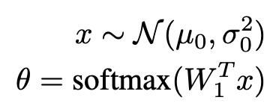
Miao, 2018 - Model: Gaussian Softmax (GSM)
We define θ ~ G(μ, σ²) as
Notes:
straightforward: will make theta sum to one and assign non-zero probabilities to all the values.
learning happens in W

Slide 27
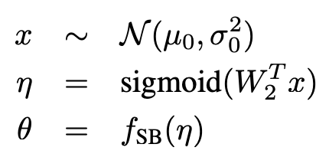
Miao, 2018 - Model: Gaussian Stick Breaking (GSB)
Define θ ~ G(μ, σ²) by
Notes:
Draw x randomly from a multivariate Gaussian
learn weights and normalize the values to be between 0 and 1
use the fractions to progressively bite off more and more of the stick, aka the document-topic distribution
breaks exchangeability assumption aka the order of the topics now matters

Slide 28
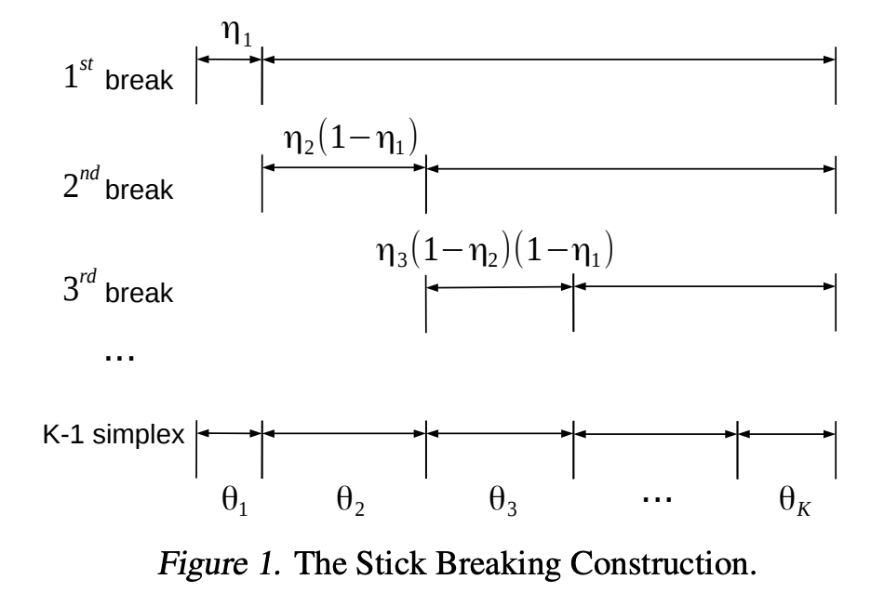
Miao, 2018 - Model: Gaussian Stick Breaking (GSB)
Notes:
Draw x randomly from a multivariate Gaussian
learn weights and normalize the values to be between 0 and 1
use the fractions to progressively bite off more and more of the stick, aka the document-topic distribution
breaks exchangeability assumption aka the order of the topics now matters

Slide 29
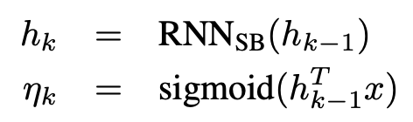
Miao, 2018 - Model: Recurrent Stick Breaking (RSB)
Define θ ~ G(μ, σ²) by relying on how you broke the stick the last time We use an RNN to maintain state information h about how we've been breaking the stick, and use that and our latent topic parameter x determine the proportion of how much to break η for the kth topic

Slide 30
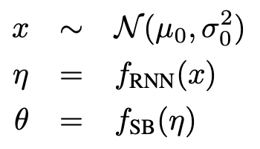
Miao, 2018 - Model: Recurrent Stick Breaking (RSB)
Now the model looks pretty much the same as Gaussian Stick Breaking, except...
Notes:
Draw x randomly from a multivariate Gaussian
Now we use the RNN to determine the next fraction to bite off
use the fractions to progressively bite off more and more of the stick, aka the document-topic distribution
this also breaks exchangeability assumption aka the order of the topics now matters

Slide 31
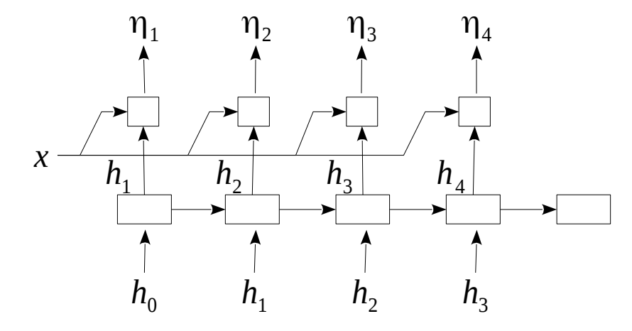
Miao, 2018 - Model: Recurrent Stick Breaking (RSB)
An unbounded number of topics!

Slide 32
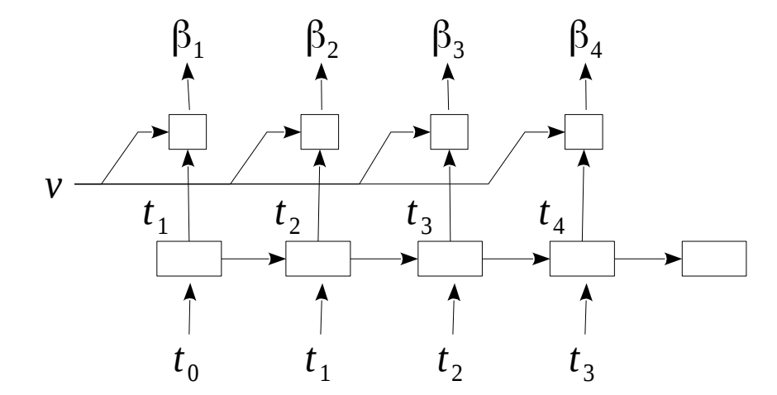
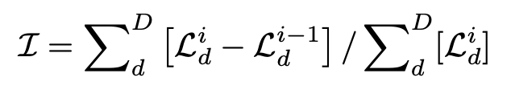
Miao, 2018 - Model: Recurrent Stick Breaking (RSB)
Likelihood increase by adding another topic to the model. If greater than hyperparameter γ, increase the number of topics present. Do this check after each document processed.
Generating the topic vectors in RSB, and determining when to add another topic

Slide 33
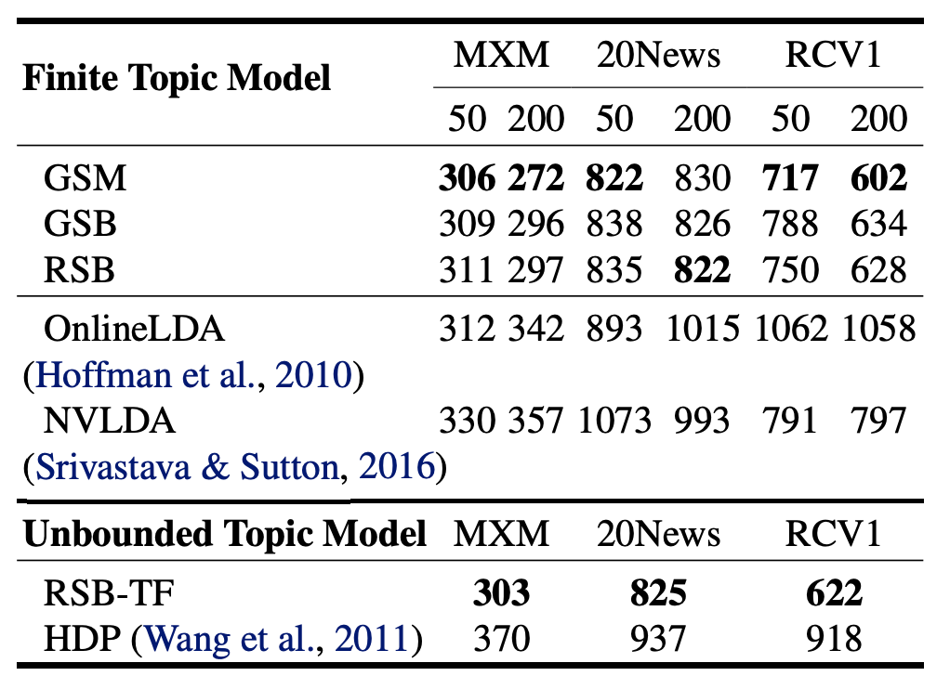
Miao, 2018 - Results
Intuition for interpreting perplexity: "our topic models are about as good as rolling a n-sided die to guess a word within a topic"
Notes:
RSB can be limited to do finite topic modelling if you limit the depth

Slide 34
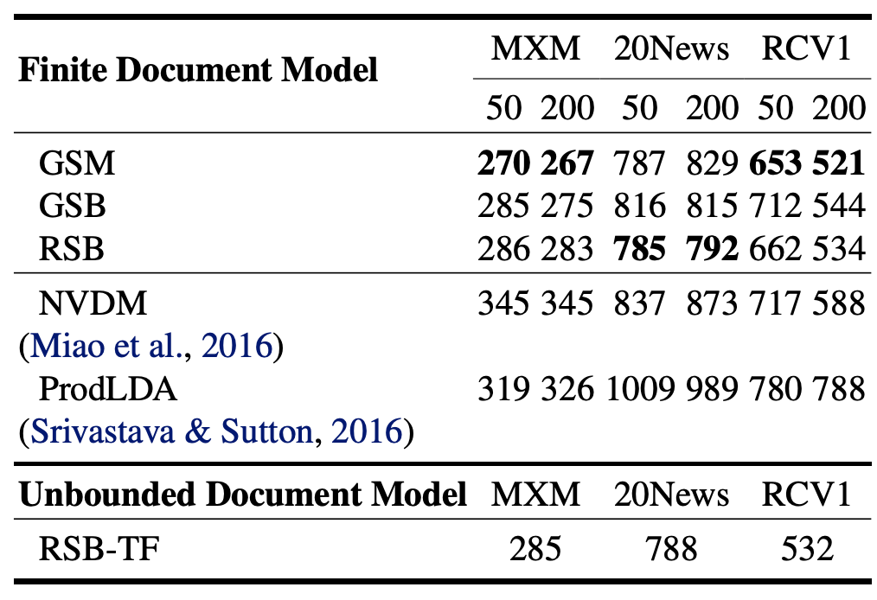
Miao, 2018 - Results
Intuition: "our document models are about as good as rolling a n-sided die to guess the next word in a document"
Notes:
RSB can be limited to do finite topic modelling if you limit the depth

Slide 35
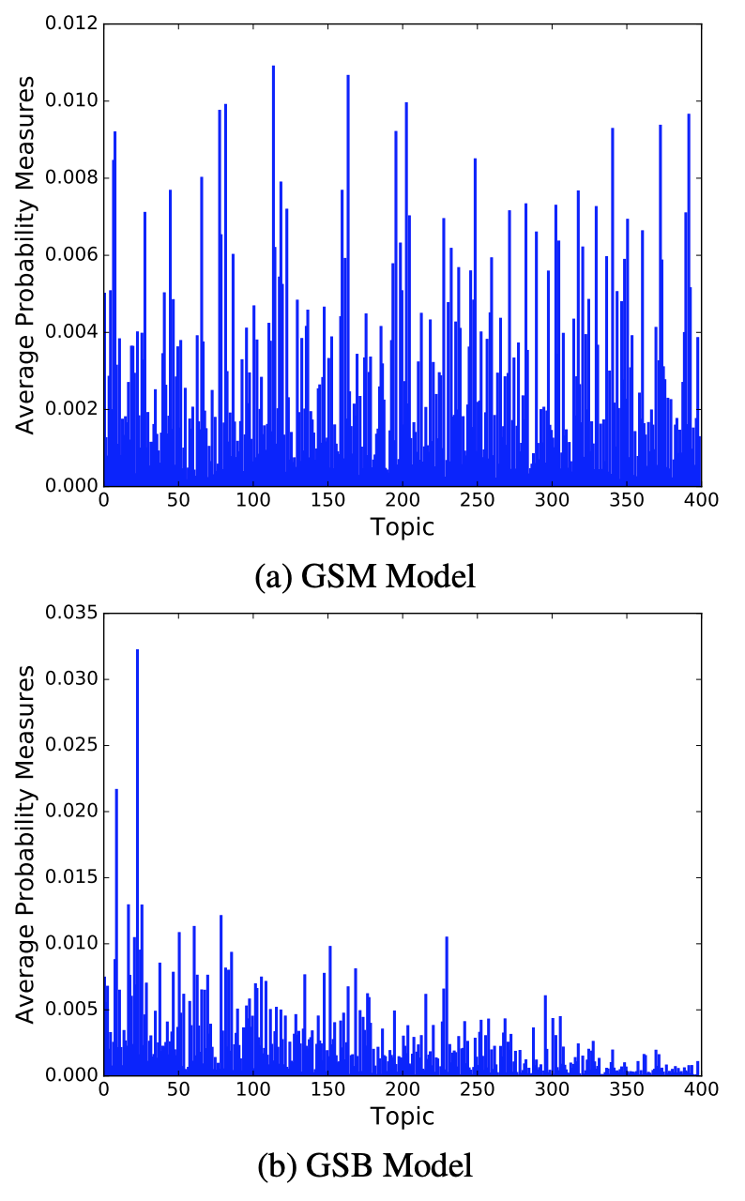
Miao, 2018 - Discussion
In GSM, we preserve exchangeability (topic 1 is as likely to be sampled as topic 400)
In stick-breaking, the sticks get smaller as we increase our index, so topics aren't exchangeable. We're inducing sparsity!
Stick breaking does NOT mean monotonically decreasing probability measures.
Notes:
why are there still really large avg probability measures towards the end? Shouldn't stick breaking force every subsequent stick to be smaller than the next one?
No, if eta_i < .5, then topics won't have ordered probabilities

Slide 36
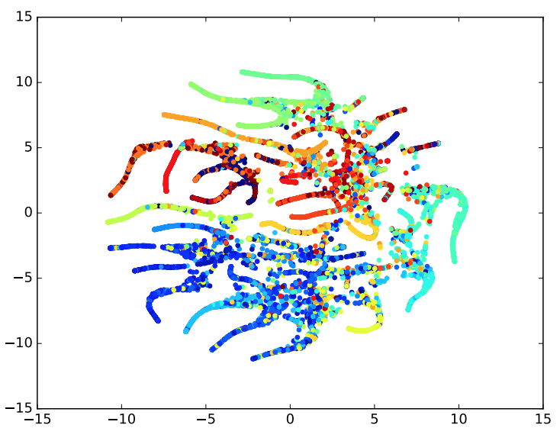
Miao, 2018 - Discussion
t-SNE projection of q( θ | d ) for all the documents
Colors = subgroup of the dataset by article category (ground truth)
Colors being in groups near each other => q(θ | d) is good at determining document topics
Notes:
why are there still really large avg probability measures towards the end? Shouldn't stick breaking force every subsequent stick to be smaller than the next one?
No, if eta_i < .5, then topics won't have ordered probabilities

Slide 37
Neural Variational Inference for Text Processing
Miao et al., ICML 2016

Slide 38
Miao, 2016 - Quick Recall
The objective of inference in a latent model is to learn p(z | x)
There's often an intractable integral, so we need to approximate it
In variational inference, we're finding an optimal q(z | x) prior that minimizes the KL Divergence / maximizes ELBO versus p(z | x), the true posterior

Slide 39
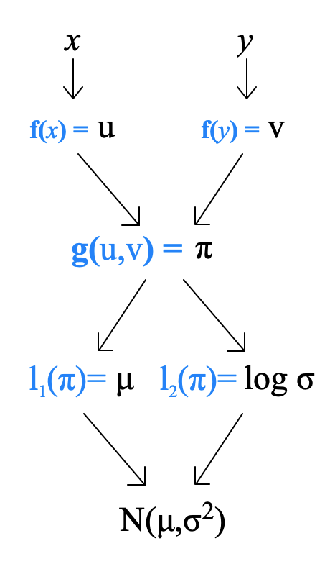
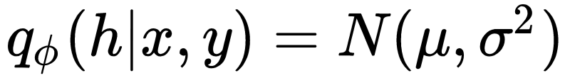
Miao, 2016 - The Model
We first get our text strings x and y
We then turn x and y into vectors u and v using an function f (maybe an LSTM in NLP).
We then feed u and v into g (an MLP) to assemble a joint representation vector π.
We then derive the parameters of our Gaussian prior for h using l, a linear transformation.
Key insight:
should look familiar!
Notes:
Works in supervised or unsupervised context

Slide 40
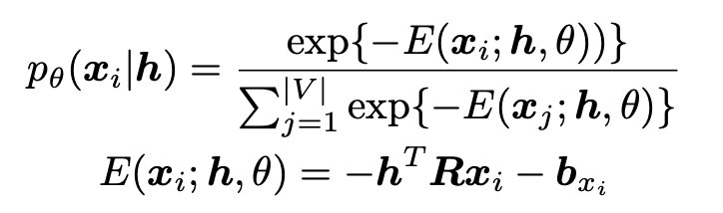
Miao, 2016 - Application 1: NVDM
Neural Variational Document Model (NVDM)
Works kind of like a Variational Autoencoder
In this context, since we aren't pairing the document with anything, we don't need to worry about constructing a joint representation for X and Y (since Y isn't there), so the NVIF model is simpler.
We still need to learn the decoder network! We use our learned latent variable h to then draw words iid
Notes:
x_i is a one-hot word vector
R learns semantic word embeddings during training
x_i = |V| x 1; h = 50 x 1 or 200 x 1; R = |V| x 200 ("learning word embeddings across all compressed documents' dimensions")
In training, we alternate between training the encoder and decoder

Slide 41
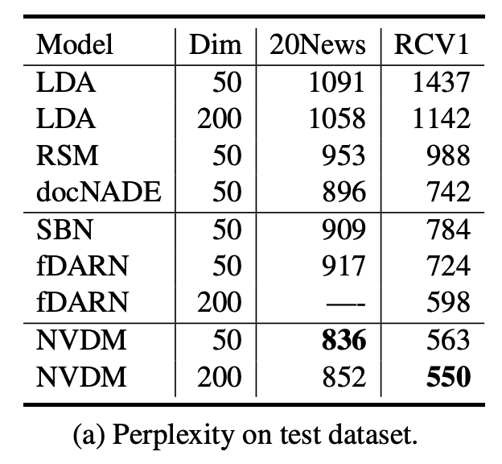
Miao, 2016 - Application 1: NVDM Results
Recall: perplexity = "as good as an n-sided die"
In this context, it's for guessing the next word
Setting benchmarks
Notes:
What are these other models?

Slide 42
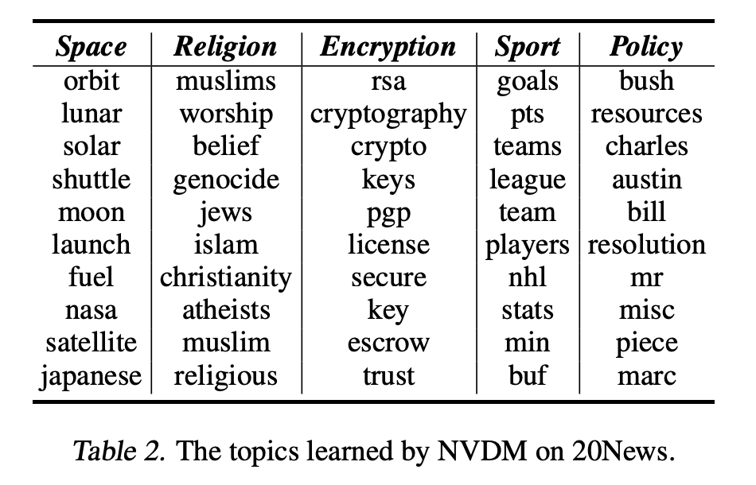
Miao, 2016 - Application 1: NVDM Results, cont'd
What does each dimension mean?
Get topic modeling for free!
"the strongest positive connection with the topic" isn't defined in the paper
Notes:
topic modeling revisited later

Slide 43
Miao 2016 - Application 2: NASM
Neural Answer Selection Model (NASM)
Problem: given a set of possible answers for a given question, can you pick the most correct answer? Aka multiple choice questions.

Slide 44
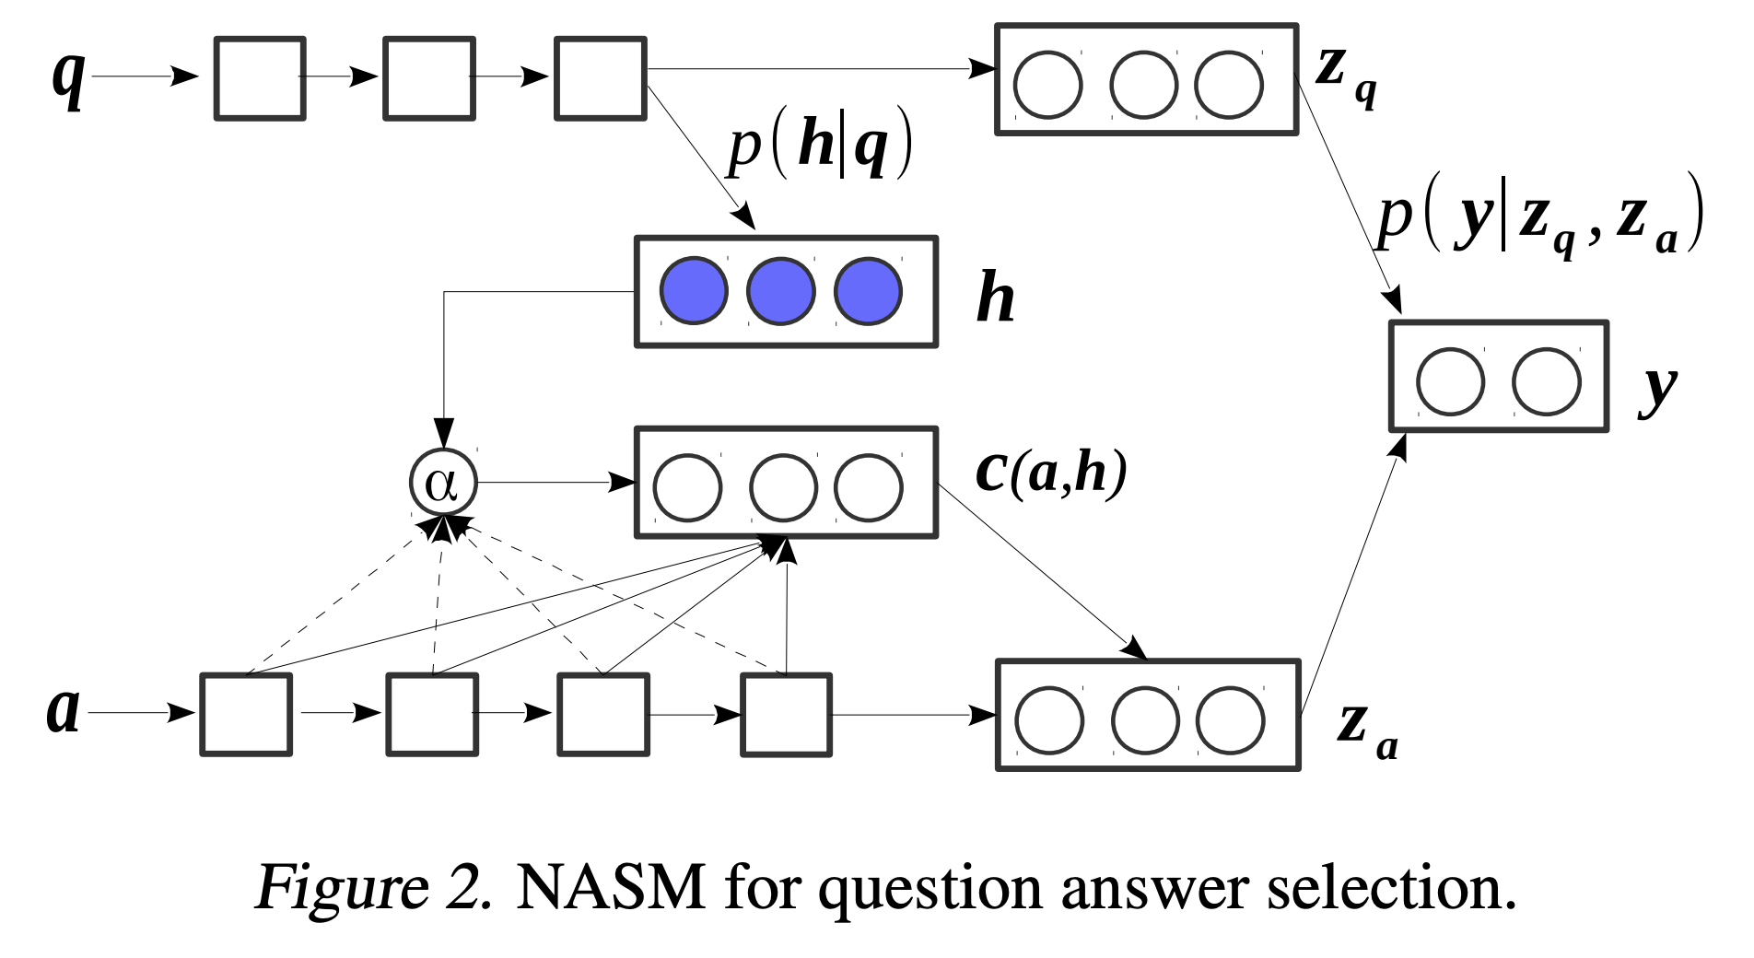
Miao, 2016 - Application 2: NASM
Notes:
z_q is just the vector representation of the question
z_a you just saw
Now z_q and z_a are part of a two-sided NVIF model, and y is on the other side.
Not actually used as a generative model, used for calculating gradients in training.

Slide 45
Miao, 2016 - Application 2: NASM
Notes:
z_q is just the vector representation of the question
z_a you just saw
Now z_q and z_a are part of a two-sided NVIF model, and y is on the other side.
Not actually used as a generative model, used for calculating gradients in training.

Slide 46
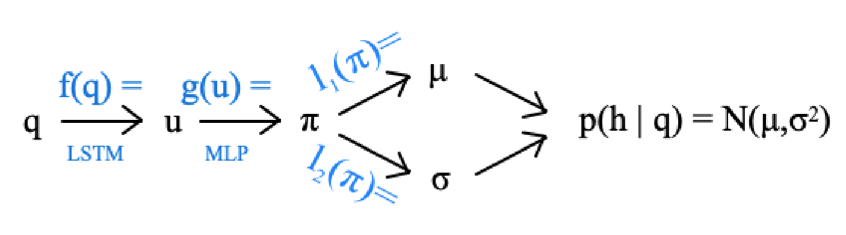
Miao, 2016 - Application 2: NASM
Learning the latent question space

Slide 47
Miao, 2016 - Application 2: NASM
Notes:
z_q is just the vector representation of the question
z_a you just saw
Now z_q and z_a are part of a two-sided NVIF model, and y is on the other side.
Not actually used as a generative model, used for calculating gradients in training.

Slide 48


Miao, 2016 - Application 2: NASM
"Learning how to associate the question with words in a possible answer" aka word based attention
"How to evaluate the whole answer given the learned attention" aka a context vector
"Learning how to associate a possible answer and its context"
Notes:
we don't just use s(a) because that doesn't give us question based context
we want to learn context based parameters that associate the question with the answer before we determine if a possible answer is the correct answer to the given question
Learning how to better pay attention to the question, which gives it better predictive power for correct answer identification.

Slide 49
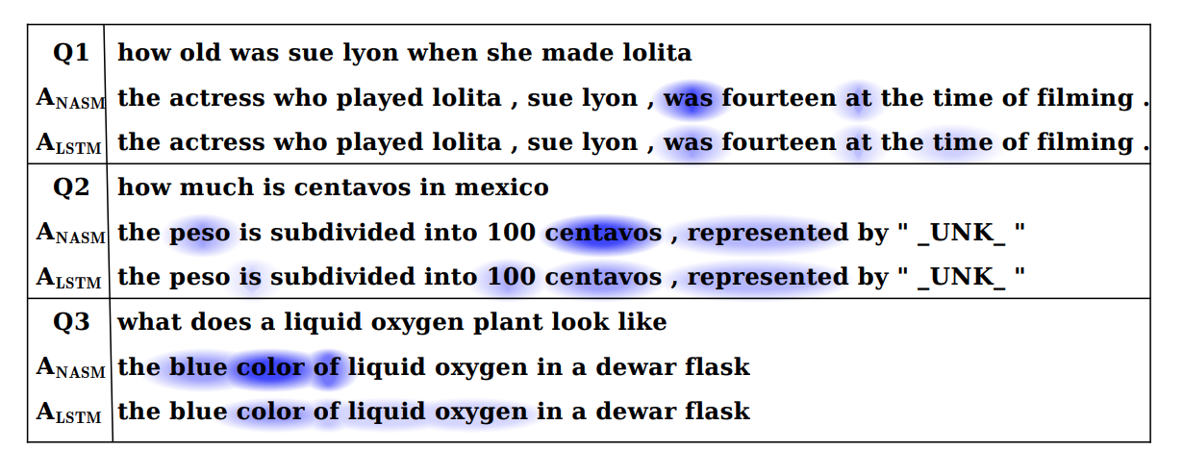
Miao, 2016 - Application 2: NASM
Notes:
Examples to show importance of context association
The NASM model is learning to better understand how to answer a given question, which make for better prediction scores.

Slide 50
Miao, 2016 - Application 2: NASM
Notes:
z_q is just the vector representation of the question
z_a you just saw
Now z_q and z_a are part of a two-sided NVIF model, and y is on the other side.
Not actually used as a generative model, used for calculating gradients in training.

Slide 51

Miao, 2016 - Application 2: NASM
Now we need to learn the latent question-answer association space, and associate our h with the correct answers for the given question.
"latent attention mechanism"
Notes:
z_q is just the vector representation of the question
z_a you just saw
Now z_q and z_a are part of a two-sided NVIF model, and y is on the other side.

Slide 52
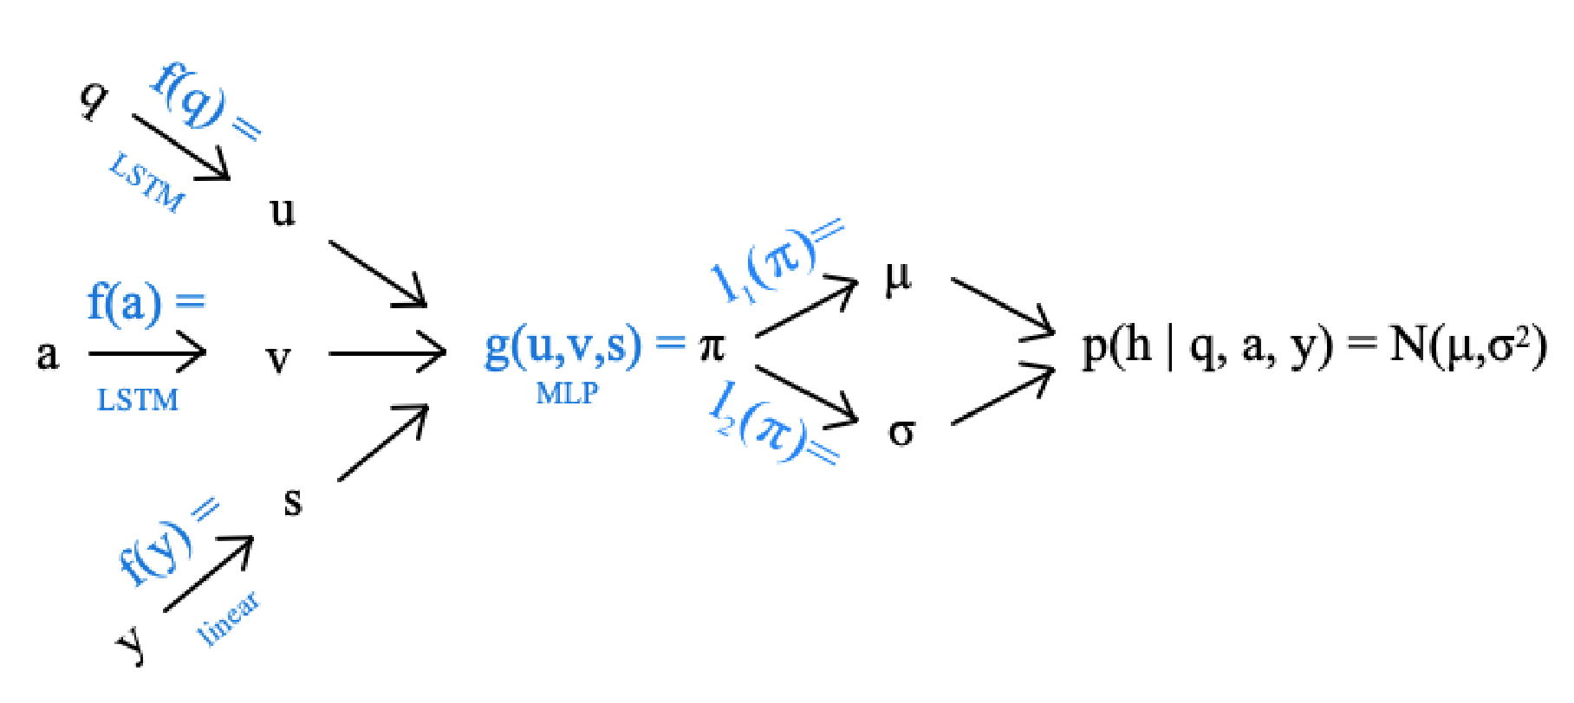
Miao, 2016 - Application 2: NASM
Learning the latent question/correct answer association space, used for SGVB gradient calculations in the attention network.
Notes:
z_q is just the vector representation of the question
z_a you just saw
Now z_q and z_a are part of a two-sided NVIF model, and y is on the other side.
Not actually used during classification, just for training.

Slide 53
Miao, 2016 - Application 2: NASM
Modeled during training for SGVB for learning right weights to create z's; determined during testing afterwards, so disregard the NVIF.
Notes:
z_q is just the vector representation of the question
z_a you just saw
Now z_q and z_a are part of a two-sided NVIF model, and y is on the other side.
Not actually used as a generative model, used for calculating gradients in training.

Slide 54
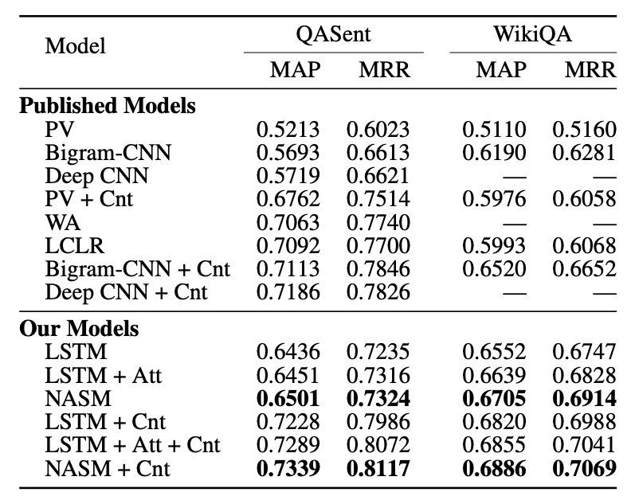
Miao, 2016 - Application 2: NASM Results
Notes:
Cnt = "lexical overlap" and the original model aka context
1% wow is this statistically significant or was this p-hacking?

Slide 55
Generating Sentences from a Continuous Space
Bowman et al., CONLL 2016

Slide 56
Bowman, 2016 - Summary
Problems with current RNN Language Models
RNNs generate sentences one word at a time.
RNNs lose sentence level don't expose sentence-level structure like style, topic or syntax.
What if we tried to model a latent sentence space instead?

Slide 57
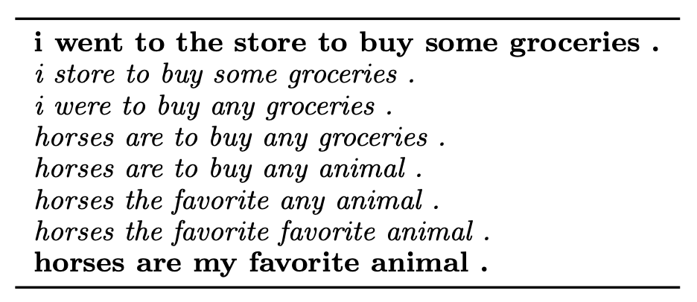
Bowman, 2016 - Other, inferior sentence encoders
Standard autoencoders for sentences don't preserve semantics
Skip-thought models rely on neighboring sentences to generate new ones
Paragraph vectors are used for prediction, not generation.
We want a generative model for encoding sentences.

Slide 58
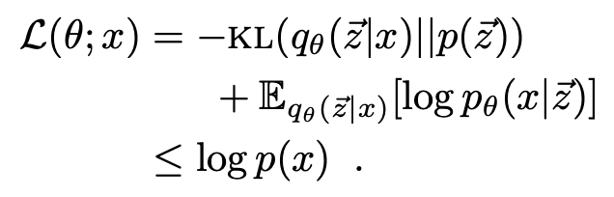
Bowman, 2016 - Variational Autoencoder
"variational autoencoders learn codes not as single points, but as soft ellipsoidal regions in latent space"
Use diagonal Gaussians (like the last two papers) to model the prior p(z) and posterior q(z | x), and minimize the loss given by ELBO:
Notes:
data likelihood under the posterior (expressed as cross entropy)
the kl divergence of the posterior from the prior

Slide 59
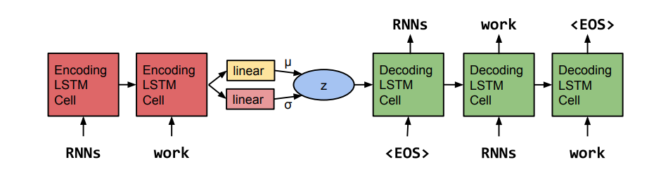
Bowman, 2016 - Model
Use LSTMs to create sentence-level variational autoencodings, and then use the sentence-level variational autoencodings to reconstruct the original sentence, thus learning the latent sentence-level semantic space.

Slide 60
Bowman, 2016 - Training Problem
Recall the loss function we want to optimize over is We want to balance these two terms, rather than optimize one at the cost of the other. In training, if q(z | x) = p(z), then the KL term goes to 0, but we want it to stay slightly non-zero to ensure that we are actually learning variational parameters.
How do we force the model to use the variational parameters effectively?
Notes:
if KL = 0, then we pretty much just have a regular RNNLM, which we want to avoid

Slide 61
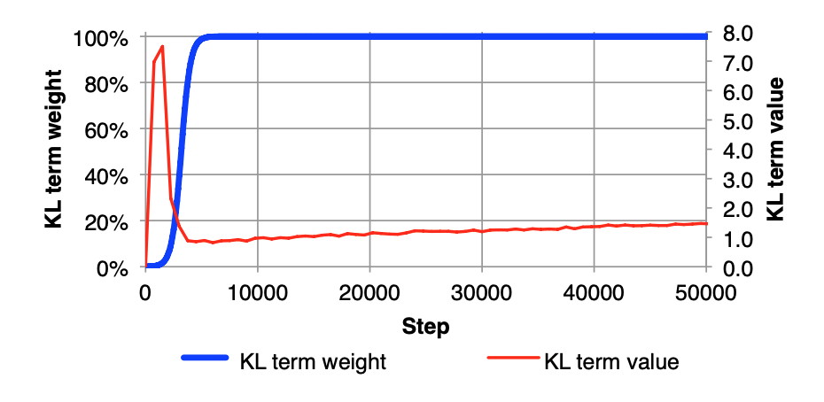
Bowman, 2016 - KL Annealing
What if we first ignored trying to minimize the KL divergence and focused on maximizing the data likelihood from the posterior (the second term in our cost function)?
At first, we don't care what distribution the posterior fits, we just want good encodings. As we keep training, we then try to smooth out the shape of the posterior.
Notes:
Behavior in the graph: KL is cheap to fit, so it spikes early while the model can encode information easily. Then, as we start penalizing for the latent distribution's fit to the prior, KL goes down. Finally, it rises again as it learns to condense more information into z.

Slide 62
Bowman, 2016 - Word Dropout
Another way to ensure a balanced loss is by weakening the model's ability to decode, aka worsen p(x | z), which would detract from the data likelihood under the posterior.
We can do this by dropping out random words during decoder training.
This forces the decoder to rely on z to make predictions, which leads to better latent space representation.
Parameterized by a keep rate k, which when k=0 means the decoder sees no words
Notes:
forcing intuition: if we can't rely on the words alone during training, that means we need to rely on the latent sentence representation's space and shape; thus our understanding of the space and shape of the latent space will improve if we don't/can't rely on the words.

Slide 63
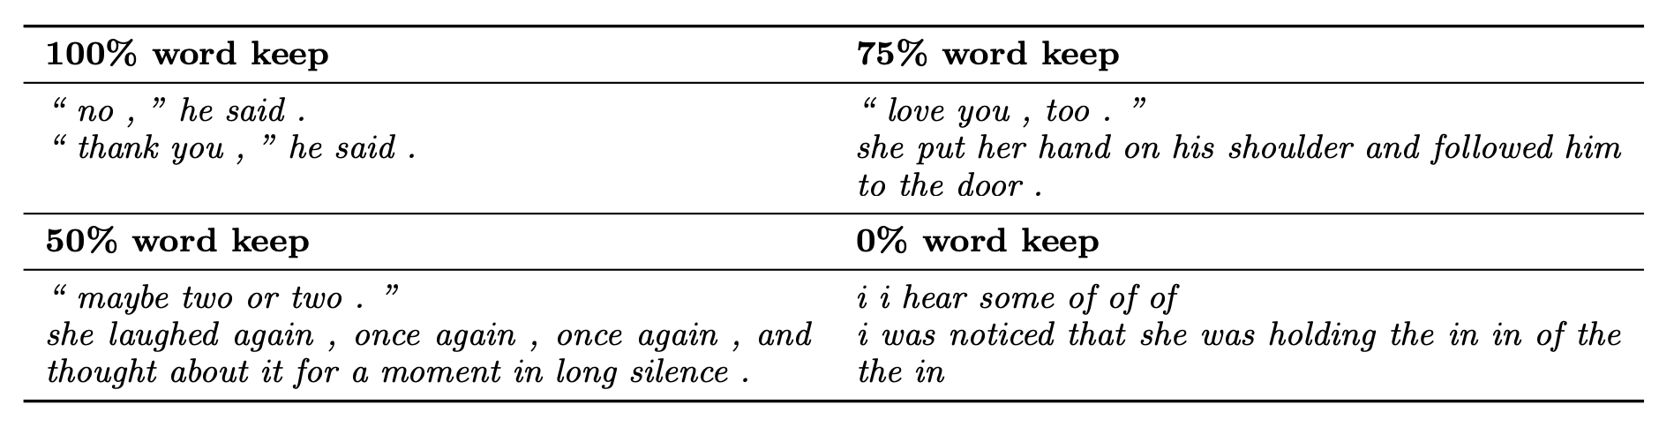
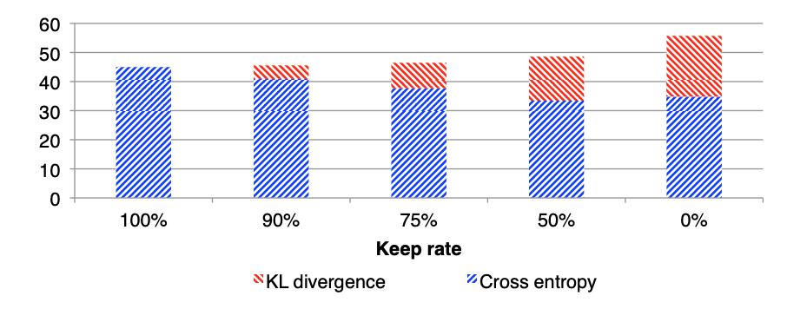
Bowman, 2016 - Word Dropout
The effect of varying level of word dropout on sentence generation and loss values
Notes:
0% keep rate = passing no words to the LSTM
Why is the KL Divergence loss increasing, but the data likelihood loss decreasing?
A model with no dropout doesn't really depend on the latent variable, so the latent variable can very easily meet the diagonal prior Gaussian constraint, so the KL loss is lower.
As we lower keep rate, the amount of information stored in the latent variable is increasing, so the decoder is more dependent on the latent variable, which diminishes its ability to keep high likelihoods for generated decodings. At the same time, it's getting harder for us to encode and meet the constraints of the diagonal prior Gaussian, so the KL loss increases.

Slide 64
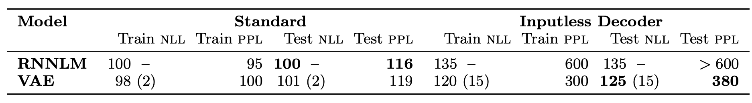
Bowman, 2016 - Results: Language Modeling
Lower is better
In parenthesis is the KL term of the likelihood. Note how much smaller it is! This means that the model has an easier time learning how to shape the latent space than it does learning how to encode effectively.

Slide 65
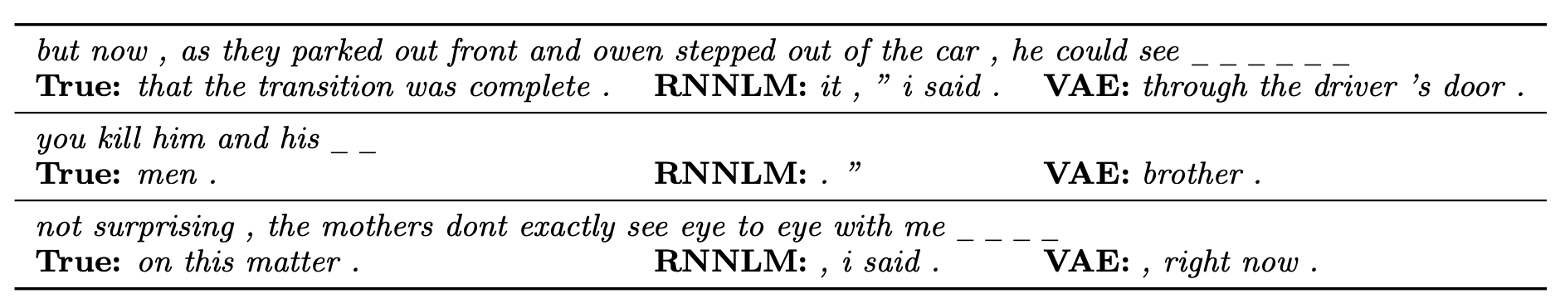
Bowman, 2016 - Results: Imputing Missing Words
Regular RNNs are bad at this since they
work on a sentence to sentence level
have an implicit direction which means that known words down the line don't pass information backwards
Because there's a global latent variable in a VAE, information is more easily shared between RNN cells
Uses beam search (n=5) after drawing the latent sentence semantic variable for the sentence with UNK tokens in the missing word slots
Notes:
Authors claim this model is particularly well suited for fill-in-the-blank tests
beam search: exploring a graphical model by going down n branches to determine the best candidate
how do you evaluate these results?

Slide 66
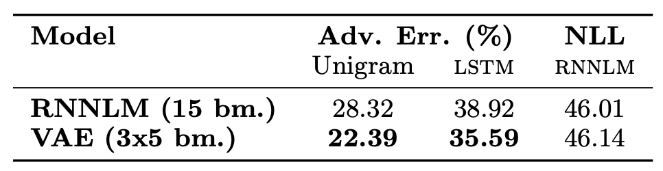
Bowman, 2016 - Results: Imputing Missing Words
Use "adversarial error" to evaluate results
Train a discriminator to classify actual sentences w/out missing words vs the same sentence with imputed missing words; training data has 50% of each
Adv. error = gap between ideal accuracy of imputation generator vs actual accuracy
Adversarial error for VAE is lower, meaning the discriminator has a harder time distinguishing imputed sentences from real sentences.
Notes:
If the imputed sentences are really good, then the discriminator shouldn't be able to distinguish between it and real sentences. Then the accuracy of the discriminator will be 50%, since it has an equal chance of being real or imputed. The adversarial error is the difference between the actual error and 50%.
NLL here is negative log likelihood, a measure of sentence typicality

Slide 67
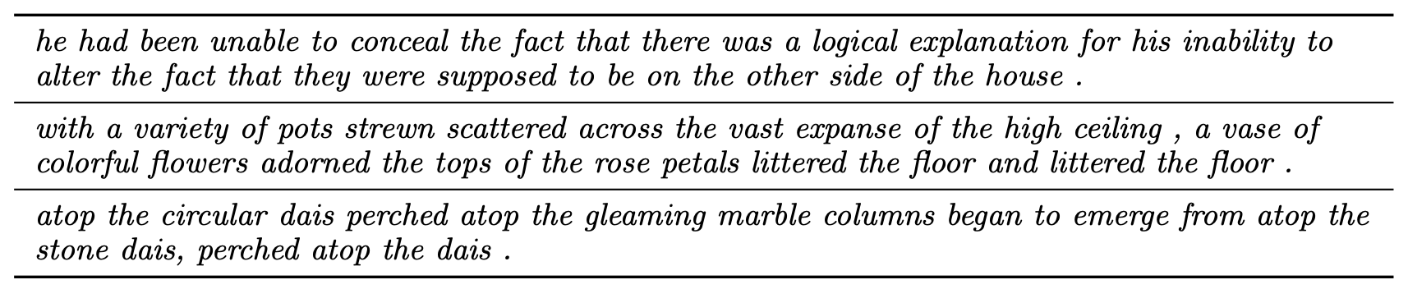
Bowman, 2016 - Analysis of Variational Parameters
Looking at improbably drawn latent variables, which are then decoded. Authors thought this was a good indicator that the latent variable is capturing rich features.

Slide 68
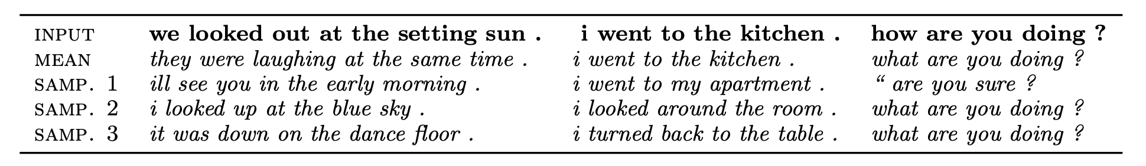
Bowman, 2016 - Analysis of Variational Parameters
Given a sentence, generate its latent variable. How well does the decoder reconstruct the original sentence?

Slide 69
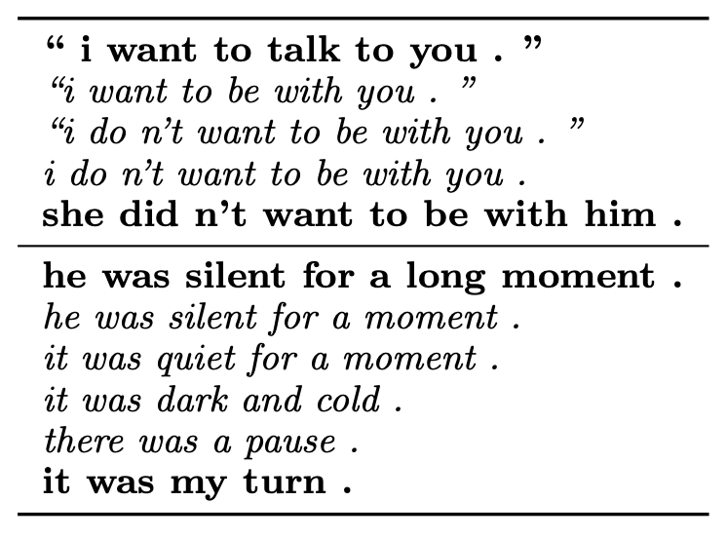
Bowman, 2016 - Analysis of Variational Parameters
Studying homotopies, aka linear paths between randomly sampled points in the latent space.
Gives us a sense of the surface of the latent space distribution.
Compare to regular RNNLM homotopy!

Slide 70
Bowman, 2016 - Discussion
Some of this paper feels kind of made up?
Cool and exploratory though
Definitely needs more work in learning the sentence space

Slide 71
Conclusion
Latent variable models are great if there's a space you think is out there that you want to model
Variational inference is great because it's an optimization problem
Neural variational inference gives us more freedom to choose flexible priors for the latent space
Variational autoencoders let us model continuous spaces
Main ideas of papers
Miao, 2018 - model the latent space of topics
Miao, 2016 - model the latent space of document modeling
Bowman, 2016 - model the latent space of sentences

Slide 72
Discussion Questions
What makes latent variable models compelling?
Are sequences amenable to being represented well as vectors? What kinds of information are being preserved, and what kinds are being lost?
All of these papers rely on diagonal Gaussian priors for the latent space. Are there other priors that we should explore? Why?
Are perplexity and negative log likelihood the best measures of generative models? How do we know?

Slide 73
Other Papers
Review papers/old papers :
Latent Dirichlet Allocation (2003)
Variational Inference: A Review for Statisticians (2018)
Auto-encoding Variational Bayes (2014)
Other Papers:
A Fast Unified Model for Parsing and Sentence Understanding (2016)
Spherical Latent Spaces for Stable Variational Autoencoders (2018)
Blog posts:
Applications of Autoencoders in Natural Language Processing
Blackbox and Approximate (Variational) Neural Inference

