Slide 1
Neural Information Retrieval
Daniel Keller
12/4/2018

Slide 2
Refresher: What is information Retrieval?
The purpose of information retrieval is to help people find the right information in the right format at the right time.
We will avoid going over basic IR techniques since they were covered by Rui Zhang in their Sept 25 lecture.

Slide 3
What tasks use IR?
IR is used in several tasks:
Question Answering
Document Filtering
Document Routing
Ad-hoc Retrieval

Slide 4
Question Answering
Definition: Given a question and a dataset containing the answer, how can we identify and retrieve the answer?

Slide 5
Document Filtering
Definition: Given a stream of documents arriving over time, filter this stream for documents relevant to a set of topics.
The distinguishing feature of document filtering is the temporal aspect introduced by the stream of documents.

Slide 6
Document Routing
Definition: Give a stream of documents arriving over time, how can we disseminate them to different users given each user’s unique preferences?

Slide 7

Ad-hoc Retrieval
Definition: Given a query that is meant to represent a selection of documents that a user is searching for, how can we find the documents that a user wants to find?
Given two texts T1 and T2, we calculate a degree of matching typically measured as a score produced by a scoring function based on the representation of each text:
Notes:
where Φ is a function to map each text to a representation vector, and F is the scoring function based on the interactions between them.
In ad hoc retrieval, T1 is a query and T2 is a document

Slide 8
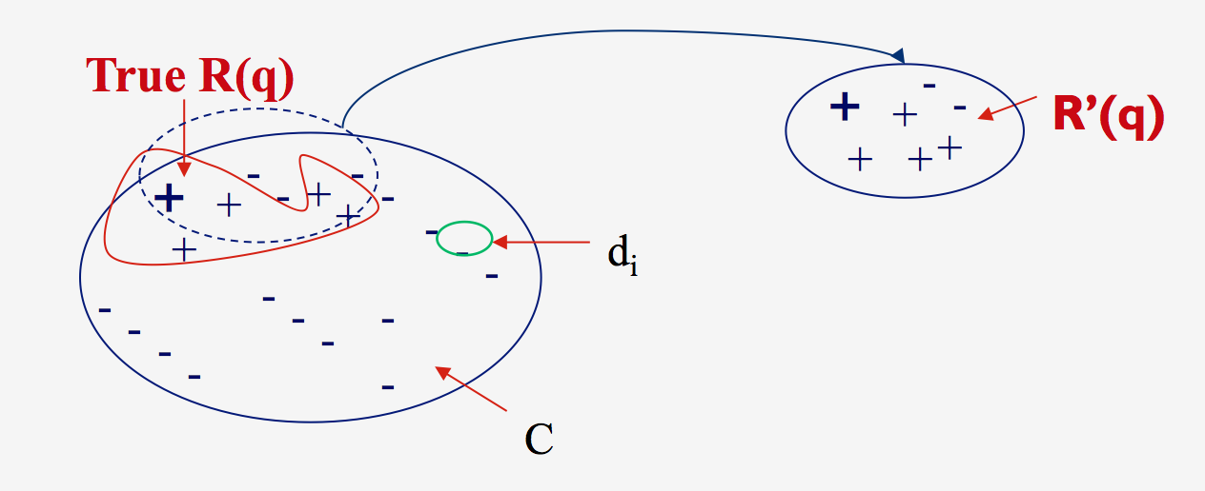

Slide 9


Slide 10
Our focus: Ad-Hoc Retrieval

Slide 11
How do Neural models come into the mix?
In the past few years, a host of new deep neural network models have been released that attempt to address these tasks with a variety of frameworks.
Primarily, they either focus on relevance matching or semantic matching.
Additionally, these models can be categorized as interaction or representation based models.

Slide 12
What are the major issues that Neural models try to address
According to Onal et al., neural models in IR were first introduced to try to address the vocabulary mismatch problem of IR.
Vocabulary Mismatch: How a query and related document may use distinctly different words to describe the same idea
Therefore, neural models are used to match queries and documents through semantics or relevance!

Slide 13
Relevance Matching versus Semantic Matching
Semantic Matching: Can we determine that a document and a query are semantically similar to each other?
Relevance Matching: Can we determine that a document is relevant to a query?
Relevance is a super set of semantic similarity. Semantic similarity can be used to help determine relevance, but relevance is often determined by other factors that do not help determine semantic similarity.

Slide 14
Interaction versus Representation
An interaction focused model first builds local interactions (e.g. query term appearance rate in a doc) between two pieces of text, and then uses deep neural networks to learn hierarchical interaction patterns for matching documents to queries.
A representation focused model tries to build a good representation of each text with a neural network, then conducts matching between the compositional and abstract text representations.

Slide 15
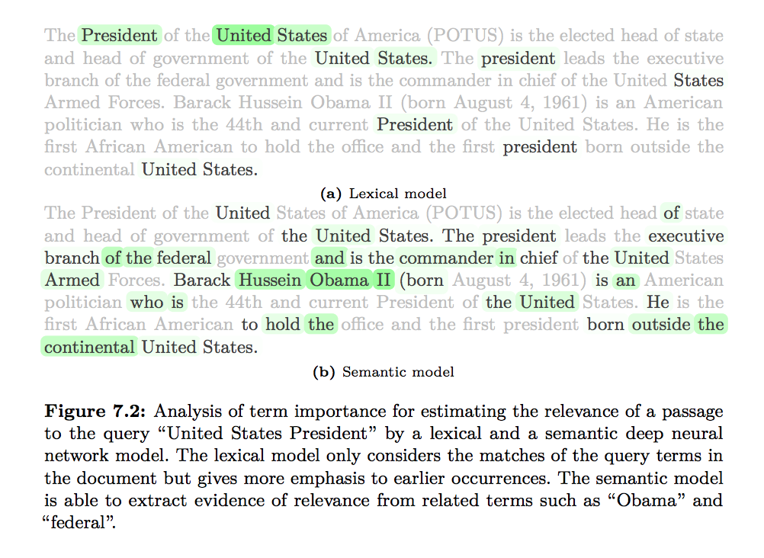
Example Interaction Analysis
Figure from Mitra and Craswell, 2018, NOW Publishing

Slide 16
Semantic Matching, in brief
Defined as “conduct query and document analysis to represent the meaning of a query and a document with richer representations and then perform matching with those representations.” - Li et al. [2014, INR]
In simpler terms: How can we represent documents and queries in a mathematical way that allows us to quickly determine if a document is a good result for a particular query.

Slide 17
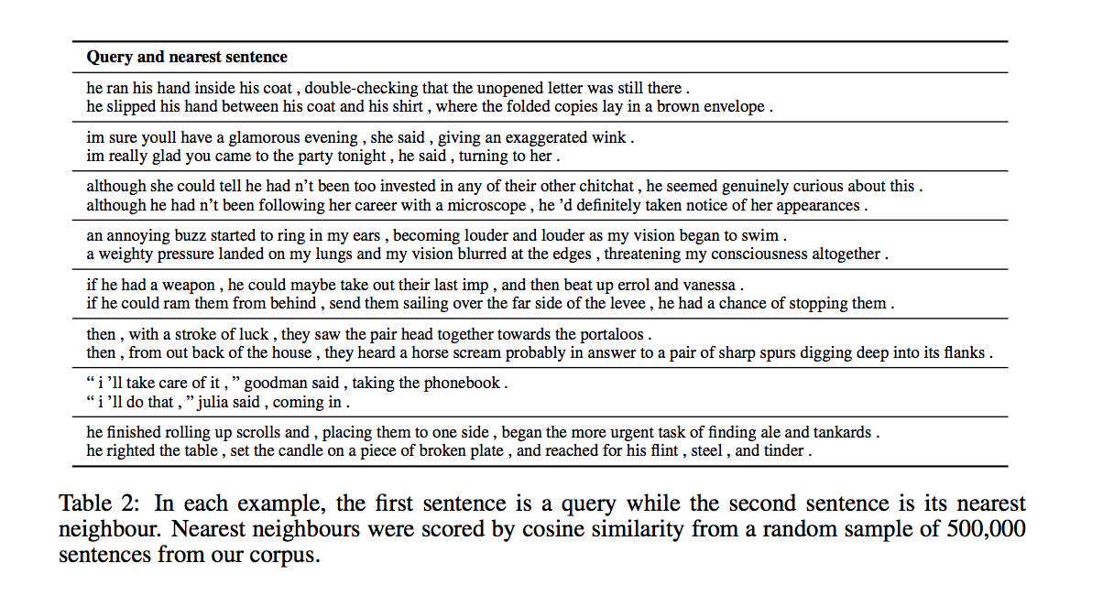
Table from Kiros et al., 2015, NIPS
Notes:
Nearest neighbors are from documents, queries are user input

Slide 18
What does this mean? Document Embeddings
Bag of Embedded words (Sum or average of word vectors) [Vulic and Moens, 2015 ACL, Zamani and Croft, 2016b ICTIR]
Skip Thought Vectors [Kiros et al., 2015, NIPS]
Doc2Vec and Paragraph2Vec [Le and Mikolov, 2014, ICML]

Slide 19
How do we use these embeddings to match documents to queries?
Embeddings can be used for:
Document Retrieval
Document Ranking
Query Term Weighting
Query Expansion

Slide 20
Pre-trained or Learned From Scratch
Models that use document embeddings can either use pre-trained embeddings or learn them from scratch.
Using pre-trained embeddings, models have used bag-of-words systems, translation model based systems, or embedding feature extraction systems.
For embeddings learned from scratch, models have used doc2vec embeddings or skip thought vectors.

Slide 21
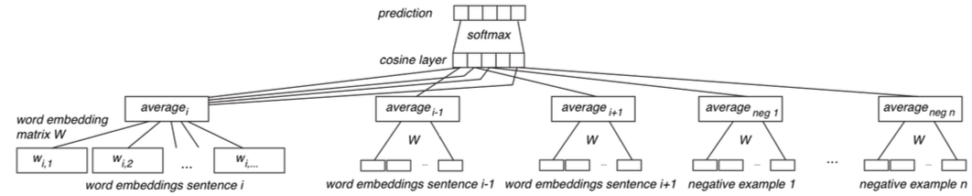
Pre-trained Embeddings
Notes:
Find pre trained embeddings and average them

Slide 22
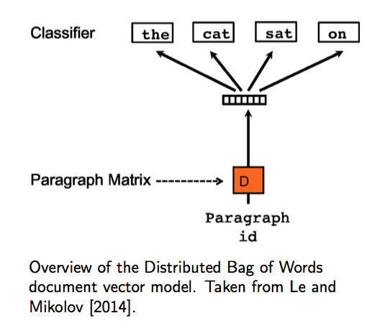
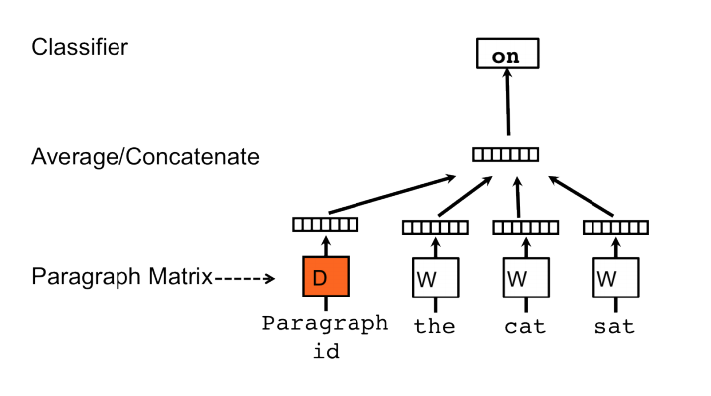
Learned From Scratch (e.g. doc2vec)
Notes:
Train embeddings for words based on full model of averaging
The construction of the embeddings is part of the overall model

Slide 23
What are some models that use semantic matching?
Representation Based Models like ARC-I [Hu et al., 2014, NIPS]
Construct a fixed-dimensional vector representation for each text separately then perform matching within the latent space
Interaction Based Models like DRMM [Guo et al., 2016, SIGIR]
Compute the interaction between each query term and a given text
Hybrid Models like ARC-II [Hu et al., 2014, NIPS]

Slide 24
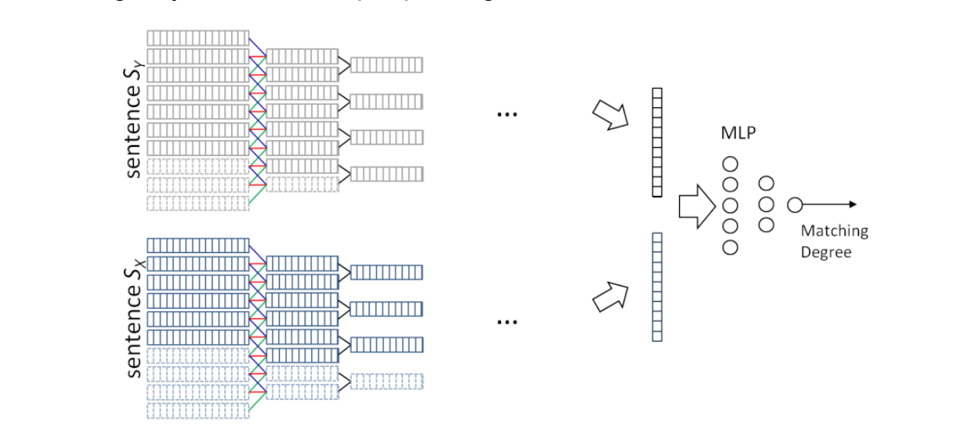
ARC-I [Hu et al., 2014 NIPS]
Perform 1-dimensional convolution on each text representation
Compare each finalized vector to query

Slide 25
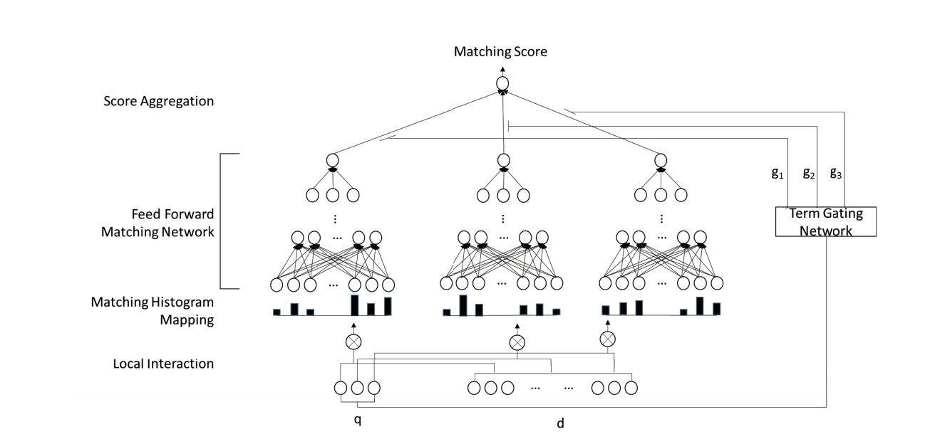
DRMM [Guo et al., 2016 SIGIR]
Compute term and document interactions using histograms of count, relative count, log-count, etc
Pass histograms into feed forward network with attention for relevance scoring

Slide 26
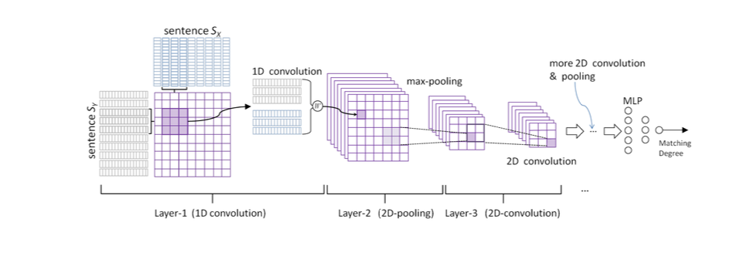
ARC-II [Hu et al., 2014 NIPS]
Word representations are generated from context using convolutional nets, and interaction matrices are introduced in between sliding window layers

Slide 27
Learning To Rank, in Brief
Defined as “the task to automatically construct a ranking model using training data, such that the model can sort new objects according to their degrees of relevance, preference, or importance.” -Liu [2009 INR]
In simpler terms: How do we build systems that can choose the “best” documents to show to our users even when those documents are new to our system?

Slide 28
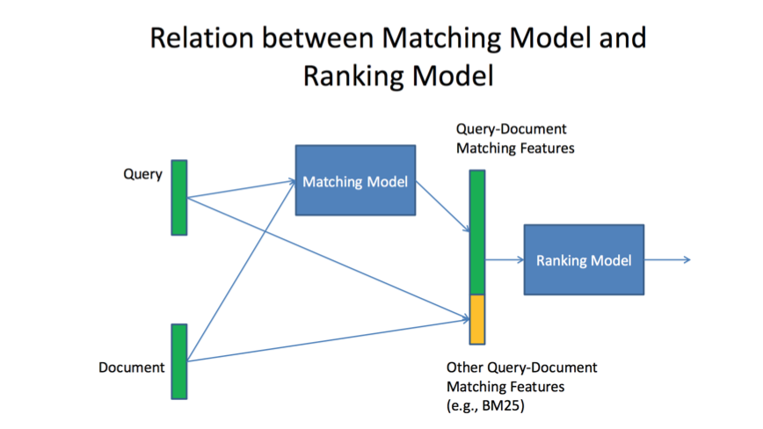
Learning to Rank versus semantic matching
The previously discussed Semantic matching is a part of learning to rank.
See the accompanying figure from [Li and Lu, 2016 SIGIR] for explanation

Slide 29
Three Major Training Objectives
Pointwise Approach
Determine the relevance number per document based on explicitly or implicitly provided human labels
Pairwise Approach
Reduce the problem to a binary classification between two documents for which is more relevant
Listwise Approach
Directly optimize for specific rank based metrics

Slide 30
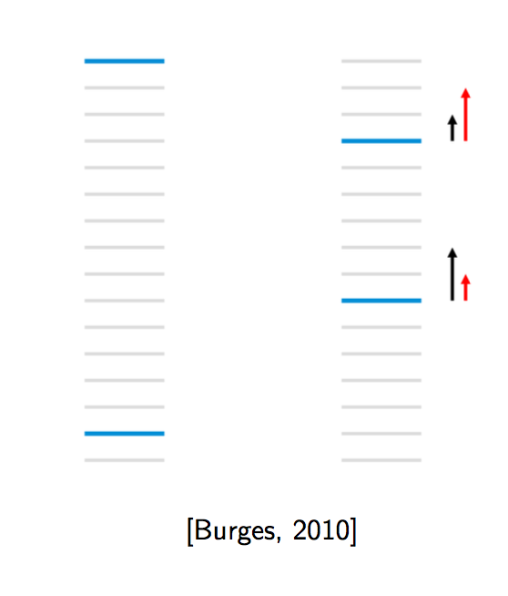
Example of listwise ranking
Blue = relevant document Grey = not relevant
Rank based metrics: NDCG (usefulness of document based on list location) ERR (expected reciprocal rank e.g. how high is the document the user chooses)
NDCG and ERR are higher for left but pairwise errors less for right
A list wise model would try to balance and optimize these statistics

Slide 31
State of the art Feature based model: BM25F
BM25F is currently used by many search engines for ranking
BM25F uses a bag of words model that measures the number of query terms in a given document regardless of their position.
This general concept is used to build a scoring function with several specific scoring functions per document field

Slide 32
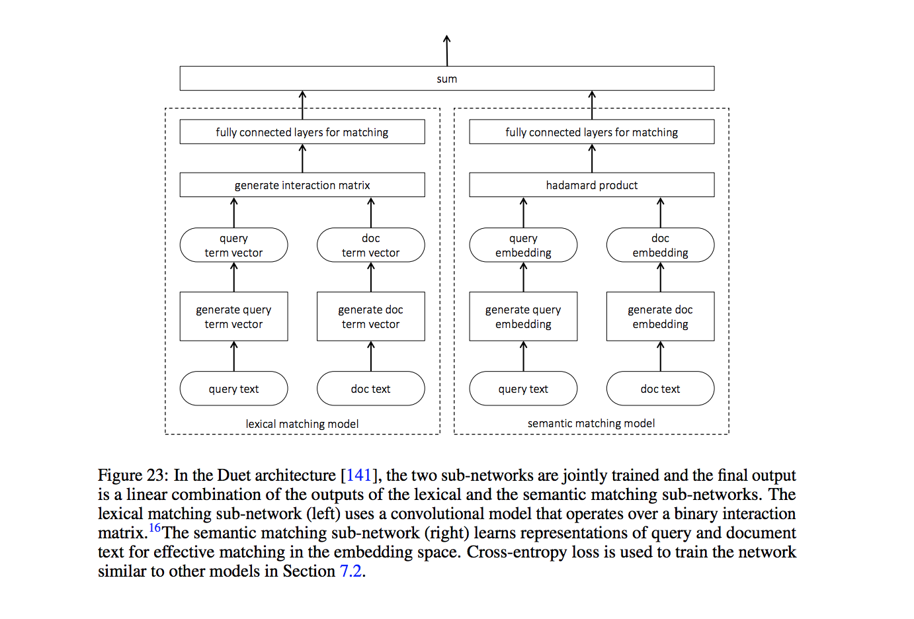
Figure from Mitra and Craswell 2017
Notes:
Here we see an example of neural models for ranking! Lexical matching + semantic matching = a final relevancy score
This is the Duet Architecture discussed by Rui

Slide 33
Papers

Slide 34
Papers
A Deep Relevance Matching Model for Ad-hoc Retrieval [Guo et al., 2017, SIGIR]
Neural Ranking Models with Multiple Document Fields [Zamani et al., 2017, WSDM]
DeepRank: A New Deep Architecture for Relevance Ranking in Information Retrieval [Pang et al. 2017, CIKM]

Slide 35
Metrics
nDCG@20, @10, @5: Normalized Discounted Cumulative Gain
P@20, @10, @5: Precision
MAP: Mean Average Precision

Slide 36
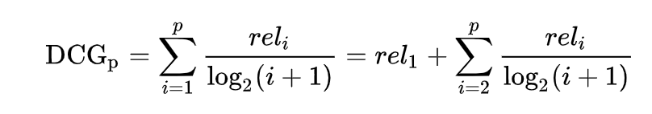
nDCG@20, @10, @5: Normalized Discounted Cumulative Gain
Sum the relevance value of ranked documents, with value being logarithmically reduced as you go down in rank
Notes:
Normalized just means we normalize it to list size (5, 10, 20, etc)

Slide 37
Precision
Precision can be calculated as the number of documents correctly selected, out of the total number selected.
E.g. where w is the number of correct documents selected, y is the number of incorrect documents selected, and precision = w / (w+y)

Slide 38
MAP: Mean Average Precision
Given a set of queries, MAP is the mean of the average precision scores for each query over some number of tests.

Slide 39
A Deep Relevance Matching Model for Ad-hoc Retrieval [Guo et al., 2017]

Slide 40
Summary
In this paper, Guo et al. introduce the model DRMM.
DRMM tries to improve on current deep learning ad-hoc retrieval techniques by using relevance matching instead of semantic matching.
DRMM is an interaction-focused model that uses matching histogram mapping, a feed forward matching network, and a term gating network in order to learn various features that contribute to relevance matching.

Slide 41
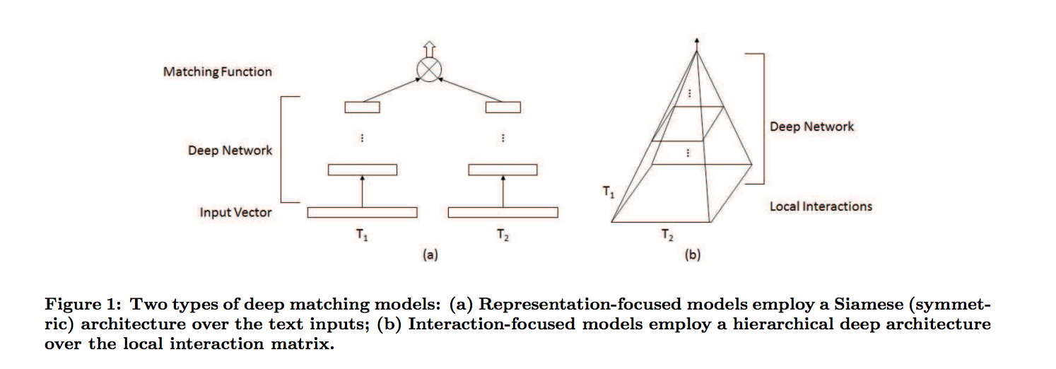
Interaction versus Representation
Figure from Guo et al., 2017

Slide 42
DRMM and Relevance matching
There are a few main features that separate relevance matching from semantic matching. Guo et. al focus on these three:
Exact matching signals (ESM)
Does the term appear exactly in a document?
Query Term Importance (QTI)
Certain terms in a query are more important than others
Diverse Matching Requirements (DMR)
A long document may be just a verbose document on one topic or a collection of short documents on different topics
Therefore, if one part of a document is relevant, then all of the document is

Slide 43
How does DRMM focus on relevance matching?
For each main feature that Guo et al. focus on, they add a different device to their DRMM model. These include:
Matching Histogram Mapping -> Exact Matching signals and Diverse Matching Requirement
Term Gating Network -> Query Term Importance
Feed Forward Matching Network -> Diverse Matching Requirement

Slide 44
Matching Histogram Mapping: What is it?
Each query term has a corresponding histogram.
A matching histogram is a data structure of fixed length where each variable represents a “bucket” from one similarity score to the next. There is also a distinct bucket for an exact match.
If a word has a similarity score that fits within a bucket (e.g. a bucket from [-1, -0.5)), then that bucket’s count is incremented by one.
Mapped histogram mappings can be absolute count based, normalized, or LogCount-based.
Notes:
Normalized shows general relevance mappings and avoids longer documents having an advantage just due to more words
LogCount Based allows the model to more easily learn multiplicative relationships

Slide 45
Matching Histogram Mapping: Why introduce it?
Most papers use matching matrices to keep track of interactions.
However, as these matrices add in position information and zero padding, they add a lot of noise.
Therefore, Guo et al. instead use a matching histogram avoiding noise.
The histogram groups local interactions according to their strength, not their positions. This takes advantage of DMR.
Additionally, the histogram keeps track of exact matches as their own class. This takes advantage of EMS.

Slide 46
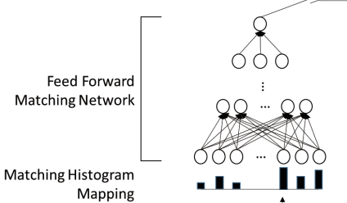
Feed Forward Network: What is it?
After matching histogram mappings are constructed, they are fed into a feed forward matching network.
This is a rather basic feed forward network with a loss function built to learn which patterns of similarity strength (tracked in the matching histograms) are best at predicting document revelance.

Slide 47
Feed Forward Network: Why introduce it?
Most other papers have used CNNs to learn hierarchical matching patterns.
While CNNs work well on semantic matching problems, they do not perform as well on relevance mapping.
This, once again, is due to the Diverse Matching Requirement of relevance mapping. CNNs learn based on positional data. Guo et al. do not want positional data to be apart of their learning process.

Slide 48
Term Gating Network: What is it, and why introduce it?
The term gating network is component of the model where term vectors are passed in. The gate learns different weights for each of the terms.
This gating network takes advantage of query term importance, learning which types of query terms have the best predictive effect on document relevance.

Slide 49
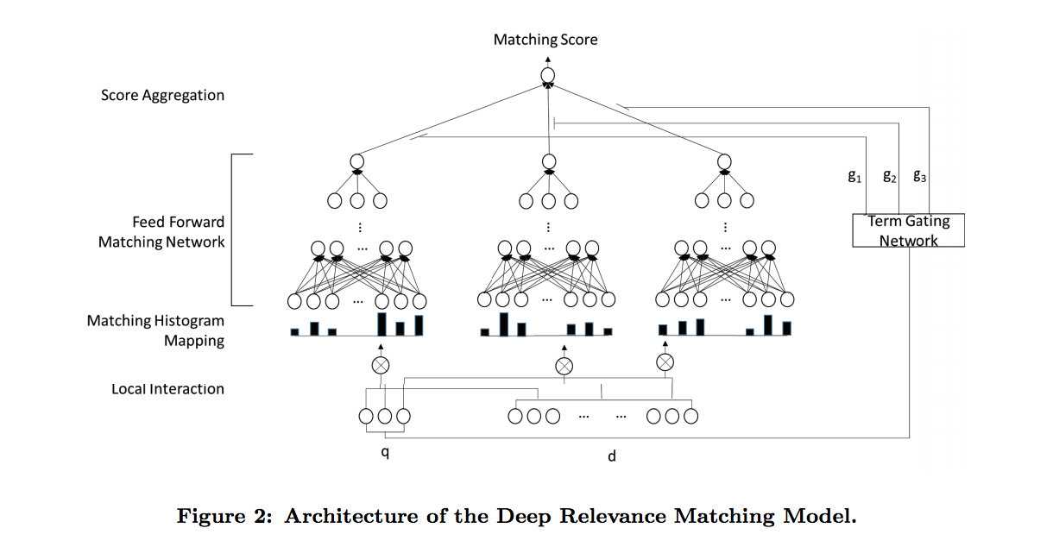
Model Overview

Slide 50
Evaluation Methodology
Guo et al. conducted 5-fold cross-validation tests
They used two datasets, ClueWeb-09-Cat-B collection (web queries and results) and Robust-04 collection (news articles and documents)
For each model, they ran tests on topic titles and topic descriptions.
For each model and test, they tracked MAP, nDCG@20, and P@20
Notes:
MAP: Mean Average Precision (what is the average precision of our ranked lists across all of the list?)
nDCG@20: normalized discounted cumulative gain at rank 20 (sum relevance value of ranked documents, with value being logarithmically reduced as you go down inrank)
P@20: precision @ 20 : of the number selected, how many of them were correctly classified?
^These can be earlier slides

Slide 51
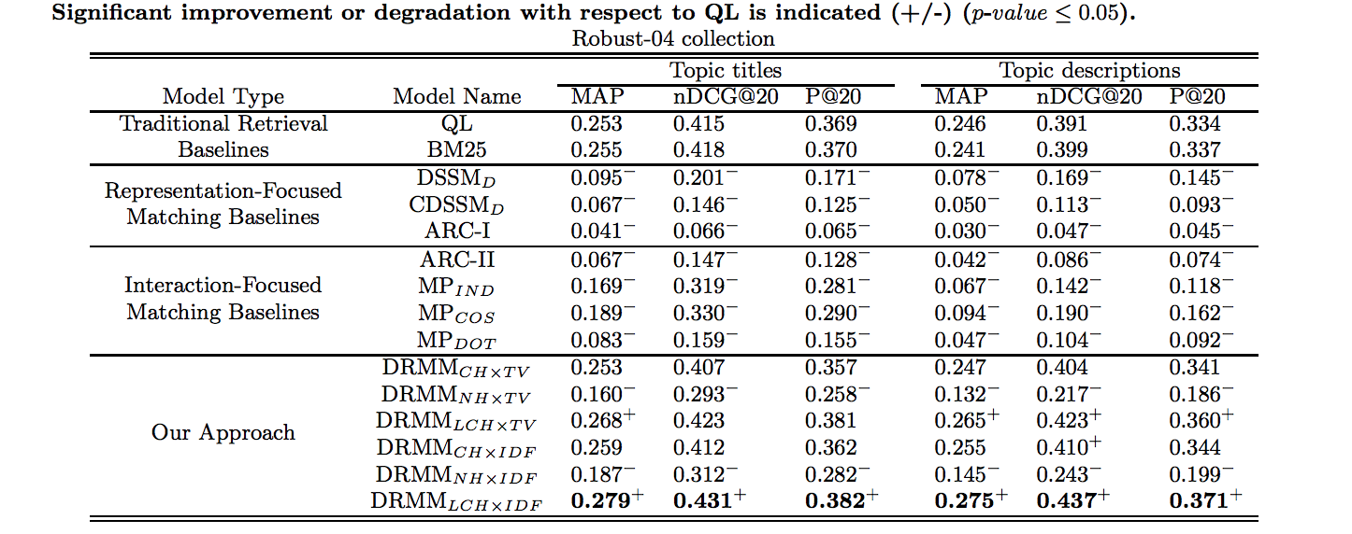
Results: Against Other Models
Notes:
First, Robust Results

Slide 52
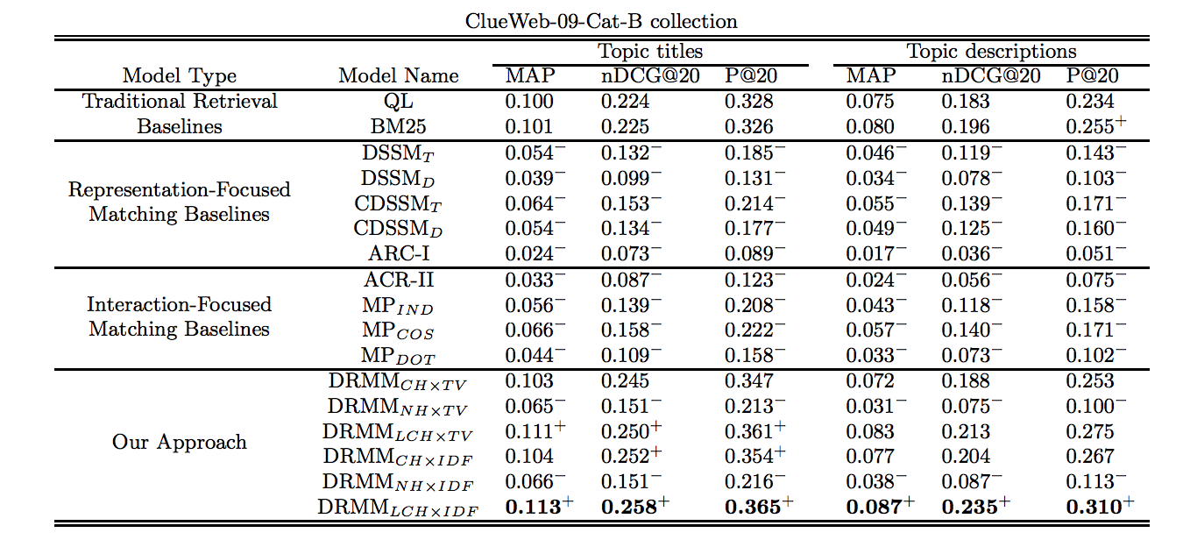
Results: Against Other Models

Slide 53
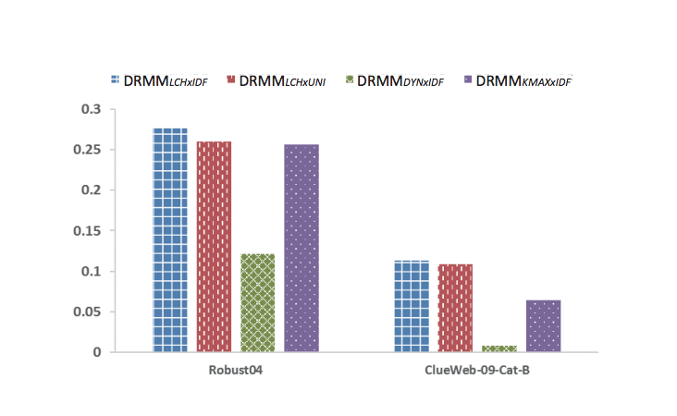
Results: Feature Ablation Tests
Notes:
DRMM LCHxIDF == the original DRMM model
DRMM LCHxUNI == DRMM without term gating, instead just sum scores of all query terms
DRMM DYNxIDF == Without histogram mapping, instead use variable length followed by dynamic pooling
DRMM KMAXxIDF == Without histogram mapping, instead use K-max pooling

Slide 54
Conclusion
From this work, Guo et al. find that relevance matching may be a better problem generalization for ad-hoc retrieval than semantic matching.
Guo et al. see that their relevance matching based model performs better than all semantic matching based models and the current traditional IR state of the art baseline.

Slide 55
Neural Ranking Models with Multiple Document Fields [Zamani et al., 2017]

Slide 56
Summary
In this paper, Zamani et. al introduce the model NRM.
NRM has a generalized framework that allows it to learn from multiple fields of a document at once in order to produce a single relevance scoring. This includes short versus long fields as well as multiple instance fields such as anchor text.
In order to do this, they introduce a field-level drop out method and a masking method to handle missing field instances.
Notes:
Motivation: Why do this?
BM25F takes advantage of full document structure and is one of the best non neural IR methods

Slide 57
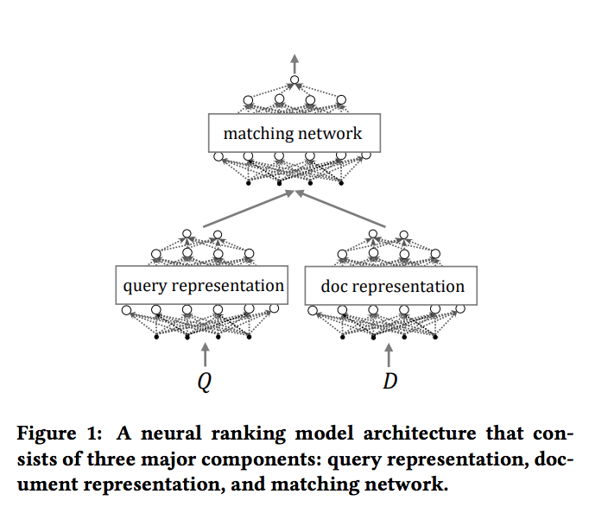
High Level Overview
NRM consists of a query representation network and document representation that both feed into a matching network in order to produce a final relevance score for a document.

Slide 58
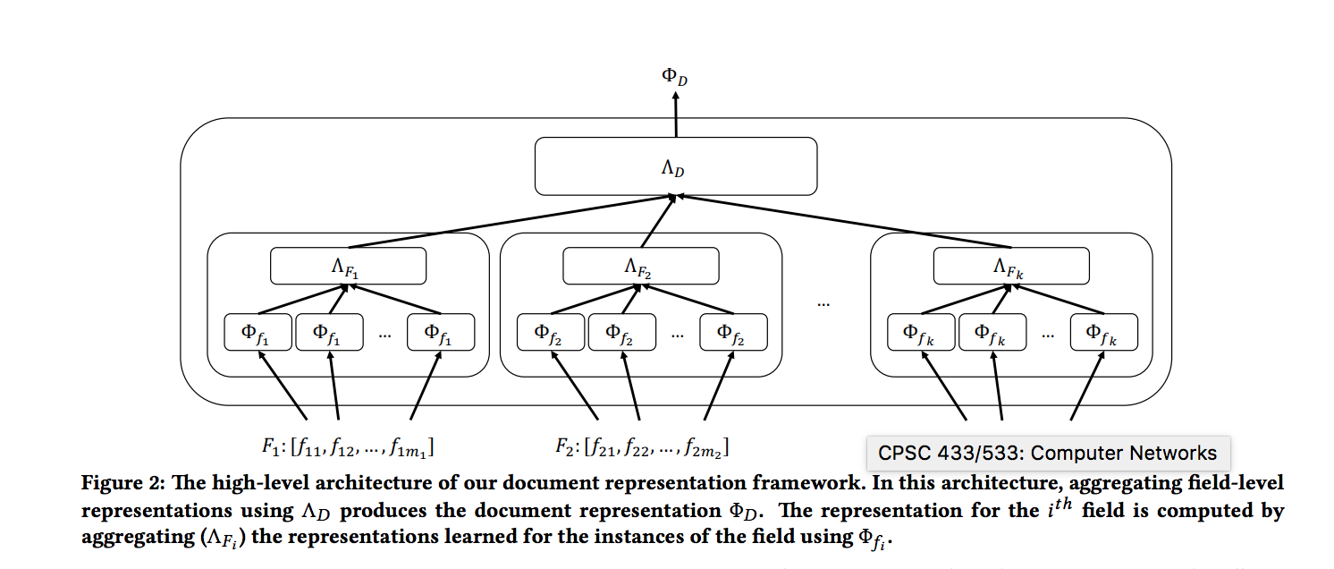
Document Representation Network
The document representation network learns an instance level representation for each field instance, aggregates those instances into a field representation, and then aggregates those field representations into a document representation

Slide 59
Document Representation Network
In order to aggregate field instances, we select a bag of at most M instances (zero padding if we don’t have enough)
In order to aggregate fields, concatenate each input vector to form a document vector.

Slide 60
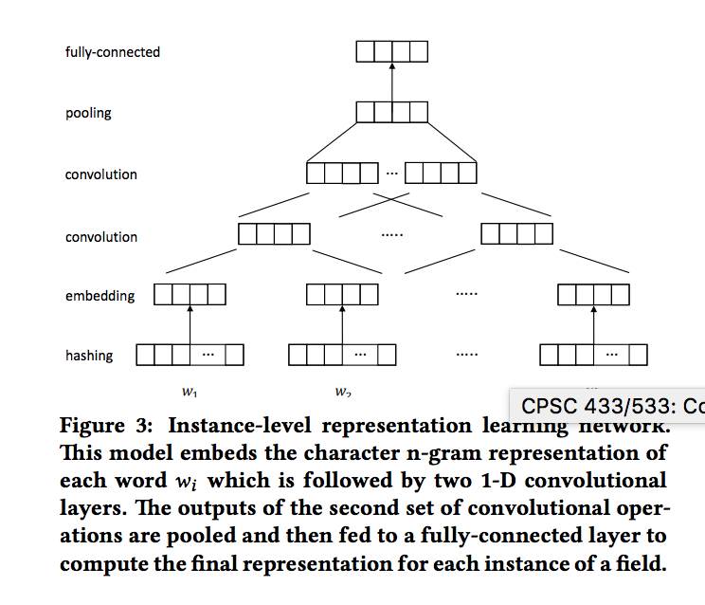
But how do we learn instance level representations?
For each instance, they construct a model with various hyperparameters that allows the model to change depending on characteristics of a doc field.

Slide 61
But how do we learn instance level representations?
Each term is represented by a character n-gram hashing vector. Each character n-gram hashing vector is turned into an embedding using a linear embedding layer

Slide 62
But how do we learn instance level representations?
Embeddings are then normalized.
After normalization, they are run through a CNN in order to learn the dependencies between terms. This is then repeated to learn sentence level dependencies.

Slide 63
But how do we learn instance level representations?
Finally, the model uses average pooling or max pooling and fully connected layer to make the final representation

Slide 64
Field Level Masking
Since this model handles multi-instance fields such as anchor text, they need a way to handle documents that have varying numbers of these field.
They handle this with zero padding; however, zero padding can lead to a model misinterpreting empty variables as instances with zero impact.
In order to counteract this, Zamani et. al introduce field level masking.
This is also used in averaging!
Notes:
Similar to many masking algorithms 1, 0
1 if not zero padded
0 if zero padded
Applied before backpropagation
Averaging: compute exact average vector: sum input, divide by summation over masking vector

Slide 65
Field Level Dropout
Documents are very inconsistent. Some documents may have Field A while others may not. If Field A is extremely predictive of a relevance score, this can be an issue.
In order to teach the model to learn the predictive nature of all fields, Zamani et al. introduce Field Level Dropout.
Notes:
While learning,
For each batch
Randomly drop out all of the units corresponding to a specific field
Hyperparameter of k values, each value being a probability that the i-th field drops out during a training batch
This gets the models to learn about all fields, not just the incredibly strong ones.

Slide 66
Query Representation
Matching Network
Since the query is only a single text field, Zamani et. al learn its representation by using the instance level network used by document representation network.
The matching network is computed by taking the element wise product of the two representations. They then train a fully connected neural network with a single non-linear hidden layer to compute the score.

Slide 67
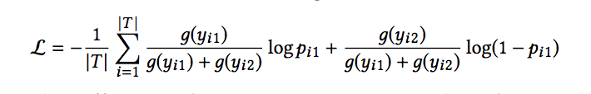
Learning
In order to compute loss, Zamani et al. use a pairwise setting. If each training instance has a query qi and two documents di1 and di2, as well as their corresponding labels yi1 and yi2, they use the cross entropy loss function:
Notes:
Where g() is a gain function. Pi1 is the estimated prob for di1 being more relevant than di2, pi1 is calculated using softmax on the labels pi1 = exp (yˆi1)/(exp (yˆi1) + exp (yˆi2)), where yˆi1 and yˆi2 denote the estimated scores for di1 and di2, respectively.

Slide 68
Experiment setup
Guo et al used a random sampling of 140k queries from Bing’s search logs for its dataset.
Using this dataset, they generate all possible pairwise training instances.

Slide 69
Hypothesis
Zamani et al wanted to prove these five hypothesis:
The ad-hoc retrieval performance of NRM-F improves as we incorporate multiple document elds.
NRM-F performs beer than competitive baselines, such as term matching and learning to rank
Learning a multiple-eld document representation is superior to scoring based on individual eld representations and summing

Slide 70
Hypothesis
4. Learning per-eld query representations performs better than learning a single query representation
5. The additional techniques of eld-level masking and eld-level dropout yield additional performance improvements.

Slide 71
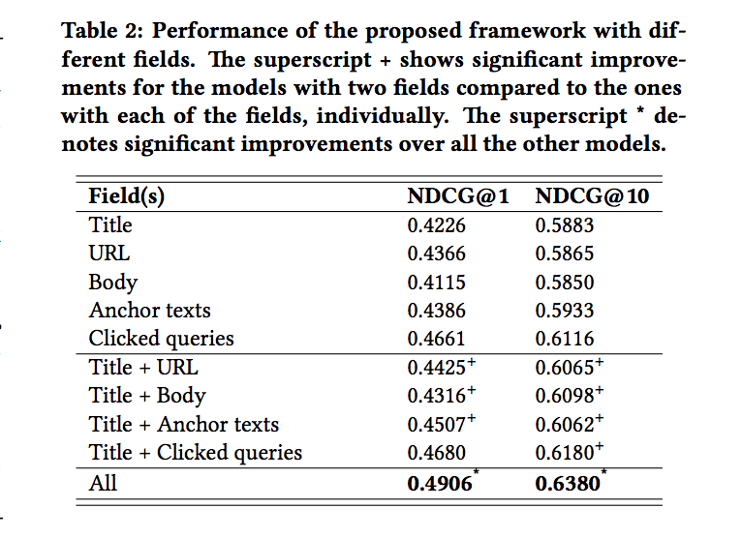
Results
Notes:
Proof of H1

Slide 72
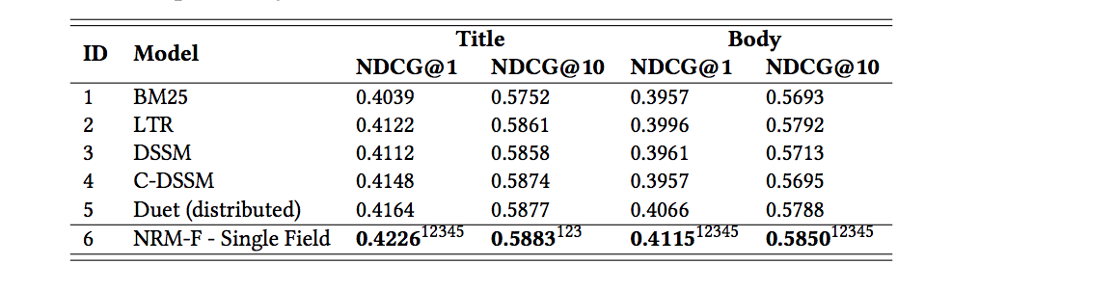
Results
Notes:
Proves H3,
Against traditional IR BM25,
LTR, DSSM, C-DSSM, Duet

Slide 73
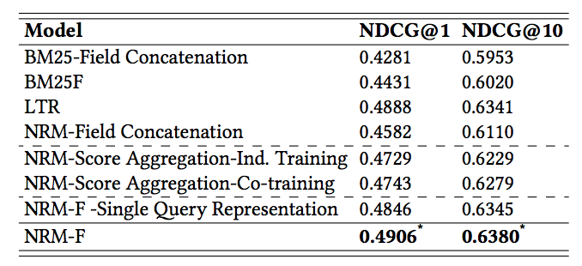
Results
Notes:
Proves H3, H4

Slide 74
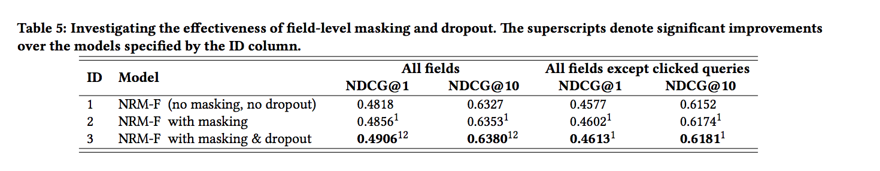
Results
Notes:
Proves H5

Slide 75
Conclusion
Zamani et al. successfully constructed a model that can learn jointly from multiple document fields in a generalized way.
As they suspected, this model performed better than the state of the art traditional IR baseline and all currently published IR models.

Slide 76
DeepRank: A New Deep Architecture for Relevance Ranking in Information Retrieval [Pang et al. 2017]

Slide 77
Summary
While DRMM tries to model IR’s own characteristics, it does not try to model the relevance generation process of a human.
DeepRank tries to do just this
DeepRank extracts relevant contexts, determines the local relevances with a CNN or 2D GRU, and then aggregates these local relevances to produce a global relevance score.
DeepRank performs better than DRMM and some state of the art Learning to Rank models

Slide 78
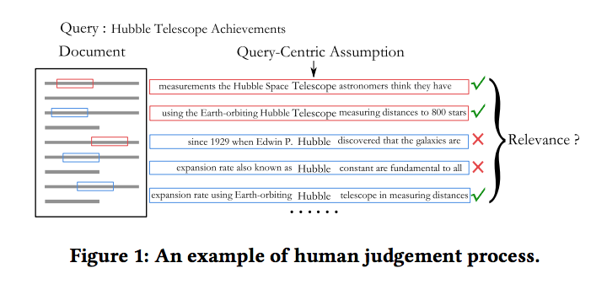
Aspects of IR modelled
Query Term Importance
Diverse Relevance Requirements
Exact/Semantic matching Signals
New:
Proximity Heuristics (Reward a document where matched query terms appear close to each other)

Slide 79
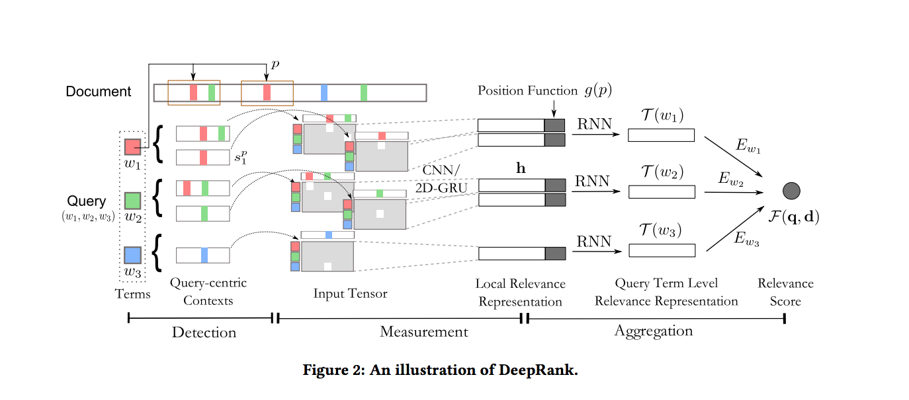
Overview of Model
Notes:
Detection Strategy
To Measurement Network
To Aggregation Network

Slide 80
Detection Strategy
The proximity heuristic of Human generated IR search shows that the most relevant terms are those near exact matches or near exact matches of query terms.
In order to simulate this, find all exact or near exact matches, and pull query-centric contexts from around them.
Notes:
Query centric context == the paragraph or section around a query term

Slide 81
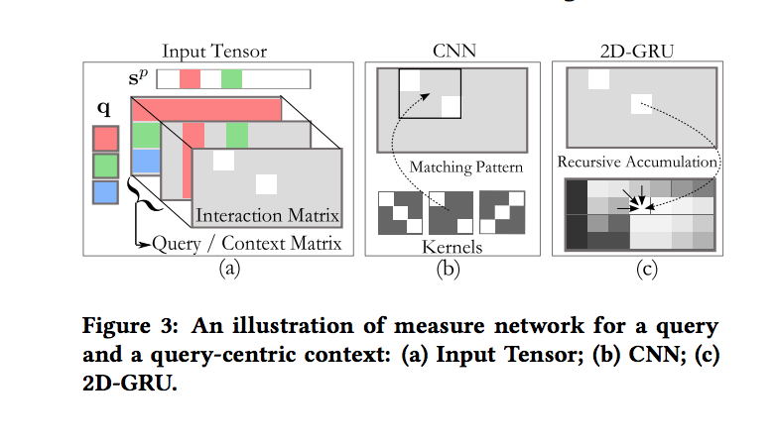
Measure Network
First, build an input tensor.
An input tensor is built by finding the word-level interaction matrix of the query q and a query level context.
Notes:
The matrix slot Sij is the semantic similarity between query term i and query context j

Slide 82
Measure Network
After an input tensor is constructed, we either use CNN or 2D-GRU on the input tensor.
These learn the proximity heuristics. They also learn general semantic matching and its relation to relevance.

Slide 83
Aggregation Network
As the last step of the model, Pang et al. use a series of aggregation steps to get their final relevance score.
First, they do Query Term Level Aggregation, appending the position of the context onto its vector h. This helps address the diverse matching requirement by adding in positional data.
Second, they use term gating, similar to Guo et al., to account for query term important. The result of this term gating is the final relevance score.
Notes:
For them, the diverse matching requirement means positional data? For Guo et al, it meant removing positional data?

Slide 84
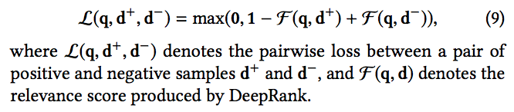
Model Training
The model is trained using stochastic gradient descent methods.
Loss is calculated using pairwise hinge loss.

Slide 85
Experiments
Pang et al. use the LETOR4.0 dataset. LETOR4.0 consists of two datasets, each consisting of queries and document rankings. In total, the datasets, MQ2007 and MQ2008, have 69,623 and 84,834 query-document pairs.
They also use ChineseClick, a large scale clickthrough dataset. This dataset is constructed by presenting 10 documents to a user’s query. Those clicked are counted as relevant. It contains 12k queries, 115k documents, and 118k query-document pairs.

Slide 86
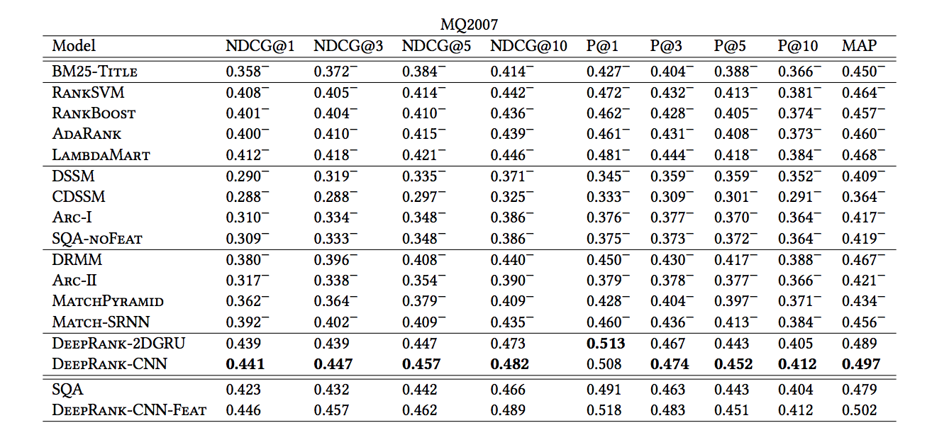
Results MQ2007

Slide 87
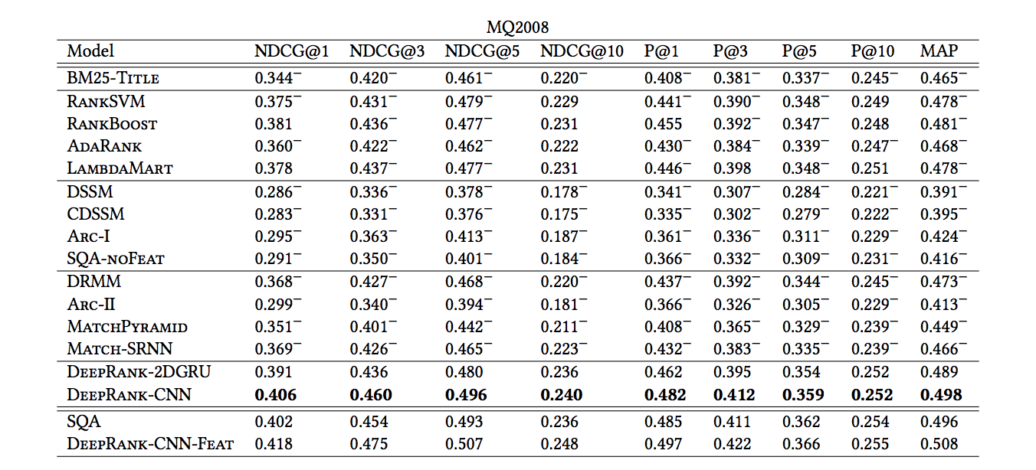
Results MQ2008

Slide 88
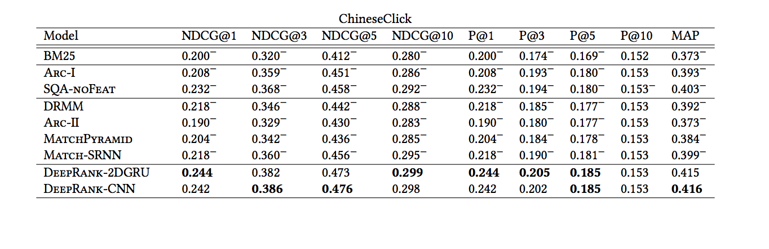
Results Chinese Clickthrough

Slide 89
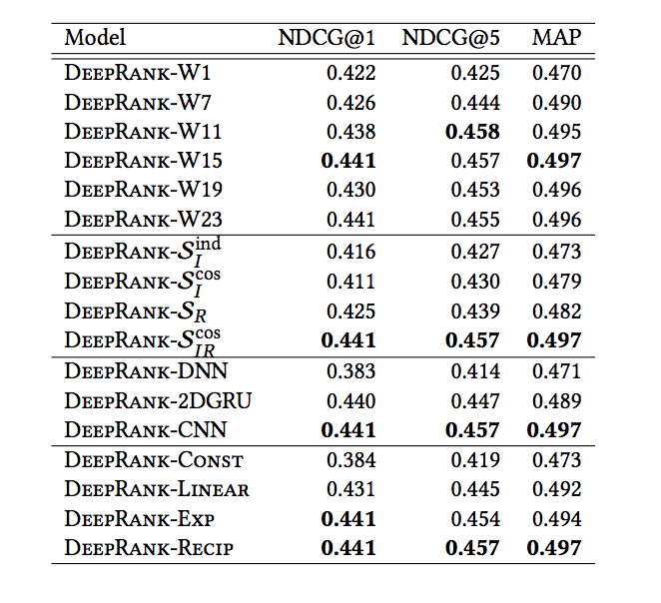
Results Ablation Studies

Slide 90
Conclusion
Pang et al. present a new model that outperforms all other forms of deep learning IR models.
They achieve this by trying to directly model the workflow of human based IR.
They address many of the similar issues as the Guo et. al DRMM model, but add in a consideration for the Proximity Heuristic.

Slide 91
Discussion
In the field, there is a lot of debate over whether semantic matching or relevance matching is best for IR. What do you think and why?
Similarly, are interaction based models better than representation based models? Why or why not?
Where do you think ad-hoc retrieval systems can be used to improve our experience of the web?
Can the models built for ad-hoc retrieval be used elsewhere? Could they help at all with paraphrase detection or question answering?

Slide 92
References
Works Cited
Ai, Qingyao, et al. “Analysis of the Paragraph Vector Model for Information Retrieval.” Proceedings of the 2016 ACM International Conference on the Theory of Information Retrieval - ICTIR '16, 12 Sept. 2016, doi:10.1145/2970398.2970409.
Dehghani, Mostafa, et al. “Neural Ranking Models with Weak Supervision.” Proceedings of the 40th International ACM SIGIR Conference on Research and Development in Information Retrieval - SIGIR '17, 28 Apr. 2017, doi:10.1145/3077136.3080832.
Guo, Jiafeng, et al. “A Deep Relevance Matching Model for Ad-Hoc Retrieval.” Proceedings of the 25th ACM International on Conference on Information and Knowledge Management - CIKM '16, 23 Nov. 2017, doi:10.1145/2983323.2983769.
Gysel, Christophe Van, et al. “Neural Vector Spaces for Unsupervised Information Retrieval.” ACM Transactions on Information Systems, vol. 36, no. 4, 2018, pp. 1–25., doi:10.1145/3196826.

Slide 93
References (cont.)
Hu, Baotian, et al. "Convolutional neural network architectures for matching natural language sentences." Advances in neural information processing systems. 2014.
Kenter, Tom, et al. “Neural Networks for Information Retrieval.” Neural Networks for Information Retrieval, nn4ir.com/.
Kiros, Ryan et al. “Skip-Thought Vectors.” NIPS (2015).
Hang Li, Jun Xu, and others. 2014. Semantic matching in search. Foundations and Trends in Information Retrieval 7, 5 (2014), 343–469
Onal, Kezban Dilek, et al. “Neural Information Retrieval: at the End of the Early Years.” Information Retrieval Journal, vol. 21, no. 2-3, 2017, pp. 111–182., doi:10.1007/s10791-017-9321-y.
Pang, Liang, et al. “DeepRank.” Proceedings of the 2017 ACM on Conference on Information and Knowledge Management - CIKM '17, 16 Oct. 2017, doi:10.1145/3132847.3132914.
Zamani, Hamed, et al. “Neural Ranking Models with Multiple Document Fields.” Proceedings of the Eleventh ACM International Conference on Web Search and Data Mining - WSDM '18, 25 Nov. 2017, doi:10.1145/3159652.3159730.

Slide 94
Thank you!

