Slide 1
Advanced NLP
Sequence2SQL
Natural Language Interfaces to Databases
Tao Yu
09-27-2018

Slide 2
Outline
Introduction & Background
Motivation
Challenges
Datasets and task definitions
Methods
Summary & Future Directions
Discussion Questions
References

Slide 3
Data is important...
Data
Data explosion
Computation power is not a big problem anymore
Make profits and reduce cost for companies by using machine learning models
Also, more and more people from different backgrounds are trying to query and use their own data.
The demand for data scientists is increasing so quickly
Even at Yale, Dept. of Stats -> Dept. of Stats and Data Science

Slide 4
Must-have skills for data scientist
Engineering
SQL database/coding
Python coding
Data visualization
Parallel computing
…...
Theory
Statistics and data analysis
Machine learning
…...

Slide 5
But not everyone is a data scientist ...
Every task requires certain technical backgrounds
Write SQL to query your data can be hard
Visualize your data would be a disaster
Come up with new models is even more challenging
Machine learning and Math are nightmares

Slide 6
Make these tasks easier to everyone
Can we talk to our databases directly to get our data?
This is our topic today!
Can data visualization effectively make sense of our data?
Different visualization tools and systems are developed
Eugene Wu, database group@Columbia is working on it
Can we build our machine learning models quicker?
Open tools - Sklearn, Pytorch, Tensorflow
Open projects - Fairseq, HarvardNMT
Can we make machine learning theories easier to understand?
Introduction blogs

Slide 7
What is SQL?
SQL stands for Structured Query Language. It is the official language to talk to these databases.
Why we care about it? A vast amount of data is stored in relational databases, which provides:
Financial exchanges
Medical history
Education records
…...

Slide 8
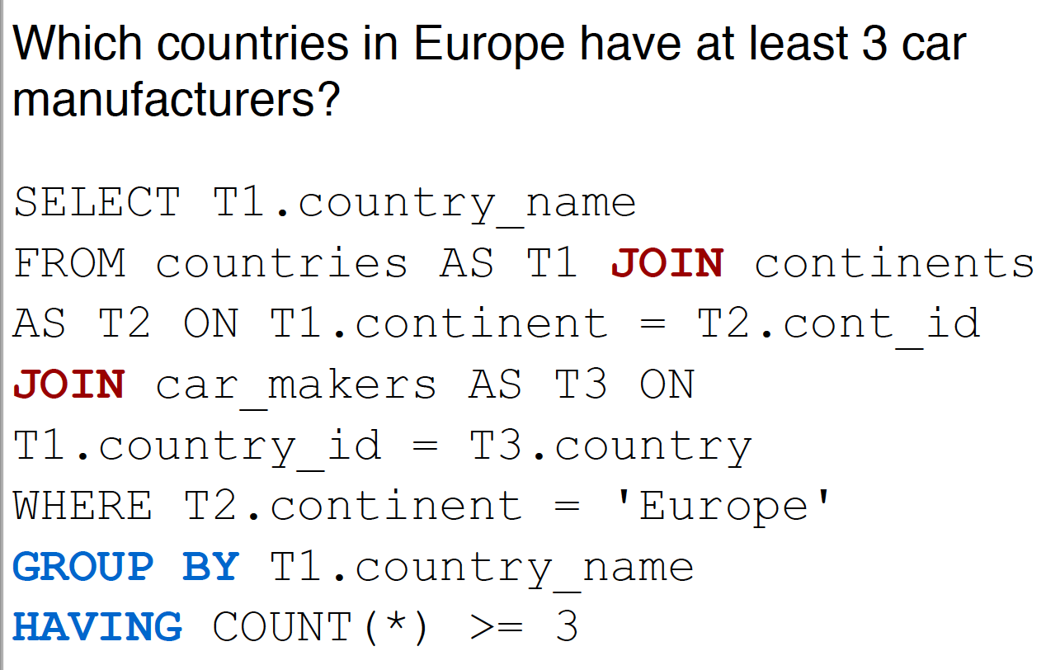
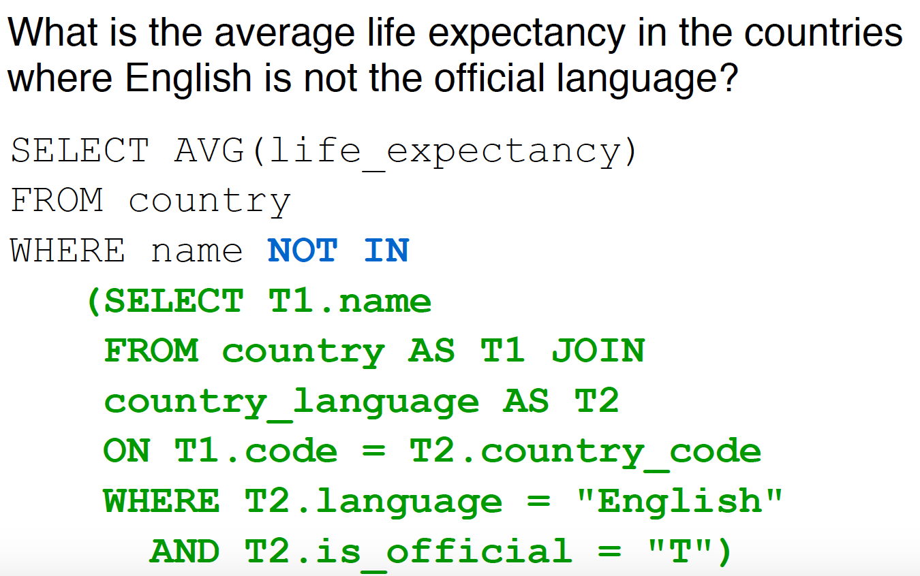
What is SQL?

Slide 9
Why sequence to SQL?
For beginners w/o any tech background
It is hard to learn this powerful but complex structured query language
For SQL masters
It is tedious to write similar queries again and again in their daily work

Slide 10
Why sequence to SQL?
Seq2SQL represents automatically mapping users’ natural language questions (sequence) to corresponding SQL queries.
In this way, we can build a natural language interface to relational databases. Through this interface
Users in any background levels can communicate directly with databases using natural language as opposed to through SQL
Querying data becomes more efficient, and the process is scalable

Slide 11
Sequence2SQL is hard
Natural language understanding
The system has to understand users’ questions, which could be ambiguous, random, and diverse
Database schema representation
Database can be very complex with >100 columns, >10 tables, and >20 foreign keys
Complex SQL decoding/generation
SQL queries can be very complex such as nested queries, with multiple conditions

Slide 12
Task comparison
Compared to other natural language understanding tasks (chit-chat chatbot), seq2SQL is more task-oriented
less ambiguous and diverse questions to be handled
Similar logic behind questions
Compared to other semantic parsing tasks such as code generation, seq2SQL
much smaller decoding search space - SQL keywords and column names
less possible language structures - SELECT, WHERE, ORDERBY, NESTED...

Slide 13
Seq2SQL history
Seq2SQL datasets
Traditional datasets: ATIS, Geo, Scholar, Advising etc.
WikiSQL
Yale Spider - https://yale-lily.github.io/spider
seq2SQL methods
Traditional grammar-based parsing methods
Database system design with user-in-loop interactions
Neural networks

Slide 14
Seq2SQL datasets are scarce!
Compared to other large datasets such as ImageNet for object recognition, seq2SQL dataset is even more time-consuming
hard to find many databases with multiple tables online
Annotation requires very specific knowledge in databases

Slide 15
Traditional Seq2SQL datasets
Traditional 9 seq2SQL datasets: ATIS, Geo, Scholar, Advising etc.
Pros
SQL queries cover complex SQL structures and components
Cons
The number of labeled queries is small (< 500)
Paraphrase about 4-10 natural language questions for each SQL query.
The total # of question-SQL pairs: ~500 -> ~5,000
Each of datasets contains SQL queries only to a single database

Slide 16
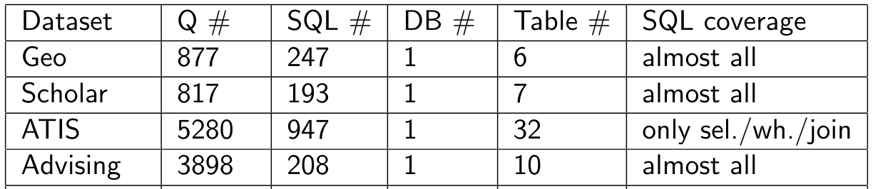
Traditional Seq2SQL datasets
Problems about the task definition based on these datasets
Random split based on questions so that the same SQL appear in both train and test
Basic seq2seq generation model can achieve > 80% accuracy on very complex SQL queries.

Slide 17
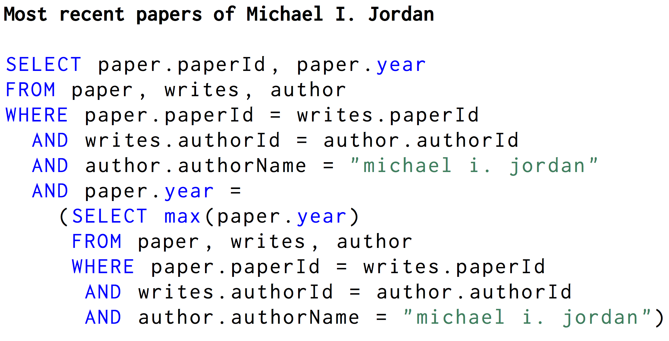
Traditional Seq2SQL datasets
Imagine a very basic seq2seq that can generate the following SQL:
It turns out these models take advantage of the problematic task setting, and they are sort of cheating!
https://arxiv.org/pdf/1704.08760.pdf

Slide 18
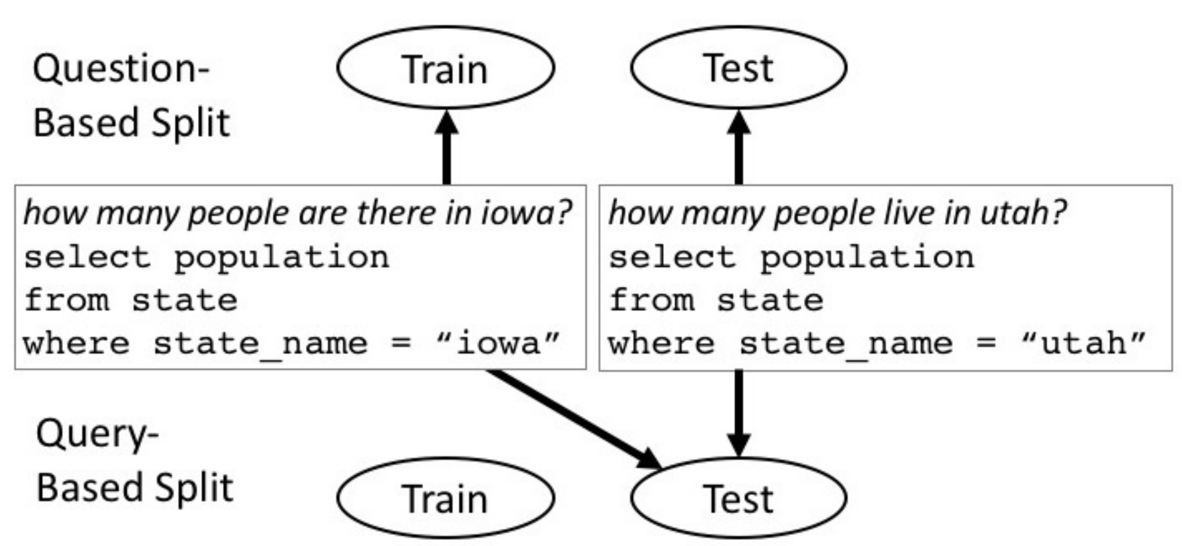
Paper 0 - Improving Text-to-SQL Evaluation Methodology
Question-based split -> query-based split
No exactly the same SQL appears in both train and test
https://arxiv.org/abs/1806.09029

Slide 19
Paper 0 - Improving Text-to-SQL Evaluation Methodology
Why Question-based split -> query-based split matters?
The text-to-SQL generation problem becomes a simpler classification problem if you have exactly the same SQL labels in the train and test splits.
Simpler classification problem:
input is natural language questions,
output classes are all unique SQL queries appeared in your train/test
Query-based split avoid this kind of cheating
https://arxiv.org/abs/1806.09029

Slide 20
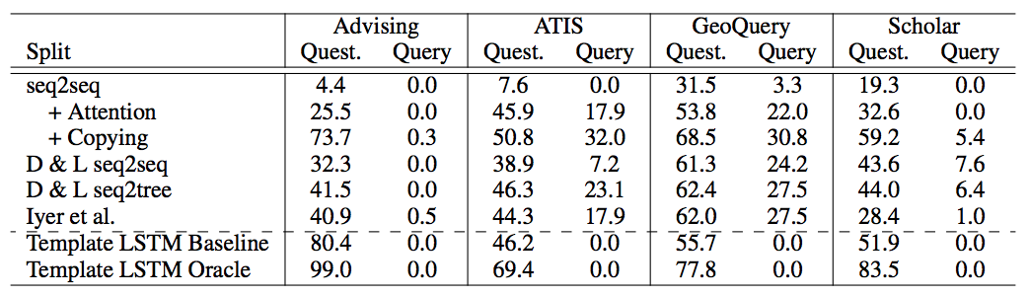
Paper 0 - Improving Text-to-SQL Evaluation Methodology
Results on question and query-based splits

Slide 21
Paper 0 - Improving Text-to-SQL Evaluation Methodology
They also cleaned and normalized all previous traditional seq2SQL datasets, and introduced a similar dataset. You can check it out at https://github.com/jkkummerfeld/text2sql-data/

Slide 22
Seq2SQL data - WikiSQL
WikiSQL - Pros
The number of SQL queries and databases is huge (>20, 000)
Databases in the test set do not appear in the train/dev set, which requires model to generalize to new databases
WikiSQL - Cons
SQL queries are generated by templates and paraphrased by Turkers
All databases have only one table - not relational database
SQL only contains SELECT and WHERE. No GROUP BY/Nested etc.

Slide 23
Seq2SQL data - WikiSQL
The first realistic seq2SQL task definition on the top of WikiSQL makes it the most popular seq2SQL dataset
Databases in the test set do not appear in the train/dev set, which requires model to generalize to new databases
https://github.com/salesforce/WikiSQL

Slide 24
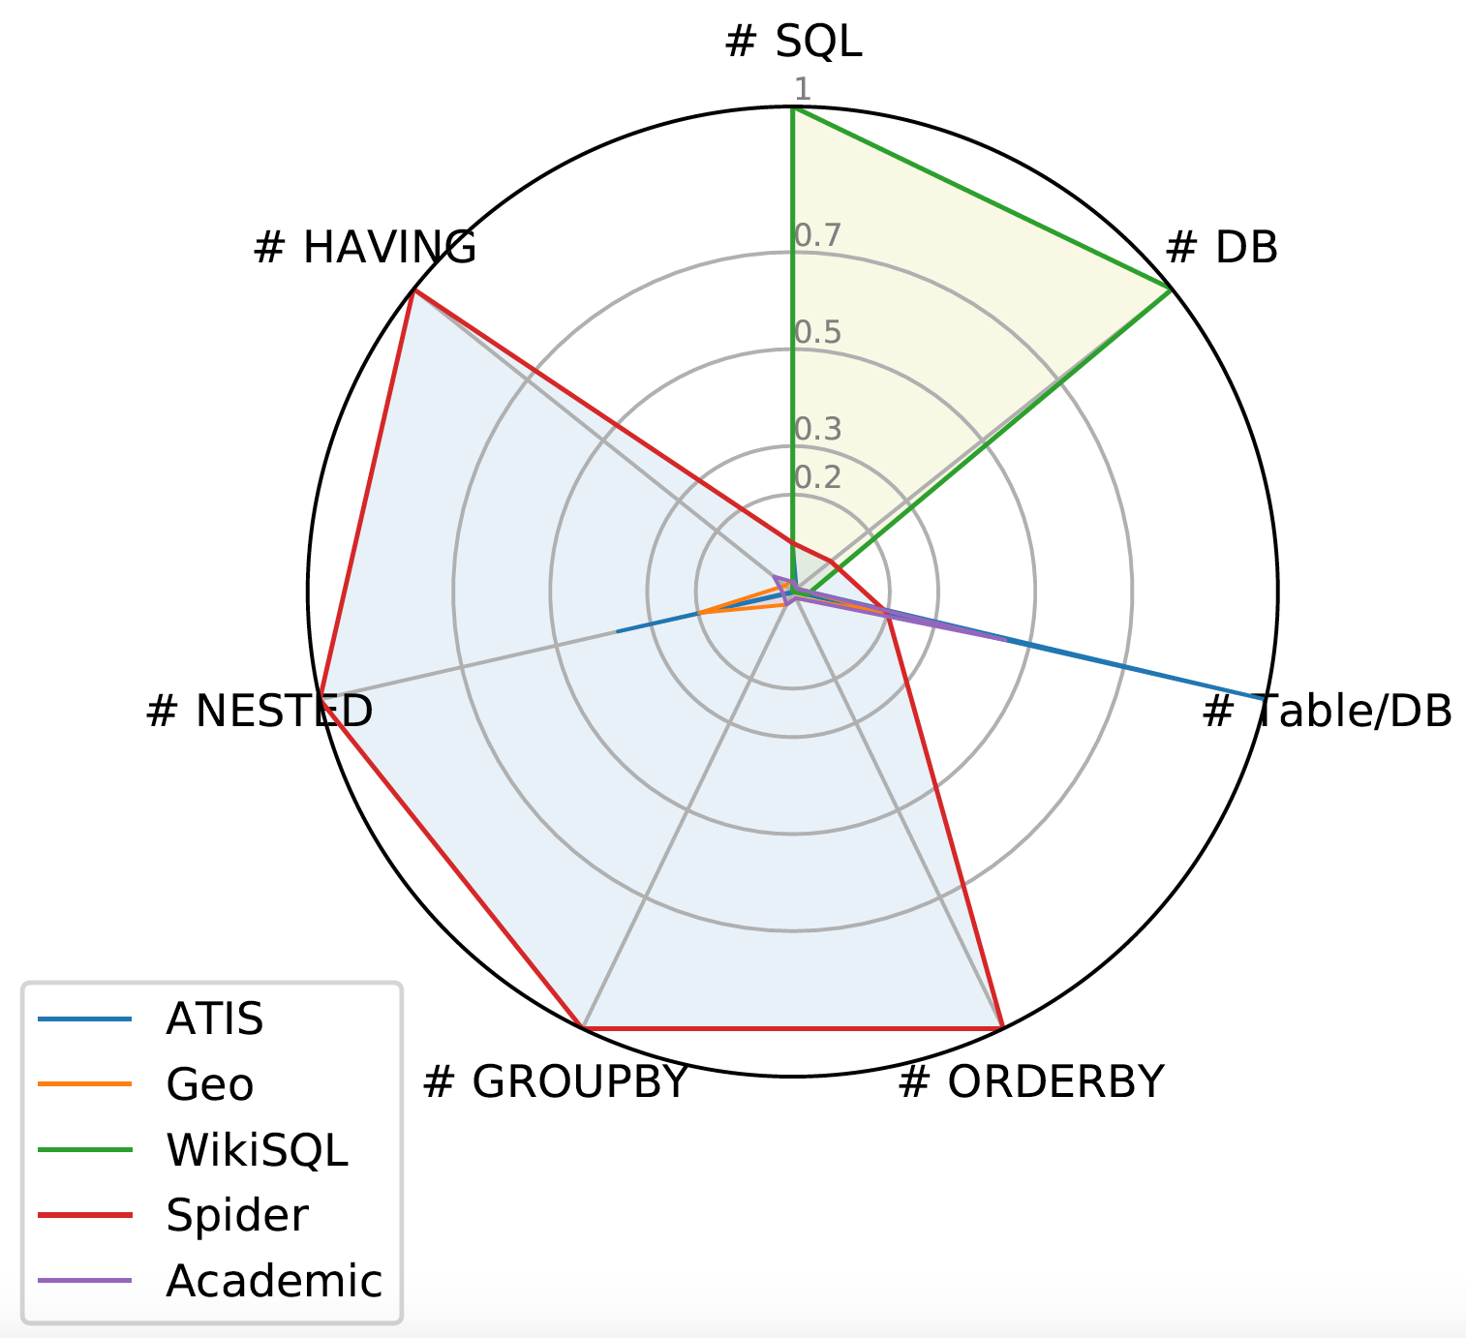
Seq2SQL data - Spider
WikiSQL is great. But many
researchers criticize its limitation
on SQL coverage and database
schema, which makes the
task simple and less interesting

Slide 25
Seq2SQL data - Yale Spider
SQL labels cover almost all important SQL components
Each database has multiple tables and several foreign keys
It is currently the only large-scale complex and cross-domain semantic parsing and text-to-SQL dataset!
Check it out!!!
Our Blog
Project Page: https://yale-lily.github.io/spider
Github Page: https://github.com/taoyds/spider
Retweet this Work, Thanks!

Slide 26
Might wonder why complex and cross-domain?
For building a natural language interface to relational databases, we want it can automatically process:
All kind of SQL queries - Complex
Includes different SQL structures (e.g. NESTED) and unseen SQL in the train
Covers all SQL clauses including SELECT, WHERE, GROUP BY, ORDER BY
Queries toward to unseen databases
You do not want to relabel data and retrain your model specific to a new database

Slide 27
Seq2SQL dataset summary
Traditional seq2SQL datasets and tasks: Data size is small with a little problematic task setting
(Finegan-Dollak et al., 2018) introduces the idea of resplitting the datasets based on SQL queries
WikiSQL makes the task more realistic by requiring generalization to new databases but with some limitations on complexity
Spider moves WikiSQL limitations, and becomes the only large complex and cross-domain seq2SQL task

Slide 28
Seq2SQL methods
Paper 1: Seq2SQL: Generating Structured Queries from Natural Language using Reinforcement Learning
Paper 2: SQLNet: Generating Structured Queries From Natural Language Without Reinforcement Learning
Paper 3: A Syntactic Neural Model for General-Purpose Code Generation
Paper 4: Learning to Map Context-Dependent Sentences to Executable Formal Queries briefly
Paper 5: DialSQL: Dialogue Based Structured Query Generation briefly

Slide 29
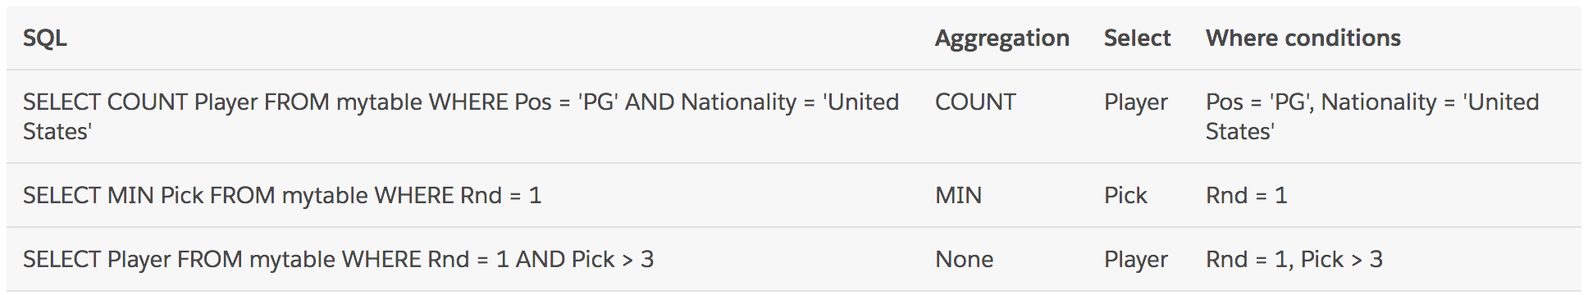
Seq2SQL methods - Paper 1 Seq2SQL
Most SQL queries can be decomposed into three components: an optional aggregation operator, selection columns, and a WHERE clause of conditions
https://einstein.ai/research/how-to-talk-to-your-database

Slide 30
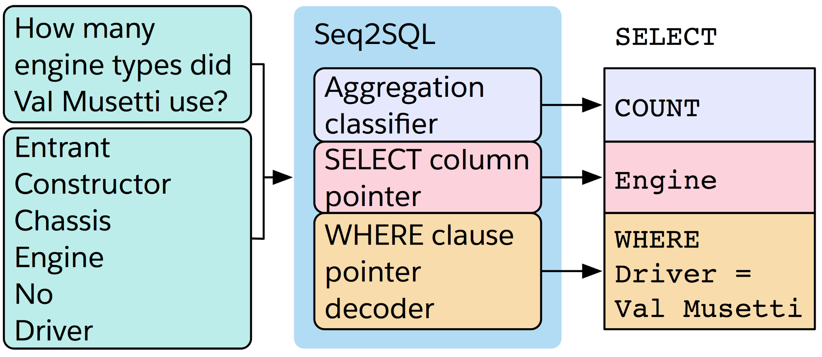
Seq2SQL methods - Paper 1 Seq2SQL
Seq2SQL leverages this inherent structure of SQL queries by
predicting each part of the query separately.
https://einstein.ai/research/how-to-talk-to-your-database

Slide 31
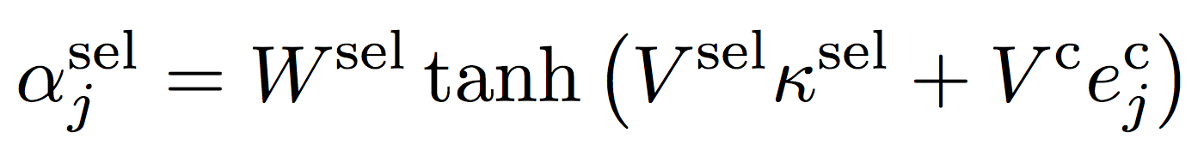
Seq2SQL methods - Paper 1 Seq2SQL
Three model components
Aggregation classifier
question encoding
agg scores using a multi-layer perceptron:
Select column pointer
question encoding is also used along with the column encodings
the a score for each column j:
WHERE clause pointer decoder
an augmented pointer network
input is the question sequence + the table schema + a set of SQL keywords

Slide 32
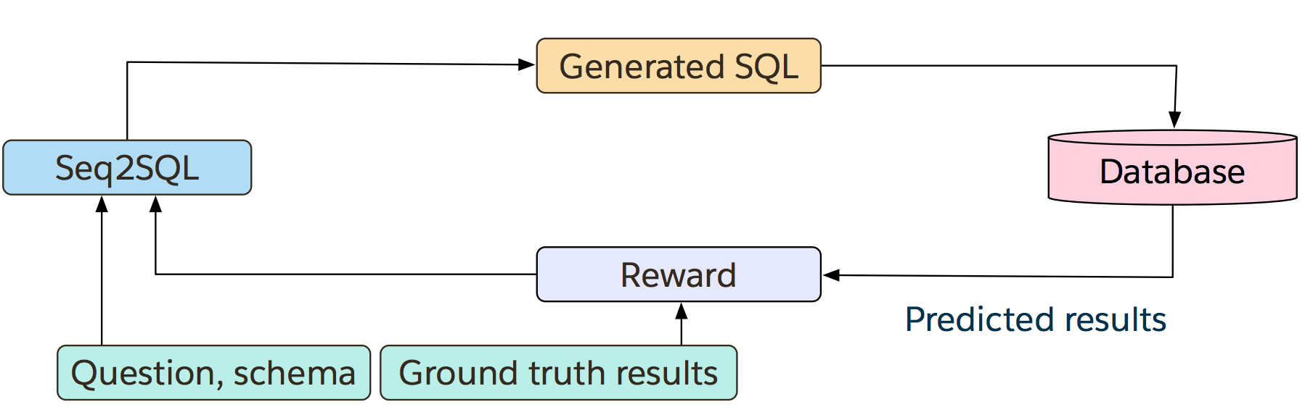
Seq2SQL methods - Paper 1 Seq2SQL
For some SQL queries, it’s possible to obtain the correct execution result despite not having exact same string match
Using cross entropy loss to supervise the generation would wrongly penalize the model
Generating equivalent queries using policy gradient
https://einstein.ai/research/how-to-talk-to-your-database

Slide 33
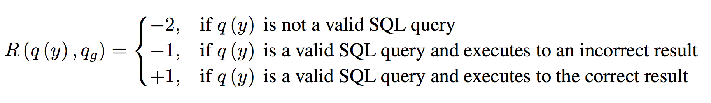
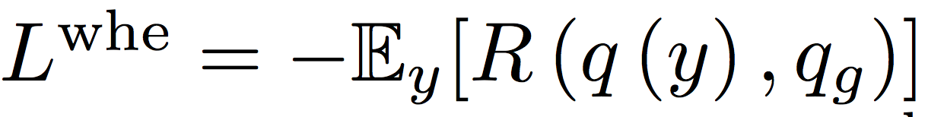
Seq2SQL methods - Paper 1 Seq2SQL
Apply reinforcement learning to learn a policy to directly optimize the expected correctness of the execution result
sample from the output distribution to obtain the next token
execute the generated SQL query against the database to obtain a reward
loss: negative expected reward over possible WHERE clauses.
Expected gradient is approximated using a single SQL sample

Slide 34
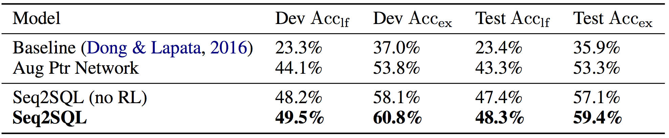
Seq2SQL methods - Paper 1 Seq2SQL
Results: the improvement from RL is limited, only ~2%

Slide 35
Seq2SQL methods - Paper 2 SQLNet
Ideas
employ a sketch-based approach
propose a sequence-to-set model
introduce the column attention mechanism

Slide 36
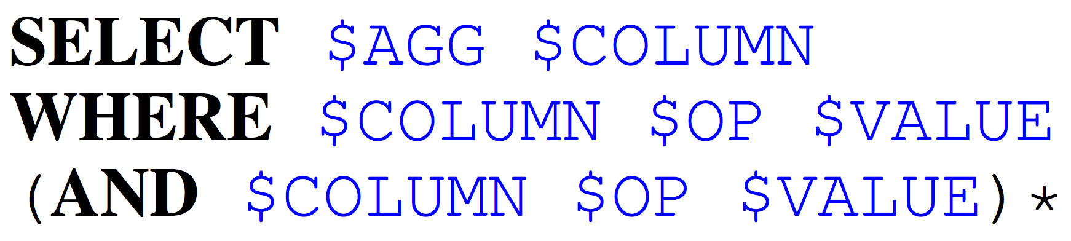
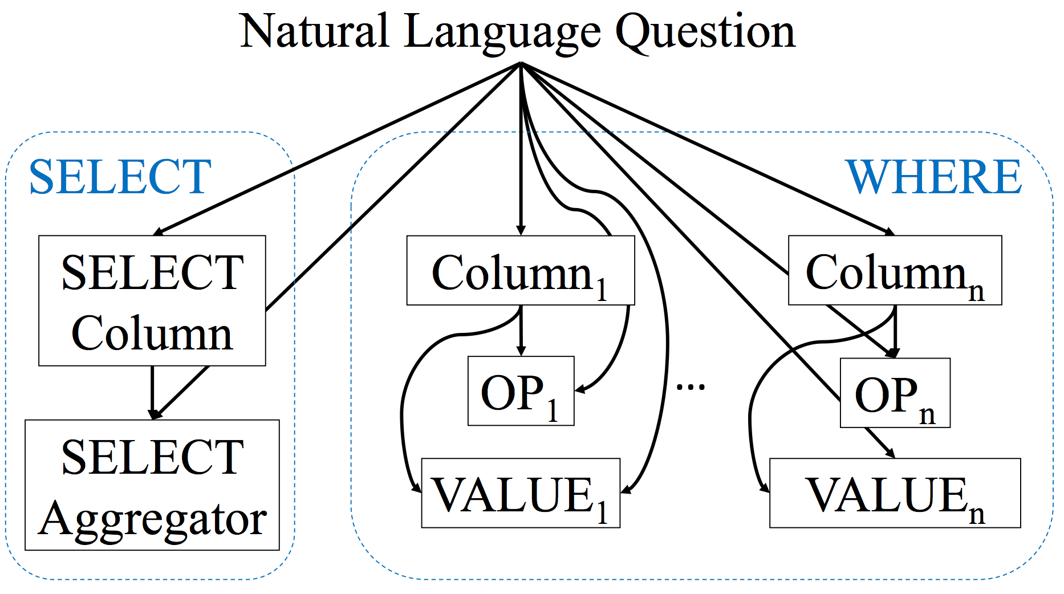
Seq2SQL methods - Paper 2 SQLNet
SQL sketch:
Graphical illustration of the dependency in a sketch

Slide 37
Seq2SQL methods - Paper 2 SQLNet
Seq2seq based model is sensitive to “order-matters” problem

Slide 38
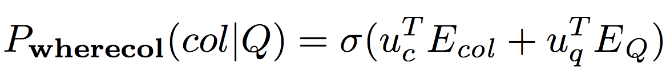
Seq2SQL methods - Paper 2 SQLNet
Sequence-to-set WHERE module - Column slots
instead of generating a sequence of column names, predict which column names appear by:
then predict the number of columns
Choose the top K columns as predicted columns in the WHERE clause

Slide 39
Seq2SQL methods - Paper 2 SQLNet
Sequence-to-set WHERE module - Op slots
For each column in the WHERE clause, predicting the value of its OP slot is a 3-way classifications: {=, >, <}
OP prediction depends on the selected column

Slide 40
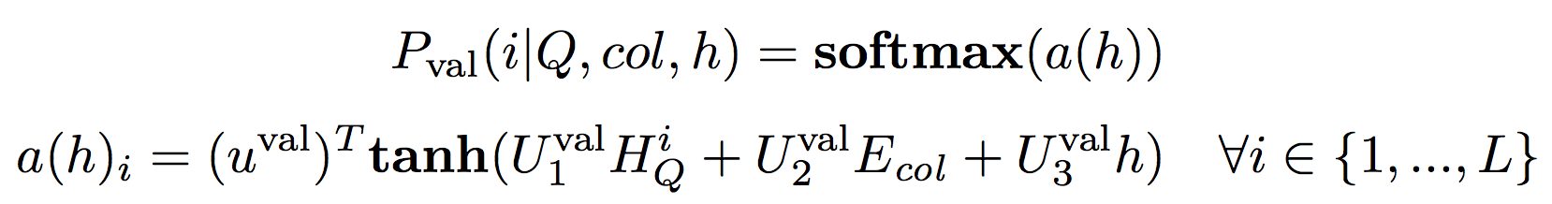
Seq2SQL methods - Paper 2 SQLNet
Sequence-to-set WHERE module - Value slots
The decoder phase computes the distribution of the next token using a pointer network
The probability of the next token to generate is the i-th token in the natural language question:

Slide 41
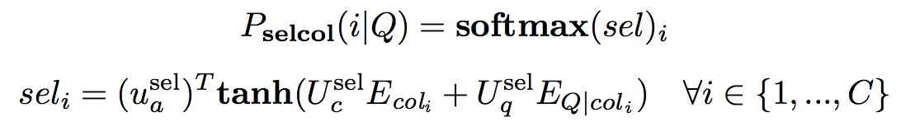
Seq2SQL methods - Paper 2 SQLNet
SELECT module
Similar to WHERE column, but only need to select one column among all
Aggregator module
assuming the predicted column name for the SELECT clause is col

Slide 42
Seq2SQL methods - Paper 2 SQLNet
Column attention - motivation
The embedding should reflect the most relevant information in the natural language question when predicting on a particular column.
For example:
Who is the player that wears number 42?
the token “number” is more relevant to predicting the column “No.” in the WHERE clause. However, the token “player” is more relevant to predicting the “player” column in the SELECT clause.

Slide 43

Seq2SQL methods - Paper 2 SQLNet
Column attention
compute the attention weights w for each token in the question with respect to col
compute the question representation as the weighted sum of each token’s LSTM hidden output based on w:

Slide 44
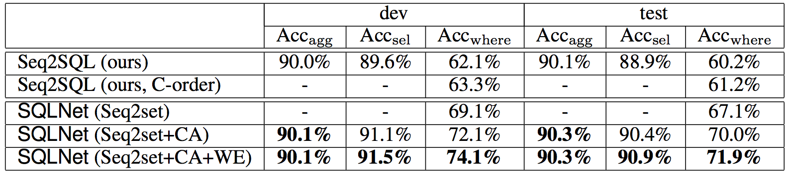
Seq2SQL methods - Paper 2 SQLNet
Results: outperforms Seq2SQL by >10 points

Slide 45
What if SQL is complex?
Seq2SQL and SQLNet are built on top of WikiSQL
WikiSQL is simple without many complex SQL components such as GROUP BY, ORDER BY, NESTED etc.
Seq2SQL and SQLNet are unable to solve these complex SQL because of their limited representation of the SQL structures.
This is where more general syntactic decoding models come in!
SQL specific syntactic model: SyntaxSQLNet
Even more general syntactic model: A Syntactic Neural Model for General-Purpose Code Generation

Slide 46
Seq2SQL methods - Paper 3 Syntactic Model
It is very general, but might be too general sometime.
Originally design for code generation task, but also can be extended to SQL generation as long as the target program has abstract syntax tree (AST) representation.

Slide 47
Seq2SQL methods - Paper 3 Syntactic Model
Syntax-driven neural code/SQL generation model
Seq2SQL and SQLNet utilize a limit number of SQL syntax info
Here, more general syntactic info is captured by the grammar of the code/SQL
Such syntactic info is expressed as an AST for a given code/SQL
Use the grammar of code/SQL as prior knowledge in a neural seq2seq model

Slide 48
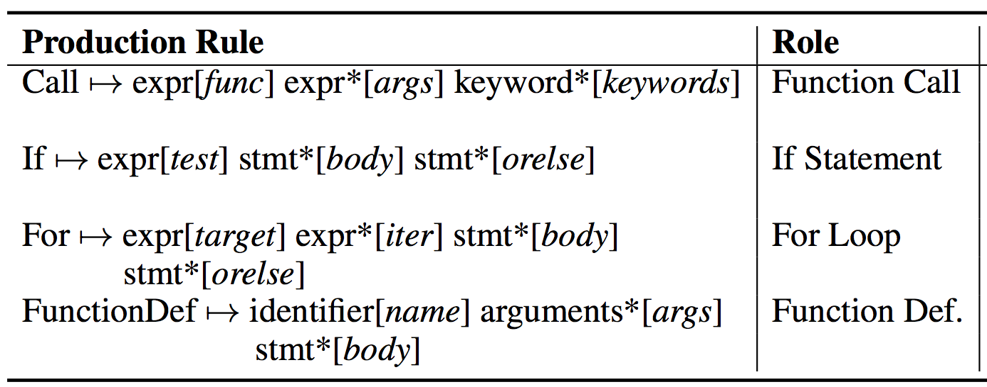
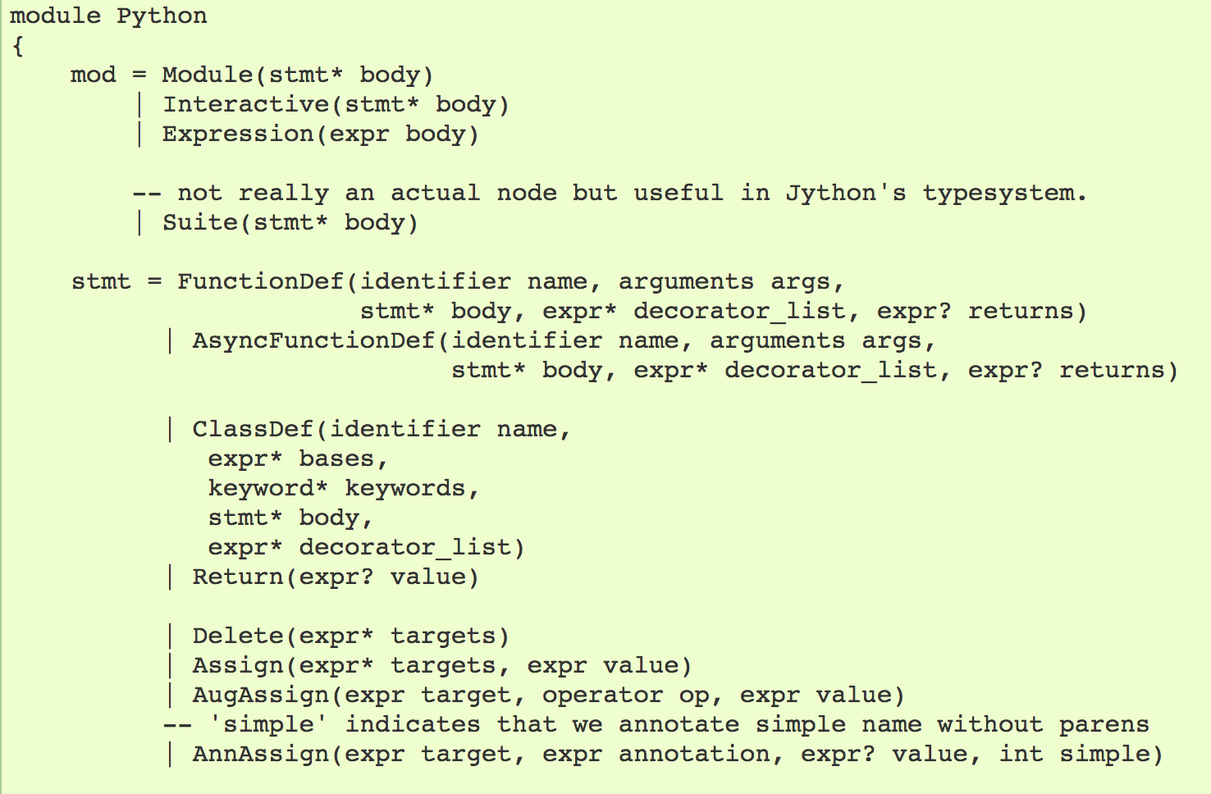
Seq2SQL methods - Paper 3 Syntactic Model
Abstract grammar

Slide 49
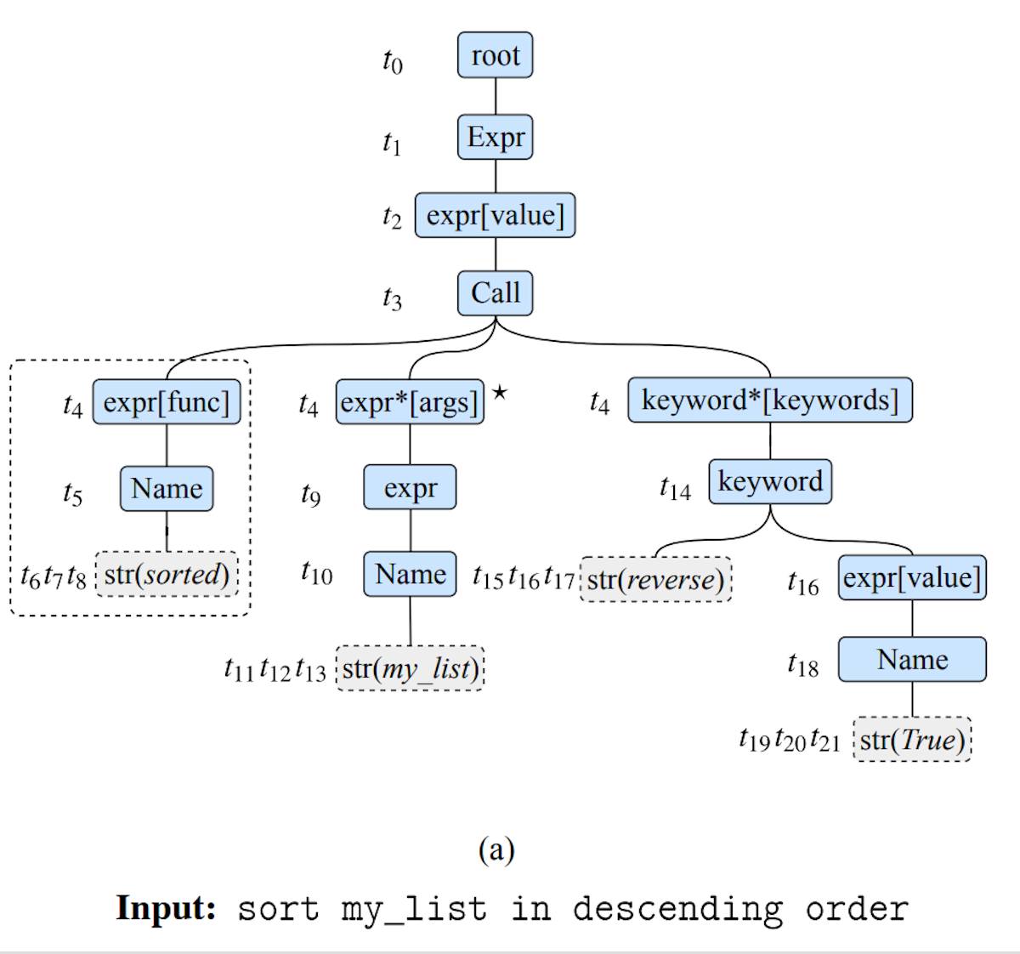
Seq2SQL methods - Paper 3 Syntactic Model
Abstract syntax tree (AST)
Tree of abstract grammar rules
Composite types: stmt, expr etc.
Each type has a collection of
constructors: ClassDef, Call etc.
Primitive types: identifier, str...

Slide 50
Seq2SQL methods - Paper 3 Syntactic Model
Steps Overview
1. Input intent x + abstract grammars -> 2. syntax neural model -> 3. output generated AST y -> 4. deterministic map back to surface code/SQL

Slide 51
Seq2SQL methods - Paper 3 Syntactic Model
code/SQL generation task -> sequential generation of rules and terminals in AST
Factorize generation story of an AST into sequential application of actions
ApplyRule [r]: apply a production rule r to the frontier node in the derivation
GenToken [v]: append a token v (e.g. variable or function names) to a terminal. Learn to generate a token or directly copy it from the input
https://vimeo.com/234954608

Slide 52
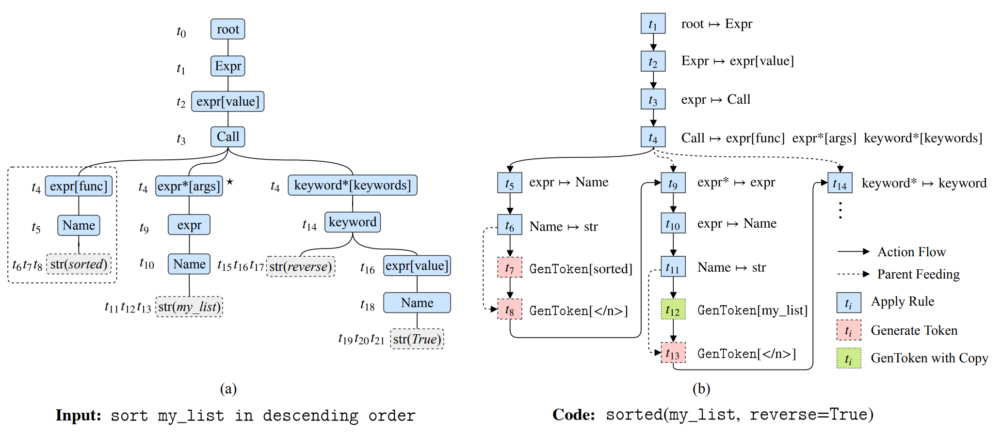
Seq2SQL methods - Paper 3 Syntactic Model
code/SQL generation task -> sequential generation of AST
https://vimeo.com/234954608

Slide 53
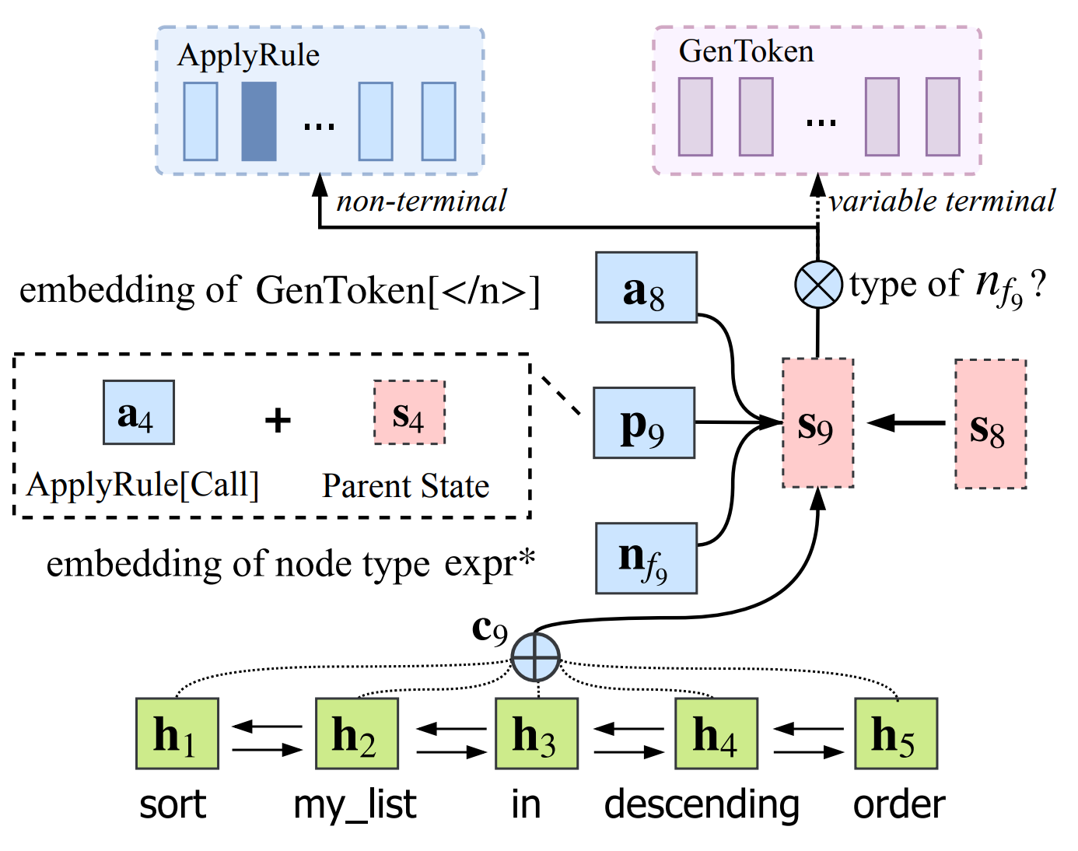
Seq2SQL methods - Paper 3 Syntactic Model
Neural encoder-decoder architecture
Encoder: Bi-LSTM on the natural language question
Decoder:
Predict an action a and grow
the AST
Parent feeding
https://vimeo.com/234954608

Slide 54
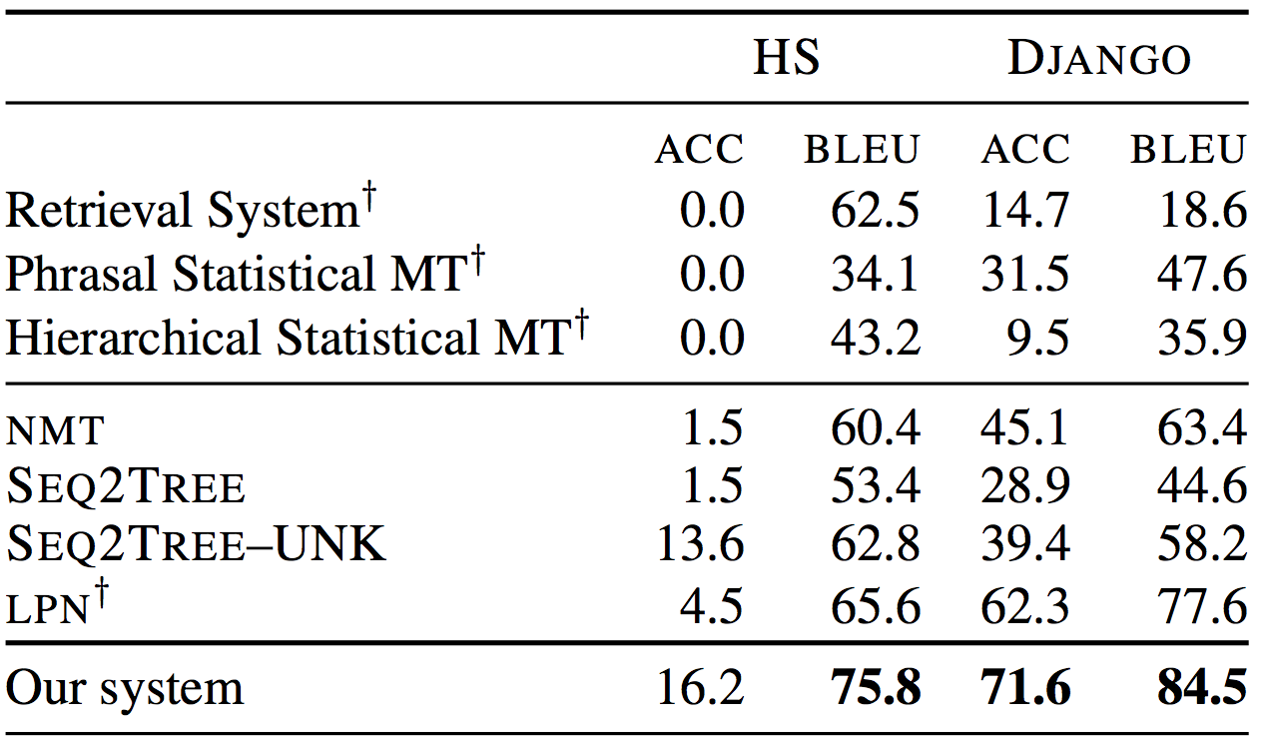
Seq2SQL methods - Paper 3 Syntactic Model
Results
https://vimeo.com/234954608

Slide 55
Syntactic info and order issue really matters?
They depends
Coarse2fine achieves better results on code/SQL generation tasks, which use no syntactic info and doesn’t take care of order issue.
StructVAE shows that integrating syntax does not significantly improves results if the size of the training dataset is large enough.
But syntactic info definitely matters when the data size is small!
https://vimeo.com/234954608

Slide 56
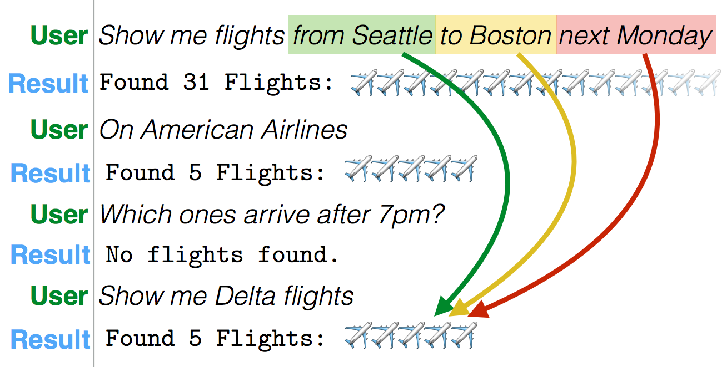
Involving context in seq2SQL task - Paper 4
Learning to Map Context-Dependent Sentences to Executable Formal Queries
Goal: language understanding in long interactions

Slide 57
Involving context in seq2SQL task - Paper 4
Key ideas
dialog has sequential questions only from users but not from the system.
as an interaction progresses, the meaning of an utterance becomes highly dependent on the history of the interaction
history includes both previous requests and generated SQL queries
solution: composing later SQL queries from segments of previous ones

Slide 58
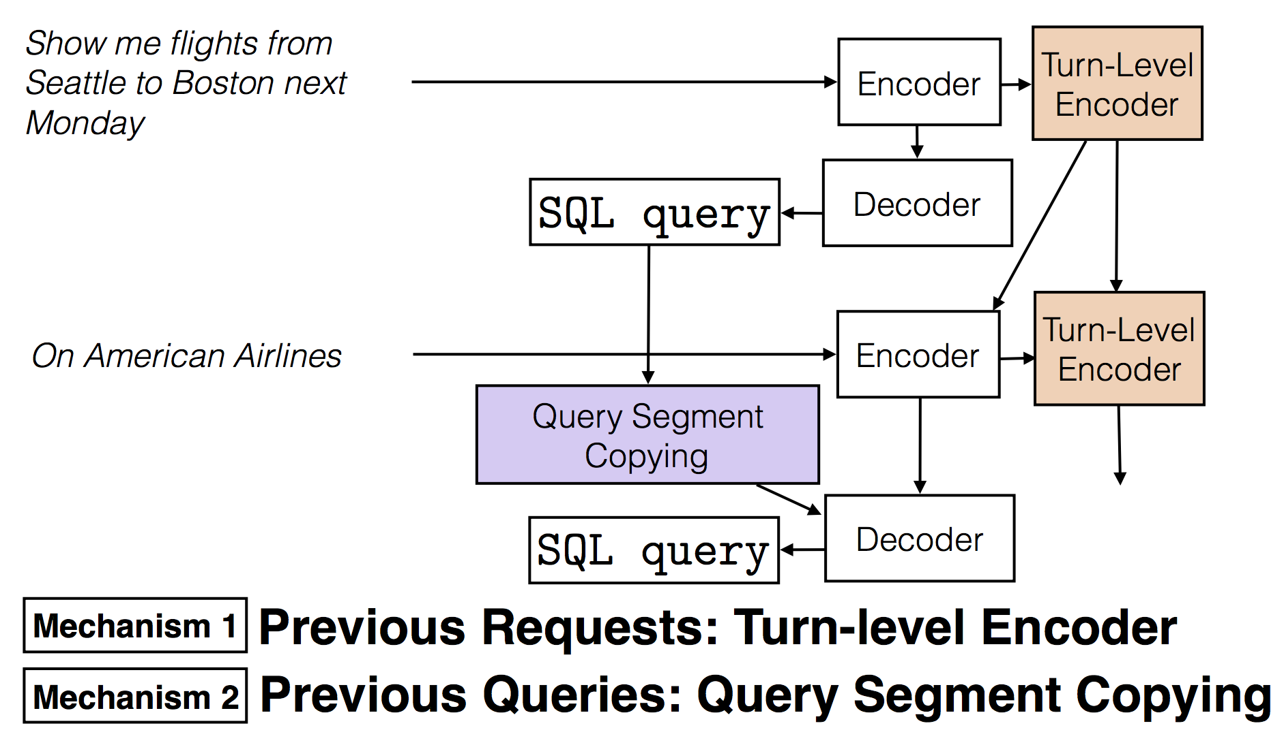
Involving context in seq2SQL task - Paper 4
Model Overview
More details can be found here: http://alanesuhr.com/sia2018-slides.pdf

Slide 59
Involving context in seq2SQL task - Paper 5
DialSQL
leverages human intelligence to boost the performance of existing algorithms via user interaction
identifying potential errors in a generated SQL query and asking users for validation via simple multi-choice questions.

Slide 60
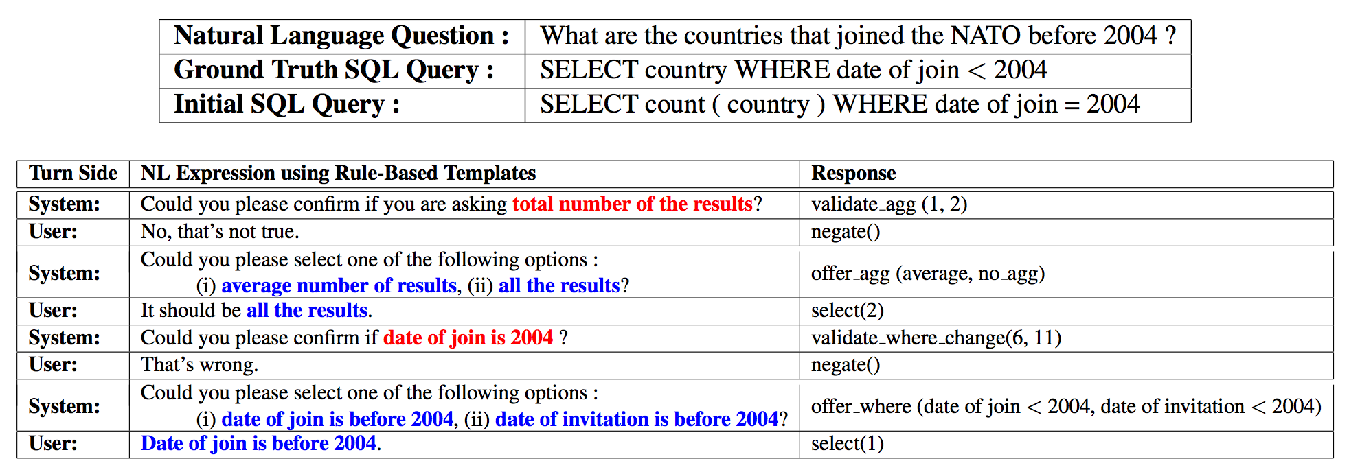
Involving context in seq2SQL task - Paper 5
DialSQL
More details can be found here: http://cs.ucsb.edu/~ysu/papers/acl18_dialsql.pdf

Slide 61
Future Research Directions
Task-Oriented Dialogue-to-SQL Task
Mapping natural language questions against cross-domain databases to corresponding SQL states as a dialog progress between users and systems
conversational dialog interactions between users and systems, which is more challenging and interactive.

Slide 62
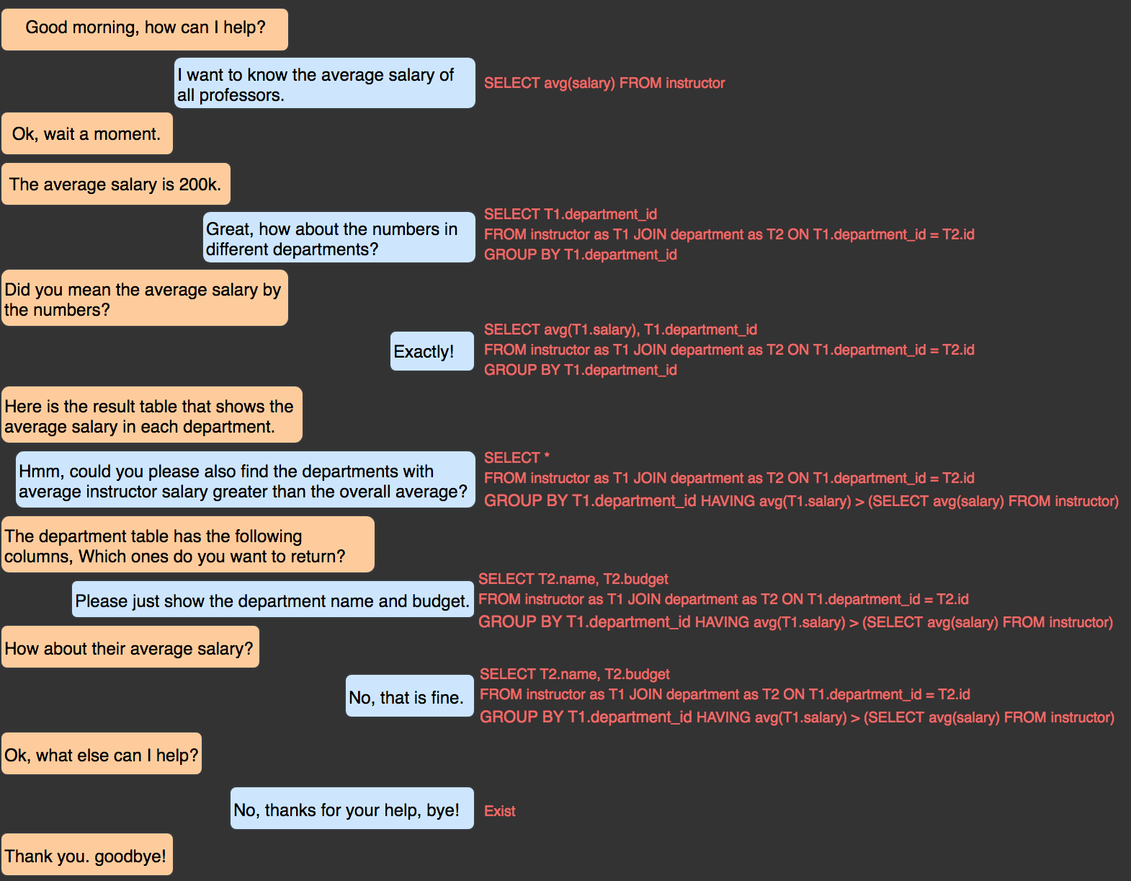
Future Research Direction-Task-Oriented Dialog-to-SQL

Slide 63
Conclusion
We have covered
seq2SQL motivation
seq2SQL datasets and task definitions
seq2SQL methods: seq2SQL, SQLNet, Syntactic Model
involving context into seq2SQL task
Future Research Direction: Task-Oriented Dialog-to-SQL

Slide 64
Discussion for class
What else do you think is important for building a real-world natural language interface to relational databases?
Other interesting and useful applications?
Any other related future research directions?
What does this work differ from Alexa?

Slide 65
References (other than images)
Blogs and talks:
https://einstein.ai/research/how-to-talk-to-your-database
Abstract Syntax Networks for Code Generation and Semantic Parsing at ACL
Learning to Map Context-Dependent Sentences to Executable Formal Queries
Papers:
SQLNet: Generating Structured Queries From Natural Language Without Reinforcement Learning
Seq2SQL: Generating Structured Queries from Natural Language using Reinforcement Learning
Improving Text-to-SQL Evaluation Methodology
Spider: A Large-Scale Complex Human-Labeled SQL Corpus for Semantic Parsing and Text-to-SQL Generation
A Syntactic Neural Model for General-Purpose Code Generation
Learning to Map Context-Dependent Sentences to Executable Formal Queries
DialSQL: Dialogue Based Structured Query Generation

Slide 66
Thanks!
Q&A

