Slide 1
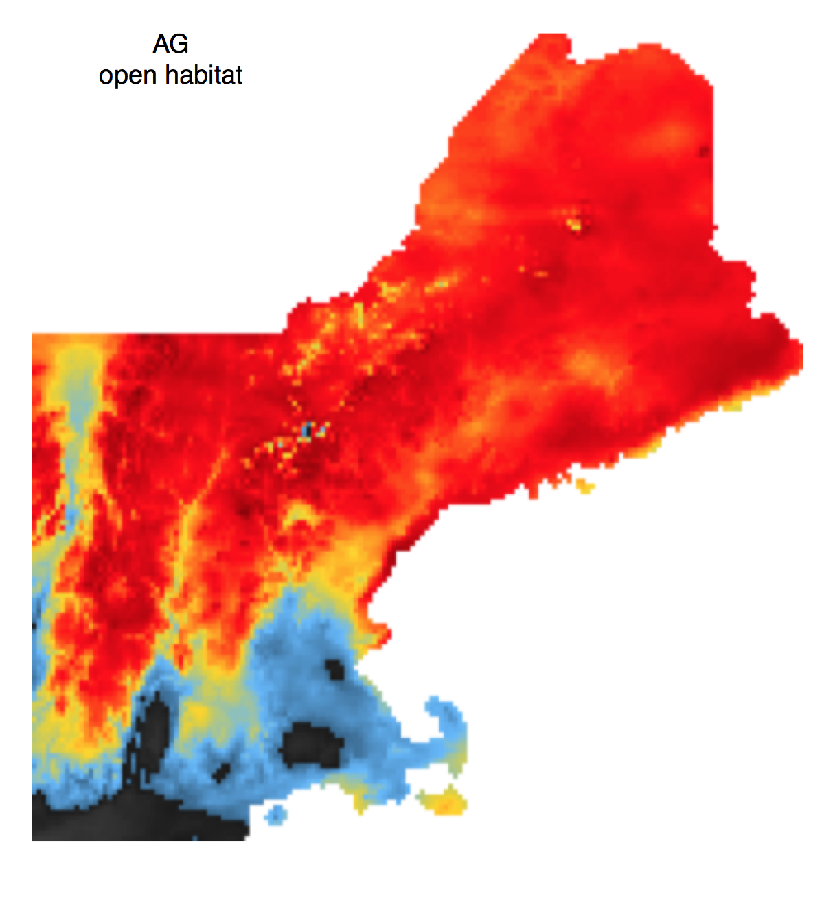
Modeling Presence Only Data
Cory Merow
^{Yale University}
Notes:
I’m going to talk about methods to use demography to forecast potential ranges and show how I’ve applied them to forecast of invasive species in new england

Slide 2
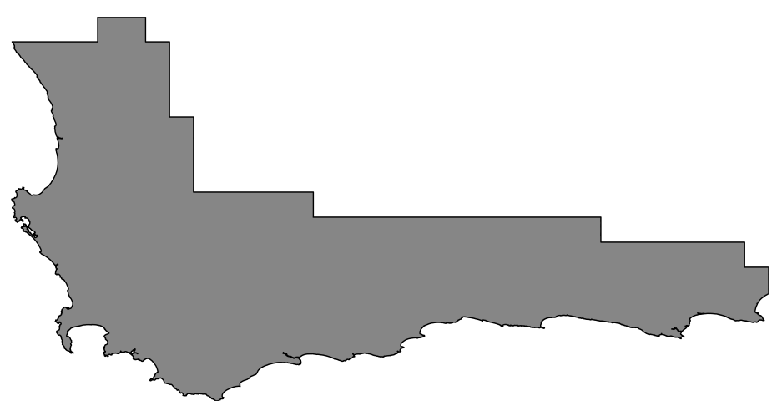
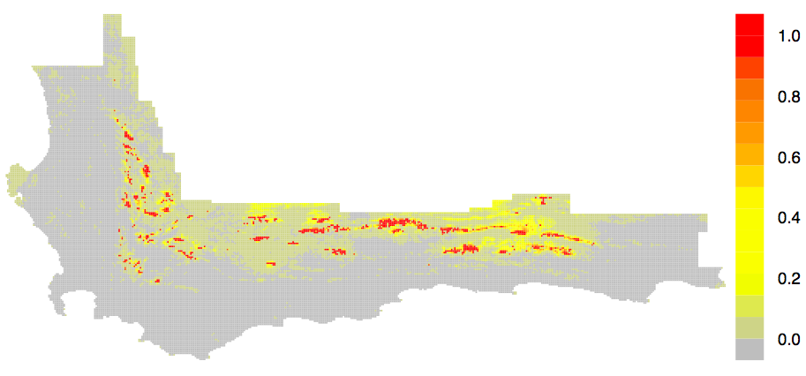
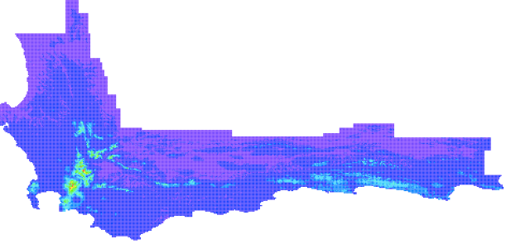
Occurrence Models
Maxent
Software
Presences
Protea punctata
wet dry
Annual Precipitation
Predictions
occurrence
probability
Notes:
If you build these models, these five papers are pretty critical, if not, their just 5 ways of saying this
I’ve done a lot of work on figure out how to build these models to balance biology with statistics
Spare the details; focus on what I do with these
If you’re skeptical about the usefulness of correlative range, I’m even more so
Incorporate other data types
as we have occurrence and env, so we should be able to build statistical relationships the describe the probability that we find the species in that environment.
These would be based on niche relationships to Predict habitat suitability.
so we should be able to build a range map by which describe spatial patterns of occurrence probability, right? Then if we know something about changing environment, we just forecast it, right?
Not so simple – I’ll show you how I’ve improved it and try to steer its use in the right direction
But because its based on machine learning principles which are unfamiliar to most ecologists, it has been widely misunderstood and misused.
So I set out to explain how it works because, with the number of studies relying on it, I felt like helping others build their own models properly could have a large impact on ecology, particularly conservation.

Slide 3
Presence vs Background
Maxent
Software
Presences
Background
Protea punctata
Notes:
If you build these models, these five papers are pretty critical, if not, their just 5 ways of saying this
I’ve done a lot of work on figure out how to build these models to balance biology with statistics
Spare the details; focus on what I do with these
If you’re skeptical about the usefulness of correlative range, I’m even more so
Incorporate other data types
as we have occurrence and env, so we should be able to build statistical relationships the describe the probability that we find the species in that environment.
These would be based on niche relationships to Predict habitat suitability.
so we should be able to build a range map by which describe spatial patterns of occurrence probability, right? Then if we know something about changing environment, we just forecast it, right?
Not so simple – I’ll show you how I’ve improved it and try to steer its use in the right direction
But because its based on machine learning principles which are unfamiliar to most ecologists, it has been widely misunderstood and misused.
So I set out to explain how it works because, with the number of studies relying on it, I felt like helping others build their own models properly could have a large impact on ecology, particularly conservation.

Slide 4
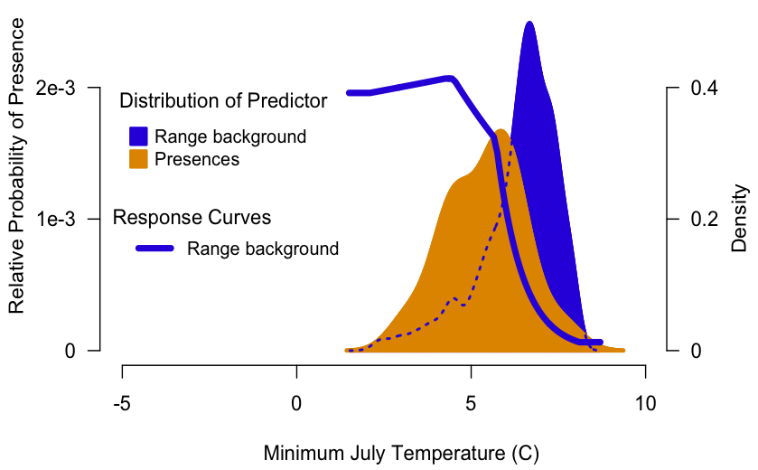
Background Selection
Notes:
Maxent derives from a use-availability sampling scheme
Some confusion, but no assumptions are made about absences.
Comparing orange to blue
What you perceive to be ‘available’ strongly influences predictions.
I won’t go into the details of how to choose background based on your questions, but I’ve thought some about this and you should ask me if you’re interested.

Slide 5
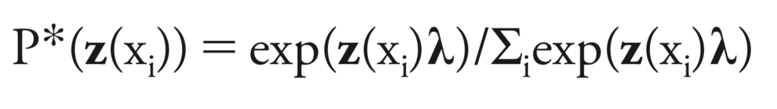
Maxent’s prediction

Slide 6
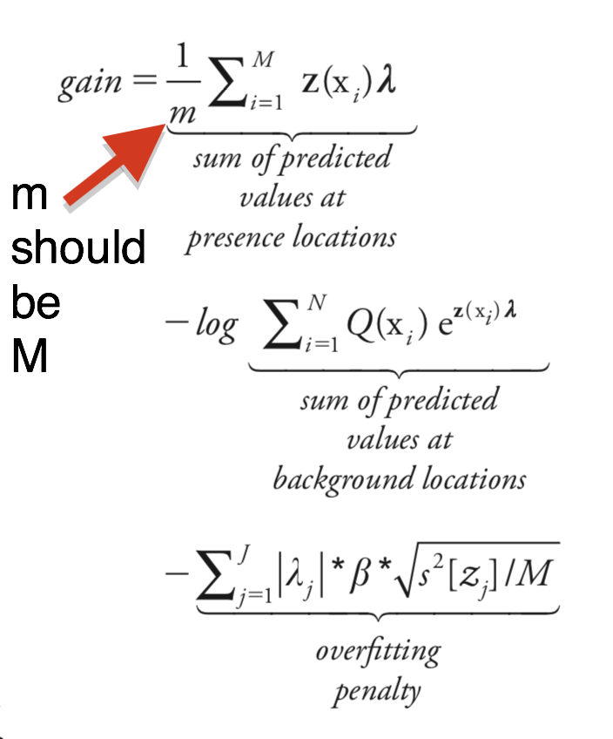
Likelihood, in case anyone asks…

Slide 7
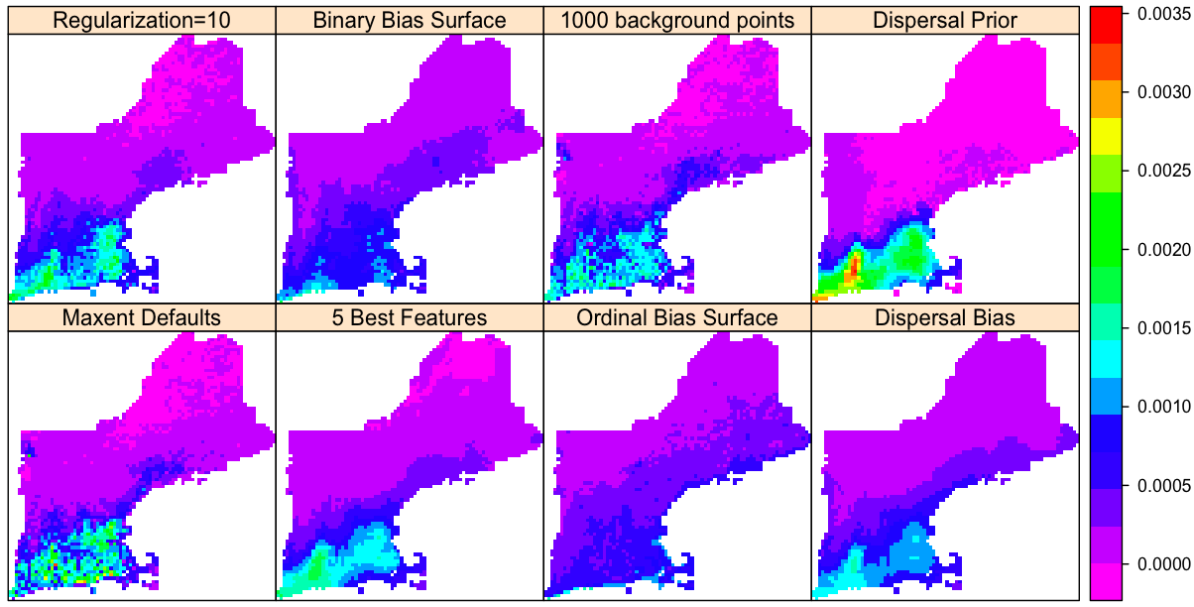
Variation in Predictions for Different Settings
High
Low
This flexibility could be very good or very bad….
Notes:
Data going into each model is the same
The greatest feature of maxent is its flexibility to accommodate different assumptions and hypotheses.

Slide 8
Variation in Predictions for Different Settings
High
Settings
affect predictions
Low
This flexibility could be very good or very bad….

Slide 9
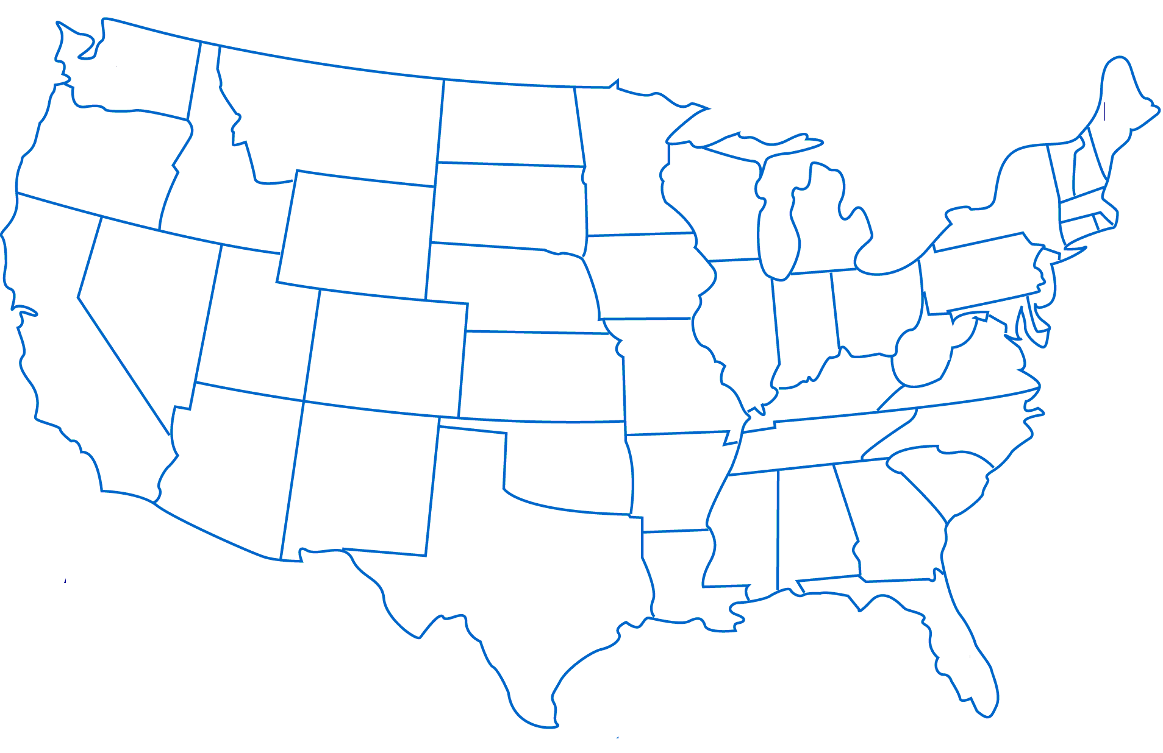
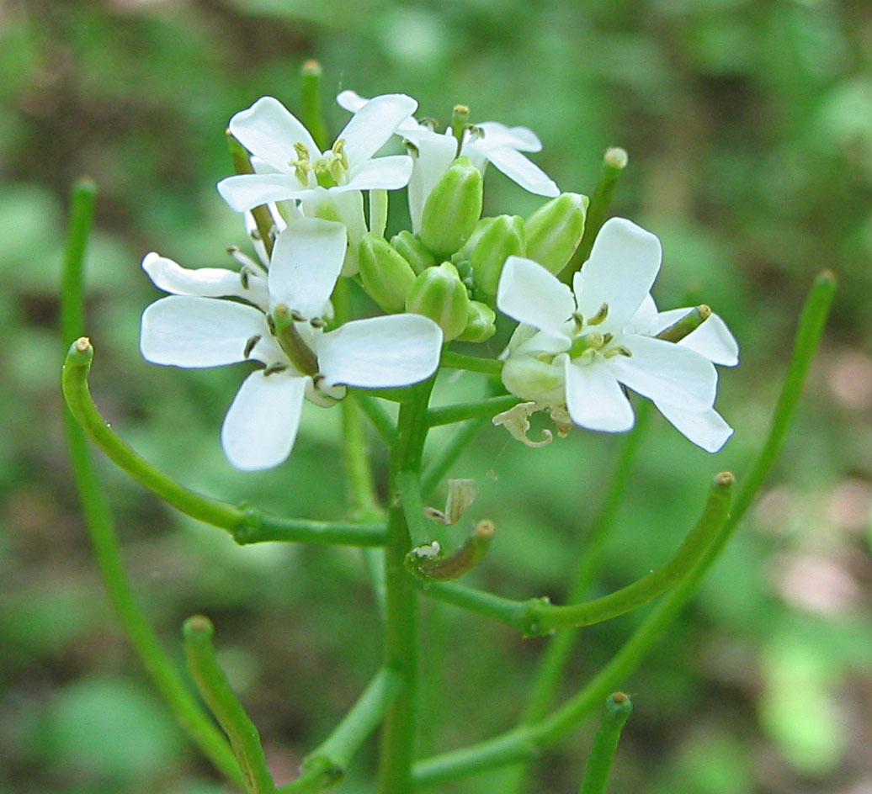
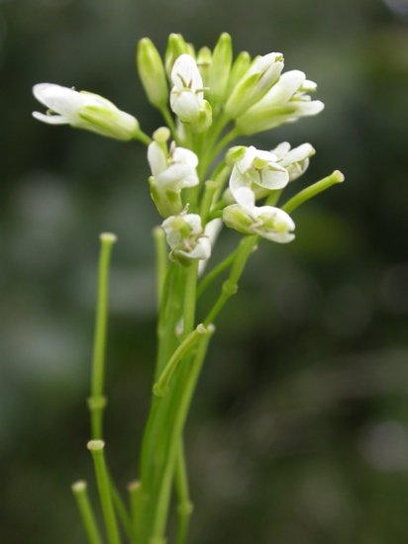
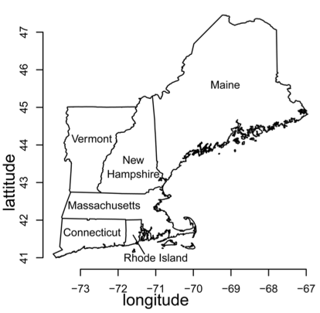
Case Study – Mustards
Invasive
Garlic Mustard
Alliaria petiolata
Native
Tower Mustard
Arabis glabra
Notes:
Two bienniels,

Slide 10
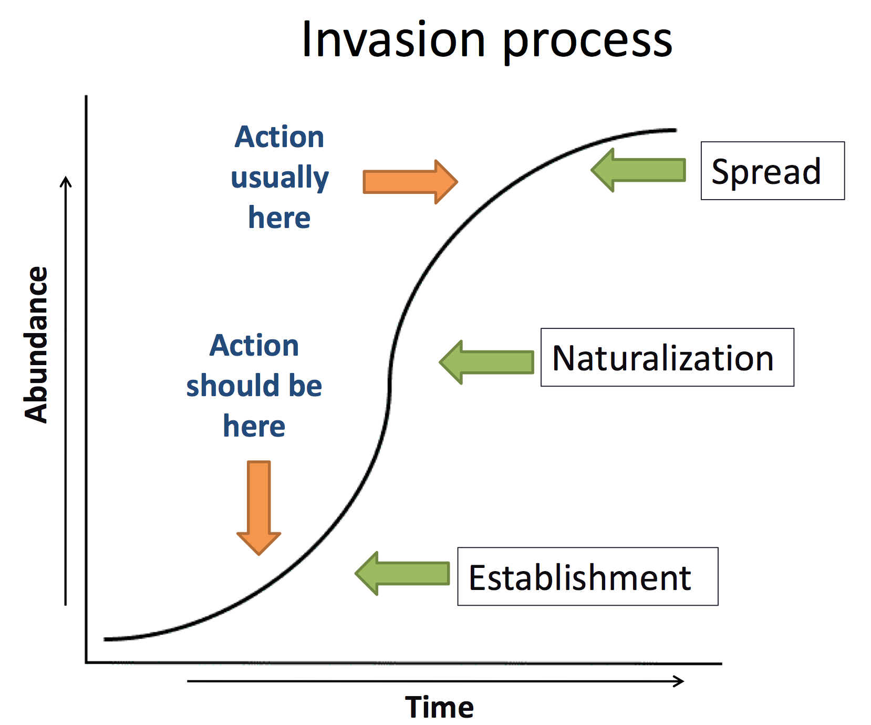
Notes:
Improve early detection
Plan preemptive management strategies
Specific to Life stage and geography

Slide 11
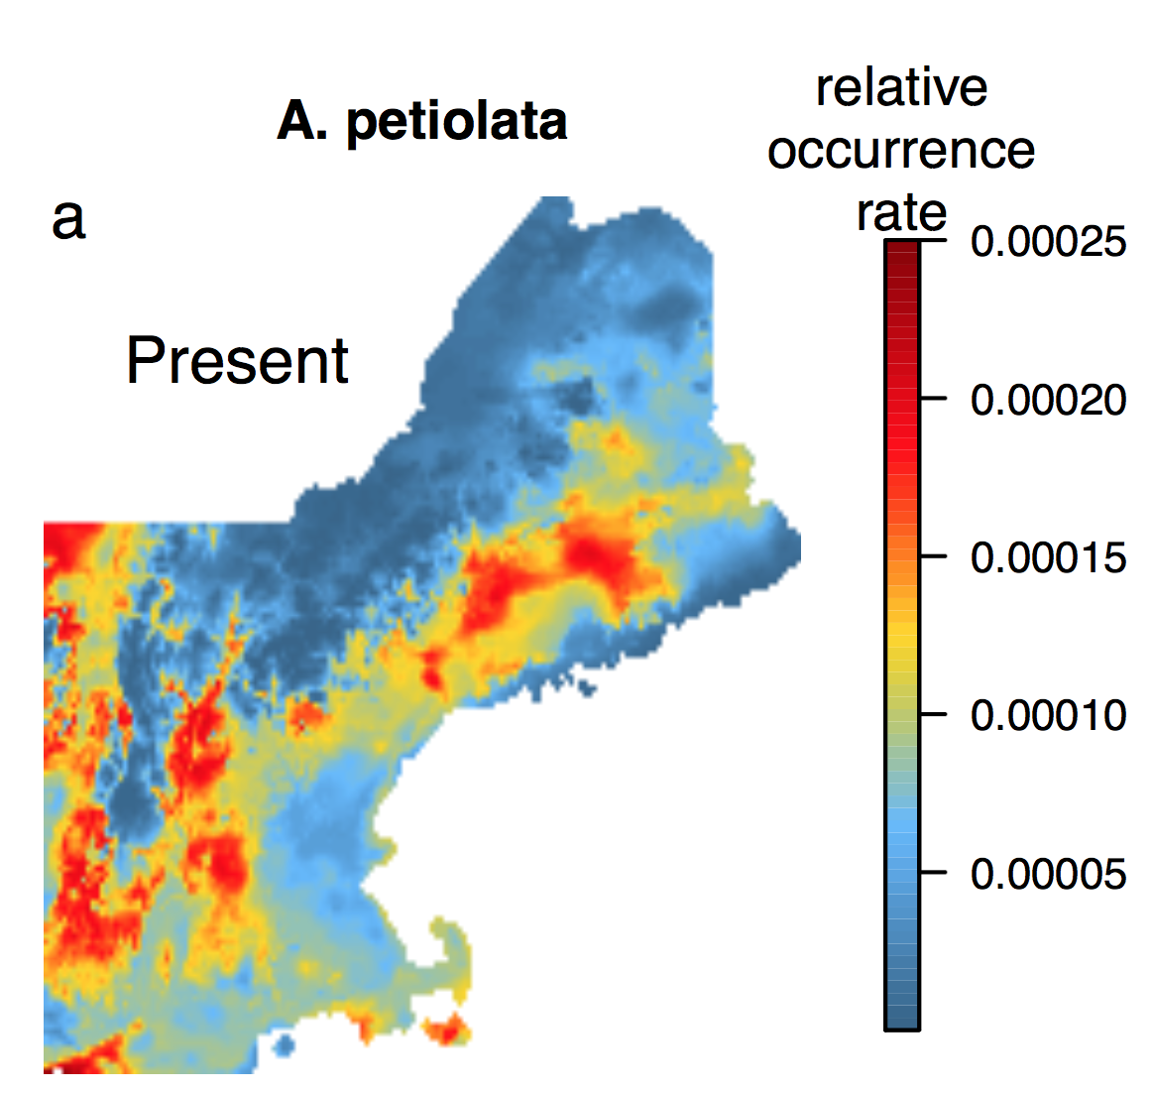
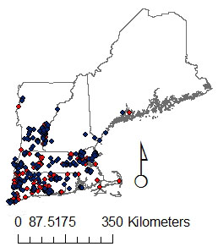
Invasions require extrapolation
What we ‘know’ already…
?
Occurrence
model
Merow, et al. PNAS, 2017
Notes:
Always extraplating in geographic space, often in environmetnal space too

Slide 12
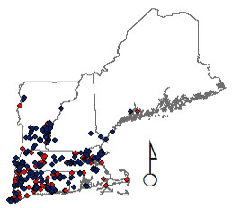
Objectives
Are uninvaded regions suitable?
How will climate change affect invasion?
Merow, et al. PNAS, 2017

