Slide 1
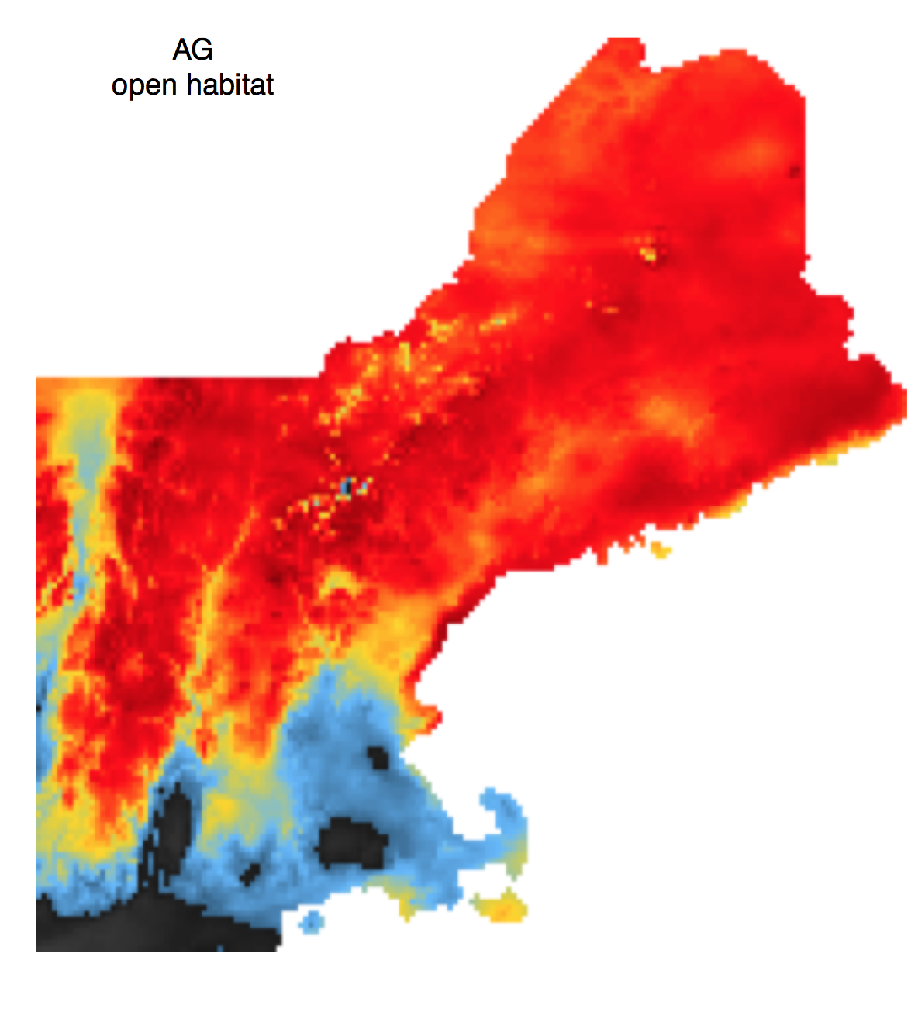
Modeling Presence Only Data
Cory Merow
^{Yale University}
Notes:
I’m going to talk about methods to use demography to forecast potential ranges and show how I’ve applied them to forecast of invasive species in new england

Slide 2
Usually, correlative models
Introduction IPMs Invasion Forecasts
Presences
Maxent
Software
Annual Precipitation
Predictions
Notes:
Often the only tool available for studying the biogeography, or spatial patterns, of invasive species is correllative species distibution models
But among the many challenges with these types of models

Slide 3
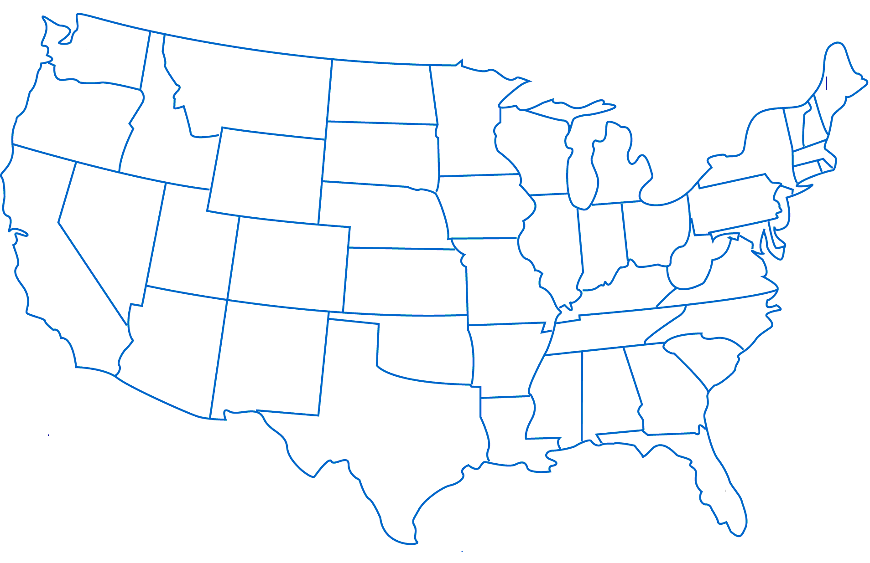
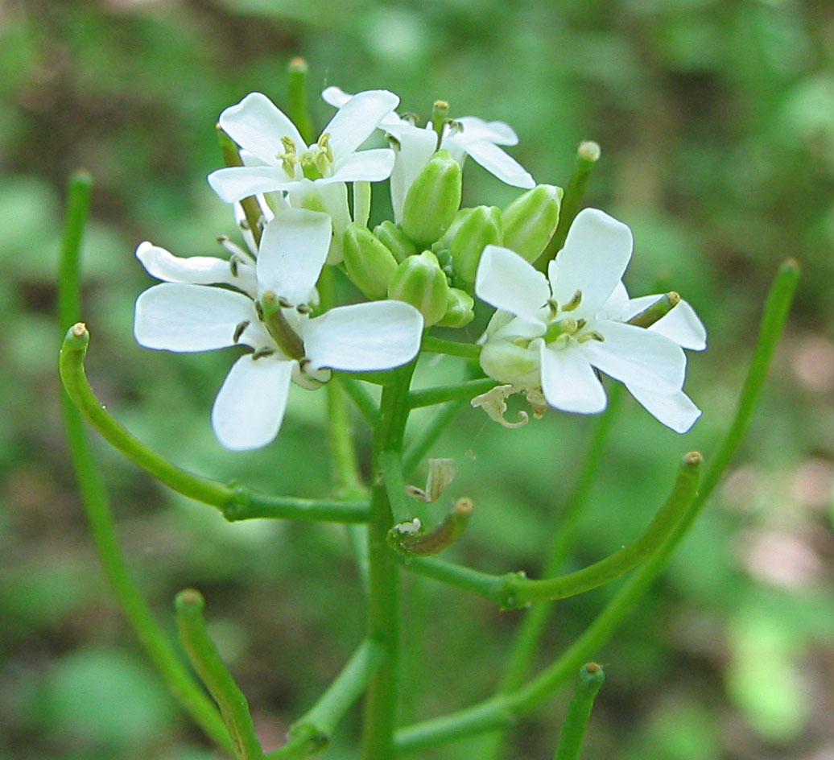
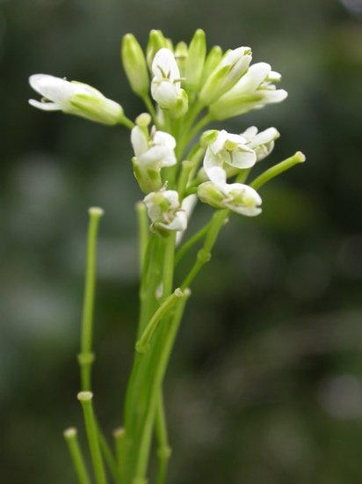
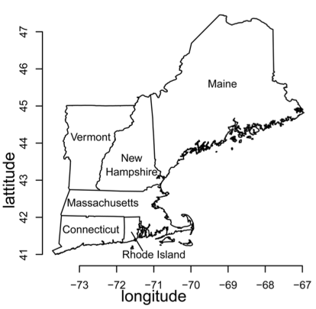
Case Study – Mustards
Invasive
Garlic Mustard
Alliaria petiolata
Native
Tower Mustard
Arabis glabra
Notes:
Two bienniels,

Slide 4
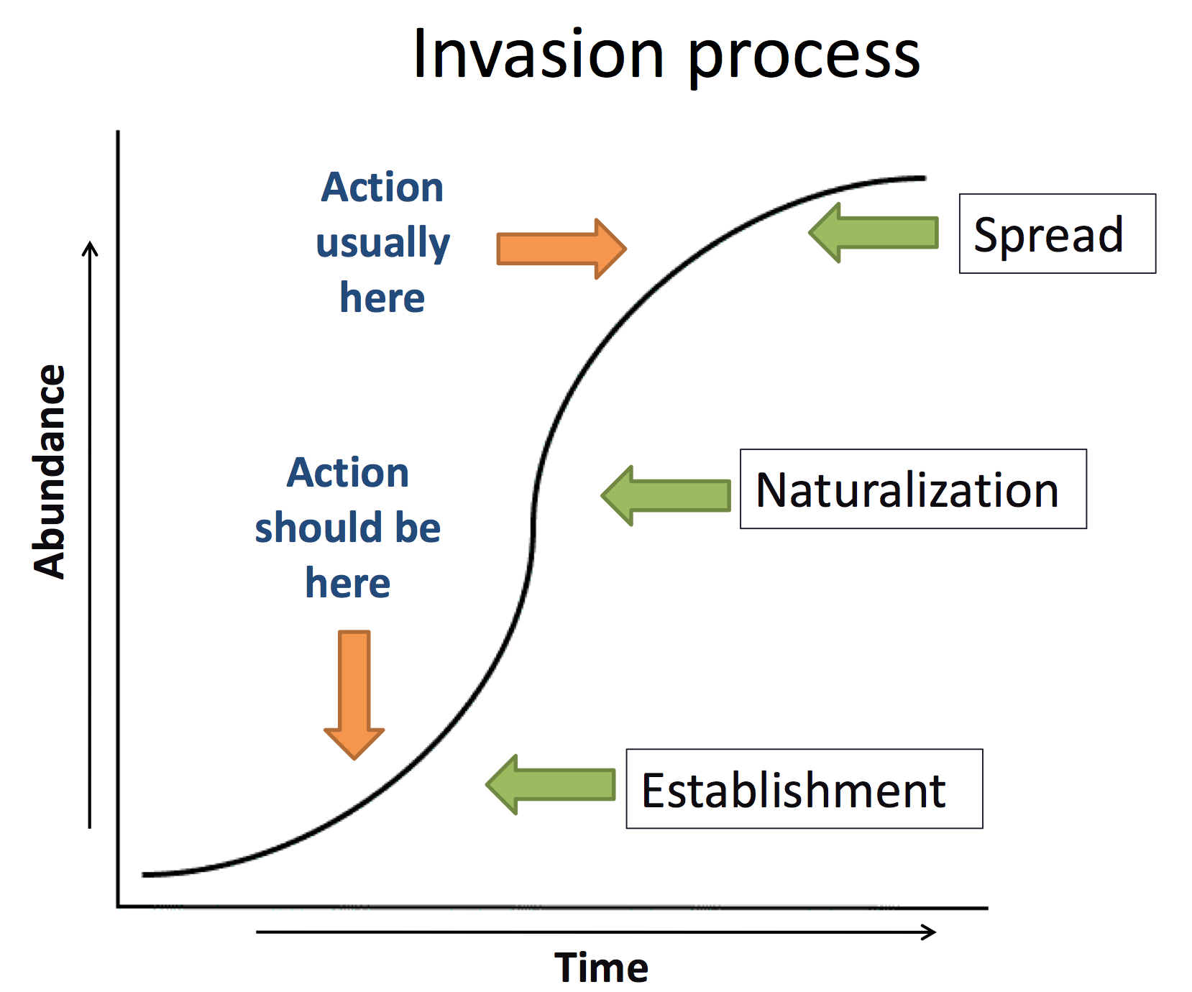
Notes:
Improve early detection
Plan preemptive management strategies
Specific to Life stage and geography

Slide 5
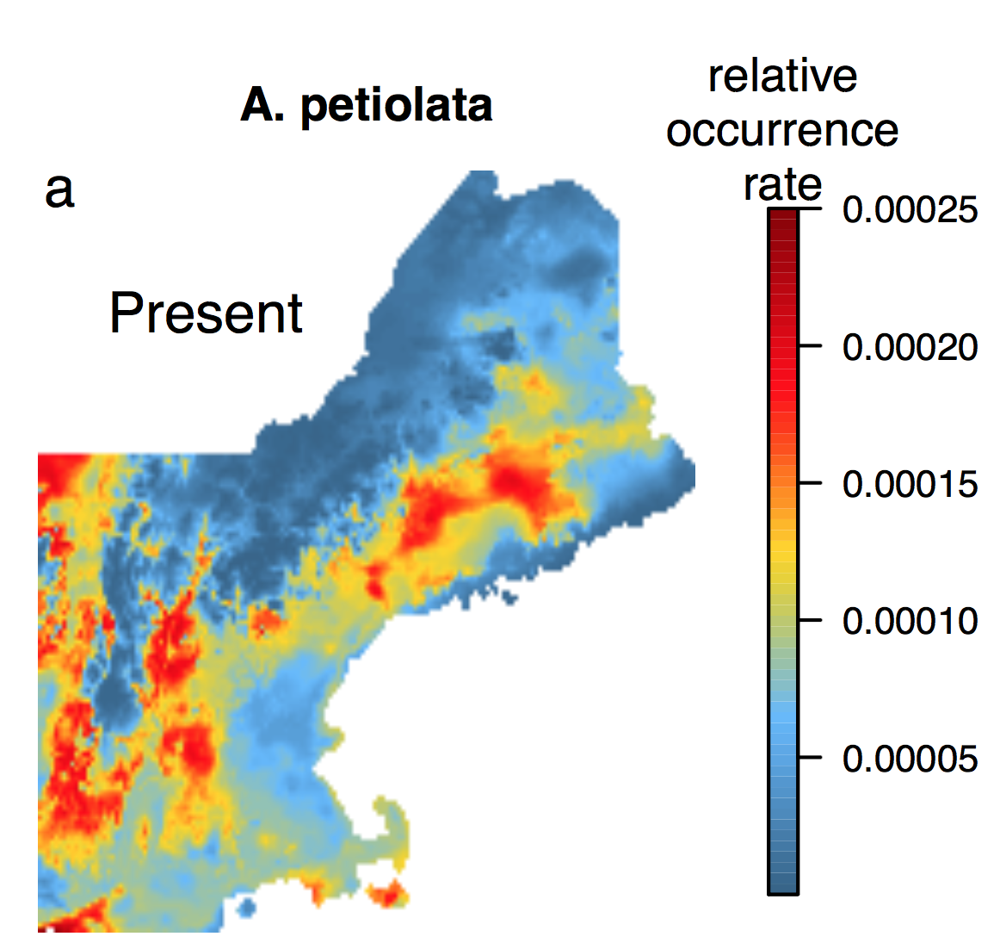
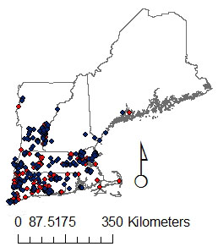
Invasions require extrapolation
Global Change Demography Biodiversity Communities Synthesis
What we ‘know’ already…
?
Occurrence
model
Merow, et al. PNAS, 2017
Notes:
Always extraplating in geographic space, often in environmetnal space too

Slide 6
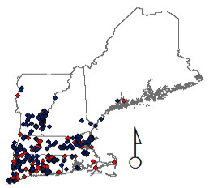
Objectives
Global Change Demography Biodiversity Communities Synthesis
Are uninvaded regions suitable?
How will climate change affect invasion?
Merow, et al. PNAS, 2017

