Slide 1

<Digital Humanity>
Jessica Ambrosio & Maria Gargiulo
Notes:
The first program most programmers write is “Hello world,” it’s time to start talking about the effect that our code has (and can have) on the world in which we live.

Slide 2
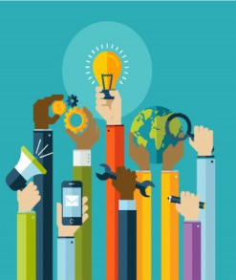
What is “coding for good”?
Applying software tools and techniques to solve problems that a community or society faces.
Notes:
Get some graphics here -- is there anything that directly screams coding 4 good? I like the idea of a network diagram like you have in the other presentation because that sort of screams “community” or “society”

Slide 3
How do we do it?

Slide 4
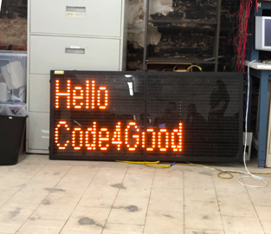
Road Sign Manager
Partners: MakeHaven & New Haven Department of Transportation
Problems: Commuters do not know where available parking spaces are. LED road signs need to be updated in person individually.
Solution: A cloud platform that allows traffic officials to update signs with parking availability information on the internet.

Slide 5
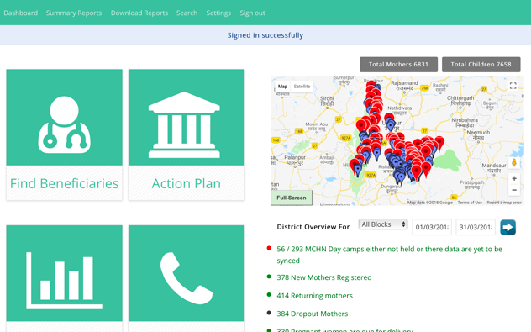
Khushi Baby System Updates
Partner: Khushi Baby
Problem: Medical professionals in India currently keep paper medical records for patients. Files are disorganized, which is particularly problematic for newborn children and their mothers.
Solution: A wearable that stores patient information that can be accessed through an online dashboard or Android app.

Slide 6
Why do we do it?

Slide 7



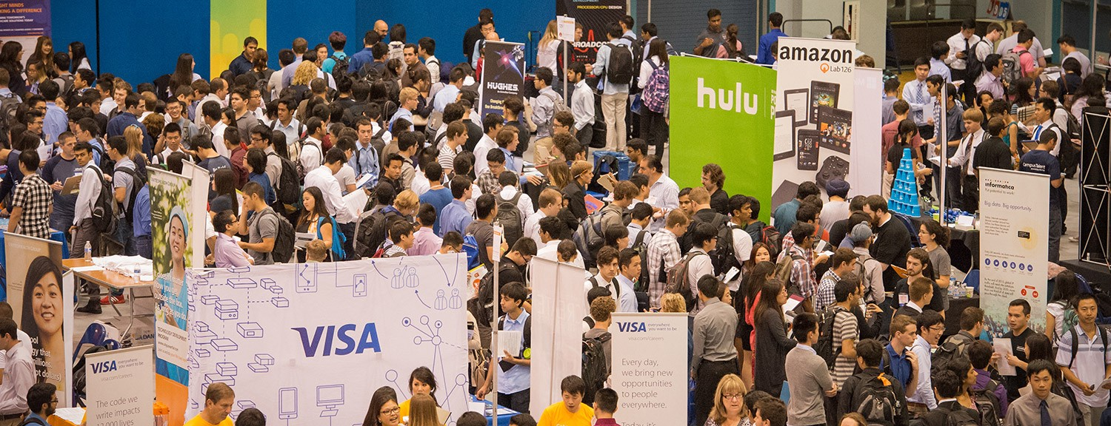





Slide 8
How can YOU do more good with technology?

Slide 9
Thank you!
Contact us at:
code4good@yale.edu

