Slide 1
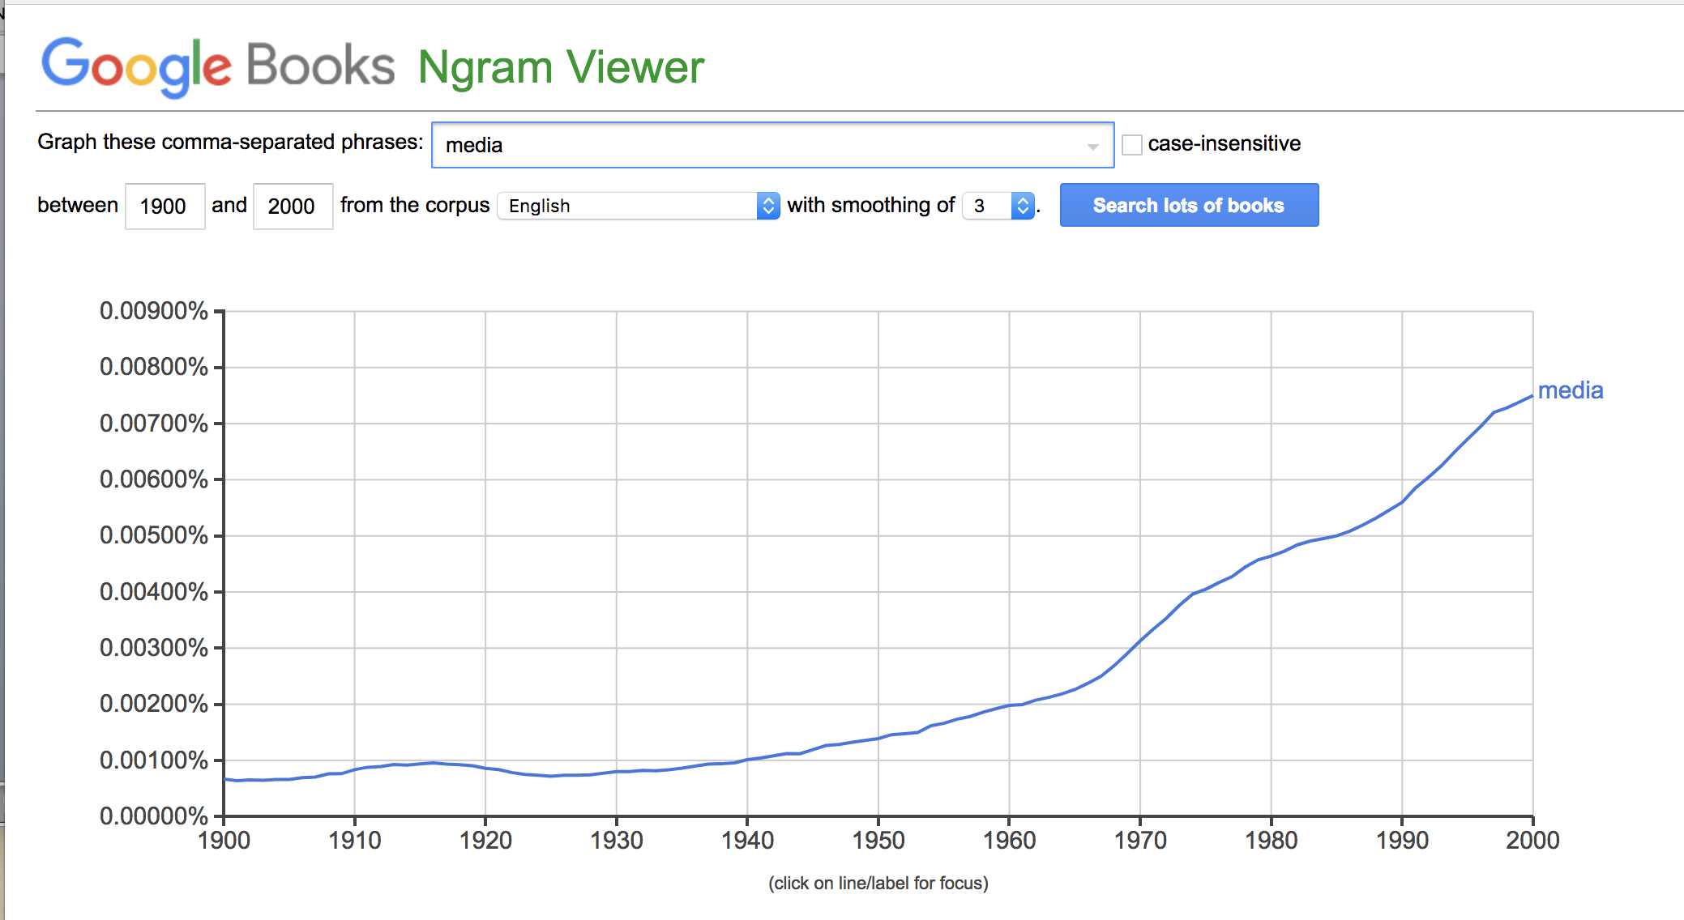
The Media Concept
Anna Shechtman, Yale University, PhD Candidate, English Literature and Film & Media Studies
Zachary Kitt, Yale University, Jackson Institute for Global Affairs

Slide 2
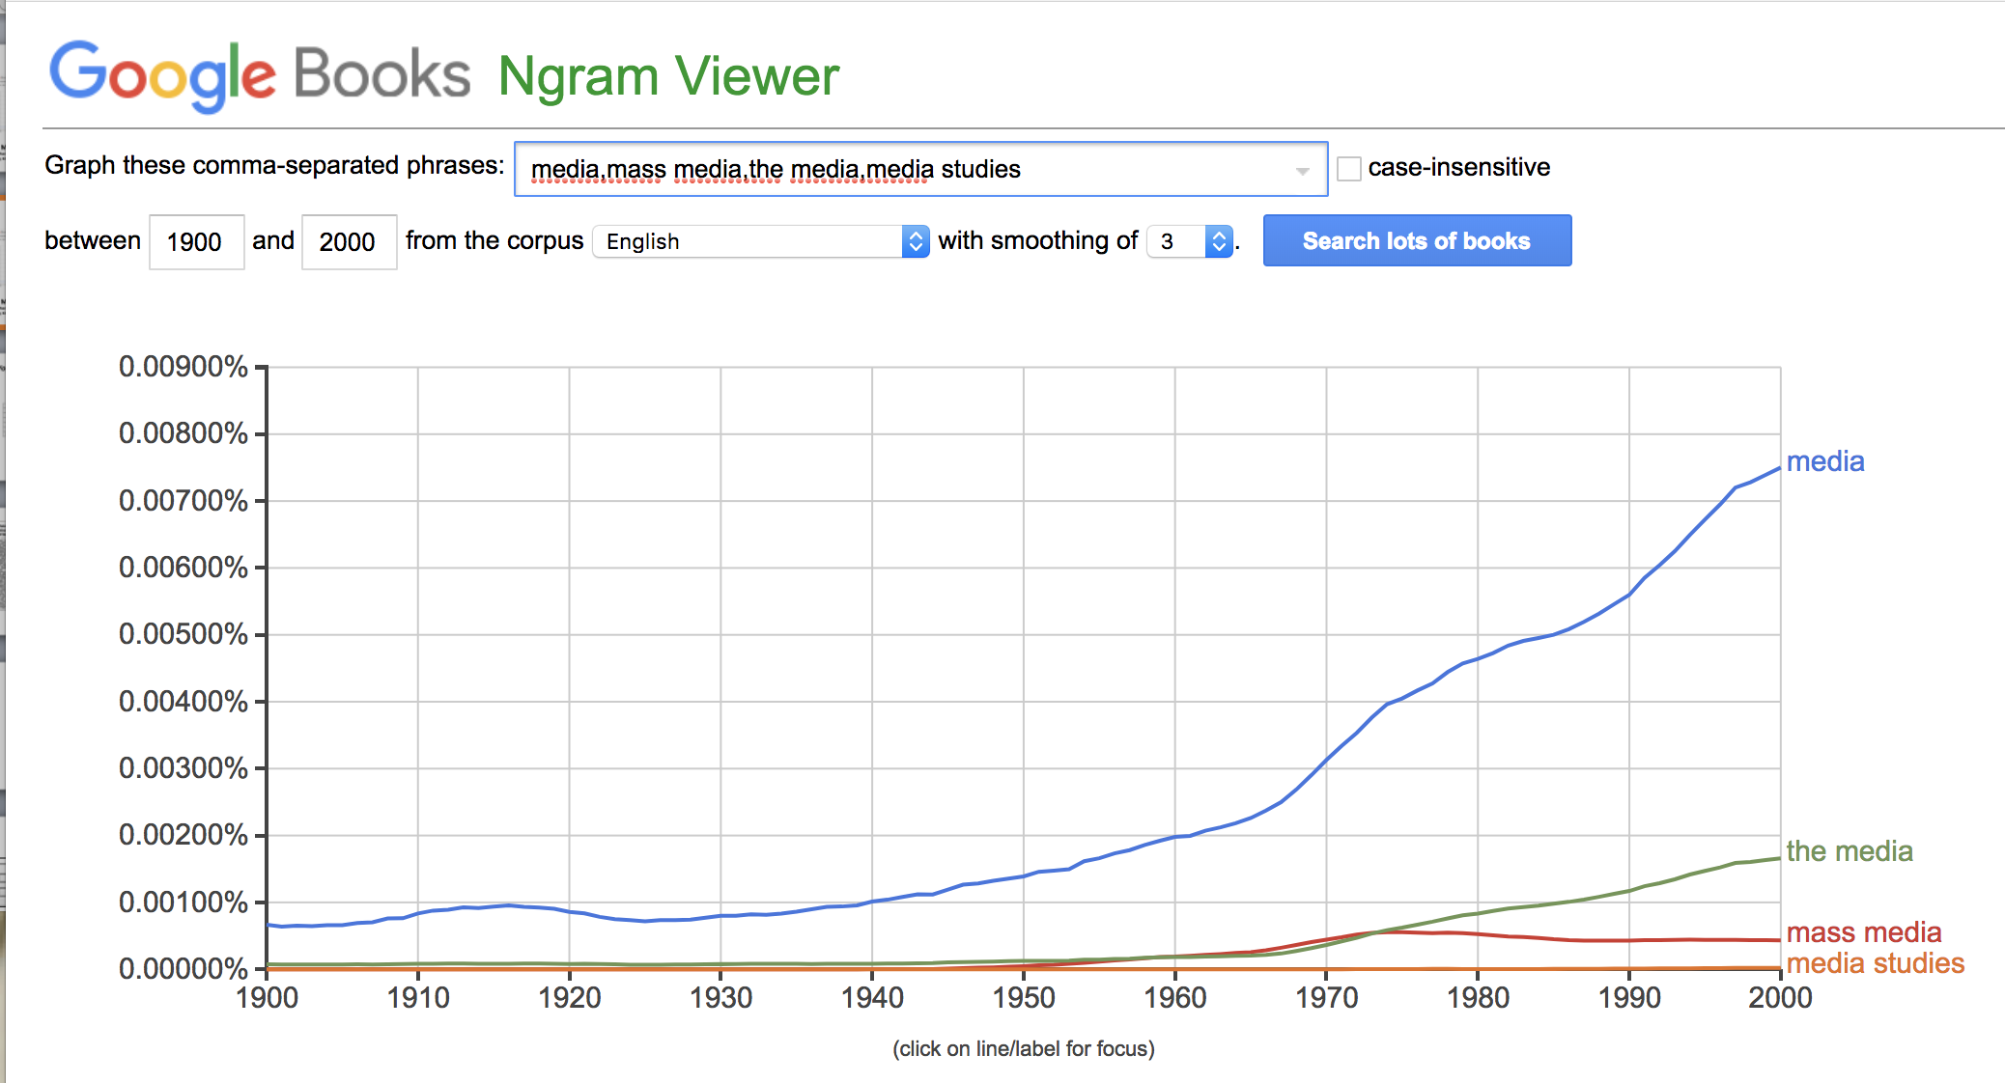
The Media Concept
Anna Shechtman, Yale University, PhD Candidate, English Literature and Film & Media Studies
Zachary Kitt, Yale University, Jackson Institute for Global Affairs

Slide 3

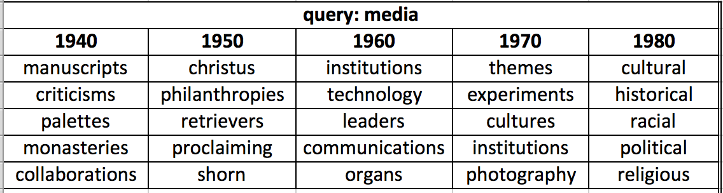

Slide 4
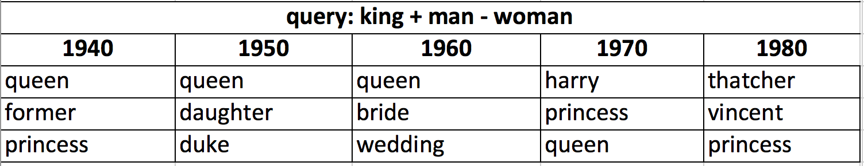
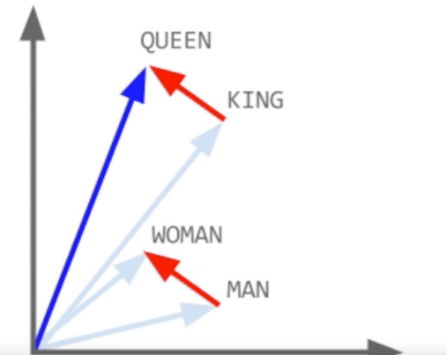
King + Man – Woman = Queen

Slide 5
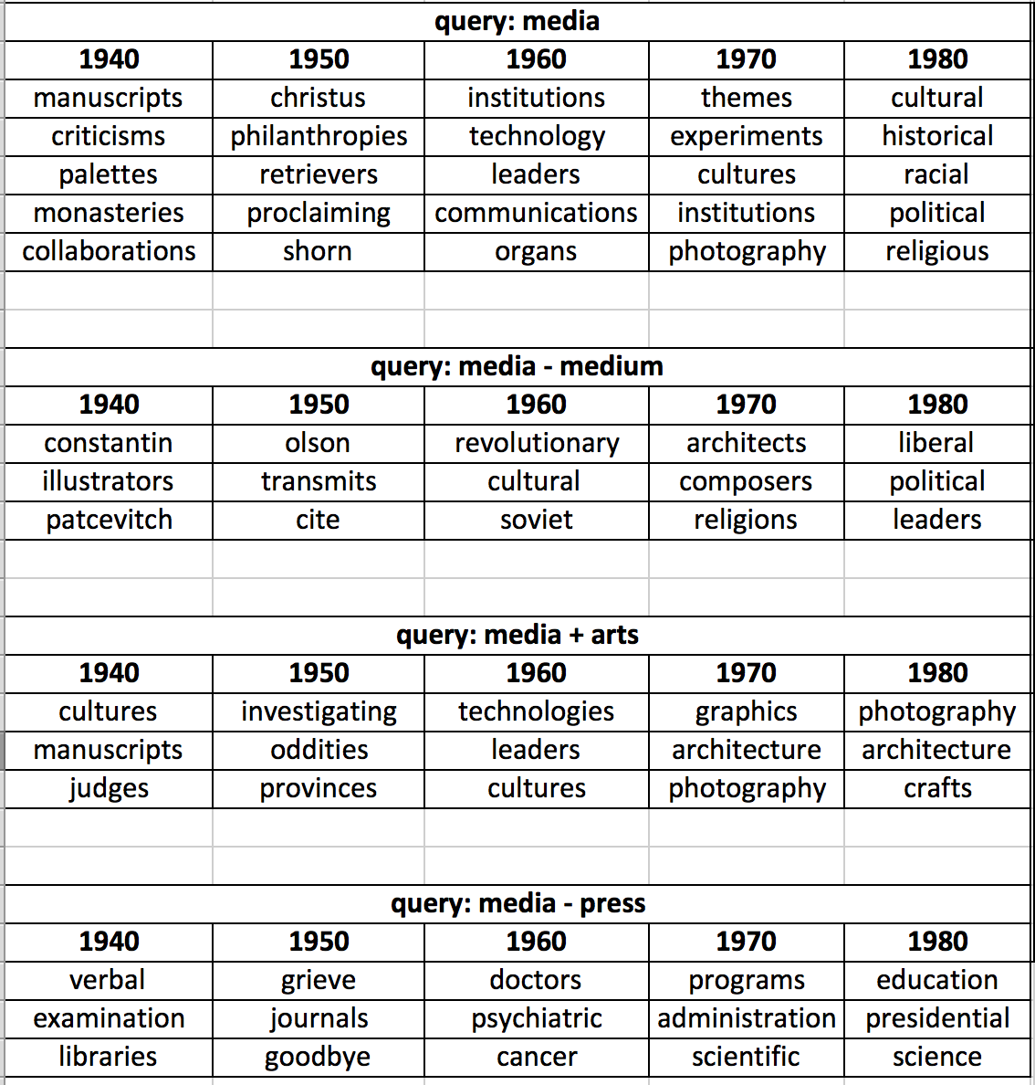
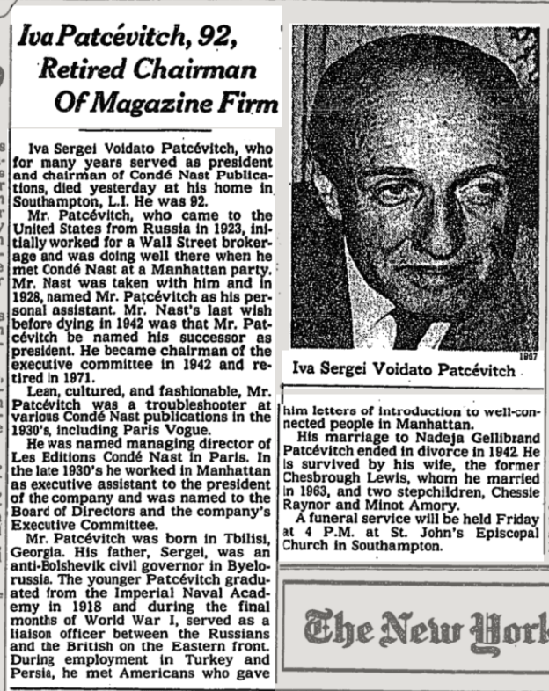

Slide 7

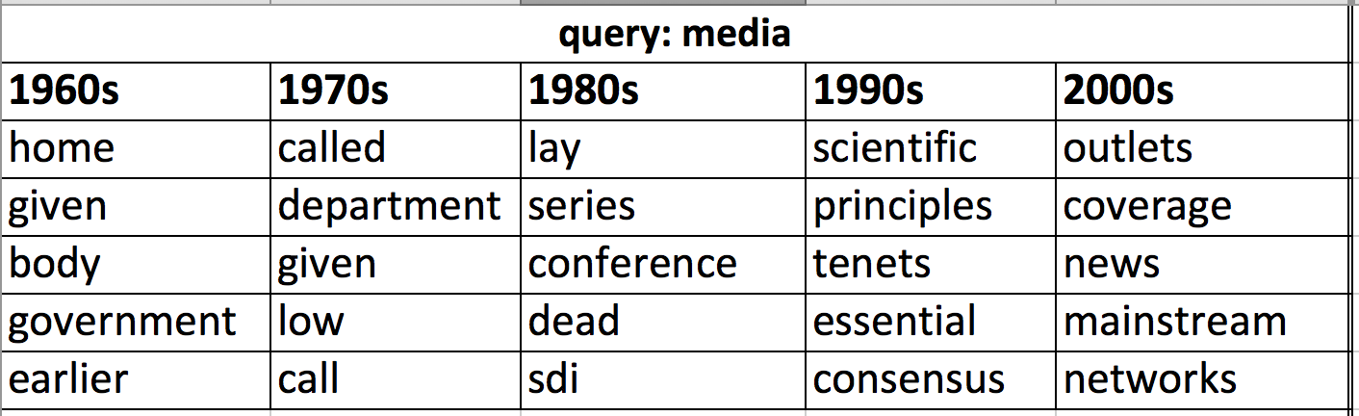

Slide 8
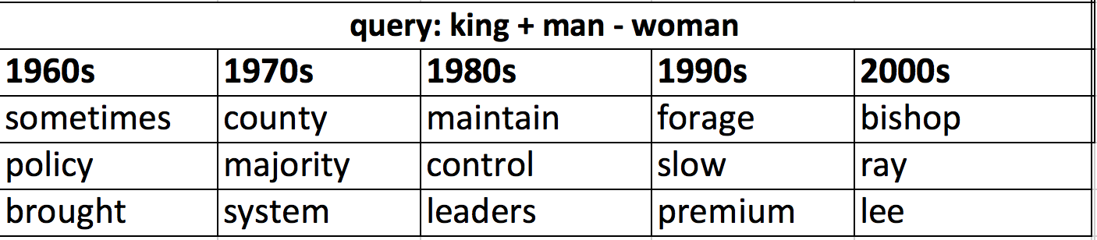
King + Man – Woman = Queen

Slide 9
