Slide 1
Asymmetric Interference Effects in Code-Switching
Alessandra Pintado-Urbanc
2025 LSA Annual Meeting
10 January 2025

Slide 2
The Bilingual Mind: Represented in DFT
Language 2
Language 1
Notes:
This presentation discusses asymmetric phonetic interference effects exhibited by bilingual speakers during instances of code-switching.
To begin, we can discuss how we conceive of the high level architecture of a bilingual mind in Dynamic Field Theory. And use DFT as a framework to ground what it would mean to have two languages in the brain and what predictions this may make for our theories.
Now that we’ve seen a production field with different inputs for a monolingual speaker, we can consider how to represent a similar production field for a bilingual speaker.
Of course, for a bilingual speaker, rather than us having one language input, we could consider two language inputs represented in the same production field.
Each of these inputs of course represent one for each of the speaker’s languages here represented as Language 1 and Language 2.

Slide 3
Overview:
Present how the bilingual mind can be represented in DFT
Discuss language dominance and language modes
Discuss code-switching and phonetic transfer
Present experimental data of phonetic transfer in code-switching
Present our DFT model that captures this effect
Present the model’s new predictions and future extensions
Notes:
Now that we’ve considered the high level architecture of a bilingual mind in DFT, we can discuss some background information on bilingualism and code-switching that will become relevant for our DFT model.
To begin, when we discuss the bilingual mind, we make the basic assumption that both languages are competing and are stored in the same mind.
Importantly, we also make the assumption that on a phonetic level, the systems of each language can be considered to be on a common representational network

Slide 4
The Bilingual Mind: Two Language Systems
Two competing languages stored within one mind
These competing languages have systems that differ on syntactic, semantic, morphological, phonological, and phonetic levels
Key Assumption:
Two phonetic systems in a common representational network (Flege, 1995)
L2
L1
Notes:
Now that we’ve considered the high level architecture of a bilingual mind in DFT, we can discuss some background information on bilingualism and code-switching that will become relevant for our DFT model.
To begin, when we discuss the bilingual mind, we make the basic assumption that both languages are competing and are stored in the same mind.
Importantly, we also make the assumption that on a phonetic level, the systems of each language can be considered to be on a common representational network

Slide 5
The Bilingual Mind: Language Dominance and Modes
Dominance Effects: (Flege, MacKay, & Piske, 2002; Grosjean, 1989)
Bilinguals typically have a dominant and non-dominant language
Resulting from age of acquisition, daily use, etc.
Language Modes: (Grosjean, 1985)
Continuum from monolingual to bilingual speech
Notes:
We can also discuss other aspects of bilingualism including language dominance and language modes that will become important for us later on in our model

Slide 6
The Bilingual Mind: Interaction between Languages
Code-Switching: Rapid systematic and predictable transitions between two (or more) languages
A code-switched word can exhibit phonetic differences from the same word produced in a monolingual context
“I think that Dynamic Field Theory es un tema muy interesante.”
Phonetic Differences: (Grosjean, 2011)
Transfer: Long-term memory representations
Interference: Working memory representations
L1
L2
Notes:
Further, given that bilinguals have two language systems, there are instances in which these two systems can interact with each other.
Code-switching is exactly this

Slide 7
DFT Predictions: Overlapping Inputs
If language inputs are overlapping, during instances when both inputs are sufficiently activated (e.g. during code-switching) productions will result in phonetic differences
VOT

Slide 8
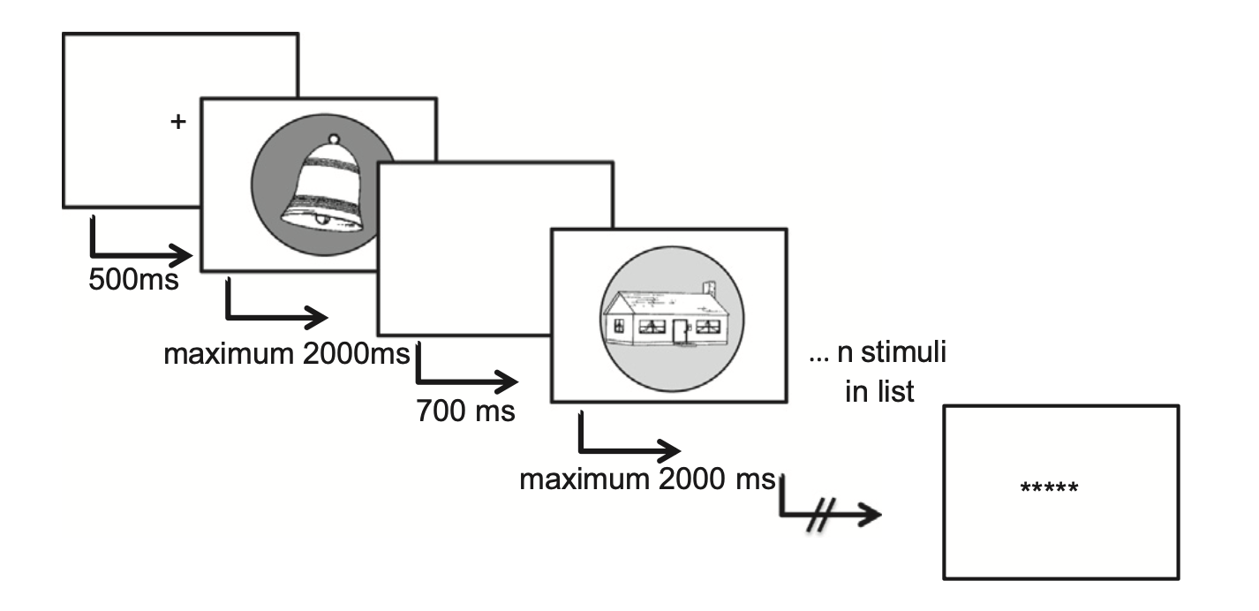


The Data: Olson (2013)’s Language Switching Task
Experimental Condition: Language Modes
Monolingual Condition: 95% of trials in dominant and 5% of trials in non-dominant
English
Spanish
Notes:
Will use this data to ground our model

Slide 9
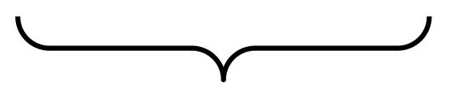
Spanish and English Voice Onset Time:
English
Spanish
Voiceless
Voiced
VOT
Short-Lag
Long-Lag

Slide 10
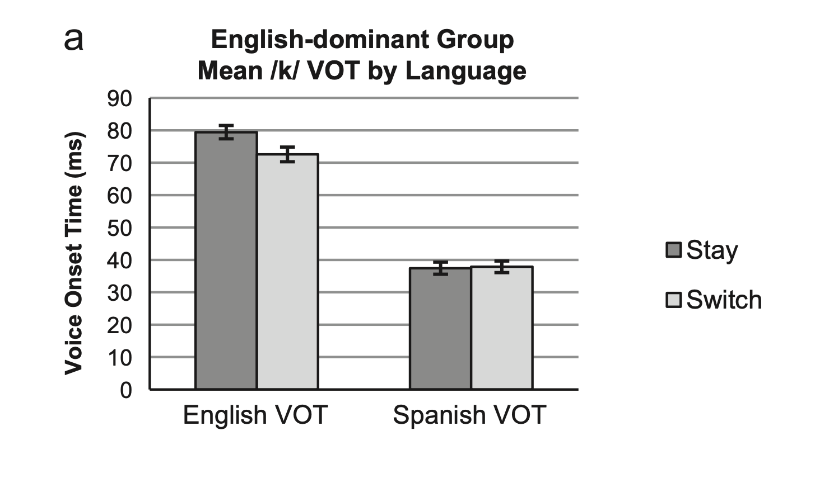
Results: Non-dominant (Spanish) impacting dominant (English)
English Dominant Participants
ENG
ENG
no language interference
SPAN
SPAN
no language interference
SPAN
ENG
language interference!
English
Spanish
ENG
SPAN
no language interference

Slide 11
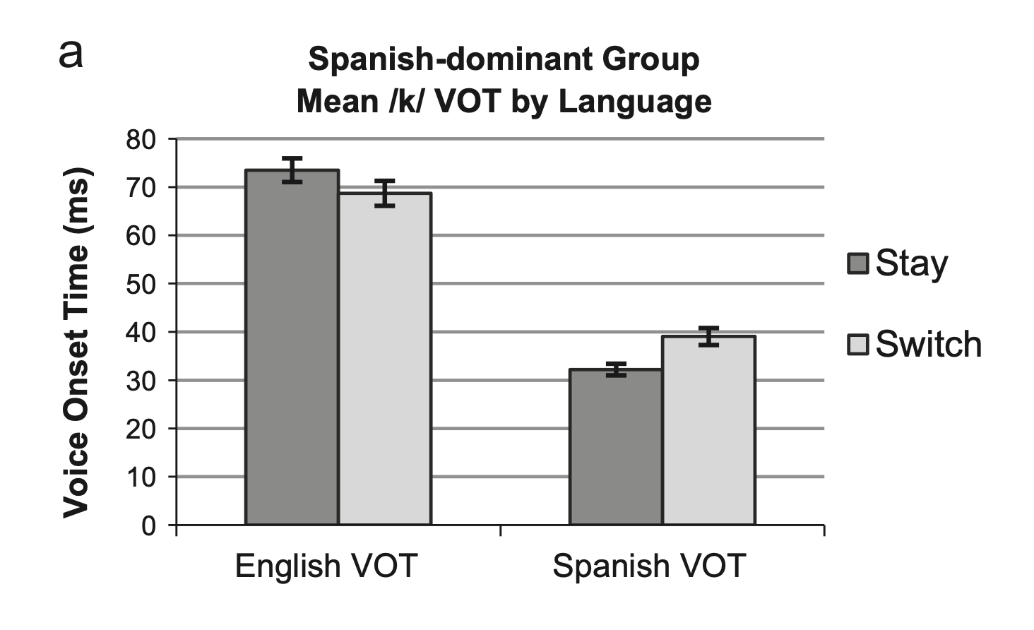
Results: Non-dominant (English) impacting dominant (Spanish)
Spanish Dominant Participants
ENG
ENG
no language interference
SPAN
SPAN
no language interference
ENG
SPAN
language interference!
English
Spanish
SPAN
ENG
no language interference

Slide 12
The Model:
Spanish
English
Modulates the activation (amplitude) of the language inputs

Slide 13
Inverse Frequency Effect (Ferreira, 2003):
Greater priming effects for less frequent items
6
Priming (Residual Activation of the Competitor)
4
2
Non-Dominant Language
Dominant Language
Frequency

Slide 14
Model Parameters:
Parameter | Value
τ | 20
h | - 5
β | 4
c_{exc} | 21
c_{inh} | 0
c_{glob} | 0.9
σ_{exc} | 5
σ_{inh} | 12.5
q | 0
w | 21
Selection Parameters:
Only want to produce one language at a time

Slide 15
Input Parameters:
 | Activation of Dominant Language Input | Activation of Non-Dominant Language Input | Reaction Time
Dominant → Dominant (DOM STAY) | 6 | 1 | 30
Non-Dominant → Non-Dominant (NON-DOM STAY) | 1 | 6 | 30
Dominant → Non-Dominant (NON-DOM SWITCH) | 1 | 5 | 46
Non-Dominant → Dominant (DOM SWITCH) | 4 | 3 | 79
Even when operating in “monolingual modes” is the competing language minimally activated
(Blumenfeld & Marian, 2007; Marian & Spivey, 2003)
Notes:
When operating in the monolingual mode, the bilingual language is minimally activated!
Because of this activation, differences in reaction times

Slide 16
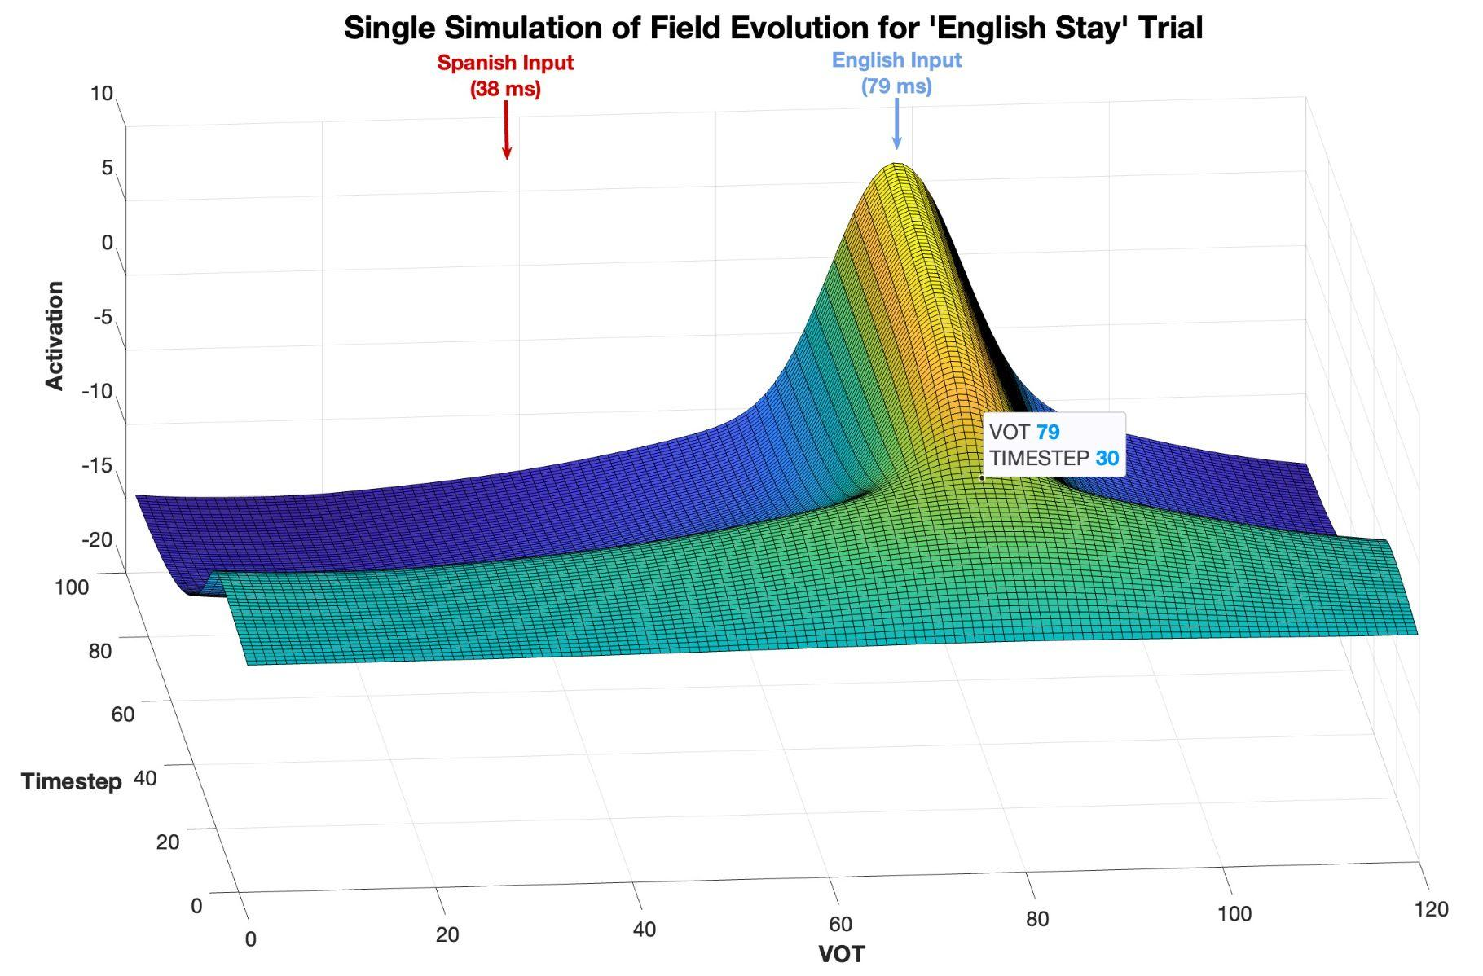
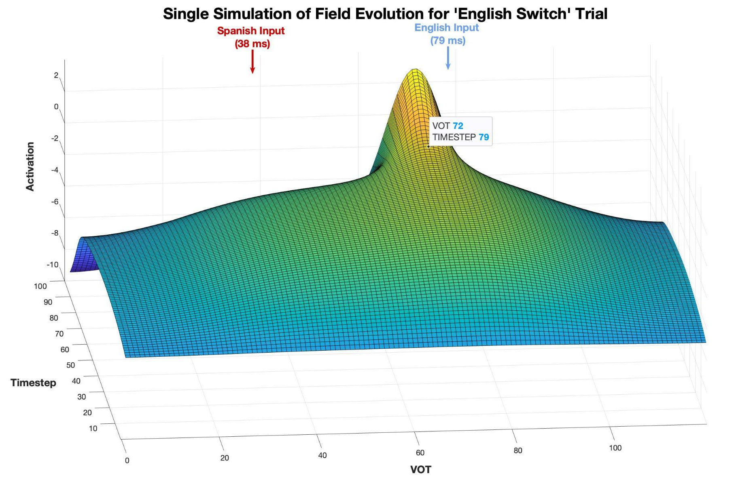
Simulations: English Dominant
English
Stay
English Switch

Slide 17
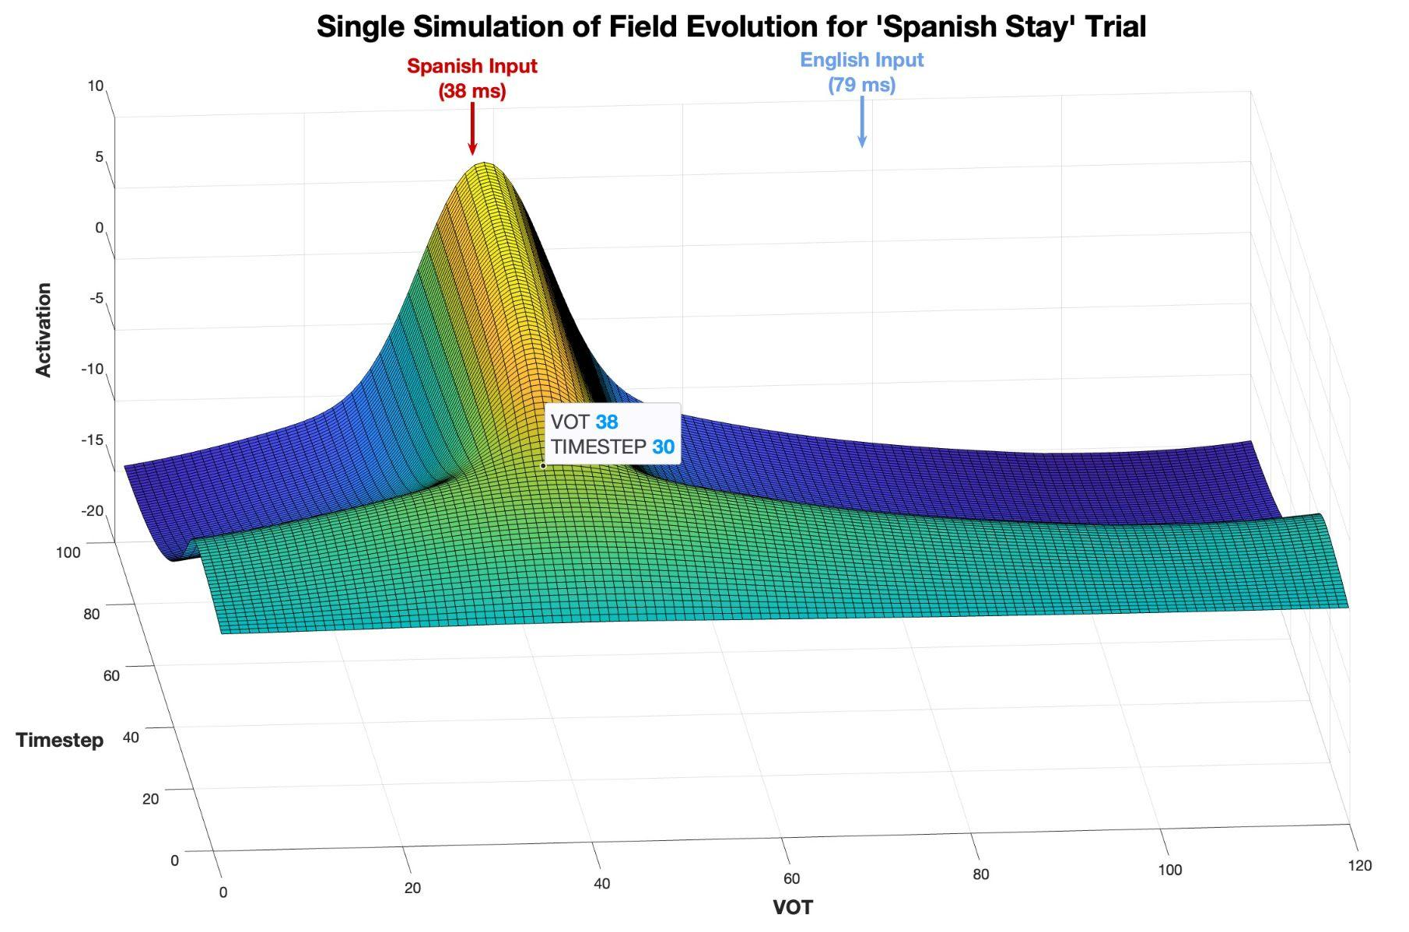
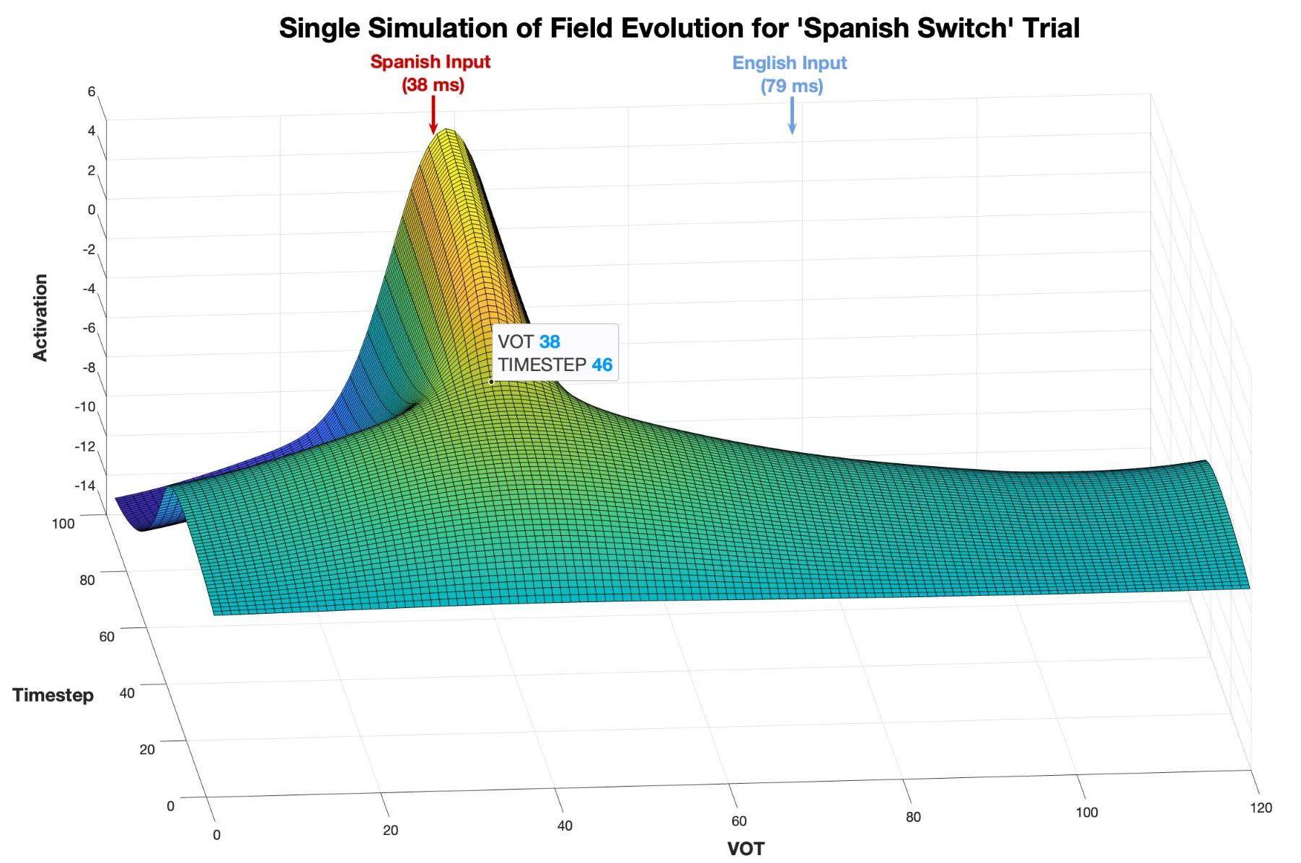
Simulations: English Dominant
Spanish Stay
Spanish Switch

Slide 18
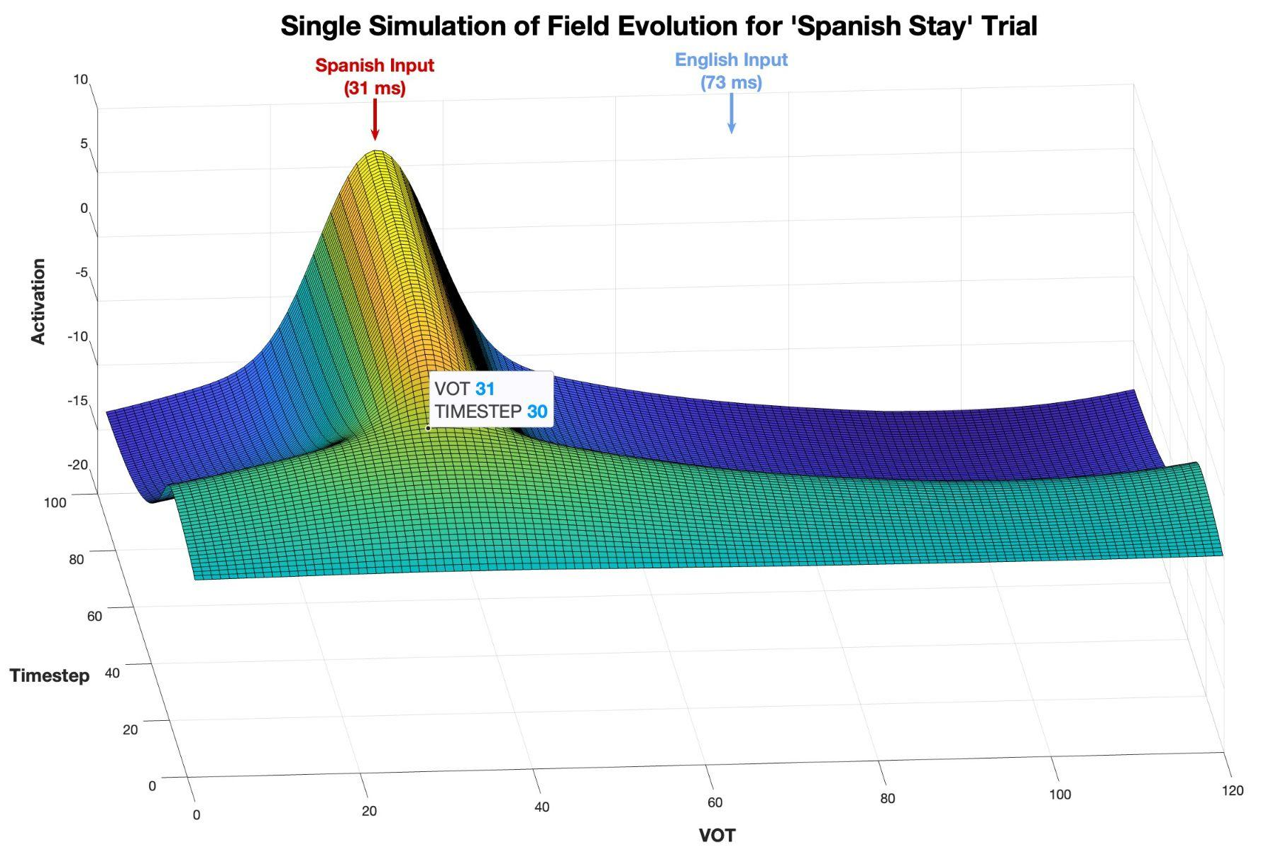
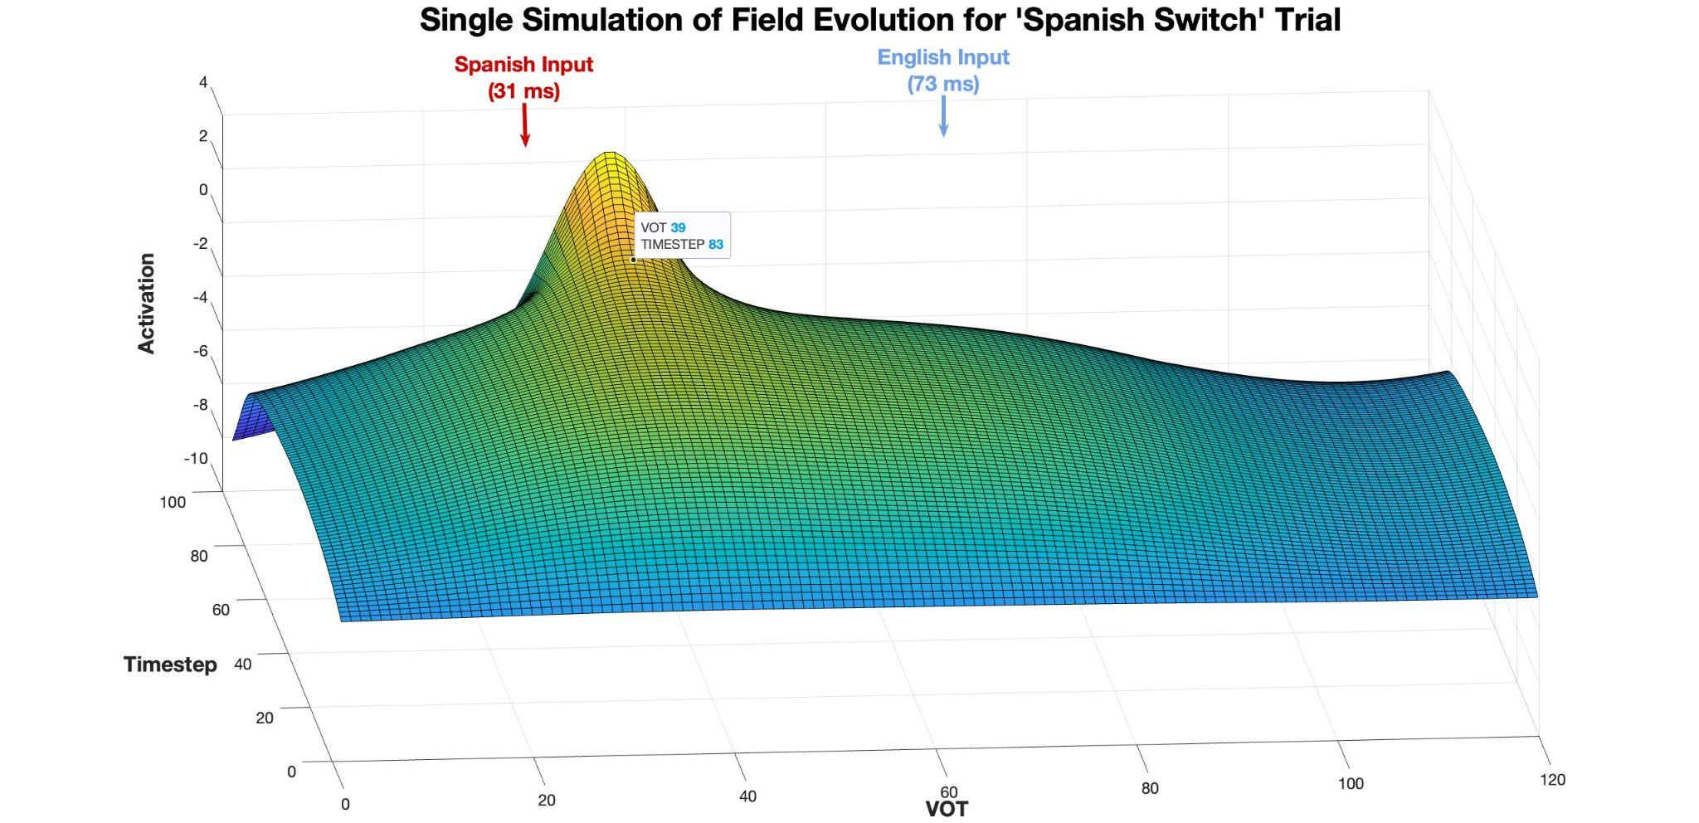
Simulations: Spanish Dominant
Spanish Stay
Spanish Switch

Slide 19
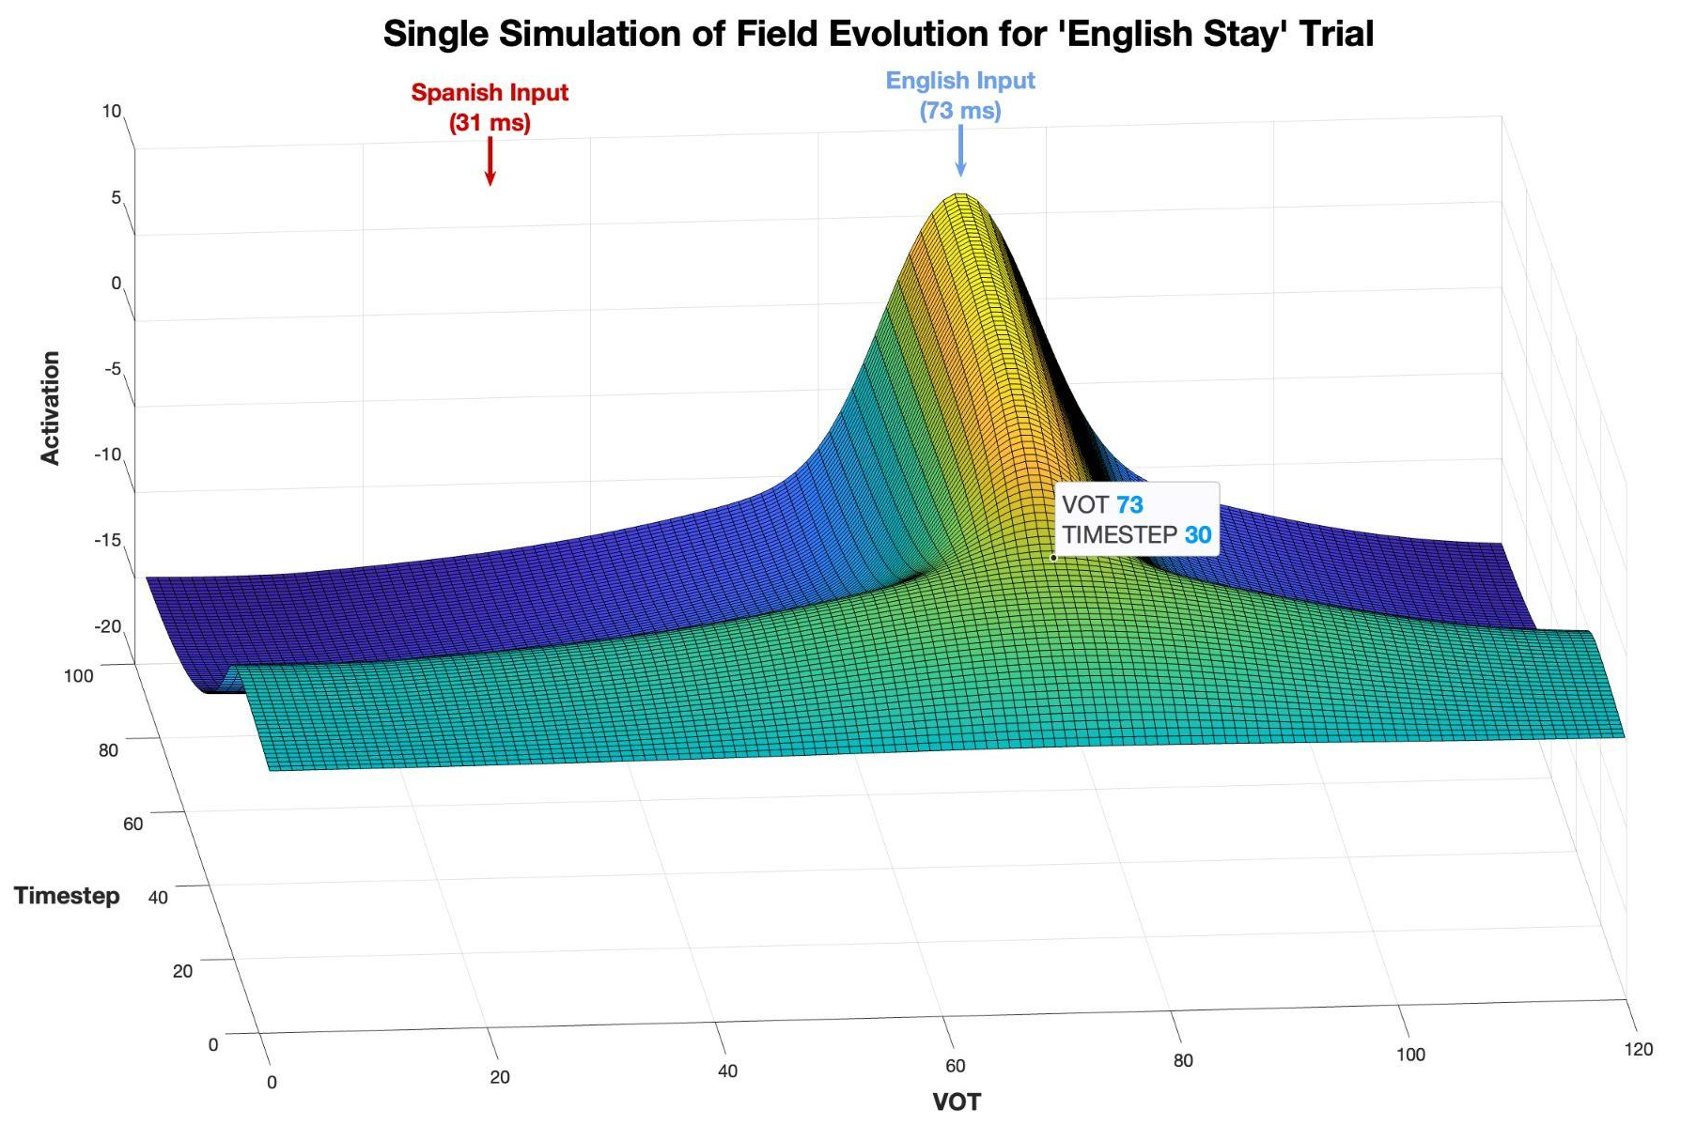
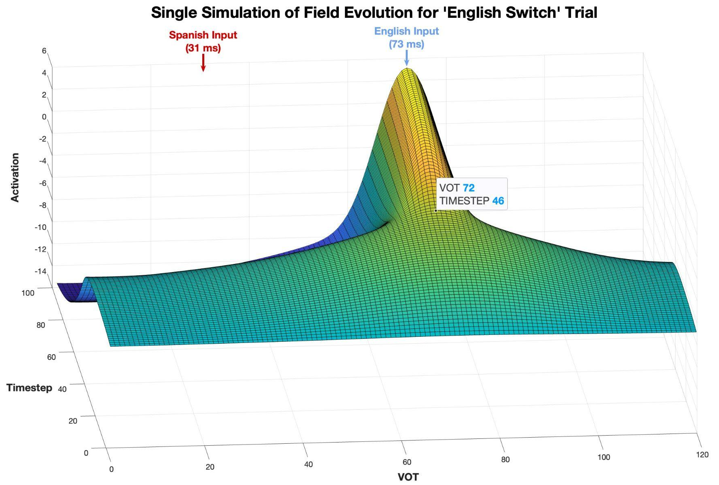
Simulations: Spanish Dominant
English
Stay
English Switch

Slide 20
New Predictions:
Future Extensions:
The model predicts there to be no interference effects for speakers of languages whose VOT distributions do not overlap
It also predicts a ‘switch-cost’ when switching from the non-dominant language into the dominant given differences in the timesteps of the onset of peak formation
Adapt the model to account for a bilingual mode of communication where asymmetric interference effect is not found (Olson, 2013)
Adapt the model to account for balanced bilinguals where interference effects are not found (Tsui et al., 2019)

Slide 21
Thank You!

Slide 22
voiced
voiceless
English VOT
-80
0
+80
voiced
voiceless
Spanish VOT

