Slide 1


Dynamic Field Theory for unifying discrete and continuous aspects of linguistic representations (two-part organized session)
Part I (1:45-3:15)
Dynamic Field Theory: An introduction, Michael C. Stern (1:50-2:15)
Case Studies
Speech Errors in Vowels: trace effects, Manasvi Chaturvedi (2:15-2:35)
Asymmetric Interference Effects in Code-Switching, Alessandra Pintado-Urbanc (2:35-2:55)
Discussant: Khalil Iskarous (2:55-3:05)
General discussion (3:05-3:15)
Part II (3:30-5:00)
More case Studies
A Dynamic Neural Field Model for Production Mode and Phonological Neighborhood Density Effects, Xiaomeng (Miranda) Zhu (3:30-3:50)
Deriving sibilant-vowel phonotactics from a soft bias in perception, Ayla Karakaş (3:50-4:10)
Error-driven Learning in DFT: A case study of structural priming, Zhenghao (Herbert) Zhou (4:10-4:30)
Discussant: Khalil Iskarous (4:30-4:40)
General discussion (4:40-5:00)
Thanks also to Teresa Borneo.
Notes:
Welcome to the organized session on Dynamical Field Theory. I’m Jason Shaw, a faculty member in linguistics at Yale University, and I’m going to briefly introduce this session. It features presentations by 6 Yale PhD students who have been thinking deeply about the applicability of Dynamic Field Theory to language over the last couple of years, as well as commentary on the talks by Khalil Iskarous who has been thinking about language as a dynamical system for much longer.
The session is titled “Dynamic Field Theory for unifying discrete and continuous aspects of linguistic representations”. As you’ll hear more about in the introduction, Dynamic Field Theory is a general theory of cognitive processing with roots in a dynamical systems account of neural function.
Recently DFT has been applied to linguistic phenomena. This organized session features a gentle introduction to DFT and 5 case studies applying DFT to topics that might otherwise be spread across different sessions at the LSA, including phonetics, bilingualism, psycholinguistics, speech perception, phonology. One aim in proposing a special session was to show how diverse language phenomena can all be understood in terms of a common framework.
The session will start with Michael Stern’s talk which provides a general introduction to Dynamic Field Theory. We’ll then have two talks presenting case studies: Manasvi Chaturvedi will apply DFT to derive trace effects in speech errors in vowels. Then, Alessandra Pintado-Urbanc will apply DFT to code-switching in bilinguals, accounting for asymmetric interference effects. This will be followed by the first commentary by Khalil Iskarous.
Part II will feature three more case studies, Xiaomeng (Miranda) Zhu will use DFT to model the interaction between production mode and Phonological Neighborhood Density in DFT. This will be followed by Ayla Karakas’s talk formalizing a soft bias in speech perception in DFT with potential implications for sibilant vowel phonotactics. Then, Zhenghao (Herbert) Zhou will present his work modelling structural priming through error-driven learning implemented in DFT.
We’ll then proceed to the commentary from our discussant, Khalil Iskarous, and then a general discussion.
Besides the 6 PhD students that are presenting, I’d like to thank Teresa Borneo who is not giving a talk but who has been involved in organizing the session.
Finally, one other comment before we begin. Besides the general discussion at the end of Part I and Part II, we have built in time, about 5 minutes, for questions during the transitions between talks. Feel free to ask questions, particularly clarification questions at the end of individual talks. The speaker can answer questions while the next one sets up. If there is not is time immediately after the presentation, we can return to lingering questions during the general discussion periods.
So, without further ado, I’ll turn it over to our first speaker, Mike Stern, to present “Dynamic Field Theory: An Introduction”.

Slide 2
Dynamic Field Theory (DFT): An introduction
Michael C. Stern
Linguistics Department, Yale University

Slide 3
Purpose of this talk
Explain the basic principles of Dynamic Field Theory (DFT)
Describe some benefits of DFT for understanding language
Provide basis for the rest of the talks in the symposium
Notes:
My plan in this talk is CLICK to explain some basic principles of DFT, including where it came from and why. CLICK And to describe some maybe unique benefits of DFT for understanding language. CLICK The reason I want to do this is that the rest of the talks in the symposium will rely on DFT to explain some linguistic phenomena, so hopefully by explaining the basic principles now, at the beginning, that will free up time for the other presenters to go into more detail about their particular phenomena and models.

Slide 4
DFT resources
Website
dynamicfieldtheory.org
Textbook
Schöner, G., Spencer, J., & DFT Research Group (2016). Dynamic Thinking: A Primer on Dynamic Field Theory. Oxford University Press.
Some overview papers
Schöner, G. (2020). The Dynamics of Neural Populations Capture the Laws of the Mind. Topics in Cognitive Science, 12(4), 1257–1271.
Schöner, G. (2023). Dynamical Systems Approaches to Cognition. In R. Sun (Ed.), The Cambridge Handbook of Computational Cognitive Sciences (2nd ed., pp. 210–241). Cambridge University Press.
Notes:
Before I start, I just wanna point out that there are some great introductory resources from the DFT community. There’s a website with events, new papers, software tutorials, stuff like that. There’s also a great introductory textbook. As well as some overview papers that give a broad overview of the theory. I’ll show these resources again at the end of my talk.

Slide 5
A brief history of DFT
1993: first DFT paper (on eye movement planning)
Since then: reaching movements, visual perception, development, robotics, word learning, speech articulation, language comprehension
Theoretical roots in dynamical systems theory (e.g., Newton), as applied to human behavior in the 1980s (e.g., Turvey, Kelso)
Details come from neuroscientific (e.g., Georgopoulos et al., 1986) and mathematical (e.g., Amari, 1977; Grossberg, 1969) work on dynamics of neural networks in the 1970s and 80s
Notes:
I’ll start with a very brief history of DFT, just to give a sense of where the theory came from. CLICK The first published paper on DFT was in 1993, the paper was on the planning of eye movements. CLICK Since then, DFT has been applied to a wide range of phenomena, including reaching movements, visual perception, development, DFT models have even been used to control robots. Most relevant for us, more recently, there’s been work on language, including word learning, speech articulation, and language comprehension in a variety of contexts. CLICK DFT’s theoretical roots come from dynamical systems theory, which we usually trace back to Isaac Newton, especially as it was applied to human behavior starting mainly in the 1980s by people like Michael Turvey and Scott Kelso. CLICK Many of the details of the theory come from both neuroscientific and more theoretical mathematical work on the dynamics of neural networks starting in the 1970s and 80s.

Slide 6
Basic hypotheses
Behavior is governed by the nervous system
Populations of neurons constitute a privileged level of description (e.g., Cohen & Newsome, 2009)
Neural processes exhibit stability: a capacity to resist change in the face of noisy and variable inputs
Instabilities allow transitions from one stable state to another
Notes:
Here are the basic hypotheses of the theory. CLICK First, behavior is governed by the nervous system. If we want to understand language behavior, for example—speaking, perceiving, comprehending, etc.—then it will help to understand the neural processes that govern these behaviors. CLICK The next hypothesis is that populations of neurons constitute a privileged level of description. If we want to understand behavior, then we shouldn’t just look at individual neurons, or at macroscopic brain regions (although, of course, those details are important, too), but the best predictor of behavior is at the level of connected populations of neurons. CLICK The next hypothesis is that neural processes exhibit stability, which basically means the property of resisting change in the face of noisy and variable inputs. CLICK At the same time, instabilities in neural processes allow qualitative transitions from one stable state to another. This interplay between stability and instability is key. Stability and instability are actually formal concepts from dynamical systems theory, which I’ll explain in more detail in the following slides.

Slide 7

Dynamical systems
The present predicts the future according to a law of change:
$$\dot{u}=f\left(u\right)$$
rate of change
relation between state and change
variable (e.g., neural activation)
Notes:
A dynamical system is just a system that changes lawfully over time. CLICK Because change is lawful, we can in theory write down that law, which allows us to predict the future from the present. CLICK Here’s a law that describes change in the variable u. CLICK In DFT, u is used to refer to neural activation or average spiking rate. CLICK u-dot is the rate of change of u, like the velocity of u. CLICK and f is the function that relates u to u–dot. If you give me the current state of u, I can pass it through f, and tell you u-dot, where u is going. The present state of u predicts the future state of u via this function f. But what is f?

Slide 8
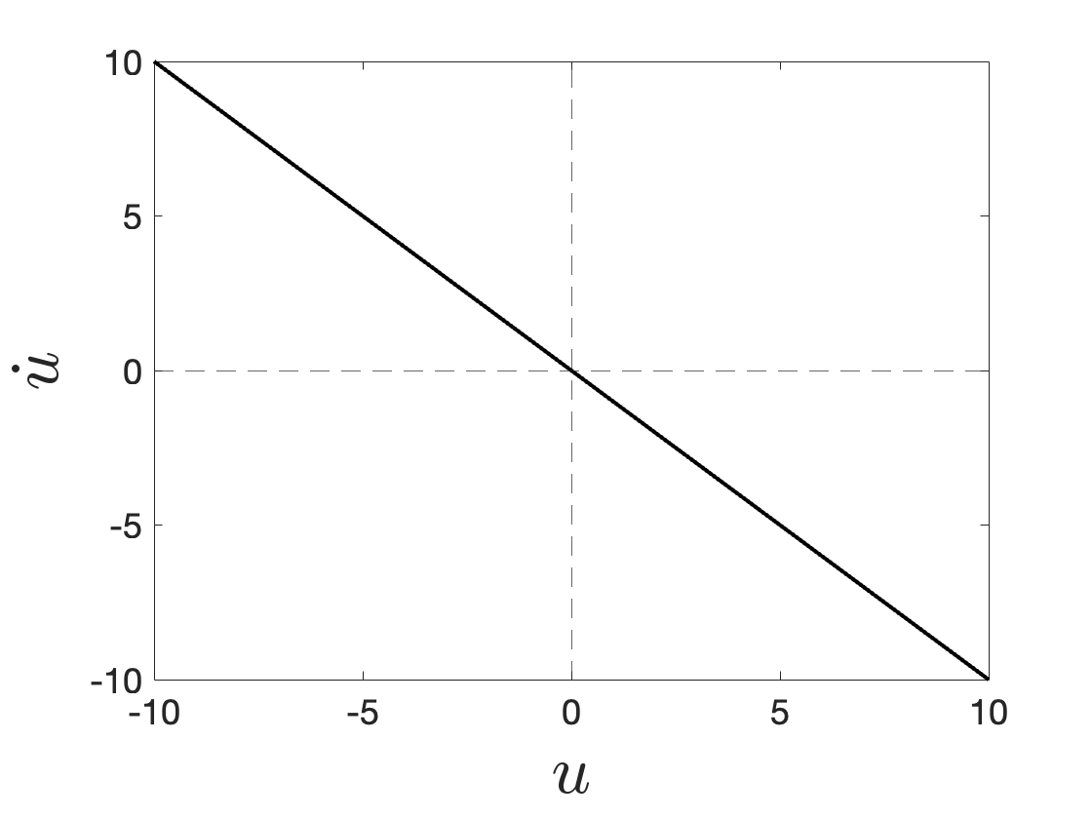
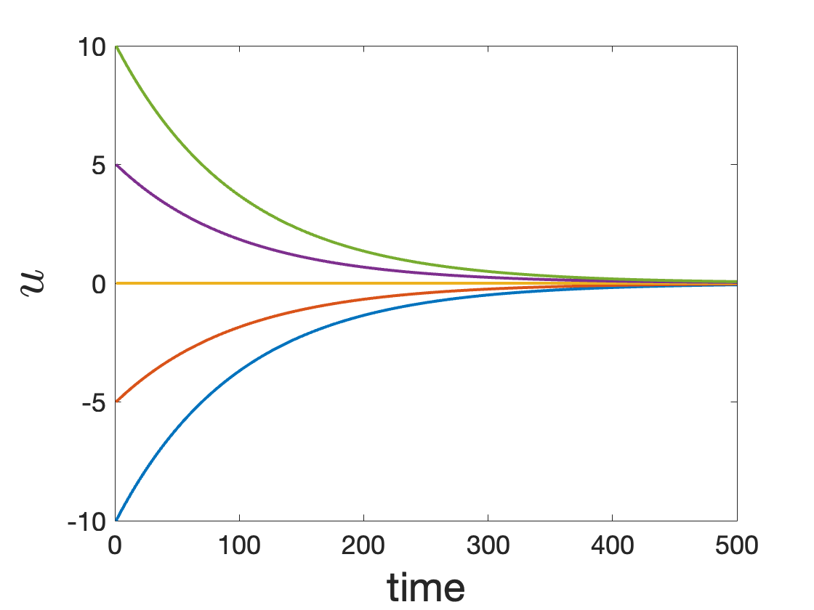


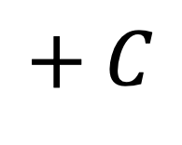
Point attractors and stability
$$+ C$$
$\dot{u}=−u$
stable point attractor
$$C$$
Notes:
Here’s a simple example, where u-dot just equals negative u. This is called a point attractor system, and to see why, CLICK it will help to look at this plot, which has u on the x axis, and u-dot or rate of change on the y axis. This is sometimes called a phase plane. You can see that as u decreases, becomes more negative, u-dot increases, becomes more positive. In other words, the farther I push u to the left, the more quickly u will move back to the right. And the farther I push u to the right, the more quickly it will move back to the left. CLICK This is what I did for a few examples, where I started u at different points, and let it evolve over time, and no matter where I start u, it always moves back to 0. And if I start u right at 0, it just stays there. CLICK This is why we call 0 a stable point attractor. The stable point just happens to be at 0, CLICK but adding some value can actually move the phase plane around, and therefore move the position of the point attractor.

Slide 9
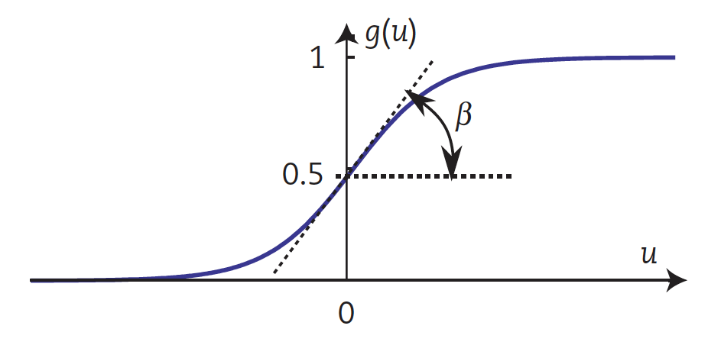

Neural activation dynamics
point attractor
$$τ\dot{u}=−u+h+s+c∙g\left(u\right)+ξ$$
resting level
interaction
noise
rate parameter
input
threshold
Notes:
Here is the main equation describing neural activation dynamics in DFT, which only differs from that last equation in two main ways. CLICK First, we added this rate parameter tau, which just modulates how quickly the system changes, and CLICK the position of the point attractor is given by a sum of a few different terms. CLICK These terms are h, the resting level of activation, CLICK s, describing inputs to the neural population from sensation or intention, for example, CLICK c, describing interaction between neurons within the population, CLICK weighted by a threshold function g, CLICK and some random noise.

Slide 10
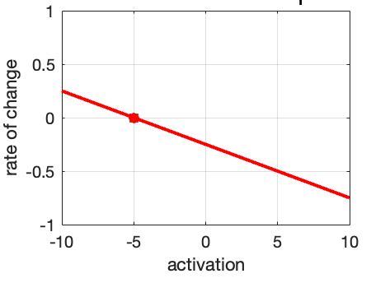




Neural activation: “feature detectors”
$$τ\dot{u}=−u+h+s+c∙g\left(u\right)+ξ$$
$$h=−5$$
$$c=0$$
plot from COSIVINA (Schneegans et al., 2021)
$$s=0$$
$$ξ=0$$
Notes:
Let’s look at an example. Imagine we’re modeling a neural population that’s tuned to some phonological feature, for example. Here’s a phase plane, with activation u on the x axis and rate of change u-dot on the y-axis. This, by the way, is just a screenshot from the COSIVINA software that you can get on the DFT website. So right now, there’s a stable point attractor at -5, because I set the resting level to -5, and everything else to 0.

Slide 11
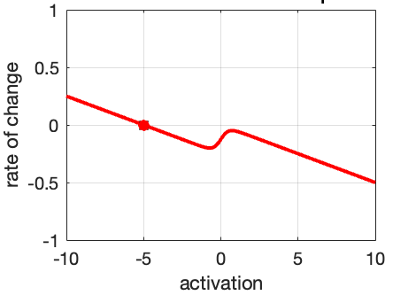

Neural activation: “feature detectors”
$$τ\dot{u}=−u+h+s+c∙g\left(u\right)+ξ$$
$$h=−5$$
$$c=5$$
$$s=0$$
$$ξ=0$$
Notes:
But let’s make things more interesting, and more realistic, by adding some interaction to the dynamics. So now, when activation reaches a certain point, namely 0, you get a little additional boost to activation from self-interaction. We’ve changed the shape of the phase plane, but there’s still just a single stable attractor at u = -5. So in this moment, the feature detector is in a negative or off state, we’re not detecting the feature in this moment.

Slide 12
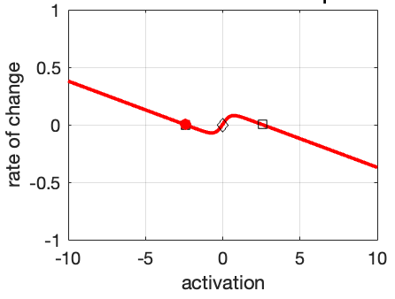

Neural activation: “feature detectors”
$$τ\dot{u}=−u+h+s+c∙g\left(u\right)+ξ$$
$$h=−5$$
$$c=5$$
From one stable state to two: bifurcation
$$s=2.5$$
$$ξ=0$$
Notes:
Now, what if I add some input. This is like, the neural population is receiving some sensory information that’s consistent with the feature. Now we’ve moved the whole phase plane up, and caused some qualitative changes, because now the line crosses the x-axis three times. Now there’s two stable point attractors, one negative and one positive, as well as an unstable repeller in between them, at 0. This kind of qualitative change in the dynamics is sometimes called a bifurcation. Notice that even though the input created a new stable positive state, the negative state is still stable, and so activation stays in that negative state.

Slide 13
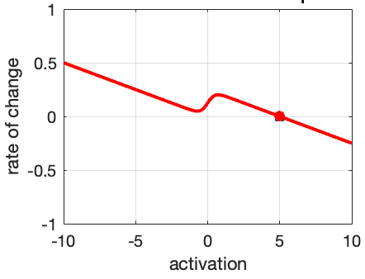

Neural activation: “feature detectors”
$$τ\dot{u}=−u+h+s+c∙g\left(u\right)+ξ$$
$$h=−5$$
Activation jumps to a positive state: detection instability
$$c=5$$
$$s=5$$
$$ξ=0$$
Notes:
Now if we increase the input even more, we create another bifurcation by removing the stability of the negative state. Now there’s only a single stable state, at positive 5, and activation jumps to this positive state. The feature has been detected. Notice that I only increased the input from 2.5 to 5, but activation increased from -2.5 to positive 5, a much bigger jump. This is a kind of phase transition that arises from the nonlinearity in the dynamics.

Slide 14
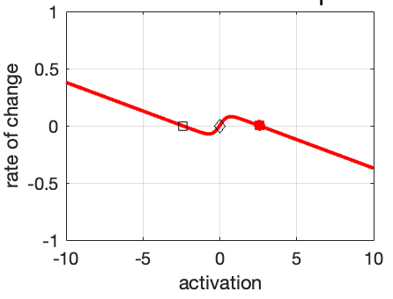
Neural activation: “feature detectors”
$$τ\dot{u}=−u+h+s+c∙g\left(u\right)+ξ$$
$$h=−5$$
Activation stays positive despite decrease in input: hysteresis
$$c=5$$
$$s=2.5$$
$$ξ=0$$
Notes:
Interestingly, if I decrease the input back to where it was, 2.5, now activation stays in the stable on state, because it was already there. This is a property called hysteresis, where the previous state of the system constrains how the system can change.

Slide 15
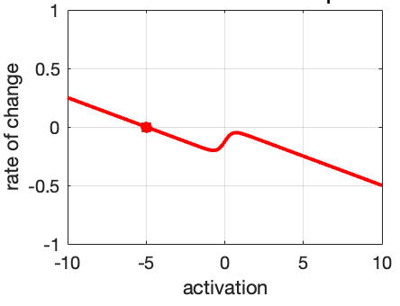
Neural activation: “feature detectors”
$$τ\dot{u}=−u+h+s+c∙g\left(u\right)+ξ$$
$$h=−5$$
Activation jumps to negative state: reverse detection instability
$$c=5$$
$$s=0$$
$$ξ=0$$
Notes:
Not until I decrease the input back to 0, and remove the stability of the positive on state, does activation return back to the negative off state. So, finally, we’re no longer detecting the feature.

Slide 16

Emergent categoriality
As $s$ changes gradually, $u$ jumps from off to on state, or vice versa
Nonlinearity allows categorical behavior to emerge from system that is fundamentally continuous in time and (activation) space
Notes:
Those are the basics of neural dynamics in DFT. CLICK Something I want to emphasize is the kind of emergent categoriality that we saw, where as the input to the system gradually changed, we saw a sudden jump or phase transition of activation from an off to an on state, and vice versa. CLICK This happened because of the nonlinearity in the system, that’s otherwise fully continuous in time and in activation space. This is a relatively simple case of nonlinearity, but this basic idea of categorical-looking behavior arising from nonlinearity continues to apply as the system gets more complex.

Slide 17
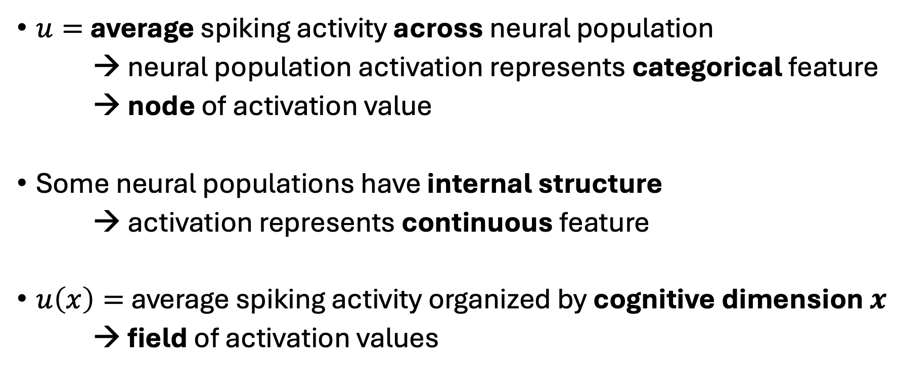
Neural fields (Amari, 1977)
$u=$ average spiking activity across neural population
→ neural population activation represents categorical feature
→ node of activation value
Some neural populations have internal structure
→ activation represents continuous feature
$u\left(x\right)=$ average spiking activity organized by cognitive dimension $x$
→ field of activation values
Notes:
Let’s look at a more complex system, which is the neural field. CLICK So far, we’ve been looking at this u variable as average spiking activity across a neural population that’s tuned to some categorical feature, like a phonological feature. We call this kind of activation variable a “node”. CLICK But some neural populations have internal structure in that their activation represents a continuous feature, like a phonetic feature like voice onset time, for example. CLICK In this case, we define activation u as a function of the continuous dimension x. CLICK Each activation value still follows the same basic dynamics I already showed you. But now we have a whole field of values representing some continuous dimension.

Slide 18
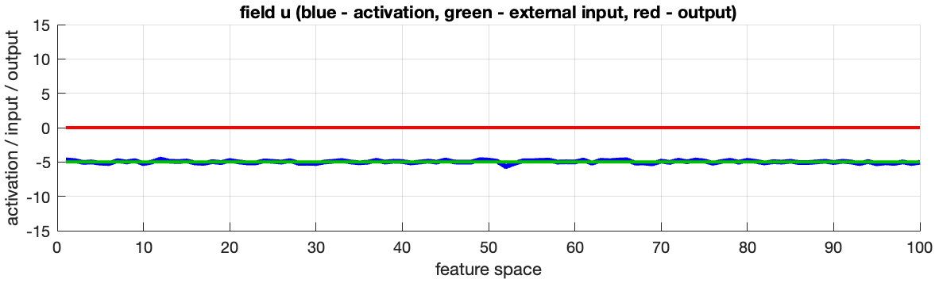

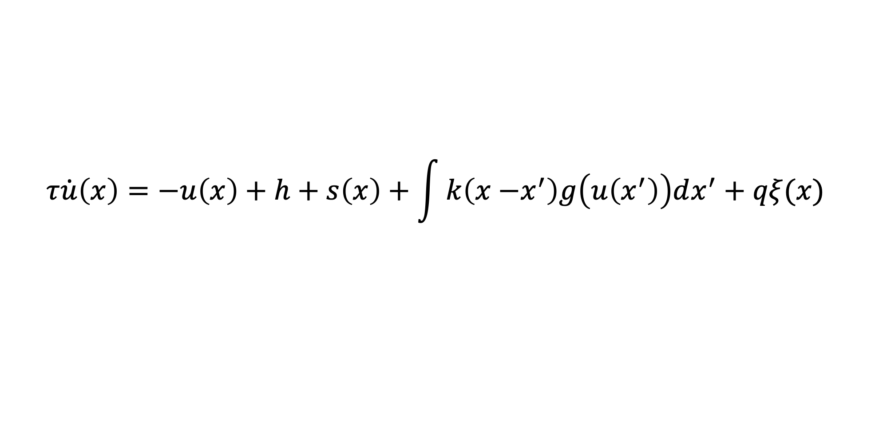
Neural fields: continuous features$x$
$$τ\dot{u}\left(x\right)=−u\left(x\right)+h+s\left(x\right)+\int{k\left(x{−x}^{′}\right)g\left(u\left(x^{′}\right)\right)dx^{′}+qξ(x)}$$
Notes:
Here’s the equation for a neural field. It’s basically the same as the last equation, with a rate parameter tau, resting level h, some input s, an interaction term, now called k instead of c, weighted by a threshold g, and a noise term. The main difference from the last equation is that now we have this x variable, representing some continuous cognitive feature. CLICK So activation u is now a function of x, which we can see in this plot, which is also from the COSIVINA software. Activation is in blue here, and we see that it’s hovering around resting level -5 across the whole field, the whole feature dimension.

Slide 19
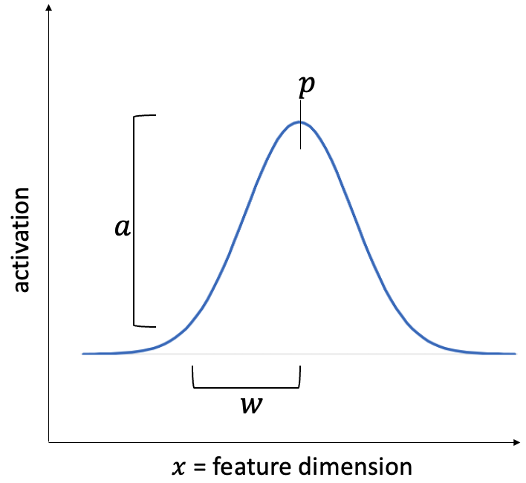
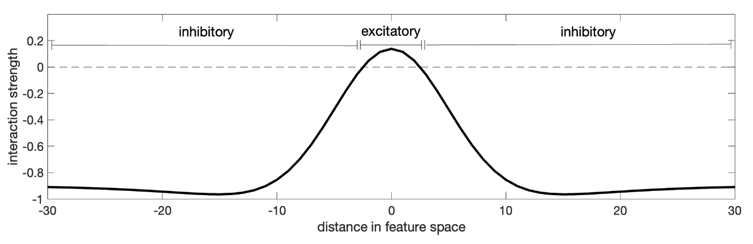
Neural fields: continuous features$x$
$$τ\dot{u}\left(x\right)=−u\left(x\right)+h+s\left(x\right)+\int{k\left(x{−x}^{′}\right)g\left(u\left(x^{′}\right)\right)dx^{′}+qξ(x)}$$
(e.g., Jancke et al., 1999)
Notes:
CLICK Input s is also a function of x, and generally it takes a gaussian shape, with a position p, a width, w, and an amplitude a. CLICK Finally, the interaction term k defines how each neuron in the field affects every other neuron in the field. In general, interaction is excitatory for neurons that are nearby in feature space, and inhibitory for neurons that are far apart in feature space.

Slide 20
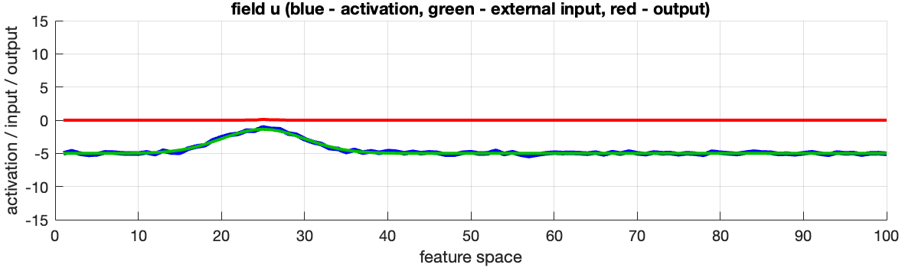

Neural fields: continuous features$x$
$$τ\dot{u}\left(x\right)=−u\left(x\right)+h+s\left(x\right)+\int{k\left(x{−x}^{′}\right)g\left(u\left(x^{′}\right)\right)dx^{′}+qξ(x)}$$
$$a=3.5$$
Notes:
Let’s see what happens when we have some positive input into the field. Input is shown with the green line, and we see that activation in blue basically follows the shape of the input.

Slide 21
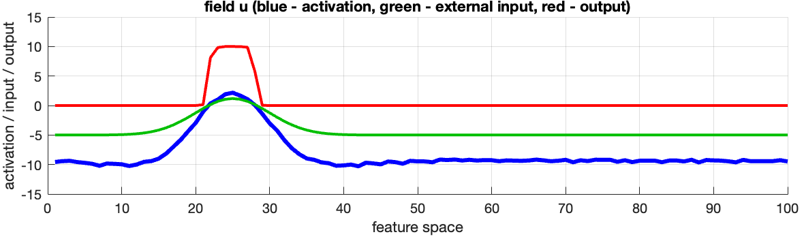

Neural fields: continuous features$x$
$$τ\dot{u}\left(x\right)=−u\left(x\right)+h+s\left(x\right)+\int{k\left(x{−x}^{′}\right)g\left(u\left(x^{′}\right)\right)dx^{′}+qξ(x)}$$
$$a=6$$
Notes:
Now, if input becomes larger, activation crosses the threshold, and lateral interaction kicks in. Excitatory interaction causes activation to actually be slightly above the input at the center of the peak, and lateral inhibition pushes activation below the resting level in the rest of the level. This combination of local excitation and distal inhibition stabilizes the activation peak.

Slide 22
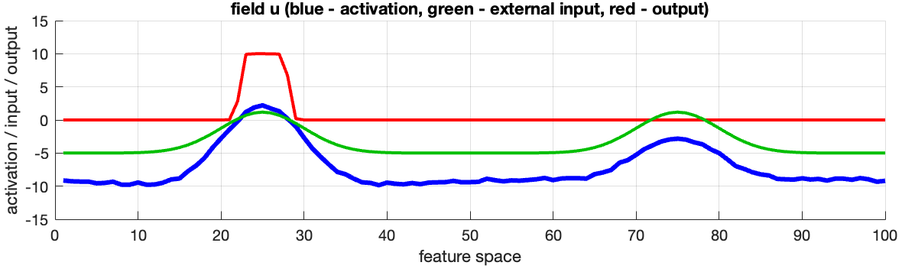

Neural fields: continuous features$x$
$$τ\dot{u}\left(x\right)=−u\left(x\right)+h+s\left(x\right)+\int{k\left(x{−x}^{′}\right)g\left(u\left(x^{′}\right)\right)dx^{′}+qξ(x)}$$
$$a=6$$
$$a=6$$
Notes:
Interestingly, if we add another input of the same amplitude to another part of the field, no additional activation peak forms because of lateral inhibition from the first peak. This is another kind of hysteresis effect.

Slide 23
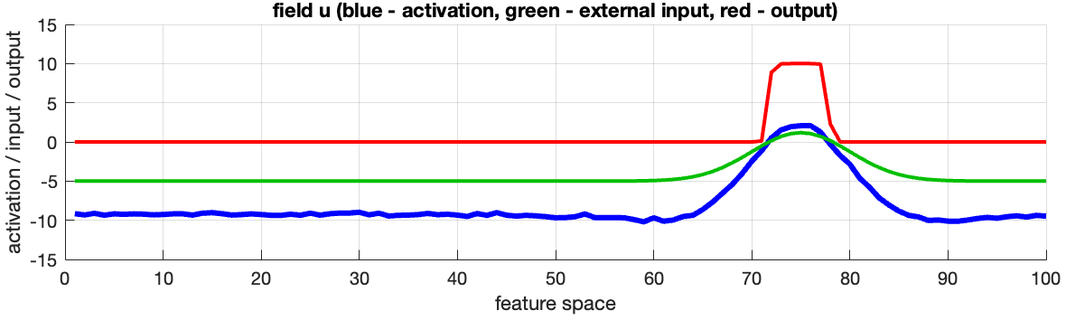
Neural fields: continuous features$x$
$$τ\dot{u}\left(x\right)=−u\left(x\right)+h+s\left(x\right)+\int{k\left(x{−x}^{′}\right)g\left(u\left(x^{′}\right)\right)dx^{′}+qξ(x)}$$
$$a=6$$
Notes:
Not until the first input is removed is another activation peak able to form at the higher end of the field.

Slide 24
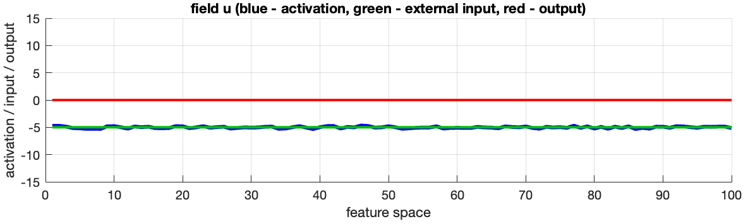
Neural fields: continuous features$x$
$$τ\dot{u}\left(x\right)=−u\left(x\right)+h+s\left(x\right)+\int{k\left(x{−x}^{′}\right)g\left(u\left(x^{′}\right)\right)dx^{′}+qξ(x)}$$
Notes:
And, when we remove the second input, the entire field settles back to resting level.

Slide 25
Activation peaks as cognitive events
Activation peaks form and dissipate as instabilities
Position of peak in feature space determines content of cognitive event (e.g., phonetic target in articulation)
Nonlinearity allows discrete cognitive events to occur in continuous space (continuous time, continuous activation, continuous features)
Notes:
In DFT, these activation peaks are cognitive events. CLICK When a peak forms or dissipates, this is an instability, jumping from a stable resting state, to a stable on state, or vice versa. CLICK The position of the activation peak in feature space determines the content of that cognitive event. So depending on the feature being represented, this could be a phonetic target in articulation, for example. CLICK Again, it’s the nonlinearity in the system that causes these discrete jumps or instabilities, despite the fact that the model primitives are all continuous, continuous in time, in activation, and in feature space.

Slide 26
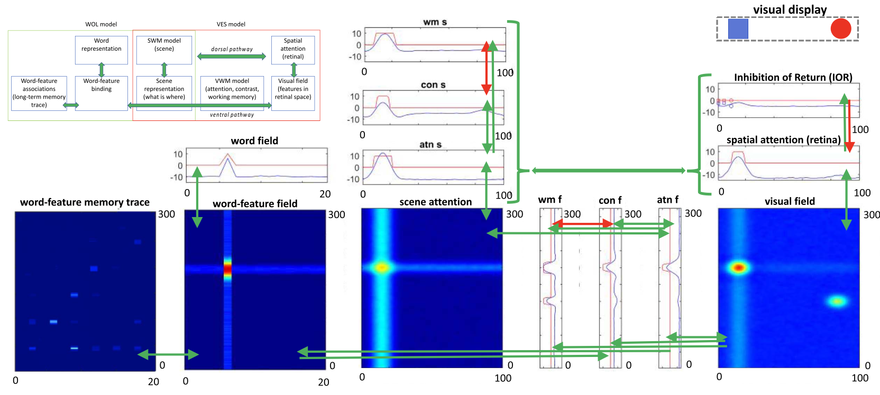
Networks/architectures through coupling
WOLVES model (Bhat et al., 2022)
Notes:
Those are the basics of how DFT works. The last general thing I want to say about DFT is that fields can be coupled to each other to build networks or architectures that can model increasingly complex cognitive phenomena. CLICK So for example here’s the architecture of the WOLVES model, or word object learning via visual exploration in space. You can see that there are a number of fields representing different dimensions, like visual features and spatial positions, there’s also some multidimensional fields, which I haven’t talked about, but what I want to show is that they’re coupled to each other in various ways, both excitatory and inhibitory, and this pattern of coupling allows the network to autonomously generate some behavior, in this case searching a visual scene and learning to associate novel words with visual objects.

Slide 27
DFT models of language
Speech production (Roon & Gafos, 2016; Stern et al., 2022; Stern & Shaw 2023a,b)
Long-term change in phonological representations (Gafos & Kirov, 2009; Shaw & Tang, 2023)
Individual differences in phonological representation (Harper, 2021)
Word learning via visual exploration (WOLVES: Bhat et al., 2022)
Noun phrases guiding visual search (Sabinasz et al., 2023)
Negation processing (Kati et al., 2024)
Notes:
DFT was not developed to understand language, but lately there has been more and more work applying DFT to linguistic phenomena CLICK like speech production, CLICK long-term change in phonological representations CLICK and individual differences in phonological representations, CLICK word learning via visual exploration, that’s the WOLVES model I just showed you, CLICK noun phrases guiding visual search, and CLICK negation processing.

Slide 28
Today
Speech errors (Manasvi Chaturvedi)
Code-switching (Alessandra Pintado-Urbanc)
Phonological neighborhood effects (Miranda Zhu)
Sibilant-vowel phonotactics (Ayla Karakaş)
Structural priming (Herbert Zhou)
Notes:
Not to mention the projects you’ll hear about in this symposium, which will explore DFT-based explanations of speech errors, code-switching, phonological neighborhood effects, sibilant-vowel phonotactics, and structural priming.

Slide 29
Benefits of DFT: single framework
Coupled differential equations all the way down
Different models can, in theory, be slotted together (e.g., WOLVES = WOL + VES)
Hypotheses in one domain generate hypotheses in other domains
Notes:
So that’s a pretty wide variety of phenomena, which I think highlights an important benefit of DFT, which is that we can use a single framework, a single language of description, to explain a wide range of phenomena. CLICK It’s all just coupled differential equations describing neural activation variables. CLICK So even though each project in this symposium, for example, focuses on some particular phenomena, and therefore abstracts away from some details, and condenses some details, in theory, all of these models can be slotted together to build a larger neural architecture for language. The WOLVES model is actually an example of this, WOLVES is a coupling of two existing models, one for word-object learning, and one for visual exploration in space. CLICK Since we’re ultimately building a single architecture for language, using the same mechanisms across the board, this means that hypotheses generated in one domain, like speech production, for example, can have maybe surprising consequences in another domain, like syntactic processing.

Slide 30
Modeling choices → theoretical claims
What are the feature dimensions represented by fields?
What are the categories represented by nodes?
→ linguistic theory
Mechanisms/parameters: coupling, inputs, resting level, evolution rate, lateral interaction
→ few and interpretable
Goal: generative model, not data-fitting
Notes:
The last point I want to highlight is that all of the projects that are gonna be presented today involve models, but they’re just not just models. The models are meant to capture relevant aspects of reality, and so choices made in modeling constitute claims about reality. Some examples of these kinds of choices are CLICK which feature dimensions are represented by fields, CLICK and which categories are represented by nodes. CLICK This is where linguistic theory is really essential, because it’s linguistics that tells us what are the features and categories that are relevant for language. CLICK Besides these questions, there are a number of other mechanisms and parameters that can be adjusted and tuned, like coupling, inputs, resting level, evolution rate, lateral interaction. Each of these factors can have important and sometimes surprising consequences for how a model behaves. CLICK But there’s not that many parameters, and each parameter is interpretable. CLICK The overarching goal is not to fine-tune or train a bunch of parameters to fit the data, but actually to try to describe the neurocognitive processes that generate the data.

Slide 31
Thank you!
Website
dynamicfieldtheory.org
Textbook
Schöner, G., Spencer, J., & DFT Research Group (2016). Dynamic Thinking: A Primer on Dynamic Field Theory. Oxford University Press.
Some overview papers
Schöner, G. (2020). The Dynamics of Neural Populations Capture the Laws of the Mind. Topics in Cognitive Science, 12(4), 1257–1271.
Schöner, G. (2023). Dynamical Systems Approaches to Cognition. In R. Sun (Ed.), The Cambridge Handbook of Computational Cognitive Sciences (2nd ed., pp. 210–241). Cambridge University Press.

Slide 32
References
Amari, S. (1977). Dynamics of pattern formation in lateral-inhibition type neural fields. Biological Cybernetics, 27(2), 77–87.
Bhat, A. A., Spencer, J. P., & Samuelson, L. K. (2022). Word-Object Learning via Visual Exploration in Space (WOLVES): A neural process model of cross-situational word learning. Psychological Review, 129(4), 640–695.
Cohen, M. R., & Newsome, W. T. (2009). Estimates of the Contribution of Single Neurons to Perception Depend on Timescale and Noise Correlation. Journal of Neuroscience, 29(20), 6635–6648.
Gafos, A. I., & Kirov, C. (2009). A dynamical model of change in phonological representations: The case of lenition. Approaches to Phonological Complexity, 219–240.
Georgopoulos, A. P., Schwartz, A. B., & Kettner, R. E. (1986). Neuronal population coding of movement direction. Science, 233, 1416–1419.
Grossberg, S. (1969). On learning, information, lateral inhibition, and transmitters. Mathematical Biosciences, 4(3), 255–310.
Harper, S. (2021). Individual Differences in Phonetic Variability and Phonological Representation [PhD thesis]. University of Southern California.
Jancke, D., Erlhagen, W., Dinse, H. R., Akhavan, A. C., Giese, M., Steinhage, A., & Schöner, G. (1999). Parametric population representation of retinal location: Neuronal interaction dynamics in cat primary visual cortex. Journal of Neuroscience, 19(20), 9016–9028.
Kati, L., Sabinasz, D., Schöner, G., & Kaup, B. (2024). Interaction of polarity and truth value—A neural dynamic architecture of negation processing. Proceedings of the Annual Meeting of the Cognitive Science Society, 46.
Roon, K. D., & Gafos, A. I. (2016). Perceiving while producing: Modeling the dynamics of phonological planning. Journal of Memory and Language, 89, 222–243.
Sabinasz, D., Richter, M., & Schöner, G. (2023). Neural dynamic foundations of a theory of higher cognition: The case of grounding nested phrases. Cognitive Neurodynamics, 1–23.
Schöner, G. (2020). The Dynamics of Neural Populations Capture the Laws of the Mind. Topics in Cognitive Science, 12(4), 1257–1271.
Schöner, G. (2023). Dynamical Systems Approaches to Cognition. In R. Sun (Ed.), The Cambridge Handbook of Computational Cognitive Sciences (2nd ed., pp. 210–241). Cambridge University Press.
Schöner, G., Spencer, J., & Group, D. R. (2016). Dynamic Thinking: A Primer on Dynamic Field Theory. Oxford University Press.
Schneegans, S. (2021). COSIVINA: A Matlab Toolbox to Compose, Simulate, and Visualize Neurodynamic Architectures [Computer software]. https://github.com/cosivina/cosivina
Shaw, J. A., & Tang, K. (2023). A dynamic neural field model of leaky prosody: Proof of concept. Proceedings of the 2022 Annual Meeting on Phonology (AMP).
Stern, M. C., Chaturvedi, M., & Shaw, J. A. (2022). A dynamic neural field model of phonetic trace effects in speech errors. Proceedings of the Annual Meeting of the Cognitive Science Society, 44.
Stern, M. C., & Shaw, J. A. (2023a). Neural inhibition during speech planning contributes to contrastive hyperarticulation. Journal of Memory and Language, 132, 104443.
Stern, M. C., & Shaw, J. A. (2023b). Not all phonological neighbors affect production equivalently: Predictions from a neural dynamic model. Proceedings of the 20th International Congress of Phonetic Sciences (ICPhS), 4002–4006.

