Slide 1







Self-development Data Science Professional
Yuan Feng
Dec 2023

Slide 2



OUTLINE
Executive Summary
Introduction
Methodology
Results
Visualization – Charts
Dashboard
Discussion
Findings & Implications
Conclusion
Appendix

Slide 3

EXECUTIVE SUMMARY
This is a comprehensive program focused on data collection, processing and visualization. Based on the SpaceX Falcon 9 dataset, we experienced the entire process of treatment in different ways

Slide 4

INTRODUCTION
This presentation is geared towards my fellow data scientists. We're going to dive into the dataset of SpaceX rocket that's packed with the kind of technical details we thrive on. It's not just about learning new tricks; it's about enhancing our skills and staying at the top of our game in the ever-evolving world of data science, which include:
Data Collection
Data Wrangling
EDA (Exploratory Data Analysis)
Data Visualization

Slide 5

METHODOLOGY
Data Collection:
Rest API Lab (URL technique)
Data Wrangling
Remove duplicate, missing value
Normalization
EDA
Distribution, Outlier, Correlation
Using Data Visualization or SQL
Data Visualization
Chart (histogram, boxplot, scatter plot, bar, line, pie, etc)
Prediction
Regreesion
Cross-validation

Slide 6
RESULTS

Slide 7
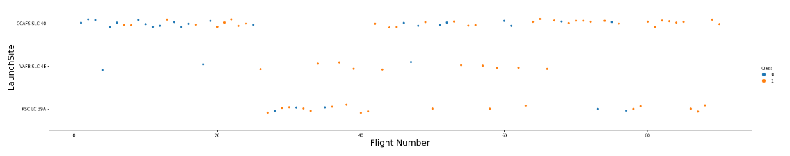
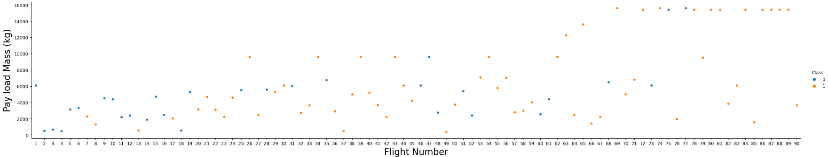
EDA with Data Visualization
Usually prefer scatter plots or bar plots

Slide 8
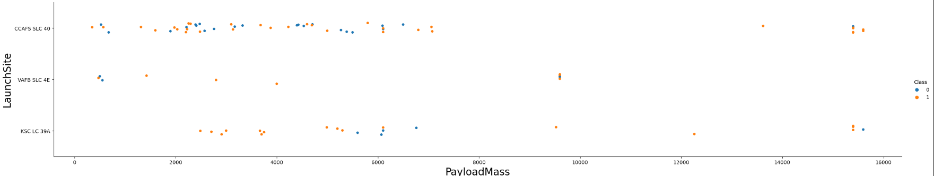
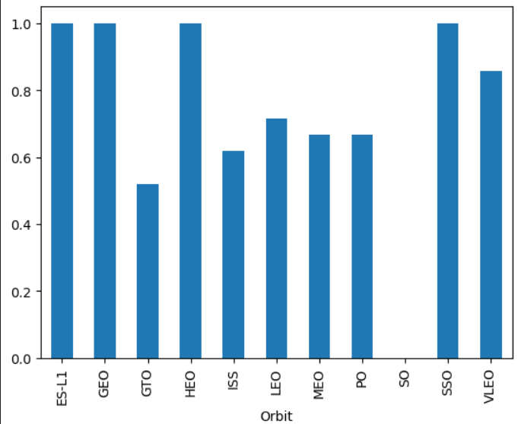
EDA with Data Visualization
Usually prefer scatter plots or bar plots

Slide 9
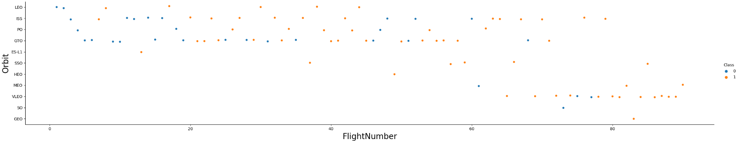
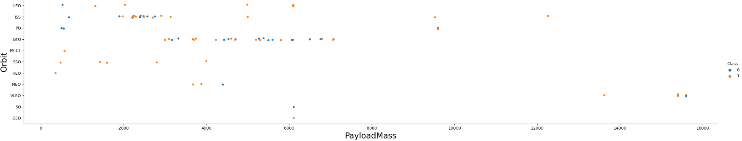
EDA with Data Visualization
Usually prefer scatter plots or bar plots

Slide 10
EDA with SQL
Including the following:
Display the names of the unique launch sites in the space mission
Display 5 records where launch sites begin with the string 'CCA’
Display the total payload mass carried by boosters launched by NASA (CRS)
Display average payload mass carried by booster version F9 v1.1
List the date when the first succesful landing outcome in ground pad was achieved
List the names of the boosters which have success in drone ship and have payload mass greater than 4000 but less than 6000
etc…

Slide 11
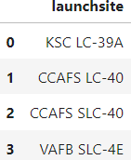
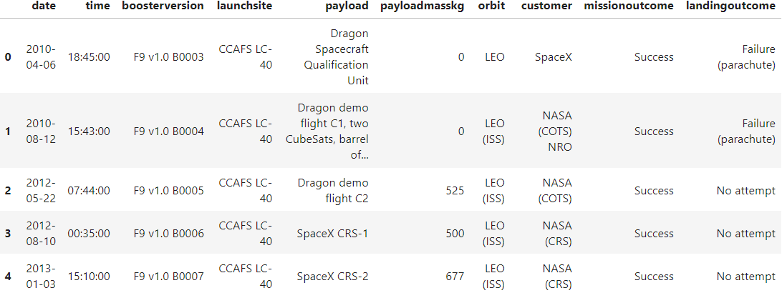



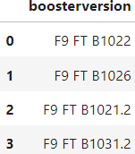
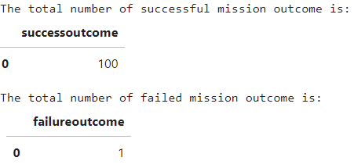
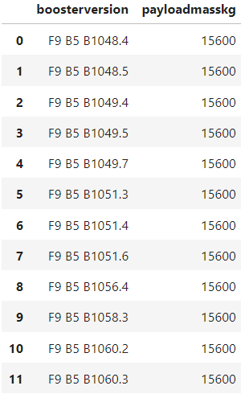
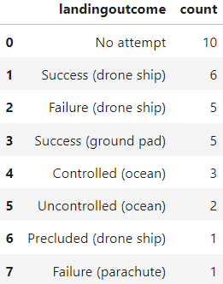
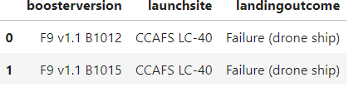
EDA with SQL

Slide 12
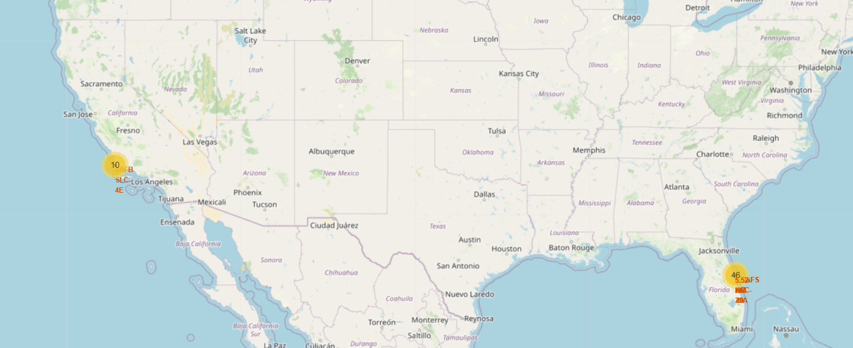
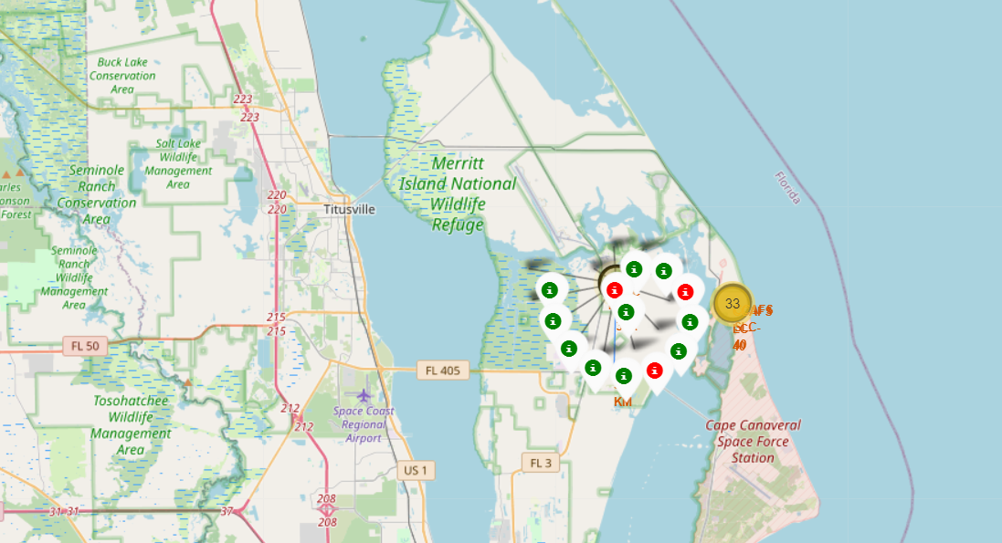
Interactive map with Folium
Two main place for SpaceX, one in California and one in Florida
The major one is Florida, with numbers of successes ang failures

Slide 13
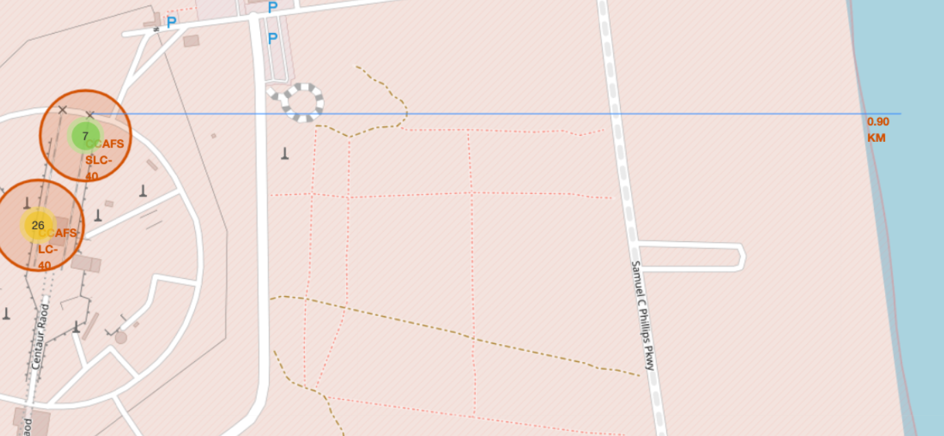
Interactive map with Folium

Slide 14
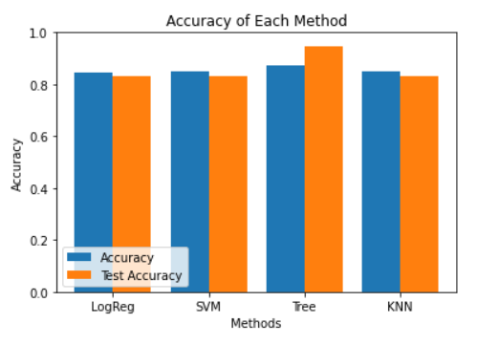
Predictive Analysis (Classification)
Use four different ways to classifier the result
Shows that the Decision Tree would be the best method for this task

Slide 15

CONCLUSION
Entire process of data analysis for a specific case related to the business.
Learning, reviewing the fundamental skills of data analysis.

Slide 16

APPENDIX

