Slide 1







Stack Overflow Developer Survey 2019
Yuan Feng
January 2023

Slide 2



OUTLINE
Executive Summary
Introduction
Methodology
Results
Visualization – Charts
Dashboard
Discussion
Findings & Implications
Conclusion
Appendix

Slide 3

EXECUTIVE SUMMARY
Relevant skills required in IT and business are evolving through the technology development.
The analysis yielded shows the following information
Most popular programming language, database usage and other technologies at the time of collection.
The future trends of the technologies accepted by the developer
Demographics (e.g., the gender gap among developers).
The current and future skill requirements and trends will help the file make decision while hiring and planning next generation product.

Slide 4

INTRODUCTION
This presentation is created for stakeholders and business decision makers within the global IT and business consulting service firm.
The trends of current and future skill requirements would affect the efficiency of hiring and planning project process.
This presentation will help to identify future skill requirements and trends in the IT sector for firm to keep pace with the technology revolution and remain competitive.

Slide 5

METHODOLOGY
Data Source: 2019 Stack Overflow Developer SurveyPoint2
Link of the data source
The dataset is pre-processed by Python and SQL.
The data used by exploratory analysis is a subset of original data, it is used to find the distribution of the data and visualize it to show the clear relationship between features.

Slide 6
RESULTS

Slide 7
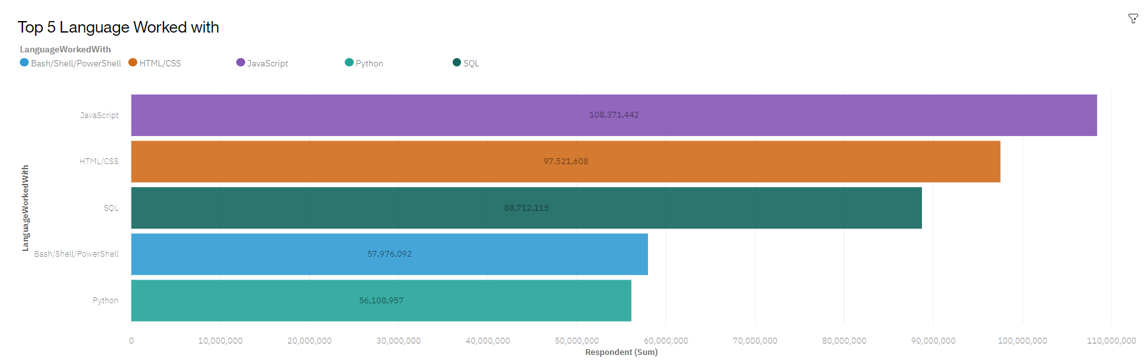
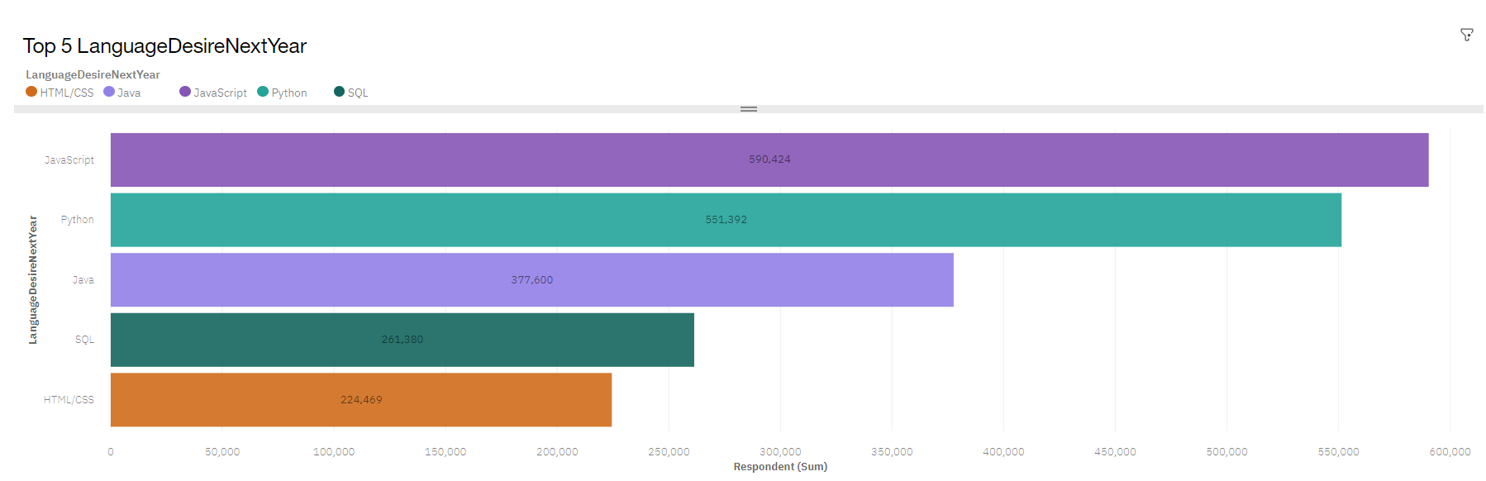
PROGRAMMING LANGUAGE TRENDS
Current Year
Next Year

Slide 8
PROGRAMMING LANGUAGE TRENDS - FINDINGS & IMPLICATIONS
Findings
JavaScript will still be the most popular programming language. HTML/CSS is also growing fast
Python and Java as new generation languages growing fast and replacing the old languages.
Implications
The web application requirement is higher than mobile application and other.
The revolution of technology development makes the higher level programming languages more popular and common

Slide 9
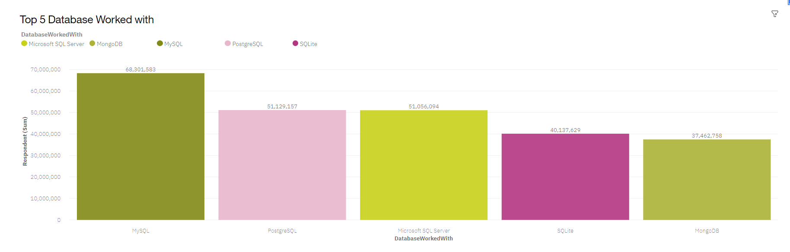
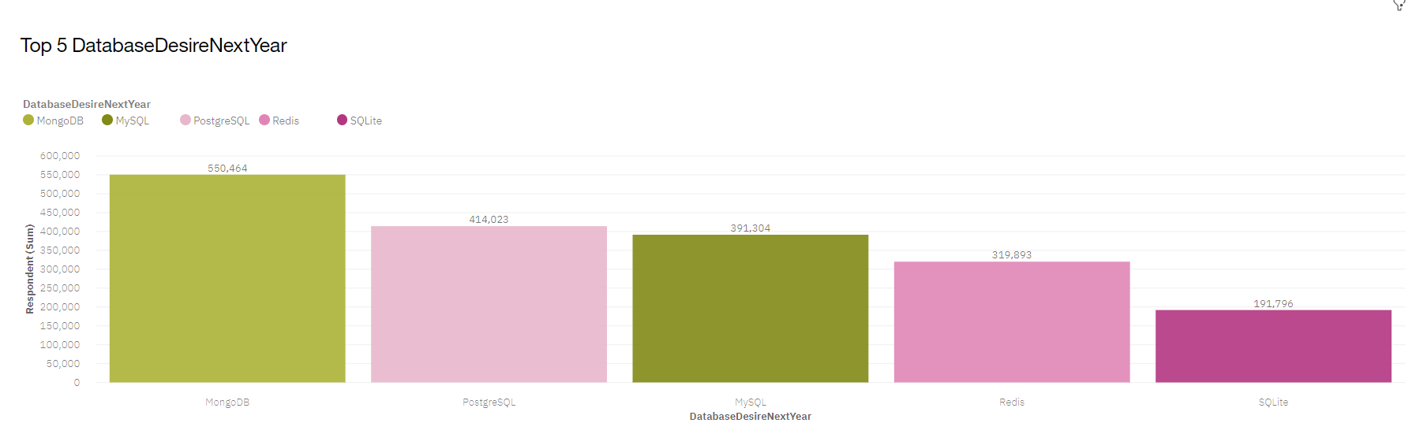
DATABASE TRENDS
Current Year
Next Year

Slide 10
DATABASE TRENDS - FINDINGS & IMPLICATIONS
Findings
Traditional database like MySQL and Microsoft SQL Server are still the most popular database currently
Web database MongoDB increased in highest level
Traditional database still in prevalent that people want to learn next
Implications
Web application growth highly that the web database is in demand
There is no new database that could replace the current database

Slide 11

DASHBOARD
Dashboard Link

Slide 12
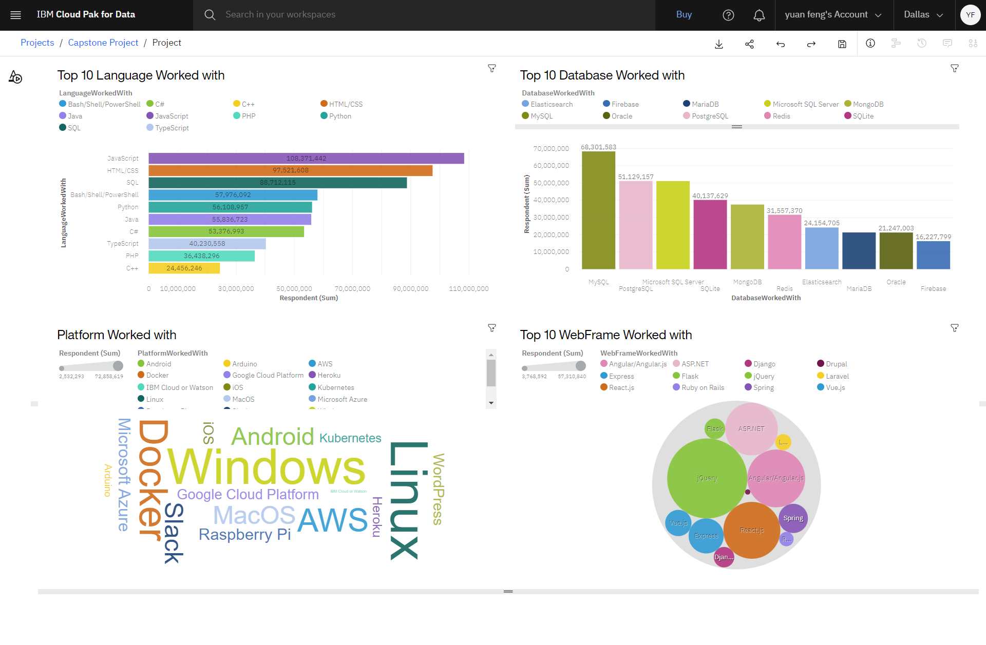
DASHBOARD TAB 1

Slide 13
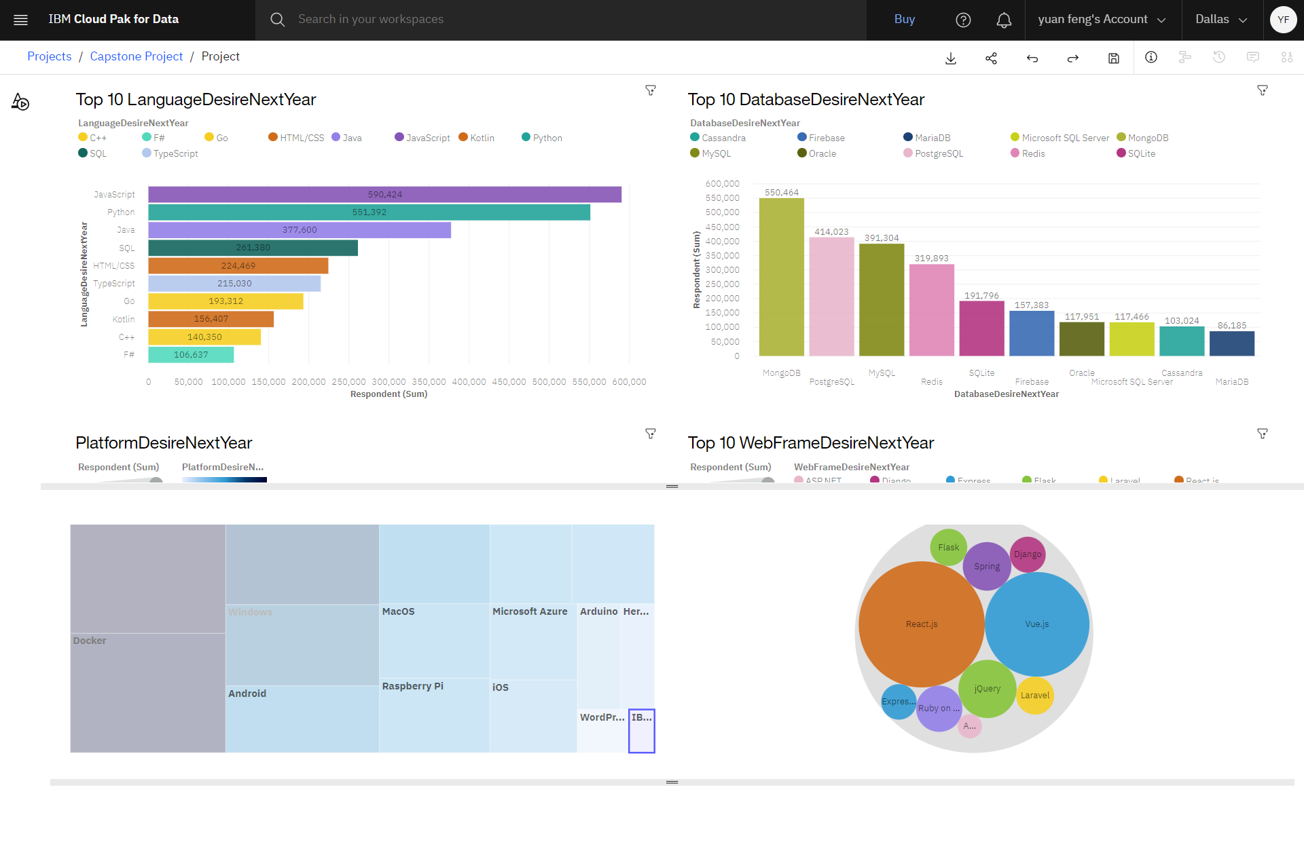
DASHBOARD TAB 2

Slide 14
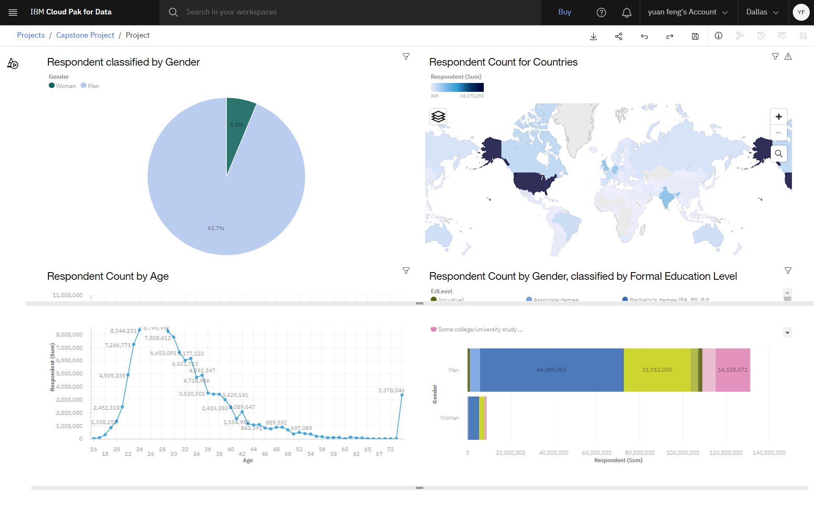
DASHBOARD TAB 3

Slide 15
DISCUSSION

Slide 16
OVERALL FINDINGS & IMPLICATIONS
Findings
The web application languages like JavaScript and MongoDB are in the highest demand
Large increased in Python and Java.
Technology divide between countries
Implications
The web application development is remained in high demand in both programming and database requirements
New generation programming language like Python and Java developed fast
Businesses need to adapt to changing technology preferences, especially in terms of talent acquisition and development.

Slide 17

CONCLUSION
A subset of data collected from 2019 Stack Overflow Developer Survey was examined.
The finding shows that the web application development is still the highest demand in IT area and the increases trends are still high
Business manager needs to focus on the technology development to reduce cost of hiring and training.

Slide 18

APPENDIX

Slide 19
JOB POSTINGS
In Module 1 you have collected the job posting data using Job API in a file named “job-postings.xlsx”. Present that data using a bar chart here. Order the bar chart in the descending order of the number of job postings.

Slide 20
POPULAR LANGUAGES
In Module 1 you have collected the job postings data using web scraping in a file named “popular-languages.csv”. Present that data using a bar chart here. Order the bar chart in the descending order of salary.

