Slide 1
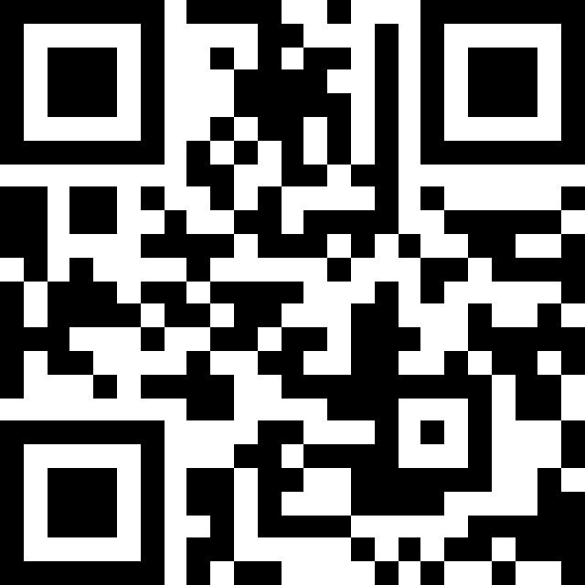
Please check in! Find your name in the Google spreadsheet and click the box next to it — just your name, please! Don’t help others.
https://tinyurl.com/y62vnjfx

Slide 2
Training Materials
https://github.com/YaleWTI-CNMI/misha-2025-fall

Slide 3
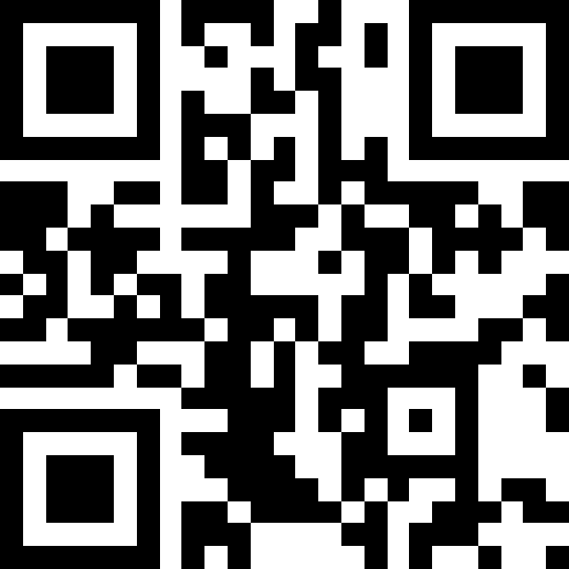
Got questions answered? Wanted to provide feedback? Submit them using this Google form:
https://tinyurl.com/mrhxbmxv

