Slide 1

Artificial Intelligence
As human as humans

Slide 2
Who dis boi 😂
Miljenko Šuflaj
1st year computer science graduate student
Department of Electronical Systems and Information Processing (ZESOI)
Contact
https://github.com/Yalfoosh
miljenko.suflaj@fer.hr (or ms50144@fer.hr if you like numbers)

Slide 3
Overview
Why even start?
Why not something else?
Why is it worth it?

Slide 4
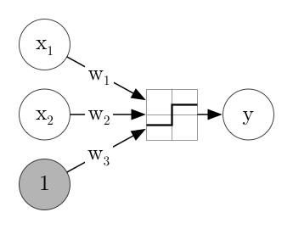
The humble beginnings
Input and output – how do we do it?
Imitate humans using computers – but what is a human?
Figure 1: Perceptron https://medium.com/@jaschaephraim/elementary-neural-networks-with-tensorflow-c2593ad3d60b

Slide 5
Achievements
Computers can learn!
Very limited power
a lot of prerequisites
modest capabilities
limited by computational capability
Still a big step forward, humanity keeps working on it

Slide 6
Turning the tides
End of the 2010's
Moore's law causes sufficiently powerful hardware to be available for low prices
internet provides free knowledge to a large amount of people
bigger number of researchers gain access to machine learning
lots of unapplied research is available
investments from large companies
Beginning of 2020's
most popular algorithms become available to the general public, consumers have almost full access

Slide 7
What we currently don't suck in
Image
almost perfect detection of objects
90-95% accuracy on non-exotic classification
promising visual generation results
Text
near-perfect artifact detection
respectable semantic comprehension
promising text comprehension and generation

Slide 8
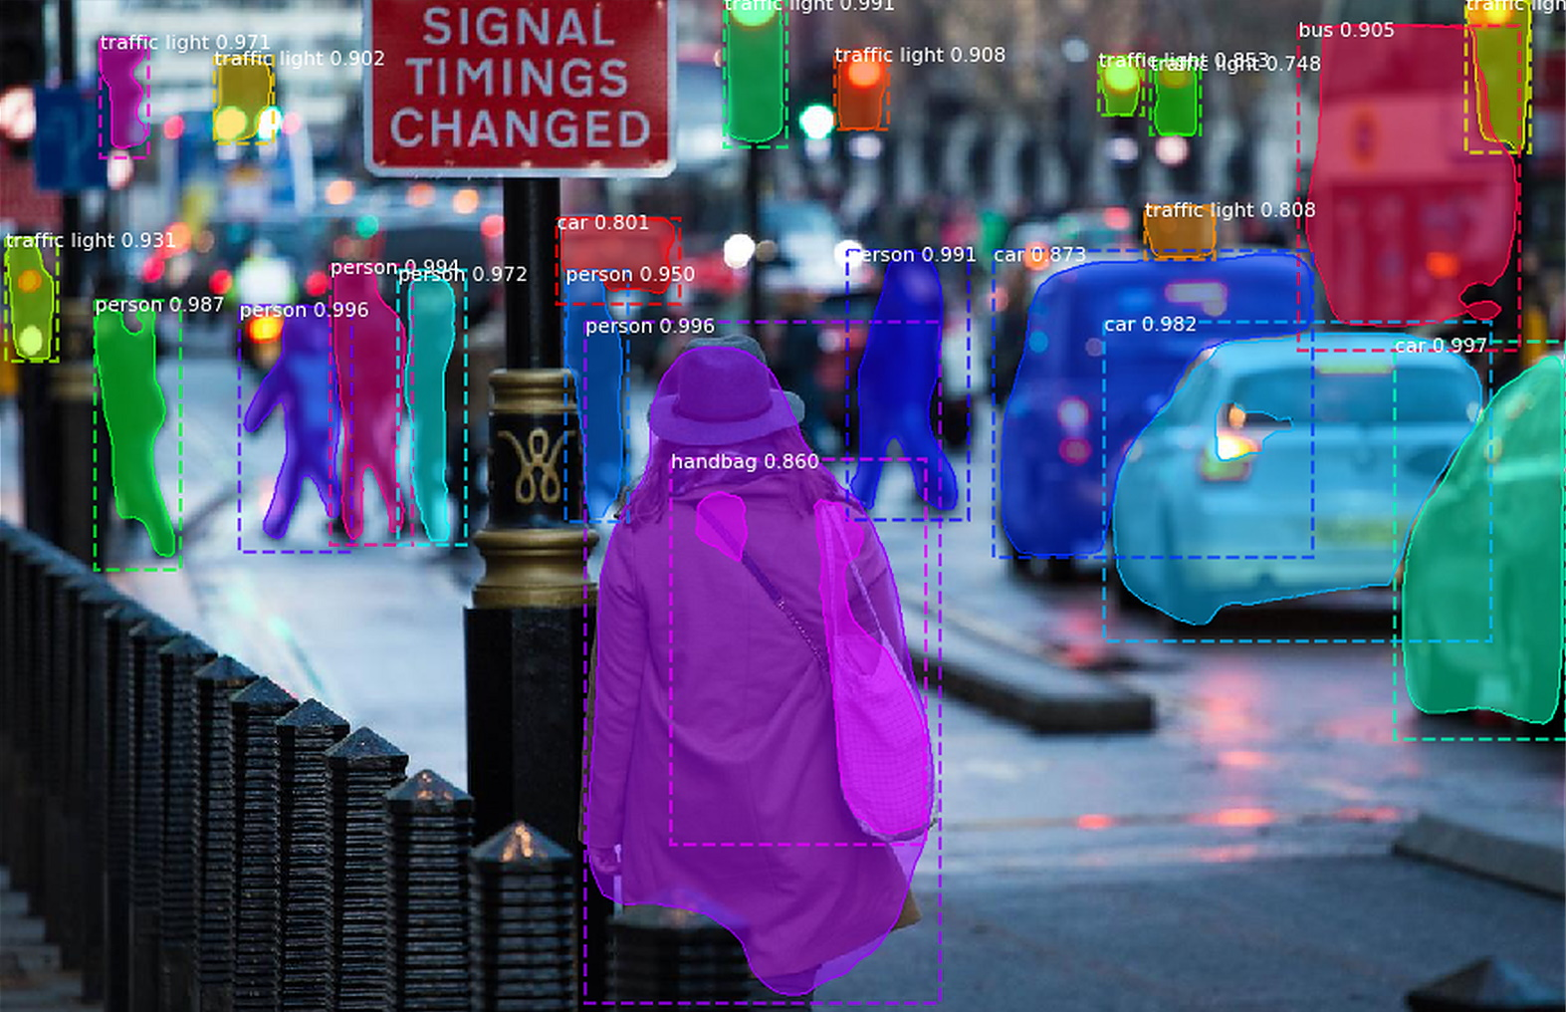
Figure 2: Mask R-CNN https://towardsdatascience.com/mask-r-cnn-for-self-driving-cars-7d254f3c7b3a

Slide 9
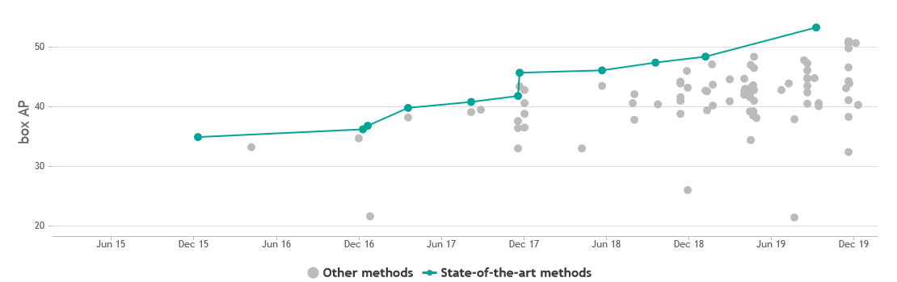
Figure 3: Progress on COCO https://paperswithcode.com/sota/object-detection-on-coco

Slide 10
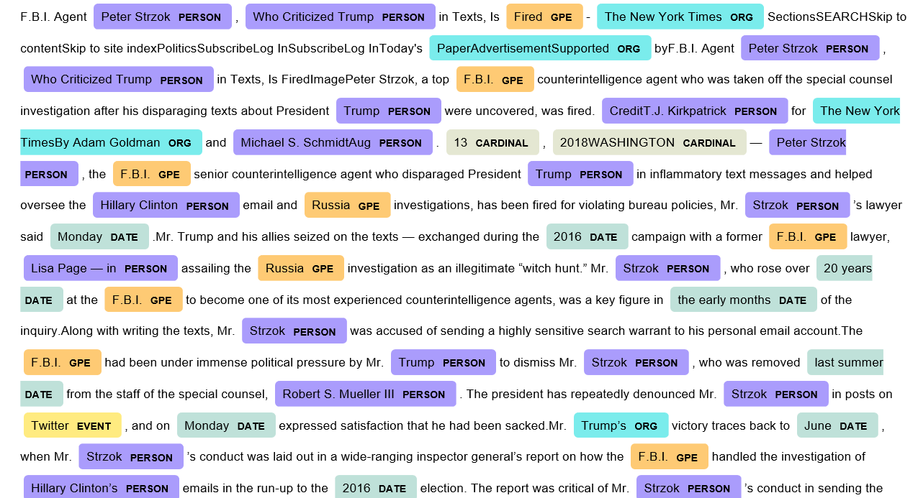
Figure 4: Named Entity Recognition https://medium.com/@ncaldwellgatsos/the-chicken-and-the-egg-paradox-of-named-entity-recognition-and-how-to-solve-it-f4a31528d78d

Slide 11
What is good, but could be better
Market prediction
generally proven to work, but models lack the capacity
today's economy is hard: cryptocurrencies, US tensions, EU instability
markets are volatile
Acoustics
solid detection, classification, prediction
clunky music generation
almost no, if any art comprehension; neural networks find it hard to remember complex structures*
low interest
*Differentiable Neural Computer begs to differ: https://en.wikipedia.org/wiki/Differentiable_neural_computer

Slide 12
Interested?
You can find scholarly articles on price prediction almost anywhere
My recommendations:
Kopernio
ArXiv Sanity Preserver
Acoustics
Performance RNN*
*Performance RNN: https://magenta.tensorflow.org/demos/performance_rnn/index.html

Slide 13
What is worse than you might think
Mechanics
knowledge is too specific to be good for neural networks, too vast for rule based controllers
difficulties punish the AI system greatly
big industry focus (cars, n-pedal robots, transhumanism)
Game playing
too difficult to emulate a human with current resources
experienced players can exploit machines easily
interesting games have deep, hidden rules not even humans understand
Medicine
useful but not nearly enough resources to unleash the full potential

Slide 14
The future – not
Skynet
Slaves (both ways)
Omnisentience
Androids
AI – a race different from ours

Slide 15
The real future
Brain-wave image reconstruction – preprint
Brain-machine interface – Neuralink - human trials beginning in a few months
Seamless text generation – GPT-2 – available to the general public
you can check it out here (https://talktotransformer.com/)
Real time translation (for all languages) - Google Assistant – available to the general public

Slide 16
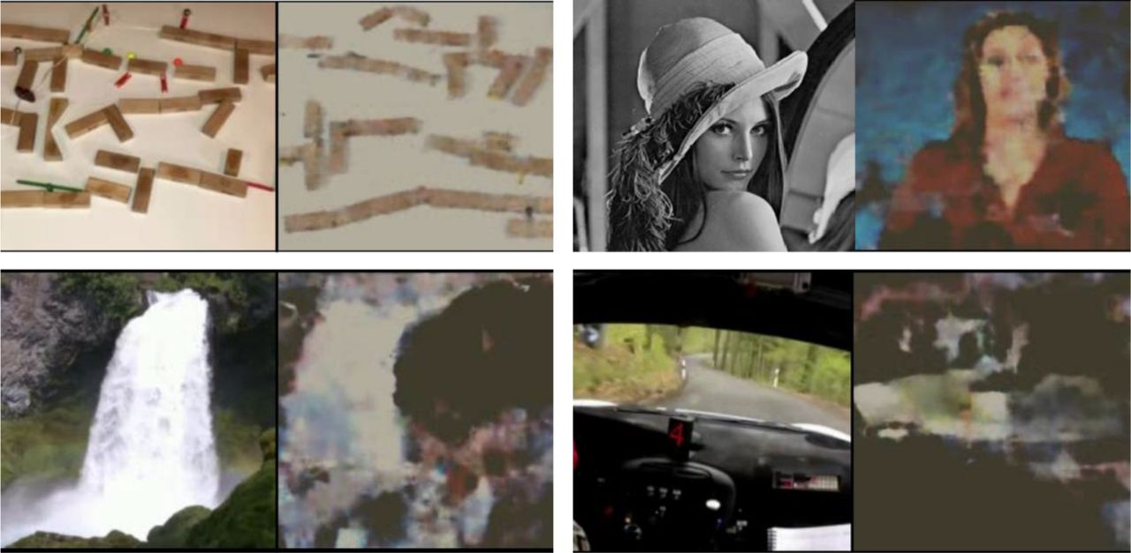
Figure 5: Brain-wave image reconstruction https://www.biorxiv.org/content/10.1101/787101v2.full

Slide 17
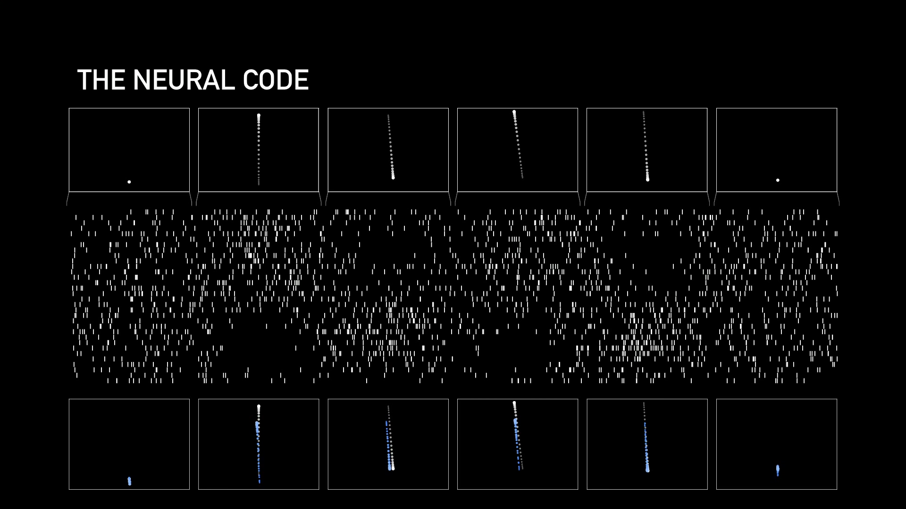
Figure 6: Decoding brain waves https://www.youtube.com/watch?v=r-vbh3t7WVI

Slide 18
Thank you for participating!
For anyone interested, the presentation can be found at https://github.com/Yalfoosh/EJUIP
If you have any questions, contact me at miljenko.suflaj@fer.hr or ms50144@fer.hr and I'll do my best to get back to you as quickly as possible!

