Slide 1
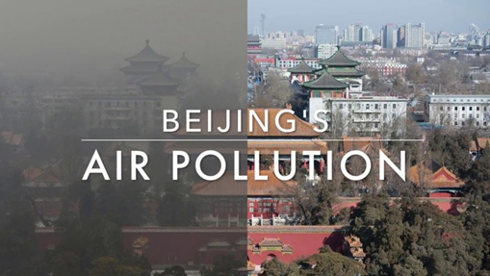
Air Pollution Forecast
Problem Statement
In recent years, air pollution has become a global concern, Expecially in some large cities with large populations like Beijing, London, Mumbai. It refers to the release of pollutants into the air that are detrimental to human health and the plant as a whole. Car emissions, chemicals from factories, dust, and pollen and mold spores may be suspended as particles. Among all those gauges of air pollution, PM2.5 concentration is no doubt the most famous and effective.
Rational Statement
In this project, we use a dataset from UCI Repository (with time series data from 2010 to 2014) to explore the factors influencing PM2.5 in Beijing, perform machine learning algorithm to predict the PM2.5 values. Suggestion on how to improve air quality in Beijing will be given at the end.
Date Set
https://archive.ics.uci.edu/ml/datasets/Beijing+PM2.5+Data

Slide 2
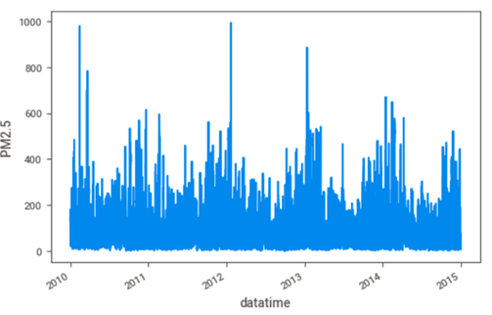
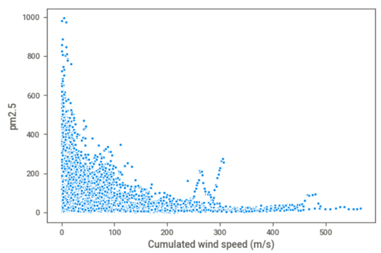
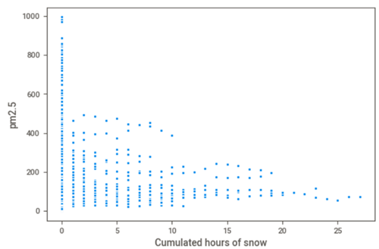
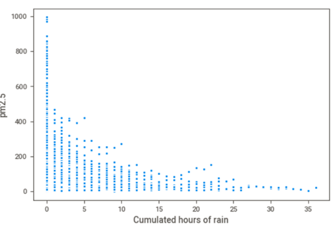
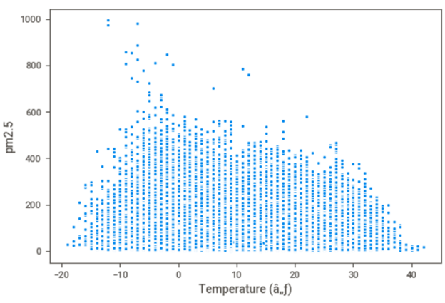
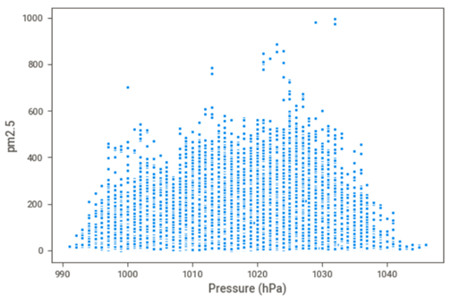
EDA

Slide 3
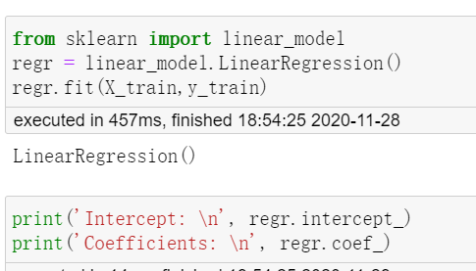
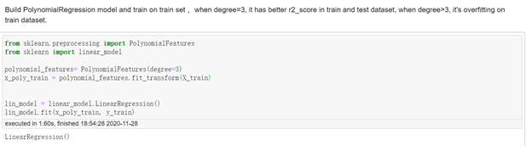
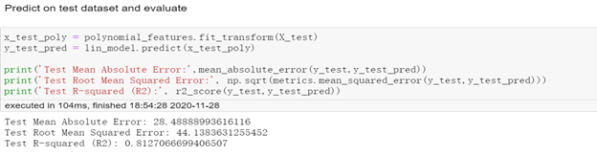
Algorithms and Evaluation
Logistic Regression
Polynomial Regression

Slide 4
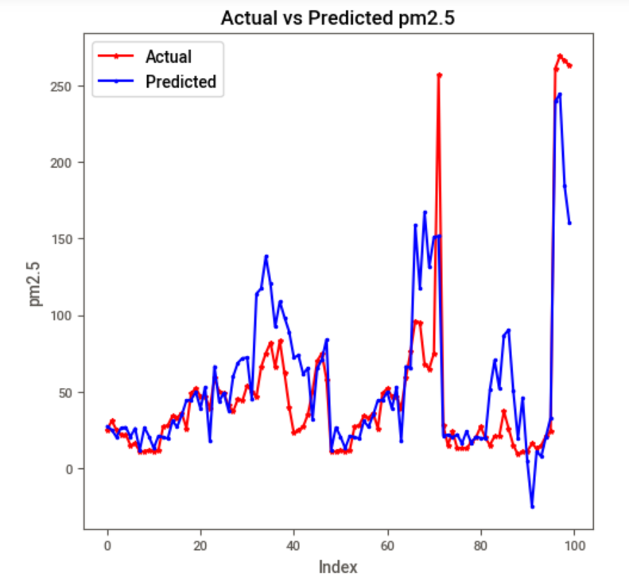
Output

Slide 5
Conclusion
We use the dataset from UCI to predict the value of PM2.5, then to predict the air quality of Beijing. We do some insights from the dataset.
Insight
The air quality of Beijing is no improvement from 2010 to 2014, there are 15% extreme heavy pollution and 11% heavy pollution, so analyze the factors and take actions right now is important and necessary.
Through all above, we can see the snow, rain can help to reduce pm2.5. In particularly bad weather, artificial precipitation can be used to improve the air quality if necessary.
The heavy wind speed, the better air quality.
Temperature and pressure also affect the pm2.5.
As this project is a regression problem, so we choose linear regression and polynomial regression to build models and predict the pm2.5 value. we use r2_score , mean absolute error and root mean squared error to evaluate our model, we found that polynomial regression is better fit for this project than linear regression.

