Slide 1
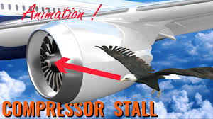
The exploration and research of Birds strikes
Project Information:
We are Federal Aviation Administration, which is the largest modern transportation agency and a governmental body of the United States with powers to regulate all aspects of civil aviation. During the past century, wildlife-aircraft strikes have resulted in the loss of hundreds of lives worldwide, as well as billions of dollars in aircraft damage. As a result of the increase in wildlife strikes, we decide to analyze wildlife strike hazard including caused factors, loss. Finally produce some suggestions to improve the airfield wildlife management.
Project Object:
Identify the main causes of wildlife strike hazard and provide advice for improving the airfield
wildlife management.
Data Set :
Dataset: Bird Strikes.csv

Slide 2

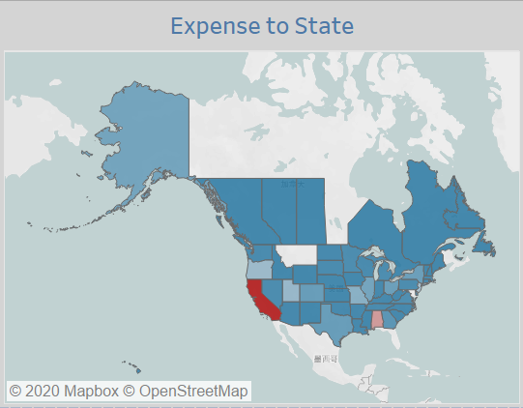
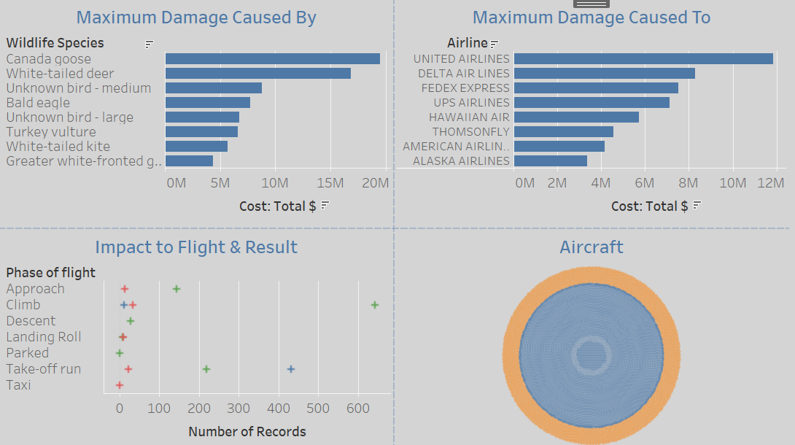
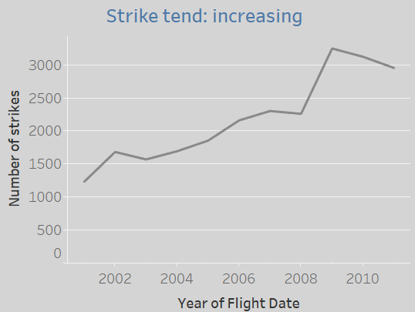
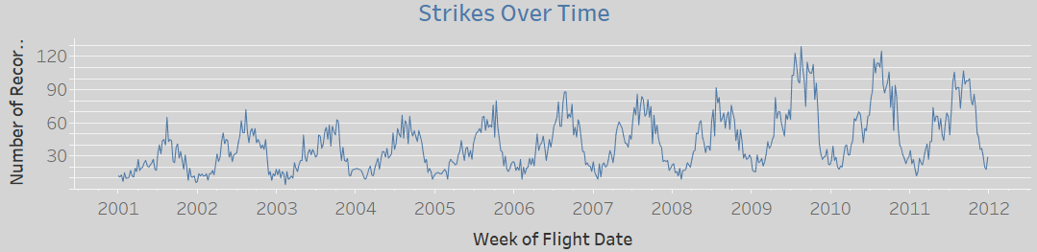

Slide 3
Conclusions and Suggestions
Airplane in the whole US are all suffer from wildlife strike, California is the most serious, it’s far more than other states.
The birds strikes are increasing year by year, and it happened mostly between March to May, and July to October. If resources are
limited, detection and countermeasures should be optimized during such times to prevent bird strikes as much as possible.
3. Wildlife strikes happen most often during takeoff or climbing, and during low altitude and low speed flights. Pilots should be informed with bird information during the approach phase if possible.
Canada goose are the most frequently involved in bird strikes, so Airports built near migration route of birds should have more countermeasures in place.
United Airline stands out as the airlines with most damaging bird strikes. More information on the airline would be needed to understand the cause, e.g. bird migration routes, airline traffic, bird control measures etc.

