Slide 1
Advancements in Energy-Efficient High-Performance Architectures for Edge Computing: Insights from Pipestitch, RipTide, and REVAMP
Nomita Meka
Venkata Kishan Kapuganti
Akshaya Yalla

Slide 2
PAPERS SELECTED
PAPER-1 :
Title : Pipestitch: An energy-minimal dataflow architecture with lightweight threads
Conference Name : 2023 56th IEEE/ACM International Symposium on Microarchitecture (MICRO)
Publication Date : 06 February 2024
Conference Location: Toronto, ON, Canada
Link : https://ieeexplore.ieee.org/document/10411417

Slide 3
PAPERS SELECTED
PAPER-2 :
Title : REVAMP: a systematic framework for heterogeneous CGRA realization
Conference Name : ASPLOS '22: Proceedings of the 27th ACM International Conference on Architectural Support for Programming Languages and Operating Systems
Publication Date : 22 February 2022
Conference Location : New York, NY, United States
Link : https://dl.acm.org/doi/abs/10.1145/3503222.3507772

Slide 4
PAPERS SELECTED
PAPER-3 :
Title : RipTide: A Programmable, Energy-Minimal Dataflow Compiler and Architecture
Conference Name : 2022 55th IEEE/ACM International Symposium on Microarchitecture (MICRO)
Publication Date : 26 October 2022
Conference Location : Chicago, IL, USA
Link : https://ieeexplore.ieee.org/document/9923793

Slide 5
CONTENTS
ABSTRACT
INTRODUCTION
MOTIVATION
METHODS
IMPLEMENTATION
RESULT
CONCLUSION
FUTURE WORK
REFERENCES

Slide 6
ABSTRACT
This presentation focuses on the three major contributions in the field of the energy efficient data flow architectures: Pipestitch, RipTide and Heterogenous CGRA realization.
Pipestitch is an architecture, which is designed to enhance the performance in the sparse workloads and maintaining the consumption of the energy.
Then RipTide is a programmable minimal energy dataflow compiler and architecture, which excels in the field and it is responsible for the energy efficiency but the performance has the limitations in the sparse nature of applications
Heterogenous CGRA realization is the way of integration of the diverse processing elements with the CGRA framework, which offers balance in the flexibility, performance and energy efficiency.
Implications are also discussed for the future research

Slide 7
INTRODUCTION
We have seen the rise of sophisticated technologies and the real time data processing, which made the path towards the interest in the extreme edge computing.
Examples for the above typically has Infrastructure monitoring, wearable health devices, and satellite systems.
So the traditional architectures are inefficient for this kind of applications, because of the fact that this architectures waste more energy on the data movement, instruction fetch and pipeline control.
So the focus of developing the energy efficient architecture has begin to balance the performance and programmability.

Slide 8
MOTIVATION
The motivation comes from the fact that, extreme edge computing faced many significant challenges due to the constraints related to energy and the high performance needs.
Energy minimal architectures are designed in a way to minimize the energy efficiency and maintaining the performance levels for the sparse or complex work loads.
So to address the challenges faced, it is viable for the extreme edge computing.

Slide 9
METHODS
Pipestitch :
It introduces a light weight hardware threads and the syncplane synchronization network, and it has a simplified programming model with the foreach construct.
RipTide :
In this, It mainly focuses on the minimization of energy consumption by the means of offloading the computational kernels onto a CGRA fabric. Compiler supports the control flow and the memory access. It tends to reduce the wastage of energy through the efficient operation mapping and the simplified architecture.
Heterogenous CGRA realization
It makes the integration of the diverse processing elements within the CGRA framework, and allows the balancing of the flexibility, performance and the efficiency in energy. It is mostly suitable in the complex and sparse computations.

Slide 10
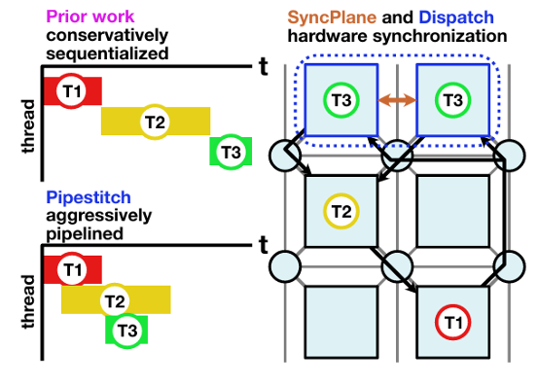
The picture besides states that, the pipestitch aggressive pipelining approach allows the efficient use of the resources by the technique of overlapping the execution of threads.
Then the right most architecture includes the SyncPlane and the Dispatch hardware components which are crucial for the management of the complexities of the thread synchronization and they dispatch in a pipelined architecture.
So the transition from the conservative sequentialization to the aggressive pipelining with the robust hardware synchronization, the system can achieve better performance and the higher throughput.

Slide 11
IMPLEMENTATION
PipeStitch :
Below is the implementation details of the PipeStich approach.
Firstly we write a C program using the ‘foreach’
Then compilation of the program to dataflow graph with the lightweight threads.
Then mapping of the dataflow graph to the CGRA fabric.
Now insertion of the dispatch operators are made for the synchronization.
Finally execution of the program is made with the synchronized threads.

Slide 12
IMPLEMENTATION
RipTide : Below are the steps which are part of the implementation.
Here first writing the program in high level C language.
Then compilation of the operations to map them in to a CGRA fabric.
Then mapping of the operations to PEs, which helps in the minimization of the energy.
Then configuration of the NoC routers for the control flow.
Execution of the program for the efficient energy use.

Slide 13
IMPLEMENTATION
Heterogenous CGRA Realization :
Firstly the designing of the CGRA fabric takes place.
Then the development of the compiler which allows to map the operations to appropriate Pes.
Then writing of the program to map to the CGRA fabric.
Configuration of the NoC takes place for the purpose of efficient communication.
Then execution of the programs.

Slide 14
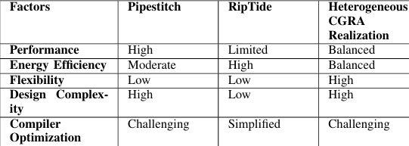
RESULT
In the below, We have made a table that contributes the evaluation of the three innovative approaches based on some of the factors on the data flow architectures.

Slide 15
CONCLUSION
As we conclude this, each architecture that we have discussed so far is contributing to the benefits and the addressing of the challeneges faced in the energy minimal data flow computing.
As the Pipestitch have excelled in the performance and the thread synchronization.
Riptide had focused on the minimizing of the energy efficiency, but it struggled with the performance in the complex applications.
Heterogenous CGRA realization has offered high flexibility and the balance in the performance, which is suitable for the diverse workloads.
So this made an emphasis on the importance of the efficient, high performance and adaptable computing architectures for the sparse load appplications.

Slide 16
FUTURE WORK
The future work should shift towards the focus on the compiler optimizations, which includes the improvement of techniques in the management of the threads and parallelism in the PipeStitch.
It also includes the inclusion of the non volatile memory for the energy efficient data storage and retrieval.
There is also a scope to implement the run time monitoring and the adaptive reconfiguration techniques.
Focus on the enabling of the real time adjustments to the work load and the environmental changes for all architectures.

Slide 17
REFERENCES
Thilini Kaushalya Bandara, Dhananjaya Wijerathne, Tulika Mitra, and Li-Shiuan Peh. 2022. REVAMP: A Systematic Framework for Het erogeneous CGRA Real ization. In Proceedings of the 27th ACM International Conference on Architectural Support for Programming Languages and Operating Systems (Lausanne, Switzer land) (ASPLOS 2022). Association for Computing Machinery, New York, NY, USA, 918–932. https://doi.org/10.1145/3503222.3507772
Han Cai, Ji Lin, Yujun Lin, Zhijian Liu, Haotian Tang, Hanrui Wang, Ligeng Zhu, and Song Han. 2022. Enable Deep Learning on Mobile Devices: Methods, Systems, and Applications. ACM Trans. Des. Autom. Electron. Syst. 27, 3, Article 20 (mar 2022), 50 pages. https://doi.org/10.1145/3486618
Chris Nicol. 2017. A Coarse Grain Reconfigurable Array (CGRA) for Statically Scheduled Data Flow Computing
Graham Gobieski, Amolak Nagi, Nathan Serafin, Mehmet Meric Isgenc, Nathan Beckmann, and Brandon Lucia. 2019. MANIC: A Vector Dataflow Architecture for Ultra-Low-Power Embedded Systems. In MICRO.
Graham Gobieski, Brandon Lucia, and Nathan Beckmann. 2019. Intelli gence Beyond the Edge: Inference on Intermittent Embedded Systems. In ASPLOS.

Slide 18


