Slide 1
Retail Sales Analysis
End-to-end Python, SQL, Excel, and dashboard project

Slide 2
KPI Summary
Total Revenue: 22,110,868.80
Total Transactions: 18,259.00
Total Countries: 38.00
Total Products: 3,096.00
Average Order Value: 1,210.96

Slide 3
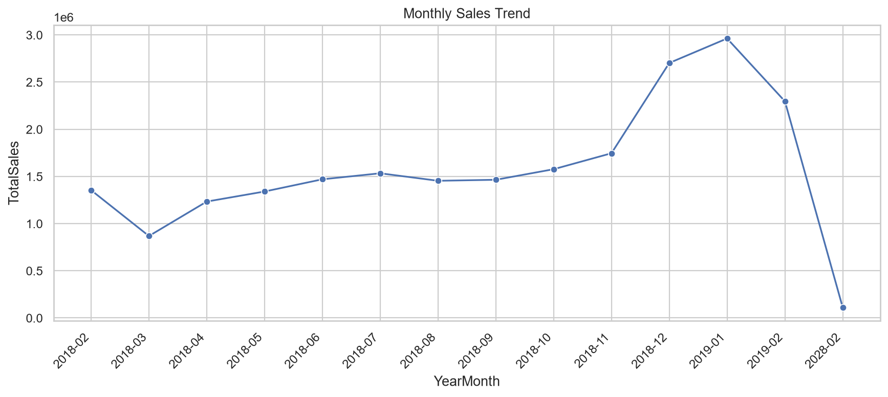
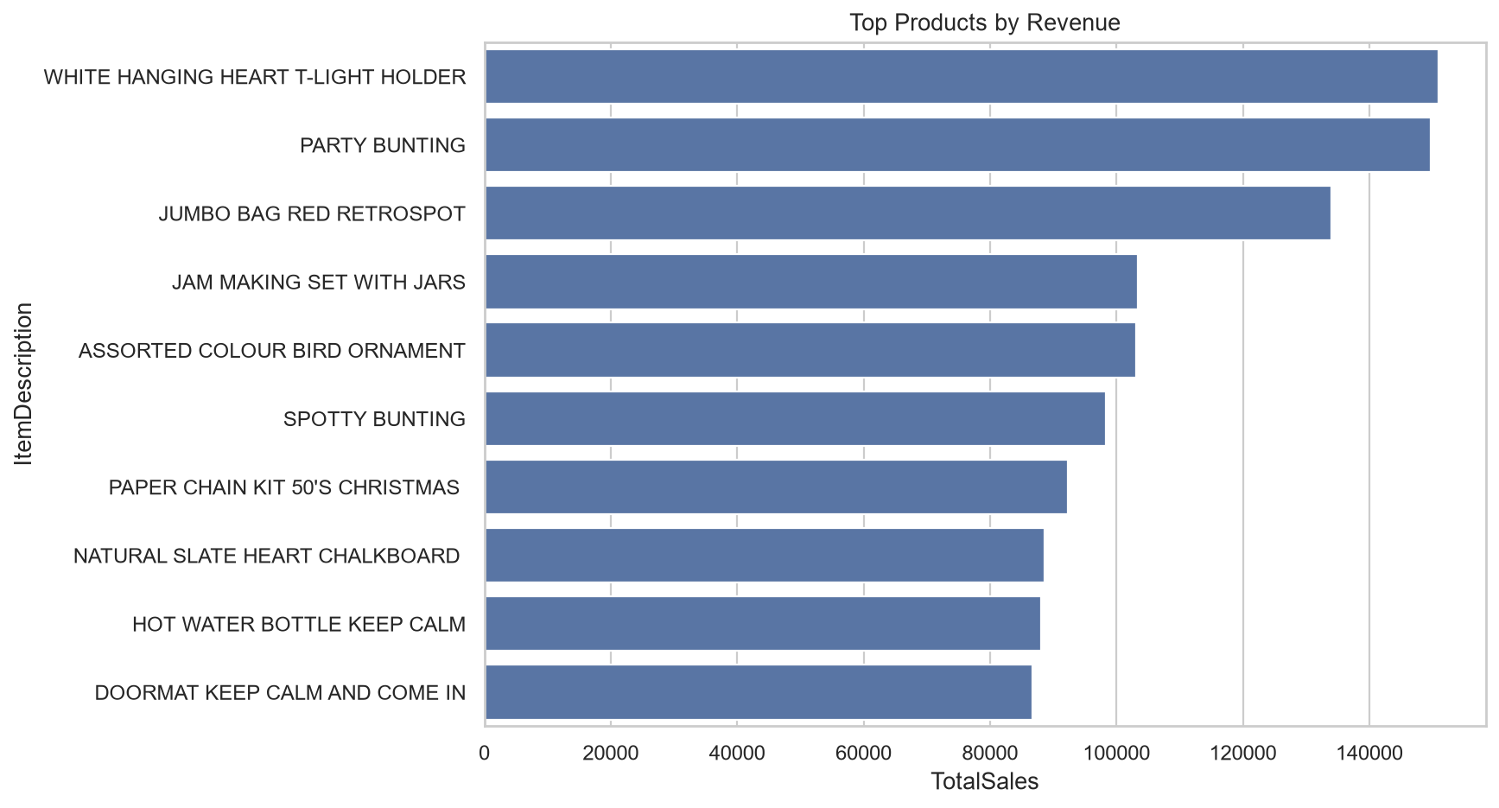
Sales Trends and Revenue Drivers

Slide 4
Business Insights
Highest revenue country is United Kingdom with 19,332,453.30 in sales.
Highest selling product by revenue is WHITE HANGING HEART T-LIGHT HOLDER (1787583).
Best sales month is 2019-01.
Peak shopping hour is 08:00.
Average transaction value is 1,210.96.
Strongest seasonal quarter is Q4 2018.

