Slide 1
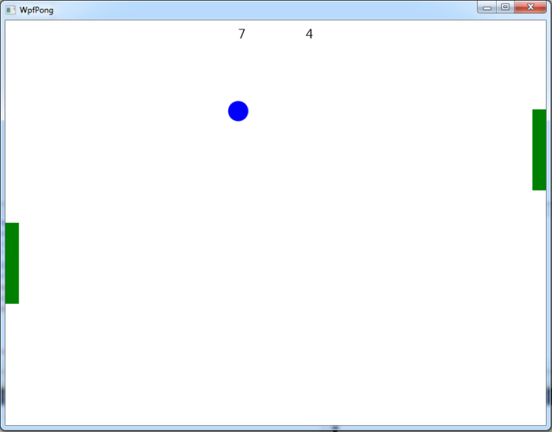
Introduction to 2D Graphics
Using OpenGL

Slide 2
Why Learn About OpenGL?
A well-known industry standard for real-time 2D and 3D computer graphics
Available on most platforms
  Desktop operating systems, mobile devices (OpenGL ES), browsers (WebGL)
Older (OpenGL 1.0) API provides features for rapid prototyping; newer API (OpenGL 2.0 and newer) provides more flexibility and control
  Many old features available in new API as “deprecated” functionality
  Today we will use the old API exclusively
  Will use a mix of the old and new APIs in lab

Slide 3
Why Learn 2D first?
A good stepping stone towards 3D – many issues much easier to understand in 2D
  no need to simulate lights, cameras, the physics of light interacting with objects, etc.
  intro to modeling vs. rendering and other notions
  get used to rapid prototyping in OpenGL, both of designs and concepts
2D is still really important and the most common use of computer graphics, e.g. in UI/UX, documents, browsers

Slide 4
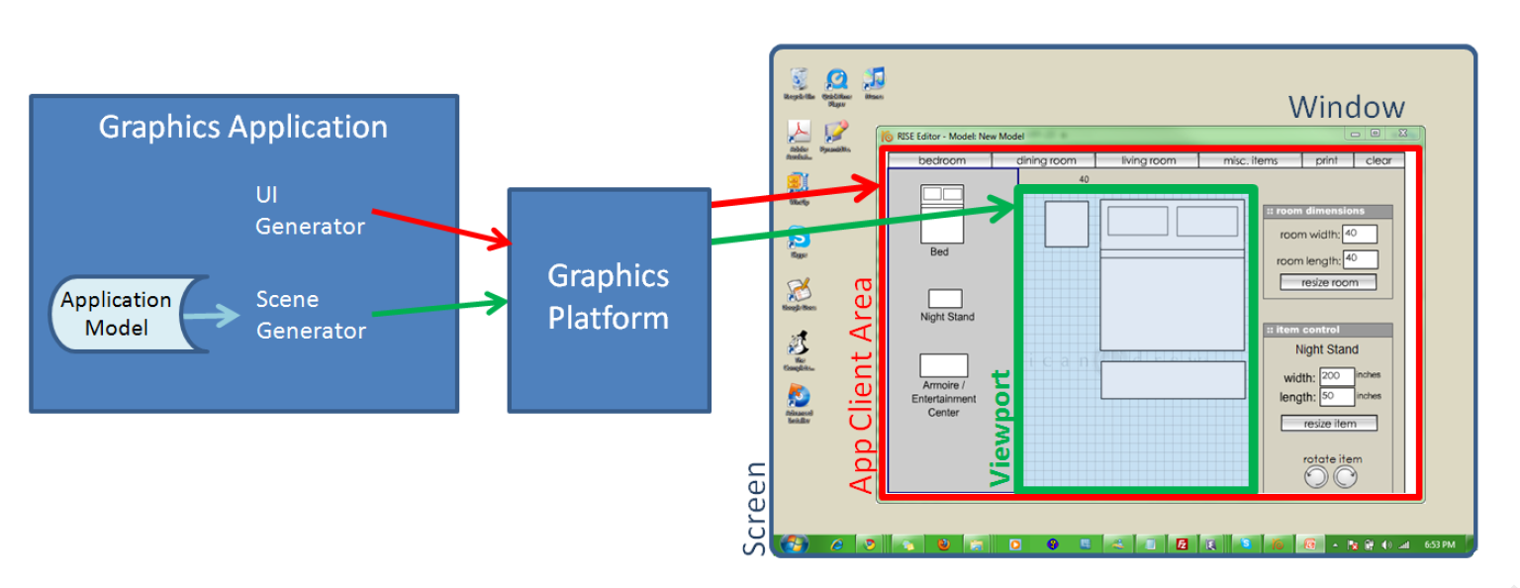
Graphics Platforms (1/4)
Applications that only write pixels are rare
  Application Model (AM) is the data being represented by a rendered image
    manipulated by user interaction with the application

Slide 5
Graphics Platforms (2/4)
  Runs in conjunction with window manager
    Determines what section of the screen is allocated to the application
    Handles “chrome” (title bar, resize handles); client area is controlled by application

Slide 6
Graphics Platforms (3/4)
Typically, AM uses client area for:
  user interface to collect input to the AM
  display some representation of AM in the viewport
    This is usually called the scene, in the context of both 2D and 3D applications
  Scene is rendered by the scene generator, which is typically separate from the UI generator, which renders rest of UI

Slide 7
Graphics Platforms (4/4)
Early raster graphics packages/libraries/platforms
  RamTek library 1981, Apple QuickDraw 1984
  Microsoft's Graphics Display Interface (GDI 1990, now GDI+), Java.awt.Graphics2D
Earliest packages usually had these characteristics:
  geometric primitives/shapes, appearance attributes specified in attribute bundles (a.k.a. ”graphical contexts”/”brushes”),
    applied modally rather than in a parameter list for each primitive (too many parameters for that)
  integer coordinates map directly to screen pixels on output device
  immediate mode (no record kept of display commands)
  no built-in functions for applying transforms to primitives
  no built-in support for component hierarchy (no composite shapes)
Early packages were little more than assembly languages for display device

Slide 8
Problems with Early Graphics Platforms (1/3)
Geometric Scalability
Integer coordinates mapped to display pixels affects apparent size of image: large on low-res display & small on high-res display
Application needs flexible internal coordinate representation
  floating point is essential
  float to fixed conversion required; actually a general mapping

Slide 9
Problems with Early Graphics Platforms (2/3)
Display updates
To perform operations on objects in scene, application must keep list of all primitives and their attributes (along with application-specific data)
Some updates are transitory “feedback animations,” only a display change
Consider an interior-design layout application
  when user picks up an object and drags to new location, object follows cursor movement
  interim movements do not relate to data changes in application model, purely visual changes
  application model only updated when user drops object (releases mouse button)
  in immediate mode, application must re-specify entire scene each time cursor moves
Alternatively, use a retained mode platform which will store an internal representation of all objects in scene
  called a display model to distinguish it from application model

Slide 10
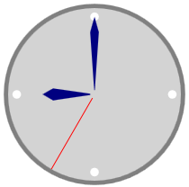
Problems with Early Graphics Platforms (3/3)
Interaction
Consider a simple clock example:
User clicks minute hand, location must be mapped to relevant application object; called pick correlation
Developer responsible for pick correlation (usually some kind of "point-in-bounding box rectangle" test based on pick coordinates)
  find top-most object at clicked location
  may need to find entire composite object hierarchy from lowest-level primitive to highest level composite
  e.g., triangle -> hand -> clock
Solution: retained mode can do pick correlation, as it has a representation of scene

Slide 11
Modern Graphics Platforms (1/2)
Device-independent floating point coordinate system
  packages convert “application-space" to "device-space" coordinates
Specification of hierarchy
  support building scenes as hierarchy of objects, using transforms (scale, rotate, translate) to place children into parents' coordinate systems
  support manipulating composites as coherent objects
Smart Objects (Widgets, etc.)
  graphic objects have innate behaviors and interaction responses
  e.g. button that automatically highlights itself when cursor is over it

Slide 12
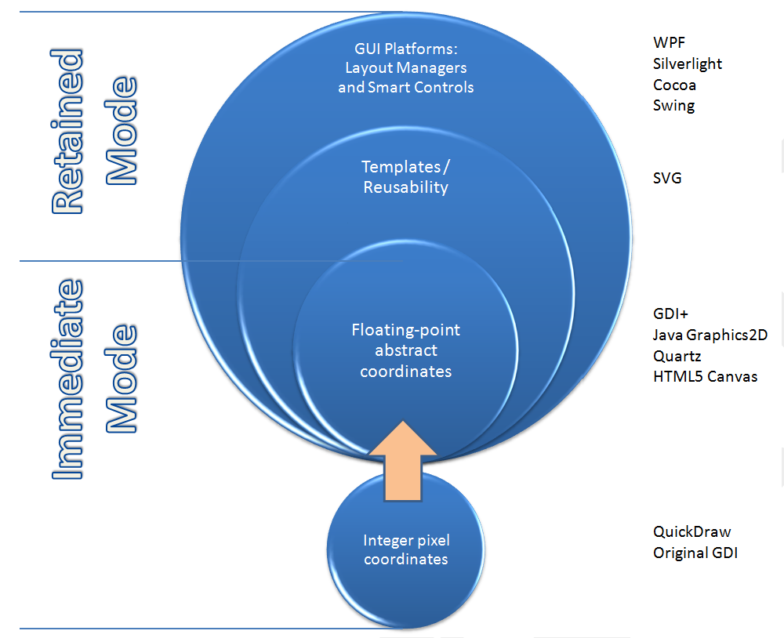
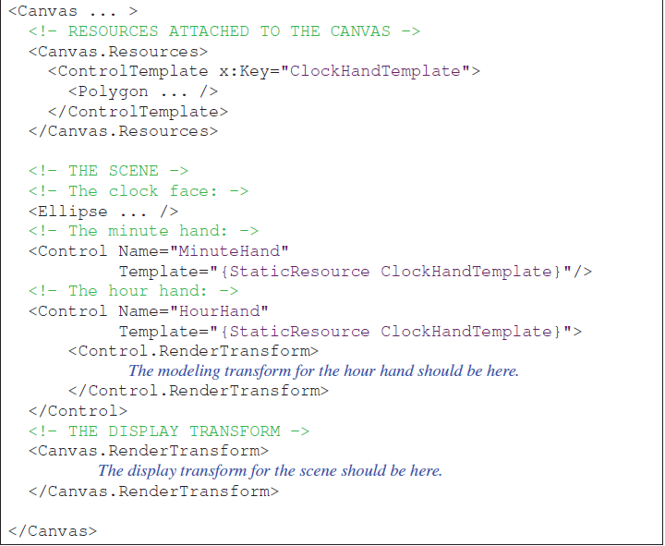
Modern Graphics Platforms (2/2)
Notes:
We’ll start with the state of the art of raster graphics in the 1980s and early 1990s.
The typical popular 2D raster graphics platform (e.g., Apple’s original QuickDraw
and Microsoft’s original GDI) provided the ability to paint pixels on a rectangular
canvas, using an integer coordinate system. Instead of painting individual pixels,
the application painted a scene by calling procedures that drew primitives that
were either geometric shapes (such as polygons and ellipses) or preloaded rectangular
images (often called bitmaps or pixmaps, used to display photos, icons,
static backgrounds, text characters extracted from font glyph sets, etc.). Additionally,
the appearance of each geometric primitive was controlled via specification
of attributes; in Microsoft APIs, the brush attribute specified how the interior of
a primitive should appear, and the pen attribute controlled how the primitive’s
outline should appear

Slide 13
Immediate Mode Vs Retained Mode
Immediate Mode (OpenGL, DirectX)
Application model: stores both geometric information and non-geometric information in Application Database.
Platform keeps no record of primitives that compose scene

Slide 14
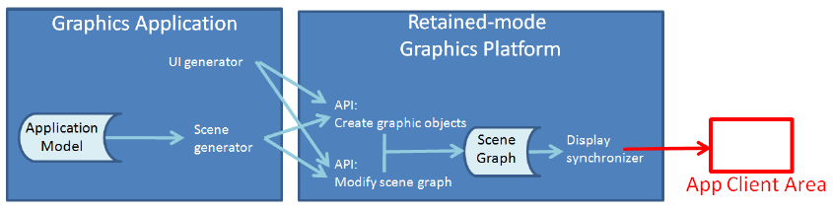
Immediate Mode Vs Retained Mode
Retained Mode (WPF, SVG)
Application model in app and Display model in platform
Display model contains information that defines geometry to be viewed
Display model is a geometric subset of Application model (typically a scene graph)
Simple drawing application does not need Application model (e.g., clock example)
No right answer on which to use – context-dependent tradeoffs
Notes:
I.M.: For example, when the FillEllipse function of GDI+ is invoked, it immediately (thus the term “immediate mode”)
performs its task—mapping the ellipse’s coordinates into device coordinates and
painting the appropriate pixels in the display buffer—and then returns control to
the application. At its most basic, the programmer’s model for working in IM is
straightforward: To effect any change in the rendered image, the scene generator
traverses the application model to regenerate the set of primitives representing the
scene.
R.M.:But other application developers look for platforms that offload as many
development tasks as possible. To satisfy these developers, RM platforms retain
a representation of the scene to be viewed/rendered in a special-purpose database
that we call a scene graph. As shown in Figure, the application’s UI and scene generators use the RM platform’s API
to create the scene graph, and can specify changes incrementally by simply editing
the scene graph. Any incremental change causes the RM platform’s display
synchronizer to automatically update the rendering in the client area. Because it
retains the entire scene, the RM platform can take on many common tasks concerning
not only the display, but also user interaction (e.g., pick correlation, the
determination of which object is the target of a user click/tap).
All RM packages can be traced back to Sketchpad [Sut63], Ivan Sutherland’s
pioneering project from the early 1960s, which launched the field of interactive
graphics. Sketchpad supported the creation of master templates, which could be
instantiated one or more times onto the canvas to construct a scene. Each template
was a group of primitives and possibly instances of subordinate templates, bundled
to compose a single unified graphics object. Each instance could be geometrically
transformed—that is, positioned, oriented, and scaled—but in all other respects,
the instance retained the appearance of its master, and changes to the master would
immediately be reflected in all instances
These key ideas from Sketchpad survive in all modern RM packages, making
these platforms excellent foundations for creating user interfaces. UI controls
(also known as widgets) are templated objects that, as an integrated collection,
have an inherent, consistent look and feel.
Examples of built-in feedback include the graying-out of a control that is currently
disabled, the glow highlighting of a button when the pointer enters its
region, and the display of a blinking cursor when the user is typing into a
control’s text box. These feedback behaviors often include nice-looking animations,
performed by the platform with no application involvement.
Most RM UI platforms also include layout managers that spatially arrange
controls in a pleasing and organized way, with consistent dimensions and spacing,
and that provide for automatic revision of the layout in reaction to programmatic
or user-initiated changes in the size or shape of the UI region.

Slide 15

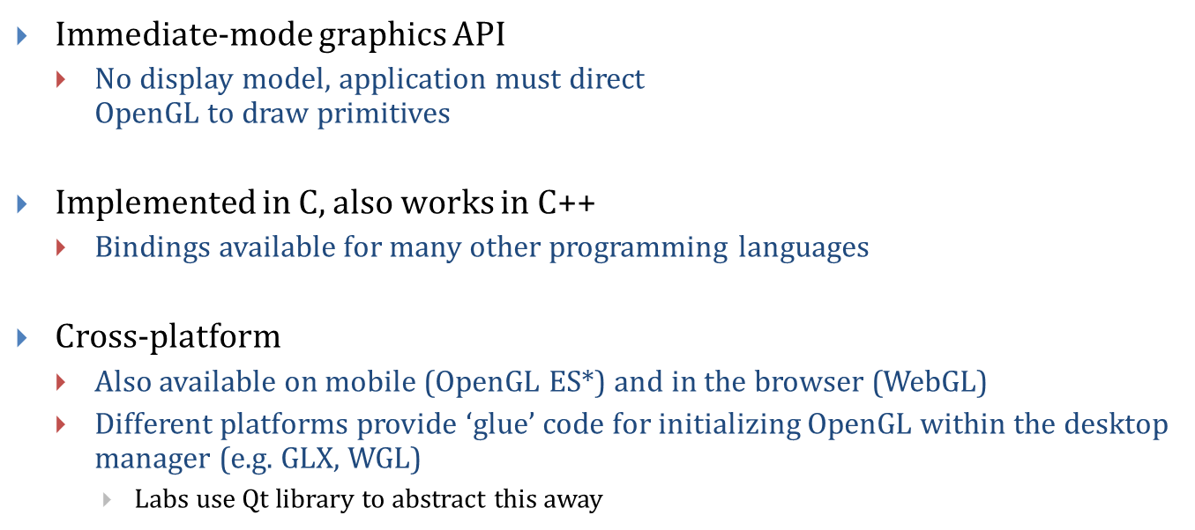
OpenGL (1/3)
* - ES: “Embedded Systems”

Slide 16
OpenGL (2/3)
Created by Silicon Graphics Inc. (SGI, http://sgi.com) in 1992, now managed by the non-profit Khronos Group (http://khronos.org)
Originally aimed to allow any OpenGL program to run on a variety of graphics hardware devices
Invented when “fixed-function” hardware was the norm
  Techniques were implemented in the hardware; OpenGL calls sent commands to the hardware to activate / configure different features
Now supports programmable hardware
  Modern graphics cards are miniature, highly parallel computers themselves, with multi-core GPUs, on-board RAM, etc.
  GPUs can run simple programs (called “shaders”), which render the scene while the CPU is busy doing other work
  Programmers can implement new features in shaders instead of waiting for hardware vendors to support them in hardware

Slide 17
OpenGL (3/3)
Fixed-function API provides features that make it easier to prototype
  e.g. the package implements much of the linear algebra needed to move objects on the screen
  GL utility library (“GLU”) provides additional high-level utilities
Programmable API implements most of the fixed-function API for backwards compatibility, but still uses shaders in the background
  Only true for desktop; must use shaders to program with OpenGL ES 2.0+ or WebGL

Slide 18
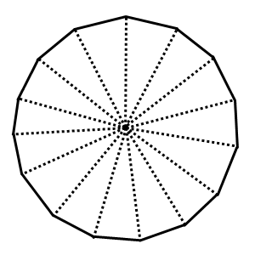
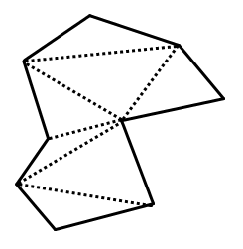
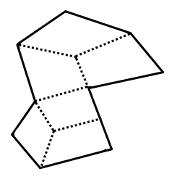
Representing Shapes
Objects in OpenGL are composed of triangles and quads. We can use these to build arbitrary polygons, and approximate smooth shapes.
A complex polygon made of triangle primitives
A complex polygon made of quad primitives
An approximate circle made of triangle primitives

Slide 19
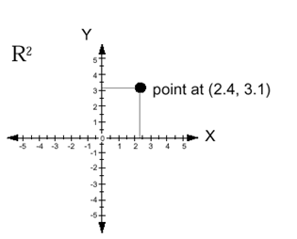
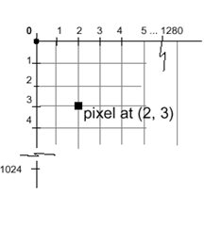
Coordinate Systems (1/6)
Cartesian coordinates in math, engineering
  typically modeled as floating point
  typically X increasing right, Y increasing up
Display (physical) coordinates
  integer only
  typically X increasing right, Y increasing
  down
  1 unit = 1 pixel
But we want to be insulated from physical display coordinates
  OpenGL is the intermediary

Slide 20
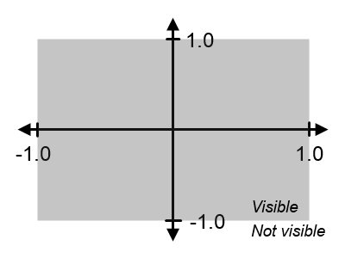
Coordinate Systems (2/6)
OpenGL Coordinates
  Choose a convention
    For us: X increases right, Y increases up
  Units are based on the size of the
  window or screen
    Visible area stretches to fill window
    Units are percentage of window size, don’t correspond to physical units or pixels
Define coordinate system using the projection matrix
glMatrixMode(GL_PROJECTION_MATRIX); // Select the projection matrix
glOrtho(-1, // X coordinate of left edge
1, // X coordinate of right edge
-1, // Y coordinate of bottom edge
1, // Y coordinate of top edge
1, // Z coordinate of the “near” plane
-1); // Z coordinate of the “far” plane
  These settings are also the OpenGL defaults

Slide 21
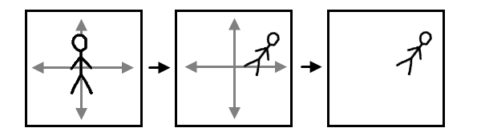
Coordinate Systems (3/6)
Two choices on how to think
  Draw everything in OpenGL coordinate system
  This is inconvenient: instead choose your own abstract object coordinate system to suit your needs, then specify all the primitives in your object to OpenGL using these coordinates. Specify a transformation to map the object coordinates to OpenGL coordinates.
    Latter coords called “application coordinates” in 2D, “world coordinates” in 3D
  When we say “transformation,” we usually mean a composition of scale, rotate and translate transforms
Object
Coordinates
Display
OpenGL Coordinates

Slide 22
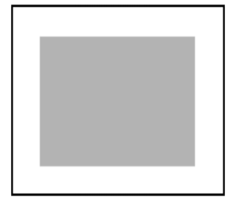
Coordinate Systems (4/6)
We will illustrate the use of OpenGL by going through step-by-step how to create a simple clock application
Start by drawing a square for the clock face:
The result is a square centered
in the window:
glBegin(GL_QUADS);
glVertex2f(-.7, -.7);
glVertex2f( .7, -.7);
glVertex2f( .7, .7);
glVertex2f(-.7, .7);
glEnd();

Slide 23
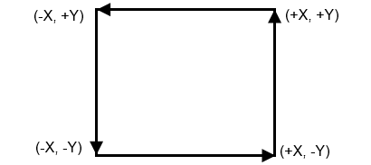
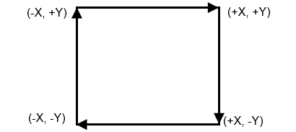
Winding Order
Order is important: vertices must be specified in counter-clockwise order relative to the viewer. Otherwise nothing shows up!
  Winding order determines the direction of the lighting normal vector; if the normal is pointing the wrong way, we won’t see anything
  Counter-clockwise winding consistent with the right-hand rule
glVertex2f(-.7, -.7);
glVertex2f( .7, -.7);
glVertex2f( .7, .7);
glVertex2f(-.7, .7);
glVertex2f(-.7, -.7);
glVertex2f(-.7, .7);
glVertex2f( .7, .7);
glVertex2f( .7, -.7);

✓

X

Slide 24
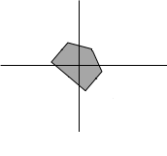
Transformations
Geometric Transformations in 2D (relative to a center for Scale and Rotate!)
  Positive angles rotate counter-clockwise
Transformations can be composed (matrix composition) but are NOT commutative, so proper order is vital
Original
Rotate
Original
Translate
glTranslatef(.1, .1, 0);
glRotatef(-45, 0, 0, 1);
Original
Scale
glScalef(2, 2, 1);

Slide 25
Coordinate Systems (5/6)
To map from object coordinates to OpenGL coordinates, use the modelview matrix:
glMatrixMode(GL_MODELVIEW);
// glTranslatef / glRotatef / etc calls go here
OpenGL provides a stack data structure so you can erase an object’s modelview transforms after you’re done drawing the object:
glMatrixMode(GL_MODELVIEW);
glPushMatrix(); // Save the current modelview matrix
// <apply transforms to the modelview matrix (glTranslatef, etc)>
// <draw an object (glBegin, glVertex, etc)>
glPopMatrix(); // Restore the saved modelview matrix
// Repeat for other objects

Slide 26
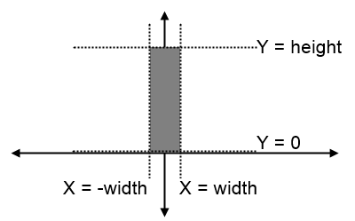
Coordinate Systems (6/6)
We’ll draw an hour hand on the clock using a quad rotated around the origin. One could do the same thing to draw minute and second hands:
float hourAngle = -45; // Rotate 45 degrees clockwise
float width = .01, height = .4;
glMatrixMode(GL_MODELVIEW);
glPushMatrix();
glRotatef(hourAngle, 0, 0, 1); // Rotate around the Z axis
glBegin(GL_QUADS);
glVertex2f(-width, 0);
glVertex2f( width, 0);
glVertex2f( width, height);
glVertex2f(-width, height);
glEnd();
glPopMatrix();

Slide 27
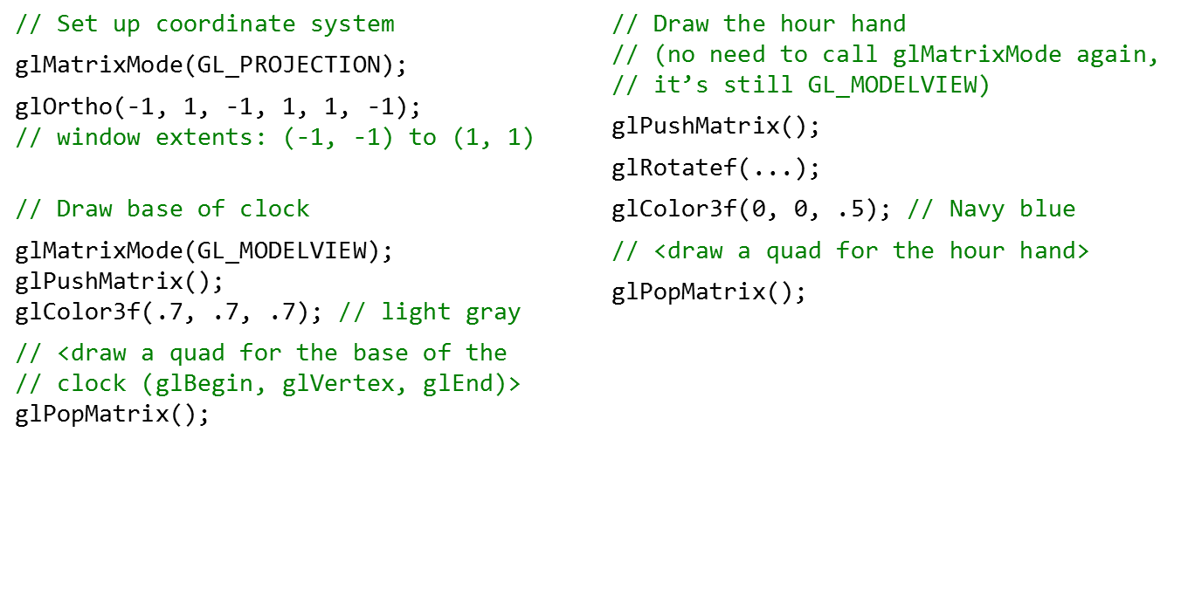
Outline of the Clock Example

Slide 28
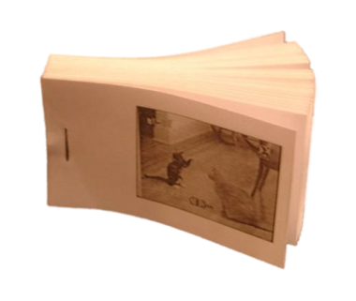
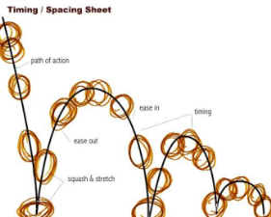
Animation (1/3)
Rapidly displaying sequence of images to create an illusion of movement
  Flipbook (http://www.youtube.com/watch?v=AslYxmU8xlc)
  Keyframe animation: spec keyframes, computer interpolates (e.g., ball bouncing)
Flipbook
Keyframe Animation

Slide 29
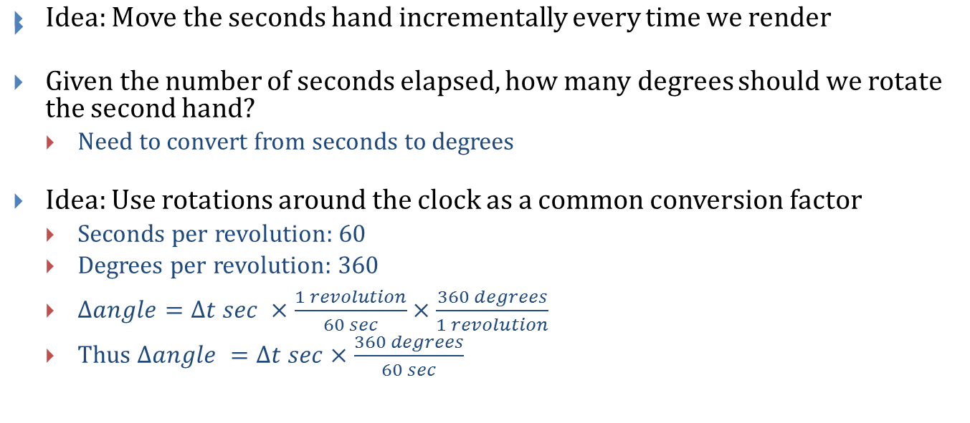
Animation (2/3)

Slide 30
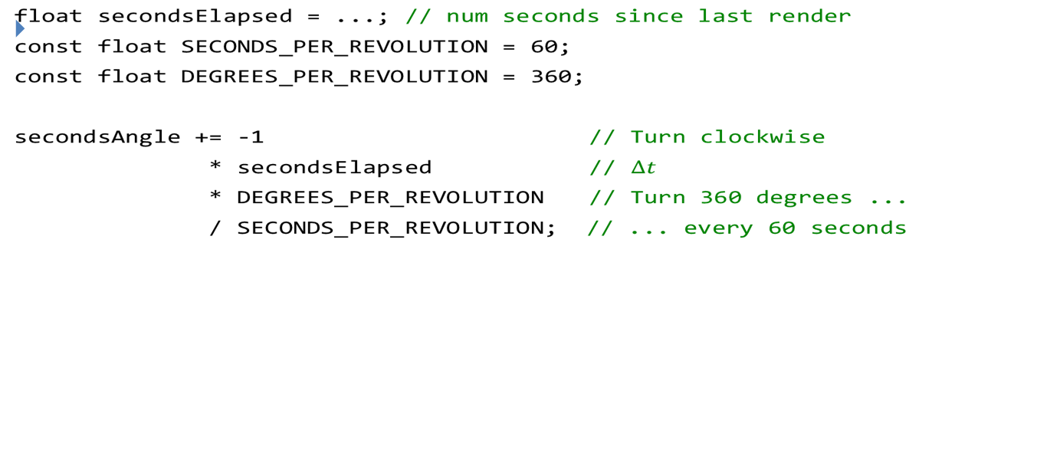
Animation (3/3)

Slide 31

OpenGL 2D Lab
We will have a 2D lab that will be held next week: Pong!
  Generate graphics and UI for the classic game using OpenGL

