Slide 1
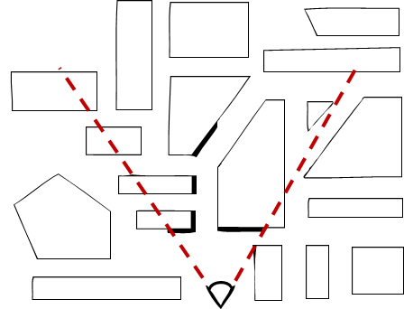
Visible Surface Determination (VSD)
To render or not to render, that is the question…

Slide 2
What is it?
Given a set of 3-D objects and a view specification (camera), determine which edges or surfaces of the object are visible
why might objects not be visible? occlusion vs. clipping
clipping works on the object level (clip against view volume)
occlusion works on the scene level (compare depth of object/edges/pixels against other objects/edges/pixels)
Also called Hidden Surface Removal (HSR)
We begin with some history of previously used VSD algorithms

Slide 3
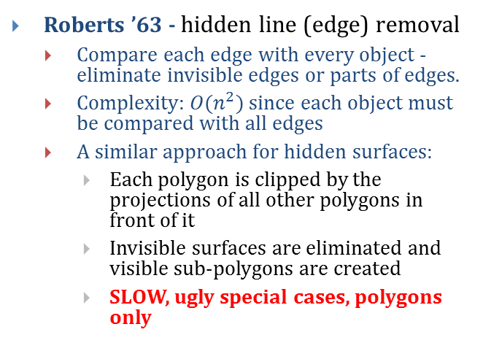
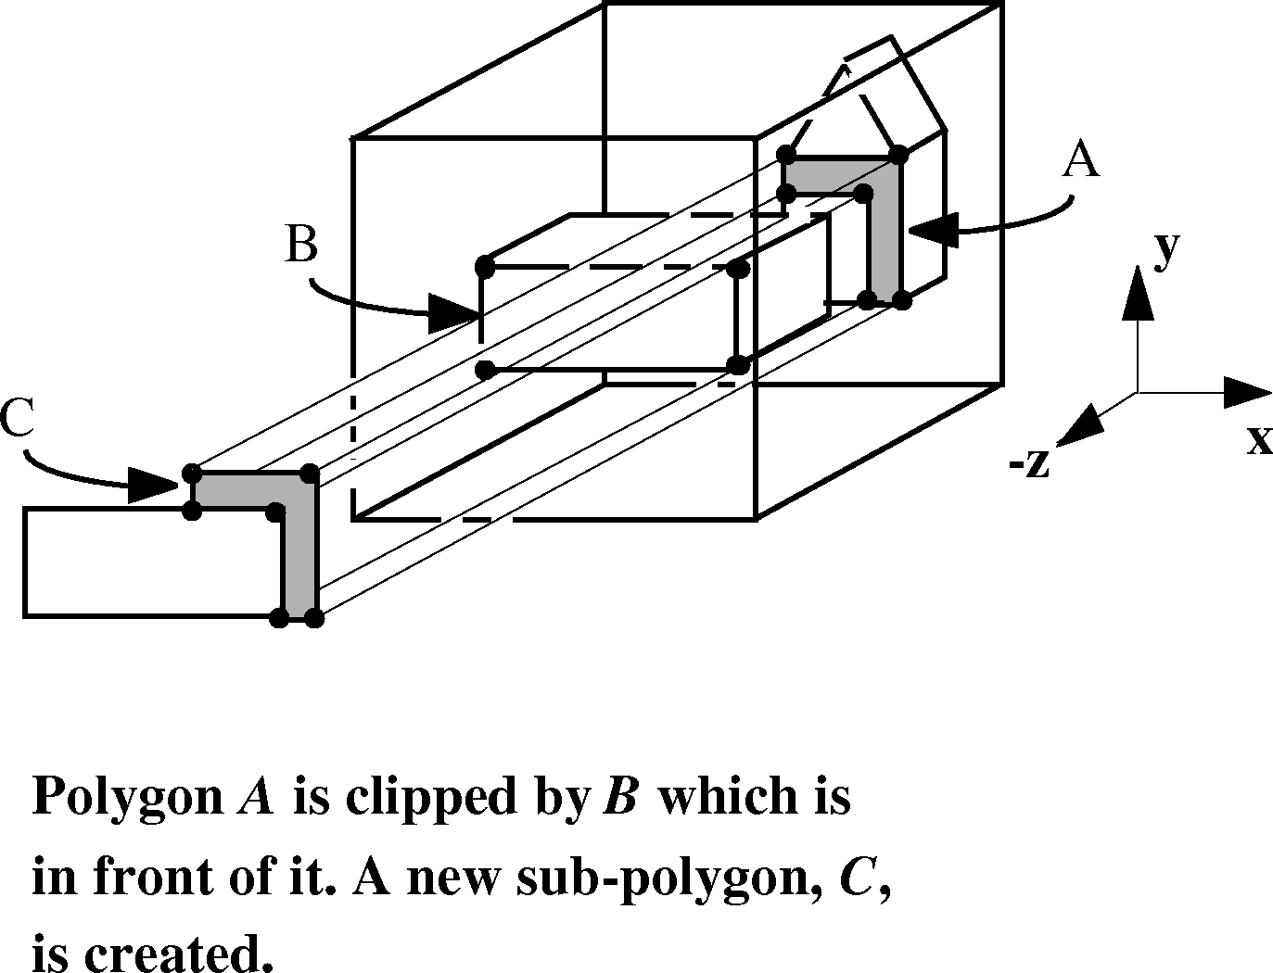
Object-Precision Algorithms
Sutherland categorized algorithms as to whether they work on objects in the world (object precision) or with projections of objects in screen coordinates (image precision) and refer back to the world when z is needed

Slide 4
Painter’s Algorithm – Image Precision
Back-to-front algorithm was used in the first hardware-rendered scene, the 1967 GE Flight Simulator by Schumacher et al using a video drum to hold the scene
http://www.youtube.com/watch?v=vajvwNctrb8
Create drawing order so each polygon overwrites the previous one. This guarantees correct visibility at any pixel resolution
Strategy is to work back to front; find a way to sort polygons by depth (z), then draw them in that order
do a rough sort of polygons by smallest (farthest) z-coordinate in each polygon
scan-convert most distant polygon first, then work forward towards viewpoint (“painters’ algorithm”)
See 3D depth-sort algorithm by Newell, Newell, and Sancha
https://en.wikipedia.org/wiki/Newell%27s_algorithm
Can this back-to-front strategy always be done?
problem: two polygons partially occluding each other – need to split polygons

Slide 5
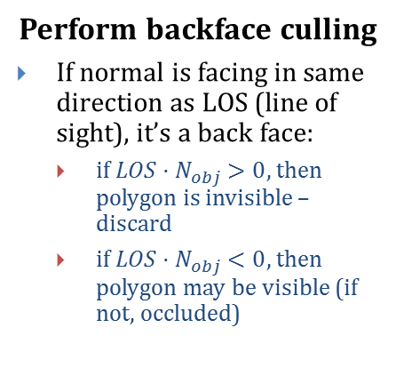
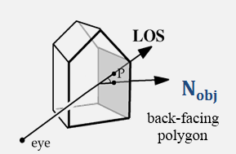
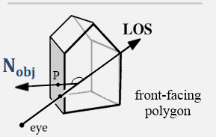
Hardware Scan Conversion: VSD (1/4)
1
2
+y
(-1, 1, -1)
+z
+x
(1, -1, 0)
Canonical perspective-transformed
view volume with cube
Finally, clip against normalized view volume
(-1 < x < 1), (-1 < y < 1), (-1 < z < 0)
3

Slide 6
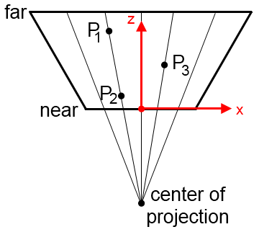
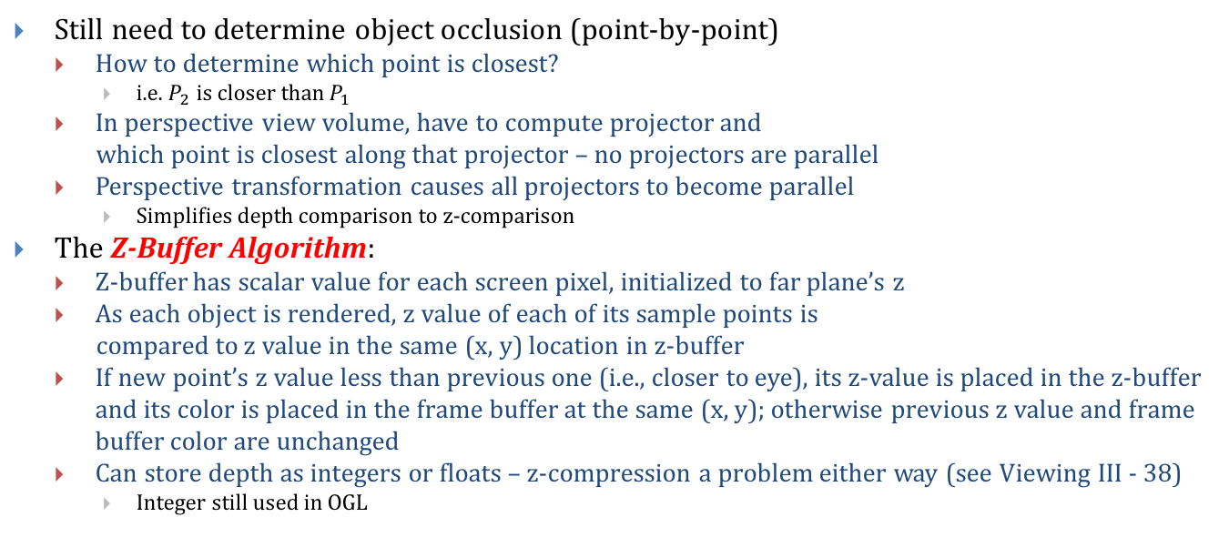
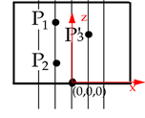
Hardware Scan Conversion: VSD (2/4)

Slide 7
Z-Buffer Algorithm
void zBuffer() {
int x, y;
for (y = 0; y < YMAX; y++)
for (x = 0; x < XMAX; x++) {
WritePixel (x, y, BACKGROUND_VALUE);
WriteZ (x, y, 1);
}
for each polygon {
for each pixel in polygon’s projection {
//plane equation
double pz = Z-value at pixel (x, y); if (pz < ReadZ (x, y)) {
// New point is closer to front of view
WritePixel (x, y, color at pixel (x, y))
WriteZ (x, y, pz);
}
}
}
}
Draw every polygon that we can’t reject trivially (totally outside view volume)
If we find a piece (one or more pixels) of a polygon that is closer to the front, we paint over whatever was behind it
Use plane equation for z = f(x, y)
Note: use positive z here [0, 1]
Applet: http://debeissat.nicolas.free.fr/zbuffer.php

Slide 8
Hardware Scan Conversion: VSD (3/4)
Requires two “buffers”
Intensity Buffer: our familiar RGB pixel buffer, initialized to background color
Depth (“Z”) Buffer: depth of scene at each pixel, initialized to 255
Polygons are scan-converted in arbitrary order. When pixels overlap, use Z-buffer to decide which polygon “gets” that pixel
255 | 255 | 255 | 255 | 255 | 255 | 255 | 255
255 | 255 | 255 | 255 | 255 | 255 | 255 | 255
255 | 255 | 255 | 255 | 255 | 255 | 255 | 255
255 | 255 | 255 | 255 | 255 | 255 | 255 | 255
255 | 255 | 255 | 255 | 255 | 255 | 255 | 255
255 | 255 | 255 | 255 | 255 | 255 | 255 | 255
255 | 255 | 255 | 255 | 255 | 255 | 255 | 255
255 | 255 | 255 | 255 | 255 | 255 | 255 | 255
64 | 64 | 64 | 64 | 64 | 64 | 64
64 | 64 | 64 | 64 | 64 | 64
64 | 64 | 64 | 64 | 64
64 | 64 | 64 | 64
64 | 64 | 64
64 | 64
64
64 | 64 | 64 | 64 | 64 | 64 | 64 | 255
64 | 64 | 64 | 64 | 64 | 64 | 255 | 255
64 | 64 | 64 | 64 | 64 | 255 | 255 | 255
64 | 64 | 64 | 64 | 255 | 255 | 255 | 255
64 | 64 | 64 | 255 | 255 | 255 | 255 | 255
64 | 64 | 255 | 255 | 255 | 255 | 255 | 255
64 | 255 | 255 | 255 | 255 | 255 | 255 | 255
255 | 255 | 255 | 255 | 255 | 255 | 255 | 255
+
=
integer Z-buffer with
near = 0, far = 255
64 | 64 | 64 | 64 | 64 | 64 | 64 | 255
64 | 64 | 64 | 64 | 64 | 64 | 255 | 255
64 | 64 | 64 | 64 | 64 | 255 | 255 | 255
64 | 64 | 64 | 64 | 255 | 255 | 255 | 255
64 | 64 | 64 | 255 | 255 | 255 | 255 | 255
64 | 64 | 255 | 255 | 255 | 255 | 255 | 255
64 | 255 | 255 | 255 | 255 | 255 | 255 | 255
255 | 255 | 255 | 255 | 255 | 255 | 255 | 255
127
127 | 127
127 | 127 | 127
127 | 127 | 127 | 127
127 | 127 | 127 | 127 | 127
64 | 64 | 64 | 64 | 64 | 64 | 64 | 255
64 | 64 | 64 | 64 | 64 | 64 | 255 | 255
64 | 64 | 64 | 64 | 64 | 255 | 255 | 255
64 | 64 | 64 | 64 | 255 | 255 | 255 | 255
64 | 64 | 64 | 255 | 255 | 255 | 255 | 255
64 | 64 | 127 | 255 | 255 | 255 | 255 | 255
64 | 127 | 127 | 127 | 255 | 255 | 255 | 255
127 | 127 | 127 | 127 | 127 | 255 | 255 | 255
+
=

Slide 9
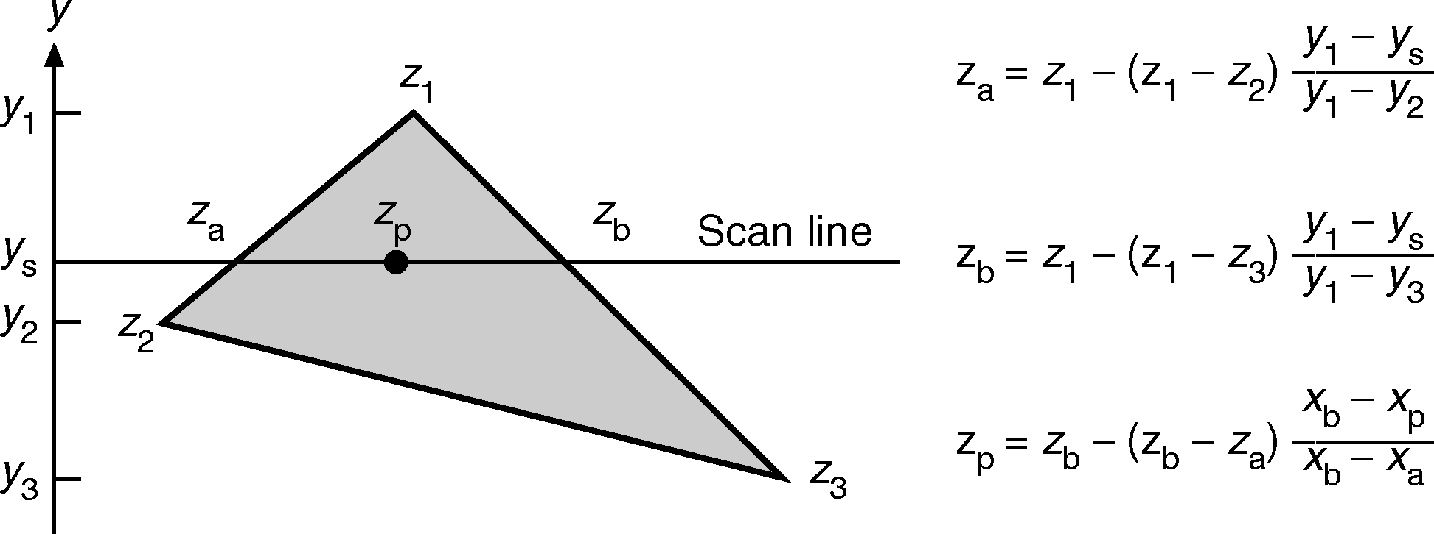
Hardware Scan Conversion: VSD (4/4)
After scene gets projected onto film plane we know depths only at locations in our depth buffer that our vertices got mapped to
So how do we efficiently fill in all the “in between” z-buffer information?
Simple answer: incrementally!
Remember scan conversion/polygon filling? As we move along Y-axis, track x position where each edge intersects scan line
Do the same for z coordinate with y-z slope instead of y-x slope
Knowing z₁, z_{2,} and z₃ we can calculate z_{a} and z_{b} for each edge, and then incrementally calculate z_{p} as we scan.
Similar to interpolation to calculate color per pixel (Gouraud shading)

Slide 10
Advantages of Z-buffer
Dirt-cheap and fast to implement in hardware, despite brute force nature and potentially many passes over each pixel
Requires no pre-processing, polygons can be treated in any order!
Allows incremental additions to image – store both frame buffer and z-buffer and scan-convert the new polygons
Lost coherence/polygon id’s for each pixel, so can’t do incremental deletes of obsolete information.
Technique extends to other surface descriptions that have (relatively) cheap z= f(x, y) computations (preferably incremental)

Slide 11
Disadvantages of Z-Buffer
near
far
z
Perspective foreshortening (see slides 44-46 in Viewing III)
Compression in z-axis in post-perspective space
Objects far away from camera have z-values very close to each other
Depth information loses precision rapidly
Leads to z-ordering bugs called z-fighting
x
Before
0
1
z
x
After

Slide 12

Z-Fighting (1/3)
Z-fighting occurs when two primitives have similar values in the z-buffer
Coplanar polygons (two polygons that occupy the same space)
One is arbitrarily chosen over the other, but z varies across the polygons and binning will cause artifacts, as shown on next slide
Behavior is deterministic: the same camera position gives the same z-fighting pattern
Two intersecting cubes
Notes:
Image from http://en.wikipedia.org/wiki/Z-fighting

Slide 13
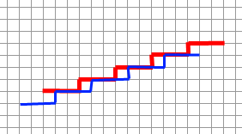
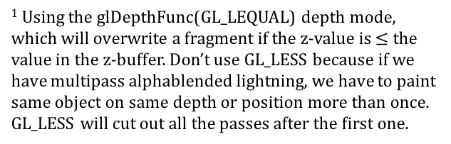
Z-Fighting (2/3)
Eye at origin,
Looking down Z axis
Red in front of blue
Blue, which is drawn after red, ends up in front of red¹
x axis of image (each column is a pixel)
Here the red and blue lines represent cross-sections of the red and blue coplanar polygons from the previous slide
z-value bins

Slide 14

Z-Fighting (3/3)
Examples
http://www.youtube.com/watch?v=UVGdOFVbvBo
/course/cs123/data/scenes/contest/ntom.xml:

