Slide 1
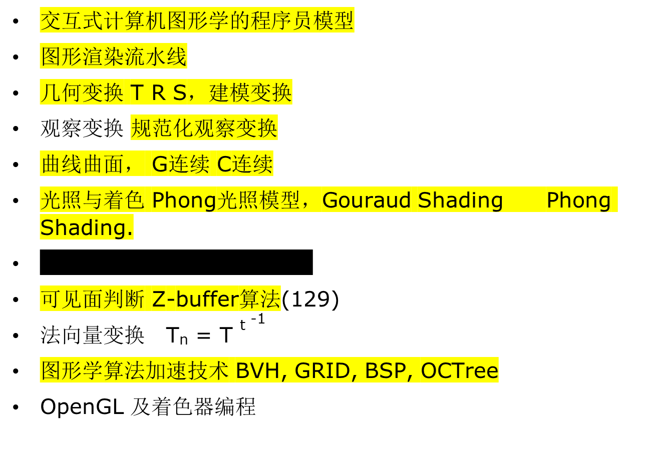
REVIEW

Slide 2
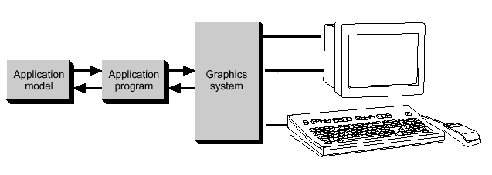
Conceptual Framework for Interactive Graphics
（1）Introduction
Graphics library/package is intermediary between application and display hardware (Graphics System)
Application program maps application objects to views (images) of those objects by calling on graphics library. Application model may contain lots of non-graphical data (e.g., non-geometric object properties)
User interaction results in modification of image and/or model
This hardware and software framework is 5 decades old but is still useful
Software
Hardware
Graphics
Library
Application
program
Graphics
System/
GPU
Application
Model / database

Slide 3
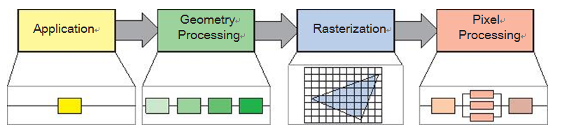
（2）Rendering Pipeline

Slide 4
Rendering Pipeline
Modeling
Transformation
Display
Illumination
Rasterization
Viewing
Transformation
Projection
Clipping

Slide 5
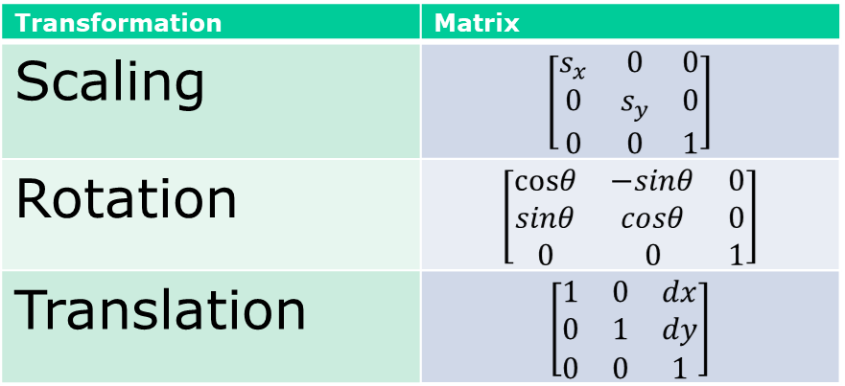
(3) Transformations Homogenized
Translation uses a 3x3 Matrix, but Scaling and Rotation are 2x2 Matrices
Let’s homogenize! Doesn’t affect linearity property of scaling and rotation
Our new transformation matrices look like this…
Note: These 3 transformations are called affine transformations

Slide 6
Transformations T.R.S.
Try to transform the line segments P₁P₂ and P₁P₃ from their start position in (a) to their ending position in (b).
The first solution is to compose the primitive transformations T, R_{x}, R_{y}, and R_{z}. This approach is easier to illustrate and does offer help on building an understanding. The 2nd, more abstract approach is to use the properties of special orthogonal matrices.
y
y
P₃
P₁
P₂
P₃
x
P₁
x
z
z
P₂
(a)
(b)

Slide 7
Composition of 3D Transformations
Breaking a difficult problem into simpler sub-problems:
1.Translate P₁ to the origin.
2. Rotate about the y axis such that P₁P₂ lies in the (y, z) plane.
3. Rotate about the x axis such that P₁P₂ lies on the z axis.
4. Rotate about the z axis such that P₁P₃ lies in the (y, z) plane.
y
y
P₃
P₁
1
P₃
P₂
P₁
P₂
x
x
z
z
2
y
y
y
4
3
P₃
P₃
P₃
P₁
P₂
P₁
P₂
P₁
x
x
x
z
P₂
z
z

Slide 8
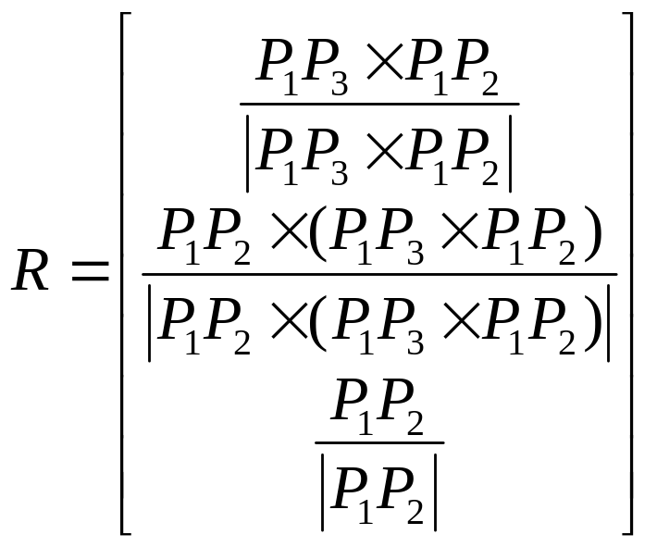
3D Rotation (cont.)
y
And the third direction is decide by the cross product of the other two directions, which is P₁P₂ ×(P₁P₃ ×P₁P₂ ).
Therefore, the rotation matrix should be
v
w
P₃
u
P₂
P₁
x
z
y
v
P₃
u
P₂
P₁
x
z

Slide 9
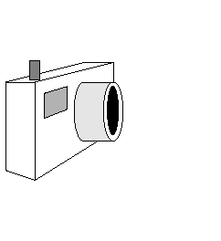
（4）Viewing
We need to know six things about our synthetic camera model in order to take a picture为了拍摄照片，我们需要了解有关合成相机模型的六件事
Position of the camera (from where it’s looking)
The Look vector specifies in what direction the camera is pointing
The camera’s Orientation is determined by the Look vector and the angle through which the camera is rotated about that vector, i.e., the direction of the Up vector
Up vector
Look vector
Position

Slide 10
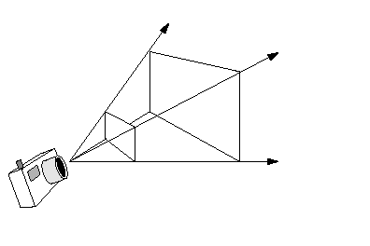
Width angle
Height angle
Front clipping plane
Back clipping plane
Aspect ratio of the electronic “film:” ratio of width to height
Height angle: determines how much of the scene we will fit into our view volume; larger height angles fit more of the scene into the view volume (width angle determined by height angle and aspect ratio)高度角：确定我们将在场景中容纳多少场景；较大的高度角可将更多场景适合视图体积（宽度角由高度角和长宽比确定）
  the greater the angle, the greater the amount of perspective distortion
Front and back clipping planes: limit extent of camera’s view by rendering (parts of) objects lying between them and throwing away everything outside of them
前后裁剪平面：通过渲染位于它们之间的（部分）对象并丢弃其中的所有内容来限制相机的视野范围

Slide 11
View Volume for Orthographic Parallel Projection
Width
Far distance
Height
Look vector
Near distance
Projection of
up vector
Up vector
Position
Limiting view volume useful for eliminating extraneous objects限制视图体积有助于消除多余的物体
Orthographic parallel projection has width and height view angles of zero正投影平行投影的宽度和高度视角为零

Slide 12
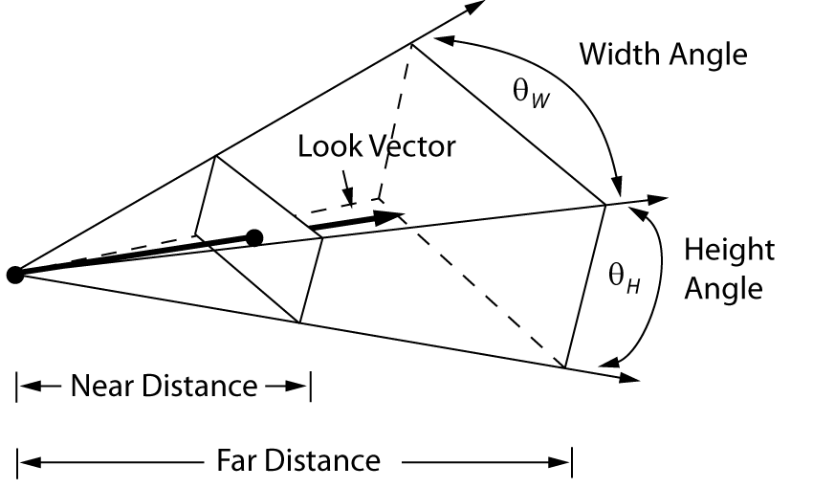
View Volume (Frustum) for Perspective Projection
Projection of
up vector
Removes objects too far from Position, which otherwise would merge into “blobs”移除距离Position太远的对象，否则这些对象将合并为“斑点
Removes objects too close to Position (would be excessively distorted)去除太靠近“位置”的物体（会过度变形）
Up vector
Position

Slide 13
Viewing in Three Dimensions
Mathematics of Projections
  mathematics of planar geometric projections
    how to get from view specification to 2D image?
  deriving 2D image from 3D view parameters is a hard problem
  easier to take a picture from
    canonical view volume (3D parallel projection cuboid)
    canonical view position (camera at the origin, looking down the negative z-axis)
  break into three steps:
    get parameters for view specification (covered in last lecture)
    transform from specified view volume into canonical view volume
    using canonical view, clip, project, and rasterize scene to make 2D image

Slide 14
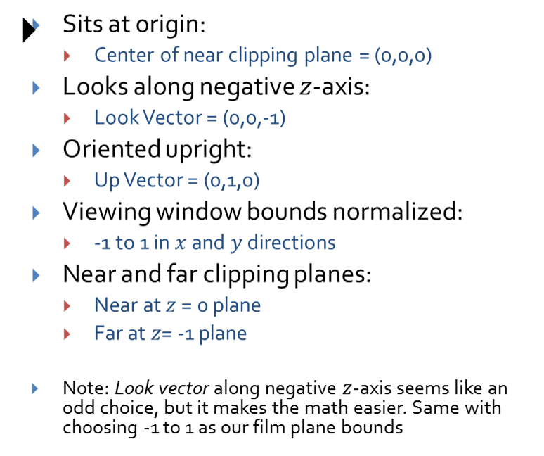
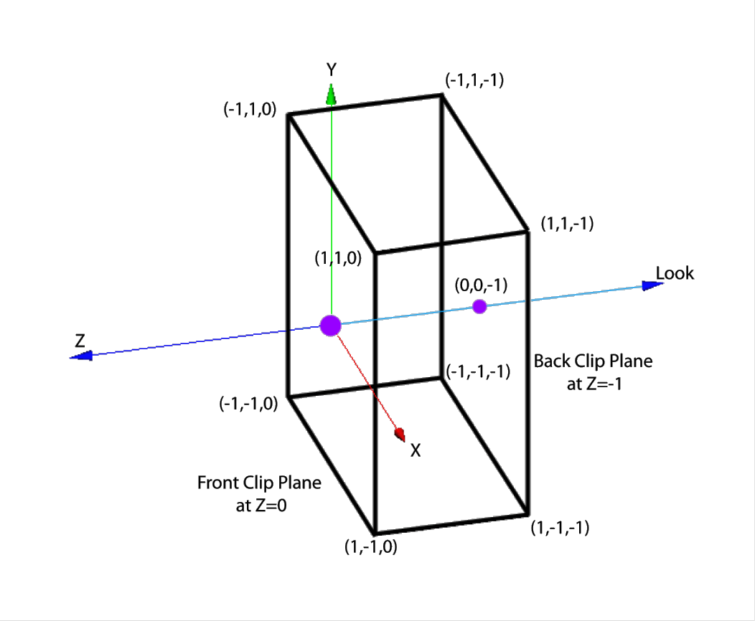
The canonical parallel view volume
Up
z

Slide 15
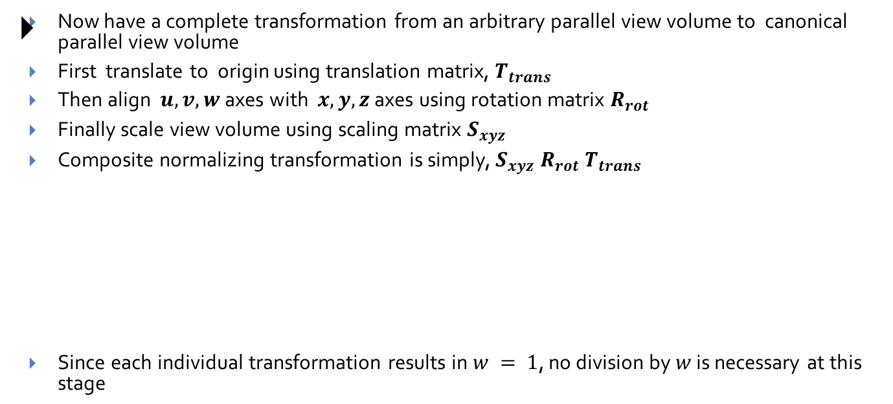
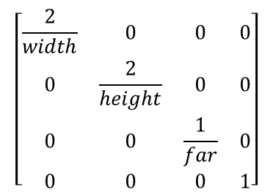
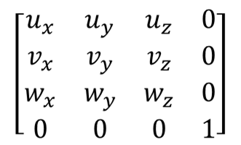
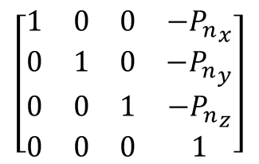
The normalizing transformation (parallel) and re-homogenization

Slide 16
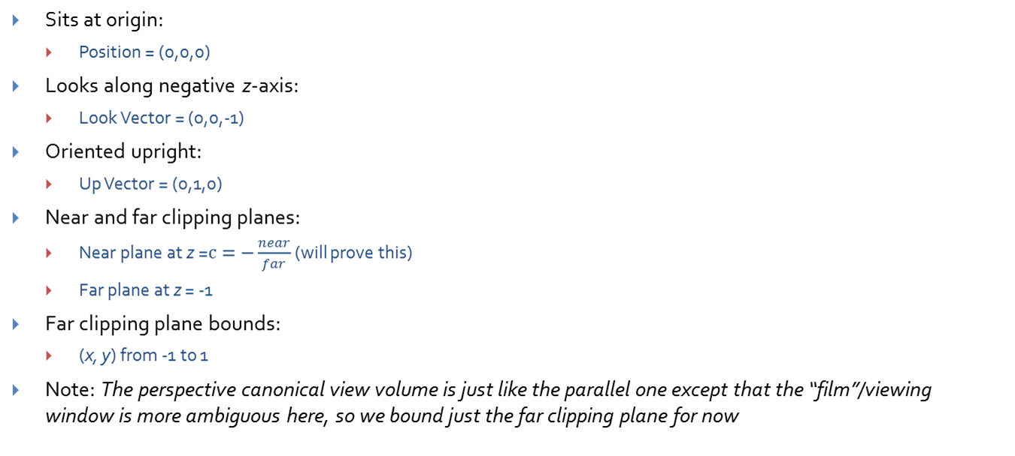




Properties of the canonical view volume
Far clipping plane
(-1,1,-1)
Near clipping plane
(1,-1,-1)

Slide 17
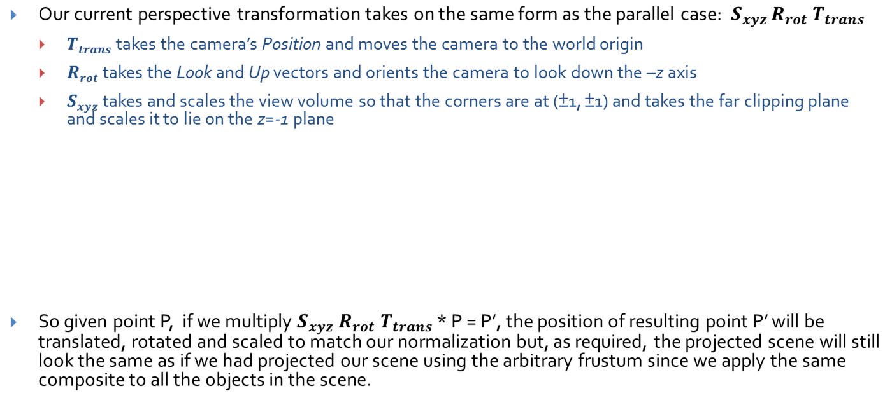
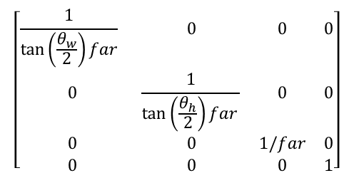
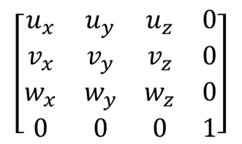
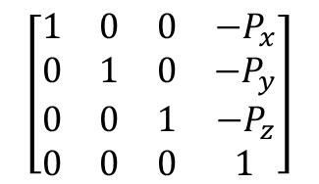
The normalizing transformation (perspective)

Slide 18
(5) Representing Curves and Surfaces

Slide 19
Parametric Curves
Hermite – two endpoints and two endpoint tangent vectors
Bezier - two endpoints and two other points that define the endpoint tangent vectors
Splines – four control points
  C1 and C2 continuity at the join points
  Come close to their control points, but not guaranteed to touch them

Slide 20

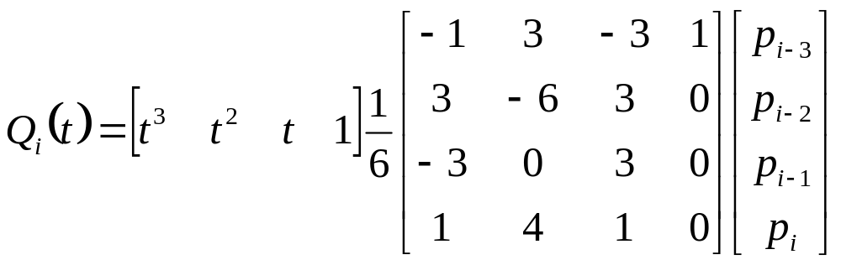
Uniform B-Spline
Points along B-Spline are computed just as with Bezier Curves

Slide 21
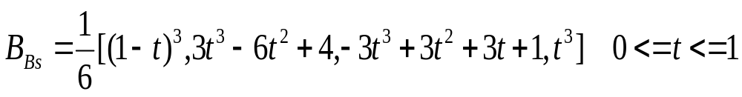
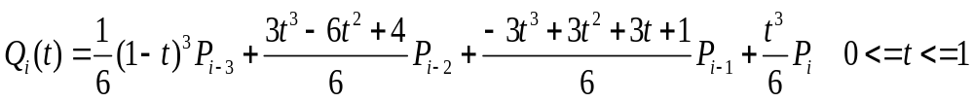
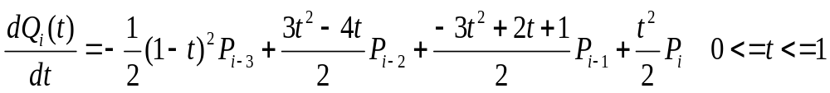
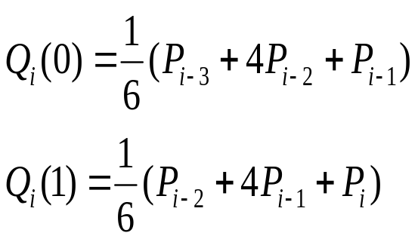
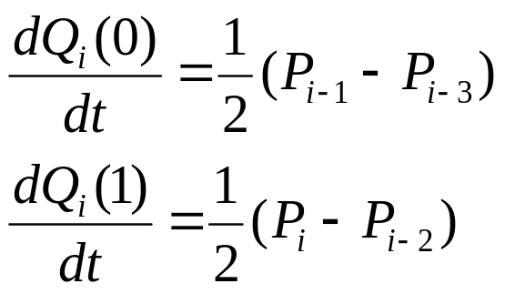
Uniform B-Spline Blending Functions

Slide 22
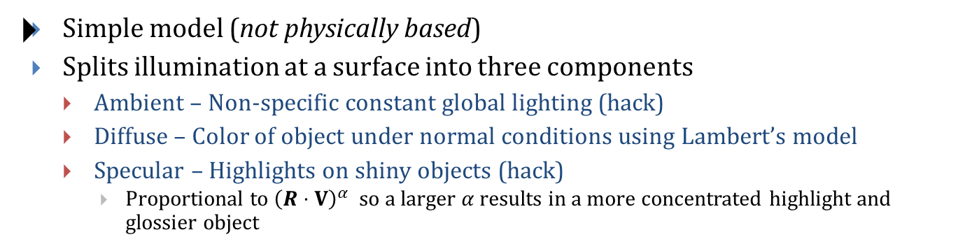
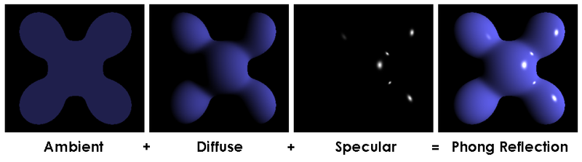
（6）Illumination Models: Phong (1/2) (Review)

Slide 23
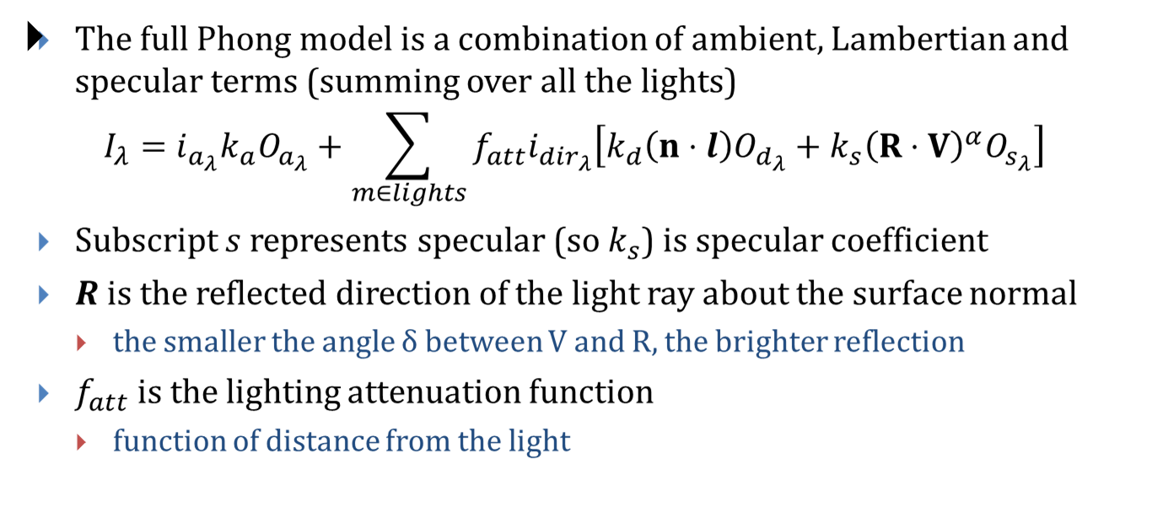
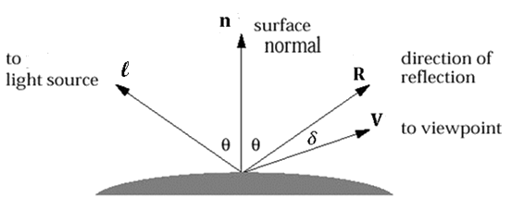
Illumination Models: Phong (2/2) (Review)
  Note: for a directional light, l is simply a directional vector. For a point light, l must be computed from the light’s positions and the surface point.

Slide 24
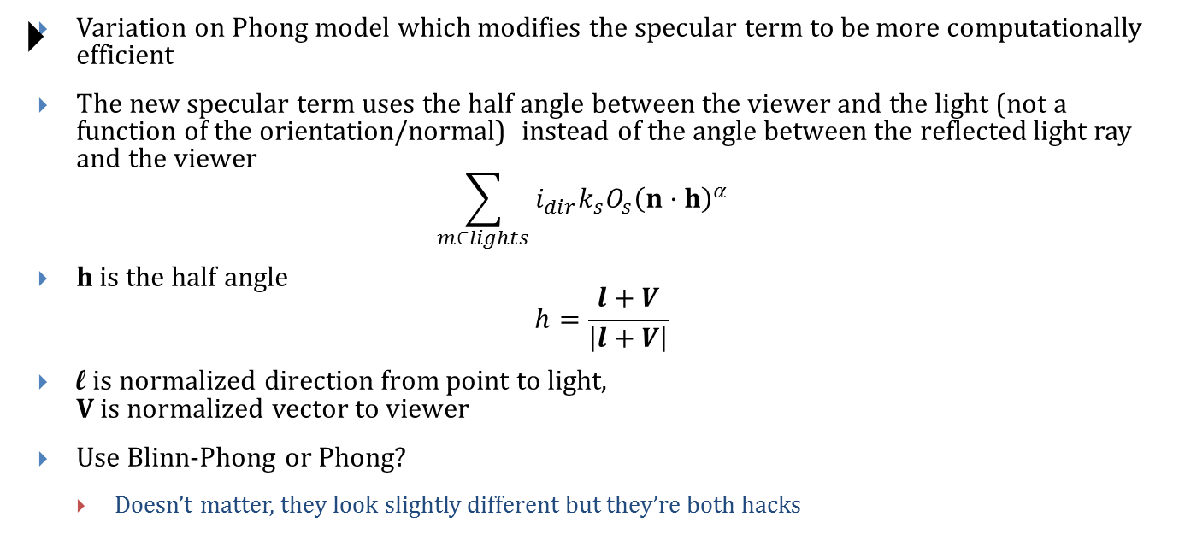
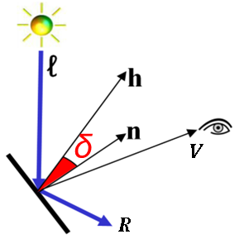
Illumination Models: Blinn-Phong
-

Slide 25
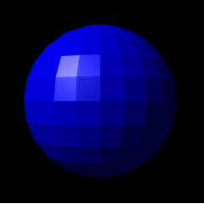
Shading Models – Flat/Constant (Review)
We define a normal at each polygon (not at each vertex)我们在每个多边形（而不是每个顶点）处定义法线
Lighting: Evaluate the lighting equation at the center of each polygon using the associated normal照明：使用关联的法线评估每个多边形中心的照明方程式Shading: Each sample point on the polygon is given the interpolated lighting value at the vertices (i.e., a total hack)多边形上的每个采样点都将在顶点处获得插值照明值（总hack）

Slide 26

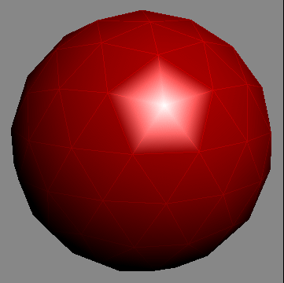
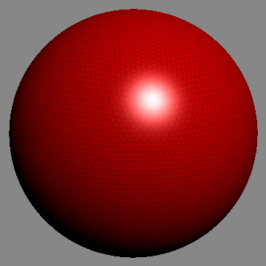
Shading Models – Gouraud (Review)
Define a normal vector at each vertex在每个顶点定义法线向量
Lighting: Evaluate lighting equation at each vertex using associated normal vector照明：使用关联的法向矢量评估每个顶点的照明方程
Shading: Each sample point’s color on polygon is interpolated from color values at polygon’s vertices多边形上每个采样点的颜色都是根据多边形顶点处的颜色值进行插值的
An issue with Gouraud shading is that specular highlights appear to “jump” as the object rotates. Simple fix is to increase polygon count, at cost of much more computation. Gouraud着色的一个问题是，随着对象旋转，镜面反射高光看起来会“跳跃”。简单的解决方法是增加多边形数量，但要花费更多的计算成本。

Slide 27
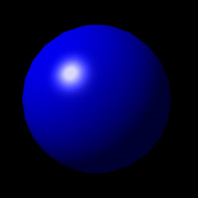
Shading Models – Phong (Review)
Each vertex has an associated normal vector每个顶点都有一个关联的法向矢量
Lighting: Evaluate lighting equation at each vertex using associated normal vector照明：使用关联的法向矢量评估每个顶点的照明方程
Shading: For every sample point on polygon we interpolate normals at vertices of the polygon and compute color using lighting equation with the interpolated normal at each interior pixel – more accurate representation of true surface normal at each point (and we don’t get moving specular highlights)对于多边形上的每个采样点，我们在多边形的顶点处进行法线插值，并使用照明方程式在每个内部像素处使用插值法线来计算颜色-更精确地表示每个点的真实表面法线（并且不会得到移动的镜面高光）

Slide 28
（7）Z-Buffer Algorithm (4/5)
  Requires two “buffers”
    Intensity Buffer
    —our familiar RGB pixel buffer
    —initialized to background color
    Depth (“Z”) Buffer
    —depth of closest object at each pixel
    —initialized to far depth = 255
  Polygons are scan-converted in arbitrary order. When pixels overlap, use Z-buffer to decide which polygon “gets” that pixel

Slide 29
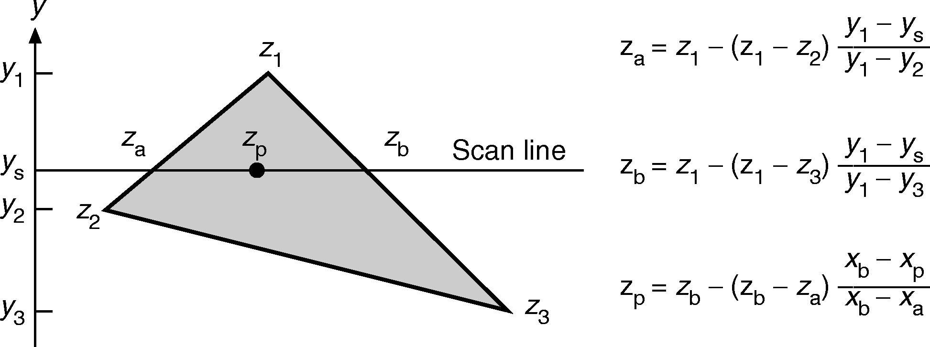
Z-Buffer Algorithm (5/5)
So how do we compute this efficiently?
  Answer is simple: do it incrementally!答案很简单：逐步进行！
  Remember scan conversion/polygon filling? As we move along Y-axis, track x position where each edge intersects scan-line还记得扫描转换/多边形填充吗？当我们沿Y轴移动时，跟踪每个边缘与扫描线相交的x位置
  Do same thing for z coordinate using “remainder” calculations with y-z slope使用y-z斜率的“余数”计算对z坐标执行相同的操作

Slide 30
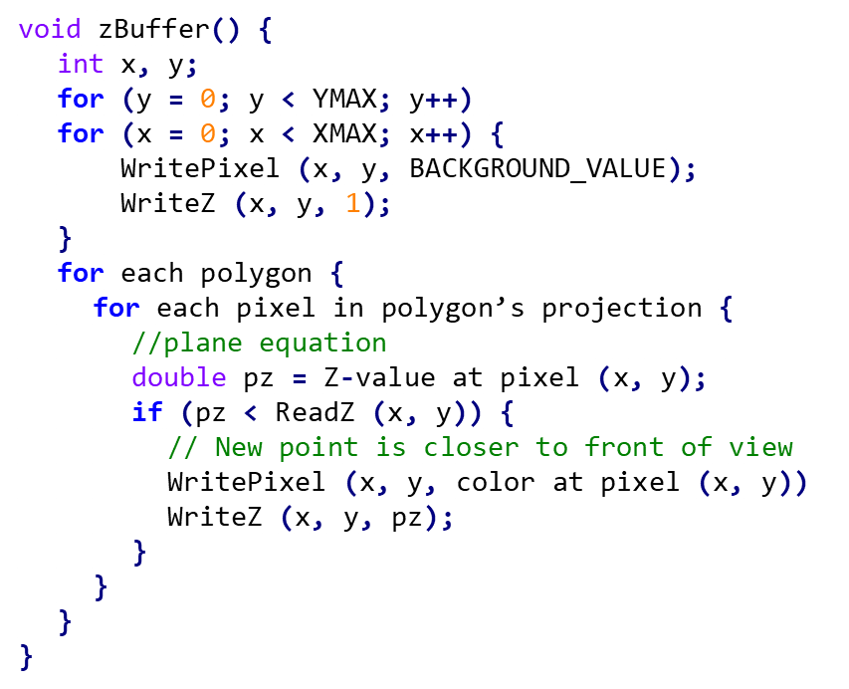
Z-Buffer Algorithm
Draw every polygon that we can’t reject trivially (totally outside view volume)
If we find a piece (one or more pixels) of a polygon that is closer to the front, we paint over whatever was behind it如果我们发现一块多边形（一个或多个像素）更靠近正面，我们会在其后面绘画
Use plane equation for z = f(x, y)
Note: use positive z here [0, 1]
Applet: http://debeissat.nicolas.free.fr/zbuffer.php

Slide 31

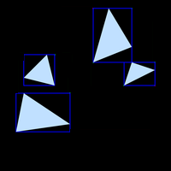
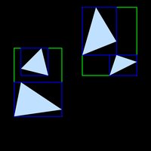


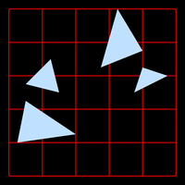
（8）Acceleration Data Structures (1/2)
Bounding Volume Hierarchy
Grids

Slide 32


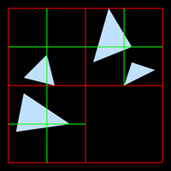


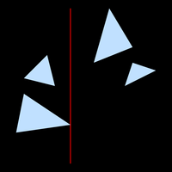


Summary of Acceleration Data Structures (2/2)
Octrees
kd-tree

Slide 33
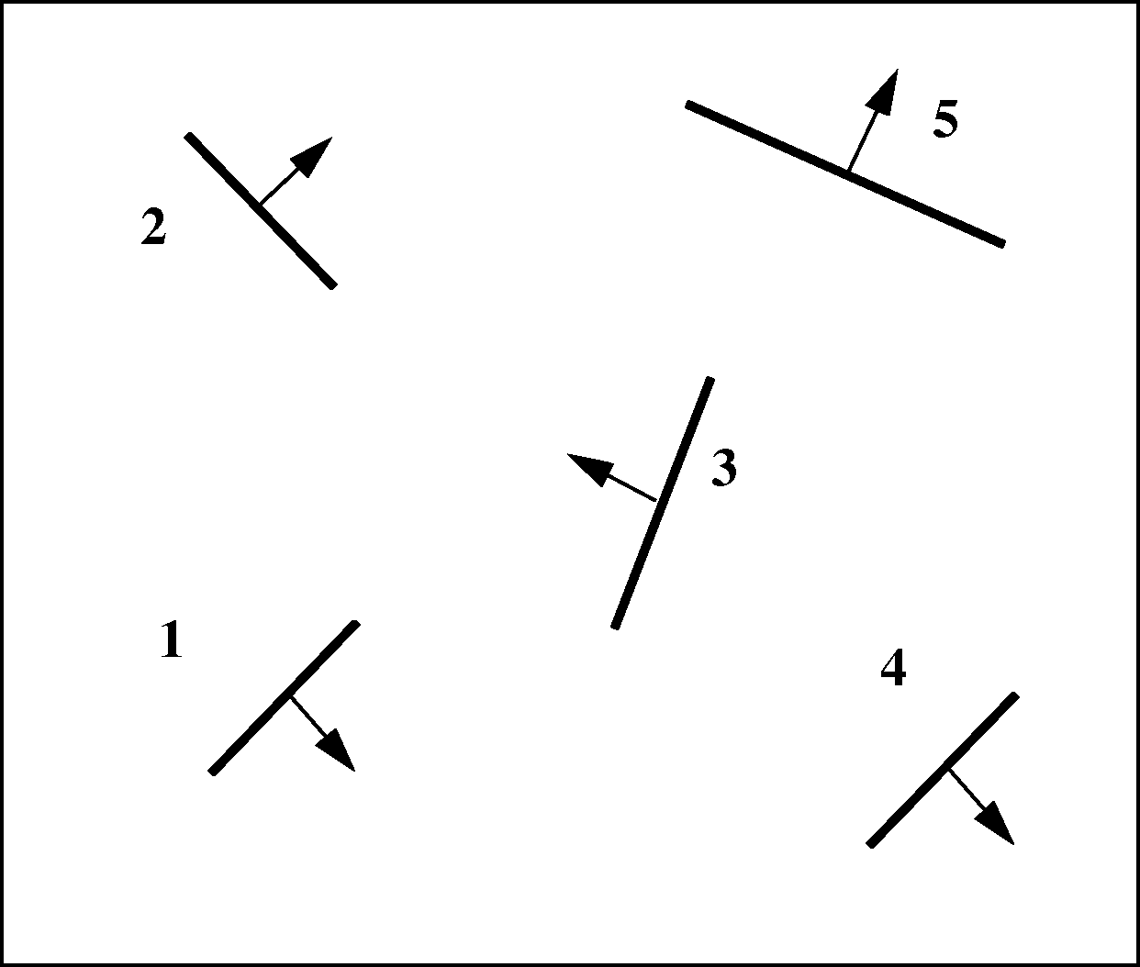
Binary Space Partitioning Trees (BSP)
  Used for polygon Visible Surface Determination (not raytracing)
  Replaces z-buffers in determining order in which objects are drawn first
  替换z缓冲区以确定先绘制对象的顺序
  Construct a binary tree with spatial subdivision用空间细分构造二叉树
    non axis-aligned version of kd-treeKD树的非轴对齐版本
    no cost evaluation; choose split plane arbitrarily没有成本评估；任意选择分割平面
BSP-0:
Initial Scene

Slide 34
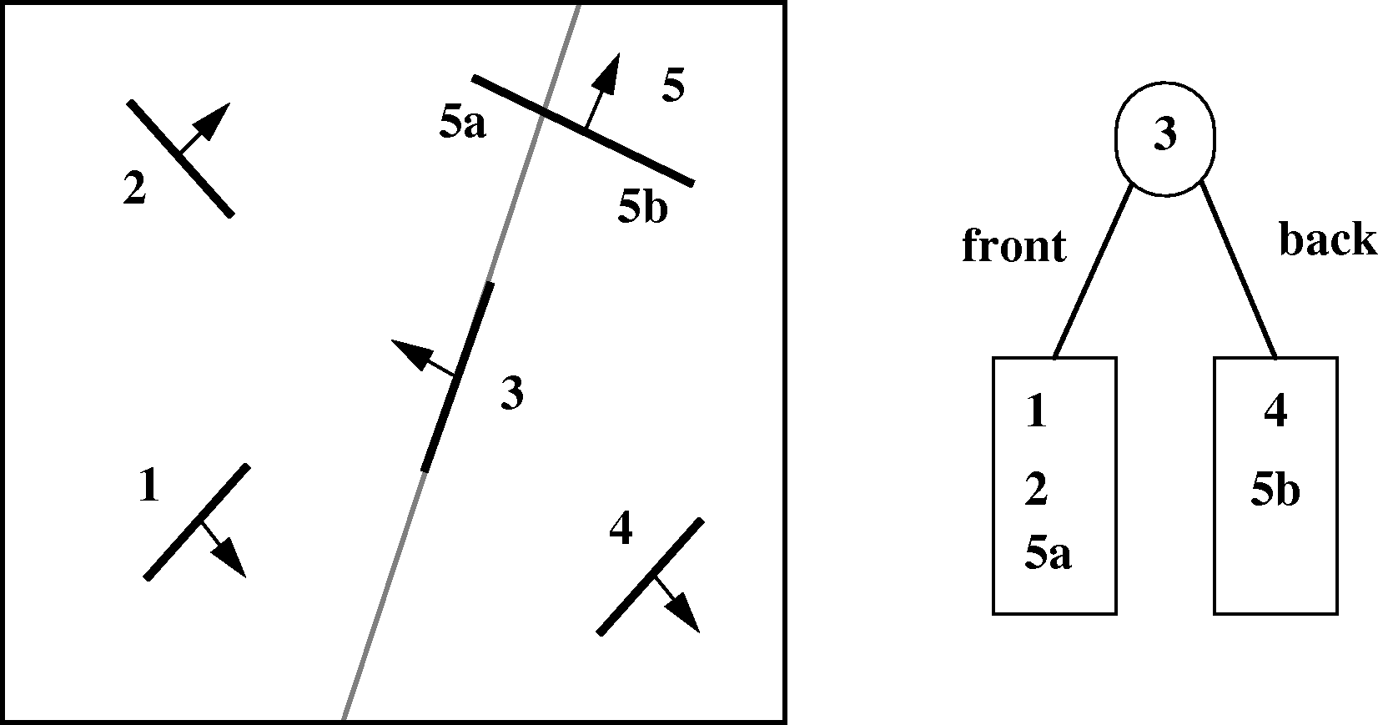
BSP Trees
BSP-1: Choose any polygon (e.g., polygon 3) and subdivide others
by its plane, splitting polygons when necessary

