Slide 1
C# Basics: Strings
An exploration of c# strings

Slide 2
Introduction
Derick Linkous
dl@steadyscience.com

Slide 3
The beloved data type
People love strings (not just developers)
We’ve been creating strings for millennia
Freehand (books, notes, comments, mail)
Some Structure (money, dates, invoice numbers)
More Structure (SSNs, phone numbers, credit cards)
Strong Structure (CSVs, HTTP, serialization, encoding)
Popular, even with developers (JSON, XML, query strings)
C# has you covered!

Slide 4
The defining feature
Strings are variable-length data type
Most other primitives data types are fixed-length
Strings are often large in comparison to other primitives
Strings are reference types; most primitives are value types
The unusual difference: strings are immutable
Efficient, yet convenient and safe; a good middle ground

Slide 5
More on this immutable reference type
Strings can be null
Although type is “variable-length”, fixed-length in memory
Copying a variable/argument creates a copy of reference
Variable itself can be modified, since it is merely a reference
Original string is never changed; copies are made
Variable can be made immutable with “const” keyword

Slide 6

Basic Memory 1
quantityOfApples
100
quantityOfBananas
1_000_000_000
stringQuantityOfApples
(Reference)
“100”
stringQuantityOfBananas
(Reference)
“1_000_000_000”

Slide 7

Basic Memory 2
quantityOfApples
100
quantity
100
stringQuantityOfApples
(Reference)
“100”
stringQuantity
(Reference)

Slide 8


Basic Memory 3
quantityOfApples
100
quantityOfApples
107
stringQuantityOfApples
(Reference)
“100”
“1007”

Slide 9
Checkpoint - Mental Model - 3 assumptions
Strings are “large”
“Modifying” a string is “expensive”
Passing strings around is “cheap” and “safe”

Slide 10
A few random notes
The types “String” and “string” are the same
“string” is a language keyword that points to “String”
“string” is recommended
Strings are stored in DLLs
Default arguments and constants stored in caller DLL
Be careful when deploying DLLs independently
This applies to more than just strings

Slide 11
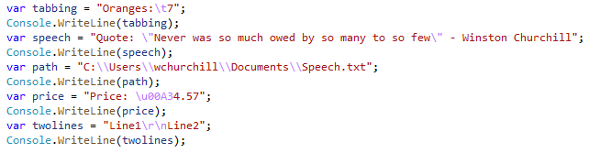

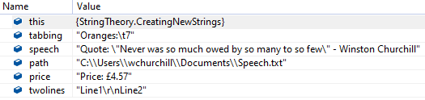
The Backslash

Slide 12



What’s in a new line?

Slide 13


Escape from verbatim

Slide 14


Open to interpolation

Slide 15


Open to interpolation

Slide 16

Open to interpolation

Slide 17
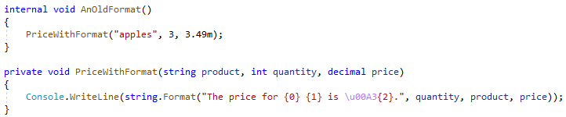
An old format

Slide 18
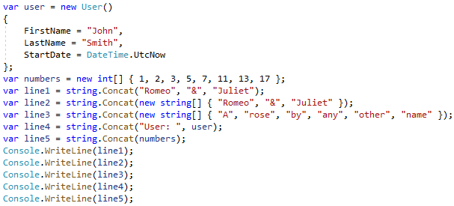

String dot …
Spaces?
What’s up with that User?

Slide 19
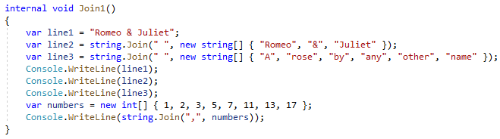

String dot …

Slide 20

String dot …

Slide 21
String dot …
What about that User?
We’ll come back to that later

Slide 22

An array of characters

Slide 23

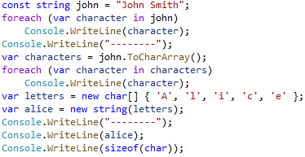
An array of characters

Slide 24
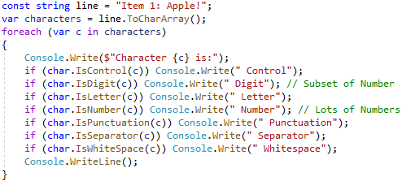
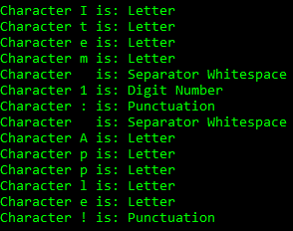
Character assessment

Slide 25
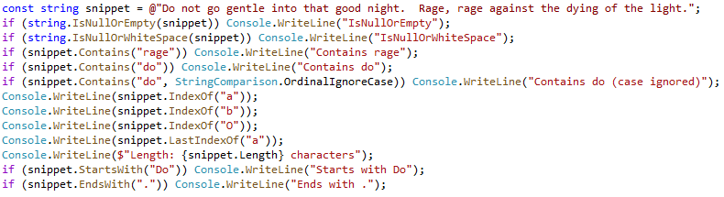
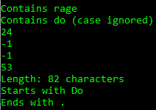
String dot …

Slide 26
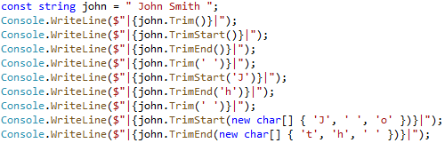
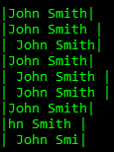
String dot …

Slide 27


String dot …

Slide 28


String dot …

Slide 29


String dot …

Slide 30
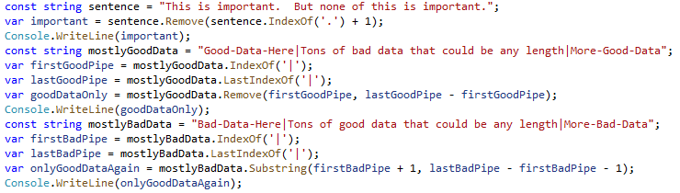

String dot …

Slide 31

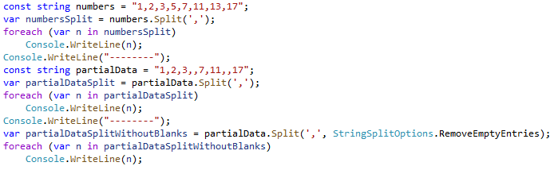
String dot …

Slide 32


Looping
10,000 – 47ms
10,000 – 1ms
20,000 – 226ms
20,000 – 1ms
30,000 – 574ms
30,000 – 2ms
40,000 – 1,186ms
40,000 – 2ms
50,000 – 1,963ms
50,000 – 3ms
100,000 – 10,349ms
100,000 – 6ms
200,000 – 58,640ms
200,000 – 11ms

Slide 33
Looping
“0”
“0”
“01”
“1”
“012”
“2”
“0123”
“3”
“01234”
“4”
“012345”
“5”
“0123456”
“6”
“01234567”
“7”
“012345678”
“8”

Slide 34
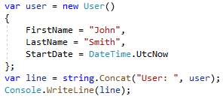
To string
What about that User?

Slide 35
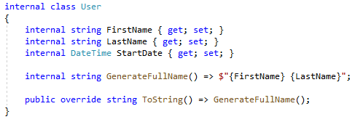
To string

Slide 36
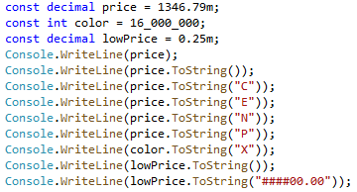
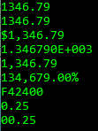
To string

Slide 37
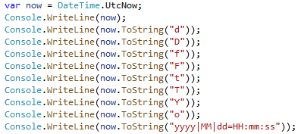
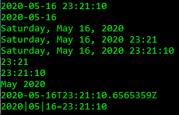
To string

Slide 38
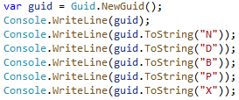
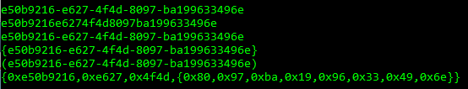
To string

Slide 39
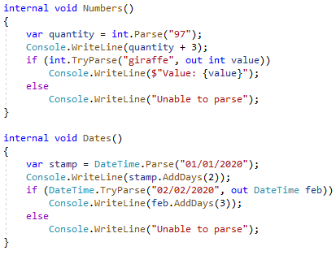

From string

Slide 40
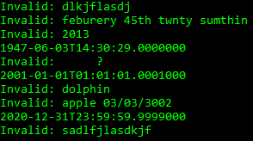
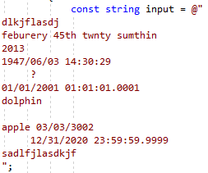
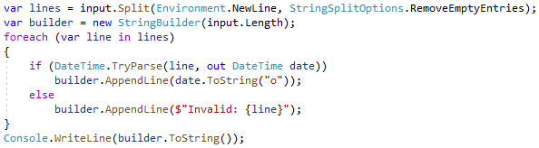
Multiline Example

Slide 41
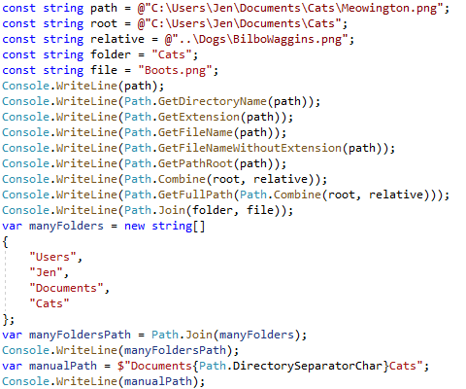
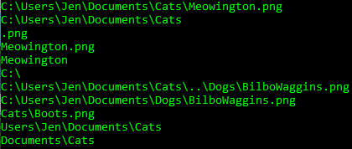
Pathing

Slide 42


HTML

Slide 43
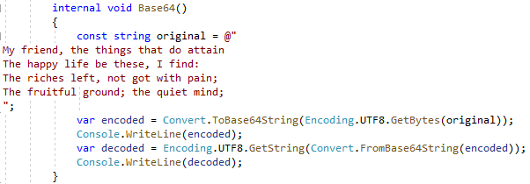
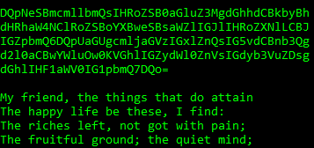
Base64

Slide 44
Widget identification
Widgets have custom human-readable identifiers
Composed of:
Lot Number
Quality Assurance Approval Date
Quality Assurance Approver Code
Quality Assurance Sequence Number
Format is: AAAA-BBBBBBBB-CCCC-D
Lot numbers are always 4 digits, numeric
Approval dates are like 20200527 (y, m, d)

Slide 45
Widget identification
Approver codes are alpha-numeric, always uppercase
Sequence numbers are 1 or higher
Widgets generally approved in batches
Often vary only by sequence number
Project already has lots and approvers
Lots are integers, and approvers are strings
Must be able to create widget labels from component parts
Must be able to retrieve parts from widget labels
We want some validation to prevent bugs

Slide 46
Widget identification
It can be tempting to bury this logic in other logic
The specification is already quite complex
The widget identifier is a real domain concept
The widget identifier is a noun
The widget identifier should be a class all by itself

Slide 47
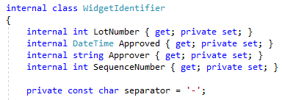
Widget identification
Format is: AAAA-BBBBBBBB-CCCC-D

Slide 48
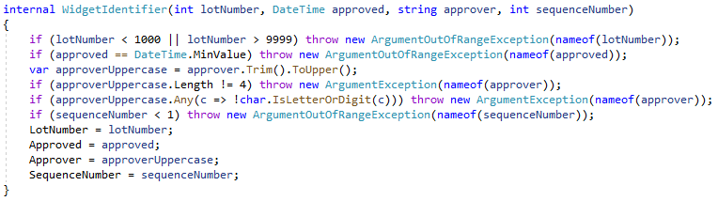
Widget identification

Slide 49
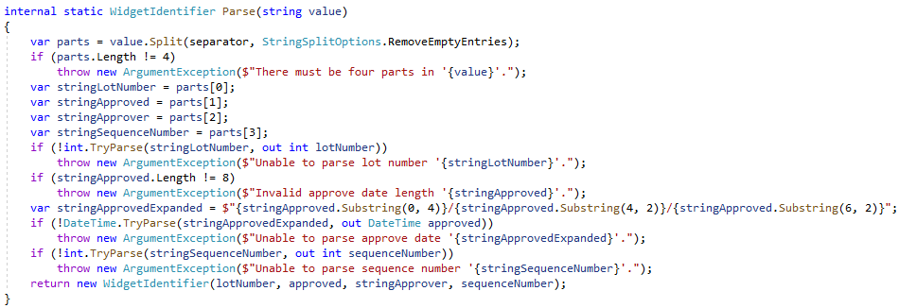
Widget identification

Slide 50
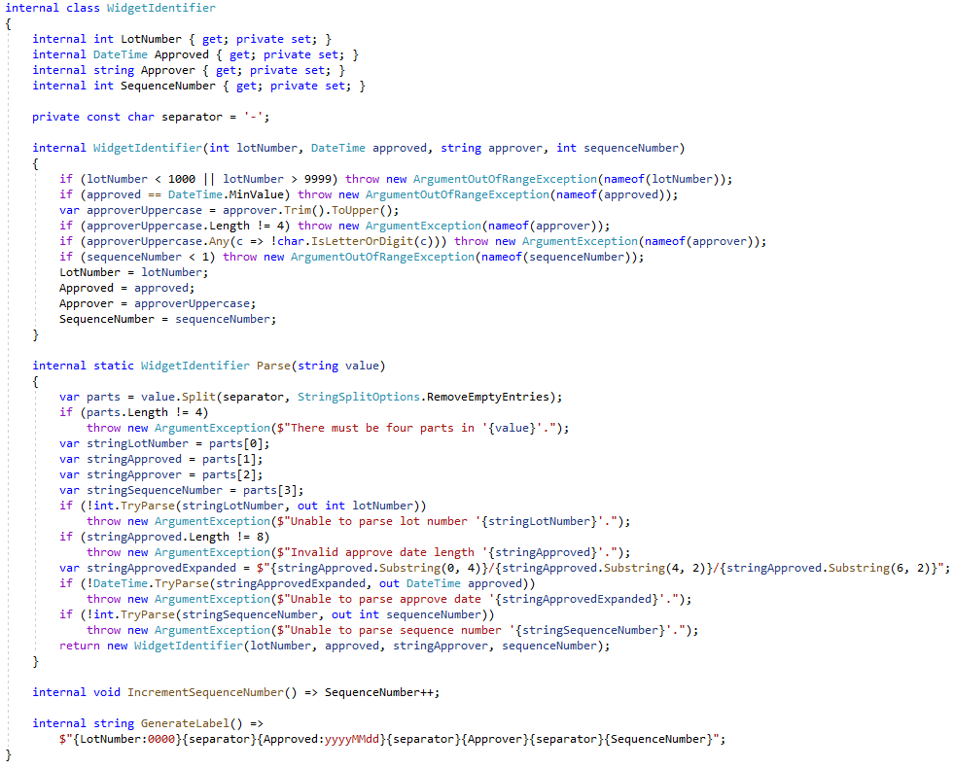

Slide 51
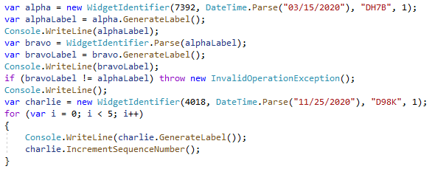
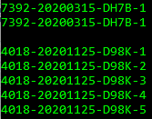
Widget identification

Slide 52
Summary
Strings are immutable reference types…
With value-type semantics
Strings are effectively an array of chars
New strings are being created often
Old strings are being garbage-collected often
Basic mental model:
Strings are “large”
“Modifying” a string is “expensive”
Passing strings around is “cheap” and “safe”

Slide 53
Summary
Backslash is the normal escape character
In verbatim strings ( @ ), use double-quotes
String interpolation is powerful and easy to read
The string class has useful static methods (IsNullOrWhitespace)
String instances have useful instance methods (Trim)
Everything has a ToString method
Many built-in ToString methods have useful formatting
Splitting and joining strings is very common
Use StringBuilder to build strings when looping

Slide 54
Summary
Many built-in types have Parse and TryParse
Use built-in methods for common functionality
File system paths
HTML
Encoding/Decoding
Serializing/Deserializing
When your project needs to create and parse strings,
create real classes to do this work, bundling both “directions”
together in one place: the class

Slide 55
Further reading
Strings may actually be mutable under the hood
The compiler is smart; it may render better solutions
For complex parsing, maybe regular expressions will work
Look in System.Text.RegularExpressions
Strings in C# are UTF-16, but what about other encodings?
Many built-in classes automatically convert intelligently
Peruse System.Text for encoding functionality
High-performance JSON is now available
Found in System.Text.Json

Slide 56
Info
Derick Linkous
dl@steadyscience.com

