Slide 1
AI Data Analytics Mini Project 1 Exploratory Data Analysis (EDA) Group 3, Member: Yam Ching Long

Slide 2
Title
Video Game Sales (1980 – 2024) Analysis
Objectives
Identify key factors which influence sales performance (e.g. platform, genre, region)
Provide sales strategy for game publishers and developers

Slide 3
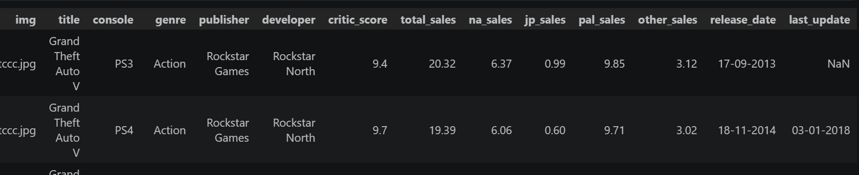
Dataset
A collection of 64,000+ video games across >40 years of gaming history
Contains 14 features

Slide 4
Dataset Characteristics
Variable Name | Description | Variable Type | Category | Data Type
img | URL for game cover | Qualitative | Nominal | Object
title | Game title | Qualitative | Nominal | Object
console | Platform that the game was released on | Qualitative | Nominal | Object
genre | Genre of the game | Qualitative | Nominal | Object
publisher | Publisher of the game | Qualitative | Nominal | Object
developer | Developer of the game | Qualitative | Nominal | Object
critic_score | Metacritic score (out of 10) | Quantitative | Continuous | Float64
total_sales | Global sales of copies in millions | Quantitative | Continuous | Float64
na_sales | North American sales of copies in millions | Quantitative | Continuous | Float64
jp_sales | Japanese sales of copies in millions | Quantitative | Continuous | Float64
pal_sales | European & African sales of copies in millions | Quantitative | Continuous | Float64
other_sales | Other regional sales of copies in millions | Quantitative | Continuous | Float64
release_date | Date that the game was released on | Temporal | N/A | Object
last_update | Date that the data was last updated | Temporal | N/A | Object

Slide 5

Data Preprocessing
Check the dimension of the dataset
Drop “img” and “last_update” (irrelevant)
In “developer”, fill the missing values with “Unknown” (retain valuable data)

Slide 6
Data Preprocessing
In “critic_score”, fill the missing values with KNN Imputation
Find the most similar K neighbors by calculating the distance between data
Fill the missing values by mean or median
of the neighbors
Here K=5

Slide 7
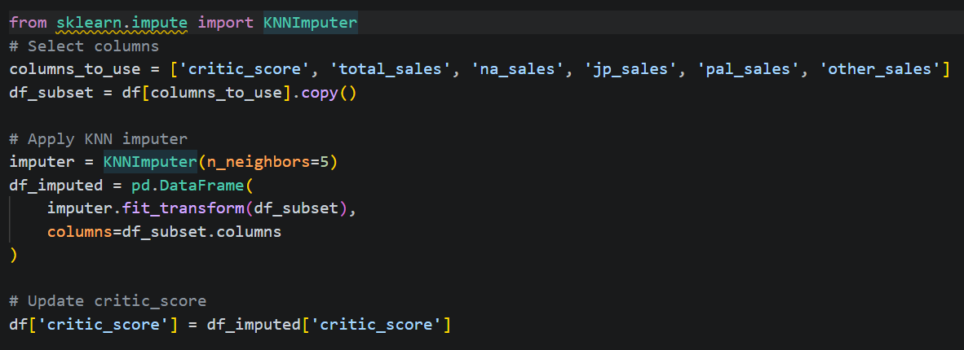

Slide 8
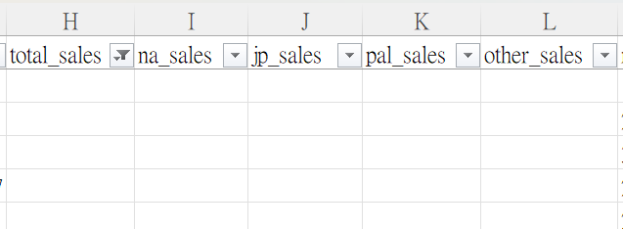
Data Preprocessing
In “total_sales”, delete the rows with value 0 and with missing values
0: impossible
Missing values: also have missing values in regional sales -> delete directly

Slide 9
Data Preprocessing
In “na_sales”, “jp_sales”, “pal_sales” and “other_sales”, fill the missing values with 0
Regional sales can be 0 (Not released in that region or prohibited from selling)
In “other_sales”, delete erroneous input (date)

Slide 10
Data Preprocessing
In ‘release_date’, drop the rows with missing values (date cannot be estimated)
Only year is extracted (month and day are not important)

Slide 11
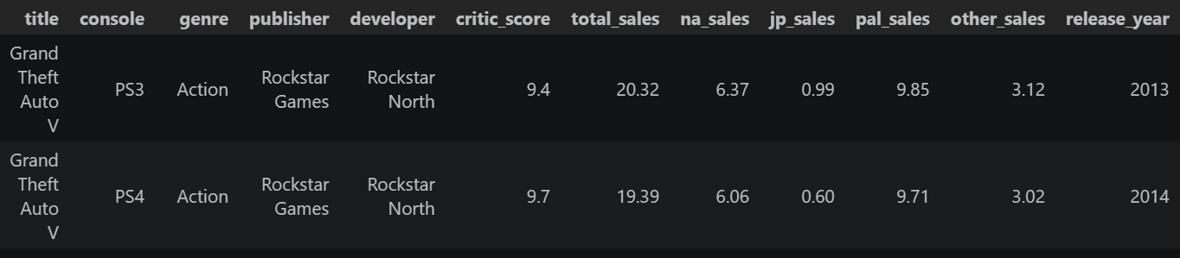

Data cleansing is completed!
Dimension:

Slide 12
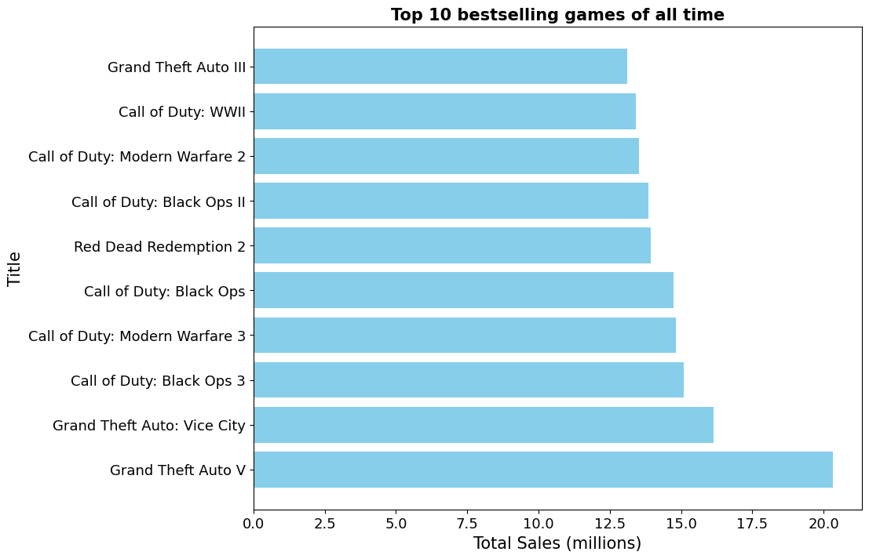
We first take a look at the top 10 bestselling games…
Dominated by GTA,
COD, RDR Franchise

Slide 13
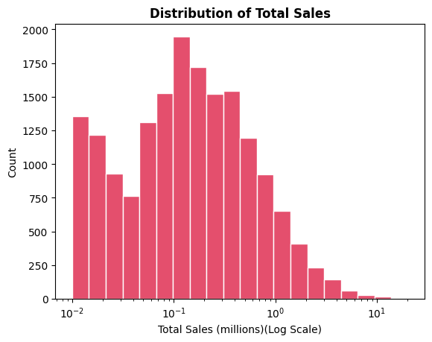
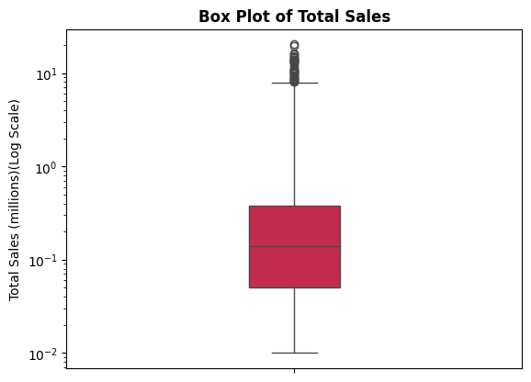
Univariate Analysis
Distribution of total sales (Histogram + Box plot)
Log scale is applied to total sales for clearer visualization

Slide 14
Observations and insights
Right-skewed distribution
Many outliers
Most games have modest sales
Top sales are dominated by few games
like GTA, COD and FIFA
Major publishers should continue these IPs
rather than developing a new one to
mitigate financial risk

Slide 15
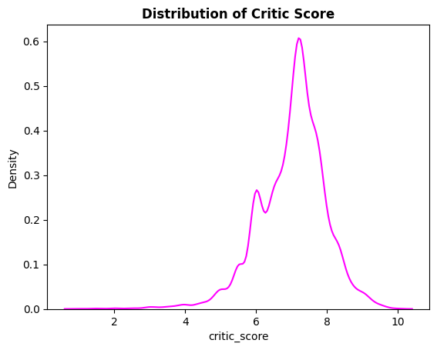
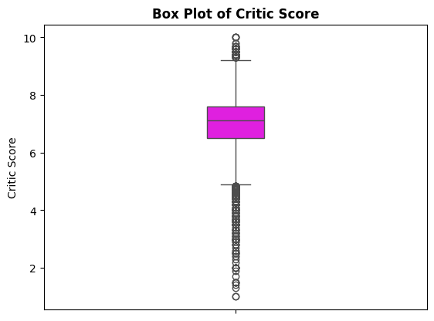
Univariate Analysis
Distribution of critic score (KDE plot + Box plot)

Slide 16
Observations and insights
Left-skewed distribution
Median ~ 7, mode ~ 6.7
Bilateral outliers
Scores are extreme
Industry standard of 7 should be achieved by developers to avoid negative perception

Slide 17
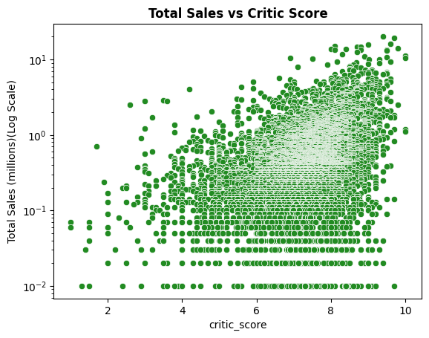

Bivariate Analysis
Total sales vs critic score (Scatter plot)
Question: Must higher critic score indicate better sales?
Correlation coefficient r
=

Slide 18
Observations and insights
r = 0.337, a positive but weak relationship
Score alone is not an ultimate predictor of sales
Within score of 5 – 9, sales have significant variance
Sales is affected by external factors like marketing spend, brand loyalty and release timing
Below score of 3, there are rarely “breakout hits”
Moderate to high scores is not a guarantee of success, but a prerequisite of it

Slide 19
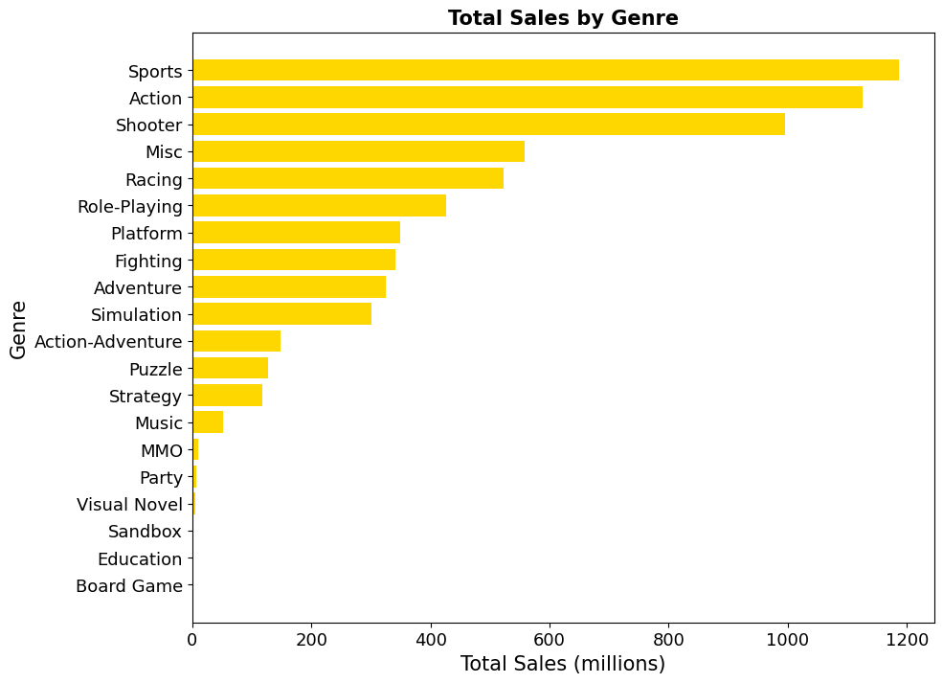
Bivariate Analysis
Gamers’ preference by genre (horizontal bar chart)

Slide 20
Observations and insights
Top 3 genres: Sports, Action and Shooter
Developers should prioritize these genres to maximize profits
Lower-budget genres like Simulation, Puzzle and Visual Novel have relatively lower sales
Genre is a more critical factor of success than score
Mediocre Action >> High-quality Visual Novel in terms of sales

Slide 21
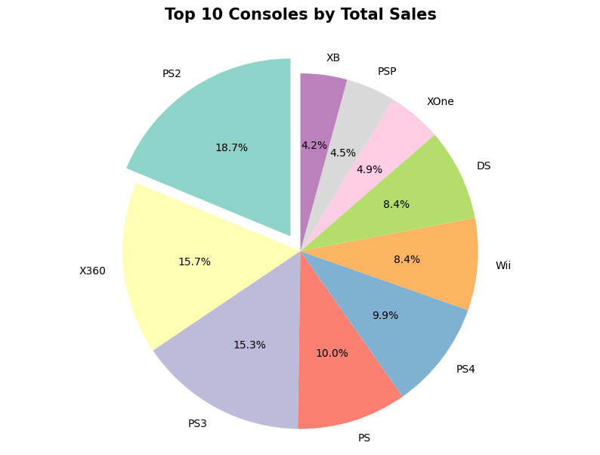
Bivariate Analysis
Market share by consoles (pie chart)

Slide 22
Observations and insights
Sony has the largest console market in history (PS2+PS3+PS+PS4+PSP)
“Generation carry-over”
Xbox360 and PS3 have nearly the same market share
Success of Microsoft is driven by Xbox Live online
Publishers should avoid platform exclusivity
Many PlayStation-exclusive games port to PC few years later
Handheld markets cannot be neglected
Former handheld developers should now target mobile market

Slide 23
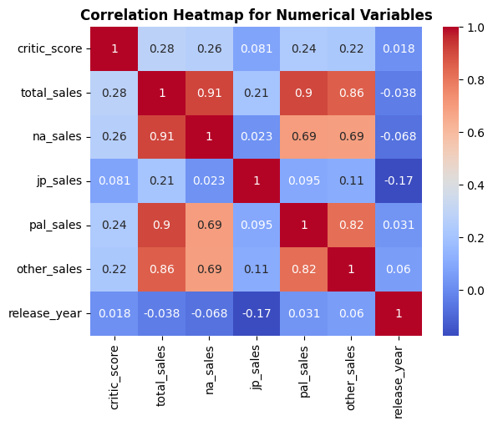
Multivariate Analysis
Correlation heatmap (critic score, total sales, regional sales, release year)

Slide 24
Observations and insights
Global sales has high correlation with North American sales (0.91), European sales (0.9) and sales in other regions (0.86), except for Japanese sales (0.21)
Japan is a distinct and independent market
Cultural adaptation for Japanese market (Special character design, themes)
Pre-order sales in NA used as an indicator for marketing spend in Western countries
Developers should invest heavily on graphic and storytelling if they want to target Western markets

Slide 25
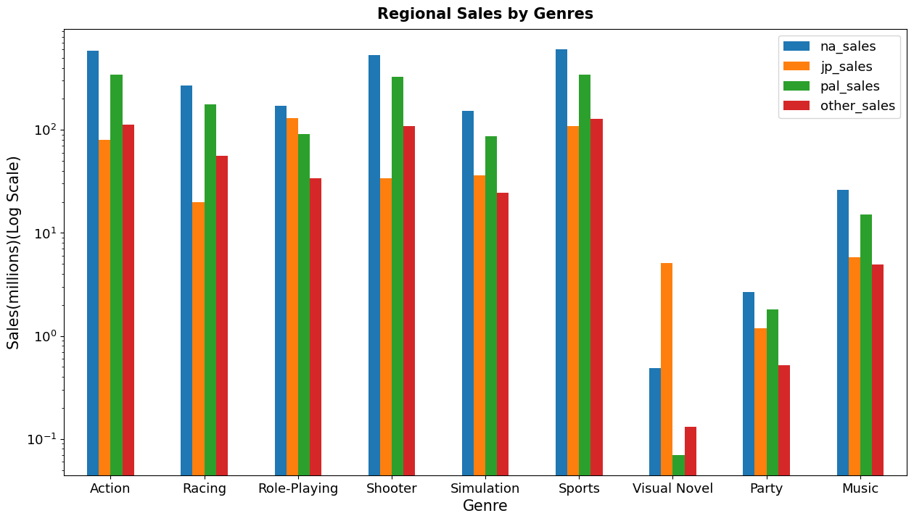
Multivariate Analysis
Regional sales by genres (bar chart)

Slide 26
Observations and insights
Action, Shooter and Sports games perform well globally except for Japan
Publishers of these games should prioritize digital distribution in Japan to reduce cost
Japan has unique preference for RPG and Visual Novel games
Entry point for indie developers due to low cost

Slide 27
Challenges
“One Man Army”
Coding, report and presentation all by myself
Handling missing values and zeros
Remove them all would remain ~1700 rows (not enough and not accurate)
Handle each column one by one
Handling outliers
“total_sales”: values between 0.01 and 20
Plotting “total_sales” results in poor visualization
Apply logarithm to “total_sales” for clearer visualization

Slide 28
Limitations of the dataset
Dataset contains digital sales? (Steam, Epic, PS Store)
If not, sales number is greatly underestimated
Dataset does not include cancelled games
Future improvement
Compare pre-release data (no. of likes from social media, trailer view counts in YouTube, Steam “Wishlist”) with final sales
Are these data a better predictor of sales than critic score?
How subscription service (Xbox Game Pass, PS Plus, EA Play) affects the sales of a game?
Popularity reflected by total sales or no. of downloads in subscription service?

Slide 29
Ideas that were not implemented and the reasons
Principal Component Analysis (PCA)
Find the principal components that represent variables of similar attributes
Reduce the number of variables for easy analysis
Complicated and time-consuming
Random Forest
Consists of many decision trees
Each decision tree contains criteria used to predict the results
Might be more accurate than KNN Imputation
Time Series Forecast
Could be used to predict future sales
Not implemented because it is not accurate to predict future sales using past data

Slide 30
Summary and key insights
Franchise Continuity: continue current IPs instead of developing a new one
Quality Standard: achieve a minimum of score 7 to sell millions of copies
Genre-First Development: target popular genres rather than niche genres
Cross-Platform Strategy: multi-platform releases rather than platform-exclusive
Mobile Market: former handheld developers should now target mobile market
Localization of Japanese Market: special character designs and add RPG elements to penetrate Japanese market
Subscription Service: small studios should join subscription service to enhance sales and exposure

Slide 31
Reference
Divekar, B. (2024). Video Game Sales and Industry Data (1980-2024) [Data set]. Kaggle. https://www.kaggle.com/datasets/bhushandivekar/video-game-sales-and-industry-data-1980-2024

Slide 32
The End

