Slide 1


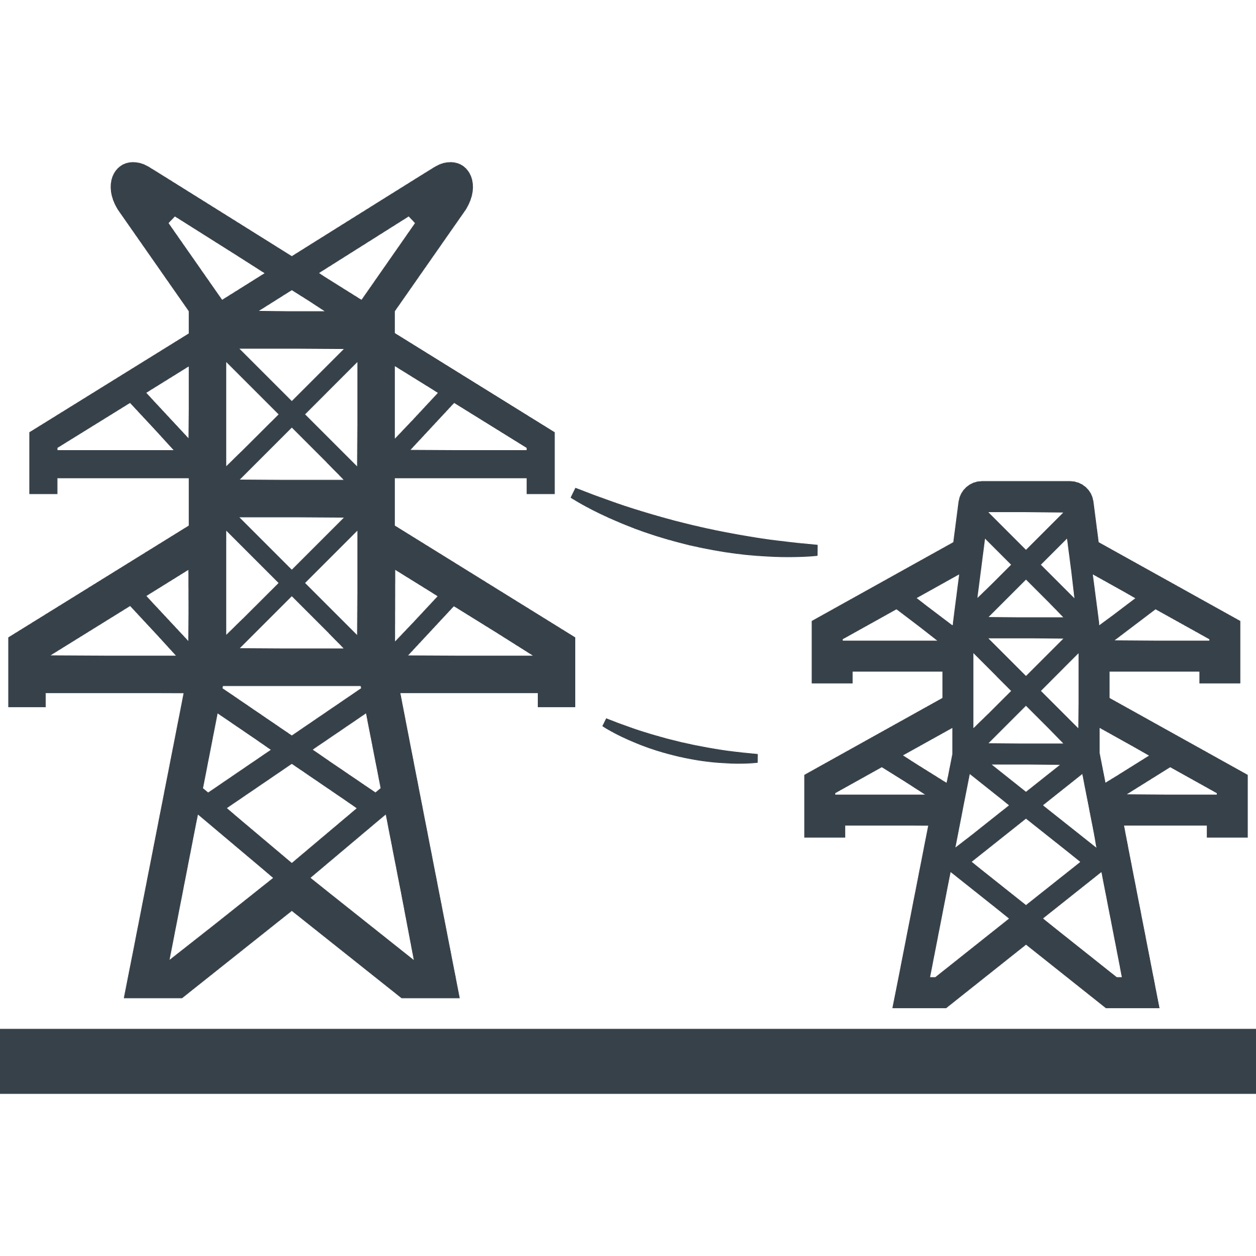



Area A
Area B
Tie line
between areas A and B
Tie line
between areas A and C
Tie line
between areas B and C
Area C

Slide 2
Target period (delivery date )
N-1 day
N day
N+1 day
0
6
12
18
0
6
12
18
0
6
12
18
0
N day
day-ahead scheduling
Optimization target period
PV/WF
Actual value of PV/WF output
Forecasted output
Margin of tie line
Fixed to defined value
Tertiary reserve
Ensure required value
Variable values are inherited
from the previous optimization
N day
intra-day scheduling
Fix variables
Optimization target period
Fix UC for large-scale power generation
PV/WF
Actual value of PV/WF output
Margin of tie line
Fixed to zero
Tertiary reserve
Use as reserve
Variable values are inherited
from the previous optimization
N+1 day
day-ahead scheduling
Fix variables
Optimization target period
Fix UC for large-scale power generation
PV/WF
Actual value of PV/WF output
Forecasted output
Margin of tie line
Fixed to zero
Tertiary reserve
Use as reserve

