Slide 1
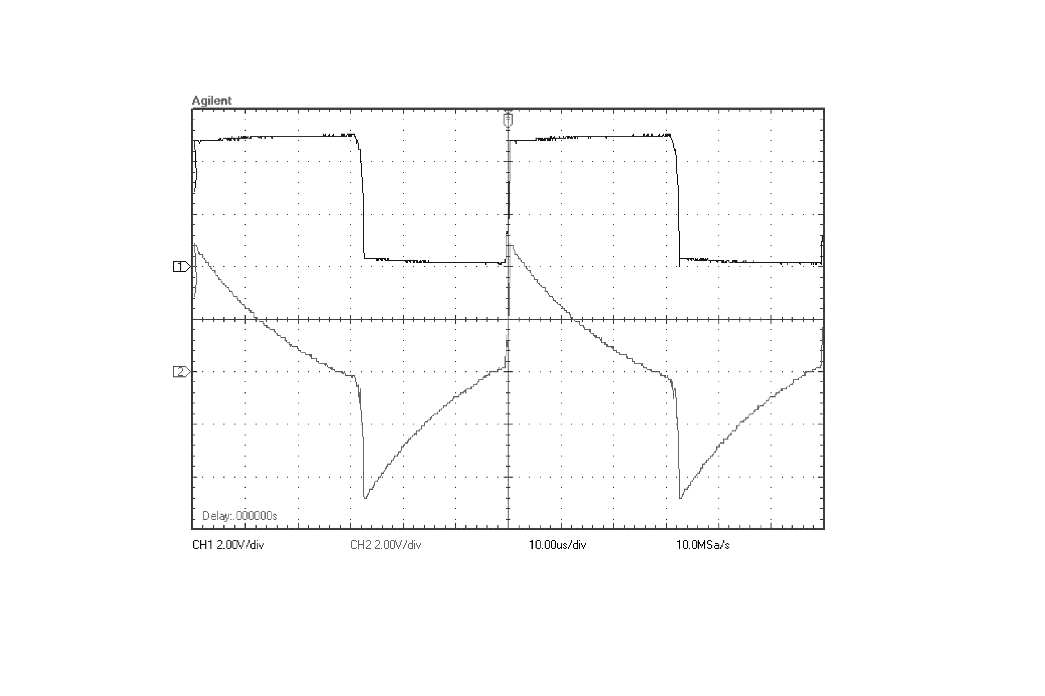
10[μs/div]
2[V/div]
V_{out}
V_{a}

Slide 2
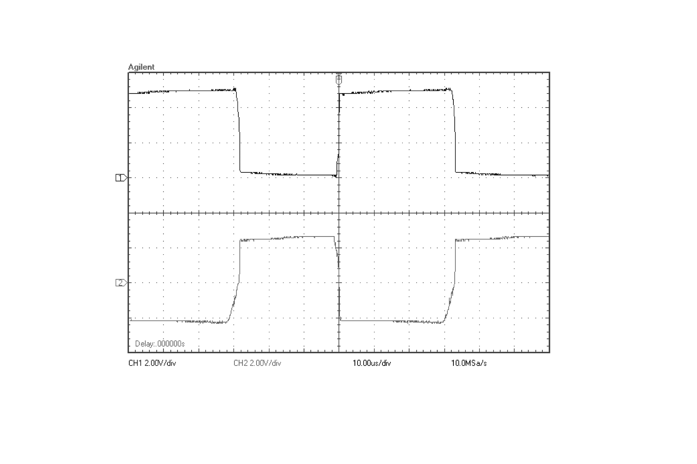
10[μs/div]
2[V/div]
V_{out}
V_{b}

Slide 3
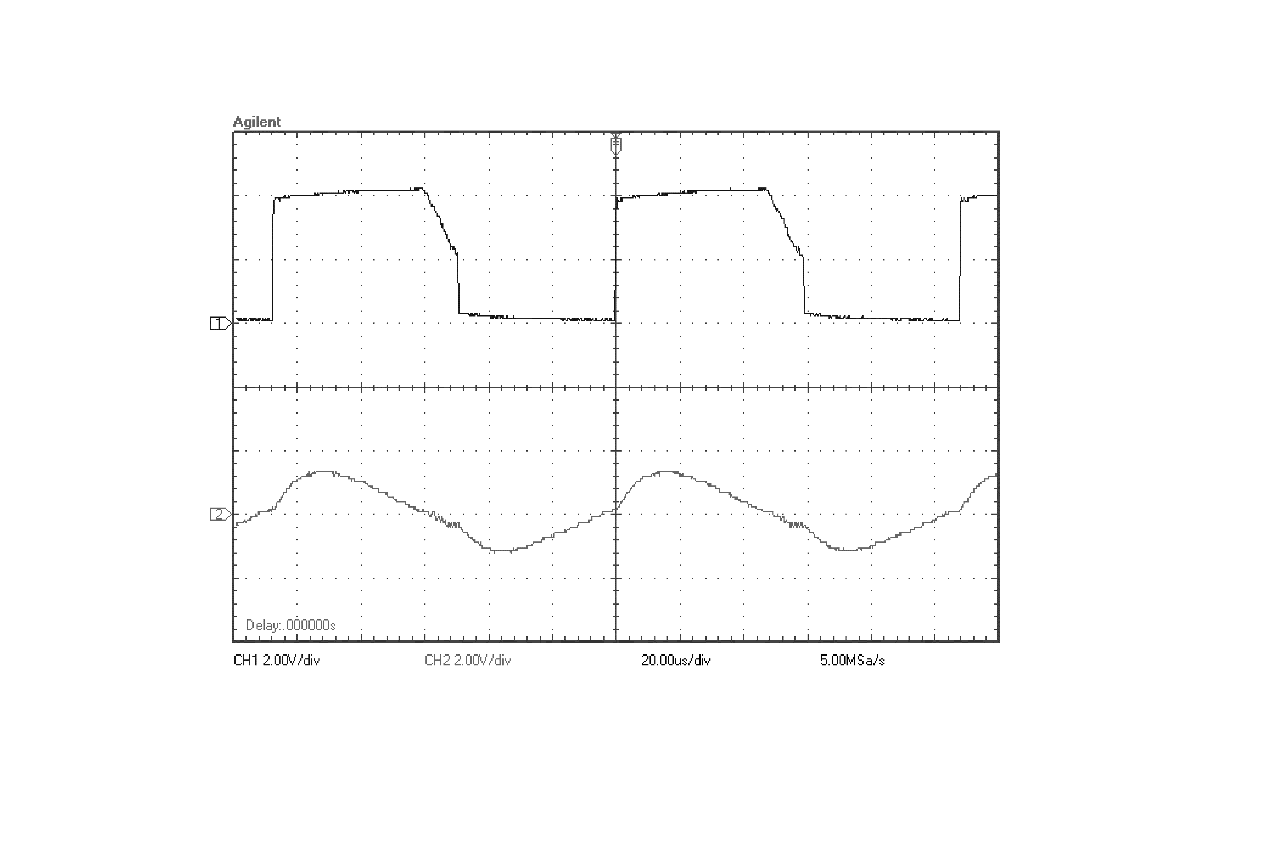
20[μs/div]
V_{out}
2[V/div]
V_{d}

Slide 4
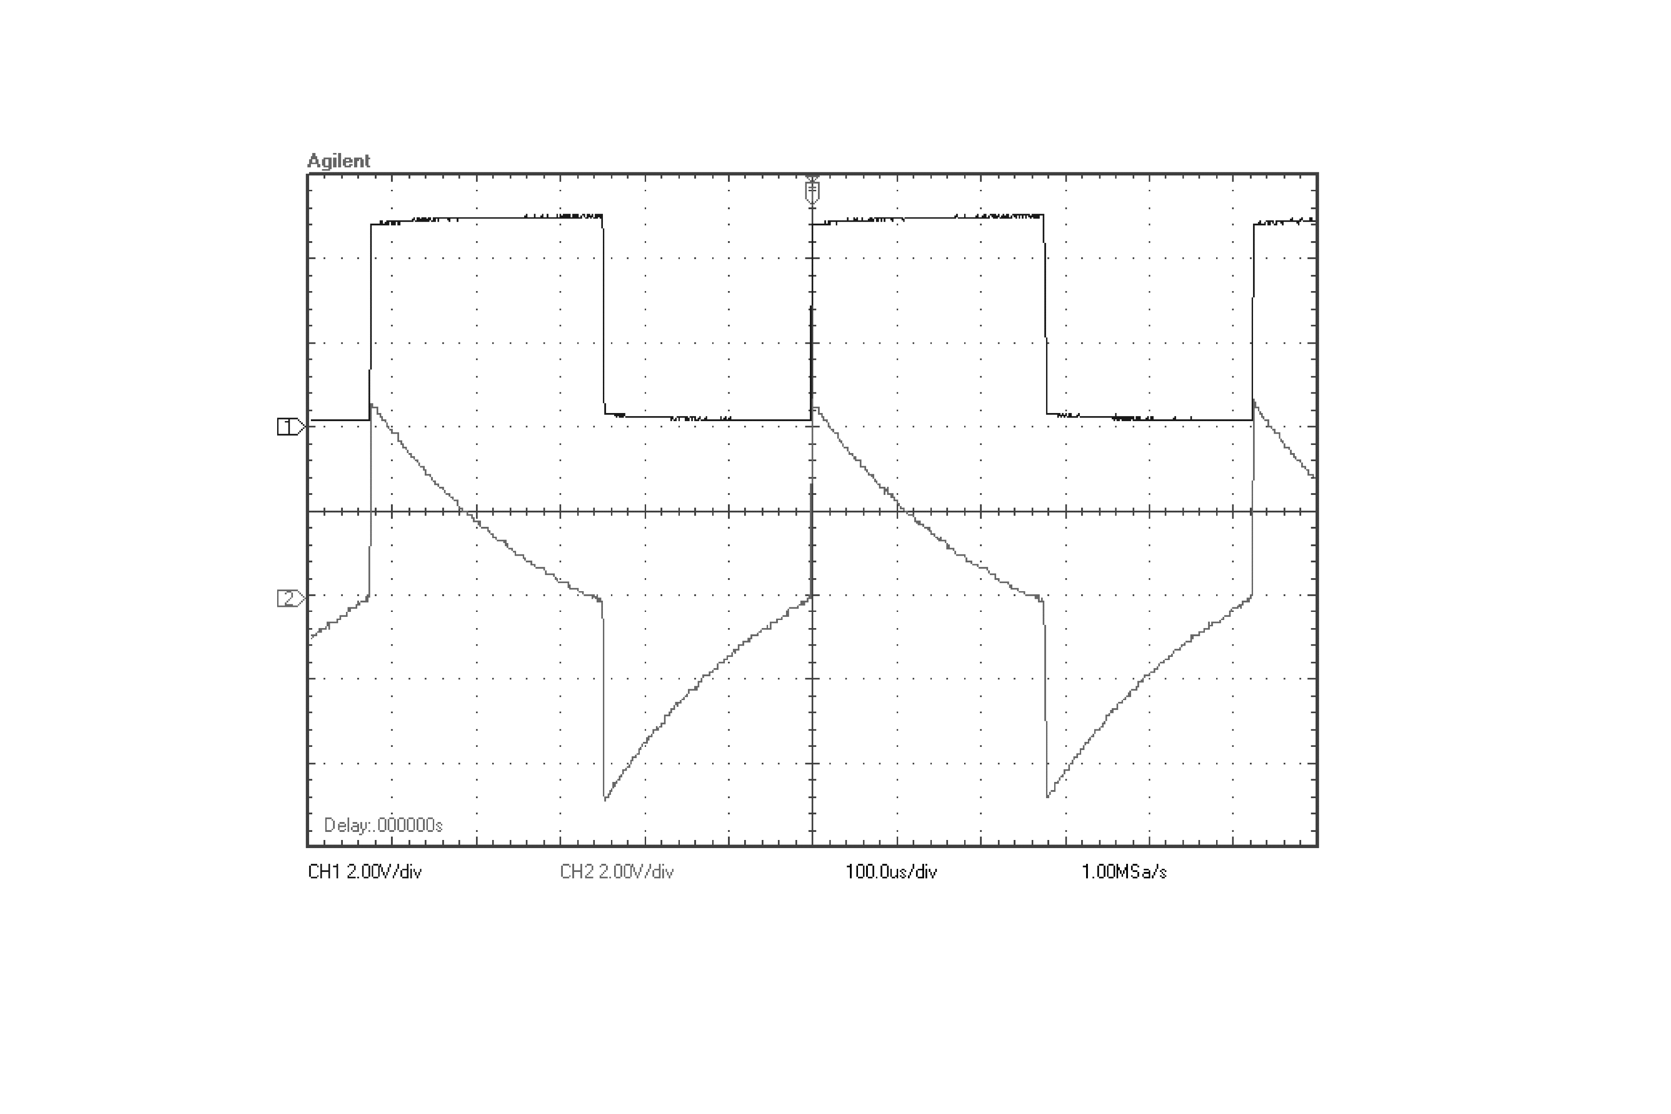
100[μs/div]
V_{out}
2[V/div]
V_{a}

Slide 5
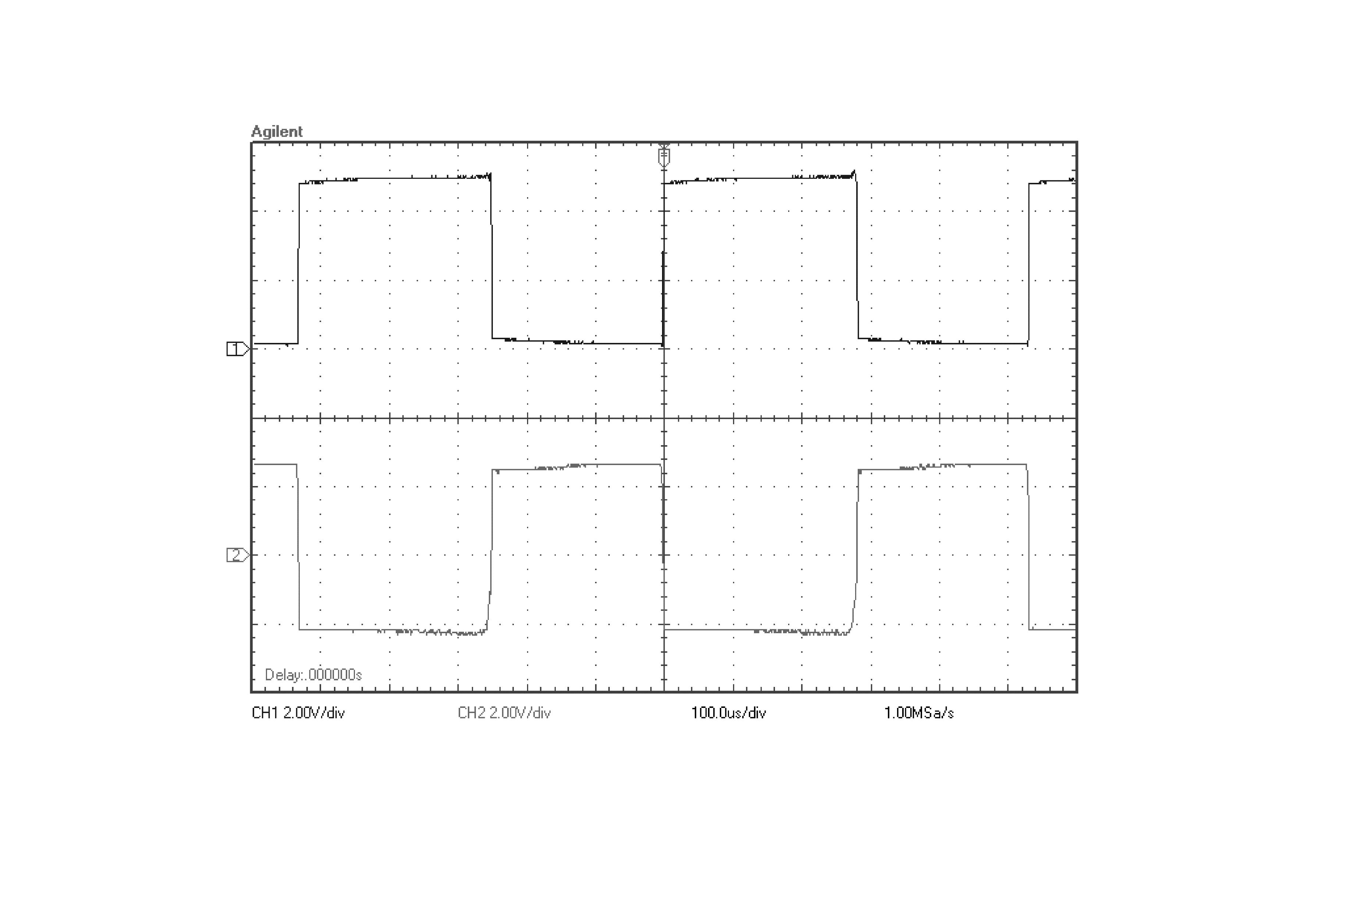
100[μs/div]
V_{out}
2[V/div]
V_{b}

Slide 6
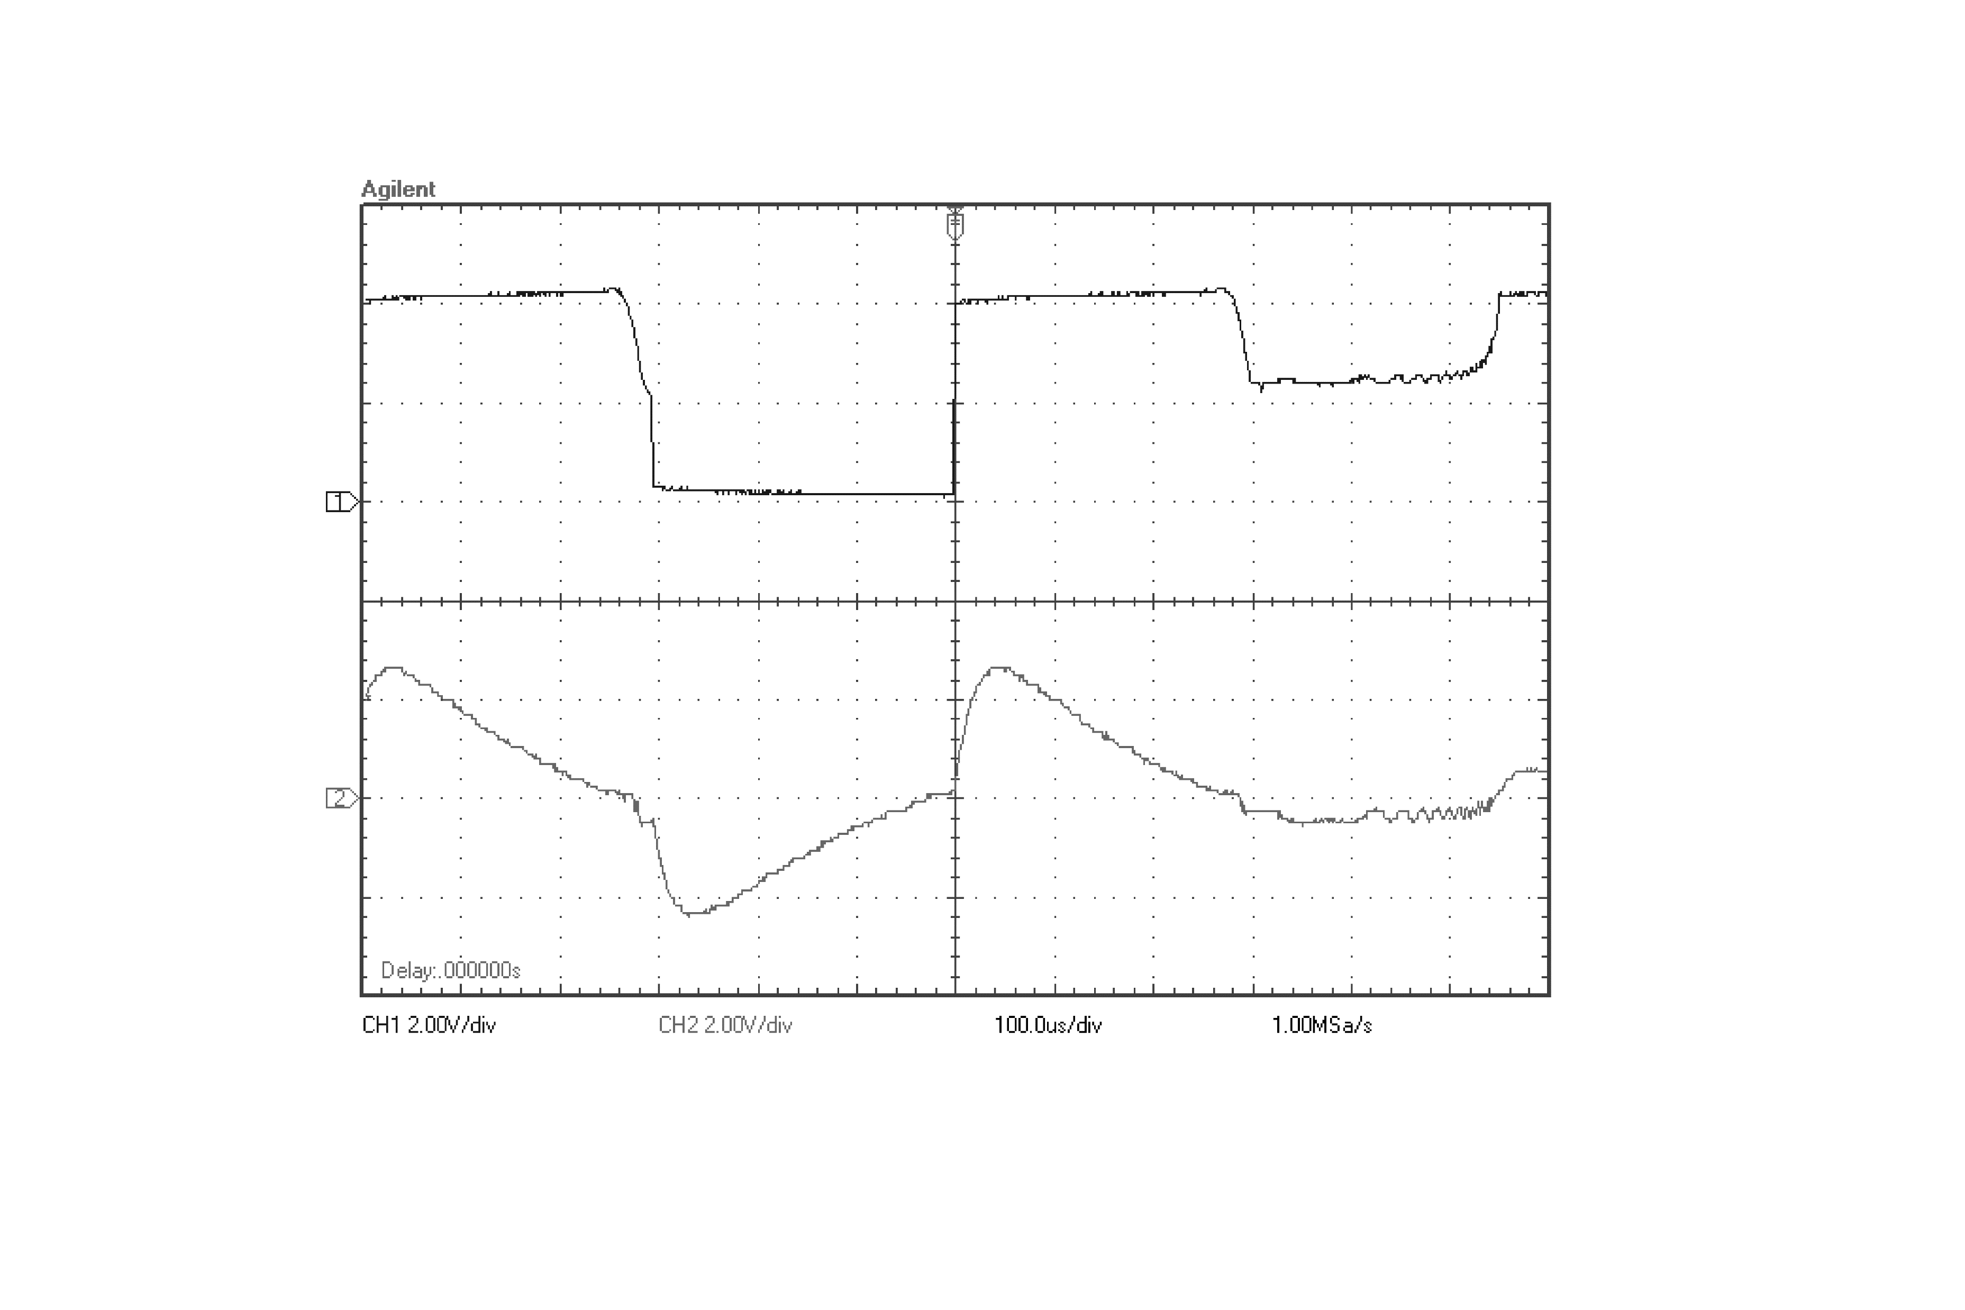
100[μs/div]
V_{out}
2[V/div]
V_{d}

Slide 7

500[μs/div]
V_{out}
2[V/div]
V_{a}

Slide 8
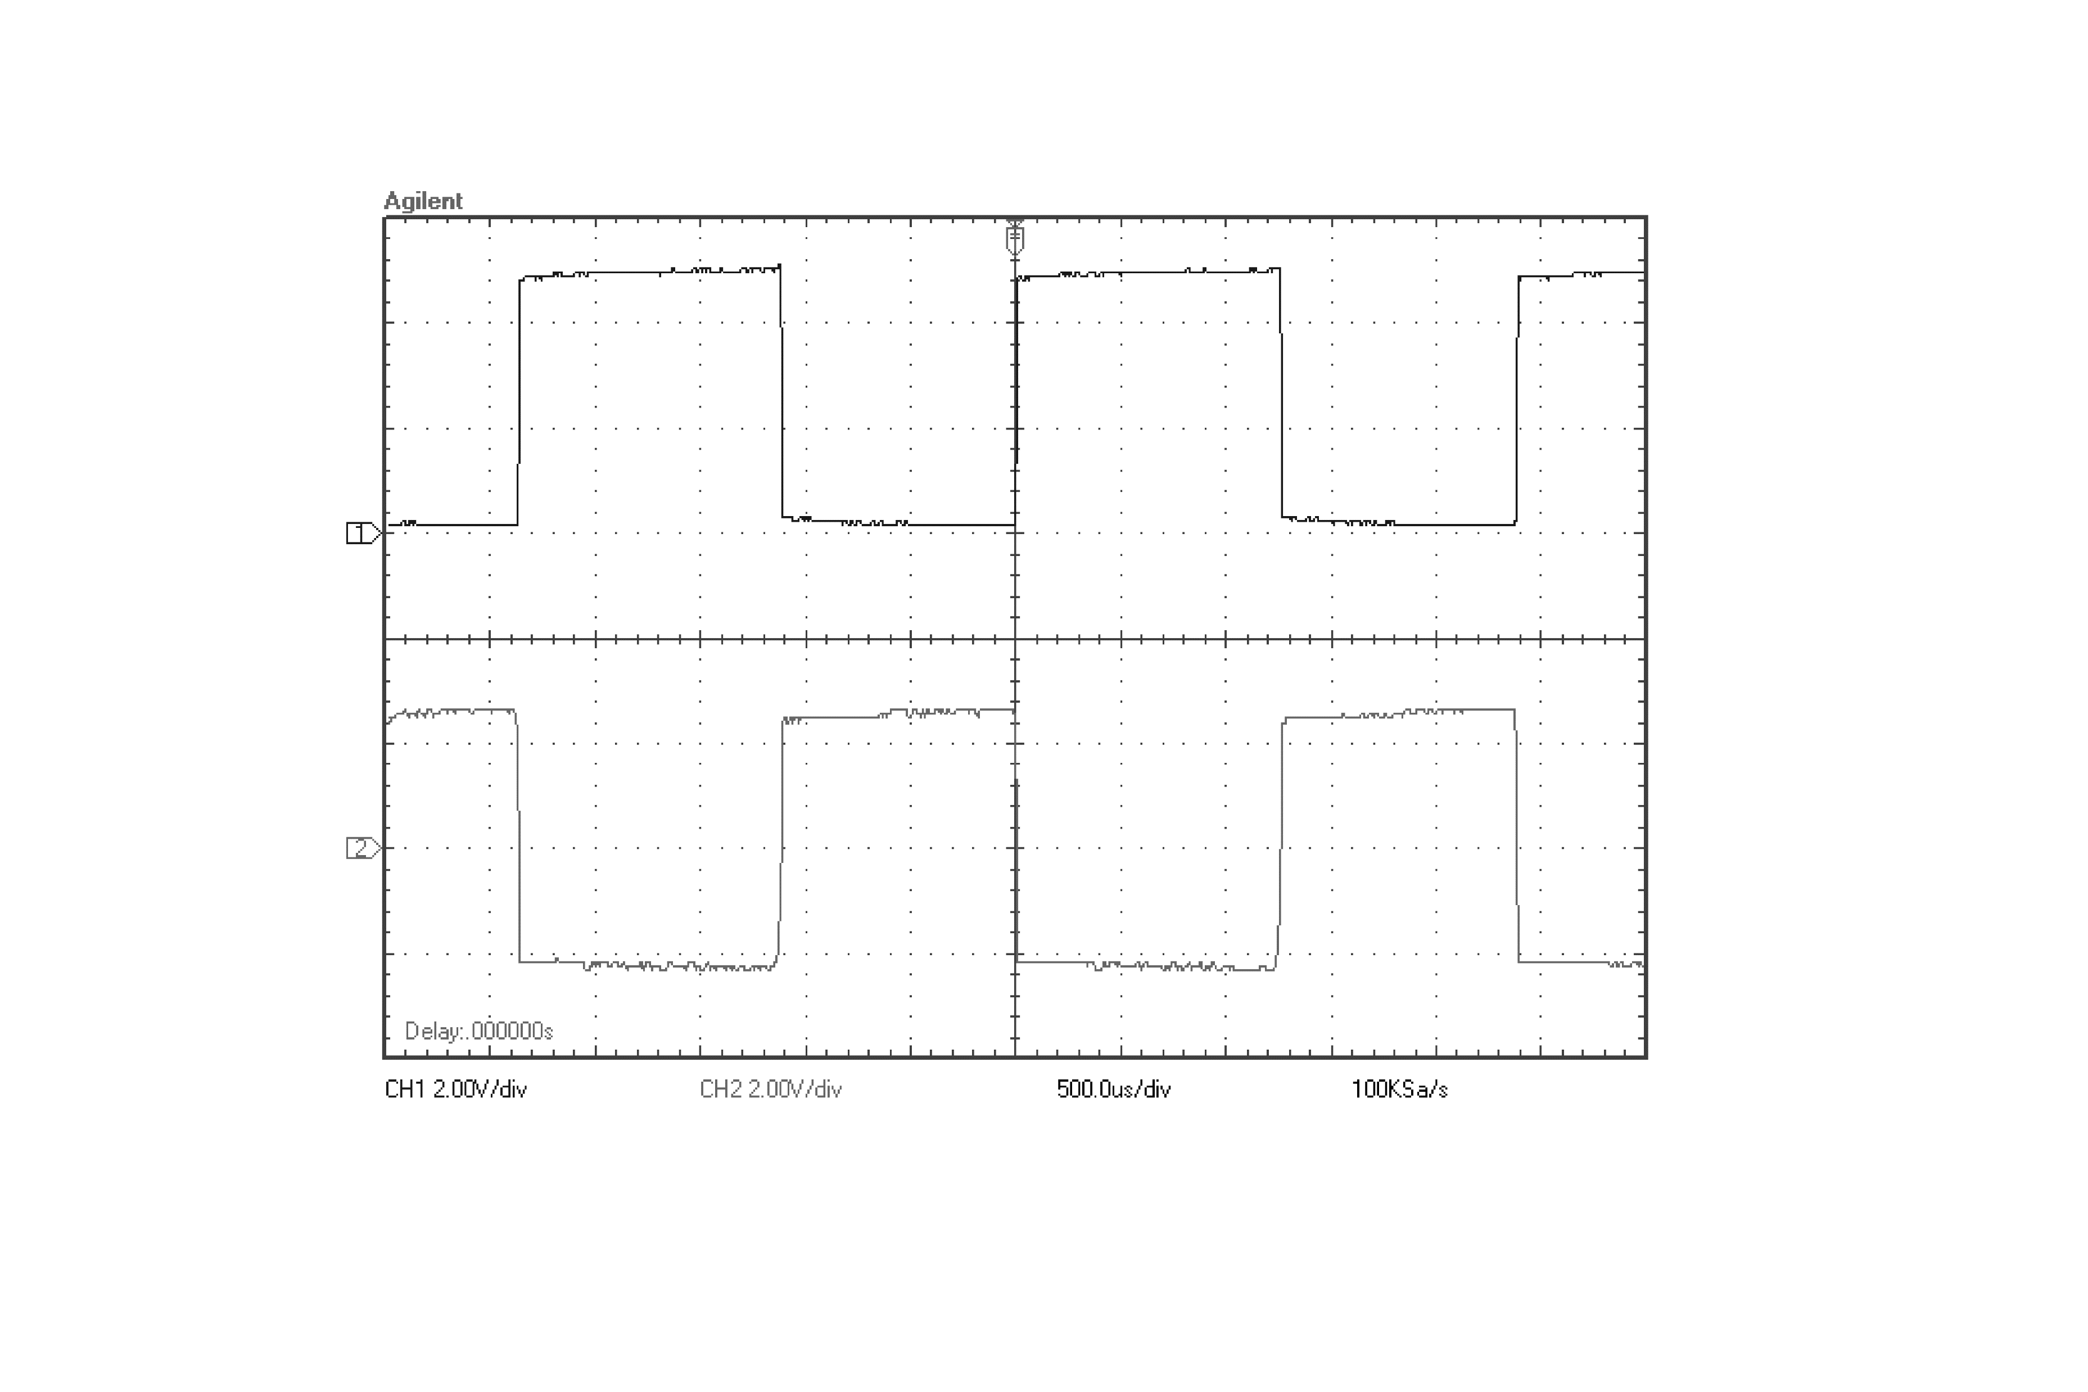
500[μs/div]
V_{out}
2[V/div]
V_{b}

Slide 9
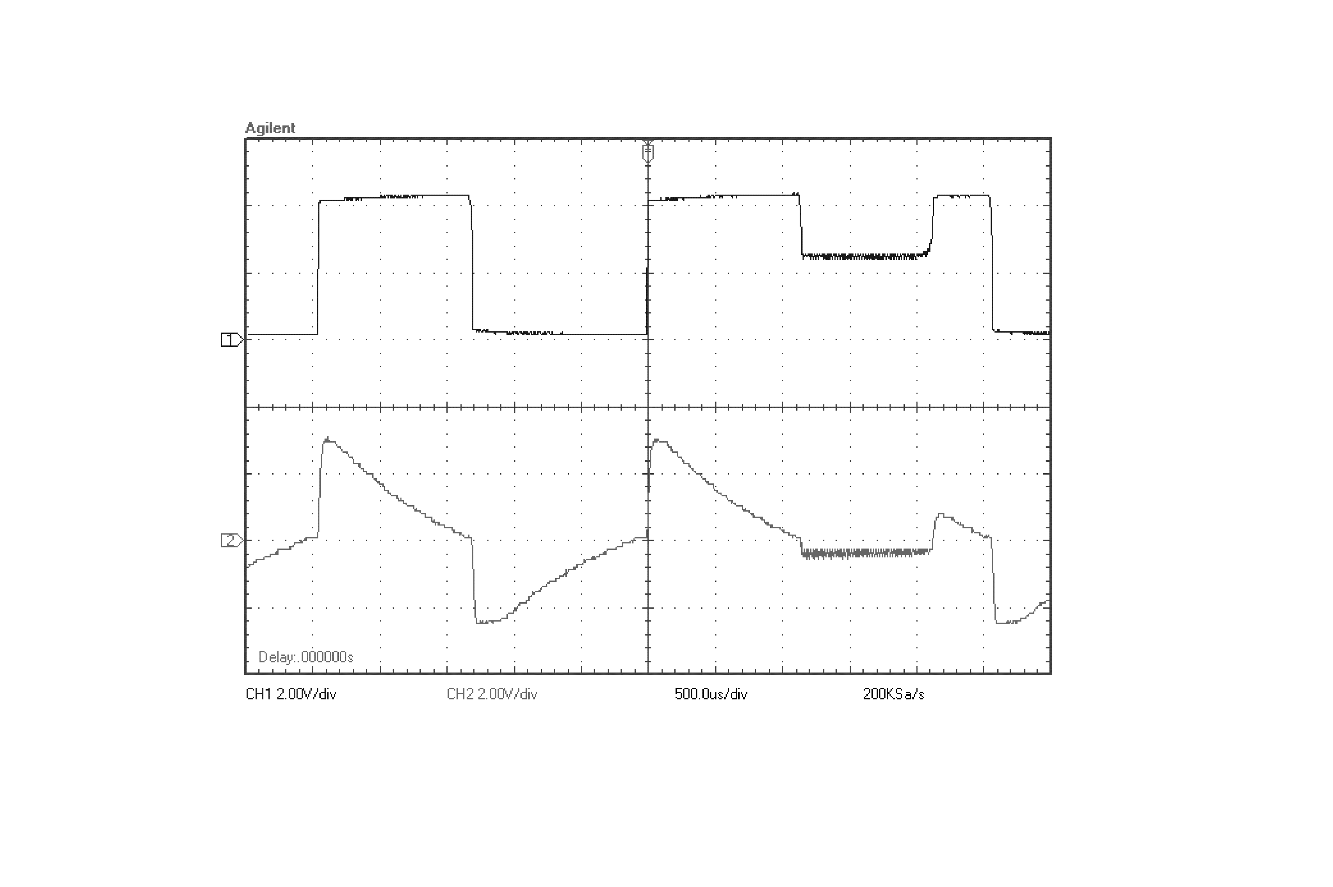
500[μs/div]
2[V/div]
V_{out}
V_{d}

Slide 10
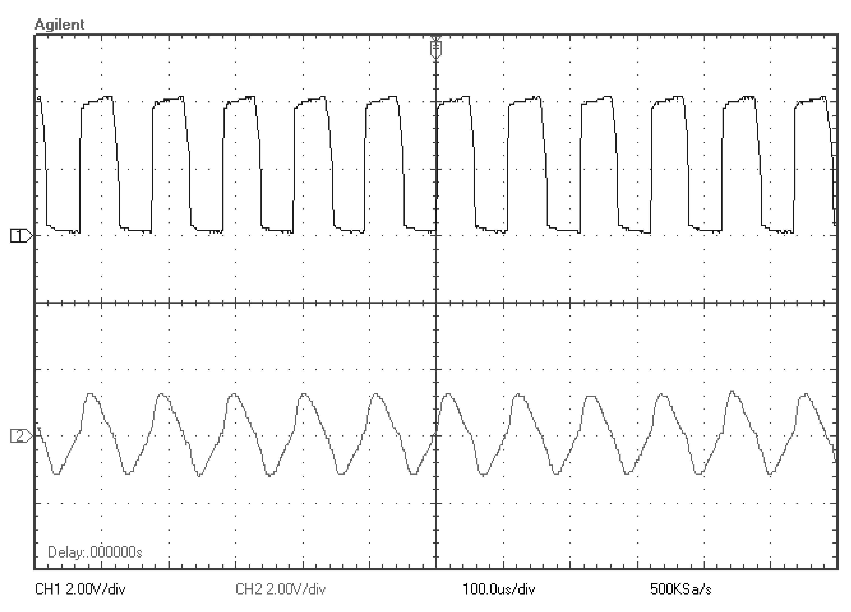
V_{out}
V_{d}

Slide 11
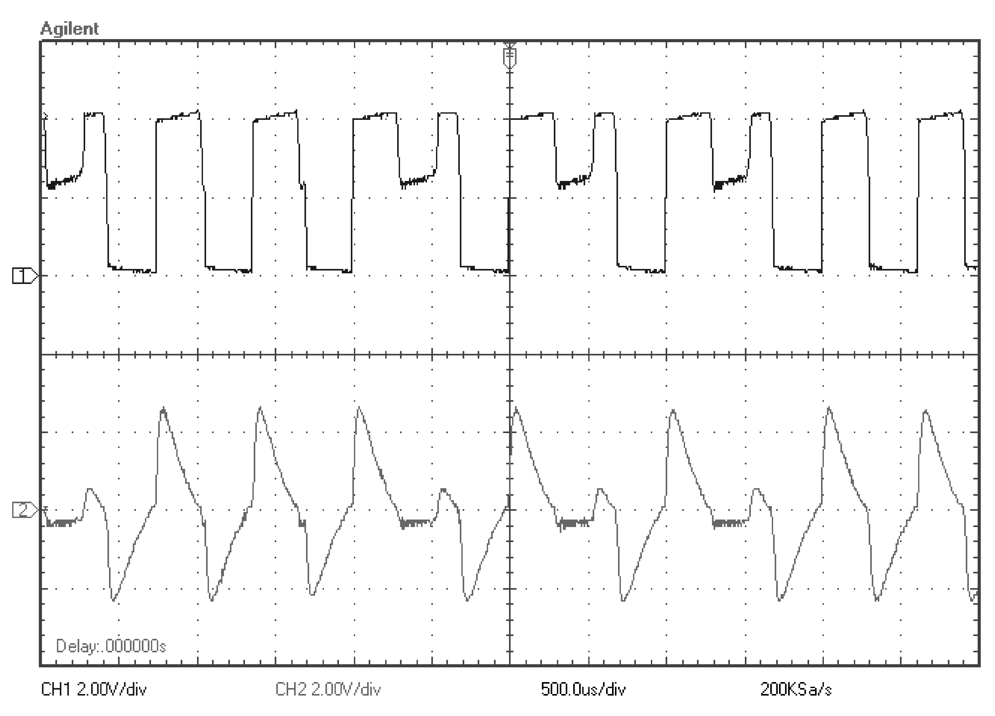
V_{out}
V_{d}

Slide 12
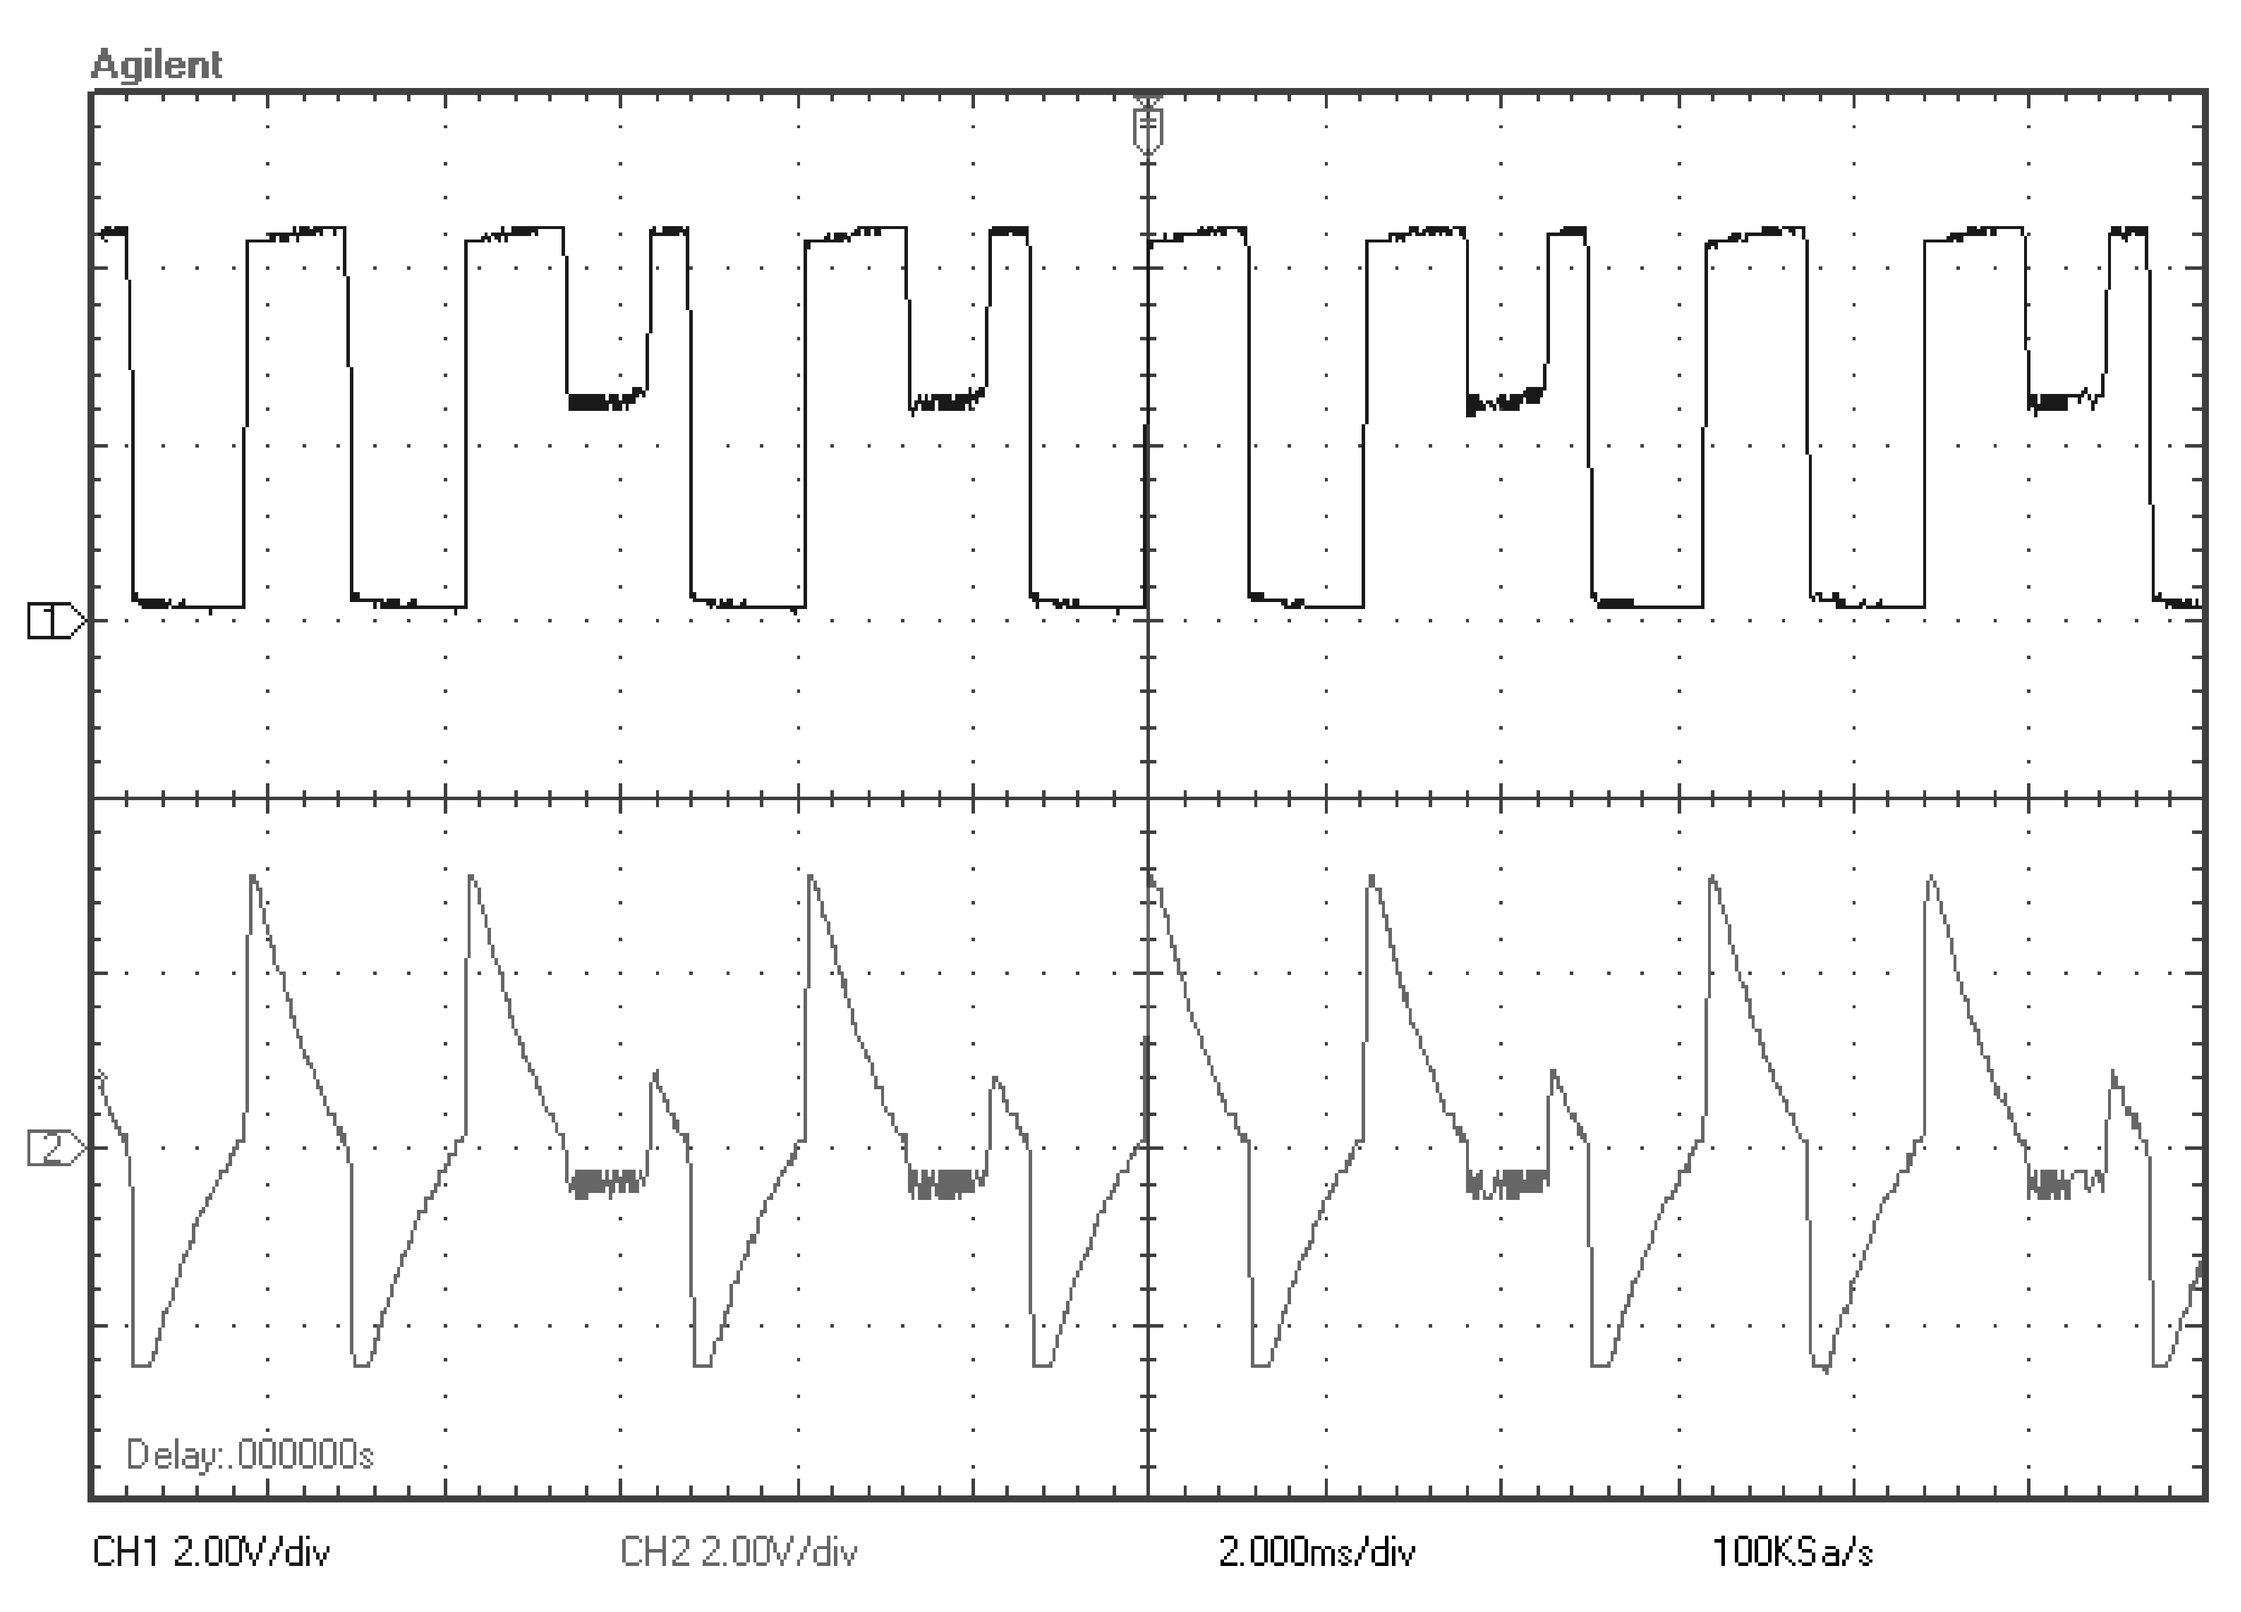
V_{out}
V_{d}

