Slide 1
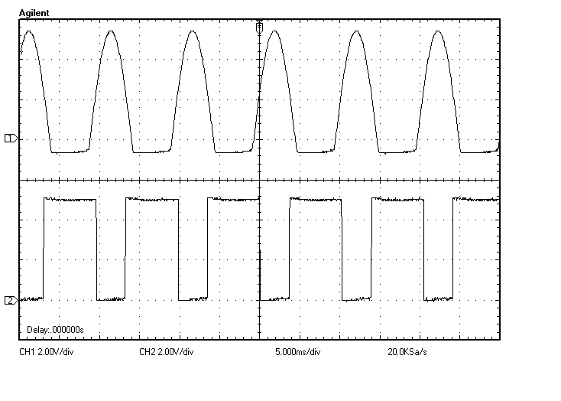
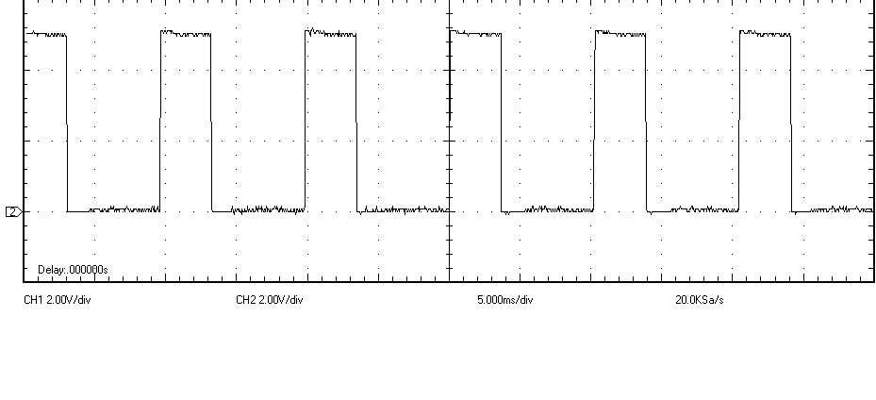
5[ms/div]
2[V/div]
A(入力波形)
B
C(出力波形)

Slide 2
